Slide 1
Intelligent Cloud Operations Part 4. Distributed Tracing Technologies
Definition (Gartner) [AIOps]
AIOps platforms utilize big data, modern machine learning and other advanced analytics technologies to directly and indirectly enhance IT operations (monitoring, automation and service desk) functions with proactive, personal and dynamic insight.
Prof. Jorge Cardoso
E-mail: jorge.cardoso@huawei.com
Intelligent Cloud Operations/SRE Dept.
Ireland and Munich Research Centers
2020
Notes:
Presentation adapted from the previous presentation:
AIOps: Anomaly Detection of Distributed Traces, National University of Ireland, Galway (NUI Galway), 2019.08.20
AIOps-driven Anomaly Detection in microservice architectures, ICT Autonomous Network O&M Conference
2019.06.27, Dublin, Ireland

Slide 2
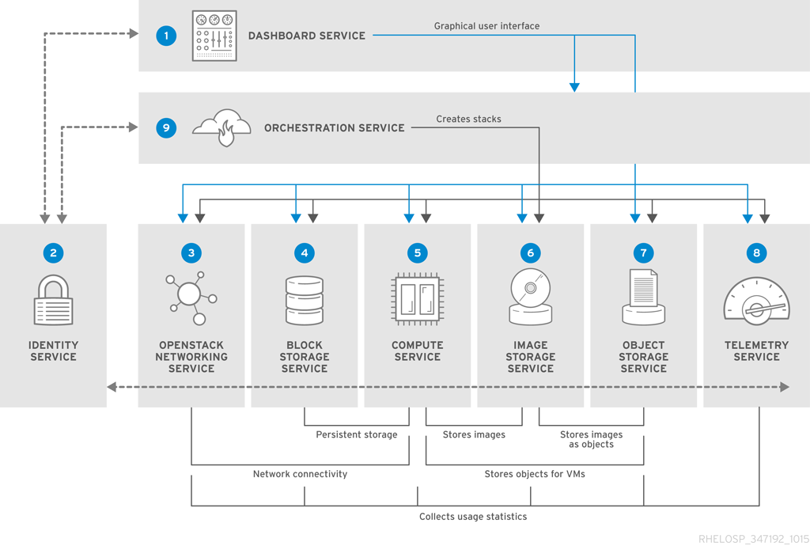
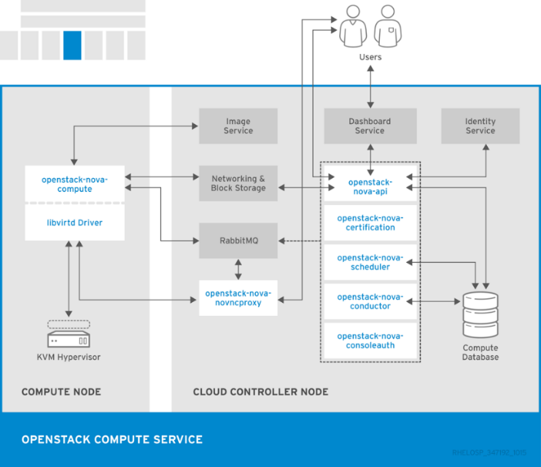
OpenStack Troubleshooting
Troubleshooting
Find root cause issues in requests across several services / hosts
Benchmark different systems and identify performance bottlenecks
Reconstruct the workflow of service-to-service communications
https://access.redhat.com/documentation/en/red-hat-openstack-platform/8/paged/architecture-guide/chapter-1-components

Slide 3
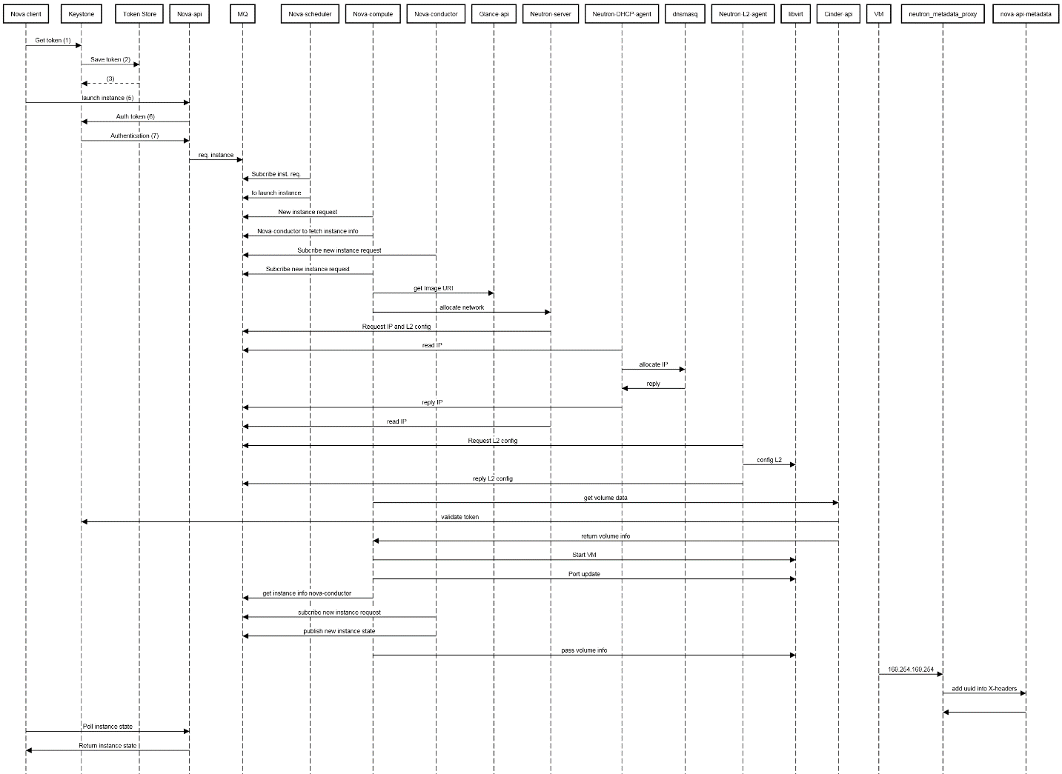
Troubleshooting Workflow for VM Creation
Nova client-> Keystone: Get token (1)
Keystone-> Token Store: Save token (2)
Token Store--> Keystone: (3)
Keystone-->-Nova client: Auth token (4)
Nova client-> Nova-api: launch instance (5)
Nova-api-> Keystone: Auth token (6)
Keystone->Nova-api: Authentication (7)
Nova-api->MQ: req. instance
Nova-scheduler->MQ: Subcribe inst. req.
Nova-scheduler->MQ: to launch instance
Nova-compute->MQ: New instance request
Nova-compute->MQ: Nova-conductor to fetch instance info
Nova-conductor->MQ: Subcribe new instance request
Nova-compute->MQ: Subcribe new instance request
Nova-compute-> Glance-api: get Image URI
Glance-api->-Nova-compute: Return image URI
Nova-compute->Neutron-server: allocate network
Neutron-server->MQ: Request IP and L2 config
Neutron-DHCP-agent->MQ: read IP
Neutron-DHCP-agent->dnsmasq: allocate IP
dnsmasq->Neutron-DHCP-agent: reply
Neutron-DHCP-agent->MQ: reply IP
Neutron-server->MQ:read IP
Neutron-L2-agent->MQ: Request L2 config
Neutron-L2-agent->libvirt: config L2
Neutron-L2-agent->MQ: reply L2 config
Neutron-server->-Nova-compute: net info
Nova-compute->Cinder-api: get volume data
Cinder-api->Keystone: validate token
Keystone-->-Cinder-api: updated auth headers with roles and acl
Cinder-api->Nova-compute: return volume info
Nova-compute->libvirt: Start VM
Nova-compute->libvirt: Port update
Nova-compute->MQ: get instance info nova-conductor
Nova-conductor->MQ: subcribe new instance request
Nova-conductor->MQ: publish new instance state
Nova-compute->libvirt: pass volume info
VM->neutron_metadata_proxy: 169.254.169.254
neutron_metadata_proxy->nova-api-metadata: add uuid into X-headers
nova-api-metadata->neutron_metadata_proxy:
neutron_metadata_proxy->-VM-instance: return metadata
Nova client->Nova-api: Poll instance state
Nova-api-> Nova client: Return instance state
https://sequencediagram.org/
https://docs.openstack.org/install-guide/get-started-logical-architecture.html

Slide 4
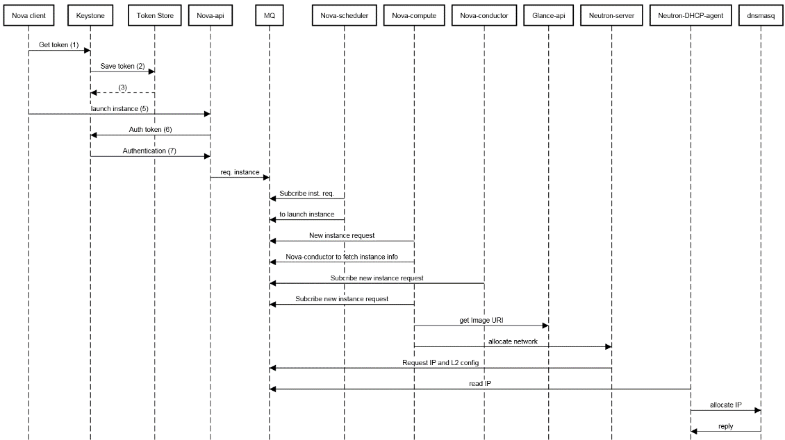
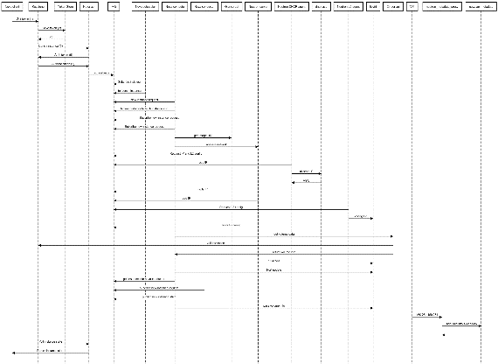
Troubleshooting Workflow for VM Creation
Distributed Tracing
Provides developers a detailed view of requests as they flow across a distributed system
Identifies which microservices are involved in processing a request
Trace the path of a request to generate a transaction
Localize which microservice in a path (trace) is anomalous

Slide 5
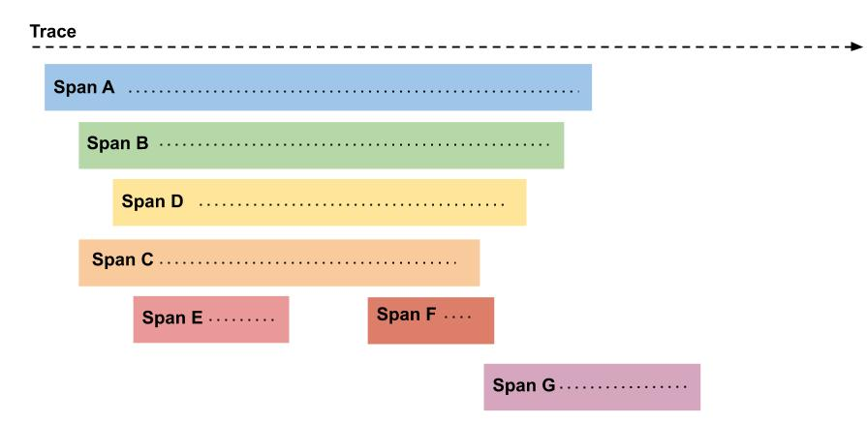
Tracing Services/Systems Concepts
Trace
A transaction which captures the path that a request follows across a distributed system. It is tree or a directed acyclic graph (DAG) of spans
Span
Spans represents an individual unit of work done in a distributed system. Spans are related to one another through a parent-child causal relationship.
Root Span
The first span in a trace. The root span duration often represents the duration of the entire trace
Context propagation
Span can be correlated together by propagating a context across microservices. The context contains a request id which identifies the trace to which it belongs.
Figure. A trace is composed of spans. The root span is A. Spans B and C are children of span A.
Span Content
Operation name. API call that created the span
Start/finish timestamp: Start and finish time of the operation
Tags: Information injected into the span
SpanContext: Span metadata transported across span boundaries

Slide 6
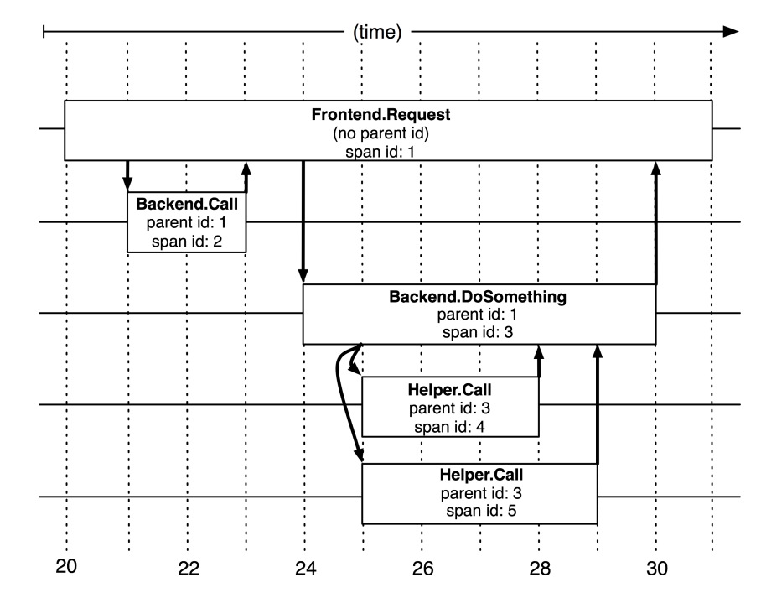
Tracing Services/Systems Concepts
Context Propagation
Create a new request_id when a user request is received by a service at the boundary of the distributed system
Store the request_id in a local context object and other metadata
Propagate the context across the distributed as the user request is processed
Service create spans and place key-value pairs describing the service/operation processing inside, along with the request_id
time
Figure. The causal and temporal relationships between five spans in a Dapper trace tree (from Dapper, a Large-Scale Distributed Systems Tracing Infrastructure)
Service A / Span 1
1. CS (Client send)
4. CR (Client receive)
2. SR (Server receive)
3. SS (Server send)
Service B / Span 2
Service C / Span 3
Client Send (CS): timestamp when client initiated the request
Server Receive (SR): timestamp when server receives the request
Server Send (SS): timestamp when server sends back the response
Client Receive (CR): timestamp when client receives back the response

Slide 7
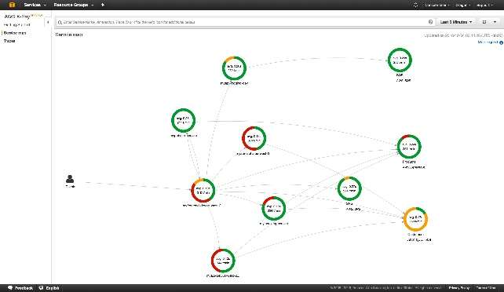
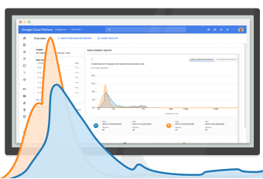


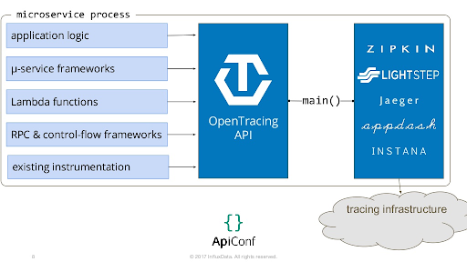
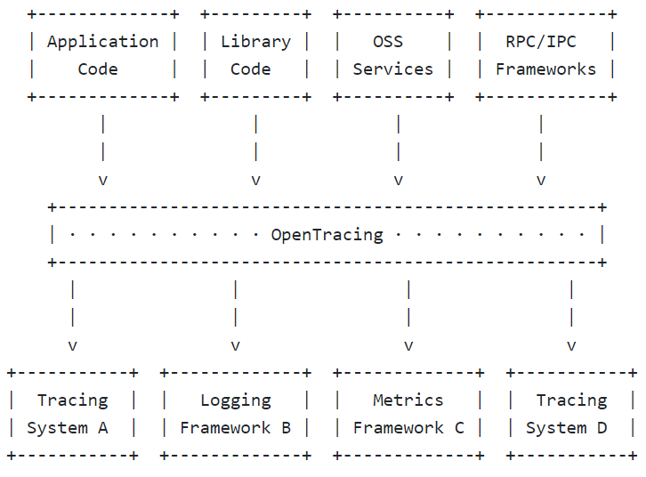
Commercial/Open Source Solutions Tracing Services Systems, and Standards
Tracing Services
Google Stackdriver (cloud.google.com/trace)
Amazon AWS X-Ray (aws.amazon.com/xray)
Lightstep (lightstep.com)
Tracing Systems
Twitter Zipkin (zipkin.io)
Uber Jaeger
OSProfiler
Pivot Tracing (pivottracing.io)
Tracing Standards
opentelemetry.io
OpenTracing
OpenCensus
Fig. Amazon AWS X-Ray
Fig. Google Cloud Trace
2019: The open source distributed tracing projects OpenCensus and OpenTracing were merged into anew project called OpenTelemetry
Fig. OpenTracing
OpenTracing provides a consistent, expressive, vendor-neutral APIs for popular platforms [1]
[1] http://opentracing.io/documentation/
[2] https://github.com/opentracing/specification/blob/master/specification.md

Slide 8
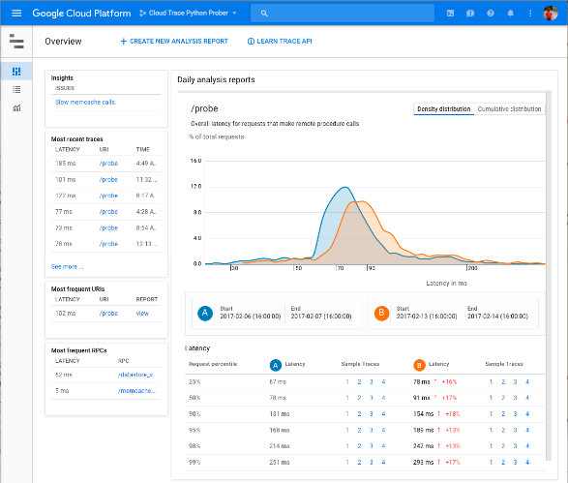
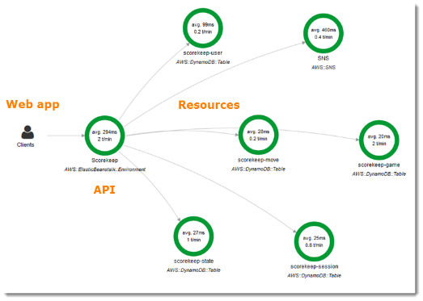
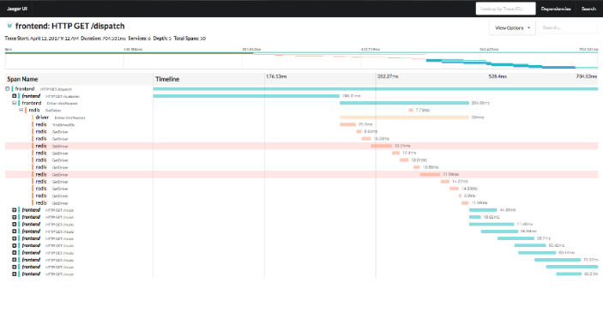
Tracing Services/Systems Stackdriver, X-Ray, Jaeger
Stackdriver (Google) Characteristics
Support for Python and gRPC
Support Zipkin traces with forwarding to Stackdriver
Easy to install: start Docker image on Compute Engine and view traces of a sample app within a few of minutes
X-Ray (AWS) Characteristics
Support for OpenCensus but not OpenTracing
Support for Python, Node, Java, and .NET apps (X-Ray SDK pushes metrics to a local collector).
Sampling rates configuration based on different objects (e.g. service types like EC2 or Beanstock)
Jaeger (Uber) Characteristics
Supports OpenTracing
Send traces to a local agent via UDP, who sends traces to a collector
Supports Cassandra for trace storage

Slide 9
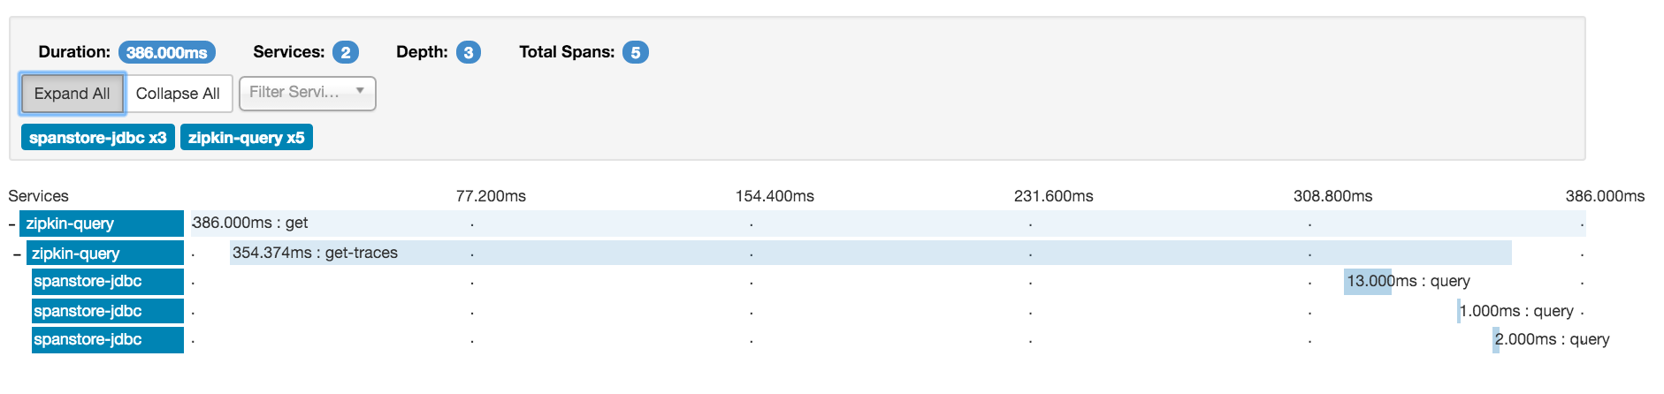
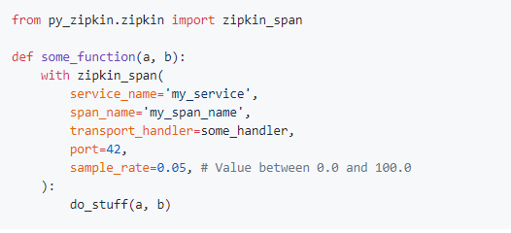
Tracing Services/Systems Zipkin
Figure. Gantt view of individual traces (tree of dependencies)
Zipkin Characteristics
Supports Cassandra, ElasticSearch, and MySQL
Implementations in Java, Go, JavaScript, Ruby, and Scala.
Instrumented apps send data to a remote collector via HTTP, Kafka, and Scribe
Python libraries: py_zipkin, pyramid_zipkin, swagger_zipkin, and flask-zipkin
Figure. Example of how to add instrumentation when using https://github.com/Yelp/py_zipkin

Slide 10
Tracing Services/Systems Jaeger/OpenTracing Key Constructs
Install Jaeger
$ docker run -d -p5775:5775/udp -p6831:6831/udp -p6832:6832/udp -p5778:5778 -p16686:16686 -p14268:14268 -p9411:9411 jaegertracing/all-in-one:0.8.0
$ pip install jaeger-client
1. Configure Tracer
import logging
from jaeger_client import Config
def init_tracer(service):
logging.getLogger('').handlers = []
logging.basicConfig(format='%(message)s',
level=logging.DEBUG)
config = Config(
config={
'sampler': {
'type': 'const',
'param': 1,
},
'logging': True,
},
service_name=service,
)
# this call also sets opentracing.tracer
return config.initialize_tracer()
2. Initialize Tracer
tracer = init_tracer('service-name')
3. Create Spans
with tracer.start_span('span-1') as span1:
span1.set_tag(‘tag-1', ‘001')
with tracer.start_span('span-2', child_of=span1) as span2:
span2.set_tag('tag-2', ‘002')
4. Tracing HTTP requests
with tracer.start_span('get-python-jobs') as span:
homepages = []
res = requests.get('https://jobs.github.com/’
’positions.json?description=python')
span.set_tag('jobs-count', len(res.json()))
for result in res.json():
with tracer.start_span(result['company'],
child_of=span) as site_span:
print('Getting website for %s' % result['company'])
try:
homepages.append(
requests.get(result['company_url']))
site_span.set_tag('request-type', 'Success')
except:
print('Unable to get site for %s' %
result['company'])
site_span.set_tag('request-type', 'Failure')
Example extracted from https://opentracing.io/guides/python/quickstart/

Slide 11
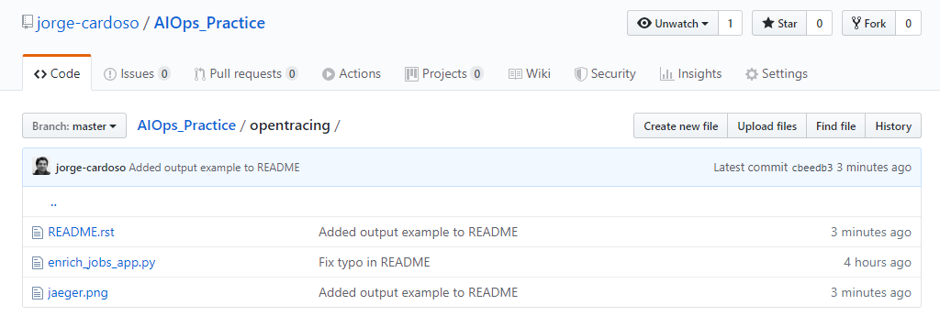

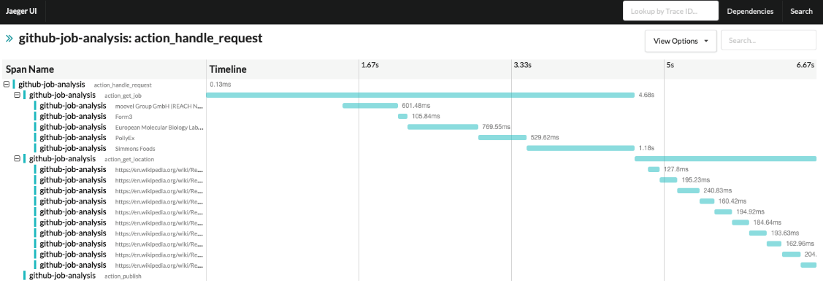
Tracing Services/Systems Jaeger/OpenTracing Simple Application
1. GitHub example of using tracing
2. Output of the application
$ python enrich_jobs_app.py
Getting website for moovel Group GmbH (REACH NOW)….
Unable to get site for moovel Group GmbH (REACH NOW)
Getting website for Form3: https://form3.tech/
Getting website for European Molecular Biology …..
Getting website for PollyEx: https://www.pollyex.com/
Getting website for Simmons Foods: ……
Input to process: [('Form3', 'Remote'), ('European Molecular…
Getting link: https://en.wikipedia.org/wiki/Remote_control
Getting link: https://en.wikipedia.org/wiki/Remote_Desktop_Protocol
Getting link: https://en.wikipedia.org/wiki/Remote_sensing
Getting link: https://en.wikipedia.org/wiki/Remote_viewing
Getting link: https://en.wikipedia.org/wiki/Remotely.....
Getting link: https://en.wikipedia.org/wiki/Remote_Desktop_Services
Getting link: https://en.wikipedia.org/wiki/Remote_control_animal
Getting link: https://en.wikipedia.org/wiki/Remote_procedure_call
Getting link: https://en.wikipedia.org/wiki/Remote_keyless_system
Code available at: https://github.com/jorge-cardoso/aiops_practice
Subdirectory: opentracing
3. Traces generated by the application
https://github.com/jorge-cardoso/aiops_practice.git

Slide 12
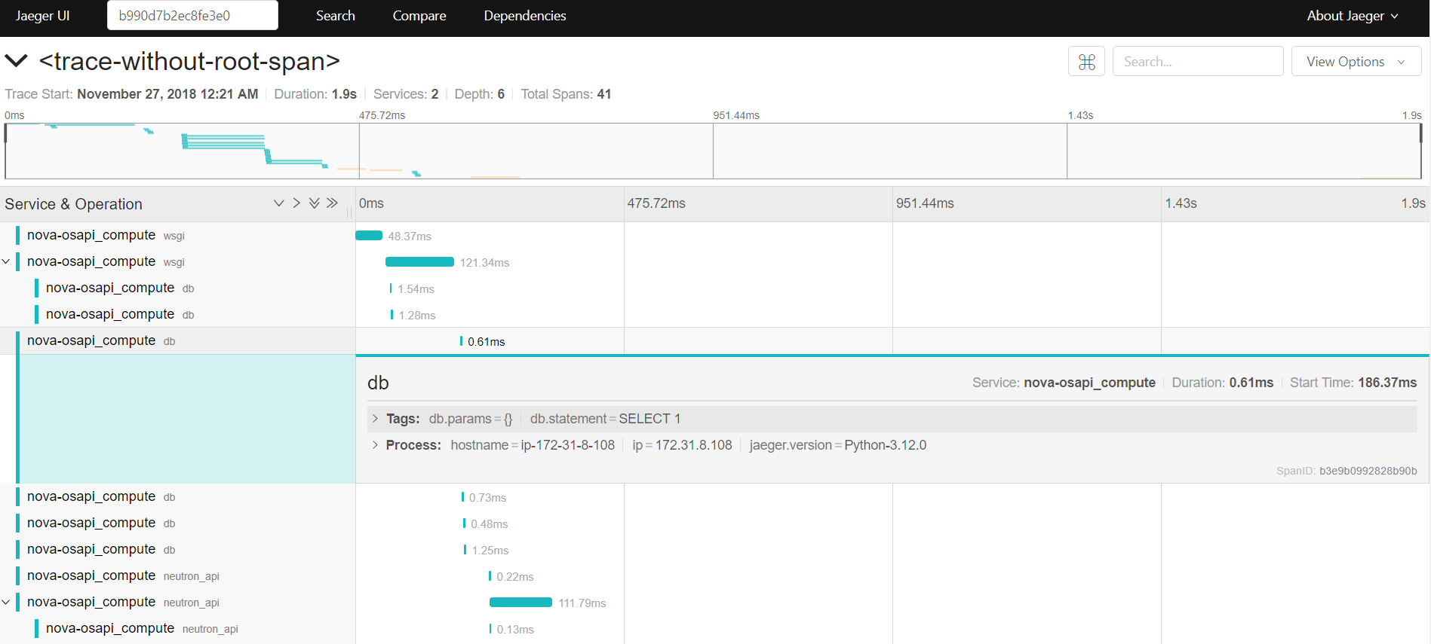


Tracing Services/Systems Tracing for OpenStack
OSprofiler
Generate a trace for API requests
Categories: WSGI, RPC, DB calls
Call hierarchy
Time spent in each services/methods
Projects/services
Logging/debugging information
Reports in HTML, JSON, DOT
Data store: MongoDB, Redis, Loginsight, Ceilometer, Monasca, OpenTracing
Uber

Slide 13
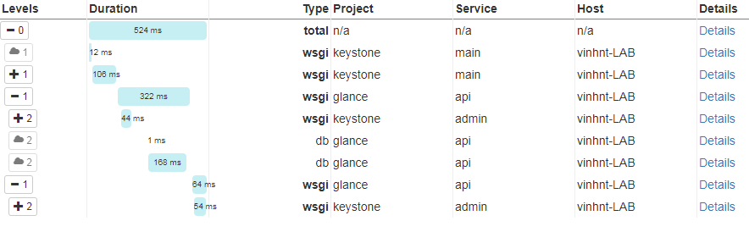
Tracing for OpenStack JSON example
{
"data": [
{
"traceID": "9f2b949d93df62ba",
"spans": [
{
"traceID": "9f2b949d93df62ba",
"spanID": "ab6d567ee059e105",
"flags": 1,
"operationName": "db",
"references": [
{
"refType": "CHILD_OF",
"traceID": "9f2b949d93df62ba",
"spanID": "b3e1a556d2b93a7b"
}
],
"startTime": 1543274757701637,
"duration": 11414,
"tags": [
{
"key": "db.params",
"type": "string",
"value": "{}"
},
"logs": [],
"processID": "p1",
"warnings": null
},
{
"traceID": "9f2b949d93df62ba",
"spanID": "890dab5d58860e56",
"flags": 1,
"operationName": "db",
"references": [
{
"refType": "CHILD_OF",
"traceID": "9f2b949d93df62ba",
"spanID": "b3e1a556d2b93a7b"
}
],
"startTime": 1543274757715987,
"duration": 2501,
https://docs.openstack.org/install-guide/get-started-logical-architecture.html

Slide 14
Tracing for OpenStack Enabling OSProfiler
1. Edit devstack/local.conf
For Redis add
enable_plugin osprofiler https://git.openstack.org/openstack/osprofiler master OSPROFILER_COLLECTOR=redis
For Jaeger add
enable_plugin osprofiler https://git.openstack.org/openstack/osprofiler refs/changes/67/611067/4
OSPROFILER_BRANCH=refs/changes/67/611067/4
OSPROFILER_COLLECTOR=jaeger
2. Run devstack/stack.sh
3. Prepare the CLI
$ cd /opt/stack/devstack
$ source openrc admin admin
4. Run the openstack commands by appending --os-profile SECRET_KEY in the end of command for example:
$ openstack volume list --os-profile SECRET_KEY
$ openstack image list --os-profile SECRET_KEY
The OSProfiler library is an official project which enables to trace calls made to OpenStack. This enables to understand the workflow supporting calls and identify which types of calls are made inside OpenStack
Instead of having to go through the whole code and adding instrumentation points near HTTP/RPC/DB calls, osprofiler is already integrated in all of the main projects of OpenStack (Nova, Neutron, Keystone, Glance etc..).
5. To view the trace
For Redis
$ osprofiler trace show --connection-string redis://localhost:6379 --html <trace-id> --out <some_name>.html
Copy that file to your local laptop and open in browser
You can use JSON format as well
For Jaeger
Check Jaeger UI at http://VM_IP:16686
Use the shortened traceid printed in the search box of Jaeger UI and search for the trace
More details
https://github.com/openstack/osprofiler
https://docs.openstack.org/osprofiler/latest/

Slide 15
Distributed Tracing References
Systems
OpenZipkin: A distributed tracing system: https://zipkin.io
AWS X-Ray Distributed Tracing System: https://aws.amazon.com/xray/
Jaeger: open source, end-to-end distributed tracing: https://www.jaegertracing.io
Papers
Dapper, a Large-Scale Distributed Systems Tracing Infrastructure: https://ai.google/research/pubs/pub36356
Facebook Canopy: https://cs.brown.edu/~jcmace/papers/kaldor2017canopy.pdf
So, you want to trace your distributed system? Key design insights from years of practical experience: http://www.pdl.cmu.edu/PDL-FTP/SelfStar/CMU-PDL-14-102.pdf

