Slide 1
PROPOSAL FOR DISCUSSION
Histology Redesigned
Closing handoff gaps in the histology workflow, measured first
Prepared for: Director of Operations, Platinum Dermatology
Jorge Rodriguez, histology assistant · [meeting date]
Courier
Intake
Grossing
Slides and blocks
Operations
Synthetic demonstration · fictional data · not endorsed by anyone
Notes:
About 30 s.
Thank you for giving me thirty minutes. I'll spend about five minutes on a live demo and about ten on how the lab could try this safely. The rest is for your questions. One thing up front: everything you'll see is made-up data on my own laptop. It has never touched EMA, the lab network or any patient information, and nobody has endorsed or approved it. At the end I'll ask for one small decision, and it isn't a purchase.

Slide 2
What I see at the bench
1
The same details copied by hand at several handoffs
Observations, not measurements
2
Office-to-doctor routing kept in people’s memory
I don’t know how often each one happens, or whether some already have a fix.
3
Parts A and B sometimes arriving as separate orders
4
Clarification replies can wait; we don’t know why yet
Step one is to measure.
5
Gross entry batched late; labels and “the bible” by hand
My observations as an employee, not measured rates.
Notes:
About 45 s.
These are things I've seen myself. Accessioners remember which office goes to which doctor. Parts A and B sometimes come in as two orders, and that's hard to fix later. Some clarification replies take a long time, and I don't know why. Gross descriptions get typed in after the batch, some nights until about nine. Many labels, and the bible, are handled by hand. I want to be careful: these are observations, not measurements. I don't know how often each one happens. Some may already have a fix I don't know about. That's why the first step I'm proposing is to measure.

Slide 3
Configure first, buy second, build last
1
2
3
Configure
Buy
Build
Check what EMA and our existing tools already do
Look at existing products. Several LIS vendors advertise ModMed integrations: vendor claims, to check
Only for gaps that remain, and only after measuring
A good outcome is the problem solved, even if this software isn’t what solves it.
Vendor claim example: ligolab.com (LigoLab on its ModMed integration). A vendor claim, not independent evidence; to confirm with the vendor.
Notes:
About 40 s.
The order matters. First EMA. ModMed advertises features like gross defaults, label printing and tracking, and I don't know what we have licensed or switched on. A configuration change could be the cheapest and safest fix. Second, existing products. Several LIS and tracking vendors say they integrate with ModMed. Those are their claims, and we'd check them. Building comes last, and only for what's left. I built this demo as evidence that the remaining gaps can be closed safely. It isn't a request to buy or install it.

Slide 4
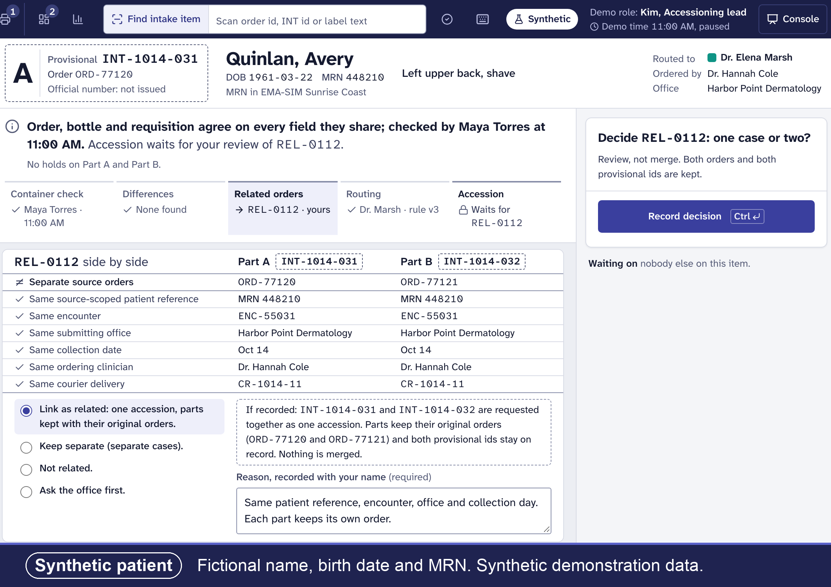
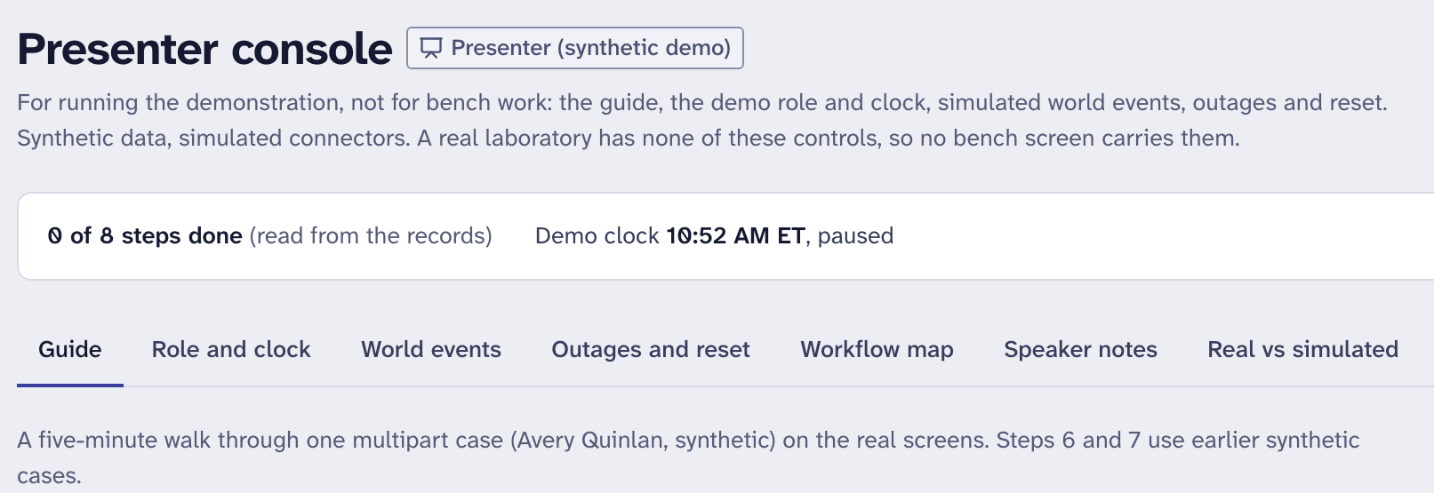
Demo, part 1: arrival and two orders for one patient
Guided demo · steps 1–2 of 8
Presenter console: the eight-step guide
Courier delivery checked against what was expected
Routing by a written, versioned rule; an unknown office is flagged, not guessed
Two orders, one patient: the system suggests, a person decides
Nothing is merged; both original orders are kept
Intake: REL-0112, two source orders side by side; "Link as related" chosen, nothing merged
Notes:
Fallback only, about 60 s, if the live demo fails.
Here is what the live demo would have shown. The guide runs eight steps in a fictional lab called Lumen Bay. The courier arrives at eleven, and the screen compares what was expected with what came in. It suggests the doctor from a written rule and shows which version. An office with no rule goes to an exception list, so no doctor is guessed. Here, parts A and B came in as two orders. The system shows why they might belong together, and the accessioning lead decides, with a reason. Nothing is merged.

Slide 5
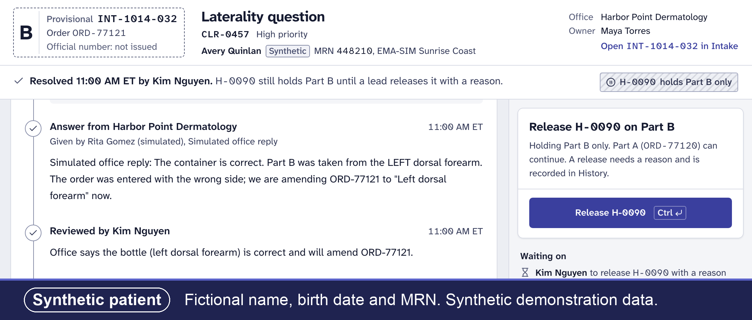
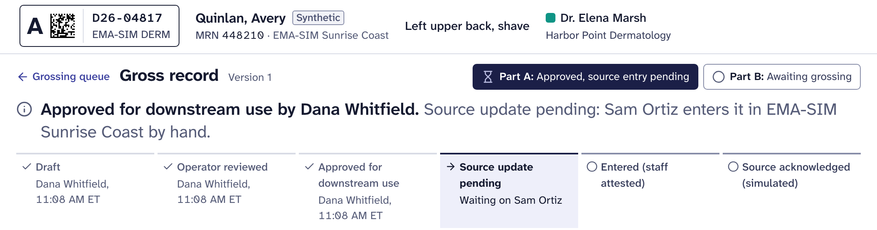
Demo, part 2: hold only what’s wrong
Guided demo · steps 3–5 of 8
Bottle says left, order says right: one clarification, and only Part B is held
A person reviews the office’s answer before the question is closed
The hold comes off separately, with a reason, after the corrected order arrives
Part A’s gross record moves on; Part B stays visibly unfinished
Clarification CLR-0457: answer reviewed; hold H-0090 still holds Part B only
Gross record, Part A approved for downstream use; Part B still awaiting grossing
Notes:
Fallback only, about 60 s.
Part B's bottle says left forearm and the order says right. Instead of stopping the whole case, one specific question goes to the office, with an owner and a follow-up time, and only Part B is held. The office's answer is simulated here. The answer itself doesn't close anything: the lead reviews it, and the hold comes off only after the corrected order arrives. On the right, the grosser confirms every number for Part A, and the next tasks appear right away. Part B still shows as waiting, so the case never looks finished when it isn't.

Slide 6
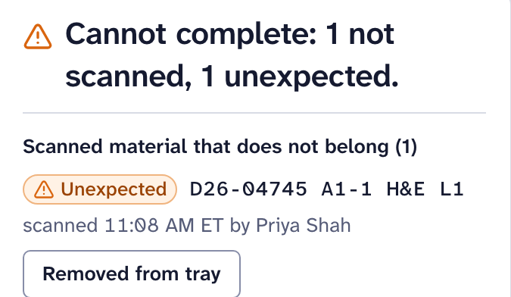
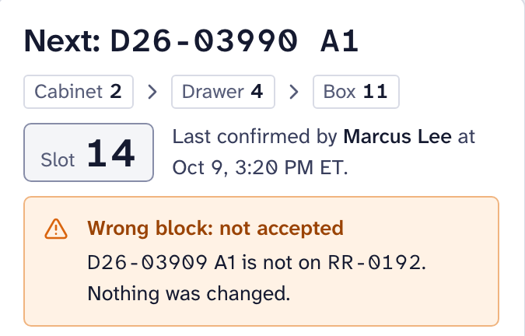
Demo, part 3: physical checks, and what is still blocked
Guided demo · steps 6–8 of 8
Printer timeout
The screen shows “unknown”, never “printed”, until someone checks the printer. No reprint before that.
Not pictured
A tray missing a slide can’t be marked complete
A wrong block scan is rejected, and nothing changes
Operations: what is blocked, who owns the next step, how long it has waited. Made-up numbers, not lab results.
Notes:
Fallback only, about 60 s.
These use earlier made-up cases. The tray expects ten slides; one is missing and one belongs to another doctor's case, so it can't be completed. A label job timed out, so the screen says unknown, and someone checks the printer before anything is reprinted. A web page can't apply labels for us. Real printing depends on our printers and label stock. Scanning the wrong block is rejected and nothing changes. Last, Operations shows what's still blocked and who owns the next step. These numbers come from made-up data, not results, and they're not for ranking anyone.

Slide 7


What’s real and what’s simulated
The Integration screen (two crops): simulated EMA messages, and what a person must still decide. The real EMA interface is still to confirm with ModMed.
on synthetic data: workflow rules, role checks, audit trail, backup and restore, health checks
EMA, offices, couriers, printers, scanners and the drafting “assistant”
Works today
Simulated
real sign-in and hosting, until the organization provides them
screen readers, paper printing, real hardware, touchscreens
Blocked
Needs people to check
About 800 automated checks pass, on synthetic data. Not clinical validation.
Notes:
About 60 s.
I want to be exact about what's real. The rules you saw run for real on my laptop, with role checks on the server, an audit trail that shows if anyone edits it, and encrypted backups that I've restored and checked. Everything outside is simulated: EMA, the offices, the printers, the scanners. On the right, the simulated EMA messages: five need a person to review, and nothing changed by itself. Real sign-in is built but switched off until IT gives it a real identity provider and a place to run. The tests pass, but tests only show the code does what the tests say. They aren't clinical validation.

Slide 8
Implementation: six phases, with gates where the plan can stop
0
1
2
3
4
5
Discovery and governance
Synthetic sandbox at the lab
Technical foundation
Validation and training
Limited pilot
Decision
Weeks 1–4
Weeks 5–10
Weeks 8–22
Weeks 20–28
Weeks 28–36
Weeks 36–38
Decide: configure, buy, build or stop
Bench usability with real scanners and printers; no patient data
Hosting, sign-in, security review, vendor interface (test only)
Under the lab’s quality system, approved by the Medical Director
One workflow, one bench; shadow first; weekly continue-or-stop reviews
Continue, expand, change or stop
Phases 0–3 end at a gate (◆) where the plan can stop; the pilot is reviewed every week.
Stopping, or configuring existing tools, is a success. Weeks from approval are rough estimates to refine in Phase 0. Phases overlap; vendor scoping runs without a contract, and nothing is signed or purchased before Gate 1.
Notes:
About 75 s.
If you say yes, it goes one phase at a time, and every phase ends with a gate where we can stop. Phase 0 is four weeks of looking and asking, with no patient data and nothing installed. If we still want to build after that, Phase 1 puts the demo, with made-up data, on one lab computer so coworkers can try it with our real scanners and printers. At that gate you'd also name who builds the interface connector, our IT or a contracted developer, so it never depends on me alone. Phase 2 is IT's part: a real place to run it, real sign-in, an outside security review, and a test interface with the vendor. Phase 3 is validation and training, approved by the Medical Director. Then one small pilot, reviewed every week, and a decision.

Slide 9
Timeline (rough estimates, weeks from approval)
Week
1
5
10
15
20
25
30
35
38
Best case: about
0 Discovery
wk 1–4
7–9 months
1 Sandbox
wk 5–10
to the end of a limited pilot, if a vendor test environment is ready by about week 15
2 Foundation
wk 8–22
vendor-dependent: 2–6 months
Up to about 12 months with vendor delays
3 Validation
wk 20–28
4 Pilot
wk 28–36
Cheapest decision-grade path
5 Decision
About 10 weeks
wk 36–38
Gates
Phases 0–1 only, no patient data
G0
G1
G2
G3
G5
Phases 0–1: about 10 weeks, no patient data
This is the build path. If Phase 0 chooses configure or buy, the plan is redrawn with ModMed or the vendor.
Notes:
About 60 s.
These are my rough estimates, and Phase 0 is where we'd correct them. The phases overlap because IT and vendor questions take the longest, so they start early, with no contract. In the best case, the vendor gives us a specification and a test environment by about week fifteen, three months in, and we'd reach the end of a small pilot in about seven to nine months. If the vendor test environment is not ready by about week fifteen, plan on the twelve-month case. One caution: ModMed also has its own Pathology module. If our lab works inside it, orders may never travel to a separate system, and the build path would likely stop at the end of Phase 0. The cheapest useful path is the first two phases: about ten weeks, no patient data. That's enough to know whether this is worth more. This plan is for the build path. If we choose to configure EMA or buy a product, we redraw it with them.

Slide 10
What it takes (roles and time, rough estimates)
Across the whole build path. Phase 0 alone is on slide 12 (the ask). Ranges, not commitments.
Sponsor (Director of Operations)
Medical Director
IT
about 1 h a week
about 4–8 h
about 40–100 h
plus gate decisions
plus gate reviews and validation approval
hosting, sign-in, backups, monitoring
Compliance/Privacy
Bench staff
Validation
about 10–30 h
sessions of 1–2 h
about 60–150 h
data handling review and agreements
usability, for 5–8 people; 1–2 h training per role
testing and documentation, depending on the workflow
Unknown until quotes or estimates: vendor interface fees, connector development, external security test, hosting, a support contract or IT time after go-live, hardware and label stock.
Notes:
About 60 s.
Here's who would be involved across the whole plan. For Phase 0 alone it's much less: mostly a few meetings and the inventory. These are ranges, not commitments. The biggest pieces are IT and validation. Validation depends on which workflow we pick, and it's the lab's responsibility under its own quality system. My own time would need an agreement with my manager [to confirm]. Several things I can't estimate yet: the work to build the interface connector, what a vendor would charge, an outside security test, hosting, and hardware or label stock. And one that lasts: support after go-live, whether that's IT time or a contract, including updates, backups and re-checking after changes. Those need quotes or estimates, at Gate 1 and in Phase 2, if we get that far. There are no dollar figures in this proposal on purpose.

Slide 11
Risks and safeguards
Risk
Safeguard
One developer (me)
A named developer before any interface work; a named owner before any pilot (internal IT, a contracted developer, or a vendor product instead)
A second system, double entry
EMA stays the system of record; the extra work is measured, not hidden
Interface delays or fees
Phases 0–1 need no interface; we can stop or switch at any gate
Wrong or stale information
Shows “unknown” and data age; fails closed; tamper-evident audit
Unproven safety
An independent security test; validation approved by the Medical Director
Audit check: the activity record has a check that would detect an edit. In the demo it uses a public key, so it only shows how the check works.
Notes:
About 75 s.
The biggest risk is me. Right now one person built this, and a lab can't depend on one employee. So before any interface work there has to be a named developer who isn't only me, and before any pilot a named owner: our IT, a contracted developer, or a vendor product instead. Second, it could become one more system to type into. EMA stays the record, and we count any extra work honestly. Third, vendor interfaces can be slow or cost money; the first two phases don't need one. When the software doesn't know something, it says unknown instead of guessing, and the activity record has a check that would detect an edit. In the demo it uses a public key, so it only shows how the check works. None of that replaces an outside security test or validation.

Slide 12
The ask: Phase 0 only
Four weeks of discovery and observation
At week 4: a written recommendation to
1
2
3
4
configure
buy
build
stop
Week 1
Week 2
Week 3
Week 4
Gate 0
No patient data
No software installed on lab systems
No purchase
Phase 0 effort (rough estimate)
What you would allow
You: about 4 h over the 4 weeks, plus Gate 0
Medical Director, IT lead, Compliance/Privacy: [to estimate at kickoff]
Me: [to confirm with my manager, and who covers my bench]
Observation, with staff consent
A 30-minute small-group demo review
Questions to ModMed or an LIS vendor, sent through [to confirm: the EMA administrator or IT lead]
No contract, no data. Not a request for money or system access.
Notes:
About 50 s.
So here's what I'm asking for: Phase 0 only. Four weeks. I'd observe and time the current workflow, with my coworkers' agreement and no patient identifiers in my notes. A small group would spend thirty minutes telling me what's wrong with the demo. We'd answer the discovery checklist and ask ModMed what we already have and can configure, through whoever you choose. You'd be the sponsor, about four hours over the four weeks. At the end you get a written recommendation: configure, buy, build or stop. If the answer is that EMA can already do this, that's a success, and I'll be glad we checked. I'm not asking for money, system access or patient data.

Slide 13
Where this could go
Vision, not a request
Today’s ask is Phase 0 only.
A full lab system built on the same bench rules, working with EMA, not replacing it
A
Pilot
B
Sign-out and result delivery
C
Core lab workflow
D
Platform and migration
The current proposal, starting with Phase 0
Pathologist workspace; results back to EMA
Billing support, special stains and IHC
Production hosting; alongside B and C
Possible later steps. Each is a separate decision, made only on the evidence of the one before.
about 18–24 months Rough estimate
about 3–5 years Rough estimate
The pilot comes first
after the pilot, including validation and go-live:
the lab’s own system of record for lab work
(EMA stays the practices’ record)
with a funded team of about 5–8 people
after the pilot:
a product used by many labs
Does it help the bench?
Do staff want to use it?
Can it connect to EMA?
What does validation really take?
Rough planning ranges: rough estimates only, not quotes or commitments. Who would fund, own and support it is an open question.
Notes:
About 45 s.
One last slide, and it's a vision, not a request. If the pilot works, the foundation is designed to grow into a full lab system that works with EMA, not one that replaces it. Next would come the pathologist's sign-out and sending results back to EMA, then billing support and special stains. To be honest about the scale: a funded team of about five to eight people, roughly eighteen months to two years after the pilot for one lab's own system of record for lab work, with EMA still the practices' record, and three to five years after the pilot for a product many labs could use. Those are rough estimates, not quotes, and who would fund or own it is an open question. None of it is part of today's ask. The pilot comes first, and it's worth doing even if nothing after it happens. I have a short write-up if you'd like it.

Slide 14
Questions
Leave-behind: the two-page brief, the timeline, the FAQ and the one-page decision checklist
Jorge Rodriguez, histology assistant · [to confirm: preferred work contact]
Synthetic demonstration · fictional data · not endorsed by anyone
Notes:
For handling questions.
"Thank you. I'm happy to take any question, including the hard ones." Then, during questions:
• Answer short first, then offer detail. The likely questions and honest answers are in the Director FAQ.
• If you don't know, say: "I don't know yet. That's a Phase 0 question," and write it down.
• Never guess a cost, a saving, a time saved or a vendor capability. Never name a coworker.
• If the conversation turns to buying a product or configuring EMA, support it. That is a good outcome.
• If asked about the long term, point back to slide 13 and offer the optional Product vision write-up. Keep it as "where this could go", never as part of the ask.

Slide 15
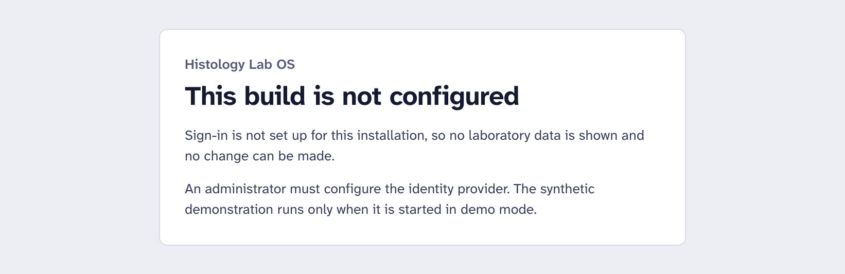
Appendix: evidence and sources
Latest verification (2026-10-24): type check clean; 643/643 unit, integration and contract; 139/139 demo browser; 26/26 secured. Re-run on the frozen code before the meeting
Fails closed: a build that isn’t configured shows no data and opens no database
Public sources on ModMed interfaces and CAP information-system requirements: to confirm with the vendor
Full documents: pilot proposal, discovery checklist, production readiness
The locked build: the same software (Histology Lab OS) started without demo mode and without sign-in configured. Every page leads here: no data, no database opened, no changes possible.
Sources: public pages. Confirm each with the vendor, and check CAP items against the current checklist edition.
ModMed, HL7 connectivity: modmed.com/synapsys/hl7
ModMed, lab orders and results interface: modmed.com/?p=31624
ModMed, lab connection (partner) process: modmed.com/lab-connect
ModMed API portal (FHIR R4, EMA API): portal.api.modmed.com
LigoLab on its ModMed integration (vendor claim): ligolab.com/post/…
CAP information-system requirements, via MLO (2017): mlo-online.com/…/13009283/
Notes:
About 50 s.
If you want the evidence behind what I said: these are the automated test results from the last full run. This screen is what the software shows when it isn't set up properly. It refuses to show any data, instead of falling back to something unsafe. On integration, ModMed's public pages say EMA sends lab orders out as HL7 messages and takes results back the same way, and that labs connect through a partner process. I haven't confirmed any of that with ModMed; Phase 0 would. The CAP checklist has information-system requirements, and the exact items need checking against the current edition.
Sources for this slide (public pages; each must be confirmed with the vendor or against the current checklist edition):
• ModMed HL7 (orders out as HL7 ORM, pathology results in as HL7 ORU, with PDF and chart matching): https://www.modmed.com/synapsys/hl7/ and https://www.modmed.com/?p=31624
• ModMed lab connection (partner) process: https://www.modmed.com/lab-connect/
• ModMed API portal (Certified FHIR R4 API with OAuth 2.0 / SMART on FHIR, mainly read and search; a proprietary EMA API): https://portal.api.modmed.com
• A third-party LIS vendor's description of its ModMed integration (vendor claim): https://www.ligolab.com/post/seamless-diagnosis-mapping-why-ligolabs-modmed-integration-matters-for-dermatopathology
• CAP information-system requirements: validation at installation and after changes, laboratory director or designee approval, and interface checks. Requirement numbers in older sources (for example GEN.43022, GEN.48500) must be checked against the current edition: https://www.mlo-online.com/information-technology/lis/article/13009283/the-inspectionready-lab-includes-it

