Slide 1

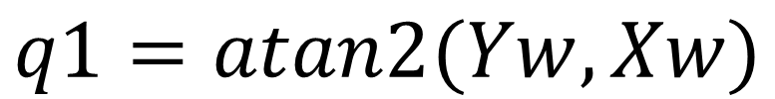
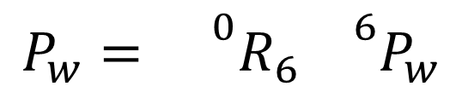
L2
$${}^{6}P_{w}={}^{6}R_{0}P_{6}−L6\hat{z_{6}}$$
L5
$$P_{w}={}^{0}R_{6}{}^{6}P_{w}$$
L4
L6
L3
w
Pw
P6
L1
Z0
Yw
Y0
X0
q1
$$q1=atan2(Yw,Xw)$$
Xw

Slide 2
L2
L5
L4
L6
L3
w
Pw
L1
Z0
Yw
Y0
X0
r
$$q1=atan2(Yw,Xw)$$
Xw

Slide 3
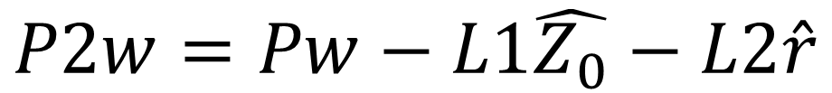
Z0
q3
L4
L5
q2
w
$$P2w=Pw−L1\hat{Z_{0}}−L2\hat{r}$$
L3
P2w
L2
Pw
L1
r

Slide 4
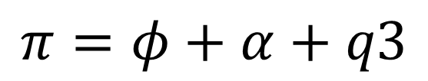

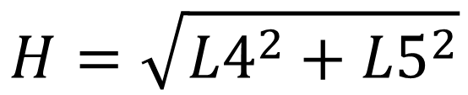
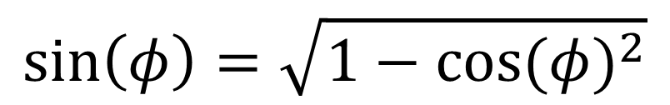
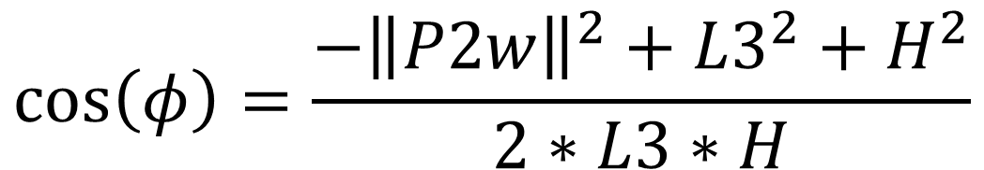

$$H=\sqrt{{L4}^{2}+{L5}^{2}}$$
$$α=Atan2(L5,L4)$$
q3
$${\left\|P2w\right\|}^{2}={L3}^{2}+H^{2}−2∗L3∗H∗cos⁡(φ)$$
L4
$$\cos\left(φ\right)=\frac{−{\left\|P2w\right\|}^{2}+{L3}^{2}+H^{2}}{2∗L3∗H}$$
α
L5
w
φ
H
$$\sin\left(φ\right)=\sqrt{1−{cos⁡(φ)}^{2}}$$
L3
$$φ=Atan2(\sin\left(φ\right),cos⁡(φ))$$
P2w
$$π=φ+α+q3$$
$$q3=π−φ−α$$

Slide 5
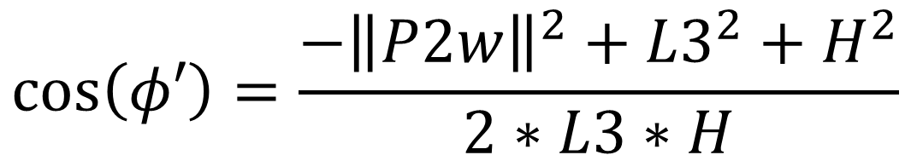

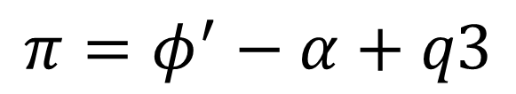
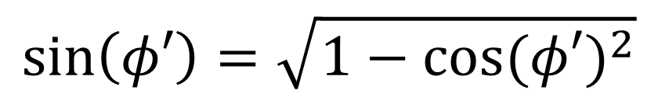
$${\left\|P2w\right\|}^{2}={L3}^{2}+H^{2}−2∗L3∗H∗cos⁡(φ′)$$
$$\cos\left(φ′\right)=\frac{{−\left\|P2w\right\|}^{2}+{L3}^{2}+H^{2}}{2∗L3∗H}$$
H
L5
w
q3
$$\sin\left(φ′\right)=\sqrt{1−{cos⁡(φ′)}^{2}}$$
α
$$φ′=Atan2(\sin\left(φ^{′}\right),cos⁡(φ′))$$
L4
Φ’
L3
$$π=φ^{′}−α+q3$$
P2w
$$q3=π−φ′+α$$

Slide 6


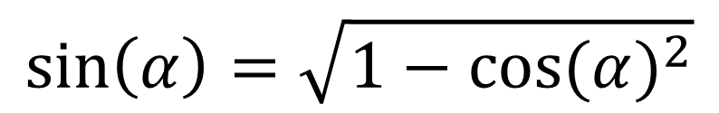
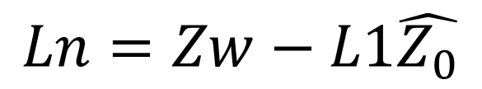
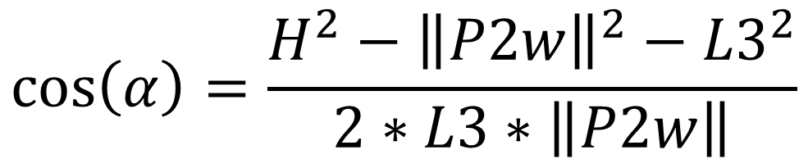
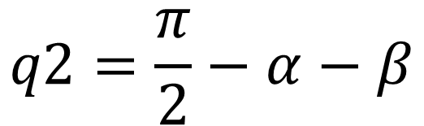
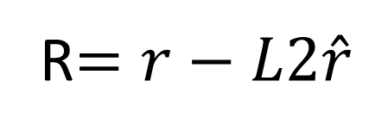
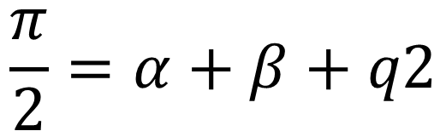
$$Ln=Zw−L1\hat{Z_{0}}$$
R$=r−L2\hat{r}$
q3
$$β=Atan2(Ln,R)$$
$$H^{2}={L3}^{2}+{\left\|P2w\right\|}^{2}−2∗L3∗\left\|P2w\right\|∗cos⁡(α)$$
L4
L5
w
$$\cos\left(α\right)=\frac{{H^{2}−\left\|P2w\right\|}^{2}−{L3}^{2}}{2∗L3∗\left\|P2w\right\|}$$
H
q2
L3
$$\sin\left(α\right)=\sqrt{1−{cos⁡(α)}^{2}}$$
α
P2w
Ln
$$α=Atan2(\sin\left(α\right),cos⁡(α))$$
β
R
$$\frac{π}{2}=α+β+q2$$
$$q2=\frac{π}{2}−α−β$$

Slide 7

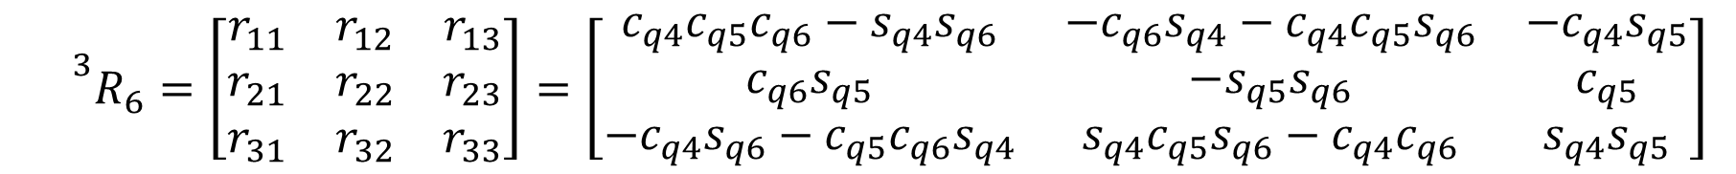


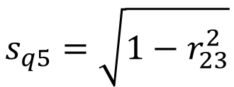



$${}^{0}{R_{3}}^{−1}∗R=^{3}R_{6}$$
$${}^{3}R_{6}=\left[\begin{matrix}r_{11} & r_{12} & r_{13} \\ r_{21} & r_{22} & r_{23} \\ r_{31} & r_{32} & r_{33}\end{matrix}\right]=\left[\begin{matrix}c_{q4}c_{q5}c_{q6}−s_{q4}s_{q6} & −c_{q6}s_{q4}−c_{q4}c_{q5}s_{q6} & {−c}_{q4}s_{q5} \\ c_{q6}s_{q5} & −s_{q5}s_{q6} & c_{q5} \\ {−c}_{q4}s_{q6}−c_{q5}c_{q6}s_{q4} & s_{q4}c_{q5}s_{q6}−c_{q4}c_{q6} & s_{q4}s_{q5}\end{matrix}\right]$$
$$r_{13},r_{23}≠0$$
$$c_{q5}=r_{23}$$
$$s_{q5}=\sqrt{1−r_{23}^{2}}$$
$$q_{5}=\operatorname{atan}{2\left(s_{q_{5}},c_{q_{5}}\right)}$$
$$q_{4}=\operatorname{atan}{2\left(r_{33},{−r}_{13}\right)}$$
$$q_{6}=\operatorname{atan}{2\left(−r_{22},r_{21}\right)}$$

Slide 8

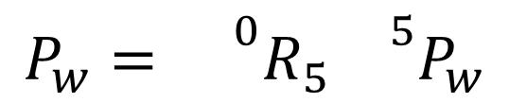
L2
$${}^{5}P_{w}={}^{5}R_{0}P_{6}−L6\hat{z}$$
L5
$$P_{w}={}^{0}R_{5}{}^{5}P_{w}$$
L4
L6
L3
L1
$$q1=atan2(Yw,Xw)$$

Slide 9
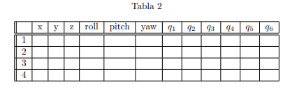
479.5 | 0 | 680 | 0 | 0 | 0

