Slide 1
Shared Memory
Arquitectura de Computadors

Slide 2
Shared memory is a memory that is parallely accessed by multiple programs
with an intension to provide communication among them or avoid redundant
copies.
Shared memory is an efficient means of passing data between two programs.
Its depending on the context, that programs may run on a single processor or
on multiple separate processors.
Using memory for communication inside a single program, for instance
memory sharing among multiple threads, we can call this as a shared memory.

Slide 3
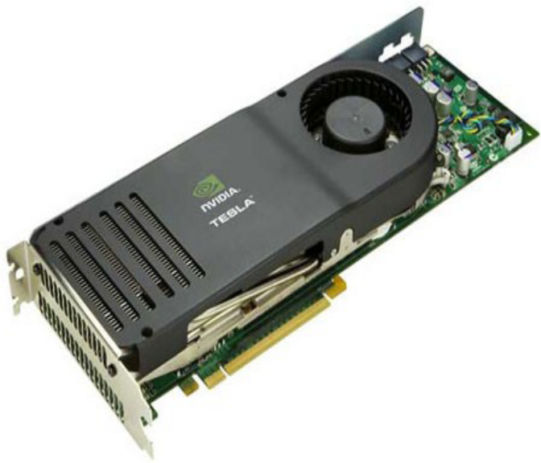
Matrix Multiplication using shared memory
Discussion on Advantages of shared memory

Slide 4
Matrix Multiplication Using
shared Memory
A common strategy is partition the data into
subsets called tiles so that each tile fits into the shared memory.

Slide 5
CUDA C makes available a region of memory that we call shared memory.
__global__ As a programmer, we can modify our variable declarations with the CUDA C keyword
__shared__ to make this variable resident in shared memory.

Slide 6
The CUDA C compiler treats variables in shared memory differently than typical variables.
It creates a copy of the variable for each block that you launch on the GPU.
Every thread in that block shares the memory, but threads cannot see or modify the copy of this variable that is seen within other blocks.
This provides an excellent means by which threads within a block can communicate and collaborate on computations.
Furthermore, shared memory buffers reside physically on the GPU as opposed to residing in off-chip DRAM.

Slide 7
Threads within the same block have two main ways to communicate data with each other.
The fastest way would be to use shared memory.
When a block of threads starts executing, if your program is using too much shared memory to store data, or your threads simply need to share too much data at once, shared memory is not the good point to accommodate all the data that needs to be shared among the threads.
In such a situation, threads always have the option of writing to and reading from global memory.
Global memory is much slower than accessing shared memory; however, global memory is much larger.

Slide 8
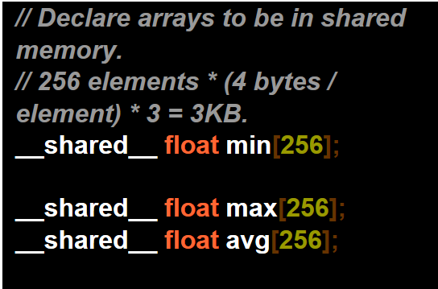
Declaring shared arrays
For CUDA kernels, there is a special keyword,
__shared__, which places a variable into shared memory for each respective thread block. The __shared__ keyword works on any type of variable or array.

Slide 9
Static Shared Memory
If the shared memory array size is known at compile time,
As in the staticreverse kernel, then
We can explicitly declare an array of that size, as we do with the arrays.
Example:
__global__ void staticReverse(int *d, int n)
{
__shared__ int s[64];
int t = threadIdx.x;
int tr = n-t-1;
s[t] = d[t];
__syncthreads();
d[t] = s[tr];
}

Slide 10
Dynamic Shared Memory
The other three kernels in this example use dynamically allocated shared memory, which can be used when the amount of shared memory is not known at compile time. In this case the shared memory allocation size per thread block must be specified (in bytes) .
Syntax:
dynamicReverse<<<1, n, n*sizeof(int)>>>(d_d, n);
Example:
extern __shared__ int s[];
int *integerData = s; // nI ints
float *floatData = (float*)&integerData[nI]; // nF floats
char *charData = (char*)&floatData[nF]; // nC chars
In the kernel launch, specify the total shared memory needed, as in the following.
myKernel<<<gridSize, blockSize, nI*sizeof(int)+nF*sizeof(float) )+nC*sizeof(char)>>>(...);

Slide 11
Synchronization thread to the GPU Using Shared memory
If we expect to communicate between threads, we also need a mechanism for synchronizing between threads.
For example, if thread A writes a value to shared memory and we want thread B to do something with this value, then thread B has to wait untill thread A completes.
Without synchronization, we have created a race condition where the correctness of the execution results depends on the nondeterministic details of the hardware.

Slide 12
Synchronization between threads
To ensure correct results when parallel threads cooperate, we must synchronize the threads.
CUDA provides a simple barrier synchronization primitive,
__syncthreads(). A thread’s execution can only proceed past
a __syncthreads() after all threads in its block have executed the __syncthreads().
Thus, we can avoid the race condition described above by calling __syncthreads() after the store to shared memory and before any threads load from shared memory.
It’s important to be aware that calling __syncthreads() in divergent code is undefined and can lead to deadlock—all threads within a thread block must call __syncthreads() at the same point.

Slide 13
A minimum of 64 threads per block should be used, and only if there are multiple concurrent blocks per multiprocessor.
Between 128 and 256 threads per block is a better choice and a good initial range for experimentation with different block sizes.

Slide 14
Performance
In the GeForce 8800 GTX implementation, each SM has 8K registers, which amounts to 128K registers for the entire processor.
In order to achieve the maximal (768 thread slots), each thread can use only 8K/768= 10 registers.
If each thread uses 11 registers, the number of threads in each SM will be reduced. Such reduction is done at the block granularity.
Use nvcc options -cubin or --ptxas-options=-v to determine the number of registers used in a kernel as well as local, shared, and constant memory usage..

Slide 15
Practical's LAB 4
Calculate the Scalar product value using, shared memories and syncthreads.

Slide 16
References
1- NVIDIA CUDA Programming Guide
2-NVIDIA CUDA Reference Manual
3- Programming Massively Parallel Processors, By David Kirk, NVIDIA Fellow, Wen-mei Hwu, Professor, University of Illinois

Slide 17
Thank You!!

