Slide 1
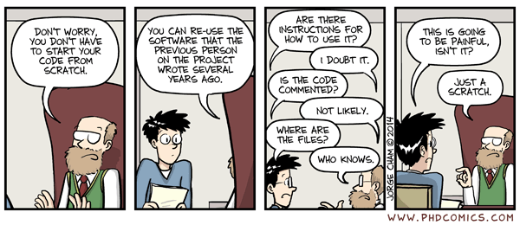
How to manage a Bioinformatics project
Jorge Eduardo Amaya Romero
https://github.com/jorgeamaya

Slide 2

Content
Why all this is important.
How to plan your project.
How to write scripts that are easy to understand.
How to write a good README with Markdown.
How to use AI to help you be a more efficient programmer.

Slide 3
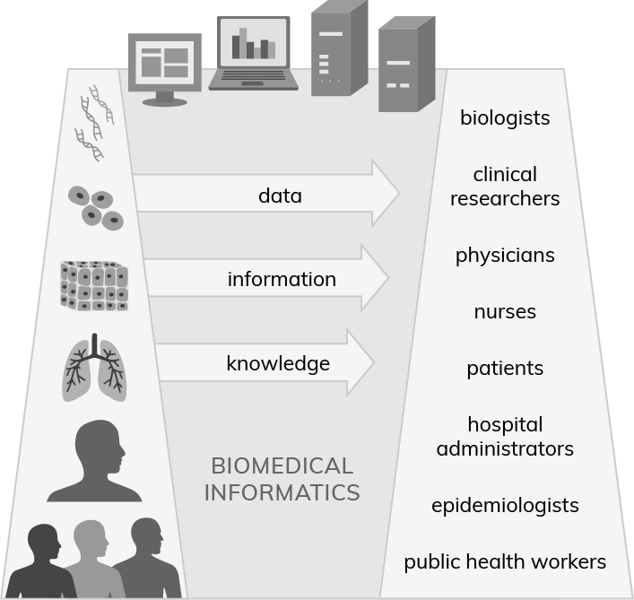
FROM THE BENCH TO THE CUSTOMER
The field of biomedical informatics is structured around several key components:
Biomedical entities (left)
People (right)
Information technologies (top).
Central to this landscape are biomedical data, information, and knowledge.
https://www.research.uky.edu/institute-biomedical-informatics/what-biomedical-informatics

Slide 4
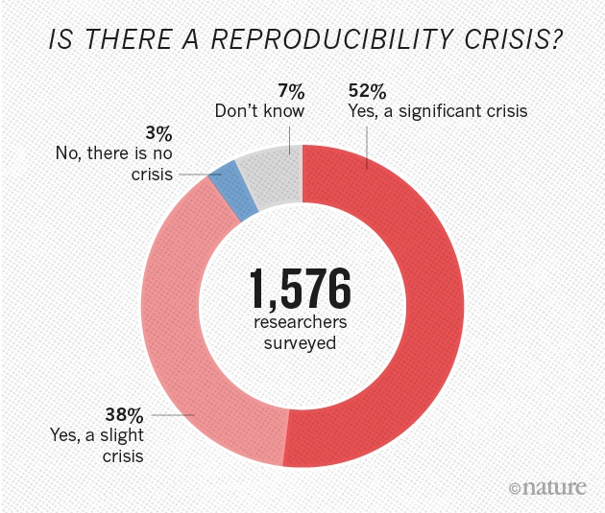
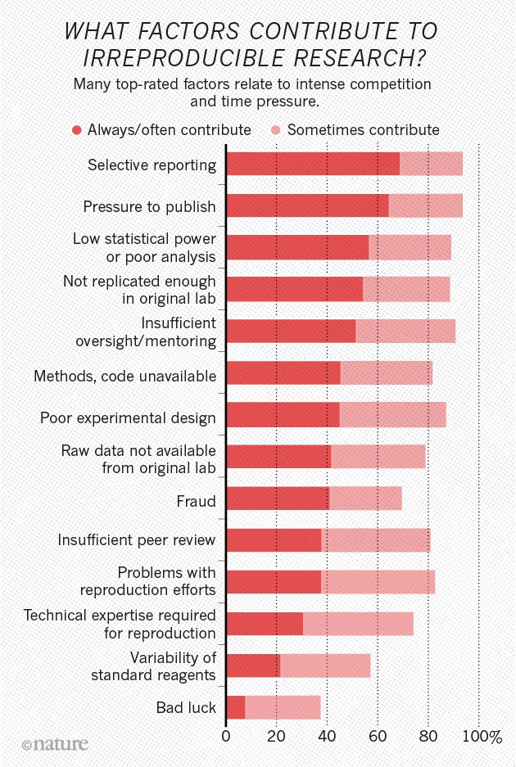
(Baker, 2016) https://www.nature.com/articles/533452a

Slide 5
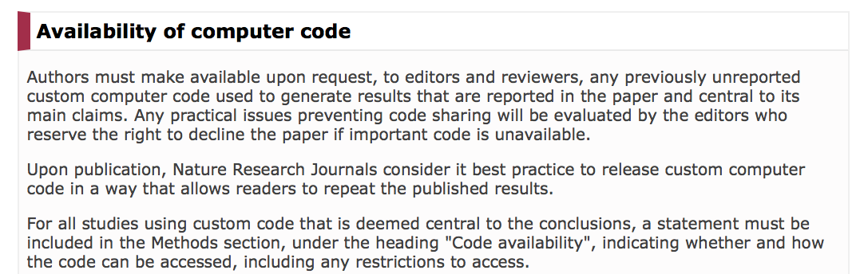



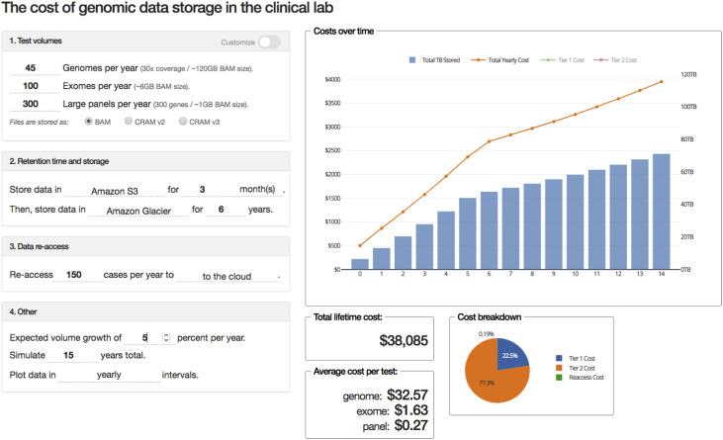



Why is this important for you and your team?
DON’T WASTE YOUR COLLABORATORS’ TIME.
DON’T WASTE YOUR OWN TIME.
DON’T REINVENT THE WHEEL.
SCIENCE MOVES FORWARD THROUGH COLLABORATION.
MOST JOURNALS HAVE CODE AND DATA ACCESSIBILITY POLICIES IN PLACE
GOOD PROJECT PLANNING TRANSLATES INTO GOOD DATA MANAGEMENT, WHICH MEANS SAVED MONEY 💸 💸 💸.
https://doi.org/10.1016/j.plabm.2020.e00168
http://www.nature.com/authors/policies/availability.html#code

Slide 6
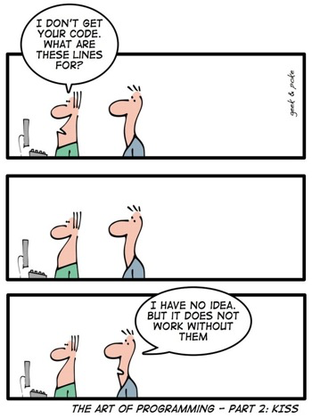
Plan and stay organized
Slow is smooth and smooth is fast:
Device an action plan.
Sit at the computer ONLY when you have a clear strategy to tackle the problem.
Take notes on paper:
A plain list is enough for most use cases.
Flowchart and pseudocode are more advanced options.
From the start, make a README file per directory:
What the scripts in your directory do.
How to run the scripts.
What are the expected results.
Track changes in the README file.

Slide 7

Example of a list for a simple script that demultiplexes reads in a fastq files based on their barcodes
Load the reference table with the sample name.
Loop through each line of file with a for loop. Extract the Name, Forward, and Reverse barcode using pandas. Skip HEADER line.
Use the Name to open the forward and reverse fastq files.
Make the name of the output fastq files using Name.
Get the length of the Forward (x) and Reverse (y) Barcode.
Loop through the reads in the file.
Get len(x) and len(y) nucleotides from the beginning of the forward and reverse read.
Calculate the hamming distance to the forward and reverse barcode for the extracted nucleotides.
If distances less than 2, store the read in output file.
Make your list as descriptive as possible.

Slide 8
The Philosophy
Divide your project in concrete, manageable sections
Assign each section to a directory
Divide each section into steps
Assign each step to a script (or line of code, depending on the complexity of the task)

Slide 9

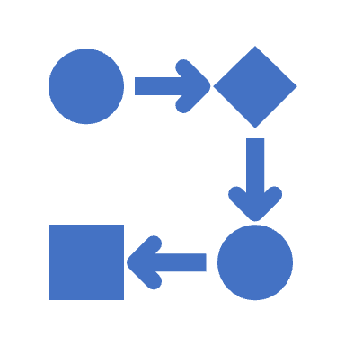


Use a consistent structure for your project
A project directory that will include all the steps of your project (and a README file with the general description of the project).
Project Name
…
Create subdirectories for each step of the project.
Step_1
Step_2
Step_3
Data
Data
Data
Each subdirectory must include three sub-subdirectories: Code, Data, Results, a master.sh script, and a README file.
Code
Code
Code
Results
Results
Results
A TMP directory is optional but must be gone by the end.
master.sh
master.sh
master.sh
README.md
README.md
README.md

Slide 10


Data Structure
Project Name
Step_1
Data for Step 1 is stored in a separate Data Repository outside the project directory.
Data
Code
Results
master.sh
Inter-directory linking of files from Repository to Step 1 Data is done with symbolic links.
README.md

Slide 11
Running your program
All processes in a step must be executed from master.sh by calling scripts in Code.
./master.sh
NEVER write to Data or Code
You might corrupt your Data or your scripts.
Write intermediate files or dynamically created scripts to TMP.
The Results subdirectory of Step 1 is the Data subdirectory of Step 2, and so on for subsequent directories.
Inter-directory linking of files from Step to Step is done with symbolic links.
Project Name
Step_1
Step_2
Step_3
Data
Data
Data
Code
Code
Code
Results
Results
Results
master.sh
master.sh
master.sh
README.md
README.md
README.md
TMP?
TMP ?
TMP ?

Slide 12
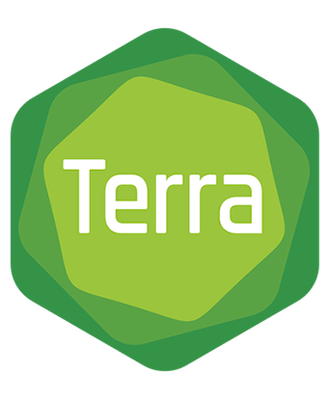
Can we translate this project design into Terra?
Project_Name
Step_1
Step_2
Step_3
Data
Data
Data
Code
Code
Code
Results
Results
Results
master.sh
master.sh
master.sh

Slide 13
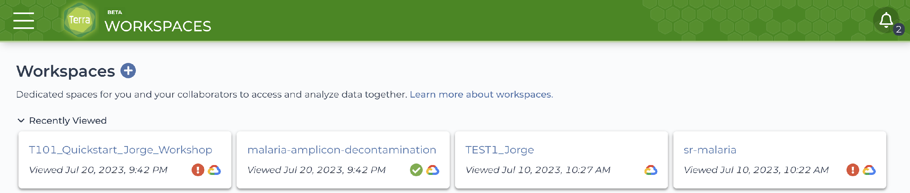
Yes, Terra already (sort of) follows this structure
Project_Name
Step_1
Step_2
Step_3
Data
Data
Data
Code
Code
Code
Results
Results
Results
master.sh
master.sh
master.sh

Slide 14
Yes, Terra already (sort of) follows this structure
Workspace
Step_1
Step_2
Step_3
Data
Data
Data
Code
Code
Code
Results
Results
Results
master.sh
master.sh
master.sh

Slide 15
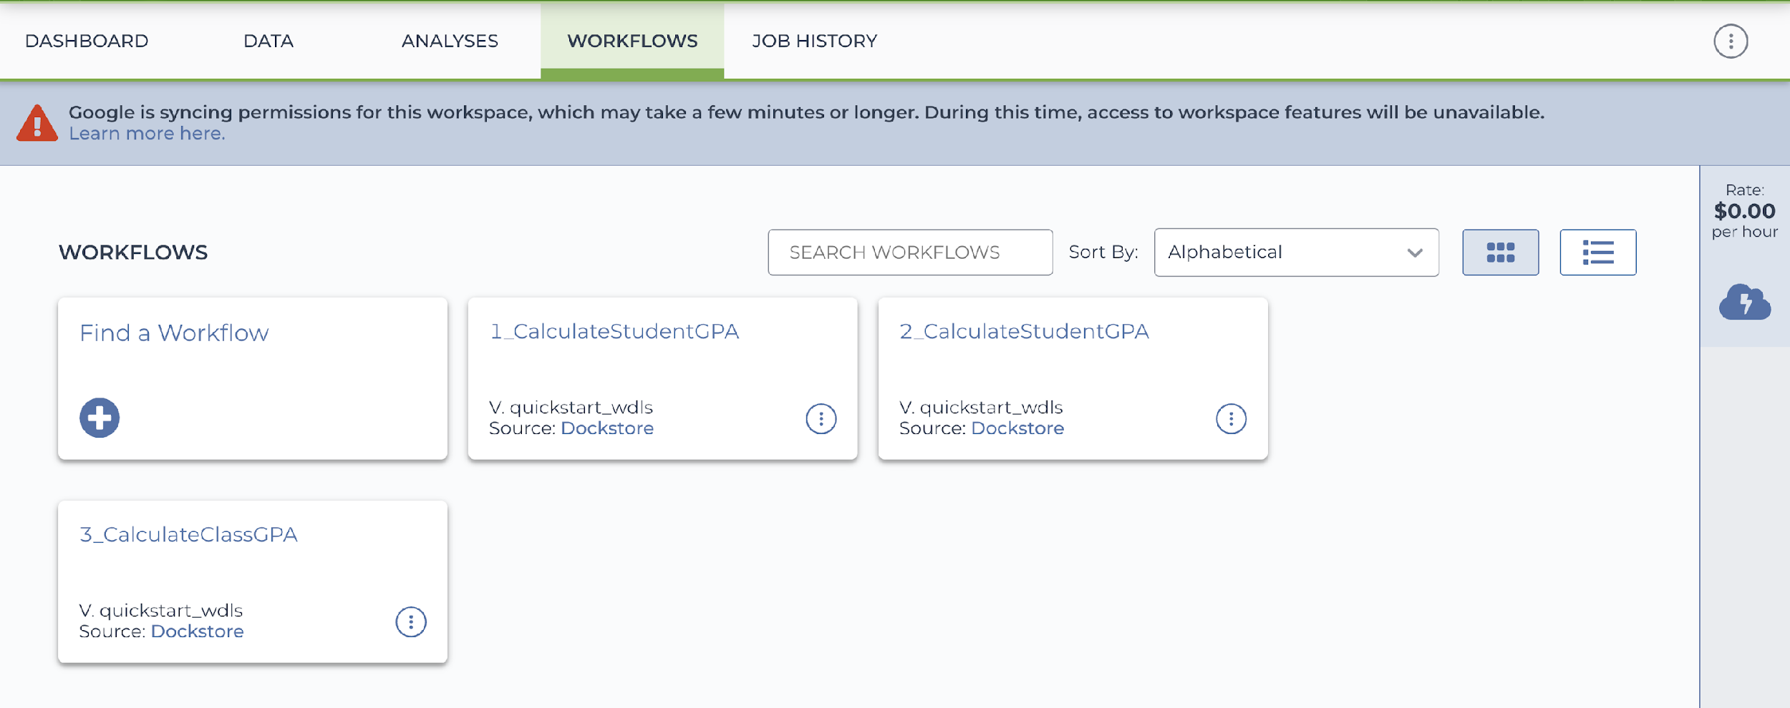
Yes, Terra already (sort of) follows this structure
Workspace
Workflow_1
Workflow_2
Workflow_3
Data
Data
Data
Code
Code
Code
Results
Results
Results
master.sh
master.sh
master.sh

Slide 16
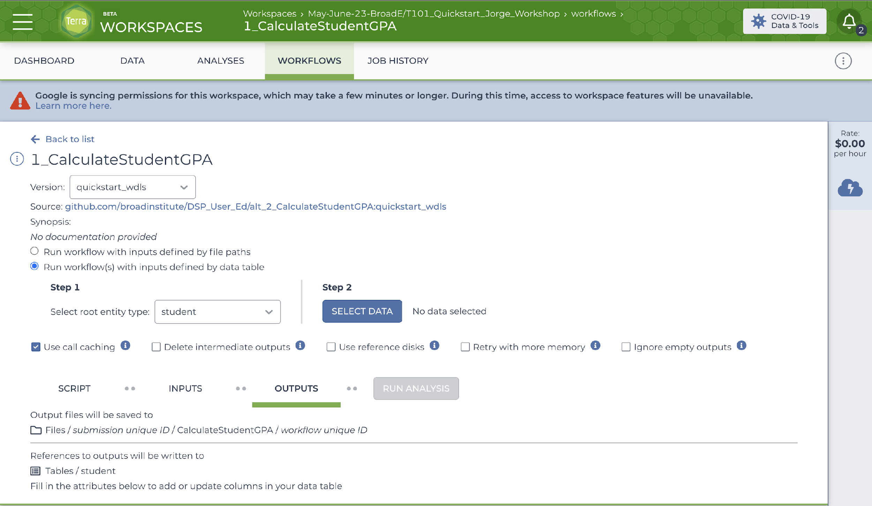
Yes, Terra already (sort of) follows this structure
Workspace
Workflow_1
Workflow_2
Workflow_3
Data
Data
Data
Code
Code
Code
Results
Results
Results
master.sh
master.sh
master.sh

Slide 17
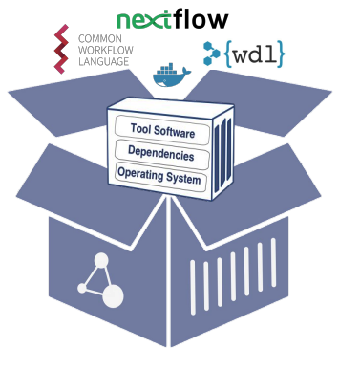
Yes, Terra already (sort of) follows this structure
Workspace
Workflow_1
Workflow_2
Workflow_3
Data
Data
Data
Code
Code
Code
Results
Results
Results
Docker containers must encapsulate enough functionality to be meaningful, but not so much that they become unwieldy.
master.sh
master.sh
master.sh

Slide 18
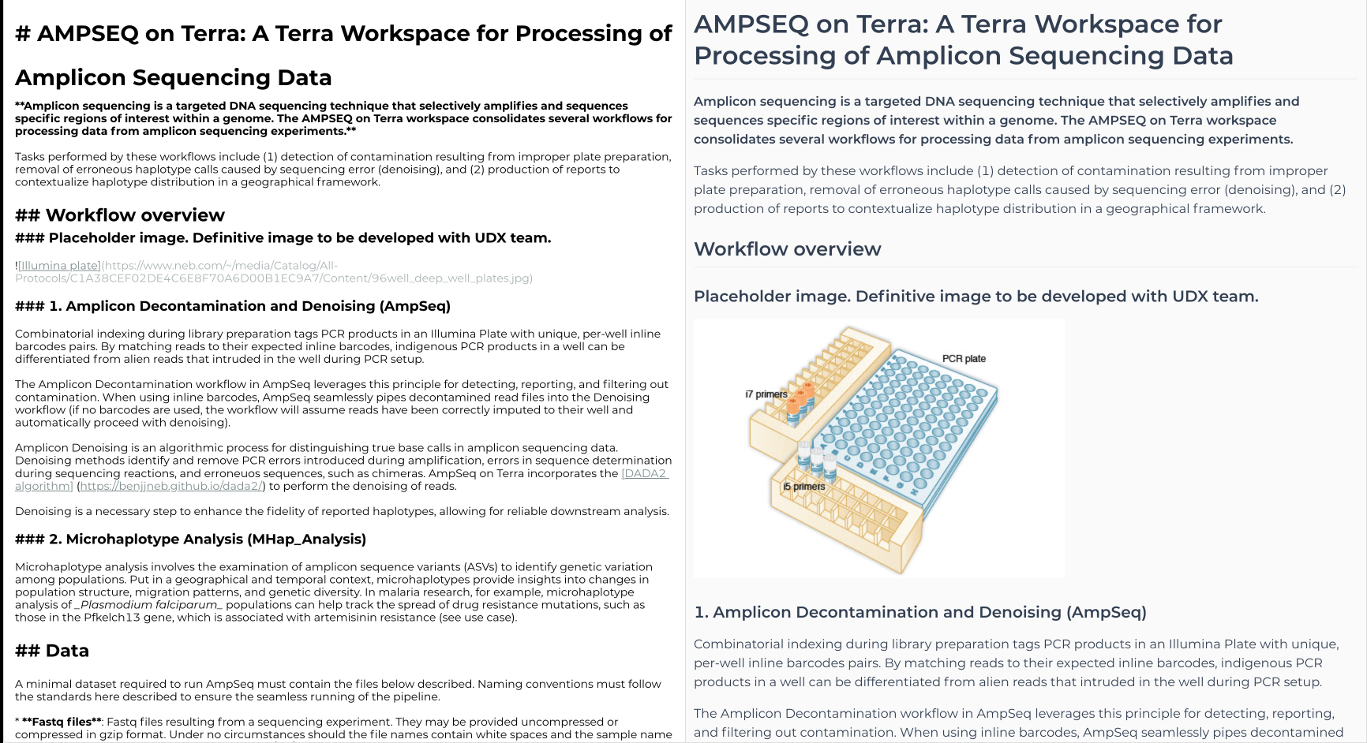
Yes, Terra already (sort of) follows this structure
The Dashboard is the equivalent of the README.md file and it is written in Markdown.

Slide 19
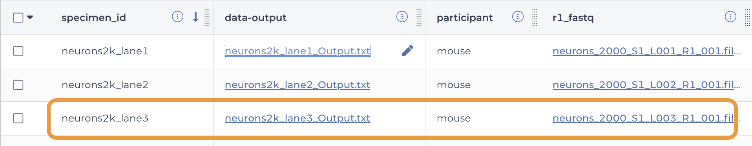
Yes, Terra already (sort of) follows this structure
Preserve the structure of the DATA in RESULTS
Results
Data

Slide 20
Version control (with GitHub)
What is version control?
To do version control is to record changes to files or set of files.
It allows you to keep track of the changes you’ve done to your program.

Slide 21
Version control (with GitHub)
What is version control?
To do version control is to record changes to files or set of files.
It allows you to keep track of the changes you’ve done to your program.
Start program

Slide 22
Version control (with GitHub)
What is version control?
To do version control is to record changes to files or set of files.
It allows you to keep track of the changes you’ve done to your program.
Start program
Add feature 1

Slide 23
Version control (with GitHub)
What is version control?
To do version control is to record changes to files or set of files.
It allows you to keep track of the changes you’ve done to your program.
Start program
Add feature 1
Add feature 2

Slide 24
Version control (with GitHub)
What is version control?
To do version control is to record changes to files or set of files.
It allows you to keep track of the changes you’ve done to your program.
Start program
Add feature 1
Add feature 2
Add feature 3

Slide 25
Version control (with GitHub)
What is version control?
To do version control is to record changes to files or set of files.
It allows you to keep track of the changes you’ve done to your program.
Combine feature 1 and 2 and make them compatible with feature 3
Start program
Add feature 1
Add feature 2
Add feature 3

Slide 26
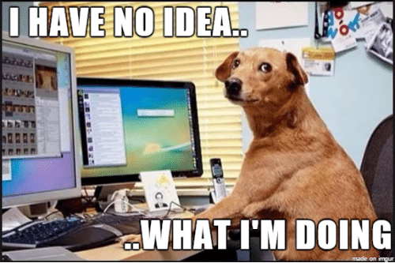
Version control (with GitHub)
What is version control?
To do version control is to record changes to files or set of files.
It allows you to keep track of the changes you’ve done to your program.
Combine feature 1 and 2 and make them compatible with feature 3
Start program
Add feature 1
Add feature 2
Add feature 3

Slide 27
Version control (with GitHub)
What is version control?
To do version control is to record changes to files or set of files.
It allows you to keep track of the changes you’ve done to your program.
Combine feature 1 and 2 and make them compatible with feature 3
Start program
Add feature 1
Add feature 2
Add feature 3

Slide 28
Version control (with GitHub)
What is version control?
To do version control is to record changes to files or set of files.
It allows you to keep track of the changes you’ve done to your program.
Combine feature 1 and 2 and make them compatible with feature 3
Start program
Add feature 1
Add feature 2
Add feature 3
New strategy

Slide 29
Version control (with GitHub)
What is version control?
To do version control is to record changes to files or set of files.
It allows you to keep track of the changes you’ve done to your program.
Combine feature 1 and 2 and make them compatible with feature 3
Start program
Add feature 1
Add feature 2
Add feature 3
New strategy
Add feature 4

Slide 30
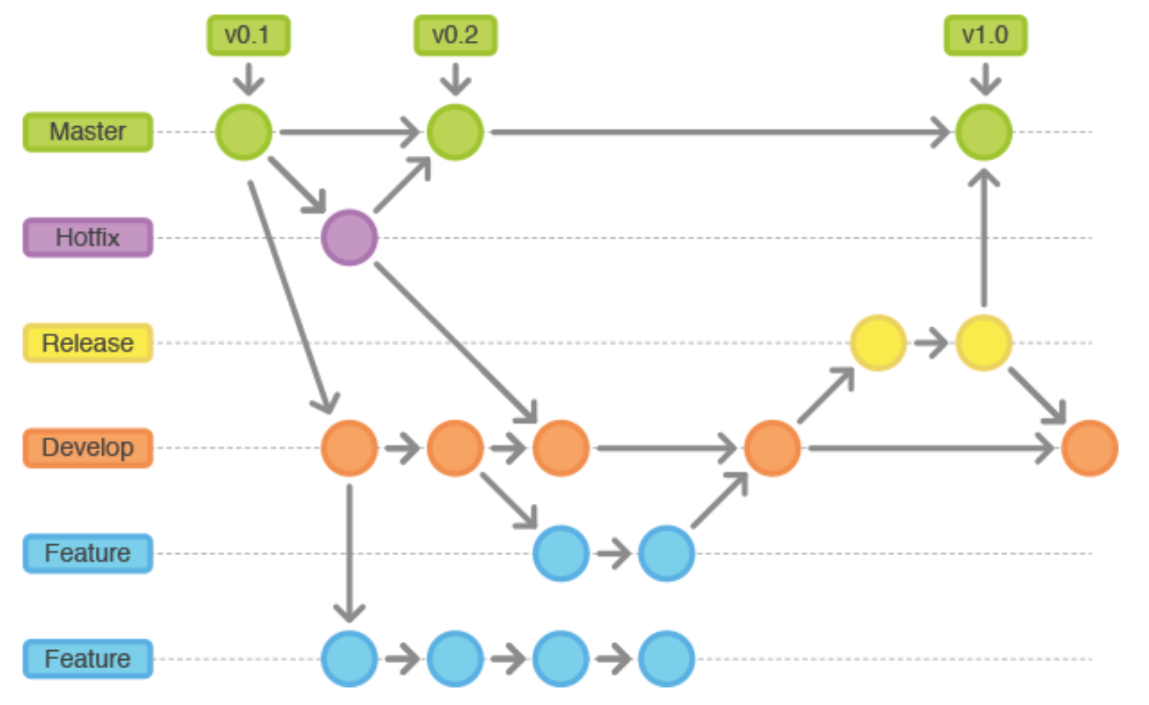
Version control (with GitHub)
The Version Control System (VCS) is a “database” of all the changes you made to your files.
Things you can do:
Revert individual files to a previous state.
Revert the whole project to a previous state.
Store your progress on a safe place.
Review your productivity.
Recover files if they are lost.
It’s like the undo – redo buttons in Office.

