Slide 1
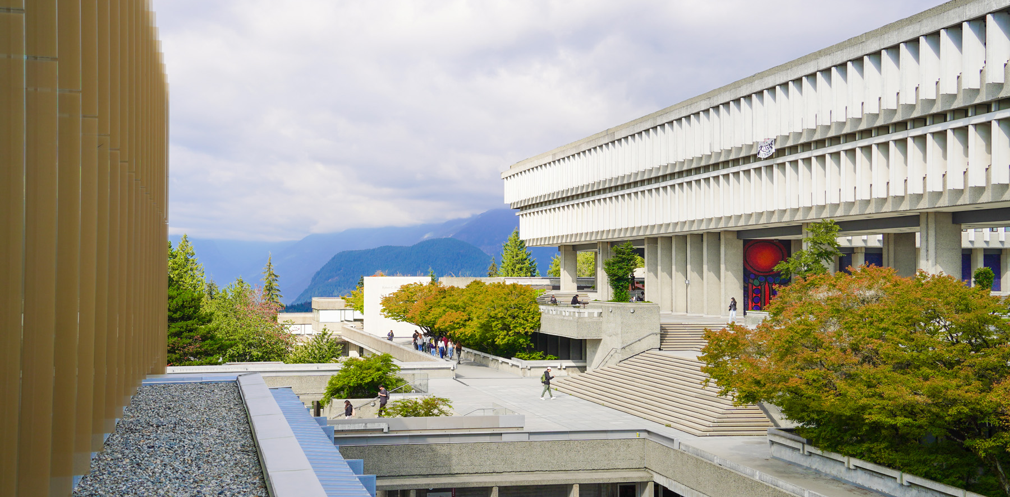
Social prescribing and loneliness
A data-driven exploratory analysis of the Canadian Social Connection Survey
Notes:
This is the “Title Slide Simon Fraser University” layout slide.

Slide 2
Canadian Social Connection Survey
What Canadians can do to form meaningful social connections
Open online survey of Canadian 16+
Collected data during and after COVID-19 (2021-2024)
Current study
Understand social patterns and behaviours, their interplay, and how they relate to loneliness.
Notes:
This is the “Title and Content” layout slide.

Slide 3
Key measures
Emotional loneliness
I experience a general sense of emptiness
I miss having people around me
I often feel rejected
Social loneliness
There are plenty of people I can rely on when I have problems*
There are many people I can trust completely*
There are enough people I feel close to*
Notes:
There are negatively (1-3) and positively (4-6) worded items. On the negatively worded items, the
neutral and positive answers are scored as “1”. Therefore, on questions 1-3 score Yes=1, More or
less=1, and No=0. On the positively worded items, the neutral and negative answers are scored
as “1”. Therefore, on questions 4-6, score Yes=0, More or less=1, and No=1

Slide 4
Key measures
Social activities
In the PAST THREE MONTH, how often have you...
“Not in the past three months"
“Less than monthly”
“A few times a month”
“Monthly”
“Weekly”
“A few times a week”
“Daily or almost daily”
Notes:
There are negatively (1-3) and positively (4-6) worded items. On the negatively worded items, the
neutral and positive answers are scored as “1”. Therefore, on questions 1-3 score Yes=1, More or
less=1, and No=0. On the positively worded items, the neutral and negative answers are scored
as “1”. Therefore, on questions 4-6, score Yes=0, More or less=1, and No=1

Slide 5
Key measures
Social patterns
In the PAST WEEK, how many HOURS in total did you spend socializing with others from the following groups?
In the PAST WEEK, how many DAYS in total did you spend socializing with others from the following groups?
In the PAST WEEK, how many PEOPLE from each of the following groups did you spend at least 5 minutes socializing with?
Notes:
There are negatively (1-3) and positively (4-6) worded items. On the negatively worded items, the
neutral and positive answers are scored as “1”. Therefore, on questions 1-3 score Yes=1, More or
less=1, and No=0. On the positively worded items, the neutral and negative answers are scored
as “1”. Therefore, on questions 4-6, score Yes=0, More or less=1, and No=1

Slide 6
Objectives
Notes:
This is the “Section Divider” master slide.

Slide 7
Objectives
Exploratory Factor Analysis
Social activities and behaviours → Constructs
Bayesian Network Analysis
Constructs + outcome → Probabilistic Relations (DAG)
Estimation
Probabilistic Relations → Estimates
Notes:
This is the “Title and Content” master slide.

Slide 8
Objectives
Exploratory Factor Analysis
Social activities and behaviours → Constructs
Latent Class Analysis
Constructs → Clusters
Bayesian Network Analysis
Clusters + Demo + outcomes → Probabilistic relations
Estimate
Probabilistic relations → Dependencies
Notes:
This is the “Title and Content” master slide.

Slide 9
Sample characteristics
Notes:
This is the “Section Divider” master slide.

Slide 10
Analytic Sample Flow Chart
Survey participants
2021
n = 3,555
2022 n = 3,890
2023 n = 2,974
2024 n = 1,126
Eligible n = 7,655
Missing outcome: 1,462
n = 6,193
Significantly:
Older
Poorer
Less educated
White
Cis-het
Men
Notes:
This is the “Title and Content” master slide.

Slide 11
Participants characteristics (1 of 4)
 | Overall (n=6,193) | 2021 (n=2930) | 2023 (n=2158) | 2024 (n=1105)
Age (mean (SD)) | 45.78 (18.04) | 37.43 (15.03) | 53.77 (17.11) | 52.32 (17.33)
Gender and orientation (%)
2SLGBTQ+ Men | 763 (13.1) | 610 (20.8) | 83 ( 4.6) | 70 ( 6.4)
2SLGBTQ+ Women | 951 (16.3) | 459 (15.7) | 317 (17.5) | 175 (15.9)
Cis-Het Men | 1167 (20.0) | 811 (27.7) | 188 (10.4) | 168 (15.3)
Cis-Het Women | 2714 (46.5) | 980 (33.5) | 1120 (61.7) | 614 (55.9)
Non-binary | 246 ( 4.2) | 67 ( 2.3) | 107 ( 5.9) | 72 ( 6.6)
White (%) | 4594 (74.4) | 1877 (64.2) | 1840 (85.7) | 877 (79.4)
Indigenous (%) | 344 ( 5.6) | 207 ( 7.1) | 58 ( 2.7) | 79 ( 7.1)
Student (%) | 963 (16.3) | 684 (25.4) | 187 ( 8.7) | 92 ( 8.6)
Bachelors or Higher (%) | 2706 (46.3) | 1168 (39.9) | 921 (50.6) | 617 (56.2)
Notes:
This is the “Title only” layout slide with a table.
This layout includes a title placeholder. Here it is used to provide a sample table.
This sample table has:
Bold text for column headings with light gray shading (the lightest gray available in the SFU colour theme),
SFU dark red for gridlines, and
Left justified text.
Minimize gridlines for a cleaner look.
Note how the header row is wider than the rows in the table to help the headings stand out.

Slide 12
Participants characteristics (2 of 4)
 | Overall (n=6,193) | 2021 (n=2930) | 2023 (n=2158) | 2024 (n=1105)
Province or Territories (%)
Alberta | 792 (12.9) | 377 (13.0) | 259 (12.1) | 156 (14.1)
British Columbia | 1444 (23.5) | 629 (21.7) | 549 (25.6) | 266 (24.1)
Manitoba | 342 ( 5.6) | 154 ( 5.3) | 129 ( 6.0) | 59 ( 5.3)
New Brunswick | 241 ( 3.9) | 155 ( 5.4) | 58 ( 2.7) | 28 ( 2.5)
Newfoundland and Labrador | 209 ( 3.4) | 142 ( 4.9) | 44 ( 2.0) | 23 ( 2.1)
Territories | 270 ( 4.4) | 245 ( 8.5) | 14 ( 0.7) | 11 ( 1.0)
Nova Scotia | 341 ( 5.5) | 173 ( 6.0) | 110 ( 5.1) | 58 ( 5.3)
Ontario | 1739 (28.3) | 600 (20.7) | 728 (33.9) | 411 (37.2)
Prince Edward Island | 98 ( 1.6) | 71 ( 2.5) | 20 ( 0.9) | 7 ( 0.6)
Quebec | 521 ( 8.5) | 296 (10.2) | 170 ( 7.9) | 55 ( 5.0)
Saskatchewan | 149 ( 2.4) | 53 ( 1.8) | 66 ( 3.1) | 30 ( 2.7)
Notes:
This is the “Title only” layout slide with a table.
This layout includes a title placeholder. Here it is used to provide a sample table.
This sample table has:
Bold text for column headings with light gray shading (the lightest gray available in the SFU colour theme),
SFU dark red for gridlines, and
Left justified text.
Minimize gridlines for a cleaner look.
Note how the header row is wider than the rows in the table to help the headings stand out.

Slide 13
Participants characteristics (3 of 4)
 | Overall (n=6,193) | 2021 (n=2930) | 2023 (n=2158) | 2024 (n=1105)
Household income (%)
Under $20,000 | 750 (14.4) | 471 (19.2) | 174 (10.2) | 105 ( 9.8)
$20,000 to $39,999 | 1214 (23.3) | 565 (23.1) | 425 (24.9) | 224 (21.0)
$40,000 to $59,999 | 884 (16.9) | 441 (18.0) | 290 (17.0) | 153 (14.3)
$60,000 to $99,999 | 1232 (23.6) | 560 (22.9) | 400 (23.5) | 272 (25.5)
$100,000 to $149,999 | 665 (12.7) | 248 (10.1) | 231 (13.5) | 186 (17.4)
$150,000 to $199,999 | 320 ( 6.1) | 122 ( 5.0) | 115 ( 6.7) | 83 ( 7.8)
$200,000 or more | 155 ( 3.0) | 40 ( 1.6) | 70 ( 4.1) | 45 ( 4.2)
Notes:
This is the “Title only” layout slide with a table.
This layout includes a title placeholder. Here it is used to provide a sample table.
This sample table has:
Bold text for column headings with light gray shading (the lightest gray available in the SFU colour theme),
SFU dark red for gridlines, and
Left justified text.
Minimize gridlines for a cleaner look.
Note how the header row is wider than the rows in the table to help the headings stand out.

Slide 14
Participants characteristics (4 of 4)
 | Overall (n=6,193) | 2021 (n=2930) | 2023 (n=2158) | 2024 (n=1105)
Hours worked per week (%)
Unemployed/retired | 1918 (34.7) | 357 (14.6) | 1052 (53.1) | 509 (46.1)
Works <20 h/week | 1278 (23.1) | 972 (39.7) | 188 ( 9.5) | 118 (10.7)
Works 20 h/week or more | 2333 (42.2) | 1117 (45.7) | 740 (37.4) | 476 (43.2)
Household size (%)
Alone | 1233 (20.2) | 352 (12.4) | 572 (26.5) | 309 (28.0)
1 other person | 1663 (27.2) | 494 (17.4) | 769 (35.6) | 400 (36.2)
2 other people or more | 3208 (52.6) | 1995 (70.2) | 817 (37.9) | 396 (35.8)
Emotional loneliness (mean (SD)) | 1.93 (1.10) | 2.26 (0.91) | 1.64 (1.17) | 1.62 (1.18)
Social loneliness (mean (SD)) | 1.94 (1.15) | 1.78 (1.13) | 2.06 (1.15) | 2.11 (1.14)
Notes:
This is the “Title only” layout slide with a table.
This layout includes a title placeholder. Here it is used to provide a sample table.
This sample table has:
Bold text for column headings with light gray shading (the lightest gray available in the SFU colour theme),
SFU dark red for gridlines, and
Left justified text.
Minimize gridlines for a cleaner look.
Note how the header row is wider than the rows in the table to help the headings stand out.

Slide 15
Social activities & connections
Notes:
This is the “Section Divider” master slide.

Slide 16
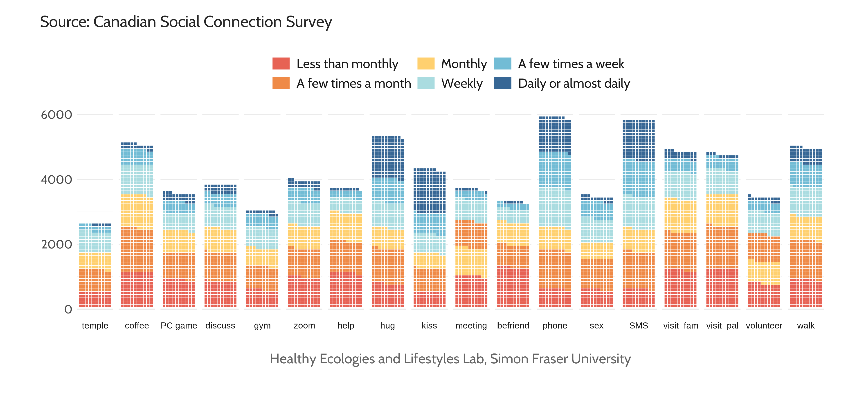
Frequency of social activities (past 3 months)

Slide 17
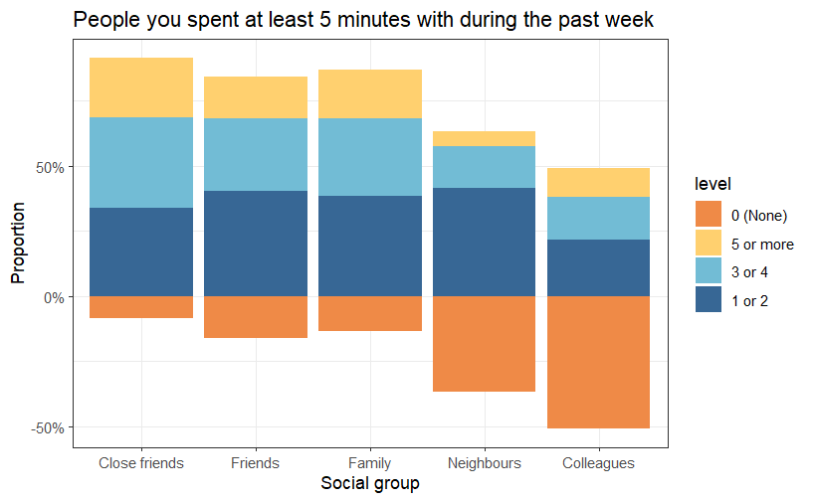
Number of social connections

Slide 18
Exploratory Factor Analysis
Notes:
This is the “Section Divider” master slide.

Slide 19
Social activities
Group activities
Non-work meeting (0.9)
Volunteering (0.6)
Physical intimacy
Kiss (0.9)
Phone conversations*†
Texting someone (0.5)
Closed meetings
Digital activities*
Going to the temple (0.5)
Group discussion (0.5)
Making a new friend (0.4)
Sex (0.5)
Calling someone (0.5)
Visiting friends (0.7)
Going out for coffee (0.6)
Visiting family (0.5)
Computer games (0.4)
Online meetings (0.6)
Helping someone (0.4)
Going for a walk (0.3)
Hug (0.7)
* Low variance
† No correlation
Notes:
There is some cross-loading between group activities and closed meetings, which makes sense as some of these group activities might indeed reflect two types of activities: open to everyone and closed. Likewise computer games crossloads with digital activities but with lower values

Slide 20
Social patterns
Time with friends
Time with family
Time with neighbours
Time with coworkers and classmates
Number of hours per week
Days per week
People you spent at least 5 minutes with
Notes:
The variables loadings were always high, median was 0.8, rarely any difference, higher loadings correlated with the number of hours per week.

Slide 21
Correlation matrix
Notes:
This is the “Section Divider” master slide.

Slide 22
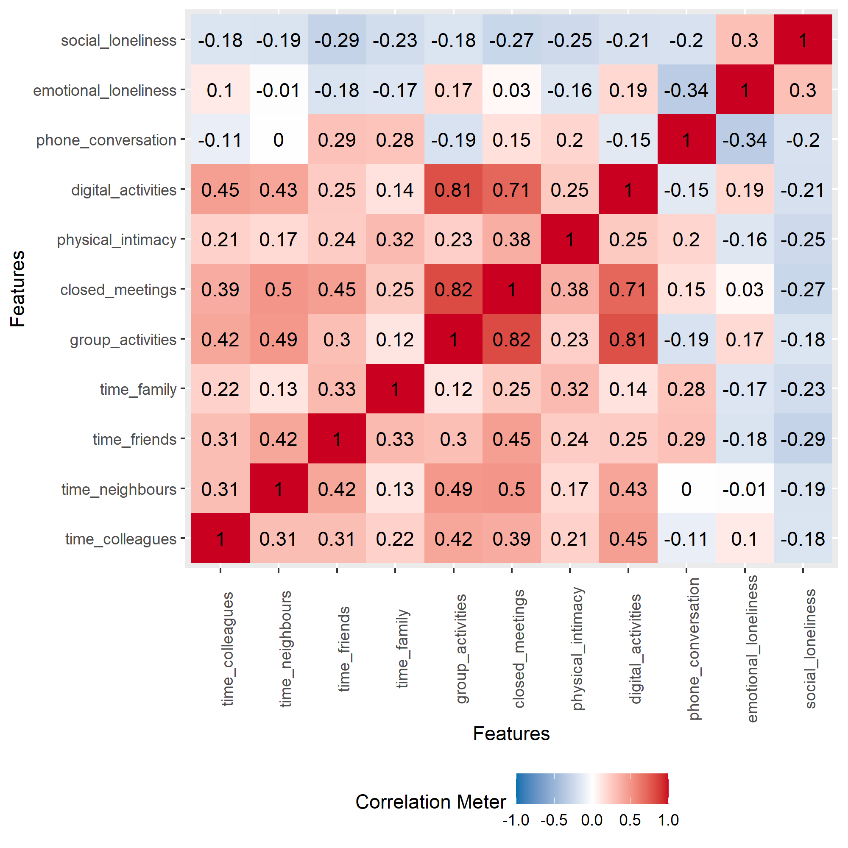
Correlation between constructs
Notes:
This is the movie poster

Slide 23
Robust Probabilistic Dependencies
Notes:
This is the “Section Divider” master slide.

Slide 24
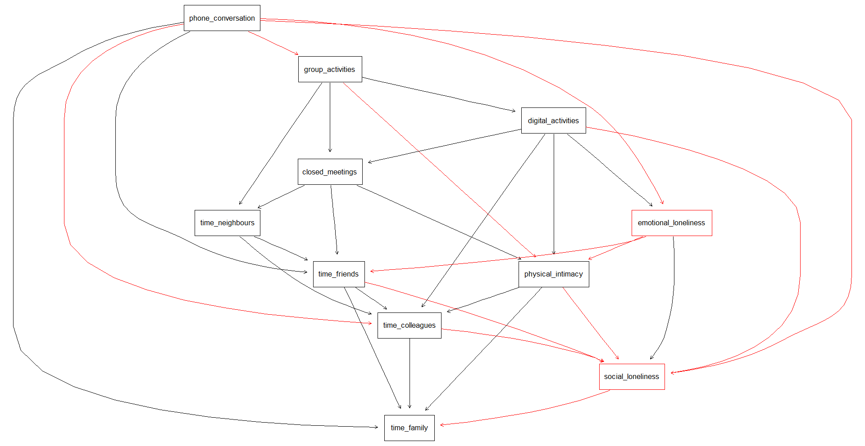
Robust conditional probabilities
+ Positive
- Negative
Notes:
This is the “Title and Content” master slide.

Slide 25
Robust CP: Emotional loneliness
+ Positive
- Negative
Phone conversations
-0.230 (~5%)
+0.188
Range EL: 0 to 3
0.188 / 3 = 0.06
(~6%)
Group activities
+0.699 (~16%)
-0.454 (~15%)
Digital activities
Emotional Loneliness
+0.188 (~6%)
Notes:
This is the “Title and Content” master slide.

Slide 26
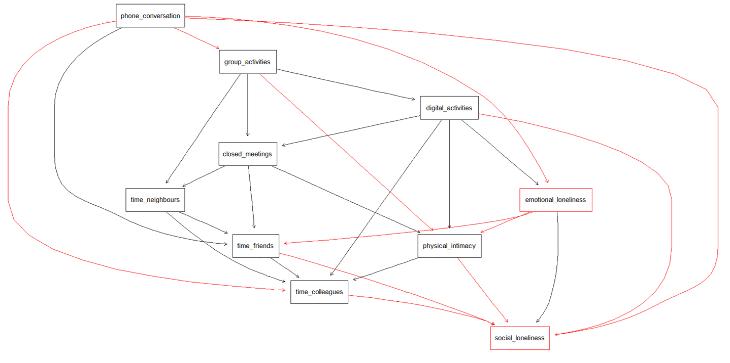
Robust CP: Social loneliness
+ Positive
- Negative
~5%
~14%
~3%
~6%
~10%
~8%
~4%
~8%
~19%
~5%
~7%
~7%
~6%
~3%
~4%
~1%
~3%
~9%
~2%
~7%
~4%
~5%
~5%
~3%
Notes:
This is the “Title and Content” master slide.

Slide 27
Latent class
Notes:
This is the “Section Divider” layout slide.

Slide 28
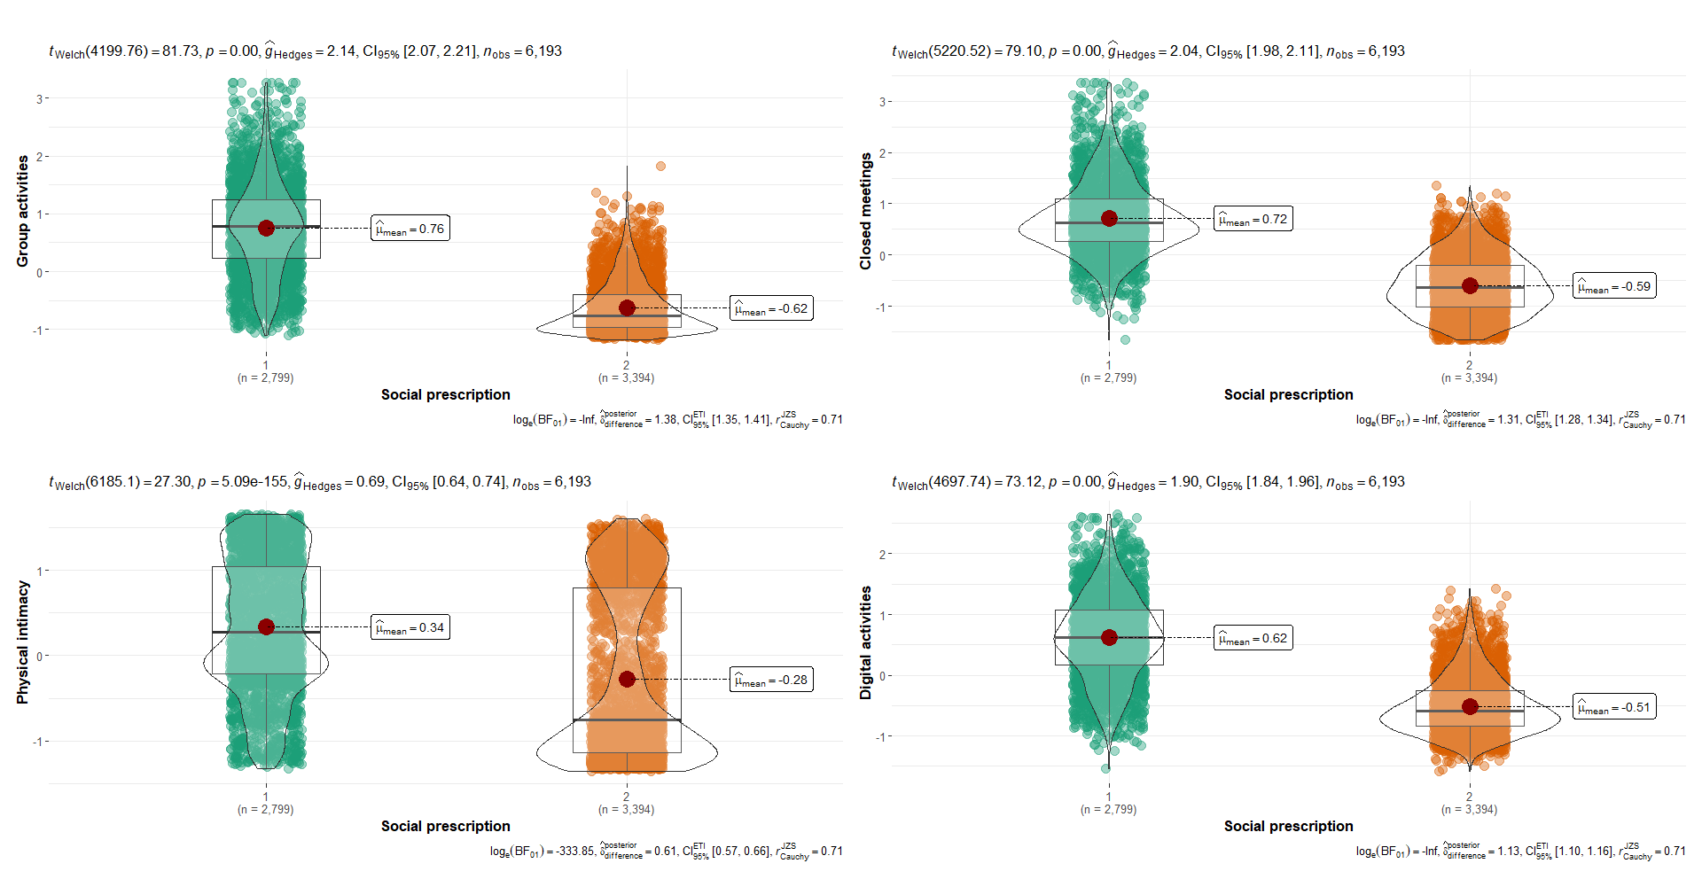
Activities vs. “Social prescription” cluster

Slide 29
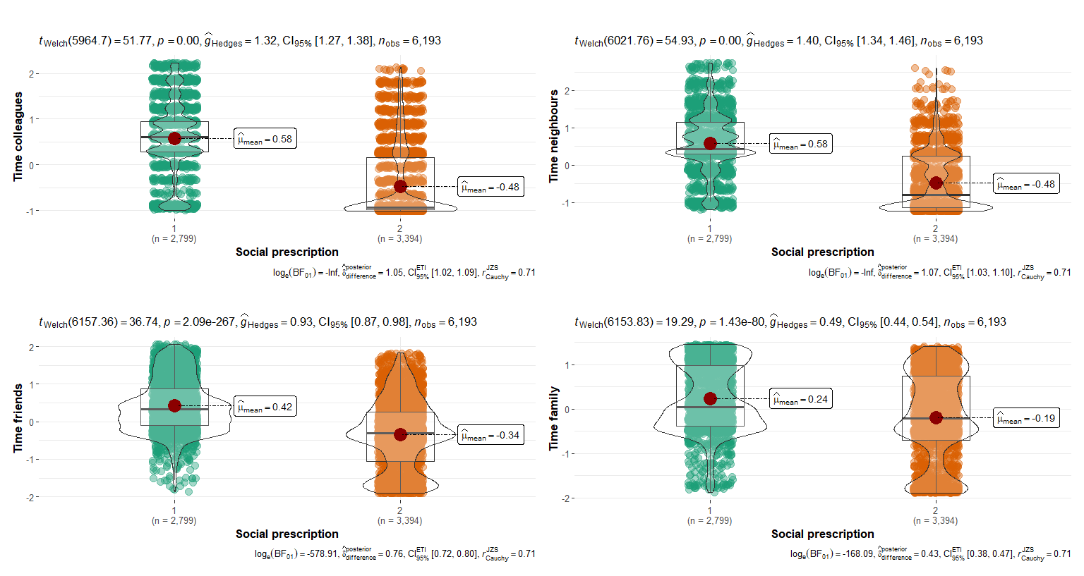
Social time vs. “Social prescription” cluster

Slide 30
Discrete Probabilistic Dependencies
Notes:
This is the “Section Divider” master slide.

Slide 31
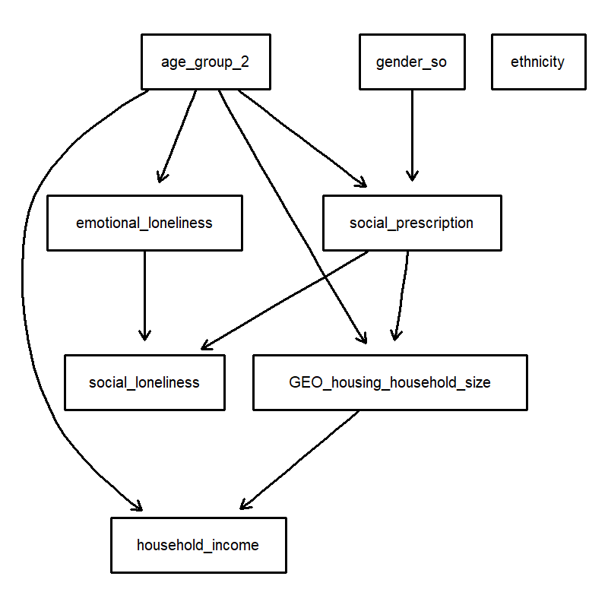
Notes:
This is the “Full Picture” layout slide.
This layout includes a picture placeholder that covers the slide.
To change a photo on a sample slide:
Right-click the photo, select Change Picture and then select an option (e.g., From Clipboard), or
You can delete the photo if it is in a picture placeholder then click on the picture placeholder to import a picture
To add a photo to a blank picture placeholder:
Click on the placeholder icon to upload a photo
Click on the placeholder, then go to Insert-Pictures to select “Insert Picture” from:
This Device
Stock Images
Online Pictures
Copy a picture (CTRL or CMD + C), click on the placeholder and paste (CTRL or CMD + V)

Slide 32
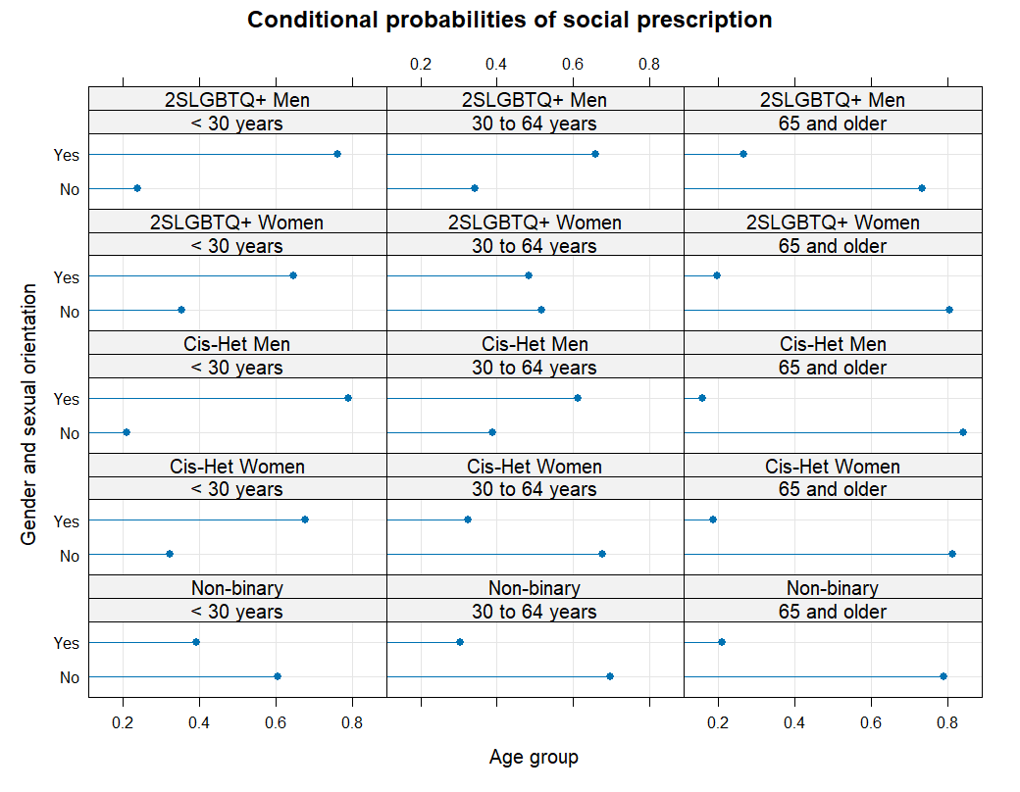
What determines latent classes of social activities and behaviour?

Slide 33
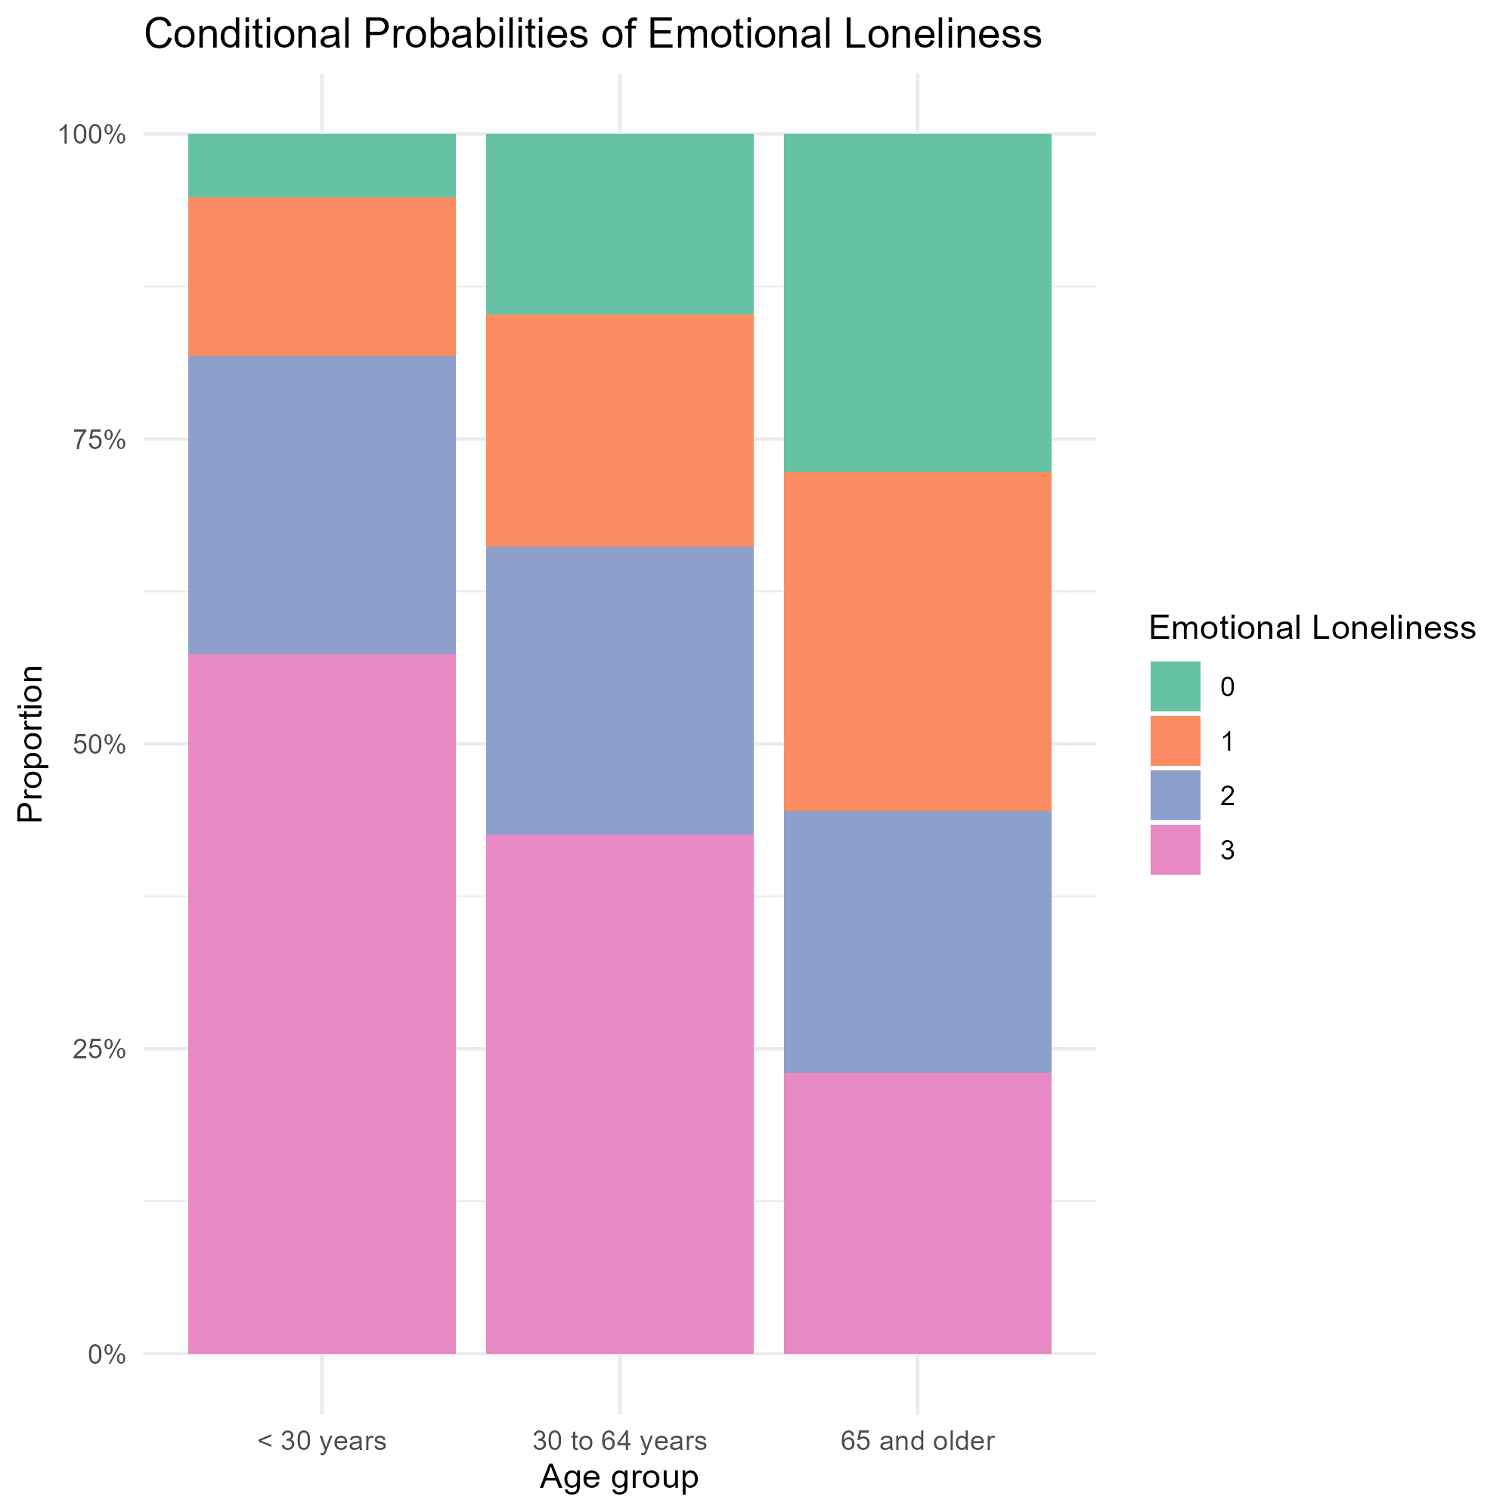
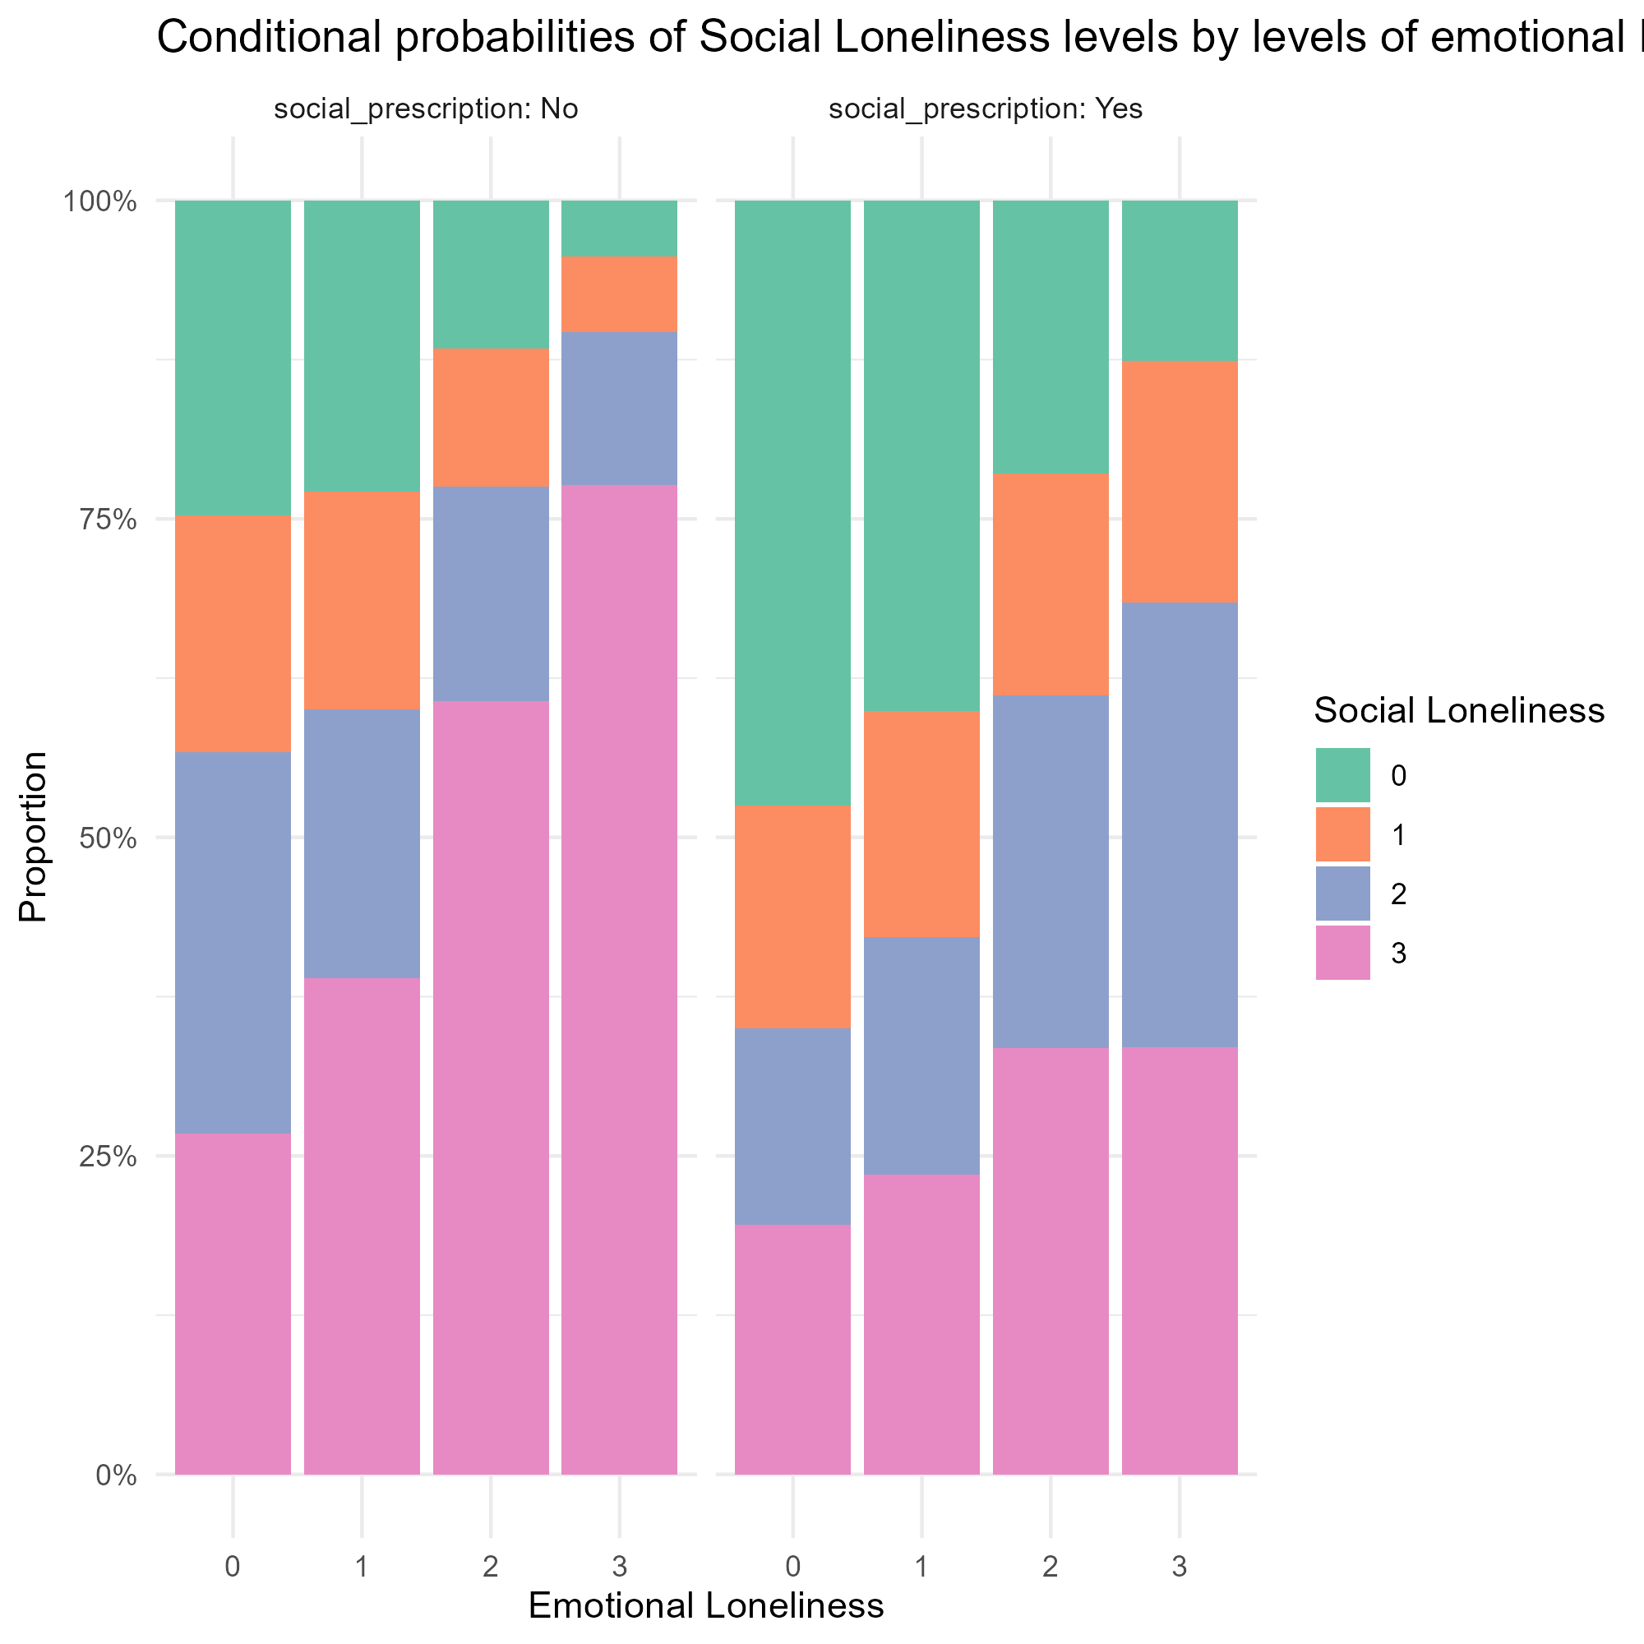
Plotting the “causes” of loneliness
Notes:
This is the “Full Picture” layout slide.
This layout includes a picture placeholder that covers the slide.
To change a photo on a sample slide:
Right-click the photo, select Change Picture and then select an option (e.g., From Clipboard), or
You can delete the photo if it is in a picture placeholder then click on the picture placeholder to import a picture
To add a photo to a blank picture placeholder:
Click on the placeholder icon to upload a photo
Click on the placeholder, then go to Insert-Pictures to select “Insert Picture” from:
This Device
Stock Images
Online Pictures
Copy a picture (CTRL or CMD + C), click on the placeholder and paste (CTRL or CMD + V)

Slide 34
Take home messages
Time spent with others (↑) → Social loneliness (↓)
“There are [plenty/many/enough] people I …”
Time spent with others ? Emotional loneliness
Time spent with ourselves (↑) → Emotional loneliness (↓)
Time spent with ourselves (↑) → Emotional loneliness (↓)
→ Social loneliness (↓)

Slide 35
Take home messages
Who are less likely to be connected/socially active
Under 30: Non-binary folks
30-64: Non-binary folks + women (particularly cis-het women)
65+: Everybody (but less so 2SLGBTQ+ men)
Who makes us feel less lonely
Not family (family disconnection might be a symptom)
Mostly friends but also colleagues

Slide 36
Take home messages
How?
Reaching out works (person-to-person)
Social settings
Closed settings
Person-to-person
Notes:
Phone conversations were the only activity that moved the needle when it came to emotional loneliness

Slide 37
Limitations
Cross-sectional data.
Pandemic data.
Limited set of activities, some are ambiguous.
Limited data on quality of connection.
Unmeasured variables (e.g., motherhood)
Subgroup analysis
Notes:
Phone conversations were the only activity that moved the needle when it came to emotional loneliness

Slide 38
Thank you
Notes:
This is the “Divider” layout slide.
This file was last updated 20250402.

