Slide 1
AI Orchestration
The new runtime for Human work

Slide 2
Attention
MMS sessions are 60-75 minutes followed by LONG Q&A
Please hold detailed questions until that Q&A starts
Feel free to ask clarification questions
Remind the speakers to use Zoom It when you can’t see

Slide 3


Chris Sires
Kevin Gros
AI Engineering Manager
??
https://www.sires.dev
@sirescreek
@
@

Slide 4
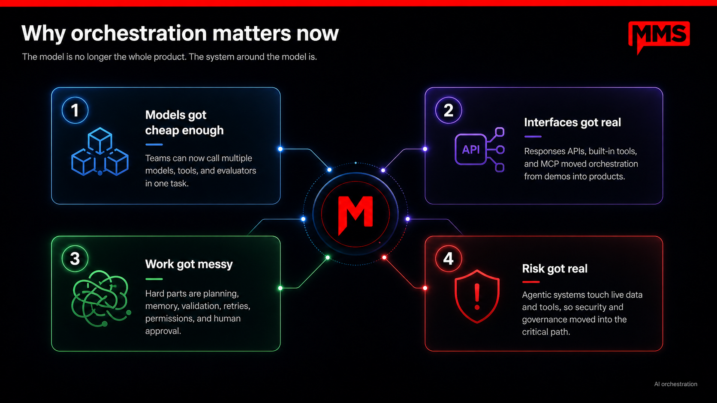
Notes:
For a while, most AI product thinking was centered on the model itself. Which model is smartest? Which one writes better? Which one reasons better?
That still matters, but it is no longer the whole product. The real product is becoming the system around the model.
There are four reasons this changed.
First, models got cheap enough. Teams can now call multiple models inside the same workflow. You can use one model to plan, another to retrieve, another to draft, another to critique, and another to evaluate. That was too expensive or too slow before. Now it is practical.
Second, interfaces got real. We are no longer limited to chat boxes and demos. APIs, built-in tools, function calling, MCP, and connected systems mean AI can actually interact with software. It can search, read, write, trigger actions, and move work through real business systems.
Third, the work got messy. Once you move beyond a demo, the hard part is not asking a model one question. The hard part is planning the steps, maintaining context, remembering prior decisions, retrying failures, validating outputs, managing permissions, and knowing when to ask a human. That is orchestration.
Fourth, risk got real. These systems are no longer just producing text in a sandbox. They touch live data, customer records, internal tools, payments, support queues, codebases, and operational workflows. That means security, governance, approvals, audit logs, and policy checks become part of the core product.
So the shift is this: the model is becoming a component. The orchestration layer is becoming the product surface.
That is what separates a cool AI demo from a dependable AI system.

Slide 5
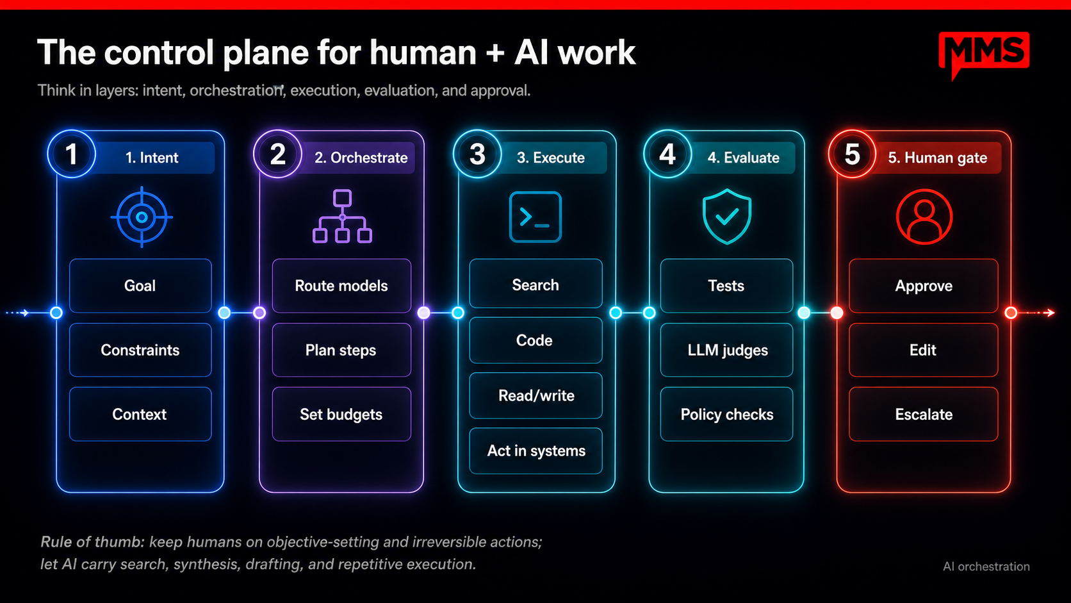
Notes:
This is the practical operating model for human and AI work.
Think of it as a control plane. The goal is not to have one giant autonomous agent doing everything. The goal is to separate the workflow into layers, with clear ownership at each layer.
First is intent. This is where humans matter most. We define the goal, the constraints, and the context. What are we trying to accomplish? What should the system avoid? What information does it need to know before acting? AI can help clarify this, but humans should own it.
Second is orchestration. This is where the system decides how work should get done. Which model should handle which task? What steps should happen in what order? How much budget, time, or risk should we allow? This is the layer that turns a human goal into an executable workflow.
Third is execution. This is where AI is strongest. It can search, write code, read and write across systems, generate drafts, update records, and perform repetitive work at scale. This is the work we do not want humans doing manually over and over again.
Fourth is evaluation. We should not treat AI output as automatically correct. The system needs tests, judges, and policy checks. Did it follow the instructions? Did it meet the rubric? Is the result safe, accurate, and within bounds? This layer gives us confidence before anything important moves forward.
Finally, there is the human gate. Humans approve, edit, or escalate. This is especially important when the action is external-facing, high-impact, politically sensitive, brand-sensitive, or difficult to reverse.
So the rule of thumb is simple: keep humans in charge of objective-setting and irreversible actions. Let AI carry the search, synthesis, drafting, and repetitive execution.
That is the pattern: humans set direction and own accountability; AI handles the scalable work in the middle; the control plane makes sure every step is routed, checked, and governed before it matters.

Slide 6
Design pattern: what AI does vs. what humans do
Best systems are not fully autonomous; they remember roles.
AI excels at
Humans excel at
High-volume retrieval across many sources
First-pass drafting and structure
Transforming formatting and option generation
24/7 monitoring, retries, and queue draining
Fast evaluation against explicit rubrics
Setting intent, trade-offs, and success criteria
Handling ambiguity, politics, and brand risk
Approving high-impact external actions
Interpreting weak signals and edge cases
Owning accountability when things go wrong
Notes:
The key point here is that AI orchestration is not about replacing human judgment. It is about designing a system where the work is routed to the right actor at the right moment.
AI should own the repeatable, high-volume, low-context parts of the workflow: pulling information from multiple systems, creating first drafts, generating options, applying known formats, checking against rubrics, retrying failed steps, and monitoring queues.
Humans should own the moments where judgment, accountability, and context matter most: setting the goal, defining what “good” looks like, resolving ambiguity, approving external-facing work, handling exceptions, and making decisions where brand, politics, customer trust, or business risk are involved.
The orchestration layer sits between those two worlds.
It decides:
What can be automated safely.
What needs human review.
What context the AI needs before acting.
Which tools or systems the AI should use.
When to escalate.
How to log decisions and outcomes.
How to improve the workflow over time.
A good orchestration layer does not just call an AI model. It manages roles, permissions, context, memory, retries, evaluations, approvals, and audit trails.

Slide 7
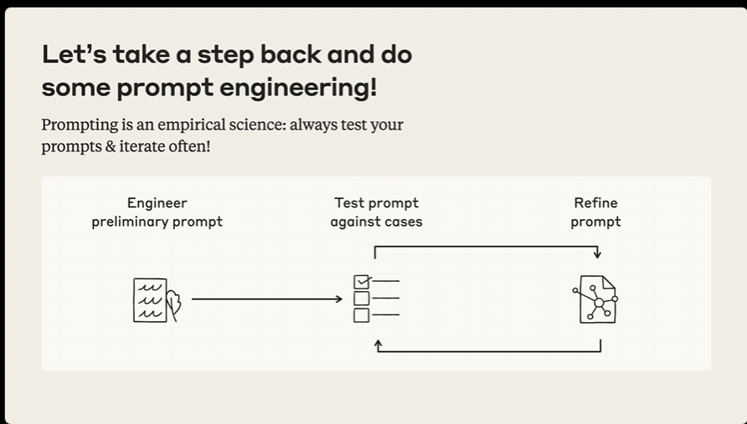
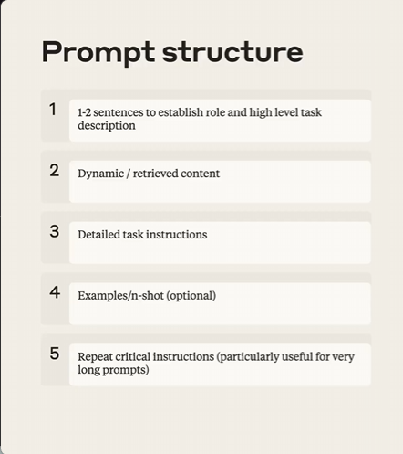
Prompting matters now more than ever
Best systems are not fully autonomous; they remember roles.
Here’s where you differentiate outcomes
Don’t believe me, believe Anthropic…
Notes:
This slide makes a simple point: prompting matters now more than ever.
A lot of people assume prompting is becoming less important as models get better. In practice, the opposite is happening. As models get more capable, the quality of the prompt has an even bigger impact on the quality, consistency, and reliability of the output.
The reason is that prompting is no longer just about asking a clever question. It is about designing the interface between the system and the model.
On the left, the message is that prompt engineering is an iterative process. You start with a draft prompt, test it against real cases, see where it fails, and then refine it. In other words, prompting is not magic. It is an empirical discipline. You do not assume the first version is right — you test and improve it.
On the right is where outcomes really start to differentiate. Strong prompts usually have a clear structure.
First, establish the role and task. Tell the model what it is doing and at what level.
Second, provide the dynamic or retrieved content — the actual context, data, or source material it should work from.
Third, give specific instructions about the job to be done. What format do you want? What constraints matter? What should it optimize for?
Fourth, where helpful, include examples. Examples are often one of the fastest ways to improve consistency.
And fifth, for longer or more complex workflows, repeat critical instructions. That helps preserve the important constraints as the prompt gets longer and the task gets more complicated.
So the takeaway is this: better models do not eliminate the need for prompt design. They raise the value of it.
If orchestration is the control plane, then prompting is the mechanism that tells each step exactly how to behave. And the teams that get good at structured, testable prompting will get better outcomes than teams that just rely on raw model capability.

Slide 8
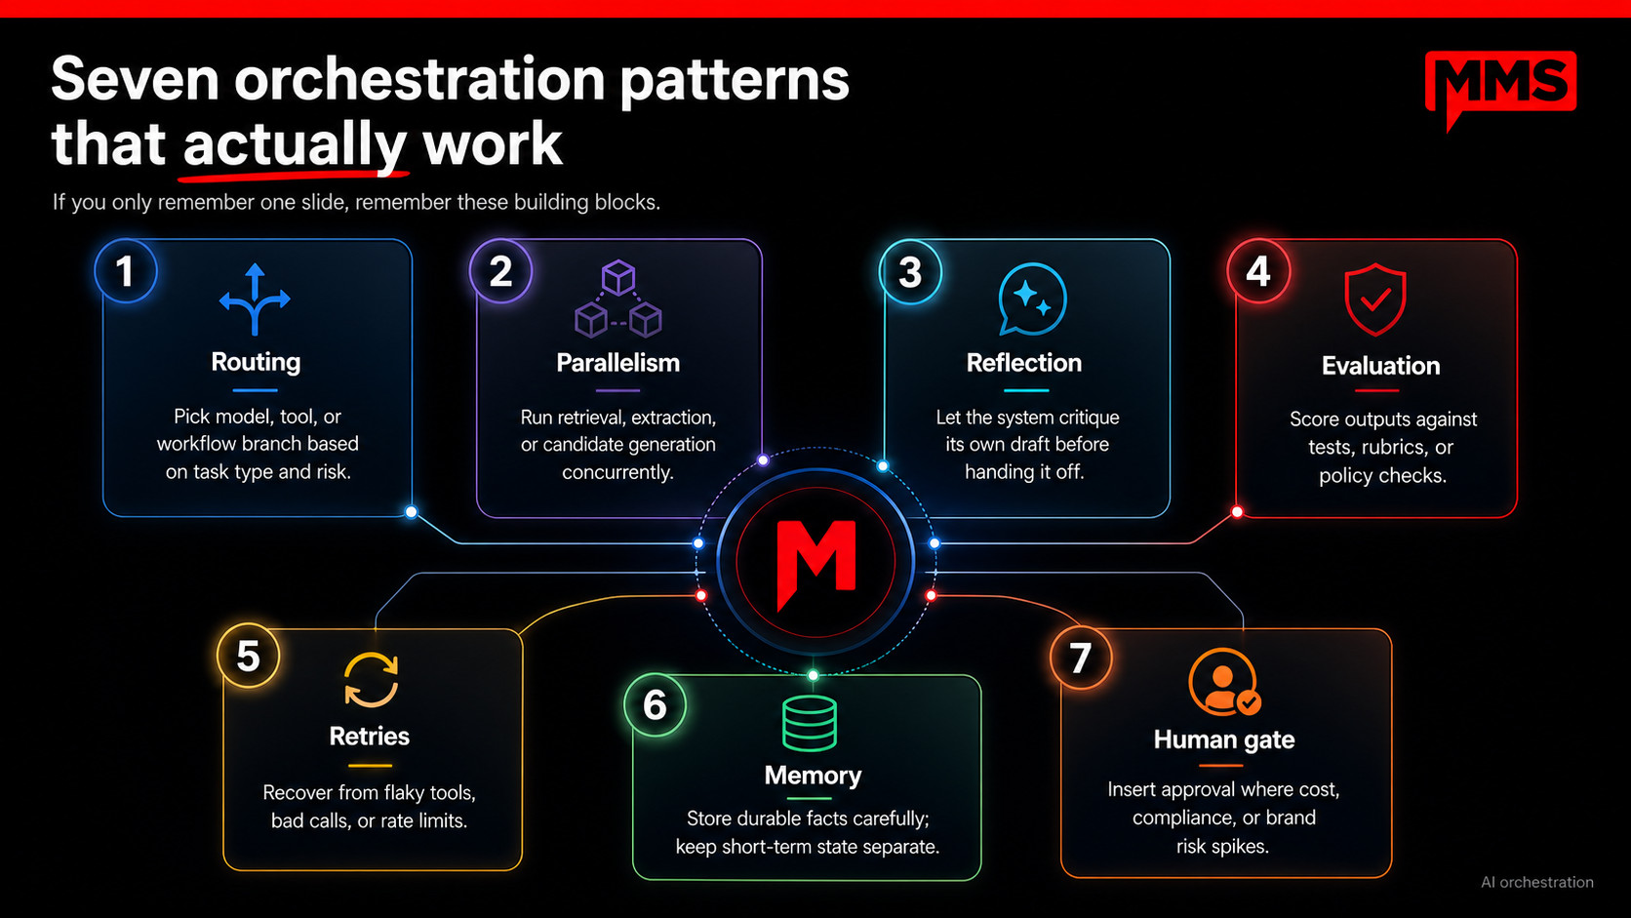
Notes:
This is the slide I would want people to remember if they only remember one.
When people hear “AI orchestration,” it can sound abstract. But in practice, most useful systems are built from a small set of repeatable patterns. These seven show up again and again.
The first is routing. Not every task should go to the same model, tool, or workflow. Some tasks are cheap and low-risk. Some require stronger reasoning. Some need a specific tool. Good orchestration routes the work based on task type, cost, latency, and risk.
The second is parallelism. Instead of doing everything one step at a time, the system can run multiple searches, extractions, or candidate generations at once. This is useful when you want broader coverage, faster execution, or multiple options before choosing the best result.
The third is reflection. Before a system hands work off, it can critique its own draft. It can ask: did I answer the question, did I follow the constraints, what is missing, what could be improved? Reflection is not a guarantee of correctness, but it is a simple way to catch obvious misses before a human sees them.
The fourth is evaluation. This is where we move from vibes to measurement. We score outputs against tests, rubrics, policy checks, or expected behavior. For production systems, this is essential. You need a way to know whether the system is improving, regressing, or drifting.
The fifth is retries. Real systems fail. APIs timeout. Tools return partial results. Models make bad calls. Rate limits happen. A strong orchestration layer does not collapse on the first failure. It knows when to retry, when to change strategy, and when to escalate.
The sixth is memory. But memory has to be handled carefully. Durable facts should be stored intentionally, with clear rules. Short-term state should stay separate. Otherwise, systems become unpredictable, stale, or overly personalized in ways users did not ask for.
The seventh is the human gate. This is where we deliberately insert human approval. Not everywhere — that would kill the value of automation — but at the moments where cost, compliance, brand risk, customer impact, or reversibility matter.
The important point is that these are not theoretical patterns. These are the building blocks of dependable AI products.
Most successful AI workflows are just combinations of these patterns: route the task, run parts in parallel, draft or act, reflect, evaluate, retry if needed, remember what matters, and gate the risky steps with a human.
That is orchestration in practice.

Slide 9
Deep dive: evaluators + human-in-the-loop
The highest leverage pattern is not “more agents.” It is “better checks.”
Evaluator stack
Where humans belong
Unit tests / schemas
Before launch: define acceptance tests and escalation rules
During run: approve side effects like sends, writes, purchases, deletes
After run: review drift, edge cases, and outliers
After incident: tune policy, memory, and permissions
Policy filters
LLM judge / rubric
Human spot check
Automatic rollback
If you cannot explain the stop conditions, you do not have orchestration yet.

Slide 10
News: the orchestration layer is standardizing
Three shifts changed the conversation from “cool demo” to “ecosystem.”
March 2025
Nov 2024
Apr 2026
OpenAI: Responses API
OpenAI positioned Responses as the direction for building agents, with web search, file search, and computer use built in.
MCP arrives
Anthropic launched MCP as an open standard for connecting AI to tools and data. OpenAI later donated MCP to a Linux Foundation-hosted initiative with broad support.
Copilot Studio multi-agent GA
Microsoft says multi-agent systems are now generally available, with coordination across Fabric, the Microsoft 365 Agents SDK, and A2A protocols.
OpenAI made tool orchestration a first-class API surface.
Standards reduce bespoke connector work.
Vendors are productizing orchestration, not just model access.
Notes:
[Sources] OpenAI, “New tools for building agents,” published March 11, 2025. https://openai.com/index/new-tools-for-building-agents/ Anthropic, “Introducing the Model Context Protocol,” published Nov. 25, 2024. https://www.anthropic.com/news/model-context-protocol Anthropic, “Donating the Model Context Protocol and establishing the Agentic AI Foundation,” published Dec. 9, 2025. https://www.anthropic.com/news/donating-the-model-context-protocol-and-establishing-of-the-agentic-ai-foundation Microsoft Copilot Blog, “New and improved: Multi-agent orchestration...,” published Apr. 1, 2026. https://www.microsoft.com/en-us/microsoft-copilot/blog/copilot-studio/new-and-improved-multi-agent-orchestration-connected-experiences-and-faster-prompt-iteration/ [/Sources]

Slide 11
Security breaches and wake-up calls
The orchestration story gets real fast when agents touch live data and tools.
Apr 2025
Oct 2024
2025–2026
Anthropic code leak
A packaging error exposed nearly 2,000 internal files and about 500,000 lines of code on Docker Hub for several hours.
Wiz AI log exposure
An unsecured server exposed 1TB+ of logs including prompts and user interactions from an AI startup service.
Indirect prompt injection
Microsoft and Google both warn that untrusted content can hijack an AI system’s instructions and drive exfiltration or unintended tool use.
Lesson: secure releases and internal artifacts.
Lesson: logs are production data.
Lesson: content can become control input.
Notes:
[Sources] The Register, “Anthropic blames contractor for exposing API keys and source code in Docker image,” Apr. 2025. InfoQ, “Anthropic Accidentally Exposes Sensitive Information in Docker Image,” Apr. 2025. Wiz Research / coverage of exposed AI service logs, Oct. 2024. MSRC, “How Microsoft defends against indirect prompt injection attacks,” July 29, 2025. https://msrc.microsoft.com/blog/2025/07/how-microsoft-defends-against-indirect-prompt-injection-attacks/ Microsoft Security Blog, “Runtime risk to real-time defense: Securing AI agents,” Jan. 23, 2026. https://www.microsoft.com/en-us/security/blog/2026/01/23/runtime-risk-realtime-defense-securing-ai-agents/ [/Sources]

Slide 12
Threat model for agentic workflows
Most failures map to a few repeatable attack surfaces.
Prompt injection / instruction smuggling
Memory poisoning and false durable facts
Over-broad tool permissions
Untrusted retrieval or connector content
Logging secrets and prompts
Supply-chain and release mistakes
Map the risk to the layer
Inputs
Malicious docs, emails, web pages
Planner
Unsafe chain-of-thought-to-action jumps
Tools
Destructive or over-scoped capabilities
Memory
Corrupted state and durable lies
Outputs
Bad sends, writes, or purchases

Slide 13
Secure-by-design orchestration patterns
The controls have to live inside the workflow, not added after the demo.
Least privilege
Separate read, draft, and write tools; grant destructive permissions only to gated paths.
Structured outputs
Use schemas and typed actions so evaluators can block malformed or risky results.
Approval boundaries
Require human confirmation for external sends, financial actions, and deletes.
Content provenance
Tag where evidence came from and whether it was trusted, user-provided, or retrieved.
Observability
Trace model calls, tool calls, retries, costs, and failures with run-level IDs.
Incident loops
Replay runs, quarantine memory, rotate secrets, and learn from evaluator misses.
Notes:
[Sources] OWASP MCP Top 10 2025, “Tool Poisoning.” https://owasp.org/www-project-mcp-top-10/2025/MCP03-2025%E2%80%93Tool-Poisoning Microsoft Security Blog, “Detecting and mitigating common agent misconfigurations,” Feb. 12, 2026. https://www.microsoft.com/en-us/security/blog/2026/02/12/copilot-studio-agent-security-top-10-risks-detect-prevent/ MSRC, “How Microsoft defends against indirect prompt injection attacks,” July 29, 2025. [/Sources]

Slide 14
Dangers of relying on a cloud-based model
Convenience comes with trade-offs that compound as adoption scales.
Vendor lock-in
Switching costs compound as workflows embed one provider’s API surface, pricing, and model behavior.
Data exposure
Prompts, outputs, and fine-tuning data transit third-party servers, risking leaks of IP and PII.
Availability risk
Outages and rate limits halt production workflows with no local fallback or failover path.
Pricing volatility
Providers change pricing, deprecate models, or alter terms with little advance warning.
Latency limits
Network round-trips and opaque model updates undermine real-time and safety-critical use cases.
Compliance gaps
Data residency, audit trails, and sovereignty rules may conflict with hosted model geography.

Slide 15
Dangers of relying on local hardware resources
Control comes at a cost that few teams budget for honestly.
Capital expense
Large upfront hardware investment with rapid depreciation and uncertain utilization rates.
Scaling limits
Capacity ceilings are physical; sudden demand spikes cannot be absorbed without pre-purchased headroom.
Talent burden
Requires specialized staff to maintain GPUs, networking, cooling, and ML infrastructure full-time.
Model lag
Running the latest models locally means lengthy procurement, testing, and integration cycles.
Redundancy cost
Achieving high availability requires duplicate hardware, power, and connectivity across sites.
Security surface
On-prem infrastructure exposes you to physical threats, patching lag, and supply-chain risks you must own entirely.

Slide 16
Governance and metrics
Do not measure “AI usage.” Measure controlled business outcomes.
Outcome quality
Latency
Cost
pass rate, rubric score, factuality
time to useful answer / completion
tokens + tools + human review
Escalation rate
Risk events
Drift
when the workflow needs a human
blocked actions, policy hits, incidents
performance by task, segment, or prompt family
Board-level question: where do humans still create disproportionate value, and where should orchestration remove drag?

Slide 17
A practical 90-day plan
Small scope, live data, strong controls.
Days 1–30
Days 31–60
Days 61–90
Pick one high-friction workflow
Add retrieval and drafting
Pilot on live traffic
Map tools, people, and approvals
Introduce evaluators and tracing
Measure quality, cost, and escalation
Define tests and stop conditions
Keep human approval on all side effects
Expand only after incident review
The winning move is not “full autonomy.” It is high-confidence partial autonomy.

Slide 18

Three takeaways
The future is not one model. It is orchestrated systems.
Human judgment belongs at goals, boundaries, and irreversible actions.
Security is the design of the workflow, not a wrapper on top.
Questions?
Let’s build the control plane, not just the prompt.
Notes:
[Sources] Decorative graphic: user-provided MMSMOA media kit asset /mnt/data/mms_assets/Graphics/MMSDots1000x1000.png [/Sources]

