Slide 1
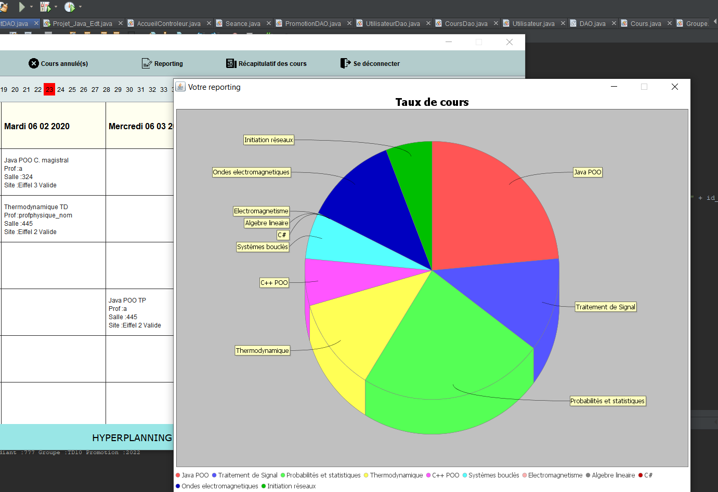
Gestion informatique d’un emploi du temps
AYLLON Jorge
BEAUJOIS Théo
WANG David
ING 3 TD10

Slide 2
SOMMAIRE
Répartition des tâches………………………………………………………………………………………… 3
Diagramme de classe……………………………………………………………………………………………4
Design de la maquette………………………………………………………………………………………….8
Versionning GIT……………………………………………………………………………………………………12
Bilan individuel…………………………………………………………………………………………………….13
Bilan collectif……………………………………………………………………………………………………….14
Sources…………………………………………………………………………………………………………………15

Slide 3
Répartition des tâches
WANG David | AYLLON Jorge | BEAUJOIS Théo

Slide 4
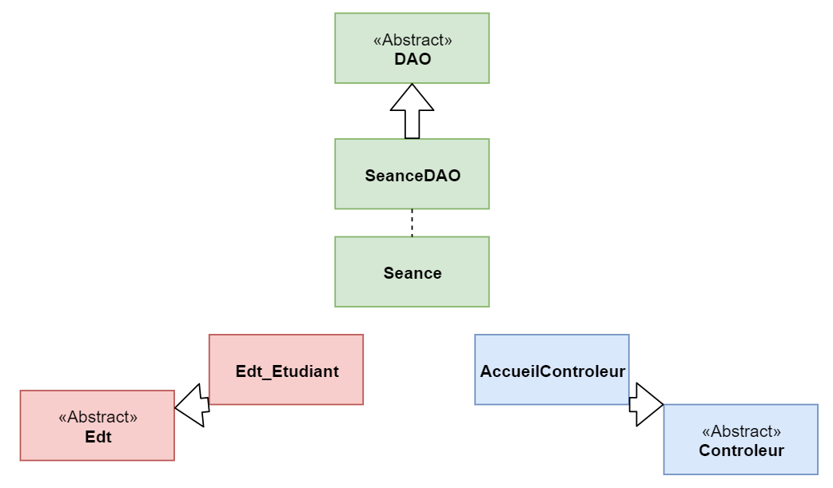
Diagramme de classe

Slide 5
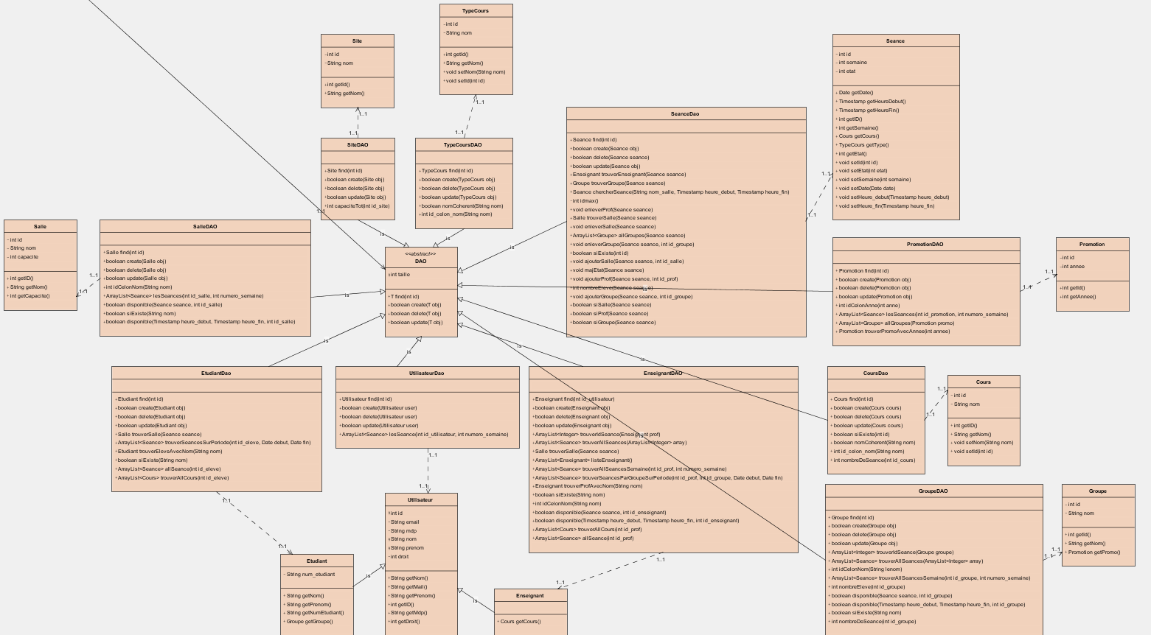
Modèle

Slide 6
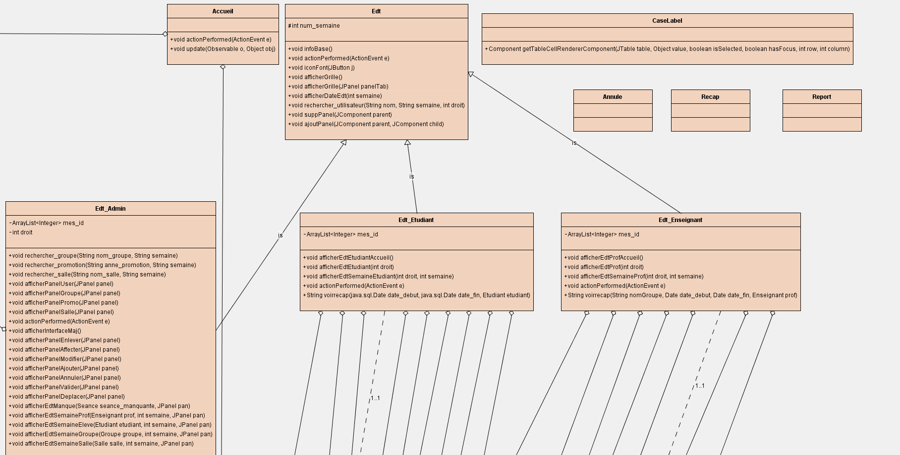
Vue

Slide 7
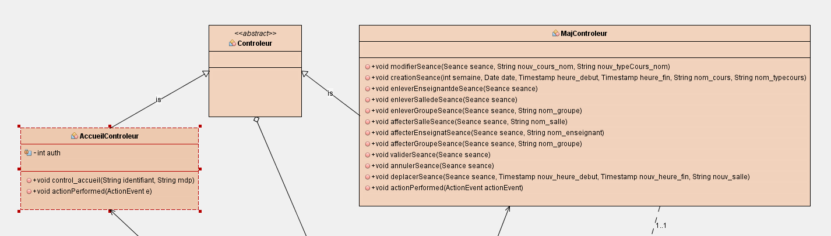
Contrôleur

Slide 8
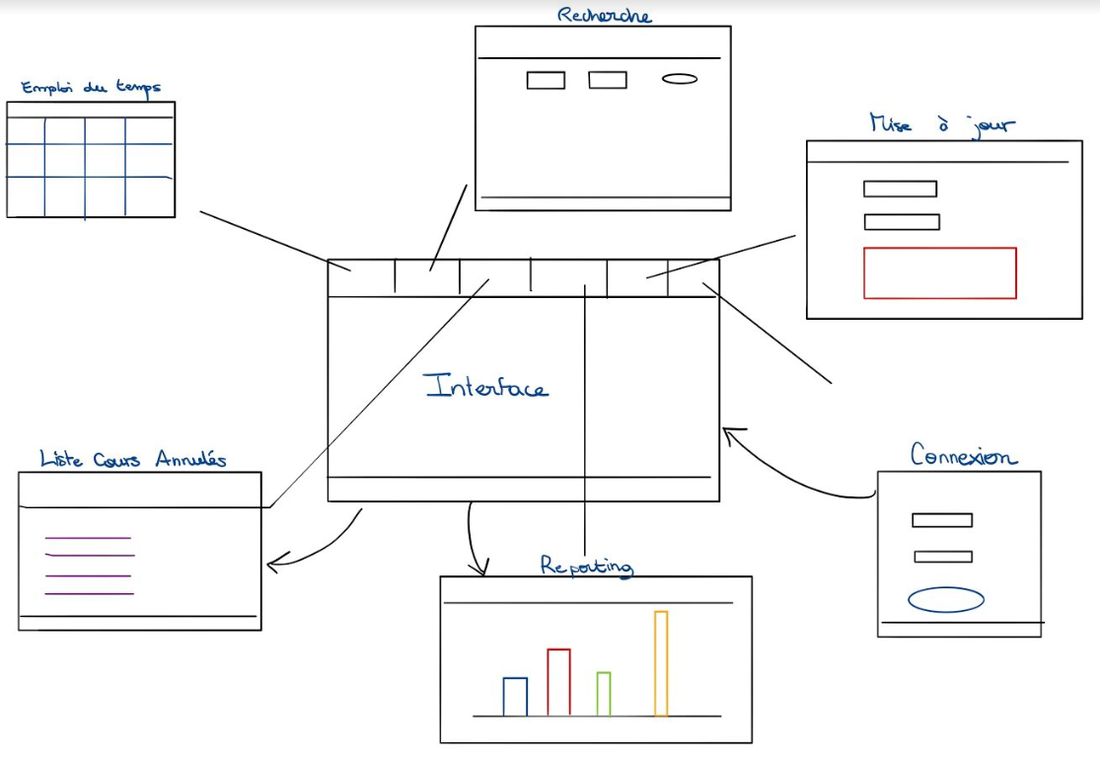
Design de la maquette
STORYBOARD

Slide 9
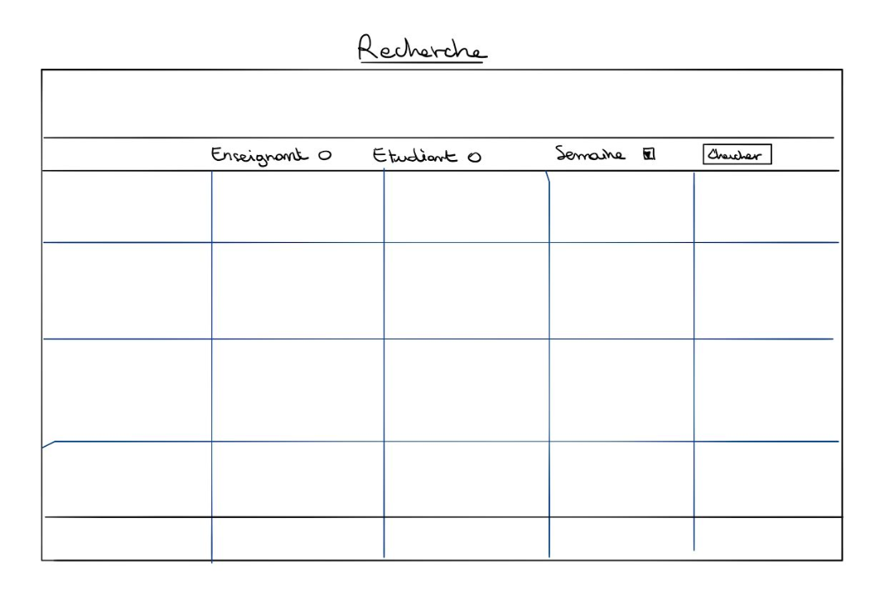
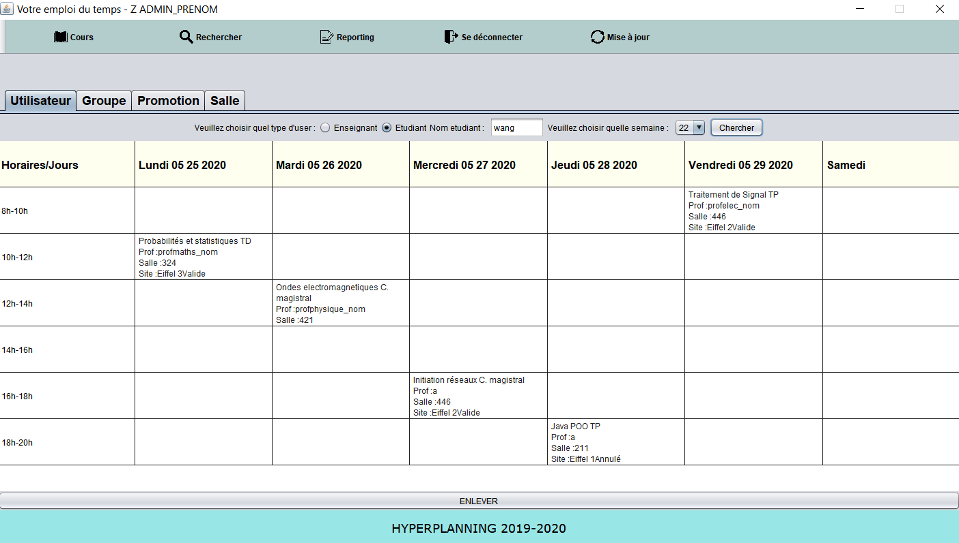
RECHERCHE
ImageIcon
JButton
JradioButton
JTextField
JTabbedPane
BorderLayout
JTable
JLabel

Slide 10
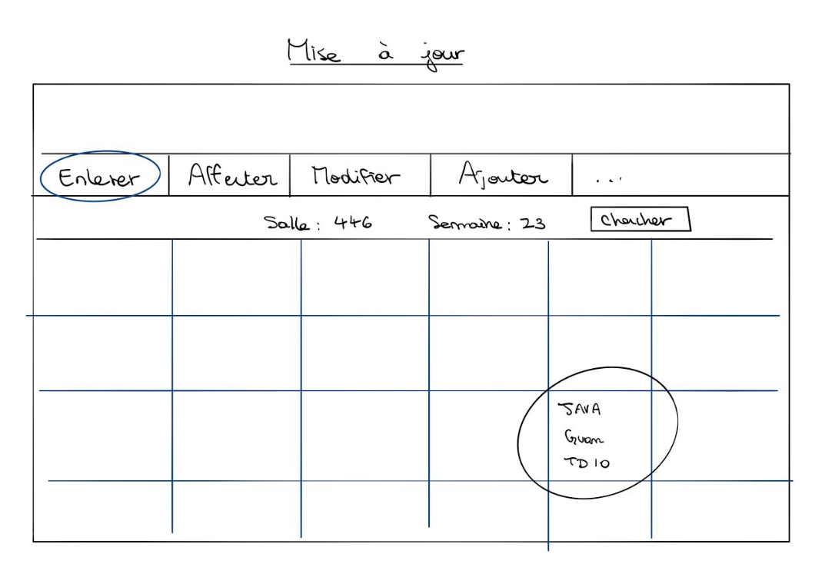
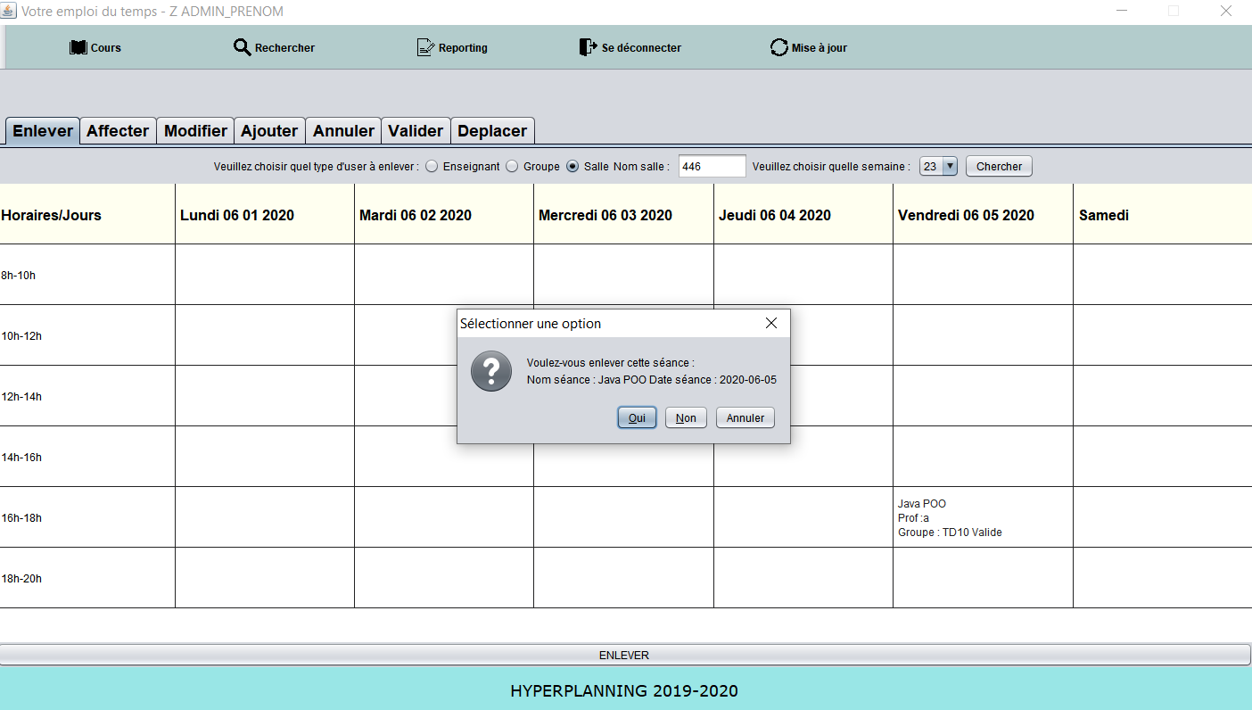
MISE A JOUR
JDialog
JPanel

Slide 11
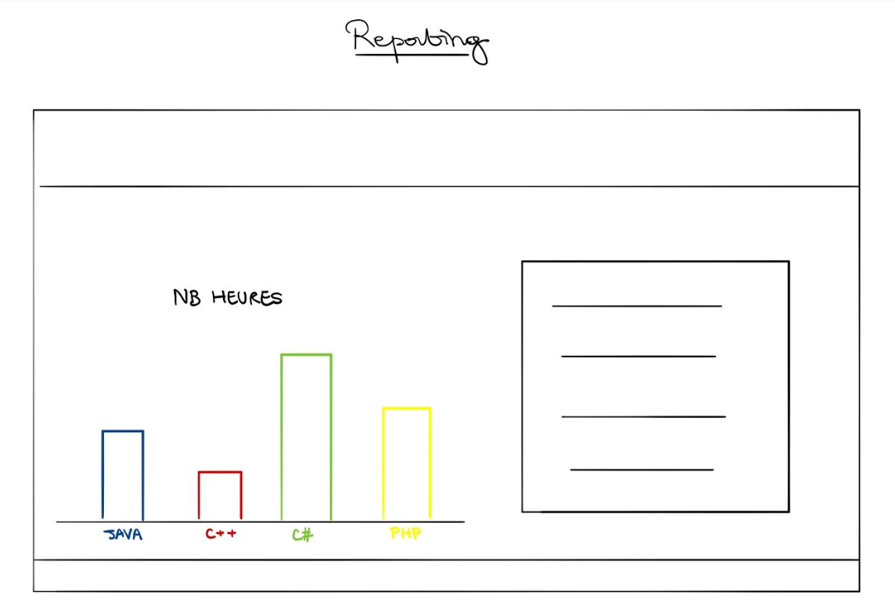
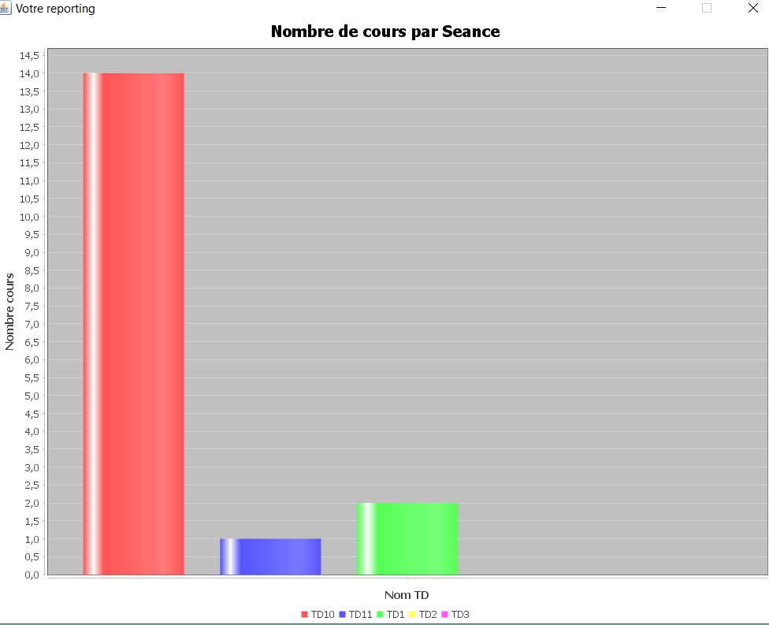
REPORTING
JFreeChart

Slide 12
Versionning GIT
https://github.com/noahghost/Java-Project

Slide 13
Bilan individuel

Slide 14
Bilan collectif
Efficacité programmation orienté objet
Utiliser l’API de JAVA
JAVADOC
Code long

Slide 15
Sources
https://openclassrooms.com/fr/courses/26832-apprenez-a-programmer-en-java/25552-structurez-mieux-votre-code-avec-le-pattern-mvc
https://openclassrooms.com/fr/courses/26832-apprenez-a-programmer-en-java/26830-liez-vos-tables-avec-des-objets-java-le-pattern-dao
https://stackoverflow.com/questions/3213045/centering-text-in-a-jtextarea-or-jtextpane-horizontal-text-alignment
https://stackoverflow.com/questions/4128872/how-to-get-the-name-of-the-day-from-java-sql-timestamp-object
https://pedago-ece.campusonline.me/pluginfile.php/233754/mod_resource/content/1/JFreeChart.pdf
https://cyrille-herby.developpez.com/tutoriels/java/mapper-sa-base-donnees-avec-pattern-dao/
https://stackoverflow.com/questions/31189811/how-to-get-date-value-from-jspinner
https://examples.javacodegeeks.com/core-java/util/date/java-util-date-to-java-sql-date/
https://stackoverflow.com/questions/7350893/click-event-on-jtable-java
https://javanepal.wordpress.com/2010/06/30/adding-jlabel-in-jtable/
https://www.programmez.com/content/jtable-mettre-un-jlabel-et-un-jbutton
https://koor.fr/Java/TutorialSwing/swing_JToolBar.wp
https://www.flaticon.com/home

