Slide 1
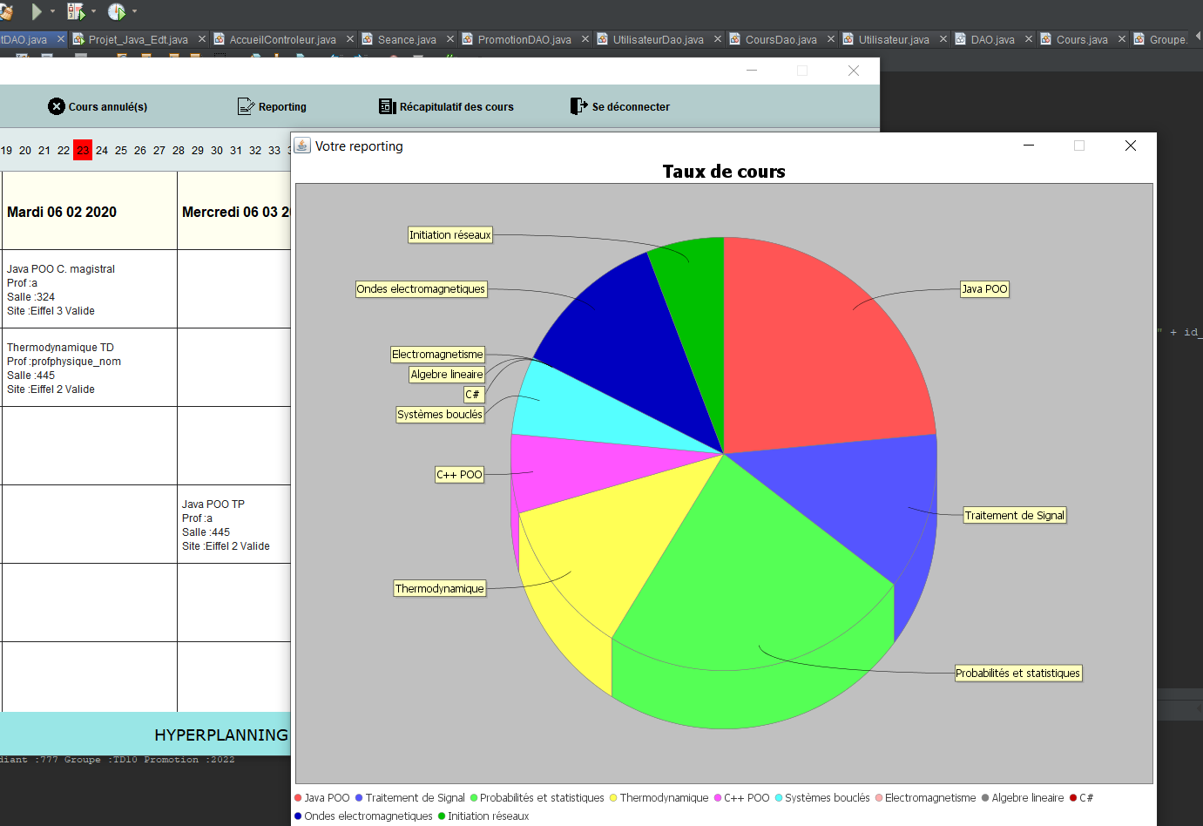
Gestion informatique d’un emploi du temps
AYLLON Jorge
BEAUJOIS Théo
WANG David
ING 3 TD10

Slide 2
SOMMAIRE
Répartition des tâches………………………………………………………………………………………… 3
Diagramme de classe……………………………………………………………………………………………4
Design de la maquette………………………………………………………………………………………….8
Versionning GIT……………………………………………………………………………………………………12
Bilan individuel…………………………………………………………………………………………………….13
Bilan collectif……………………………………………………………………………………………………….14
Sources…………………………………………………………………………………………………………………15

Slide 3
Répartition des tâches
WANG David | AYLLON Jorge | BEAUJOIS Théo

Slide 4
Diagramme de classe

Slide 5
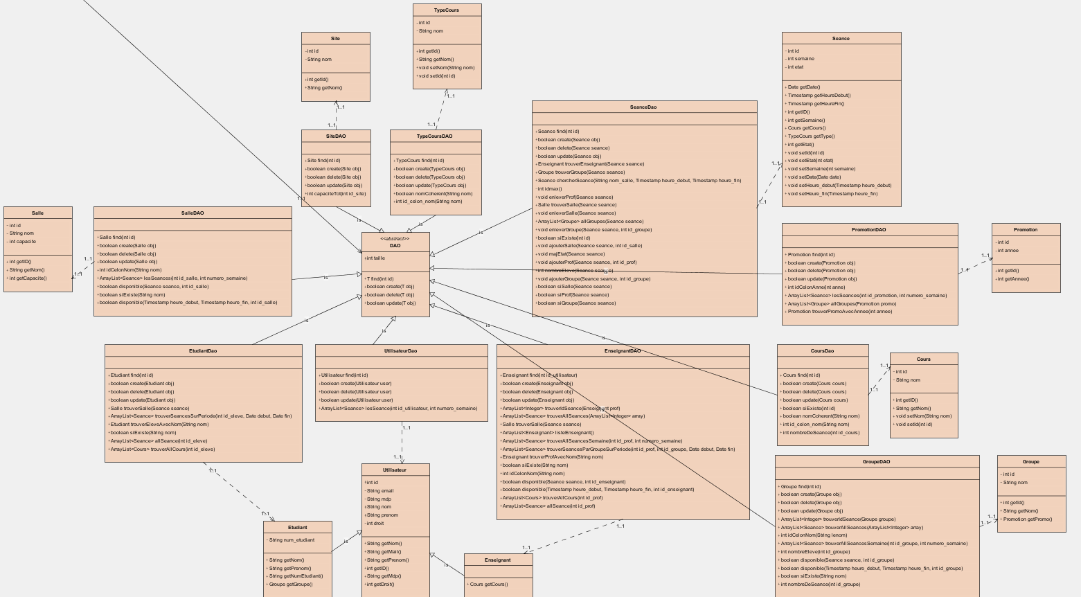
Modèle

Slide 6
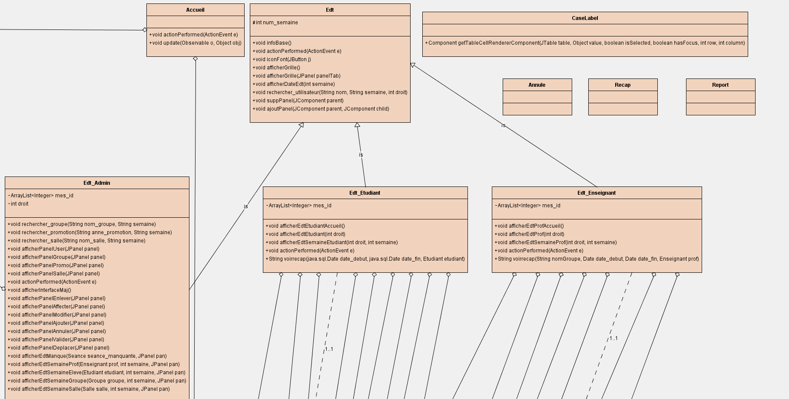
Vue

Slide 7
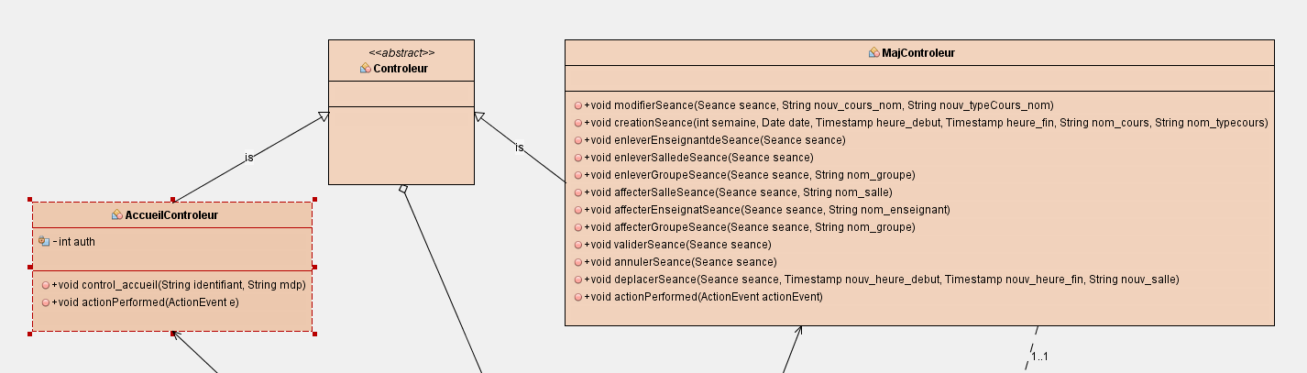
Contrôleur

Slide 8
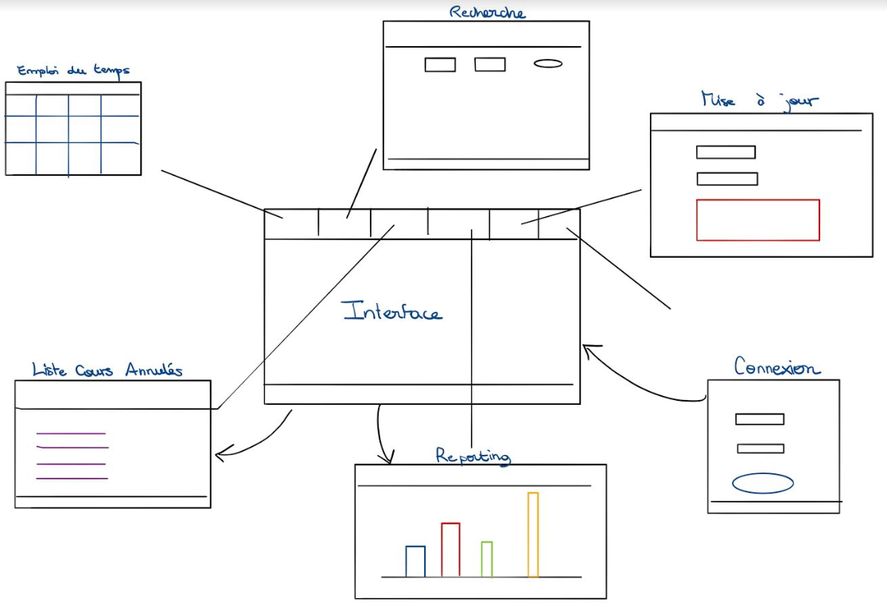
Design de la maquette
STORYBOARD

Slide 9
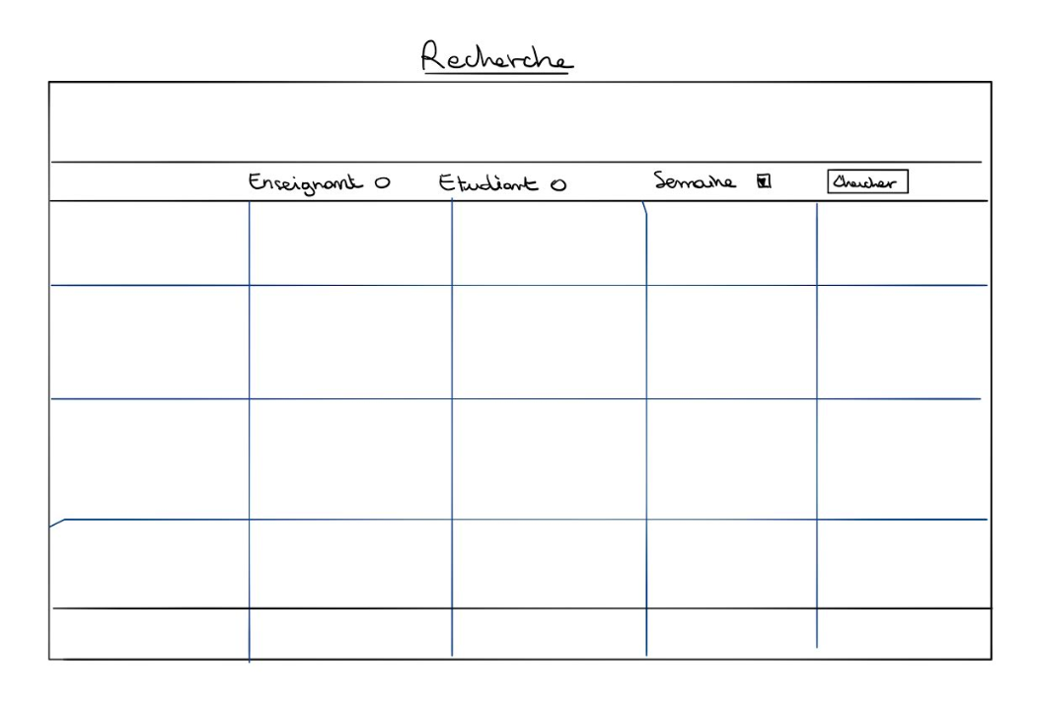
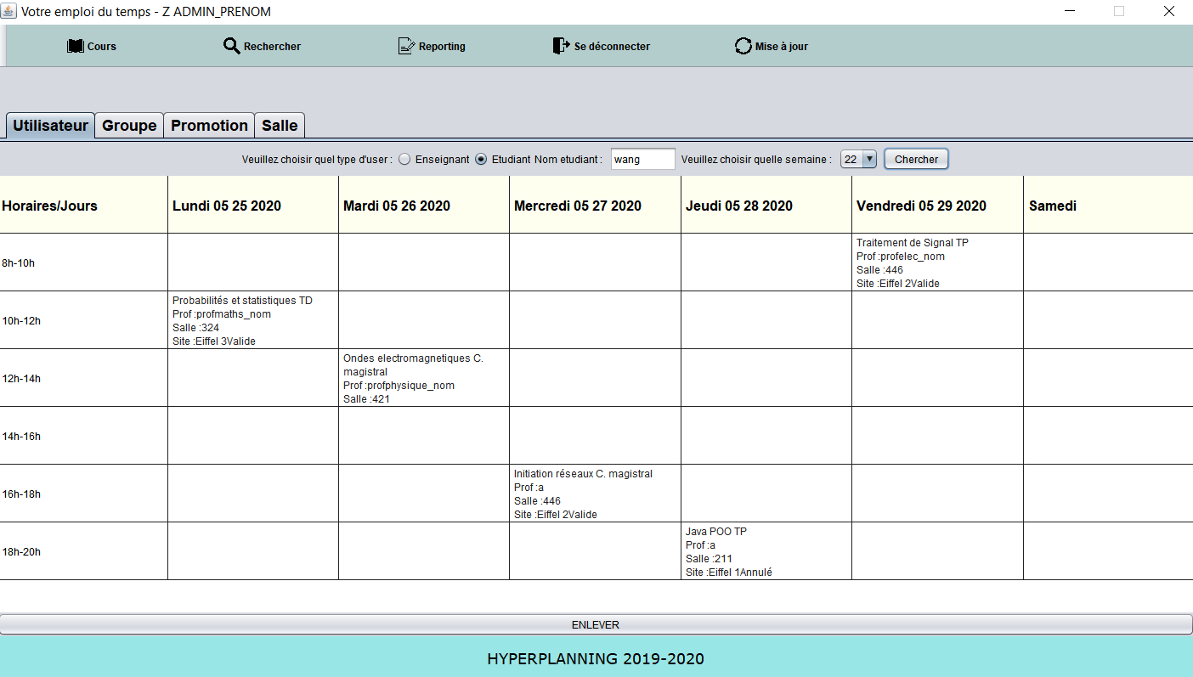
RECHERCHE
ImageIcon
JButton
JradioButton
JTextField
JTabbedPane
BorderLayout
JTable
JLabel

Slide 10
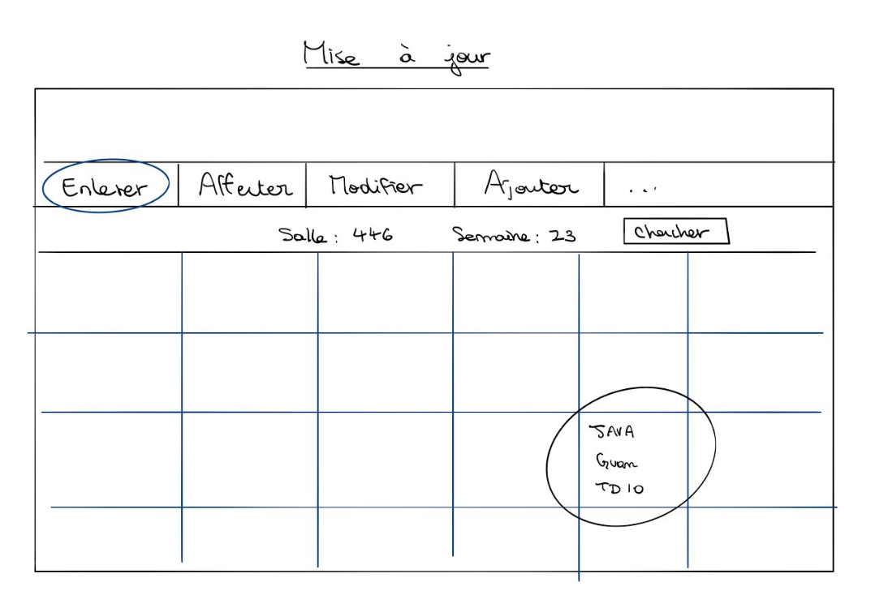
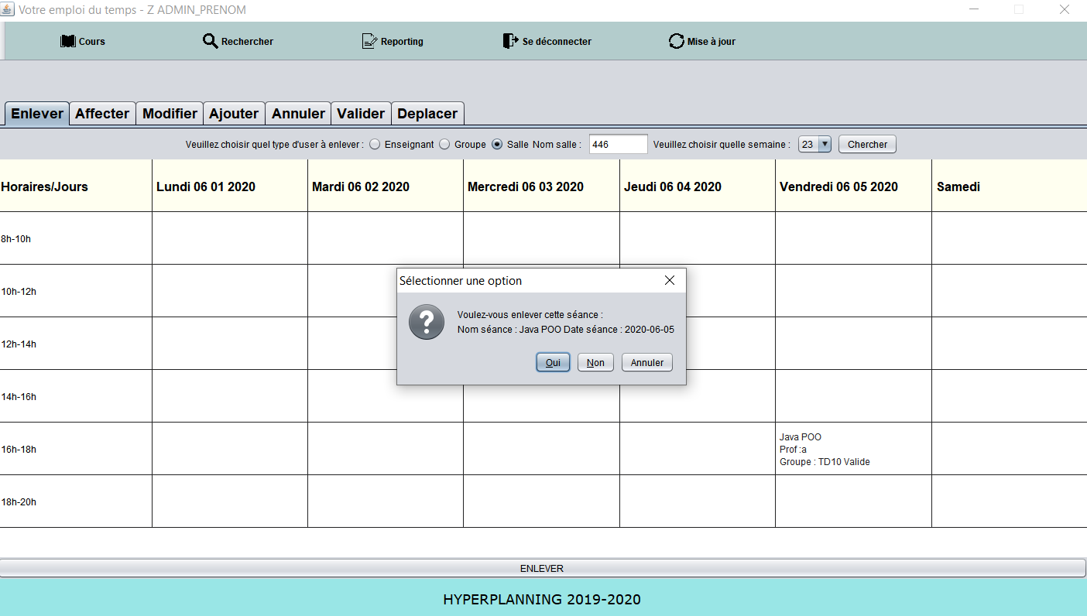
MISE A JOUR
JDialog
JPanel

Slide 11
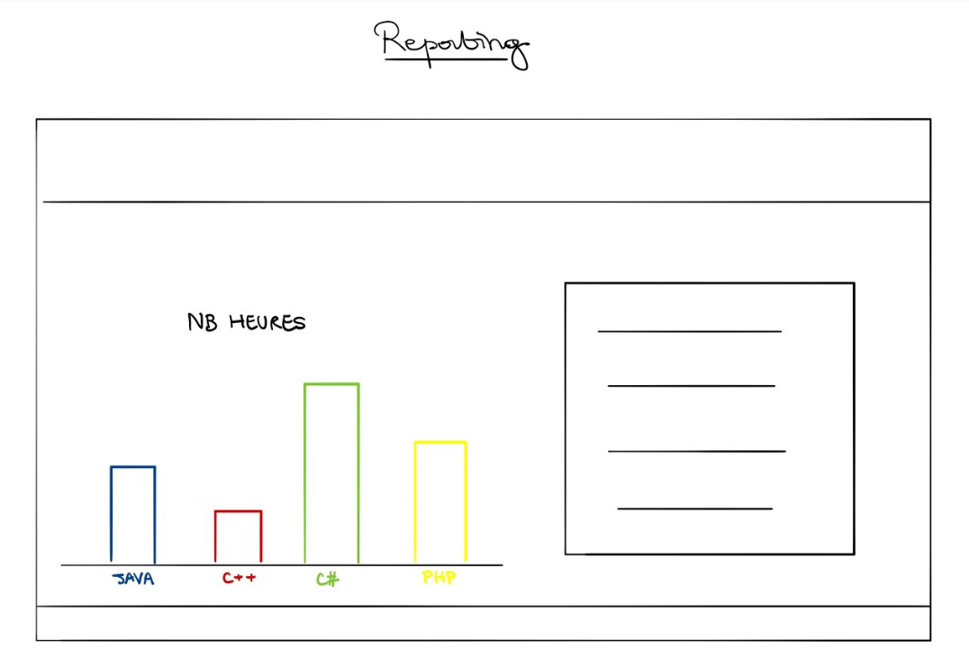
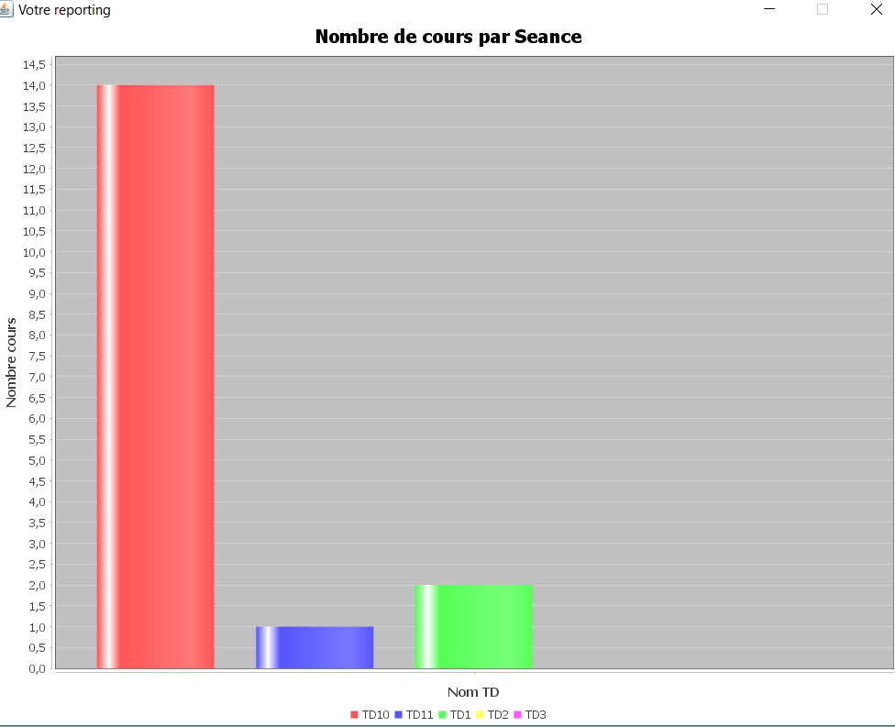
REPORTING
JFreeChart

Slide 12
Versionning GIT

Slide 13
Bilan individuel

Slide 14
Bilan collectif
Efficacité programmation orienté objet
Utiliser l’API de JAVA
JAVADOC
Code long

Slide 15
Sources
https://openclassrooms.com/fr/courses/26832-apprenez-a-programmer-en-java/25552-structurez-mieux-votre-code-avec-le-pattern-mvc
https://openclassrooms.com/fr/courses/26832-apprenez-a-programmer-en-java/26830-liez-vos-tables-avec-des-objets-java-le-pattern-dao
https://stackoverflow.com/questions/3213045/centering-text-in-a-jtextarea-or-jtextpane-horizontal-text-alignment
https://stackoverflow.com/questions/4128872/how-to-get-the-name-of-the-day-from-java-sql-timestamp-object
https://pedago-ece.campusonline.me/pluginfile.php/233754/mod_resource/content/1/JFreeChart.pdf
https://cyrille-herby.developpez.com/tutoriels/java/mapper-sa-base-donnees-avec-pattern-dao/
https://stackoverflow.com/questions/31189811/how-to-get-date-value-from-jspinner
https://examples.javacodegeeks.com/core-java/util/date/java-util-date-to-java-sql-date/
https://stackoverflow.com/questions/7350893/click-event-on-jtable-java
https://javanepal.wordpress.com/2010/06/30/adding-jlabel-in-jtable/
https://www.programmez.com/content/jtable-mettre-un-jlabel-et-un-jbutton
https://koor.fr/Java/TutorialSwing/swing_JToolBar.wp
https://www.flaticon.com/home

