Slide 1

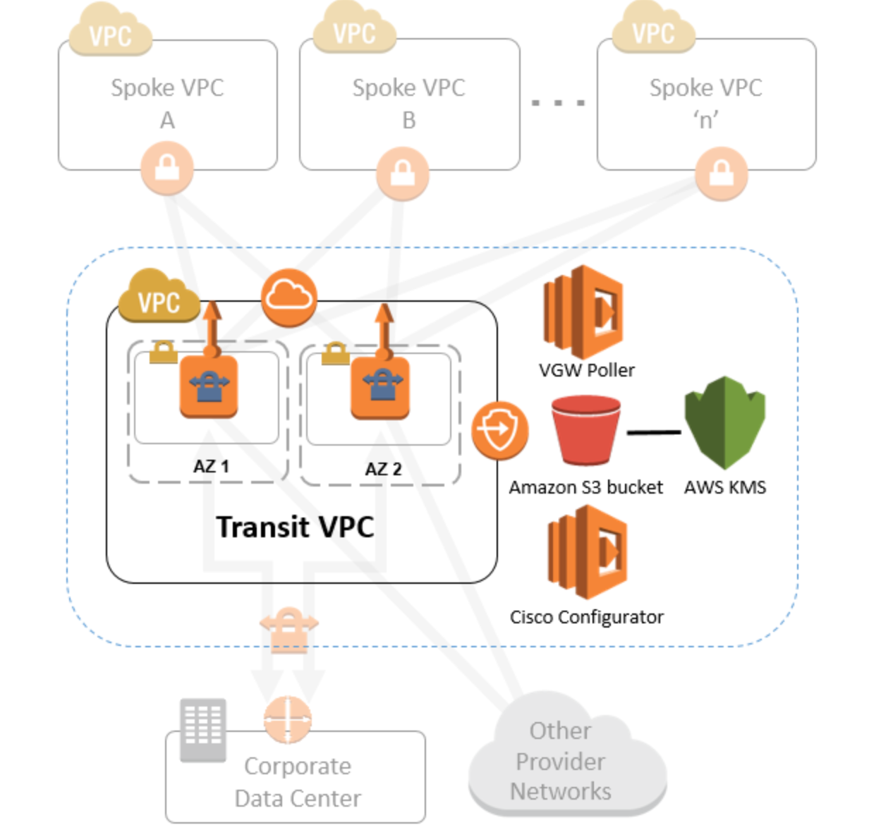

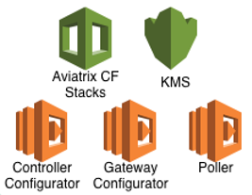



Spoke VPC
A
Spoke VPC
B
. . .
Spoke VPC
‘n’
Centralized Controller
Primary
HA
AZ 1
AZ 2
Transit VPC
VGW
IPSec Tunnel
Aviatrix Central Controller Traffic
(SQS, HTTPS)
Corporate Data Center

