Slide 1
Real Estate Investment: Commercial Buildings, Cologne, Germany
for REI Commercial
by BJS Analytics
10.10.2019 / mail@bjs-analytics.com

Slide 2
Objective
Invest in commercials buildings in Cologne, Germany
Maximize profit by investing in a growing up-coming neighbourhood
Define building type in agreement with needs and trends (e.g. medical centre, clothing shop, restaurant)

Slide 3
Data
Geographical data divided by postal code areas
(opendatasoft.com)
Population number for each postal code area
(suche-postleitzahl.org)
Venues characteristics from Foursquare
(Foursquare.com)

Slide 4
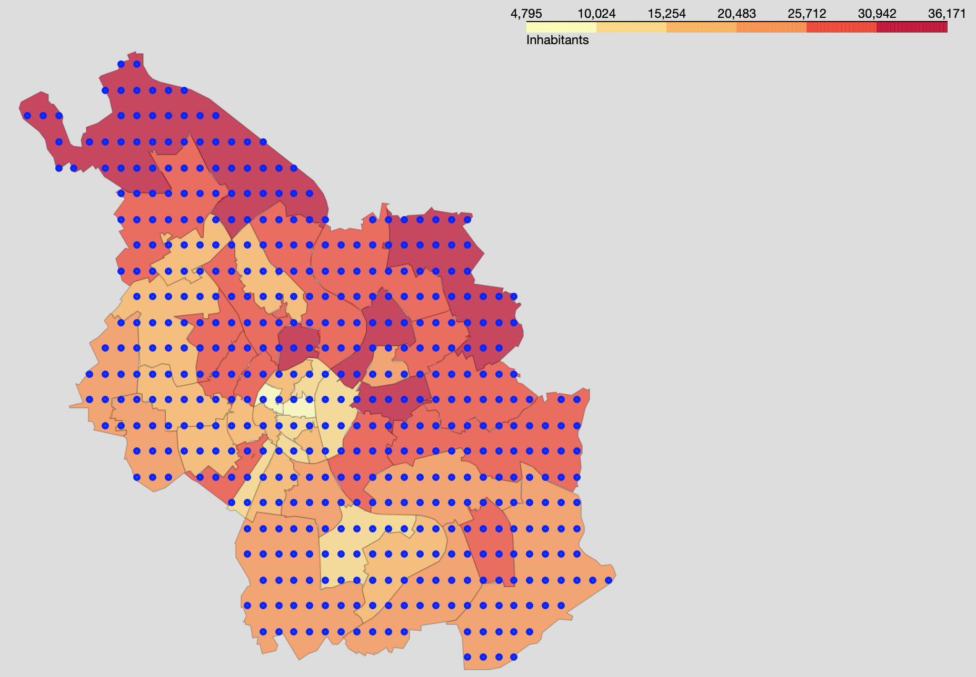
Methods
Foursquare queries
Equally spaced queries throughout the city
k-Means clustering
Clustering of city areas by type of venues
source: towardsdatascience.com

Slide 5
Methods
Assumptions
house pricing and socio-economics correlate with population and venues density
neighbourhoods with a low population density are not attractive for investment in commercial buildings

Slide 6
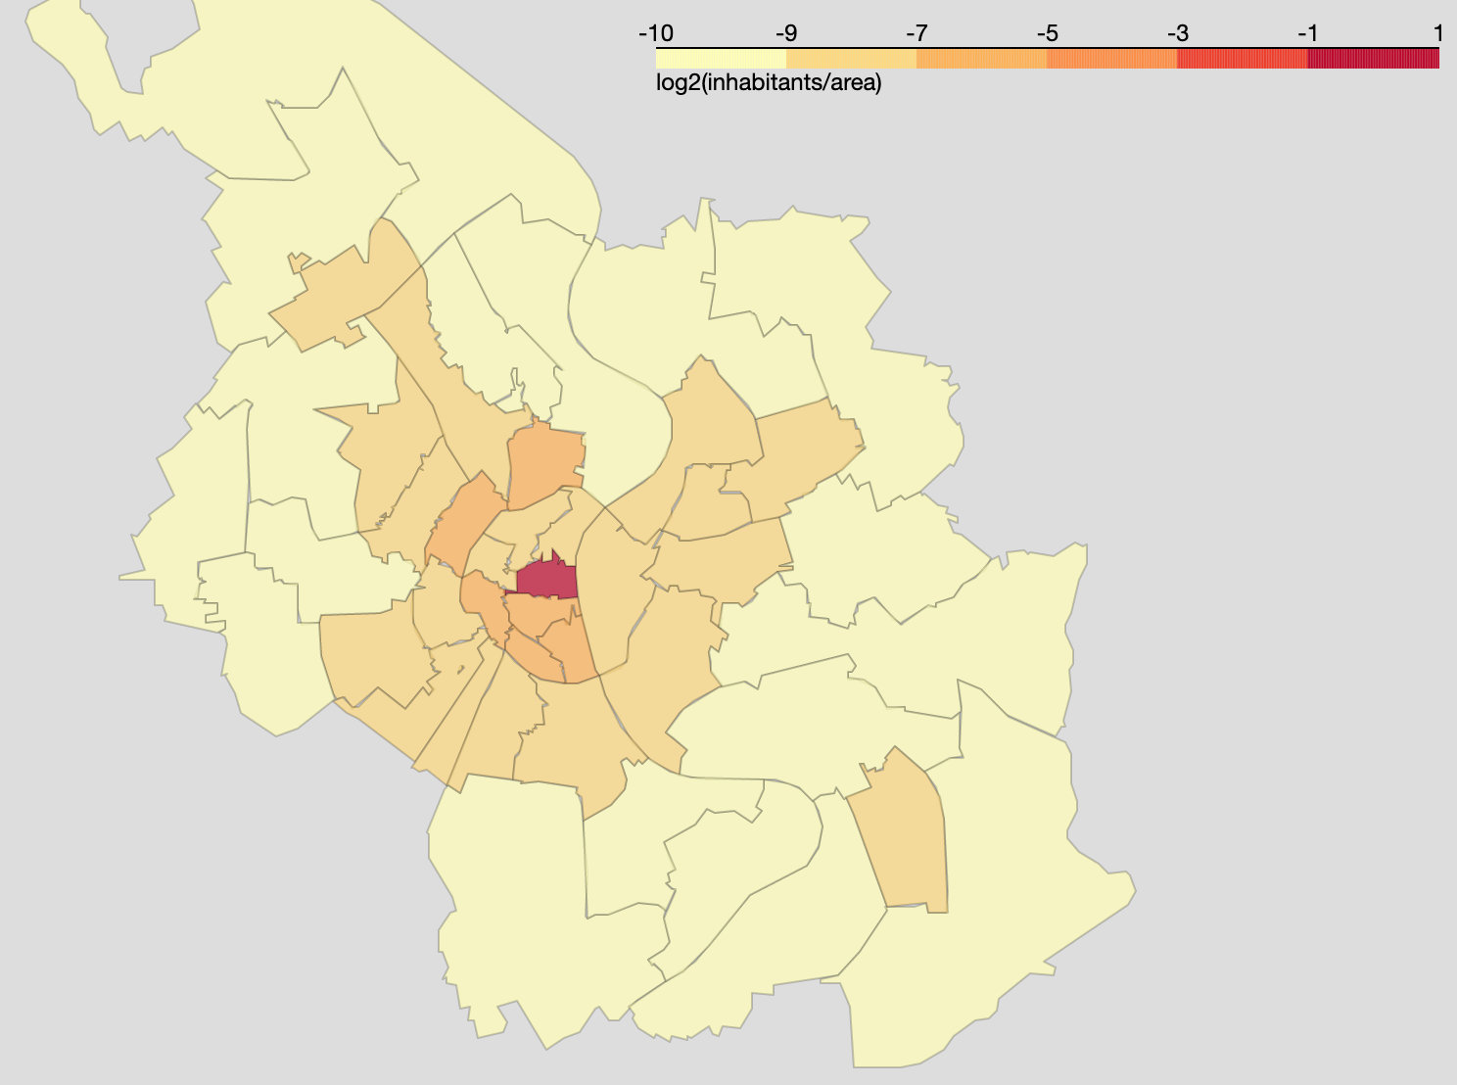
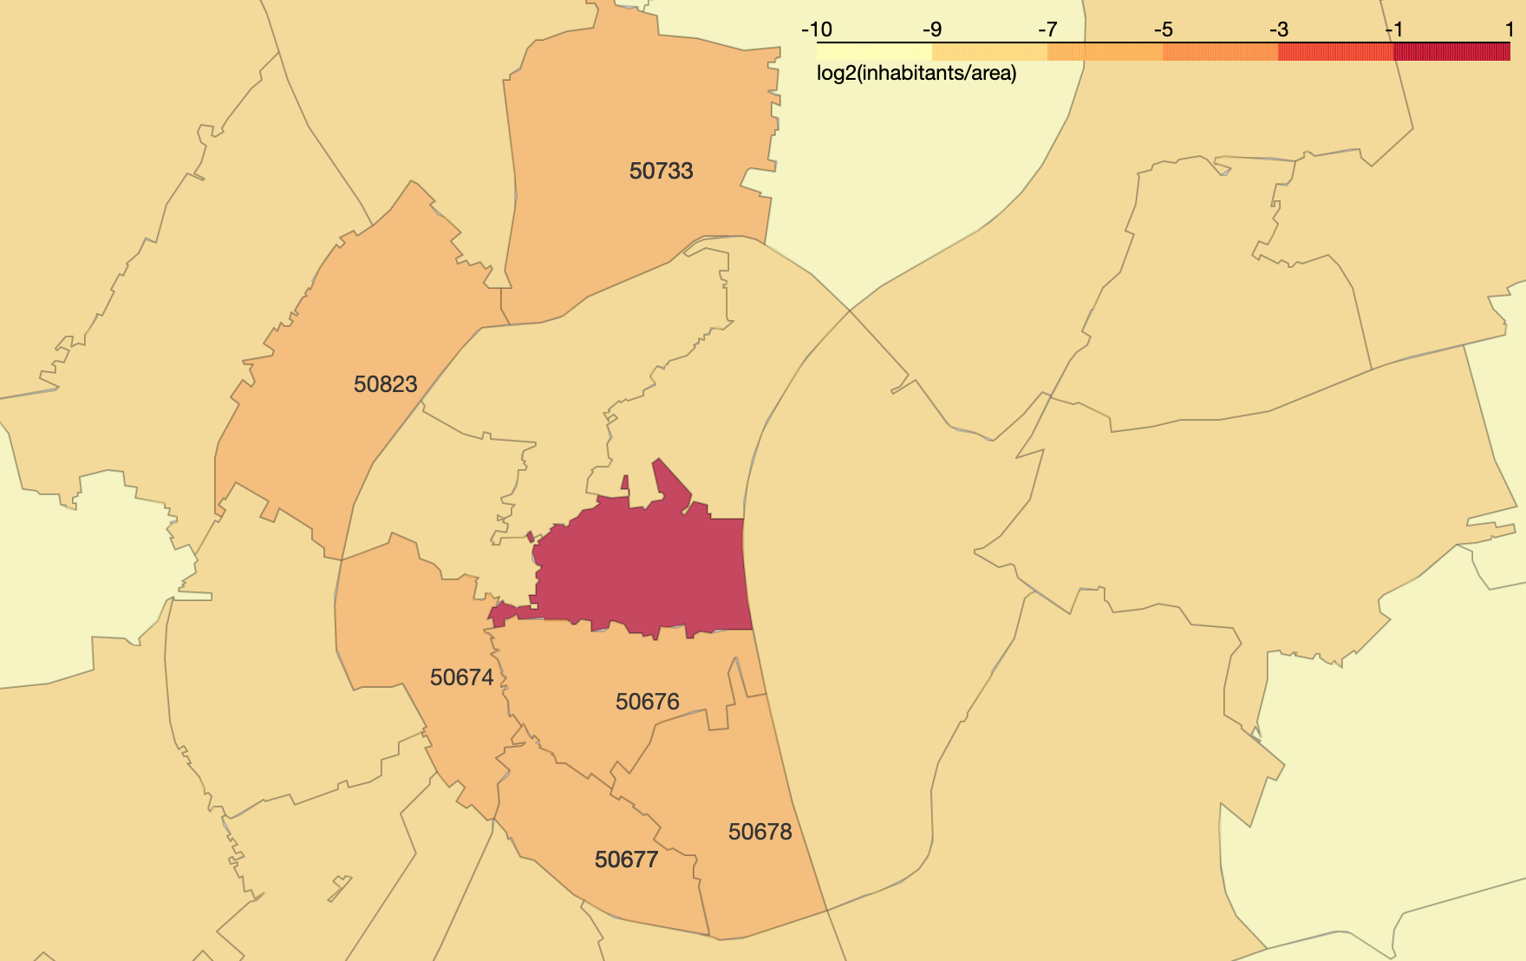
Results: population analysis
Upcoming
neighbourhoods

Slide 7
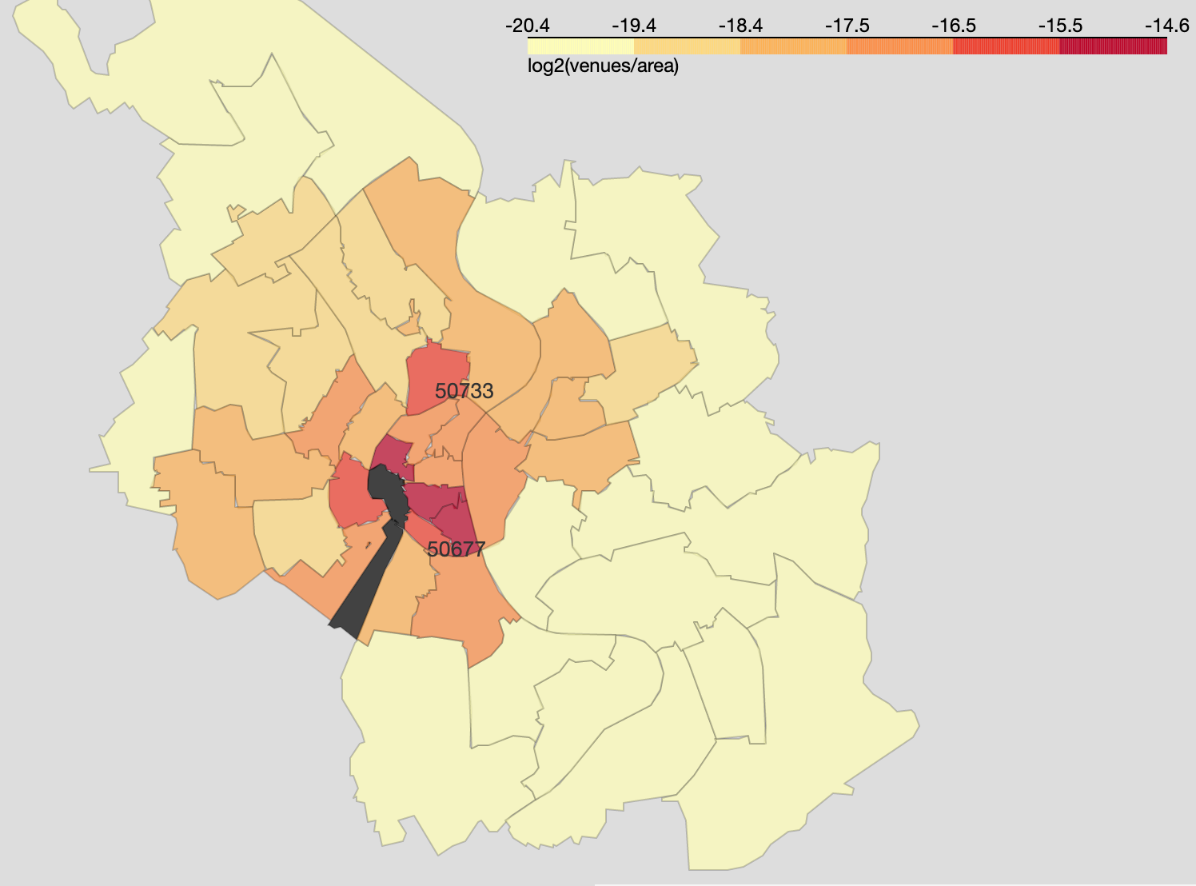
Results: venues analysis
50733 and 50677 emerge as upcoming neighbourhoods from population and venues analysis
50733 venues are geographically isolated from areas with high density of venues

Slide 8
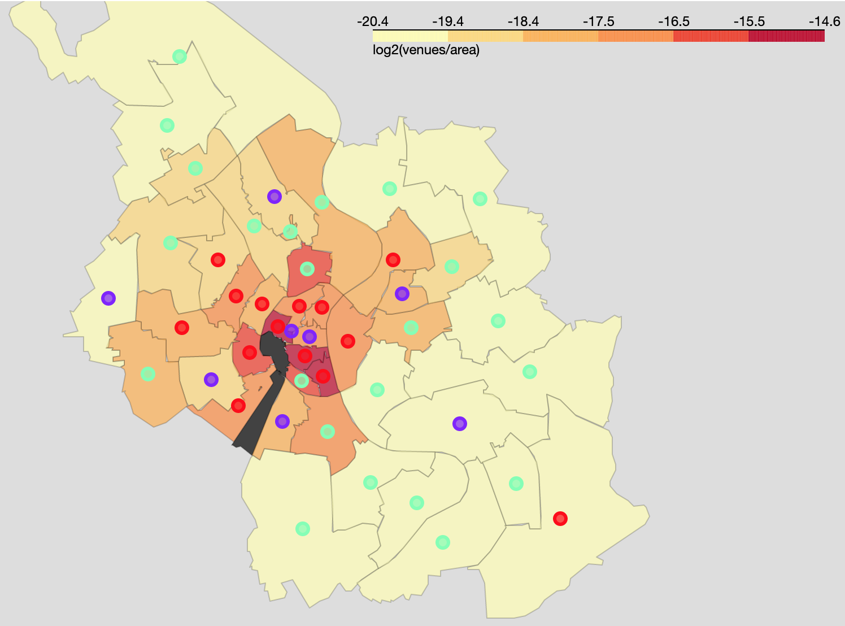
Results: cluster analysis
50733 and 50677 show distinct venues from other trendy areas in the city (red)
50733
50677

Slide 9
Results: 50733 vs trendy neighbourhoods
Nippes (50733) lacks hotels and has an overrepresentation of supermarkets
Restaurants are trending in Cologne
 | needed venues
Hotel | 0.072
Bar | 0.028
Italian Restaurant | 0.026
Nightclub | 0.022
Restaurant | 0.022
German Restaurant | 0.016
Pizza Place | 0.016
Pub | 0.013
Burger Joint | 0.013
Spanish Restaurant | 0.012
Snack Place | 0.012
Trattoria/Osteria | 0.012
Asian Restaurant | 0.012
Austrian Restaurant | 0.011
French Restaurant | 0.010
Tapas Restaurant | 0.009
Automotive Shop | 0.009
Theater | 0.009
Fast Food Restaurant | 0.009
Water Park | 0.008
 | existing venues
Supermarket | -0.105
Bakery | -0.057
Drugstore | -0.046
Doner Restaurant | -0.039
Martial Arts Dojo | -0.024
Thai Restaurant | -0.024
Kebab Restaurant | -0.024
Department Store | -0.024
Bank | -0.024
Farmers Market | -0.024
Cantonese Restaurant | -0.024
Plaza | -0.023
Organic Grocery | -0.022
Music Venue | -0.022
Bookstore | -0.022
Flea Market | -0.022
Modern European Restaurant | -0.021
Cocktail Bar | -0.019
Café | -0.019
Breakfast Spot | -0.018
increased need
overrepresented

Slide 10
Conclusion
Invest in Nippes (50733)
Large investment in acquiring space for an hotel
Smaller investments by acquiring space for restaurants
Both recommendations are not susceptible to developments in online shopping
More data on socio-economics as well as land and building costs will lower investment risk
e.g. hotels in low income neighbourhoods tend to have a small profit

