Slide 1
DevOps
By Jorge Cotillo
Technical Architect at Centric Consulting

Slide 2
Agenda
What is DevOps?
DevOps Fundamentals
Infrastructure as Code – Demo
C.I. – Demo
Automated Testing – Demo
Continuous Deployment – Demo
Questions?

Slide 3

What is DevOps?

Slide 4
Bottoms up concept

Slide 5
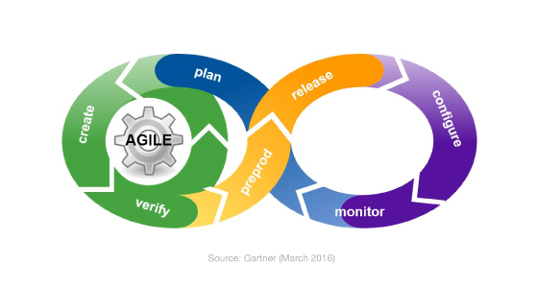
Let’s split DevOps first …

Slide 6



DevOps high level concept
People
Tools
Processes

Slide 7
DevOps Fundamentals
Infrastructure as Code
Continuous Integration
Automated Testing
Performance Monitoring
Continuous Deployment
Release Management
Configuration Management

Slide 8
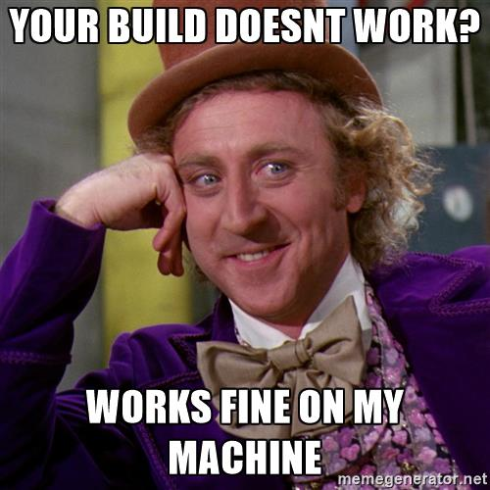
Infrastructure as Code (IaC)

Slide 9

Infrastructure as Code (IaC)

Slide 10


Infrastructure as Code (IaC)
&

Slide 11
Infrastructure as Code (IaC)
Minimizes: It works on my computer!
JSON representation of the infrastructure
Provisions your infrastructure
Two types: Imperative (JSON file that gets ingested) and Declarative (Powershell Script)

Slide 12
Demo - IaC

Slide 13
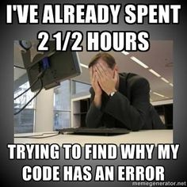
Continuous Integration (C.I.)

Slide 14





Continuous Integration (C.I.)
1. Push / Check-in
2. C.I. Server poll
3. Creates
2a. Gets source code
4. Sends notification
5. Successful / Failure message

Slide 15
Continuous Integration (C.I.)
Detect compilation errors in advanced
Ensures that the quality of the package is not compromised
Goes hand in hand with C.D. - Continuous Deployment – don’t confuse with Continuous Delivery
Orchestration tool of different tasks
Tasks created using Maven, Ant, Nant (deprecated), Gradle
C.I. tools: Jenkins, Bamboo, TeamCity, VS Team Services, Crucible

Slide 16
Automated Testing
Code and UI testing
Code testing tools: Nunit, Junit, MSTEST
UI testing tools: Selenium
Increases code coverage
Minimizes the possibility of integration bugs

Slide 17
Continuous Deployment (C.D.)
Not confuse with Continuous Delivery, Continuous Delivery is the process as a whole as it delivers a release
Ensures same source code gets released to different environments
Dev gets auto deployed
Prod usually requires approval of one or multiple parties
Tools: Jenkins, Crucible, VS Team Services, Bamboo

Slide 18
Demo

Slide 19
Questions?
Email: jorge.cotillo@centricconsulting.com
Twitter: @jorge_cotillo

