Slide 1
Reproducible Benchmarking Platform for ASP solvers
Presenter: Keeran Dhakal
Project Committee:
Dr. Jorge Fandinno Garcia
Dr. Yuliya Lierler
Dr. George Grispos
April 22, 2025

Slide 2
Outline
Introduction
Motivation
Background
System
Usage
Results
Conclusion
Department of Computer Science

Slide 3
Introduction

Slide 4
Reproducible Benchmarking Platform
The benchmarking platform performs three main tasks:
Run benchmarks for solvers
Compares and checks outputs
Analyses the output
Uses Docker to automate the above tasks and to make it reproducible.
Department of Computer Science

Slide 5
Answer Set Programming (ASP)
A form of declarative programming oriented towards solving complex search problems.
Enables solving problems by translating them into logic programs.
Uses grounding and solving approach.
Solving involves using specialized algorithms to find stable models (valid solutions).
Department of Computer Science

Slide 6
Simple ASP program
A simple ASP program
The answer set of above program is:
start. number(1) :- start. number(2) :- end.
start number(1)
Department of Computer Science

Slide 7
Solvers
Epistemic Solver
Eclingo
CASP Solver
EZSMT
Clingcon
Department of Computer Science

Slide 8
Motivation

Slide 9
Motivation
Improving solver performance requires running benchmarks for each change.
Manually running the process is a bottleneck to the process.
Reproducibility of benchmarks by other groups is complicated.
Department of Computer Science

Slide 10
Motivation
Current tools require manual inspection of output by different solvers.
This is tedious and infeasible to integrate in developing process of more advanced tools.
Adding new solvers or benchmarks requires significantly modifying the benchmarking code.
We want a tool that allow adding new solvers and new benchmarks with minimal changes.
Department of Computer Science

Slide 11
Motivation
Usually, dependencies are underspecified, which leads to irreproducible benchmarks by other groups.
Setting up environments for benchmarking is time consuming.
Different solvers need different environments, sometimes incompatible among them.
Docker allows us to use containerization technology to avoid this.
Department of Computer Science

Slide 12
Background

Slide 13
Docker
Containerization platform that allows you to build, test and deploy applications quickly and separately from underlying infrastructure using containers.
Dockerfile
Contains instructions to create a docker image.
Docker Image
Executable package of software that includes everything need to run an application.
Docker Container
Runtime instance of a docker image.
Department of Computer Science

Slide 14
Benchmarking Tool
Benchmarking Tool tracks the solving time for each benchmark instances.
Parameters that need to be setup before running benchmarks:
Timeout duration
Benchmarks to run
Benchmarks selection
Maximum Instances
Number of instances to run for each benchmark problem.
Department of Computer Science

Slide 15
Benchmarking Tool
Benchmark Results
Output file
Contains the answer set for a given instance.
Total count: Total number of instances.
ODS file
Contains solving time for all benchmark instances for all benchmark problems.
Total count: 1
Department of Computer Science

Slide 16
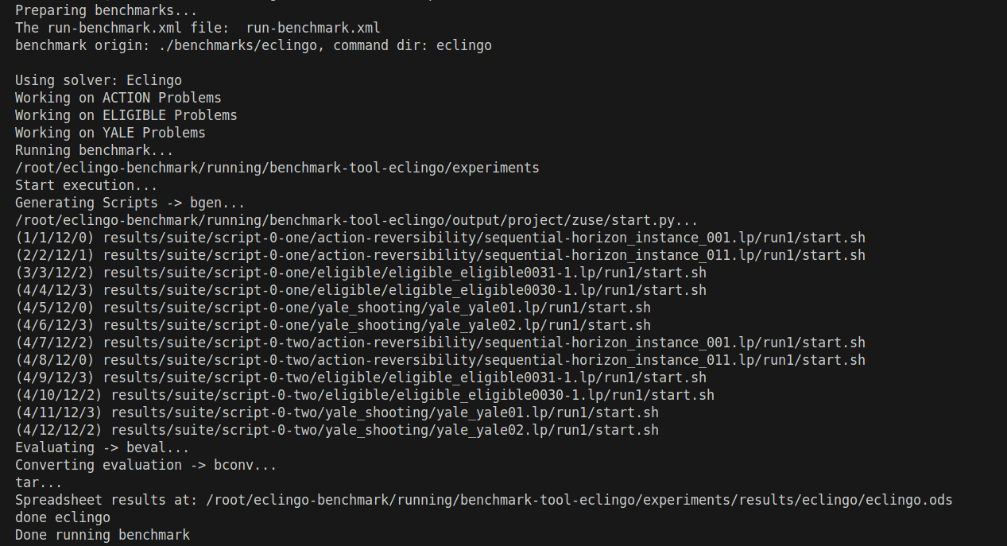
Benchmarking Tool
Department of Computer Science

Slide 17
System

Slide 18
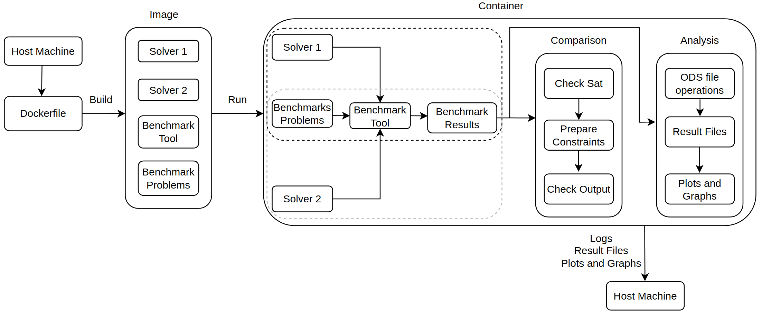
System Workflow
Department of Computer Science

Slide 19
Building Docker Image
Building image from Dockerfile involves installing and preparing the benchmarking platform.
For instance, in eclingo comparison, following packages get installed/setup:
Ubuntu 22.04
Miniconda3
Conda environments for benchmarking
Benchmarking tools
Solvers
Department of Computer Science

Slide 20
Running Docker Container
Running docker container does the following:
Benchmarks each solver on the benchmark problems.
Compares the results and checks if outputs from the solvers are consistent.
Analyzes the ODS files generated from benchmarking operations and plots the graphs and figures.
Department of Computer Science

Slide 21
Comparison Block
This component compares output from one solver to another.
This component has three steps:
Check Sat
Prepare Constraints
Check Output
Department of Computer Science

Slide 22
Check Sat
Satisfiability Check
Matching Instances
Consistent SAT and UNSAT.
We use SAT instances to check output correctness.
Non-matching Instances
Inconsistent SAT and UNSAT.
Goal is to make this zero.
Timed out Instances
Instances not solved in a certain threshold time.
Department of Computer Science

Slide 23
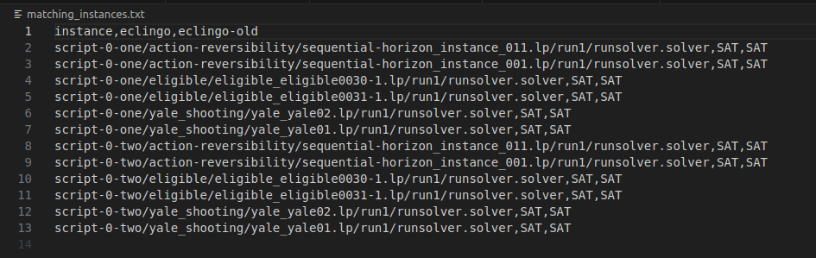
Check Sat
Department of Computer Science

Slide 24
Prepare Constraints
Only matching instances with SAT output from the first solver are used.
Atoms from the answer set are split and used to prepare constraints.
Prepared constraints are used along with the original program.
Department of Computer Science

Slide 25
Prepare Constraints
For example,
If we have answer set:
start number(1)
The constraint is produced as
:- not start.
:- not number(1).
This ensures that the second solver does not include an answer set that does not have "start" and "number(1)" atoms.
Department of Computer Science

Slide 26
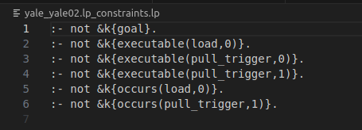
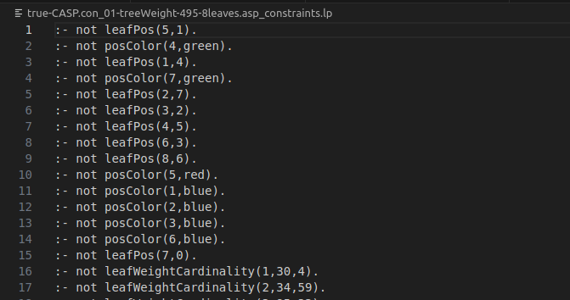
Prepare Constraints
Epistemic Solver | Constraint Answer Set Solver
Department of Computer Science

Slide 27
Check Output
Feed the second solver with the original program and constraints.
Run in loop to check for the same answer set.
The program terminates :
If the solver finds the exact same answer set (desired)
There are no more answer set (undesired).
Department of Computer Science

Slide 28
Check Output
If different answer set is generated:
start number(1) number(2)
We generate a new set of constraints:
:- not start.
:- not number(1).
:- number(2).
This ensures that the second solver does not include any answer set that does not have "start" and "number(1)" atoms and has "number(2)" atom.
Department of Computer Science

Slide 29
Analysis
Benchmark tool outputs an open document spreadsheet (ODS) file with benchmark times for respective instances.
Operations on ODS files and prepare excel sheets:
Side by side solver comparison for all instances of all benchmarks.
Average solving time for each benchmark.
Number of instances solved for each benchmark.
Resulting survival/cactus plot from the created excel sheet.
Department of Computer Science

Slide 30
Usage

Slide 31
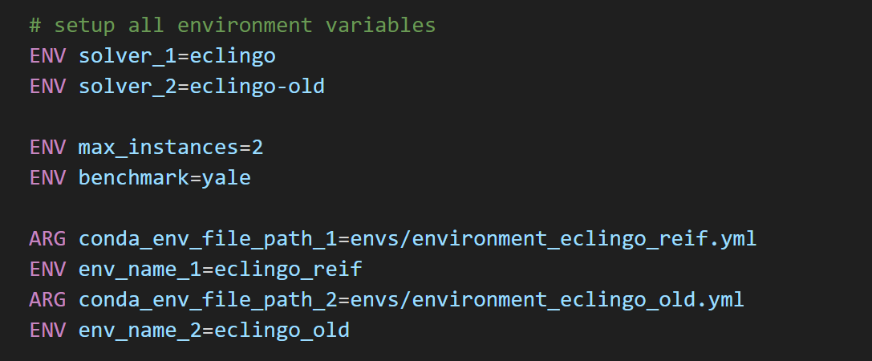
Usage: Docker Env Variables
Department of Computer Science

Slide 32
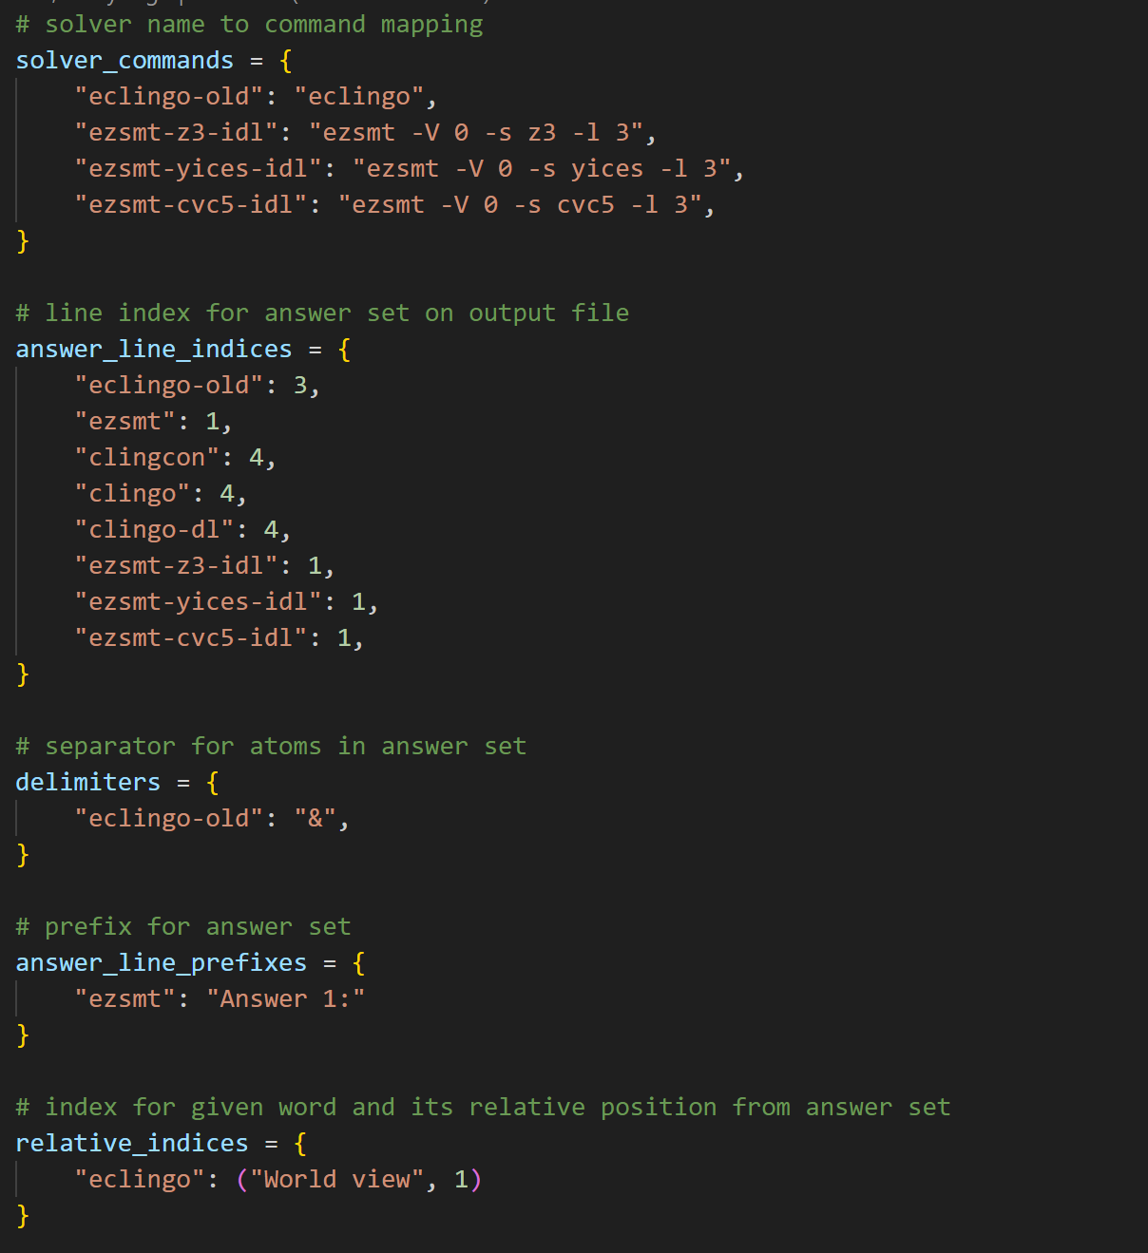
Comparison
Parameters
Department of Computer Science

Slide 33
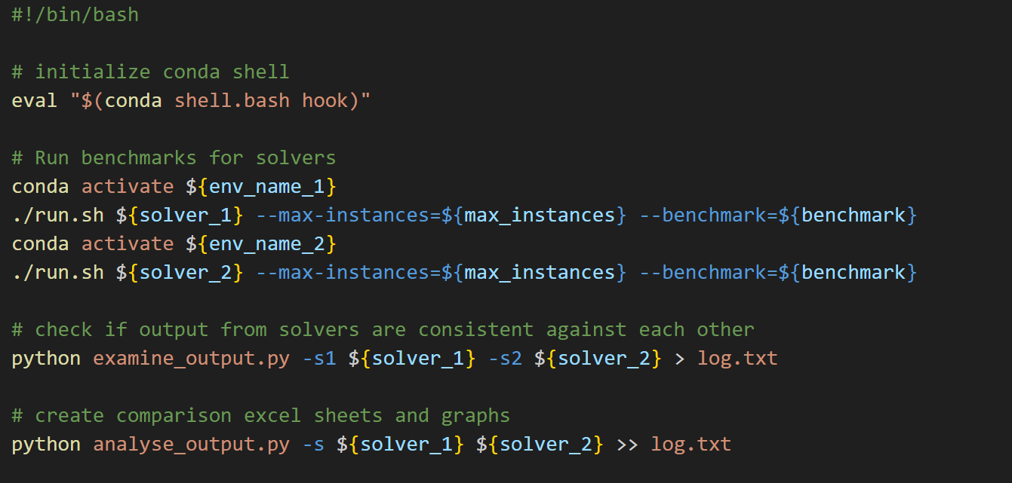
Comparison and Analysis (setup.sh)
Department of Computer Science

Slide 34
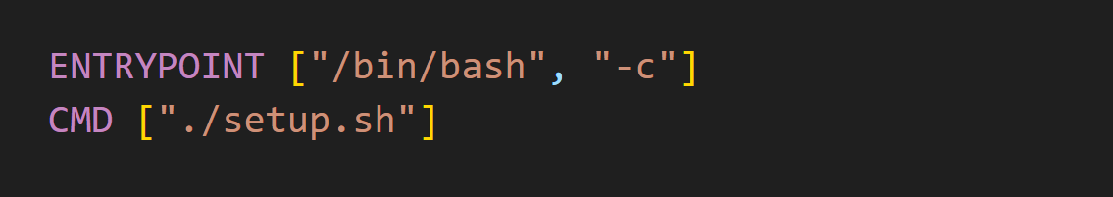
Dockerfile: Container Command
Department of Computer Science

Slide 35
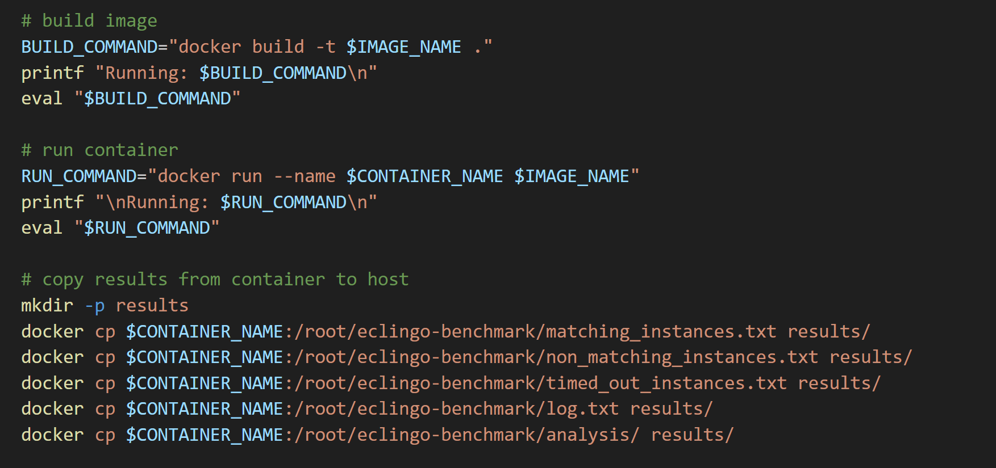
Usage: Docker Build and Run (compare.sh)
Department of Computer Science

Slide 36
Results

Slide 37
Experiment Machine Specifications
Eclingo Comparison:
Operating System: Ubuntu 22.04.3 LTS
CPU: 12th Gen Intel® Core™ i7-12700T
Memory: 32.0 GiB
EZSMT/Clingcon Comparison:
Operating System: Ubuntu 20.04.6 LTS
CPU: Intel® Core™ i7-7700 CPU @ 3.60GHz
Memory: 31.2 GiB
Department of Computer Science

Slide 38
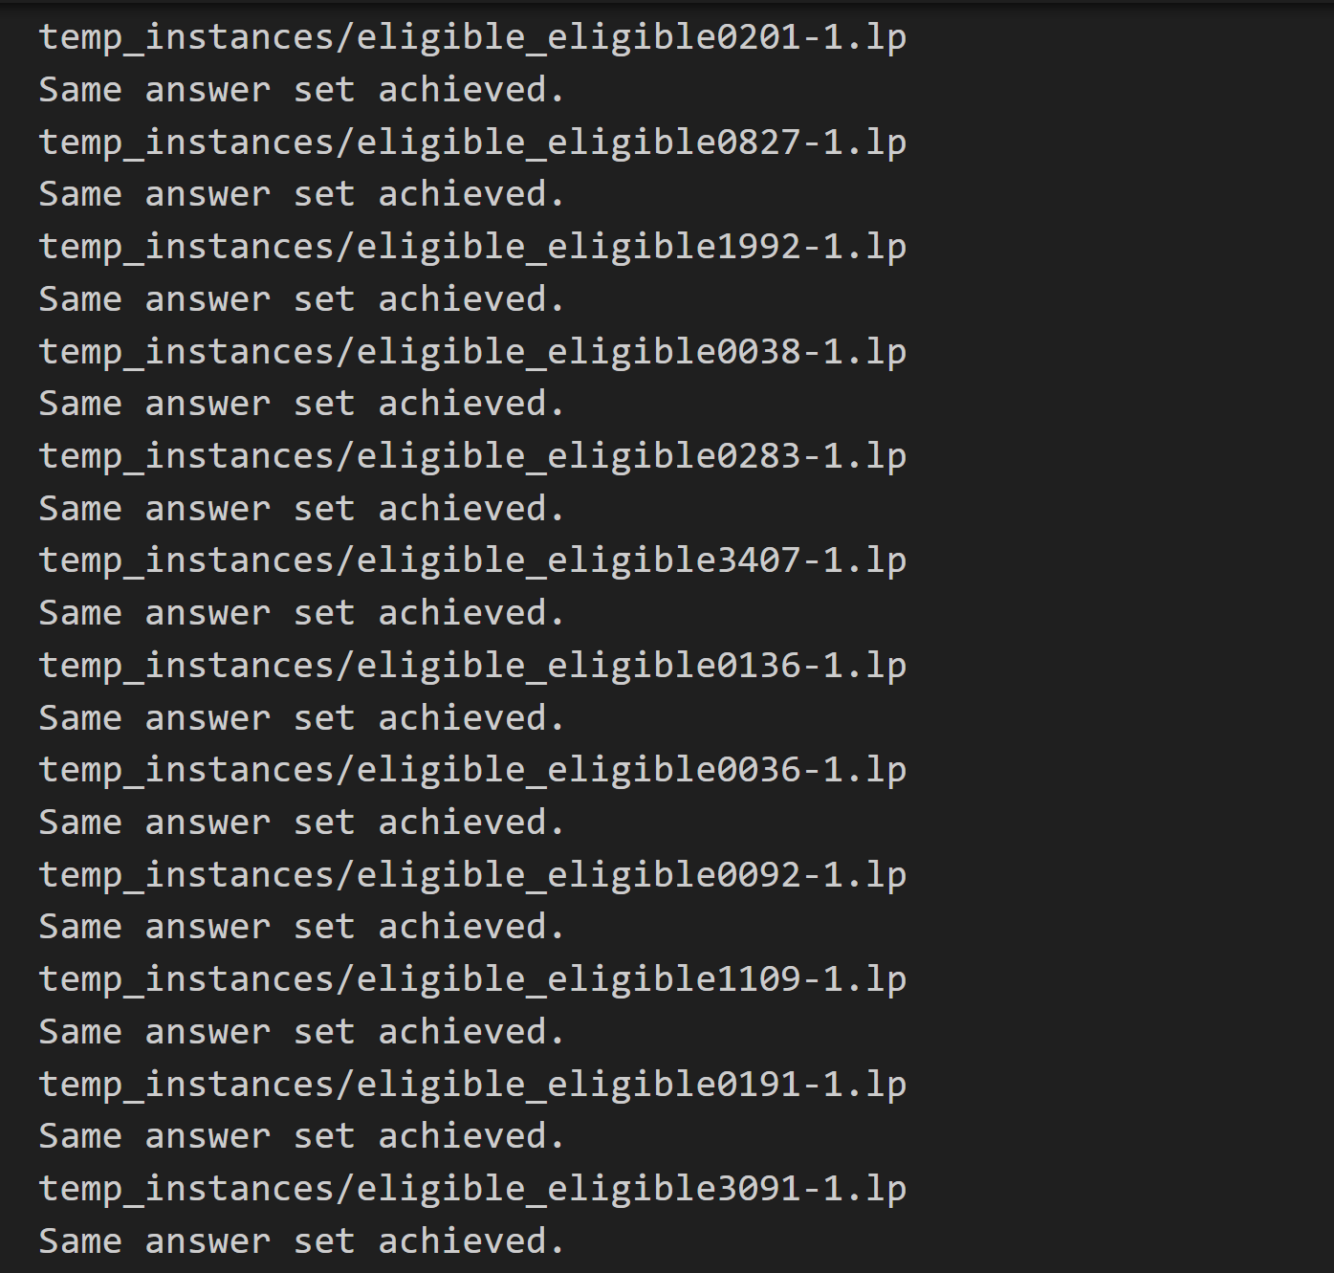
Comparison Log
Department of Computer Science

Slide 39
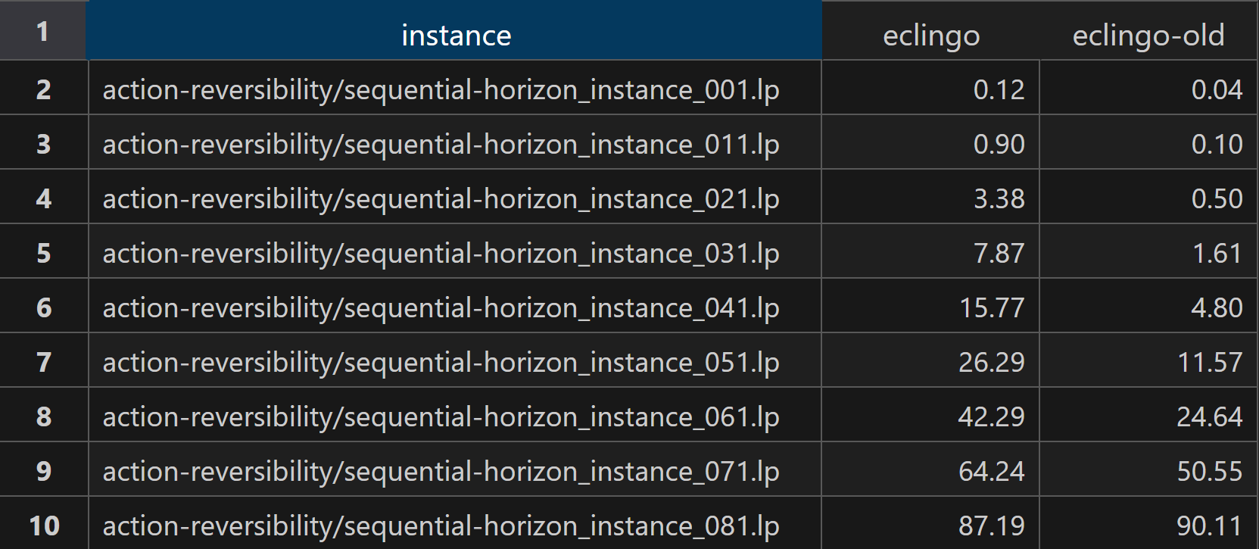
Benchmark Output:
Eclingo Comparison (New vs Old)
Docker
All Solvers Runtime Units: Seconds
Department of Computer Science

Slide 40
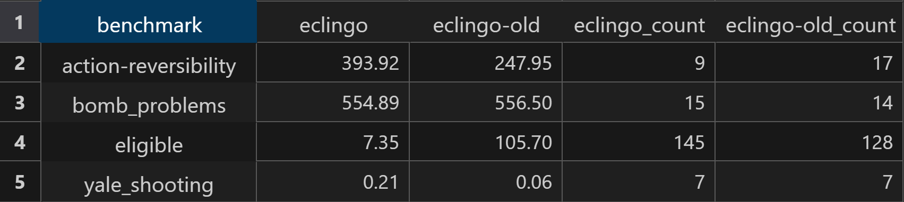
Benchmark Output:
Eclingo Comparison
Docker
All Solvers Runtime Units: Seconds
Count: Number of instances solved
Department of Computer Science

Slide 41
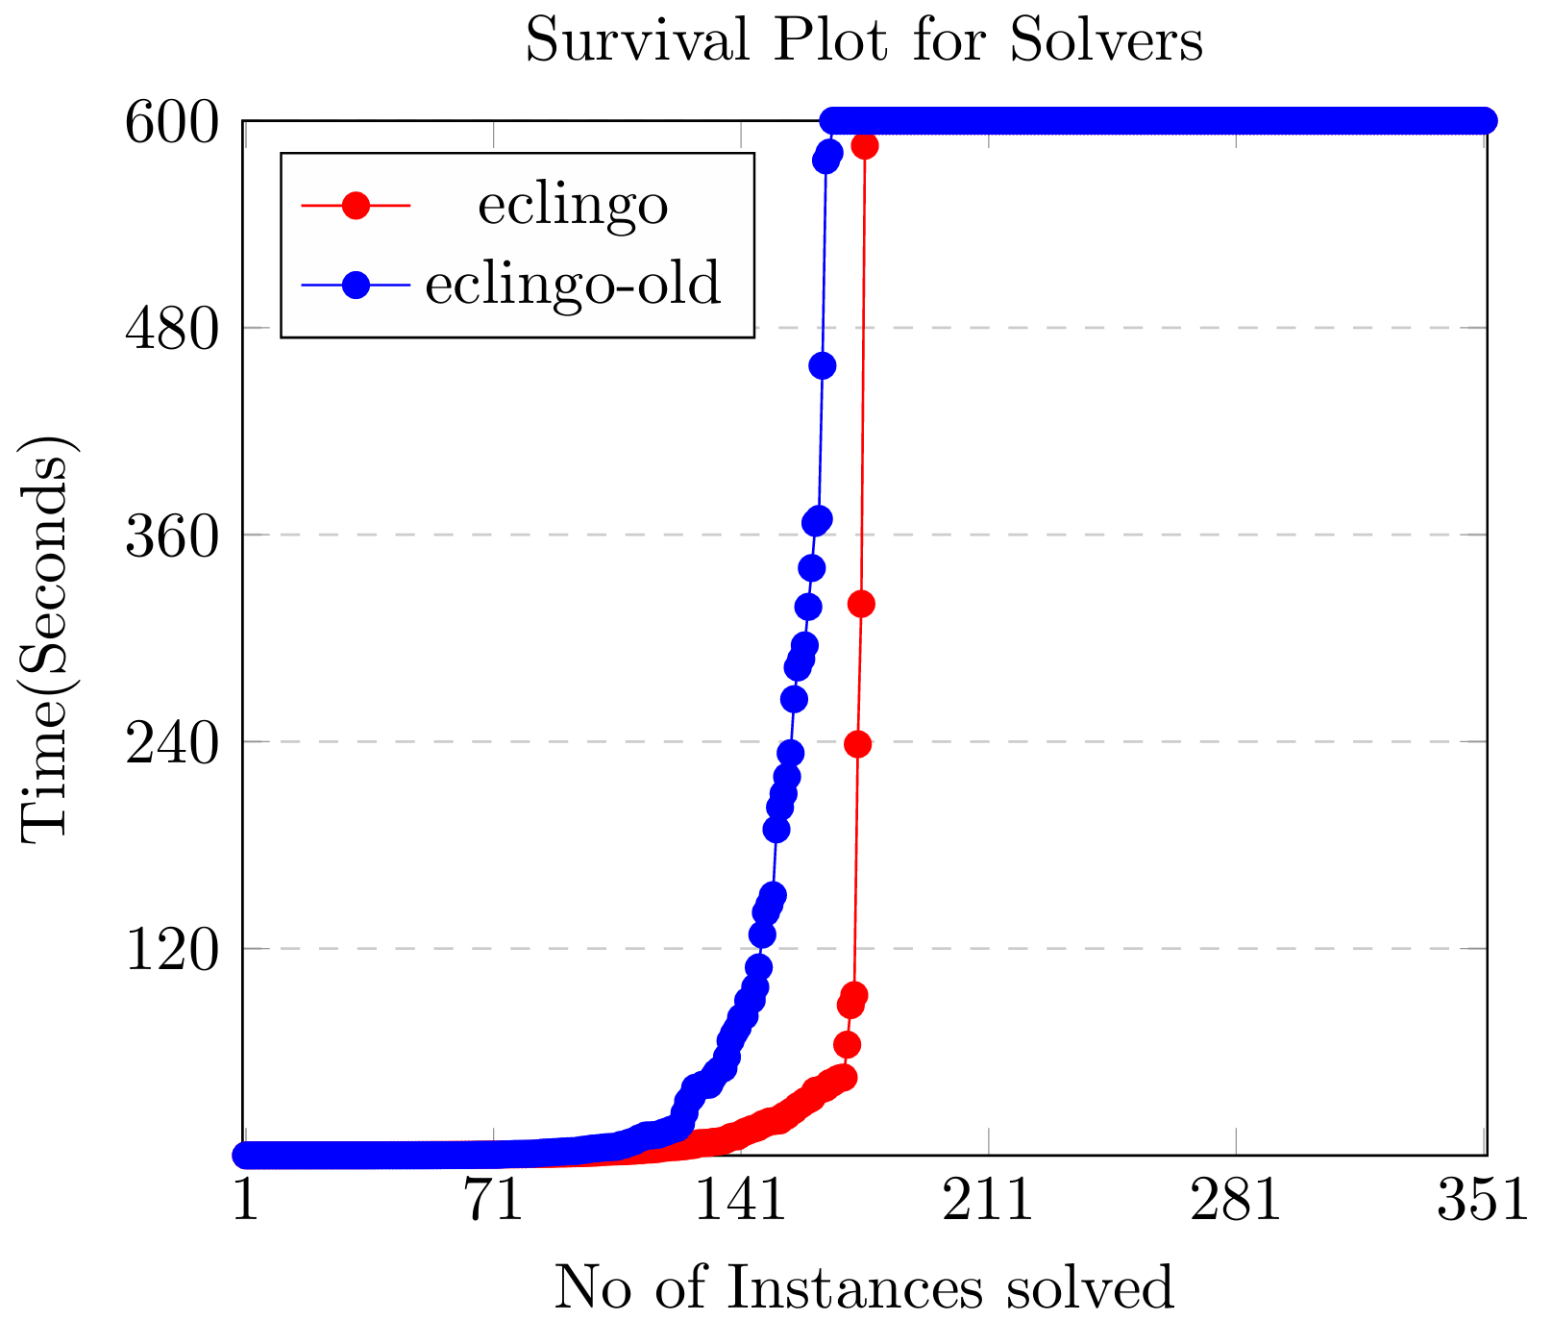
Benchmark Output:
Eclingo Comparison
Docker
Department of Computer Science

Slide 42
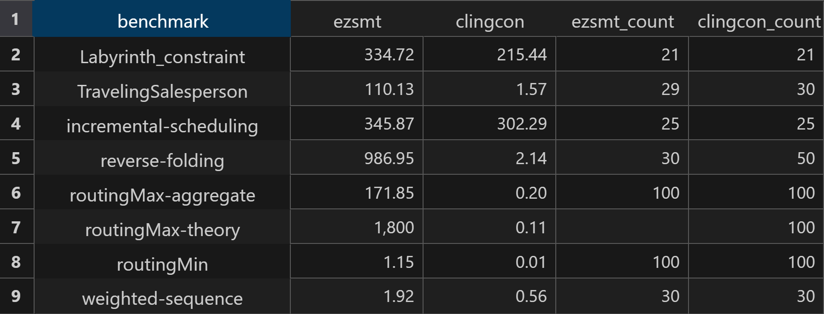
Benchmark Output:
EZSMT-cvc4/Clingcon Comparison
Docker
All Solvers Runtime Units: Seconds
Count: Number of instances solved
Department of Computer Science

Slide 43
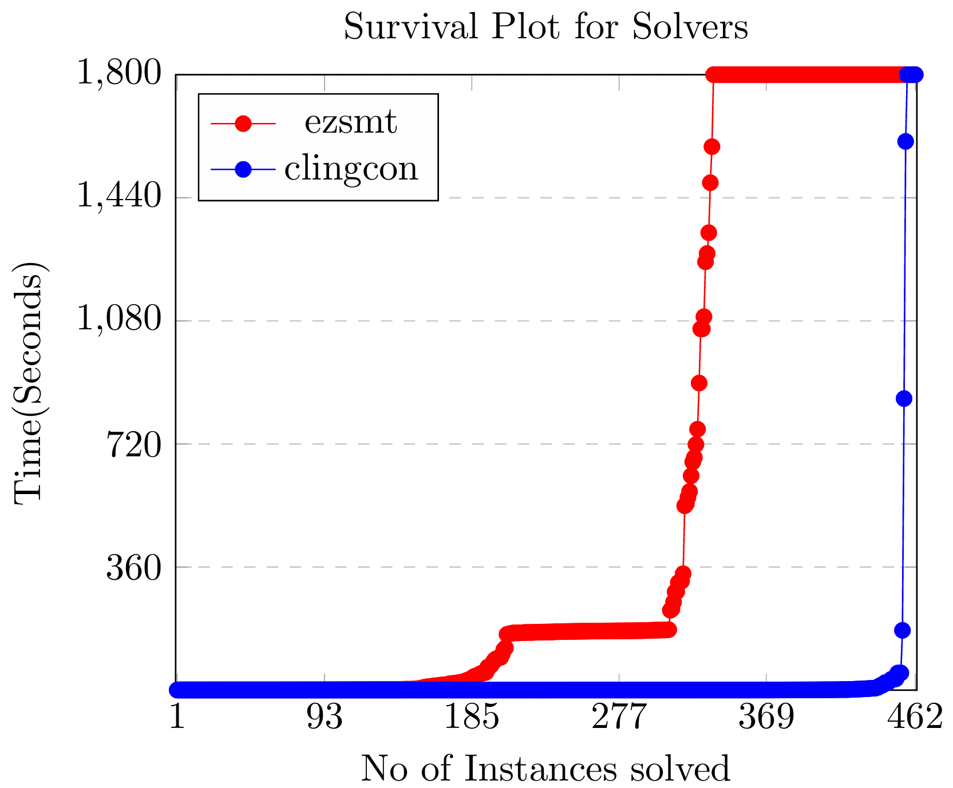
Benchmark Output:
EZSMT-cvc4/Clingcon
Comparison
Docker
Department of Computer Science

Slide 44


Docker/Host Comparison:
Eclingo-New
Average Runtime = $\frac{Sum of runtimes of all intances}{Number of instances}$
Relative Difference = $\frac{\left| docker −host\right|}{(docker+host)/2}∗100$ %
Benchmark | Number of Instances | Average Docker Runtime (seconds) | Average Host Runtime (seconds) | Relative Difference
action-reversibility | 25 | 393.92 | 393.62 | 0.08 %
bomb_problems | 174 | 554.89 | 554.60 | 0.05 %
eligible | 145 | 7.35 | 7.15 | 2.76 %
yale_shooting | 8 | 0.21 | 0.20 | 3.25 %
 | Total: 352 | Average: 239.09 | Average: 238.89 | 0.08 %
Department of Computer Science

Slide 45
Docker/Host Comparison:
Eclingo-Old
Average Runtime = $\frac{Sum of runtimes of all intances}{Number of instances}$
Relative Difference = $\frac{\left| docker −host\right|}{(docker+host)/2}∗100$ %
Benchmark | Number of Instances | Average Docker Runtime (seconds) | Average Host Runtime (seconds) | Relative Difference
action-reversibility | 25 | 247.950 | 249.271 | 0.53 %
bomb_problems | 174 | 556.500 | 556.510 | 0.00 %
eligible | 145 | 105.700 | 103.091 | 2.50 %
yale_shooting | 8 | 0.060 | 0.055 | 8.68 %
 | Total: 352 | Average: 227.553 | Average: 227.232 | 0.14 %
Department of Computer Science

Slide 46


Average Runtime = $\frac{Sum of runtimes of all intances}{Number of instances}$
Docker/Host Comparison:
EZSMT-cvc4
Relative Difference = $\frac{\left| docker −host\right|}{(docker+host)/2}∗100 \%$
Benchmark | Number of Instances | Average Docker Runtime (seconds) | Average Host Runtime (seconds) | Relative Difference
Labyrinth_constraint | 22 | 334.72 | 336.25 | 0.46 %
TravelingSalesperson | 30 | 110.13 | 104.33 | 5.41 %
incremental-scheduling | 30 | 345.87 | 335.83 | 2.95 %
reverse-folding | 50 | 986.95 | 976.38 | 1.08 %
routingMax-aggregate | 100 | 171.85 | 167.54 | 2.54 %
routingMax-theory | 100 | 1,800 | 1,800.00 | 0.00 %
routingMin | 100 | 1.15 | 1.11 | 3.54 %
weighted-sequence | 30 | 1.92 | 1.91 | 0.52 %
 | Total: 462 | Average: 469.07 | Average: 465.42 | 0.78 %
Department of Computer Science

Slide 47
Average Runtime = $\frac{Sum of runtimes of all intances}{Number of instances}$
Docker/Host Comparison:
Clingcon
Relative Difference = $\frac{\left| docker −host\right|}{(docker+host)/2}∗100 \%$
Benchmark | Number of Instances | Average Docker Runtime (seconds) | Average Host Runtime (seconds) | Relative Difference
Labyrinth_constraint | 22 | 215.44 | 202.06 | 6.41 %
TravelingSalesperson | 30 | 1.57 | 1.52 | 3.24 %
incremental-scheduling | 30 | 302.29 | 302.02 | 0.09 %
reverse-folding | 50 | 2.14 | 2.11 | 1.41 %
routingMax-aggregate | 100 | 0.20 | 0.20 | 0.00 %
routingMax-theory | 100 | 0.11 | 0.11 | 0.00 %
routingMin | 100 | 0.01 | 0.01 | 0.00 %
weighted-sequence | 30 | 0.56 | 0.57 | 1.77 %
 | Total: 462 | Average: 65.29 | Average: 63.58 | 2.66 %
Department of Computer Science

Slide 48


Speed-up Comparison:
Eclingo (New against Old)
Speed-up = $\frac{Average eclingo old runtime }{Average eclingo new runtime}$
Relative Difference = $\frac{\left| docker −host\right|}{(docker+host)/2}∗100 \%$
Benchmark | Number of Instances | Speed-up in Docker | Speed-up in Host | Relative Difference
action-reversibility | 25 | 0.63 | 0.63 | 0.61 %
bomb_problems | 174 | 1.00 | 1.00 | 0.05 %
eligible | 145 | 14.38 | 14.42 | 0.25 %
yale_shooting | 8 | 0.30 | 0.27 | 11.37 %
 | Total: 352 | Total: 16.32 | Total: 16.33 | 0.05 %
Department of Computer Science

Slide 49


Speed-up = $\frac{Average clingcon runtime }{Average ezsmt runtime}$
Speed-up Comparison:
EZSMT-cvc4 against Clingcon
Relative Difference = $\frac{\left| docker −host\right|}{(docker+host)/2}∗100 \%$
Benchmark | Number of Instances | Speed-up in Docker | Speed-up in Host | Relative Difference
Labyrinth_constraint | 22 | 0.644 | 0.601 | 6.86 %
TravelingSalesperson | 30 | 0.014 | 0.015 | 1.39 %
incremental-scheduling | 30 | 0.874 | 0.899 | 2.85 %
reverse-folding | 50 | 0.002 | 0.002 | 0.00 %
routingMax-aggregate | 100 | 0.001 | 0.001 | 8.70 %
routingMax-theory | 100 | 0.000 | 0.000 | 0.00 %
routingMin | 100 | 0.012 | 0.011 | 14.85 %
weighted-sequence | 30 | 0.290 | 0.301 | 3.73 %
 | Total: 462 | Total: 1.837 | Total: 1.829 | 0.43 %
Department of Computer Science

Slide 50
Conclusion

Slide 51
Conclusion
Benchmarking platform addresses two issues:
Manual Comparison and Analysis
Reproducibility
Very small performance difference between Docker Container and Host Machine.
Department of Computer Science

Slide 52
Thank You
Questions?
NLPKR

