Slide 1
EE 445L – Embedded System Design Lab
Brushed DC Motors
(not covered AC motors: induction, synchronous)
For more information read Section 6.5 in the book
http://www.teslamotors.com/blog/induction-versus-dc-brushless-motors

Slide 2
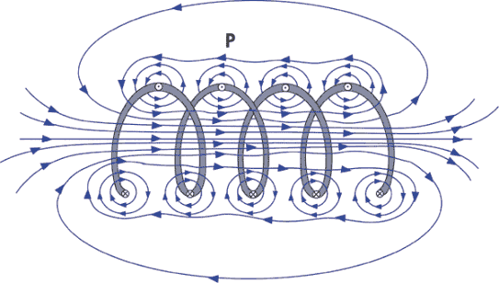
Motor EM
2

Slide 3
DC Motor Physics
Force = Current*Length*Magnetic Field
http://www.electricaleasy.com/2014/01/basic-working-of-dc-motor.html
3

Slide 4
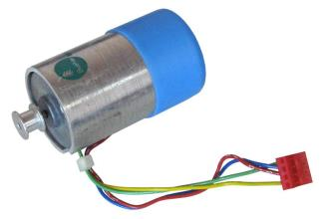
PWM DC Motor Interface
For more information read Section 6.5.4 in the book
R=30Ω
Why is I > (V-V_{CE})/30Ω?
IRLD024

Slide 5
Darlington Transistor
TIP120 (NPN)
h_{fe} = 1000
I_{ce} = 3A
+5V
I_{b} = I_{coil} /h_{fe} = 1A/1000 = 1mA
R_{b} ≤ (V_{OH}-V_{be})/I_{b} = (3-2.5)/1mA = 0.5 kΩ
R_{b} = 100 Ω
V_{CE} depends on current
TM4C123 not LM4F120

Slide 6
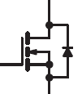
Power MOSFET (IRLD024 or IRLD120 )
V_{GS} = 3.3V turns it on
I_{DS} = 2.5A max, need 0.1A
+5V
R_{b} = 10kΩ (just to limit transients)
V_{DS} depends on current
Current depends on V_{DS}
M2
IRLD024
M1
D
G
S

Slide 7
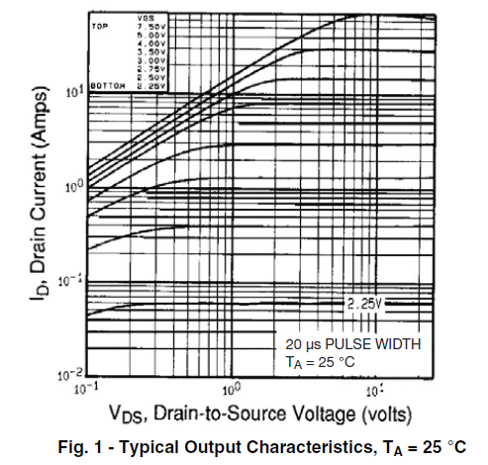
IRLD024 or IRLD120
Got V_{GS} = 3.3V
Need I_{DS} = 0.1A

Slide 8
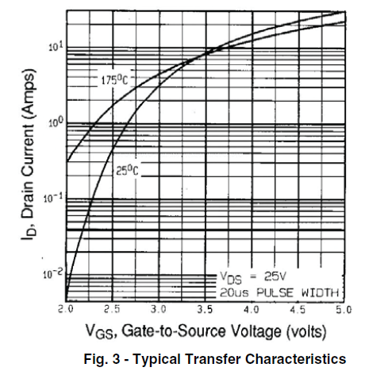
IRLD024 or IRLD120
Got V_{GS} = 3.3V
Need I_{DS} = 0.1A

Slide 9
DC Motor PWM Software
Program 6.8 in the book
void PWM0A_Init(uint16_t period,
uint16_t duty){
SYSCTL_RCGCPWM_R |= 0x01; // 1) activate PWM0
SYSCTL_RCGCGPIO_R |= 0x02; // 2) activate port B
while((SYSCTL_PRGPIO_R&0x02) == 0){};
GPIO_PORTB_AFSEL_R |= 0x40; // alt funct on PB6
GPIO_PORTB_PCTL_R =
(GPIO_PORTB_PCTL_R&0xF0FFFFFF)+0x04000000; // PWM0
GPIO_PORTB_AMSEL_R &= ~0x40; // disable analog on PB6
GPIO_PORTB_DEN_R |= 0x40; // enable digital I/O on PB6
SYSCTL_RCC_R = 0x00100000 | // 3) use PWM divider
(SYSCTL_RCC_R & (~0x000E0000)); // 1/2 divider
PWM0_0_CTL_R = 0; // 4) re-loading down-counting mode
PWM0_0_GENA_R = 0xC8; // low on LOAD, high on CMPA down
PWM0_0_LOAD_R = period - 1; // 5) cycles count down to 0
PWM0_0_CMPA_R = duty - 1; // 6) count value output rises
PWM0_0_CTL_R |= 0x00000001; // 7) start PWM0
PWM0_ENABLE_R |= 0x00000001; // enable PB6/M0PWM0
}
TM4C123 not LM4F120

Slide 10
DC Motor PWM
void PWM0A_Duty(uint16_t duty){
PWM_0_CMPA_R = duty - 1; // 6) count value output rises
}
Program 6.8 in the book
PWM0A_Init(40000, 30000);
// 1000 Hz, 75% duty
H
i
g
h
P
e
r
i
o
d
TM4C123
L
o
w
D
r
i
v
e
r
M
o
t
o
r
P
B
6
Period(1ms) = 40000
High is 300 to 39900
Power = Voltage*Current*DutyCycle

Slide 11
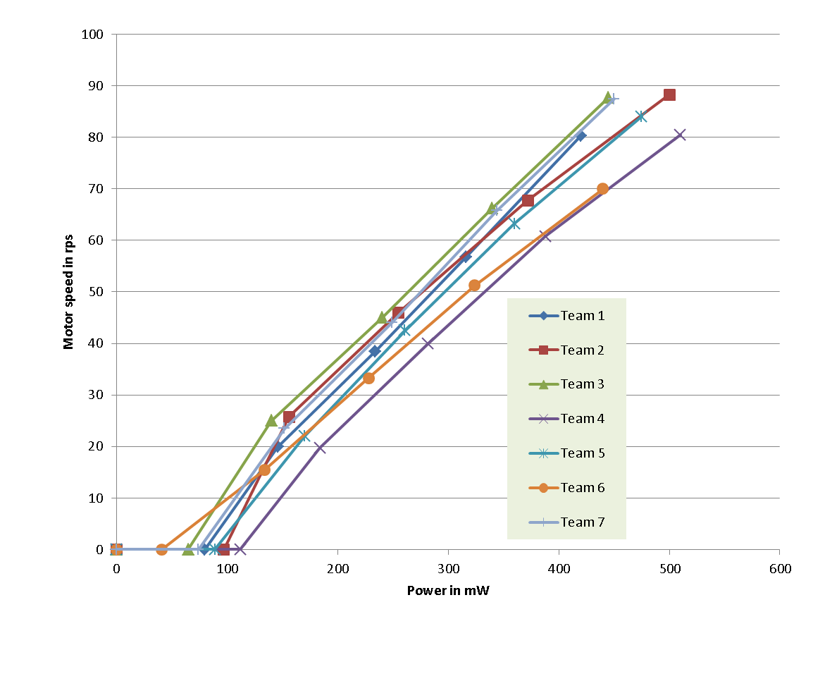
Lab 10 Motor Characterization*
Power = Voltage * Current
LAB
BENCH
SUPPLY
(VARIABLE)
BLUE WIRE
+5V (max)
METER
+
motor
TACH_OUT
TO SCOPE
GREEN WIRE
-
1N914
RED WIRE
YELLOW WIRE
1) Measure Power using Lab Bench supply and AMP Meter.
2) Use Scope to measure TACH_OUT Frequency Speed (RPS) = Frequency/4
3) Plot Speed vs. Power (mw)

Slide 12
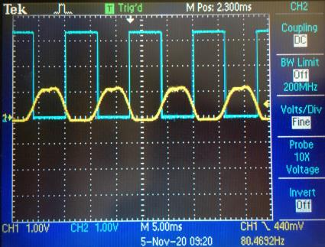
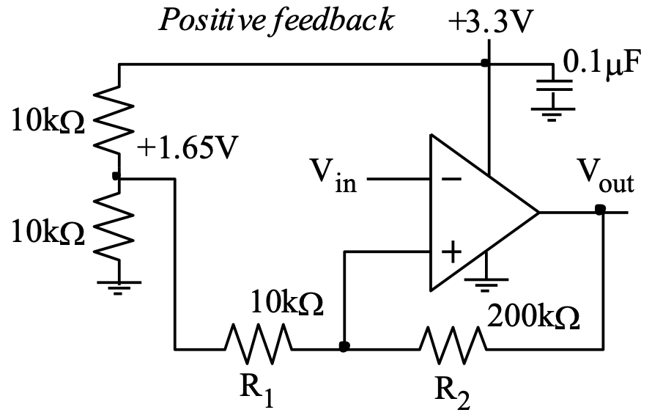
Lab 10 Motor Characterization
LAB
BENCH
SUPPLY
(VARIABLE)
3.3V
BLUE WIRE
Tach
I/F
Circuit
+5V (max)
+
TACH_OUT
TO SCOPE
motor
GREEN WIRE
-
1N914
RED WIRE
YELLOW WIRE
1) Build TACH interface circuit (Lect. 35)
2) Use Scope to confirm hysteresis calculations and correct circuit operation from 80Hz to 200Hz

Slide 13
Lab 10 Motor Characterization
TO SCOPE
3.3V
LAB
BENCH
SUPPLY
(VARIABLE)
3.3V
BLUE WIRE
Tach
I/F
Circuit
TM4C
ST7735
+5V (max)
+
TACH_OUT
motor
GREEN WIRE
PB4
-
1N914
RED WIRE
YELLOW WIRE
1) Setup period measure SW
2) Confirm RPS using scope and values outputted to LCD
3) Confirm Period calculation
uint32_t Period; // 24-bit, 12.5 ns units
uint32_t static First; // Timer0A first edge, 12.5 ns
int32_t Done; // mailbox status set each rising edge
void Timer0A_Handler(void){
TIMER0_ICR_R = 0x00000004; // acknowledge timer0A
Period = (First - TIMER0_TAR_R) // NOTE: underflow tolerant calculation
& 0x00FFFFFF;
First = TIMER0_TAR_R; // setup for next measurement
Done = 1; // set semaphore
}

Slide 14
Summary
Brushed DC motor
Simple,
Use transistor and PWM
Requires feedback

