Slide 1
Unit 2 Financial Statements I
Balance Sheet
Income Statement

Slide 2
Financial Statements
Elaborated every 12 months (in €), completed within 3 months after closure and signed.
Balance sheet
Income Statement (P&L)
Statement of changes in equity
Cash Flow Statement
Notes
Show 2 consecutive years; items can be grouped or subdivided; references to the notes

Slide 3
Abbreviated annual accounts
Balance sheet and notes if 2 circumstances occur in 2 years:
Total assets ≤ 4.000.000 €.
Sales ≤ 8.000.000 €.
Average number of employees ≤ 50
It implies that SCE and CFS are not mandatory.
Only abbreviated P&L if 2 circumstances occur in 2 years:
Total assets ≤ 11.400.000 €.
Sales ≤ 22.800.000 €.
Average number of employees ≤ 250

Slide 4
Abbreviated annual accounts
 | BS and notes abbreviated | Only P&L abbreviated | Listed
Balance | Abbreviated | Normal | Normal
P&L | Abbreviated | Abbreviated | Normal
Notes | Abbreviated | Normal | Normal
SCE | No | Yes | Yes
CFS | No | Yes | Yes
Management report | No | Yes | Yes
Audit report* | Yes | Yes | Yes
*The obligation to audit has its own thresholds, which are lower.

Slide 5
Balance sheet
It represents all resources, rights and obligations that, under the ownership of a natural or legal person, are assigned to a specific purpose and are susceptible to economic valuation.
Equity: the residual part of the assets of the entity after all liabilities have been deducted; it belongs to the owners.
Equity = resources + rights - obligations
Assets = Equity + Liabilities

Slide 6
Balance sheet
Snapshot of a company’s situation
ASSETS | EQUITY
 | LIABILITIES
Use of resources and source of resources
Economic structure and Financial structure
Notes:
Does it matter? Yes! Ferrari (mine or bank) Which is better, E or L? There is no one-fits-all- solution for a company; depends on needs, goals
A boat can be moved by the wind (sails) or by an engine.

Slide 7
Financial components
from least to most liquid | from least to most enforceable
non-current assets (LT) Intangible PPE LT Financial assets current assets (ST) Inventories Receivables Cash | equity Capital Reserves Profit
 | non-current liabilities LT Loans current liabilities ST Loans
Notes:
>12 months
Debtors Clients – Creditors Suppliers
The E also includes other funds that do not have to be returned, such as grants.
Liquidity: ability to convert assets into cash
Solvency: ability to meet debts

Slide 8
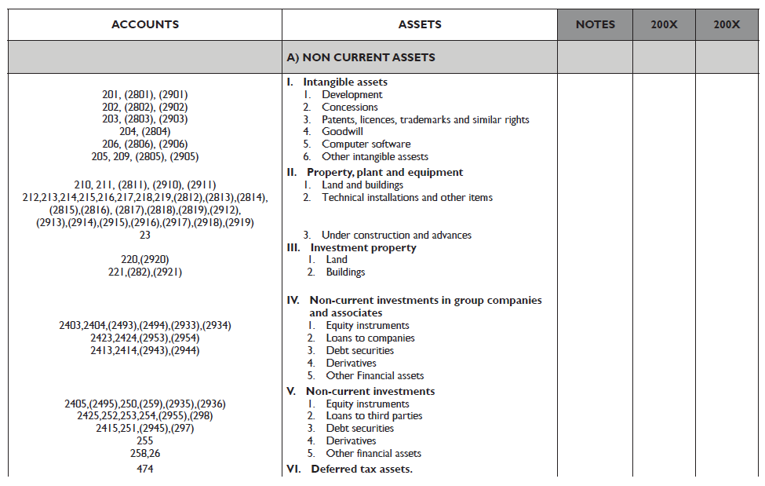

Slide 9
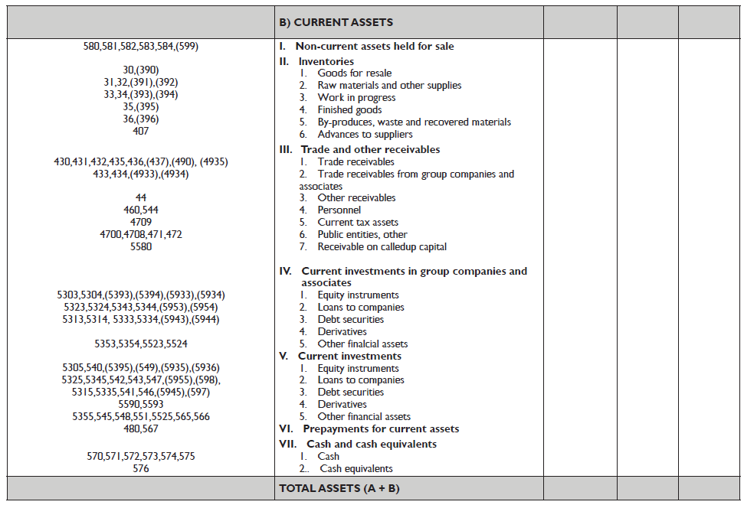

Slide 10
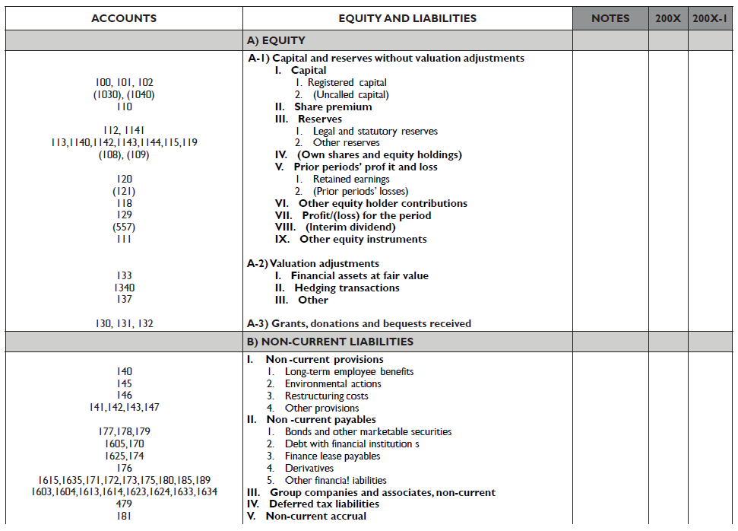

Slide 11
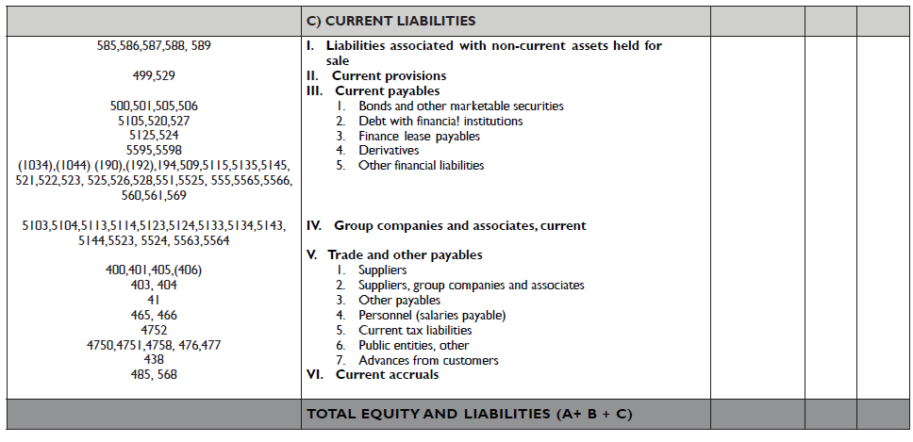

Slide 12
Income Statement
ASSETS | EQUITY
 | LIABILITIES
REVENUES
EXPENDITURES
NET PROFIT OR LOSS
Expense: a decrease in equity (value) that is not due to distributions to owners

Slide 13
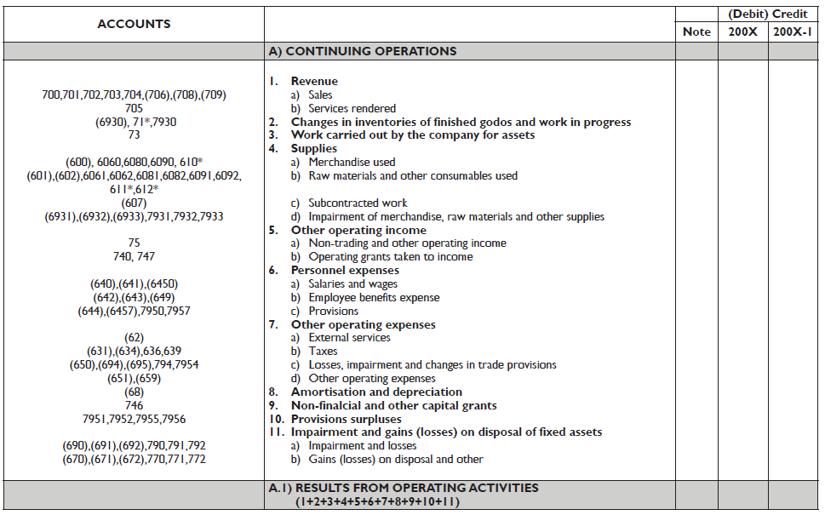

Slide 14
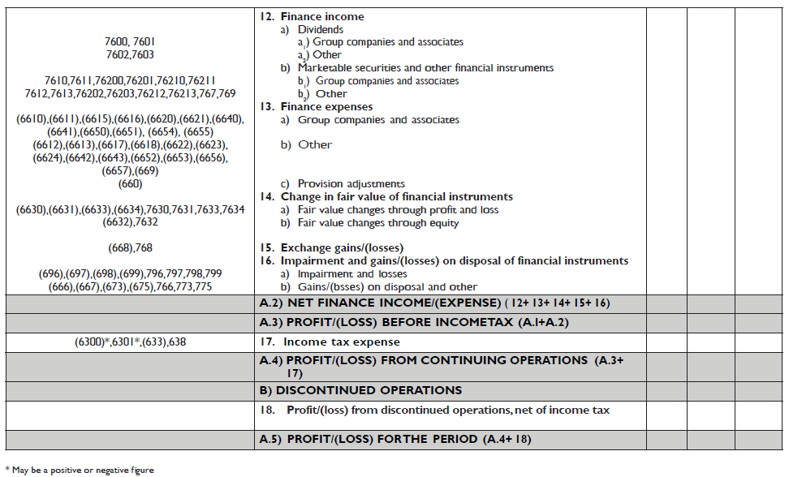

Slide 15
Corporate income tax
Law 27/2014 of 27 December 2014 on corporate taxation
It taxes corporate income directly and personally.
Taxable base: earnings
Adjustment of differences between accounting and taxation
Permanent: no impact on future tax burden.
Temporary: with an impact on the future tax burden.
Deduction for losses from previous years.
Deductions and credits (4742).
Withholdings and payments on account (473).
Deferred tax results in the recognition of deferred tax assets or liabilities.
Notes:
Micro enterprises do not record deferred tax A/L (Assets≤ 1.000.000 €; Revenue≤ 2.000.000 €: Employees ≤ 10)

Slide 16
Withholdings and payments on account (473)
Prepayments made during the year to the tax authorities.
These payments are recognised as an asset for the company, because they reduce the amount owed.
At the end of the year, these amounts can be adjusted against the final tax liability.
Withholdings and payments on account (473): €5,000
Taxable base: €25,000
Taxable base: €6,000

Slide 17
Rights to tax deductions and credits pending application (4742)
This amount is subtracted from the gross tax to determine net tax.
Companies may have rights to tax deductions and credits pending application:
International double taxation: when taxable income includes dividends or shares in the profits of foreign companies.
General tax incentives: local public services, domiciliation of companies (Ceuta and Melilla), etc.
To encourage activities: R&D&I, film production, job creation, etc.
In 2020, payments on account (473): €4,000; Taxable base: €32,000; Deduction (R&D&I): €3,000 limited to 25% of gross tax.
In 2021, payments on account (473): €12,000; Taxable base: €32,000; Deduction (R&D&I): €500

Slide 18
Tax loss carryforwards (4745)
The right to consider losses from previous years.
Apply rate for calculating deferred tax.
In 2023, Withholdings and payments on account (473): €2,000; Taxable base: €-6,000
In 2024, Earnings before taxes:
a) €20,000
b) €5,000
c) €-5,000

Slide 19
Permanent differences
Items recognised in accounting that are not taxable/deductible and will not reverse in future periods.
LIS art. 15:
Payments from equity (i.e. dividends).
Fines and penalties.
Game losses.
Donations and gifts (deductible up to 1% of revenue).
Expenditure on actions contrary to the legal order.
LIS art. 21: Profit shares in entities with a shareholding > 5% and held for more than one year.
Environmental fine 500€; EBT 20,000€; Payments on account 2,000€
Notes:
If we had account for these expenses, we have to add them to obtain the taxable base as they are non-deductible expenses.

Slide 20
Permanent differences
A company owns 100% of the shares of a French subsidiary. During fiscal year 2024, it received dividends from that subsidiary amounting to €5,000.
In addition, the company paid a traffic fine to the city council of €100.
It also has losses from previous years amounting to €1,000.
Earnings before tax are €29,900.
The company is entitled to a tax credit for job creation of €500 and has made tax prepayments of €3,000.

Slide 21
Temporary differences
Refer to items recognised in accounting that are not taxable / deductible and will reverse in future periods.
A/L arising from deductible/taxable temporary differences (4740)/(479)
LIS art. 13: Impairment losses on receivables. When:
6 months have passed since the payment was due.
The debtor has been declared bankrupt.
The debtor is being prosecuted for misappropriation.
The receivable has been claimed in court or is subject to judicial proceedings affecting its collection.
Cannot be deducted when related to public entities (unless under judicial proceedings), related parties (unless liquidation phase), or general provisions for customer insolvency risk.

Slide 22
Temporary differences
LIS art. 106: Financial leasing contracts
Applies where the lessor is a credit or financial institution.
Minimum contract duration of 2 years for movable tangible goods and 10 for real estate.
Leasing contracts must separate asset cost recovery (deductible), purchase option (excluded), and financial interests (deductible). Annual cost recovery stays constant or increases.
Only depreciable portions of assets are deductible, with limits of 2× straight-line depreciation (special taxpayers: ×1.5). Deduction applies even if not in P&L.

Slide 23
Temporary differences
A company applies the individualized method for customer insolvencies. During fiscal year 2024:
Customer 1 owed €2,000 and became insolvent on April 29, 2024, but the company has not yet initiated legal proceedings to collect the debt.
Customer 2 owed €5,000 and was declared bankrupt in October, although the bankruptcy proceedings have not yet been resolved.
Customer 3 owed €1,000 and did not pay by November 1, 2024, and no legal action has been taken to collect the debt.
The accounting profit before tax is €15,000, and tax prepayments amount to €1,000.

Slide 24
Temporary differences
A company acquired a machine at the beginning of year 2023 for €30,000.The machine has an estimated useful life of 3 years, no residual value, and is depreciated on a straight-line basis over that period.
The company benefits from a tax incentive, allowing it to fully deduct the acquisition cost in the year of purchase.
During fiscal year 2023:
Accounting profit before tax: €100,000
Losses from previous years: €10,000
Withholding and prepayments: €12,000
During fiscal year 2024:
Accounting profit before tax: €150,000
Prepayments: €18,000

Slide 25
Grants, donations and bequest received (RMS 18th)
They may represent income in the same period as the related expense or financing for asset acquisition or debt cancellation.
Refundable grants are recognised as liabilities until they become non-refundable.
Non-refundable grants are first recorded as equity and later recognised in profit or loss in line with related expenses. When:
It has been formally granted to the company.
All conditions for receipt have been met.
There are no reasonable doubts about collection.
All grants are measured at the fair value.

Slide 26
Grants, donations and bequest
In 2023, a company was granted a subsidy of €1,000 to cover personnel expenses incurred during the year, for hiring employees under 25 years old. The grant has not yet been collected.
On 31 December 2023, the company also received a grant of €3,000 in cash to partially cover, in equal parts, the employer’s social security contributions for the next two years (2024 and 2025).
The accounting earnings before taxes are €20,000 in 2023 and €22,000 in 2024.
Tax prepayments amount to €6,000 in 2023 and €2,000 in 2024.

Slide 27
Grants, donations and bequest
On 31/12/2020 a company bought a machine for €19,000 and paid €1,000 transport costs, all paid in cash. The machine’s useful life is 5 years and amortisation is straight-line.
The company applied for and was granted a capital grant equal to 40% of the investment. The grantor pays half immediately and commits to pay the remaining within 6 months.

