Slide 1
Unit 4 Profitability Analysis
Profitability analysis
Growth analysis

Slide 2
Example 1
 | T | T-1
Non-current assets | 124.000 | 130.000
Current assets | 76.000 | 80.000
∟ Inventories | 20.000 | 40.000
∟ Trade Receivables | 15.000 | 17.000
∟ Cash | 41.000 | 23.000
Total Assets | 200.000 | 210.000
Equity | 16.200 | 12.000
Non-current liabilities | 143.000 | 150.000
Current liabilities | 40.800 | 48.000
∟ Suppliers | 30.000 | 28.000
∟ Other current liabilities | 10.800 | 20.000
Total E+Liabilities | 200.000 | 210.000
Notes:
.

Slide 3
Example 1
 | T | T-1 | Origin | Use
Non-current assets | 124.000 | 130.000 | 6.000
Current assets | 76.000 | 80.000 | 4.000
∟ Inventories | 20.000 | 40.000 | 20.000
∟ Trade Receivables | 15.000 | 17.000 | 2.000
∟ Cash | 41.000 | 23.000 |  | 18.000
Total Assets | 200.000 | 210.000
Equity | 16.200 | 12.000 | 4.200
Non-current liabilities | 143.000 | 150.000 |  | 7.000
Current liabilities | 40.800 | 48.000 |  | 7.200
∟ Suppliers | 30.000 | 28.000 | 2.000
∟ Other current liabilities | 10.800 | 20.000 |  | 9.200
Total E+Liabilities | 200.000 | 210.000
Notes:
H. More liquid assets and les liabilities
V. Non-current A>current, also in L; stable situation. Current A > L (WC>0)

Slide 4
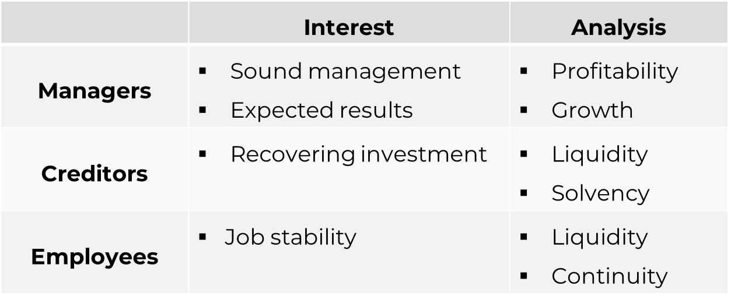
Introduction
Profitability and risk
Financial analysis
Environment, sector, strategy
Percentage analysis:
Vertical (static): relative weight of asset items. Structural variations are observed over time.
Horizontal (dynamic): comparison of the items’ growth. Over a base year (previous or specific) Contrast in growth rates.
Notes:
(a specific year or the previous one). Ex: Δsales similar to Δprovisioning.

Slide 5
Example 2
 | T | T-3
Non-current assets | 350 | 300
Current assets | 680 | 380
∟ Inventories | 420 | 220
∟ Trade Receivables | 210 | 120
∟ Cash | 50 | 40
Total Assets | 1.020 | 680
Equity | 354 | 155
Non-current liabilities | 90 | 120
Current liabilities | 573 | 380
∟ Suppliers | 223 | 80
∟ Other current liabilities | 350 | 300
Total E+Liabilities | 1.020 | 680
Notes:
.

Slide 6
Example 2
 | T | T-3 | Origin | Use
Non-current assets | 350 | 300 |  | 50
Current assets | 680 | 380 |  | 300
∟ Inventories | 420 | 220 |  | 200
∟ Trade Receivables | 210 | 120 |  | 90
∟ Cash | 50 | 40 |  | 10
Total Assets | 1.020 | 680
Equity | 354 | 155 | 199
Non-current liabilities | 90 | 120 |  | 30
Current liabilities | 573 | 380 | 193
∟ Suppliers | 223 | 80 | 143
∟ Other current liabilities | 350 | 300 | 50
Total E+Liabilities | 1.020 | 680
Notes:
.

Slide 7
TH
Income Statement | 2022 | 2021 | 2020
∟ Revenue | 1406.15 | 1063.69 | 95.74
∟ Costs of goods sold | 82.53 | 28.75 | n.a.
∟ Gross profit | 1323.62 | 1034.94 | 95.74
∟ Other operating expense (income) | 1243.85 | 943.39 | 208.24
∟ Operating profit (loss) [EBIT] | 79.77 | 91.55 | -112.50
∟ Financial profit (loss) | -0.14 | -0.85 | 0.00
∟ Financial revenue | 0.05 | n.a. | n.a.
∟ Financial expenses | 0.20 | 0.85 | n.a.
∟ Profit (loss) before tax [PBT] | 79.63 | 90.71 | -112.50
∟ Income tax expenses (benefit) | 22.10 | 23.00 | -28.13
∟ Profit (loss) for the period [Net income] | 57.53 | 67.71 | -84.38
Notes:
.

Slide 8
TH
Balance Sheet | 31/12/2022 | 31/12/2021 | 31/12/2020
Non-current assets | 409.71 | 358.70 | 241.12
Current assets | 415.74 | 339.05 | 169.70
∟ Debtors | 331.26 | 285.94 | 141.06
∟ Other current assets | 84.47 | 53.11 | 28.64
Shareholders funds | 43.81 | -13.72 | -81.43
∟ Capital | 3.00 | 3.00 | 3.00
∟ Other shareholders funds | 40.81 | -16.72 | -84.43
Non-current liabilities | 0.00 | 0.00 | 0.00
Current liabilities | 781.64 | 711.47 | 492.24
∟ Creditors | 0.00 | 0.00 | 316.82
∟ Other current liabilities | 781.64 | 711.47 | 175.42
Total assets | 825.445 | 697.75 | 410.813
Notes:
.

Slide 9


Ultimate Owner of this controlled subsidiary is
BvD ID: ESB88448998
Orbis ID: 460865380
Notes:
.

Slide 10
Profitability analysis
Economic analysis: results (PL) vs. investment (BS)
ROA = EBIT / A
Margin
Turnover
ROE = EBT / E
Economic effect
Financial effect: cost of debt * leverage
Notes:
It is not feasible to compare ratios between companies. The sector average is a good benchmark.
To test the effects on ROE, it must be fulfilled that BAII=BAI+Financial expenses (or work with the Financial Result).

Slide 11
Example 3
Balance SHEET | T | T-1
Non-current assets | 124.000 | 130.000
∟ Intangible fixed assets | 25.000 | 41.000
∟ Property, Plant and Equipment | 99.000 | 90.000
Current assets | 76.000 | 80.000
∟ Inventories | 20.000 | 40.000
∟ Trade Receivables | 15.000 | 17.000
∟ Cash and cash equivalents | 41.000 | 23.000
Equity | 16.200 | 12.000
∟ Reserves | 5.000 | 5.000
Non-current liabilities | 143.000 | 150.000
Current liabilities | 40.800 | 48.000
∟ Suppliers | 30.000 | 28.000
∟ Other current liabilities | 10.800 | 20.000
Total A = E+L | 200.000 | 210.000
Notes:
.

Slide 12
Example 3
Profit and loss account | T | T-1
∟ Revenue | 120.000 | 70.000
∟ Operating expenses | 40.000 | 35.000
∟ Gross profit | 80.000 | 35.000
∟ Other operating expenses (income) | 40.000 | 5.000
Operating result (EBIT) | 40.000 | 30.000
Financial result | (6.000) | (20.000)
∟ Financial income | 0 | 0
∟ Financial expenses | 6.000 | 20.000
Profit before tax (EBT) | 34.000 | 10.000
∟ Profit tax | 6.000 | 2.000
Profit for the year | 28.000 | 8.000
Market capitalisation | 280.000 | 240.000
No. of shares | 112.000 | 112.000
Closing price | 2,50 | 2,14
Notes:
.

Slide 13
Growth analysis
Horizontal percentages
How does the company grow?
Internally, for retained earnings.
Externally, through debt.
Does the company create value?
Market value vs. book value (MB).
Price vs. earnings (PER).

