Slide 1
Understanding Clouds from Satellite Images
Department of Computer Science
Illinois Institute of Technology
March 30, 2021
Jorge Gonzalez - A20474413
Luis Cavanillas - A20474430

Slide 2
Problem statement
Problem Statement
Build a deep learning to model to detect four types of shallow cloud formations in satellite images (Sugar, Flower, Fish and Gravel).
Motivation
Improve the physical understanding of cloud formations and help build better climate models.

Slide 3
Background materials
Main Source
Rasp, S., Schulz, H., Bony, S., &amp; Stevens, B. (2020). Combining crowdsourcing and deep learning to explore the mesoscale organization of shallow convection. Bulletin of the American Meteorological Society, 101(11). doi:10.1175/bams-d-19-0324.1
Two different approaches for cloud detection:
Object detection: draws bounding boxes around the cloud formations.
Semantic segmentation: classifies every pixel of the image, assigning them a category depending on the cloud formation.
The model used is a U-Net with a ResNet50 backbone.
Secondary source
Ronneberger, O., Fischer, P., &amp; Brox, T. (2015). U-Net: Convolutional networks for biomedical image segmentation. Lecture Notes in Computer Science, 234-241. doi:10.1007/978-3-319-24574-4_28
They design and describe a model network used for semantic segmentation: U-Net.

Slide 4
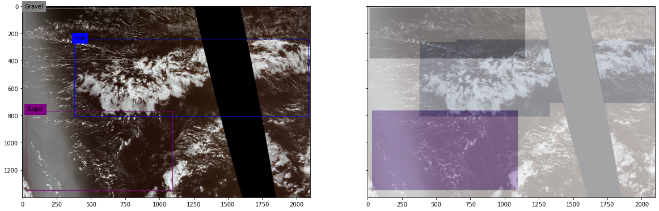
Proposed solution
Semantic segmentation:
It is a form of pixel-level prediction by clustering parts of an image together which belong to the same object class.
A mask is a representation of the target as an image where a specific class is present.
Initially a single mask overlaying all the clouds in an image was designed.

Slide 5
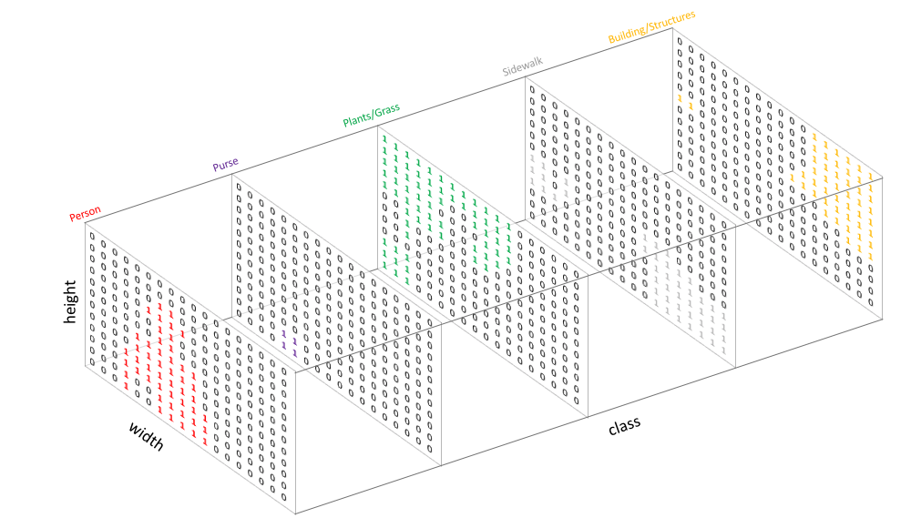
Proposed solution
Due to the poor initial results obtained:
Further research on segmentation models and the development of a mask with a depth of 4 channels, one for each type of cloud.
Therefore, a total of 4 masks are generated for each model.

Slide 6
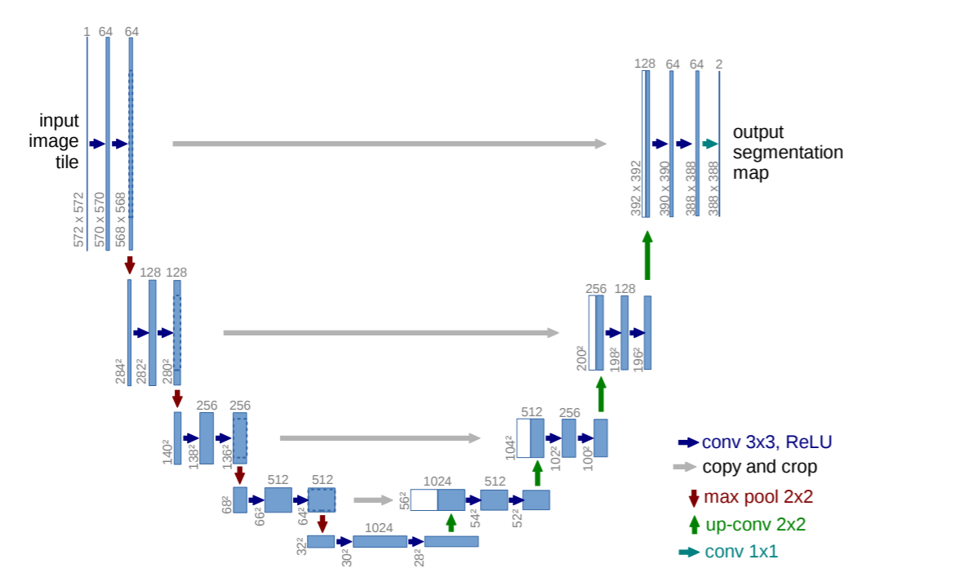
Proposed solution
Network proposed in the paper:
U-Net with a Resnet50 Backbone
We have built and trained the original U-Net from scratch.
We have trained and used the pretrained U-Net with the Resnet50 Backbone.
Multiple results have been obtained and compared.
downsampling
upsampling

Slide 7
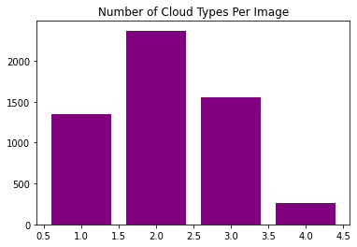
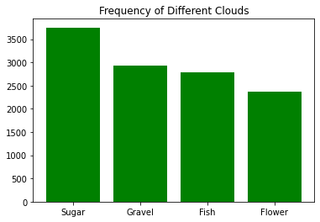
Implementation details
Initial analysis of the data

Slide 8
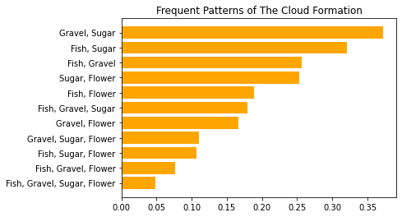
Implementation details
Initial analysis of the data

Slide 9
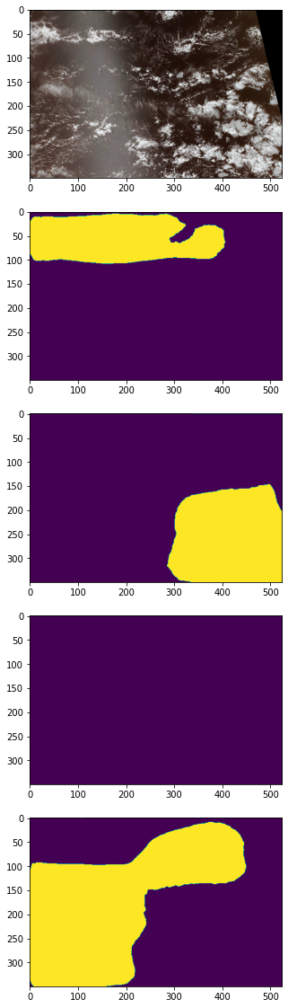
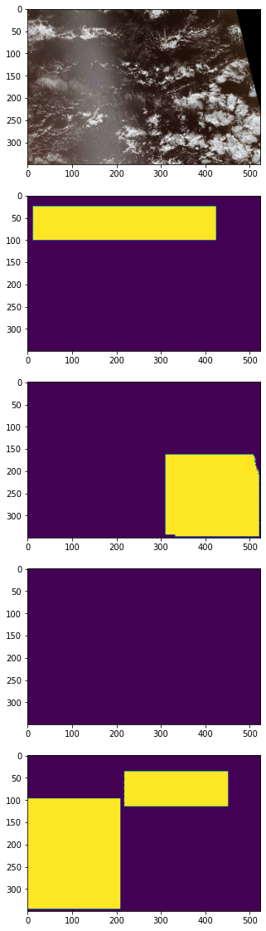
Implementation details
Pre-processing
Images (and masks) have been resized to 256 x 256 pixels.
Masks have been created for each image as a binary map:
1 : When the pixel contains the cloud formation
0 : When the pixel does not contain the cloud formation.
1
0

Slide 10
Implementation details
Pre-processing
Images (and masks) have been resized to 256 x 256 pixels.
Masks have been created for each image as a binary map:
1 : When the pixel contains the cloud formation
0 : When the pixel does not contain the cloud formation.
1
0

Slide 11

Implementation details
Image Generators and yield functions have been used.

Slide 12
Implementation details
Image Generators and yield functions have been used.
Results of hyper-parameter tuning:
Adam Optimizer
Output function: ‘Sigmoid’ (pixels normalized between 0 and 1)
Batch size: 16
Loss: binary cross entropy + dice loss (measure of overlap between images)
Epochs:
Our model: 100 epochs (very long training time)
Pretrained model: 20 epochs.

Slide 13
Implementation details
Number of filters
[64, 128, 256, 512]
Padding: same
Activation: ‘ReLu’
Network
Downsampling (x4)
Conv. (3x3)
Conv. (3x3)
Max. Pool (2x2)
Upsampling (x4)
Up. Samp. (2x2)
Conv. (2x2)
Conv. (3x3)
Conv. (3x3)

Slide 14
Results

Slide 15
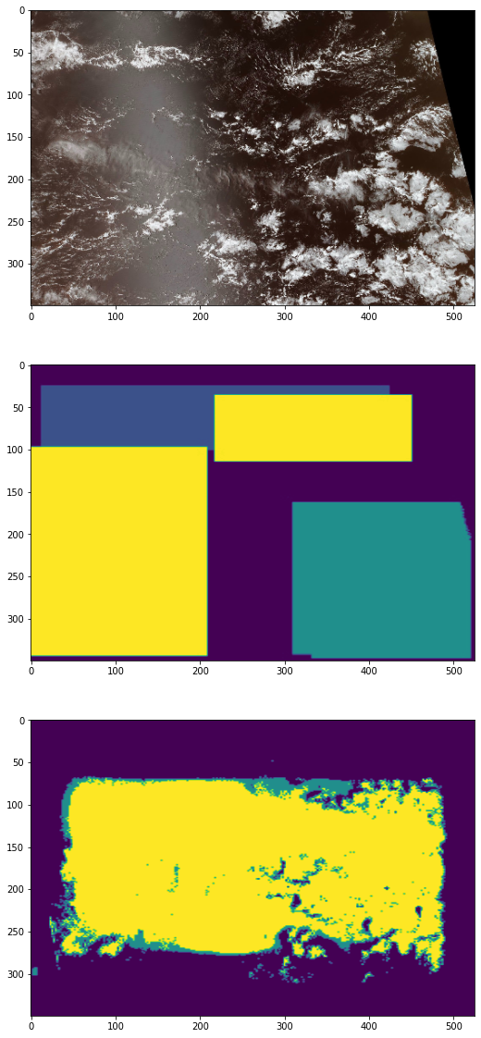
Model 1 Custom U-Net & 1 mask
Image

Slide 16
Model 1 Custom U-Net & 1 mask
Original mask
Sugar

Slide 17
Model 1 Custom U-Net & 1 mask
Original mask
Flower

Slide 18
Model 1 Custom U-Net & 1 mask
Original mask
Fish

Slide 19
Model 1 Custom U-Net & 1 mask
Prediction
Dice Loss
1.2450
??

Slide 20
Model 2 Custom U-Net & 4 masks
Image

Slide 21
Model 2 Custom U-Net & 4 masks
Image
Fish
Flower
Gravel
Sugar

Slide 22
Model 2 Custom U-Net & 4 masks
Original masks
Fish
Flower
Gravel
Sugar

Slide 23
Model 2 Custom U-Net & 4 masks
Original masks
Fish
Flower
Gravel
Sugar

Slide 24
Model 2 Custom U-Net & 4 masks
Original masks
Fish
Flower
Gravel
Sugar

Slide 25
Model 2 Custom U-Net & 4 masks
Original masks
Fish
Flower
Gravel
Sugar

Slide 26
Model 2 Custom U-Net & 4 masks
Original masks
Fish
Flower
Gravel
Sugar

Slide 27
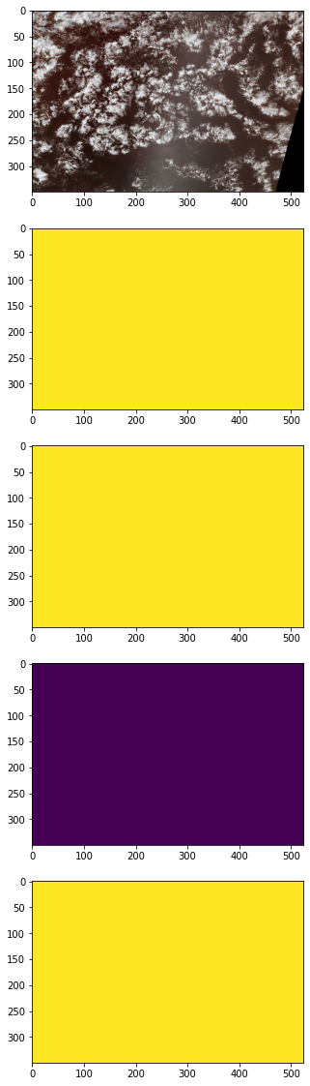
Model 2 Custom U-Net & 4 masks
Prediction
Dice Loss
1.2595
Fish
Flower
Gravel
Sugar

Slide 28
Model 2 Custom U-Net & 4 masks
Prediction
Dice Loss
1.2595
At least it predicts which clouds are present!
Fish
Flower
Gravel
Sugar

Slide 29
Model 3: Pre-Trained U-Net & 4 masks
Image

Slide 30
Model 3: Pre-Trained U-Net & 4 masks
Original masks
Fish
Flower
Gravel
Sugar

Slide 31
Model 3: Pre-Trained U-Net & 4 masks
Prediction
Dice Loss
0.2734
Before
1.2595
Fish
Flower
Gravel
Sugar

Slide 32
Conclusions
Understand the data before training (pre-processing)!
Use multiple image masks in semantic segmentation!
Use generators and yield functions to prevent RAM overflow!
Transfer learning is a great solution when limited resources are available.

Slide 33
Q & A
Thank you for your time !
Any questions?

