Slide 1
Accidents in spain 2013
Jorge Hidalgo Calderón

Slide 2
Objective:
In the link:
https://sedeapl.dgt.gob.es/WEB_IEST_CONSULTA/subcategoria.faces
I find official data about accidents in Spain during the year 2013. In this .ppt I use the online software BigMl to, via a clustering algorithm, find an answer to the following question:
¿How is the amount of vehicles involved related to the accident’s gravity?

Slide 3
¿How the amount of vehicles involved related to the accident’s gravity?
After some attempts, I apply a clustering k-means with a number of clusters k = 5, using the following variables:
TOT_MUERTOS, TOT_HERIDOS_GRAVES, TOT_HERIDOS_LEVES, TOT_VEHÍCULOS_IMPLICADOS (Deaths, Serious Injuries, Light Injuries, Amount of Vehicles Involved)

Slide 4
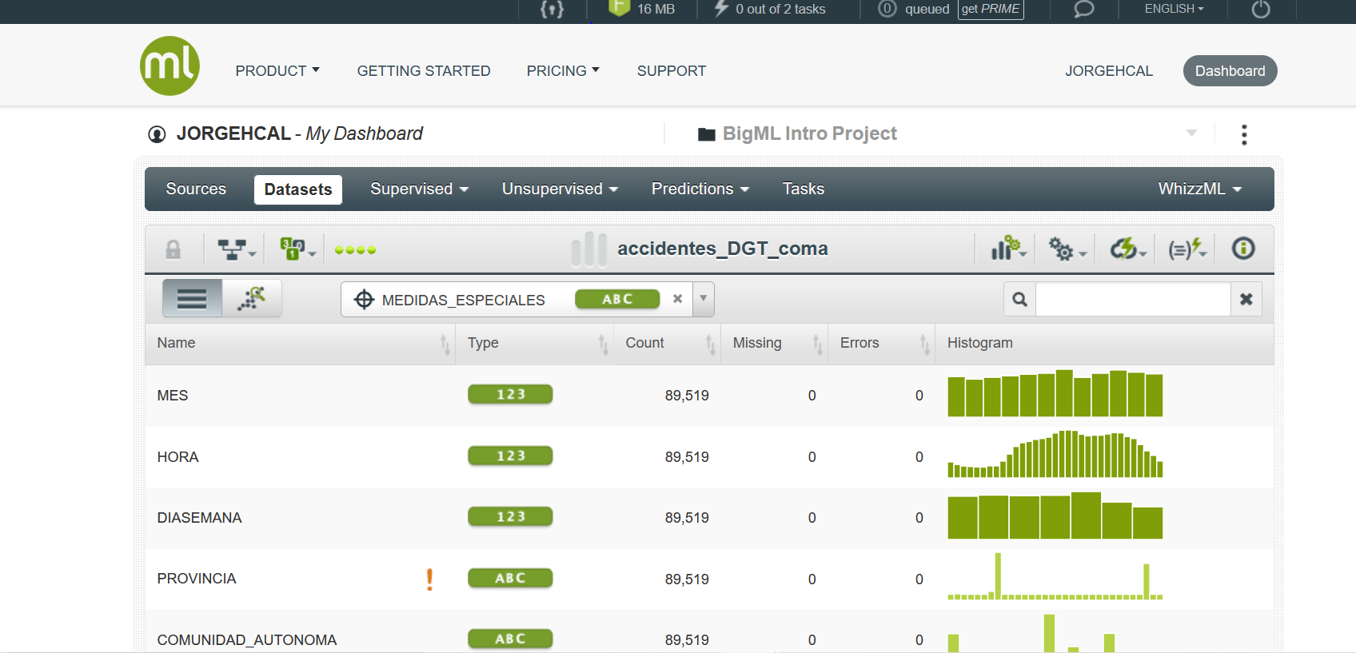
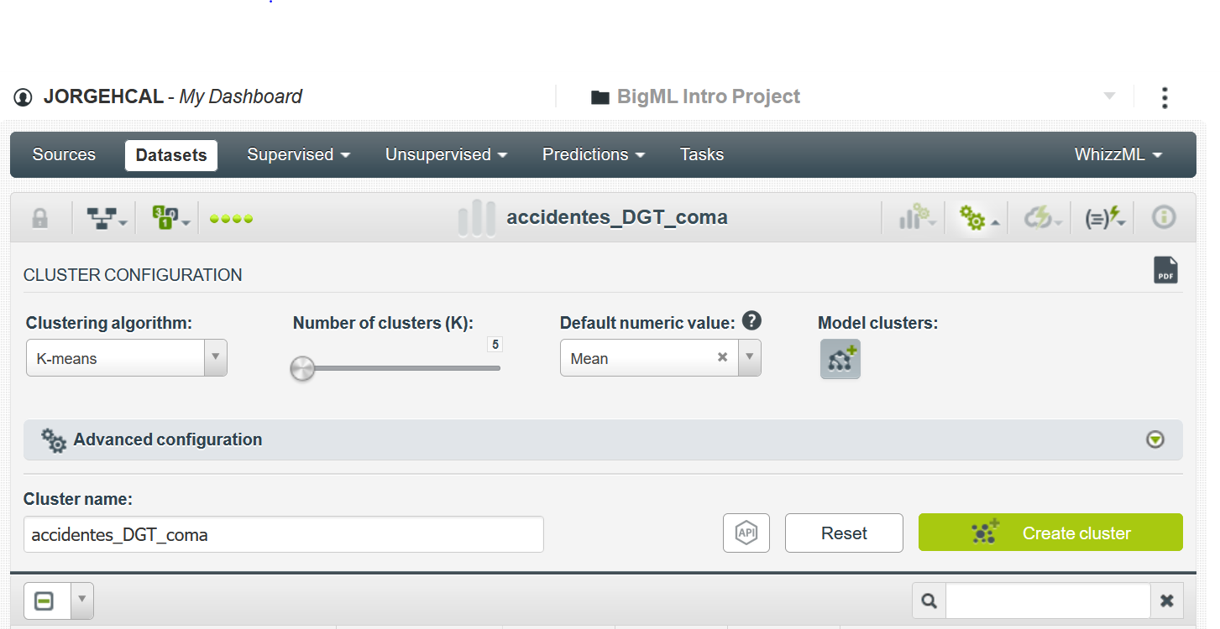
Two images, one of the dataset other of the configuration of the clustering:
The clustering use the K-means algorithm: this means that the algorithm computes distances among
data and create groups using an iterative process which has been proved to converge to a solution (a
stable collection of clusters).

Slide 5
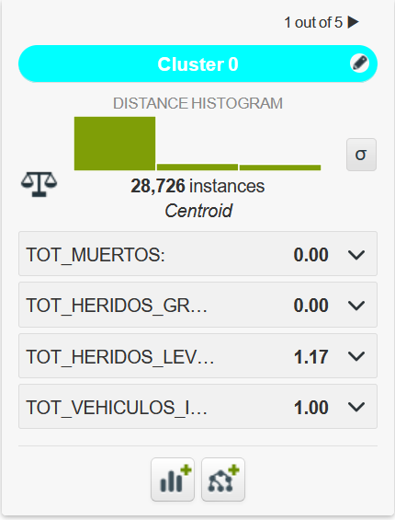
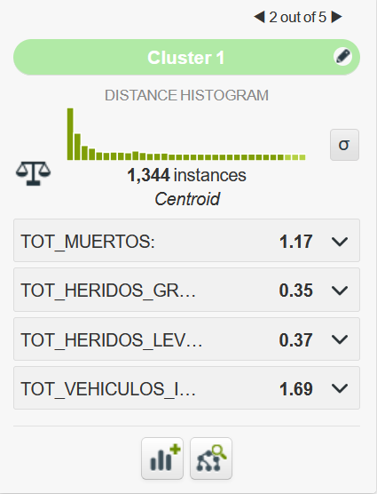
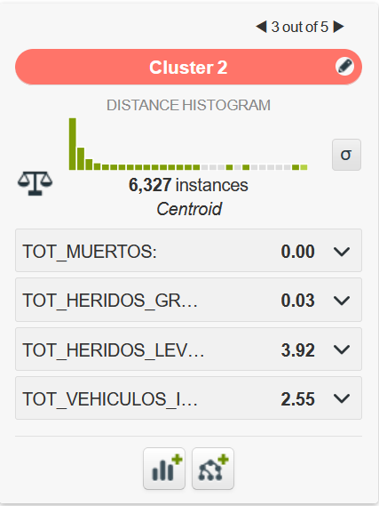
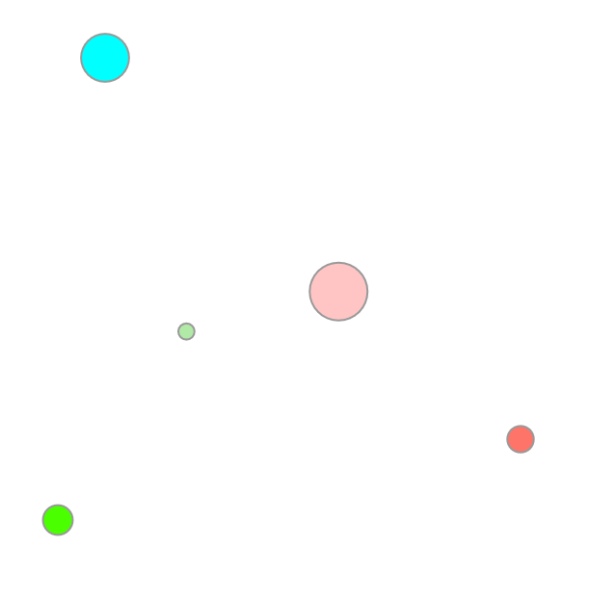
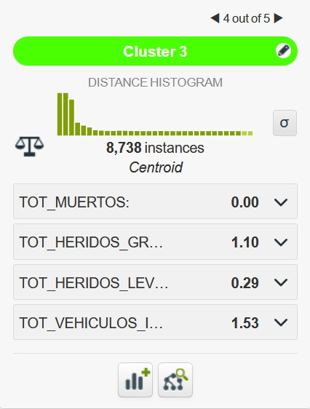
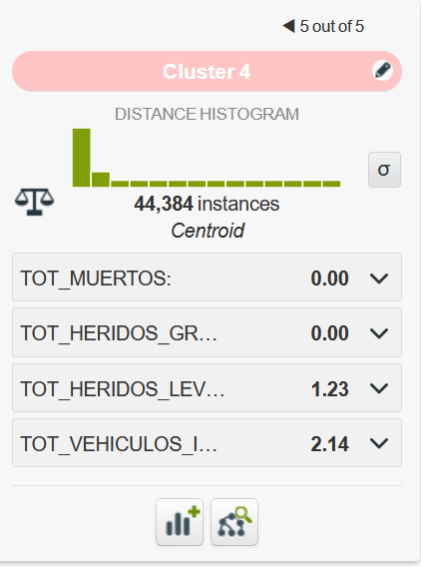
The result:
This clustering is a good one: the distance histograms
tend to accumulate data at the left, which mean that
the approximation are good enough

Slide 6
Conclussions from the clustering:
With only one vehicle (Cluster 0), there is only light damage, NOT deaths NOR serious damage. This Clustering is interesting since it is common to think that more vehicles imply more serious damage, and this seems to be false.
In the other clusters there is more than one vehicle implied in the accident. Note that in clusters where the vehicle amount increases, deaths and serious injuries dissappear, and light injuries increase.
The cluster which shows deaths also shows the others kind of injuries, and more than one vehicle involved.

