Slide 1
Where to build a GYM in Madrid, Spain?
Jorge Martínez de Hurtado Aricha

Slide 2
- Health benefits - Access to a vast variety of equipment - Socialize - Establish a healthy routine - Motivation for other tasks
GYM Benefits

Slide 3
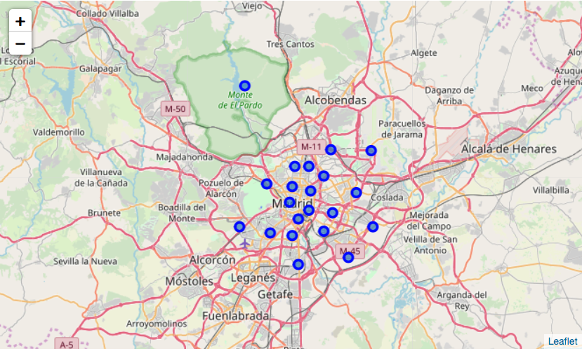
- Geocode with openstreetmas API - Foursquare API
Districts obtained with Geocode API
Data

Slide 4
- Exploratory analysis - Cleaning Data
Exploratory analysis of the top venues in Madrid
Methodology

Slide 5
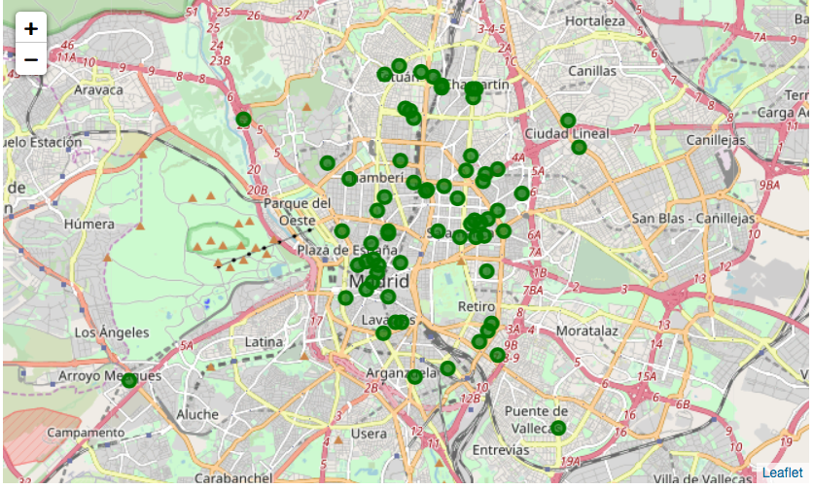
- Exploratory analysis - Cleaning Data
Gyms in Madrid after cleaning data
Methodology

Slide 6
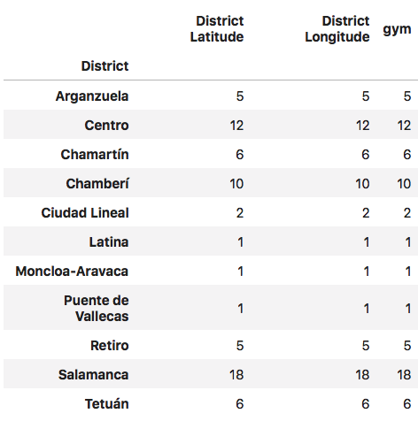
- Most in gyms in the center of Madrid - Relation between clusters and number of gyms
Results

Slide 7
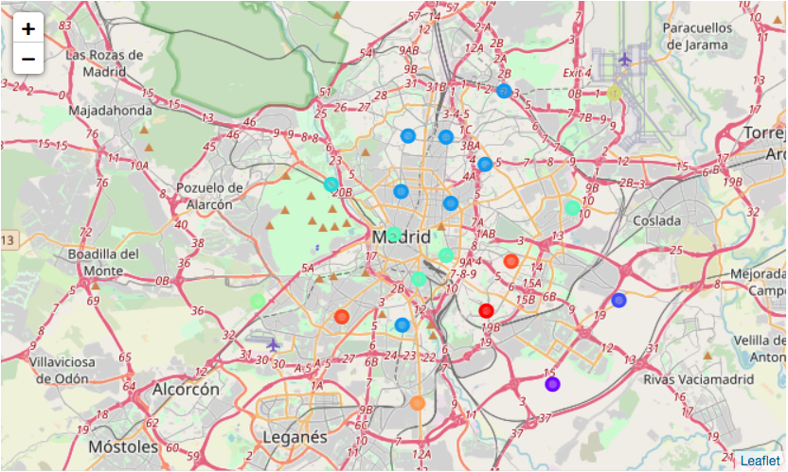
- Most in gyms in the center of Madrid - Relation between clusters and number of gyms
Clusters
Results

Slide 8
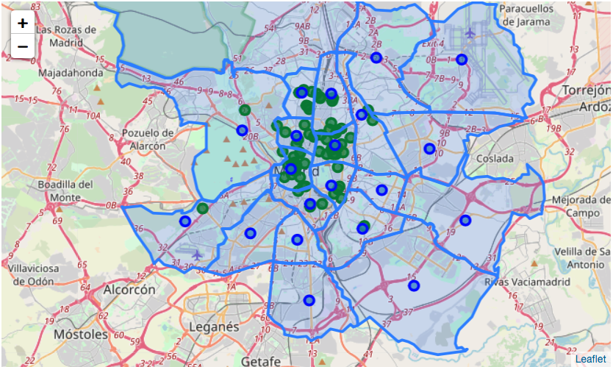
- Beware of foursquare data - Correlation between economy and number of gyms? - Correlation between number of restaurants and gyms
External districts without gyms
Discussion

Slide 9
Best place to build a gym: External Districts with the most restaurants.
Conclusion
Thank You

