Slide 1





Template DBM: A New Weakly Relational Domain for Efficient Memory-Access Validation
Yusen Su¹ Jorge A. Navas² Arie Gurfinkel¹
¹University of Waterloo
²Certora Inc.
Notes:
Hi everyone, I’m Yusen Su, a PhD student from the University of Waterloo.
I’m here to talk about a new weakly relational abstract domain,
called “Template DBM”, for efficient memory access validation.
This is the joint work with Jorge Navas from [Ser-TOR-ah] and my supervisor Arie Gurfinkel.
In this talk, I will cover the high-level design of our new domain
and some of the key operations. More details of the explanation can be found in our paper.

Slide 2
Motivation
Approach: static program analysis
  To discover numerical properties of a program
  Properties as relations between variables
Goal: guarantee memory safety
  C programs with assertion checks before memory access
  Checks for buffer overflow
Theory: abstract Interpretation
  Sound approximations of semantics
Contribution: abstract domain
  A special structure to represent program properties
  Algorithms supported for analysis
Notes:
In this work, we are doing static analysis, which computes semantic properties for programs.
Specifically, we are interested in relational properties between variables.
We want our analysis for memory safety,
where programs like C contain assertion checks for buffer overflow.
Our analysis is based on abstract interpretation, which uses an abstract domain to represent properties.
The domain itself contains operations for program analysis.

Slide 3
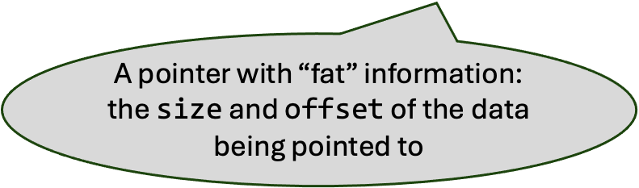
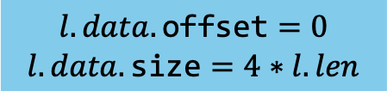
Relational Object Invariants
1
2
3
4
5
6
7
8
9
10
11
12
13
14
15
16
struct array_list {
int size; // allocated size
int len; // used length
int isz; // item size
void *data;
};
void main(int len, int idx) {
if (0 <= idx && idx < len) {
struct array_list l;
l.len = len;
l.isz = 4; // 4 bytes
l.size = l.isz * l.len;
l.data = malloc(l.size);
// Assume some code initializes l.data.
……
}
}
Line 16
size
len
isz
data
array
l:
4*len
len
4
0x100
…
A pointer with “fat” information:
the $\text{size}$ and $\text{offset}$ of the data being pointed to
Relational invariants for l.data:
$$l.data.\text{offset}=0$$
$$l.data.\text{size}=4∗l.len$$
Notes:
To understand our goal, let’s look at one example.
Say we have a C program with two inputs: length and index.
In the main function, we create an object L that stores an array list.
The C struct contains four fields:
data (pointer to buffer), cap (allocated size), len (number of stored items), and item_size (bytes per item).
We initialize L to use the entire buffer:
Treat L as an integer array.
We also assume there are some codes for initializing such an array on line 14.
After all initialization, at line 16. The object L in the memory is like this.
We have relational properties between len and size.
Now, we are interested in pointer properties.
[Click]
So, we consider pointers with extra information:
Each pointer associates with an offset for the current position
And the size is for the allocation size

Slide 4
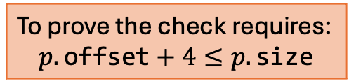
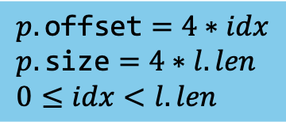
Bounds Checking
Line 24
size
len
isz
data
array
l:
4*len
len
4
0x100
…
1
2
3
4
5
6
7
8
9
10
11
12
13
14
15
16
17
18
struct array_list {
int size; // allocated size
int len; // used length
int isz; // item size
void *data;
};
void main(int len, int idx) {
if (0 <= idx && idx < len) {
struct array_list l;
l.len = len;
l.isz = 4; // 4 bytes
l.size = l.isz * l.len;
l.data = malloc(l.size);
// Assume some code initializes l.data.
void *item = malloc(sizeof(l.isz));
int ret = get_at(&l, item, idx);
assert(ret == 0);
}
}
Prove?
$$p.\text{offset}=4∗idx \\ p.\text{size}=4∗l.len \\ 0≤idx<l.len$$
To prove the check requires:
$$p.\text{offset}+4≤p.\text{size}$$
19
20
21
22
23
24
25
26
int get_at(const struct array_list *l,
void *val, int idx) {
if (l->len > idx) {
int ofs = l->isz * idx;
void *p = (uint8_t *)l->data + ofs;
assert(valid_access(p, l->isz));
assert(valid_access(val, l->isz));
memcpy(val, p, l->isz);
return 0;
} else {
return -1;
}
}
Notes:
Now we look at the rest of the code after initialization.
We want to get an item from the array list by calling this get_at function.
It also takes the program input, idx, and a pointer item for storing the item we get.
Inside the get_at function, we compute a pointer p for accessing the data buffer and perform a memcpy.
In terms of program analysis, to ensure memcpy does not go out of bounds,
we need to guarantee both the memory contents of pointers p and val can be accessed for the size of an item, which is 4 bytes.
So to check buffer inbounds, we insert two assertions before memcpy calls.
To prove on line 25 is simple, but to prove line 24 requires:
[Click]
The blue box contains what properties we inferred for the pointer p.
The properties for p.offset is computed based on new position computed following idx
The properties for p.size is the allocated size of the data buffer.
For idx and l.len, their relations can be determined through line 8, line 10, and line 21.

Slide 5
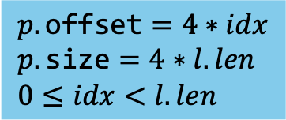

Static Analysis
Tool
Abstract Interpreter
Abstract Domains:
Verify
Assertion
✅ pass
Program
Invariants
Heap
Num
Bool
⚠️ unknown
Example Code
$$p.\text{offset}=4∗idx \\ p.\text{size}=4∗l.len \\ 0≤idx<l.len$$
$$p.\text{offset}+4≤p.\text{size}$$
Which numerical domain can represent this set of constraints?
How numerical domain can “discover” this implicit constraint?
Notes:
So how we compute properties and preforms checks?
Our analysis takes an input program and run abstract interpreter using different kinds of abstract domains.
Including a domain for heap abstraction, a domain for Boolean variables, and some numerical domain for integers.
For our running example, the analysis computes properties in the blue box.
But the question is, which numerical domains can represent such properties?
and how domain knows this property holds based on the properties we show in the blue box

Slide 6
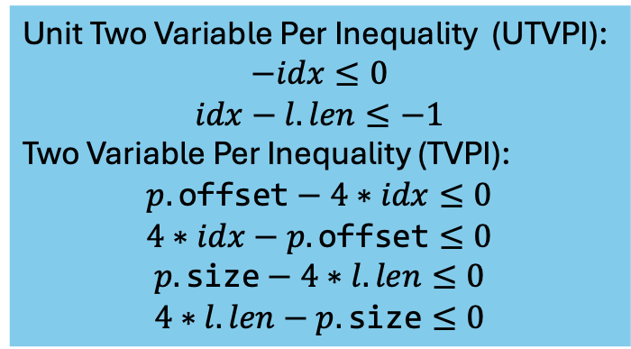
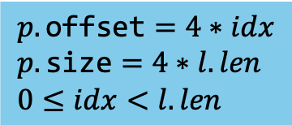
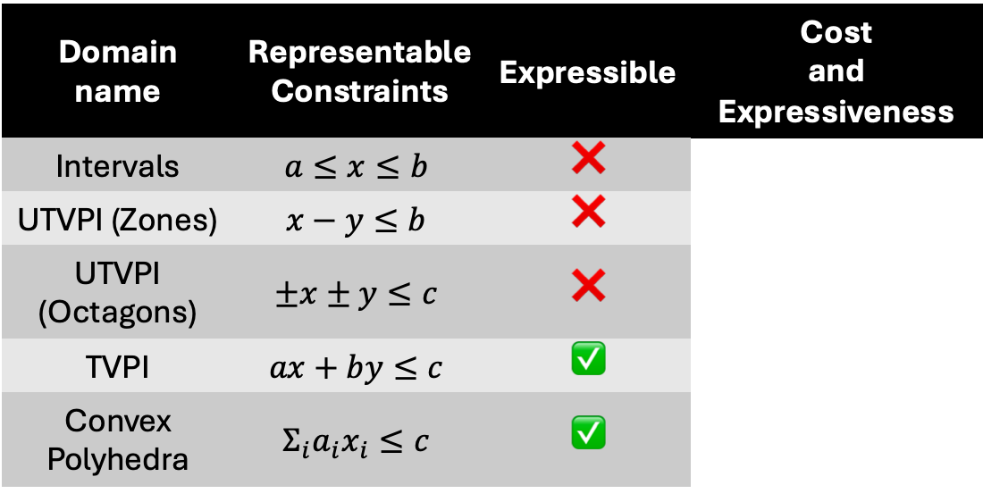
Previous Work on Numerical Domains
$$p.\text{offset}=4∗idx \\ p.\text{size}=4∗l.len \\ 0≤idx<l.len$$
Domain name | Representable Constraints | Expressible | Cost and Expressiveness
Intervals | $$a≤x≤b$$ | ❌
UTVPI (Zones) | $$x−y≤b$$ | ❌
UTVPI (Octagons) | $$±x±y≤c$$ | ❌
TVPI | $$ax+by≤c$$ | ✅
Convex Polyhedra | $$Σ_{i}a_{i}x_{i}≤c$$ | ✅
Unit Two Variable Per Inequality (UTVPI):
$$−idx≤0$$
$$idx−l.len≤−1$$
Two Variable Per Inequality (TVPI):
$$p.\text{offset}−4∗idx≤0$$
$$4∗idx−p.\text{offset}≤0$$
$$p.\text{size}−4∗l.len≤0$$
$$4∗l.len−p.\text{size}≤0$$
Notes:
Let’s look at some previous work on numerical abstract domains
The properties, as a constraint set, have two types of inequalities
The unit two variable per inequality, which stands for inequality with two variables and each variable only has unit coefficient
I will explain how to represent –idx <=0 later.
Another part is called TVPI, where it is still for two variables but allows coefficient to be arbitrary.
Here we have idx and l.len both takes coefficient 4 in the representation.
So how existing abstract domains can represent these properties.
For Intervals, the domain is impossible because it is for non-relational properties.
The domains for UTVPI, they can not represent either due to we have TVPI constraint.
For TVPI, and convex polyhedral domain, we can represent them but the challenges are the cost of operations.

Slide 7
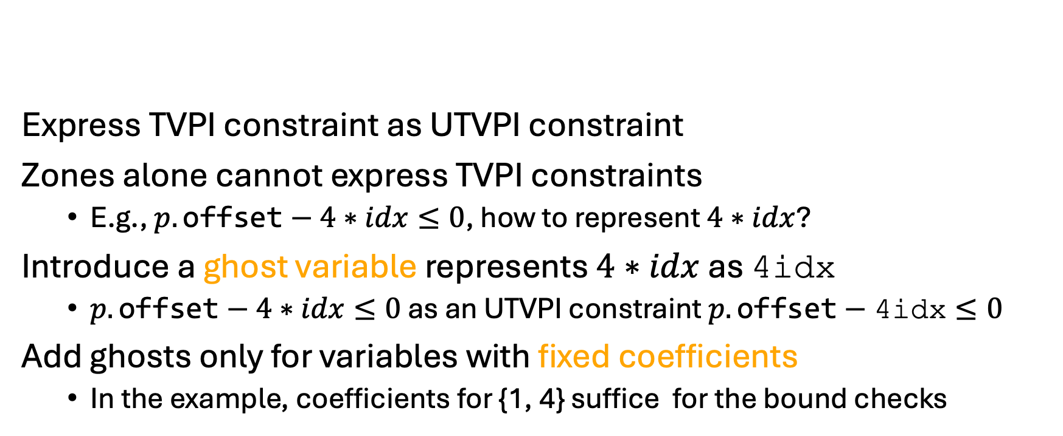
Our Work
Domain name | Cost and Expressiveness
UTVPI (Zones)
Our work
TVPI
Express TVPI constraint as UTVPI constraint
Zones alone cannot express TVPI constraints
  E.g., $p.\text{offset}−4∗idx≤0$, how to represent $4∗idx$?
Introduce a ghost variable represents $4∗idx$ as $\text{4}\text{idx}$
  $p.\text{offset}−4∗idx≤0$ as an UTVPI constraint $p.\text{offset}−\text{4}\text{idx}≤0$
Add ghosts only for variables with fixed coefficients
  In the example, coefficients for {1, 4} suffice for the bound checks
Notes:
What we want is an abstract domain
which can represent some TVPI constraints but not all of them.
So the expressiveness is between TVPI and Zones.
Besides, we want a domain that make analysis scalable.
So we wish the cost is between TVPI and Zones.
Our idea is straightforward, which we use UTVPI constraint to represent TVPI one.
Specially, we want to use Zones domain for TVPI.
For instance, one of TVPI constraint in our example is
Zones cannot represent it because there are TVPI constraints,
but if we treat a variable with non-unit coefficient
like 4 * idx as a ghost variable 4idx
Then all TVPI constraints we showed before become UTVPI constraints.
However, we don’t want our domain for representing any TVPI constraints.
So we only allows TVPI constraints with specific coefficients.
In our example, coefficients either be 1 and 4 is enough.

Slide 8
Road Map
Motivation
Background
  Zones as a Difference Bound Matrix (DBM)
Contributions
  Extending DBM
  A domain of TVPI constraints with templates
  Implementation and Experiments
Conclusion
Notes:
To understand how our new domain works, let first understand how the zones domain works

Slide 9

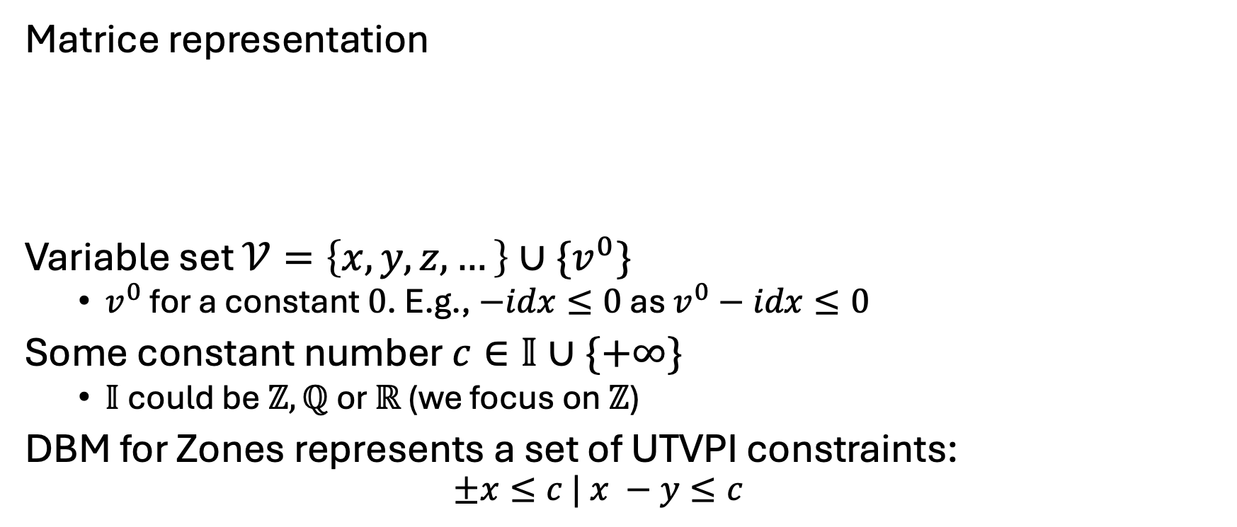
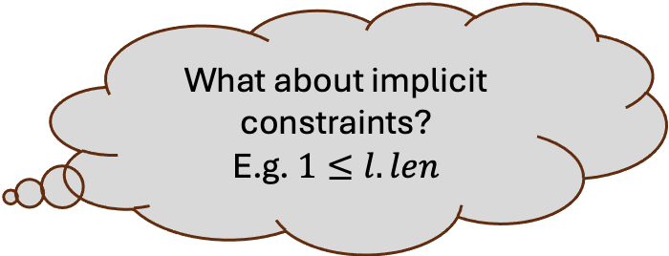

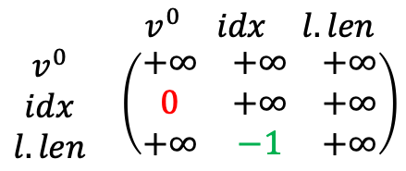

Difference Bound Matrix (DBM)
Matrice representation
Variable set $𝒱=\left\{x,y,z,…\right\}∪\{v^{0}\}$
  $v^{0}$ for a constant $0$. E.g., $−idx≤0$ as $v^{0}−idx≤0$
Some constant number $c∈𝕀∪\{+∞\}$
  $𝕀$could be $ℤ,ℚ$ or $ℝ$ (we focus on $ℤ$)
DBM for Zones represents a set of UTVPI constraints:
  $$±x≤c | x −y≤c$$
What about implicit constraints?
E.g. $1≤l.len$
$0≤idx<l.len$ in UTVPI form:
$$\begin{matrix} & \begin{matrix}v^{0} & idx & l.len\end{matrix} \\ \begin{matrix}v^{0} \\ idx \\ l.len\end{matrix} & \left(\begin{matrix}+∞ & +∞ & +∞ \\ 0 & +∞ & +∞ \\ +∞ & −1 & +∞\end{matrix}\right)\end{matrix}$$
$$−idx≤0$$
$$idx−l.len≤−1$$
$$⇒$$
Notes:
Zones use a data structure called difference bound matrix (DBM)
where rows and columns correspond to variables,
and each element represents an UTVPI constraint.
We define a set of program variables with an extra variable v0
which always has the constant value 0. In this way, -idx <= 0 is viewed as v0 – idx <=0.
For the difference bound of each constraint,
we define some constant c which could be an integer or plus infinity.
Now, we have the matrix to represent constraints.
[Click]
But you can also see 1<= l.len obviousely, but it does not represent the in DBM, so how to get it?

Slide 10
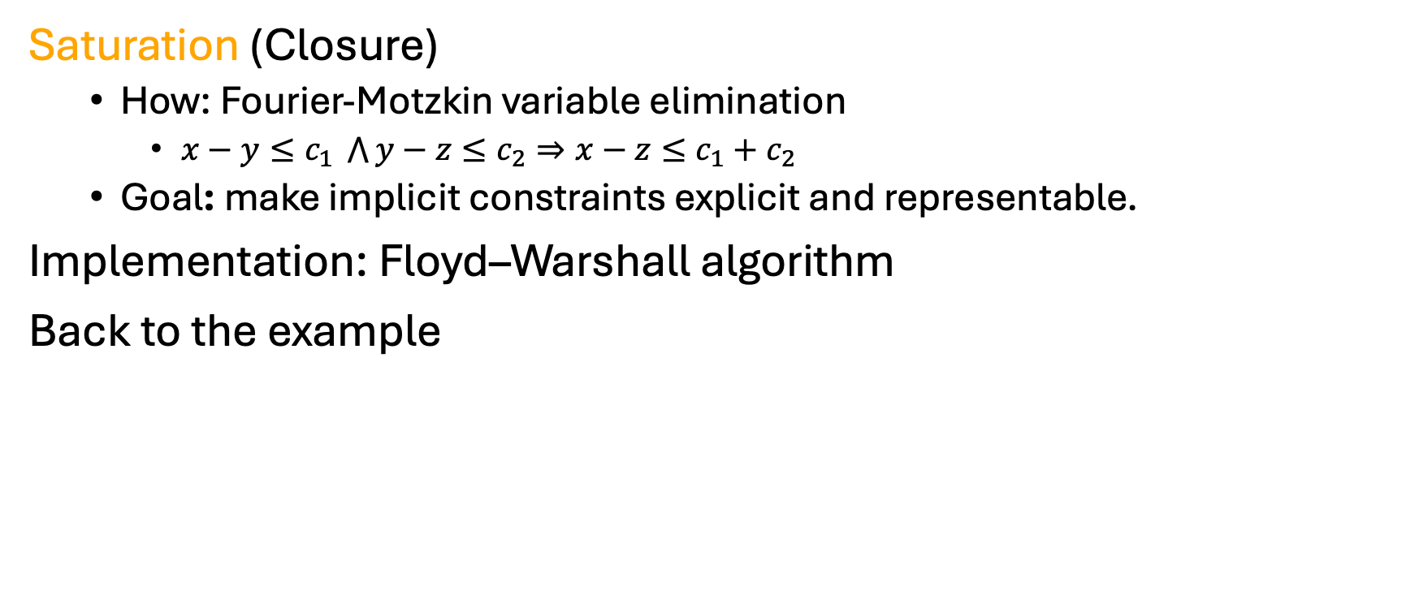
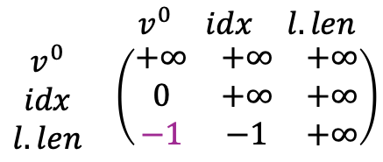


Inferring all implicit UTVPI constraints
Saturation (Closure)
  How: Fourier-Motzkin variable elimination
    $x−y≤c_{1} \bigwedge{y−z≤c_{2}}⇒x−z≤c_{1}+c_{2}$
  Goal: make implicit constraints explicit and representable.
Implementation: Floyd–Warshall algorithm
Back to the example
All constraints for $0≤idx<l.len$ in UTVPI form:
$$\begin{matrix} & \begin{matrix}v^{0} & idx & l.len\end{matrix} \\ \begin{matrix}v^{0} \\ idx \\ l.len\end{matrix} & \left(\begin{matrix}+∞ & +∞ & +∞ \\ 0 & +∞ & +∞ \\ −1 & −1 & +∞\end{matrix}\right)\end{matrix}$$
$$−idx≤0$$
$$idx−l.len≤−1$$
$$−l.len≤−1$$
$$⇒$$
Notes:
To infer constraints that are implicit, the DBM provides an operation called saturation.
Where it is based on [fr·ee·ay]-Motzkin elimination.
Such as two UTVPI constraints share the same variable y but can be eliminated to compute a new UTVPI constraint.
The saturation here computes all implicit constraints that the current DBM implies and makes them representable.
The implementation can be based on a shortest path algorithm, if you view the DBM as a directed graph
Now back to our example, if we only look at those properties in UTVPI form,
So we take existing two constraints to derive the implicit one.

Slide 11
Road Map
Motivation
Background
  Zones as a Difference Bound Matrix (DBM)
Contributions
  Extending DBM
  A domain of TVPI constraints with templates
  Implementation and Experiments
Conclusion
Notes:
Next, we show how we extend the DBM

Slide 12
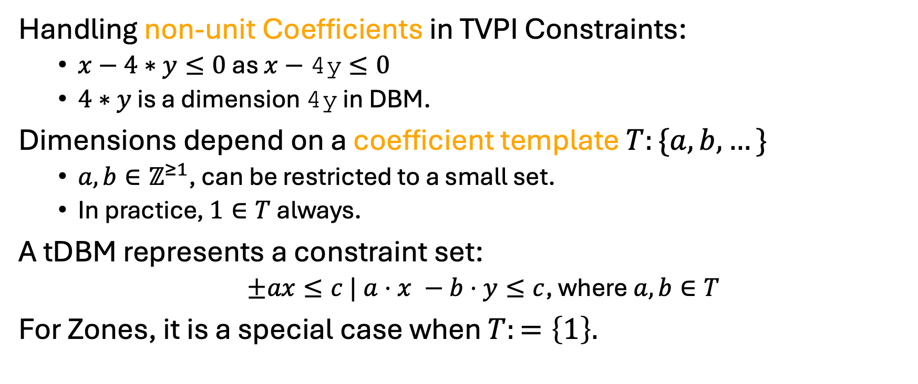
A template DBM (tDBM)
Handling non-unit Coefficients in TVPI Constraints:
  $x−4∗y≤0$ as $x−\text{4}\text{y}≤0$
  $4∗y$ is a dimension 4y in DBM.
Dimensions depend on a coefficient template $T:\{a, b,…\}$
  $a, b∈ℤ^{≥1}$, can be restricted to a small set.
  In practice, $1∈T$ always.
A tDBM represents a constraint set:
  $±ax≤c | a⋅x −b⋅y≤c$, where $a,b∈T$
For Zones, it is a special case when $T:=\left\{1\right\}.$
Notes:
We call our new DBM as a template DBM (tDBM)
The DBM handles TVPI constraints as what we described earlier
Where a variable with non-coefficient in a TVPI constraint is a ghost variable.
For tDBM, we still keep the same form as DBM but allow coefficients to be chosen from the template.
That means a special dimension in the DBM

Slide 13


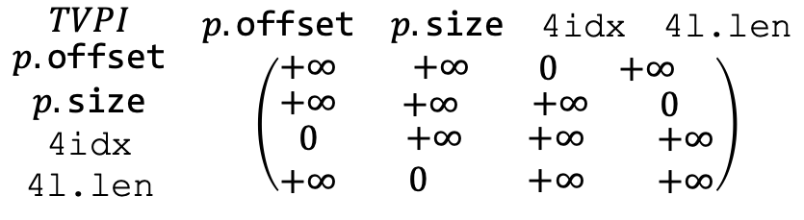
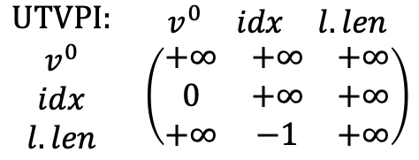

Encoding Constraints in tDBM (example)
For presentation purpose, we visualize tDBM into two parts:
  Classical UTVPI constraints for $±x≤c$and $x−y≤c$
  Extended TVPI constraints for $ax −by≤c$
$$T=\{1,4\}$$
$$\begin{matrix}UTVPI: & \begin{matrix}v^{0} & idx & l.len\end{matrix} \\ \begin{matrix}v^{0} \\ idx \\ l.len\end{matrix} & \left(\begin{matrix}+∞ & +∞ & +∞ \\ 0 & +∞ & +∞ \\ +∞ & −1 & +∞\end{matrix}\right)\end{matrix}$$
UTVPI:
$$−idx≤0$$
$$idx−l.len≤−1$$
TVPI:
$$p.\text{offset}−\text{4}\text{idx}≤0$$
$$\text{4}\text{idx}−p.\text{offset}≤0$$
$$p.\text{size}−\text{4}\text{l}\text{.}\text{len}≤0$$
$$\text{4}\text{l}\text{.}\text{len}−p.\text{size}≤0$$
$$p.\text{offset}=4∗idx \\ p.\text{size}=4∗l.len \\ 0≤idx<l.len$$
$$\begin{matrix}\begin{matrix}TVPI \\ \begin{matrix}p.\text{offset} \\ p.\text{size} \\ \begin{matrix}\text{4}\text{idx} \\ \text{4}\text{l}\text{.}\text{len}\end{matrix}\end{matrix}\end{matrix} & \begin{matrix}\begin{matrix}p.\text{offset} & p.\text{size} & \begin{matrix}\text{4}\text{idx} & \text{4}\text{l}\text{.}\text{len}\end{matrix}\end{matrix} \\ \left(\begin{matrix}+∞ & \begin{matrix}+∞ & \begin{matrix}0 & +∞\end{matrix}\end{matrix} \\ \begin{matrix}+∞ \\ \begin{matrix}0 \\ +∞\end{matrix}\end{matrix} & \begin{matrix}\begin{matrix} +∞ \\ \begin{matrix} +∞ \\ 0\end{matrix}\end{matrix} & \begin{matrix}\begin{matrix} +∞ \\ \begin{matrix}+∞ \\ +∞\end{matrix}\end{matrix} & \begin{matrix}0 \\ \begin{matrix} +∞ \\ +∞\end{matrix}\end{matrix}\end{matrix}\end{matrix}\end{matrix}\right)\end{matrix}\end{matrix}$$
Notes:
Let’s see how tDBM represents properties in our example.
First, we allow the coefficient template to include 1 and 4.
Here we just classify these two types of inequalities in the DBM.
In practice, we only use one DBM to represent all constraints.

Slide 14
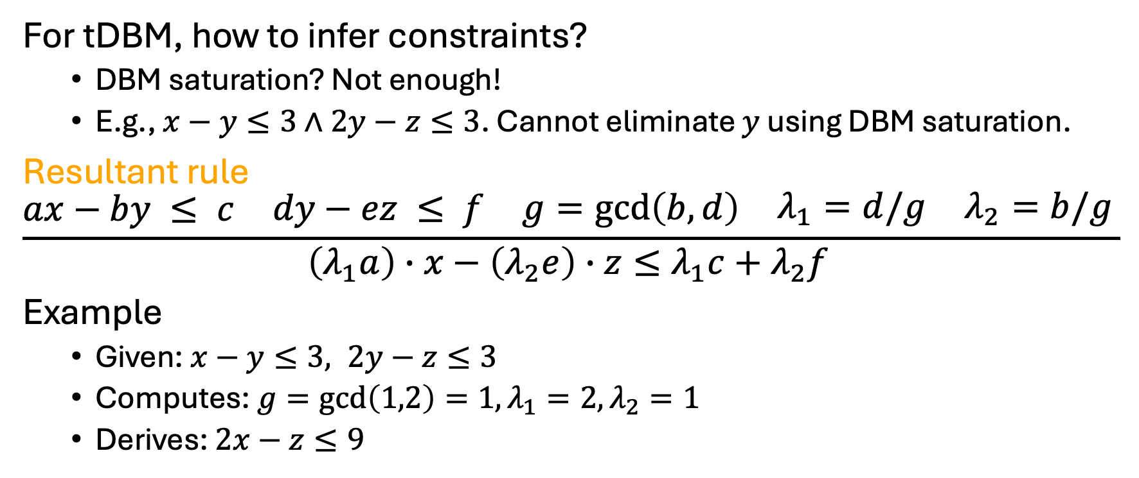
Inferring implicit constraints
For tDBM, how to infer constraints?
  DBM saturation? Not enough!
  E.g., $x−y≤3∧2y−z≤3$. Cannot eliminate $y$ using DBM saturation.
Resultant rule
$$\frac{\begin{matrix}ax−by ≤ c & \begin{matrix}dy−ez ≤ f & \begin{matrix}g=\gcd\left(b,d\right) & \begin{matrix}λ_{1}=d/g & λ_{2}=b/g \end{matrix}\end{matrix}\end{matrix}\end{matrix}}{\left(λ_{1}a\right)∙x−\left(λ_{2}e\right)∙z≤λ_{1}c+λ_{2}f }$$
Example
  Given: $x−y≤3, 2y−z≤3$
  Computes: $g=\gcd\left(1,2\right)=1,λ_{1}=2,λ_{2}=1$
  Derives: $2x−z≤9$
Notes:
So for tDBM, how do we infer all implicit constraints?
Using DBM saturation here is not enough.
As an example here,, to eliminate variable y, we need to align coefficients of y before elimination.
We achieve this on the resultant rule by taking two TVPI constraints.
We find the common coefficient for y, eliminate it, and compute the new TVPI constraint.
Given $ax−by≤c ∧dy−ez≤f$
Finds $g=\gcd\left(b,d\right)$
Computes $λ_{1}=d/g$, $λ_{2}=b/g$
Derives a new constraint: $\left(λ_{1}a\right)∙x−\left(λ_{2}e\right)∙z≤λ_{1}c+λ_{2}f$
Explain rule in high

Slide 15
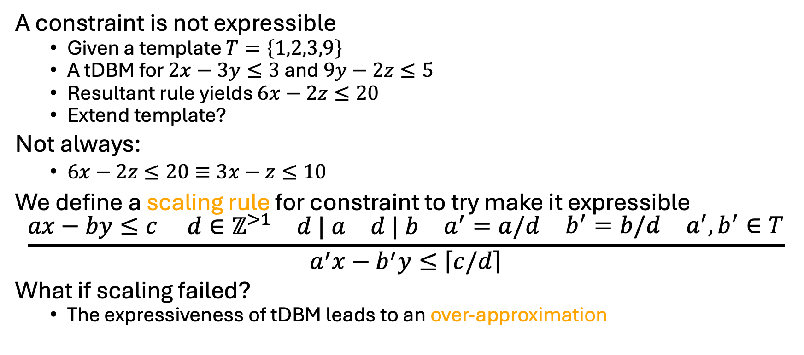
What did we miss?
A constraint is not expressible
  Given a template $T=\left\{1,2,3,9\right\}$
  A tDBM for $2x−3y≤3$ and $9y−2z≤5$
  Resultant rule yields $6x−2z≤20$
  Extend template?
Not always:
  $6x−2z≤20≡3x−z≤10$
We define a scaling rule for constraint to try make it expressible
$$\frac{\begin{matrix}ax−by≤c & \begin{matrix}d∈ℤ^{>1} & \begin{matrix}d | a & \begin{matrix}d | b & \begin{matrix}a^{′}=a/d & \begin{matrix}b^{′}=b/d & a^{′},b^{′}∈T\end{matrix}\end{matrix}\end{matrix}\end{matrix}\end{matrix}\end{matrix}}{a^{′}x−b^{′}y≤\left\lceil \left.c/d\right\rceil \right.}$$
What if scaling failed?
  The expressiveness of tDBM leads to an over-approximation
Notes:
When we apply a resultant step on constraints,
we may lose implicit constraints that are not expressible in the template.
E.g.
Should we extend the template? Not necessarily.
Like the example here, the inequality is equivalent to the one that tDBM can represents.
So here, we define a scaling rule to scale coefficients and make it expressible.
Given a template $T$ and a constraint $ax−by≤c$
Try to find a divisor $d$ that: $a^{′}=a/d∈T$ and $b^{′}=b/d∈T$
Compute an expressible constraint $a^{′}x−b^{′}y≤\left\lceil \left.c/d\right\rceil \right.$

Slide 16
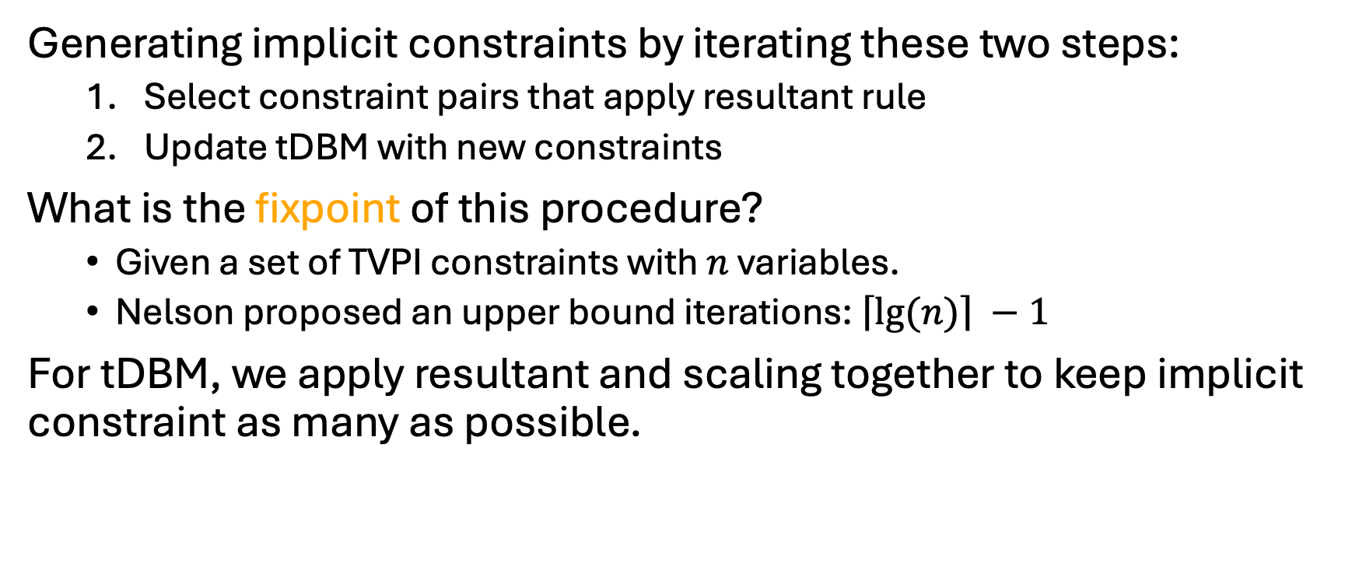
tDBM Saturation ([Nelson 78])
Generating implicit constraints by iterating these two steps:
  Select constraint pairs that apply resultant rule
  Update tDBM with new constraints
What is the fixpoint of this procedure?
  Given a set of TVPI constraints with $n$ variables.
  Nelson proposed an upper bound iterations: $\left\lceil \left.lg⁡(n)\right\rceil \right. −1$
For tDBM, we apply resultant and scaling together to keep implicit constraint as many as possible.
[Nelson 78]: Nelson, Charles Gregory: An $n^{\log{n}}$ algorithm for the two-variable-per-constraint linear programming satisfiability problem
Notes:
Overall, for tDBM saturation,
We run it into two steps:
Pick any two constraints that can eliminate the intermediate variable
Produce new constraints and update DBM
the ceiling of log n minus one.
If you are interested in how this upper bound is derived, please refer to this paper.
Since we keep constraints in the form that the given template allows, we …

Slide 17
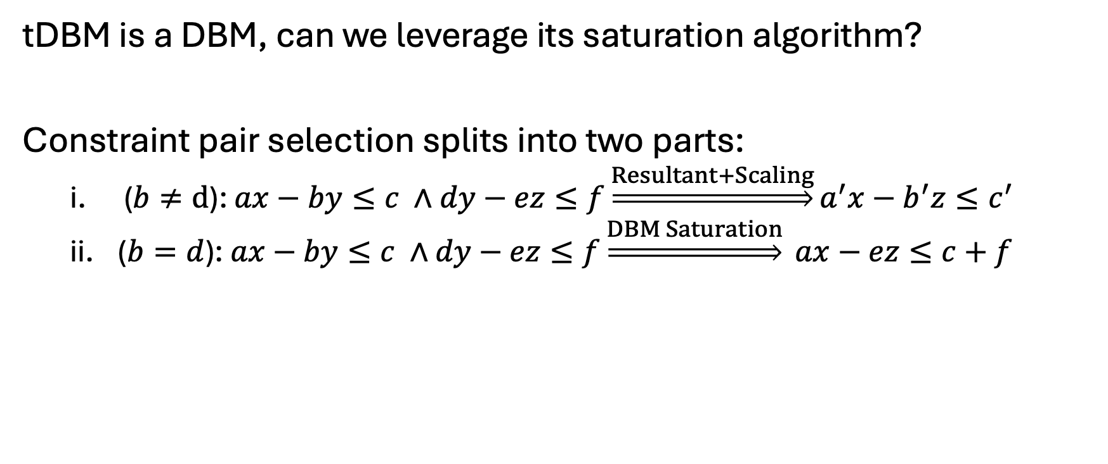
Deriving implicit constraints (DBM ver.)
tDBM is a DBM, can we leverage its saturation algorithm?
Constraint pair selection splits into two parts:
  ($b≠d$): $ax−by≤c ∧dy−ez≤f\underset{⇒}{Resultant+Scaling}a^{′}x−b^{′}z≤c^{′}$
  ($b=d$): $ax−by≤c ∧dy−ez≤f\underset{⇒}{DBM Saturation} ax−ez≤c+f$
✅
Notes:
The saturation algorithm here is more general, but a tDBM is a DBM.
The DBM itself already has a saturation algorithm and we want to reuse it.
The way we did is decomposing the resultant rule into two parts:
b is not equal to d
b is equal to d.
The DBM saturation works when b and d are equal.

Slide 18
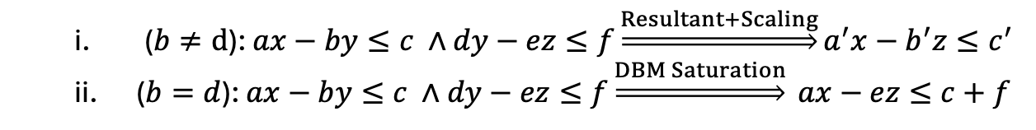
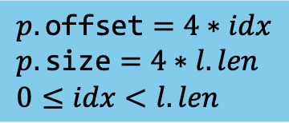



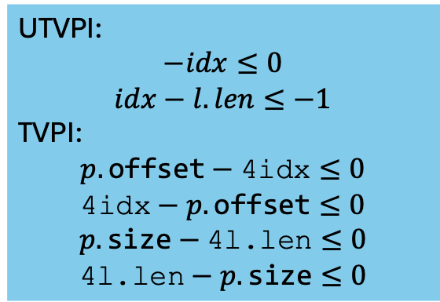
Deriving implicit constraints (Example)
$$p.\text{offset}=4∗idx \\ p.\text{size}=4∗l.len \\ 0≤idx<l.len$$
  ($b≠d$): $ax−by≤c ∧dy−ez≤f\underset{⇒}{Resultant+Scaling}a^{′}x−b^{′}z≤c^{′}$
  ($b=d$): $ax−by≤c ∧dy−ez≤f\underset{⇒}{DBM Saturation} ax−ez≤c+f$
UTVPI:
$$−idx≤0$$
$$idx−l.len≤−1$$
TVPI:
$$p.\text{offset}−\text{4}\text{idx}≤0$$
$$\text{4}\text{idx}−p.\text{offset}≤0$$
$$p.\text{size}−\text{4}\text{l}\text{.}\text{len}≤0$$
$$\text{4}\text{l}\text{.}\text{len}−p.\text{size}≤0$$
$$\underset{⇒}{Resultant+Scaling}p.\text{offset}−\text{4}\text{l}\text{.}\text{len}≤−4$$
$$\underset{⇒}{DBM Saturation}p.\text{offset}−p.size≤−4$$
$$p.\text{offset}+4≤p.\text{size}$$
Notes:
Now, following this two rules,
let’s look at how to get constraints using saturation to prove the property for memory safety.
First
[Click]
we pick these two to eliminate …
Where it requires to align coefficients.
Next,
[Click]
we pick another TVPI constraint with this derived one to eliminate.
In this case, we don’t need to align coefficient.
So the first step we use resultant and scaling, then we direct use DBM saturation to get the constraint to prove assertion.
Thus, an alternative way is we compute implicit constraints which requires aligning coefficients first
And then computes the rest using DBM saturation

Slide 19
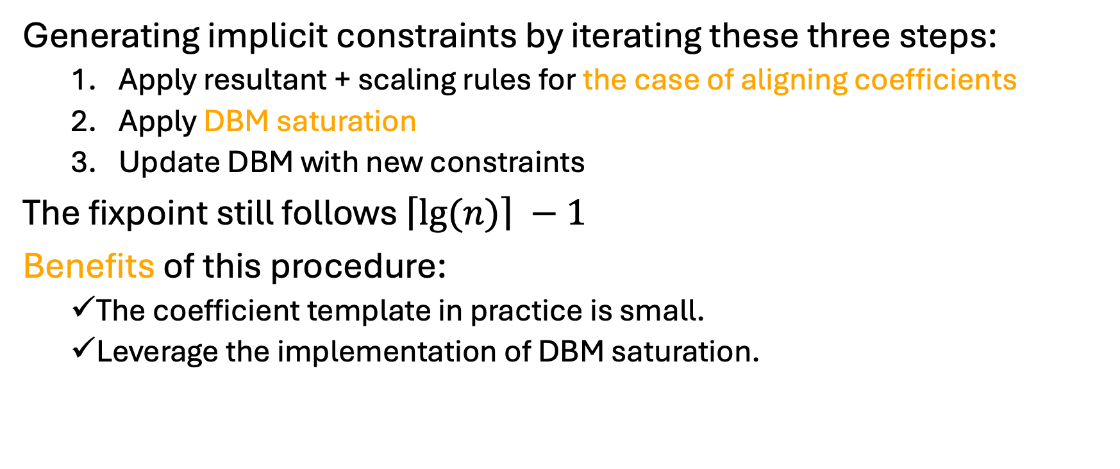
tDBM Saturation (DBM ver.)
Generating implicit constraints by iterating these three steps:
  Apply resultant + scaling rules for the case of aligning coefficients
  Apply DBM saturation
  Update DBM with new constraints
The fixpoint still follows $\left\lceil \left.lg⁡(n)\right\rceil \right. −1$
Benefits of this procedure:
  The coefficient template in practice is small.
  Leverage the implementation of DBM saturation.
Notes:
Thus, here we propose an alternative saturation algorithm to leverage the DBM.
We apply the step 1 for the cases that require aligning coefficients
And then the step 2 without alignment.

Slide 20
Road Map
Motivation
Background
  Zones as a Difference Bound Matrix (DBM)
Contributions
  Extending DBM
  A domain of TVPI constraints with templates
  Implementation and Experiments
Conclusion
Notes:
Now, let’s look at the new domain

Slide 21
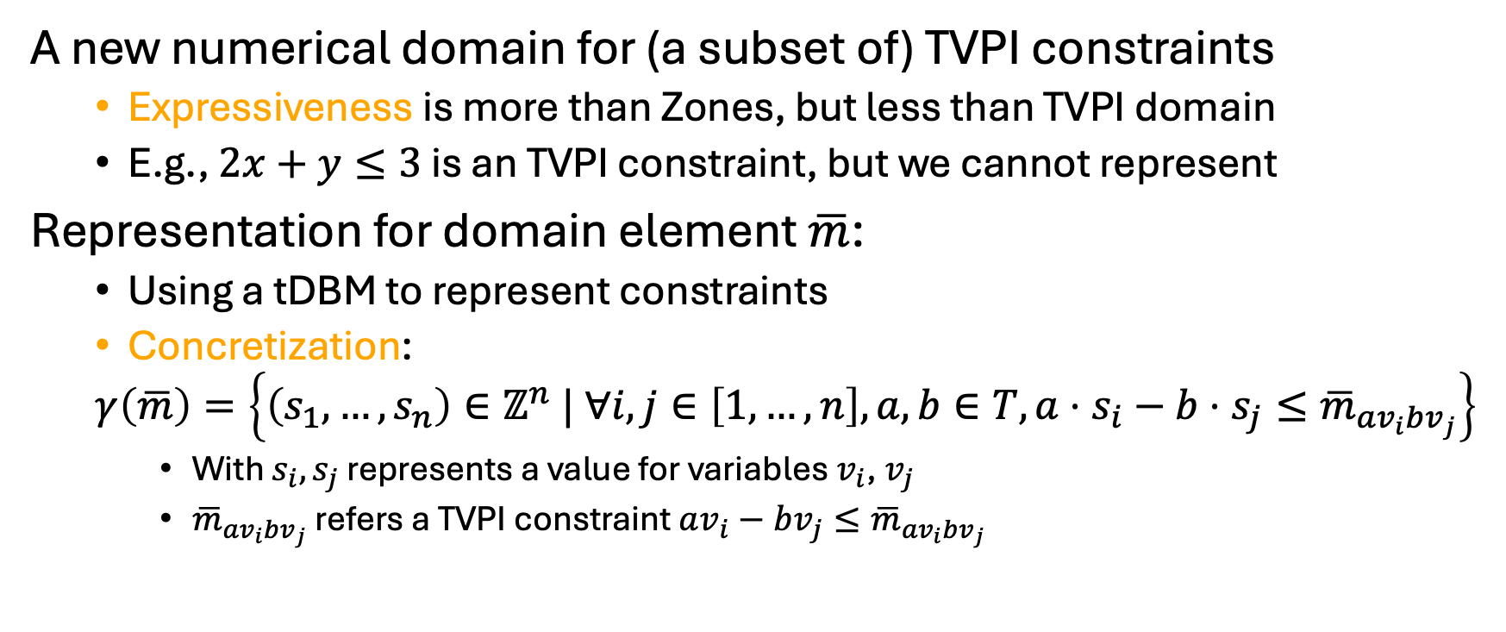
Template DBM Abstract Domain
A new numerical domain for (a subset of) TVPI constraints
  Expressiveness is more than Zones, but less than TVPI domain
  E.g., $2x+y≤3$ is an TVPI constraint, but we cannot represent
Representation for domain element $\overline{m}$:
  Using a tDBM to represent constraints
  Concretization:
  $$γ\left(\overline{m}\right)=\left\{\left(s_{1},…,s_{n}\right)∈ℤ^{n} | ∀i,j∈\left[1,…,n\right], a,b∈T,a⋅s_{i}−b⋅s_{j}≤{\overline{m}}_{av_{i}bv_{j}}\right\}$$
    With $s_{i}, s_{j}$ represents a value for variables $v_{i}$, $v_{j}$
    ${\overline{m}}_{av_{i}bv_{j}}$ refers a TVPI constraint $av_{i}−bv_{j}≤{\overline{m}}_{av_{i}bv_{j}}$
Notes:
Our new domain is based on tDBM.
The concretization function is defined for given a tDBM,
The result set includes all concrete variable assignments that satisfy all the constraints encoded in the matrix.

Slide 22
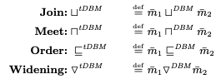
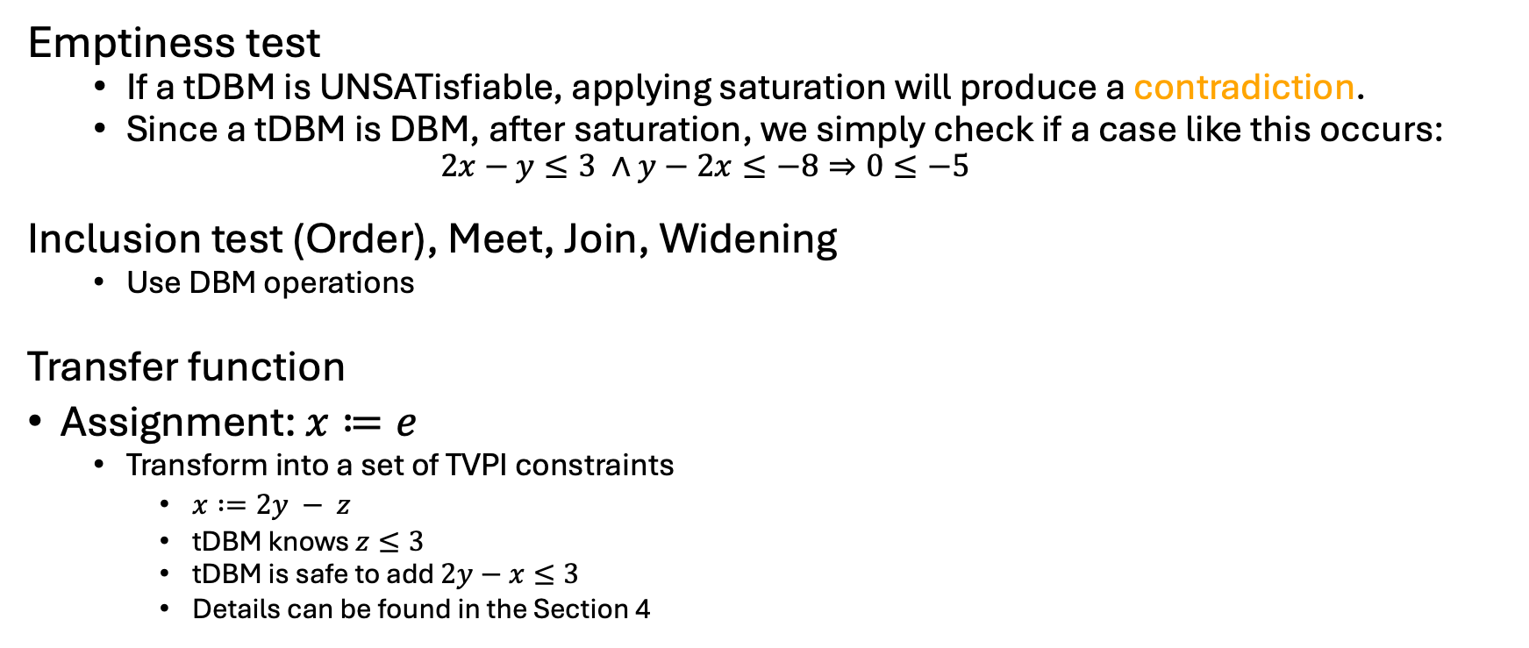
Domain Operations
Emptiness test
  If a tDBM is UNSATisfiable, applying saturation will produce a contradiction.
  Since a tDBM is DBM, after saturation, we simply check if a case like this occurs:
    $$2x−y≤3 ∧y−2x≤−8⇒0≤−5$$
Inclusion test (Order), Meet, Join, Widening
  Use DBM operations
Transfer function
Assignment: $x≔e$
  Transform into a set of TVPI constraints
    $x :=2y − z$
    tDBM knows $z≤3$
    tDBM is safe to add $2y−x≤3$
    Details can be found in the Section 4
❌
Notes:
We include several domain operations here that mainly used in the analysis.
You can find all details of explanation in our paper.
For emptiness test, is check whether the constraint set represented by tDBM is feasible?
If not, the DBM is empty or UNSAT or bottom.
The way we do is applying saturation first to represent all implicit constraints.

Slide 23
Road Map
Motivation
Background
  Zones as a Difference Bound Matrix (DBM)
Contributions
  Extending DBM
  A domain of TVPI constraints with templates
  Implementation and Experiments
Conclusion
Notes:
Finally, we cover how the domain was built
and share the results from our experiments.

Slide 24
Implementation
Template DBM is implemented in Crab [VSTTE 21] as an extension of Zones [SAS 16]:
  DBM as a direct graph
  In practice, DBM represents sparse constraint systems
  Implemented a special incremental saturation on top of DBM (details in Section 3.2 and 5)
Code available at https://github.com/LinerSu/crab/tree/tvpi_dbm.
Artifact available at https://doi.org/10.5281/zenodo.16075045.
[VSTTE 21]: Arie Gurfinkel, Jorge A. Navas: Abstract Interpretation of LLVM with a Region-Based Memory Model.
[SAS 16]: Graeme Gange et al.: Exploiting Sparsity in Difference-Bound Matrices
Notes:
We implemented in Crab, an abstract interpreter.
And our new domain is built on top of the implementation for zones.
We chose this implementation because:

Slide 25
Experiment for Template DBM
We reuse a case study on [VMCAI 25].
A pipeline integrates abstract interpreter (AbsInt) with bounded model checker (BMC)
Experiment:
  Before unrolling: AbsInt proves checks and add assumption for these checks
  After unrolling: AbsInt handles remaining checks
Goal: AbsInt proves mem assertions effectively before passing to BMC
[VMCAI 25]: Yusen Su et al.: Automatic Inference of Relational Object Invariants
Notes:
Our experiment is what we want at the beginning, to use abstract interpreter in a pipeline.
We have a case study where we apply the abstract interpreter into the bounded model checking pipeline.
So our pipeline goes like this:
We take source codes from two libraries from industry.
Along with our proof harness for verification.
Then we compile down to LLVM IR.
We insert checks on every memory access to ensure mem is safe.
Then we run the abstract interpreter twice. One before the loop unrooling.
And one after because this pipeline is for BMC.
Not explaining why we have this pipeline, if you are interested, please refer to this paper.
Here we only focus on abstint.

Slide 26
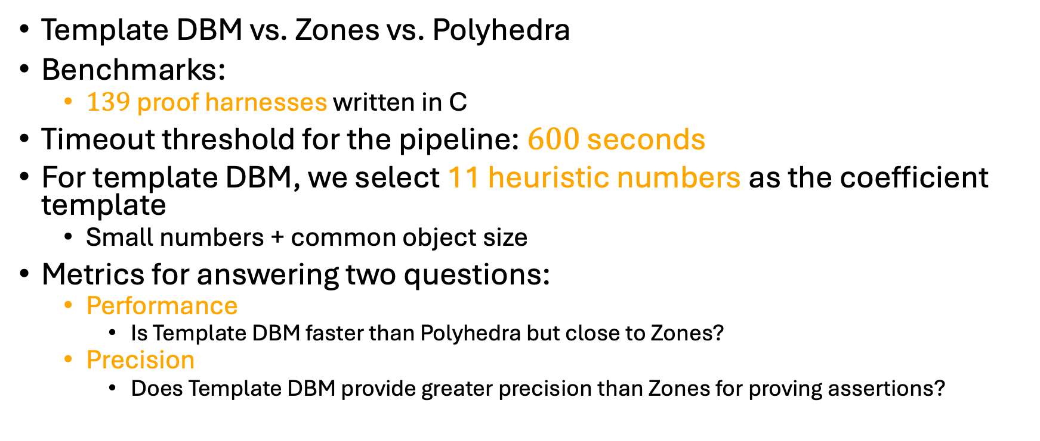
Experiment for Template DBM
Template DBM vs. Zones vs. Polyhedra
Benchmarks:
  $139$ proof harnesses written in C
Timeout threshold for the pipeline: $600$ seconds
For template DBM, we select 11 heuristic numbers as the coefficient template
  Small numbers + common object size
Metrics for answering two questions:
  Performance
    Is Template DBM faster than Polyhedra but close to Zones?
  Precision
    Does Template DBM provide greater precision than Zones for proving assertions?
Notes:
Our experiments focus on validating precision and performance of using our new domain for analysis,
We compared to two existing domains: Zones and Polyhedra.
So the only change of the analysis is just numerical domains, other domains we use the same.
We selected 139 benchmarks
The timeout is set for the entire pipeline duration
Two reasons without comparing TVPI domain
The benchmarks suite we use does not
Having a direct side-by-side evaluation is challenging.

Slide 27
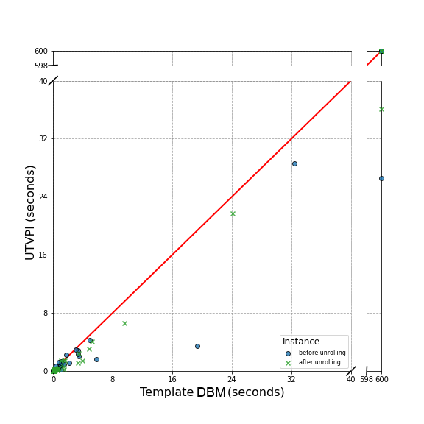
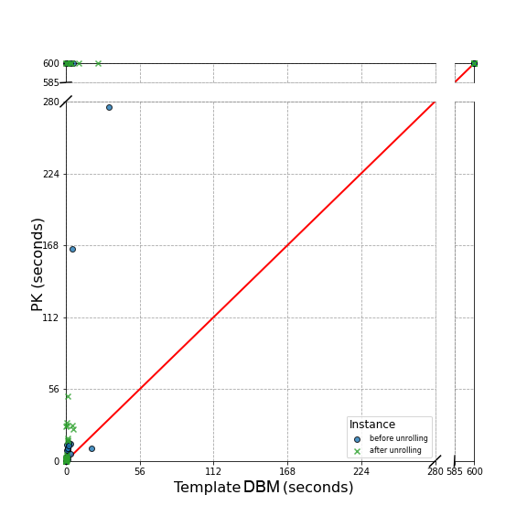
Statistics Results (Performance)
Template DBM shows the expected performance.
Running time per task close to Zones (UTVPI) on average.
Template DBM has less timeout than Polyhedra (PK)
Notes:
The points are too small.
X-axis for our new domain, Y-axis on the left is for Zones and the right is PK.
But the results here show that, compared to Zones, we did a pretty close performance in most benchmarks.
Compared to PK, using our domain scales well. PK has more timeouts cases and
[]
If someone asks how does performance go depend on the size of code?
It varies, we have some benchmarks that even have code size that are large but

Slide 28
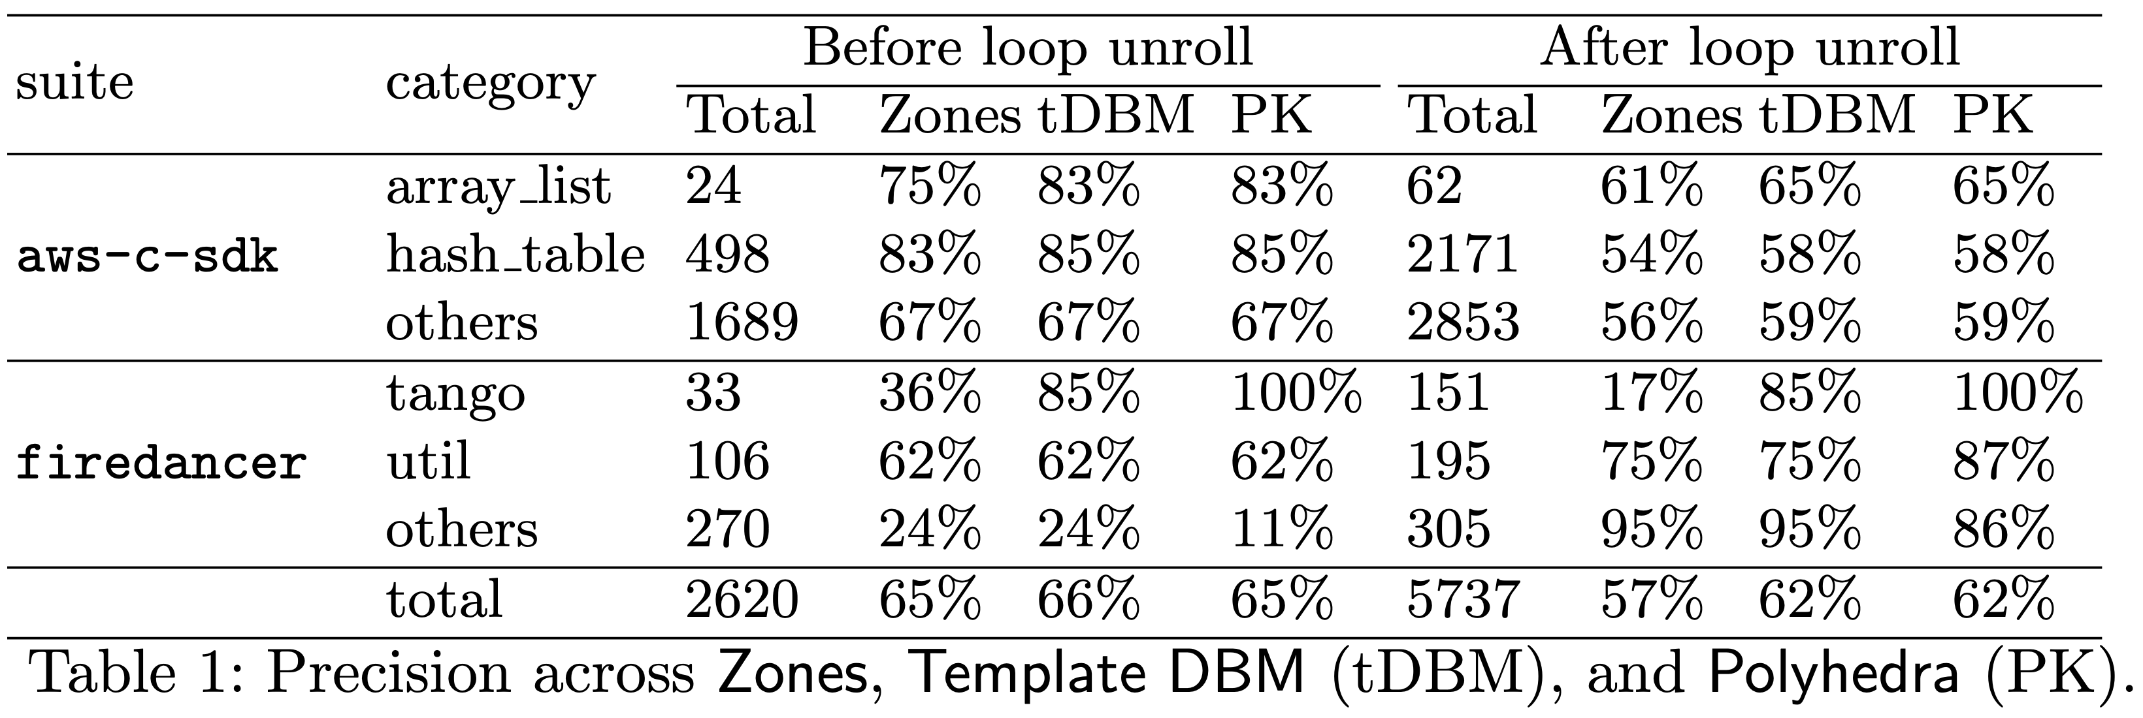
Statistics Results (Precision)
Template DBM proves more checks than Zones.
The motivating example from here.
PK join coefficient-overflows.
Template DBM shows the expected precision.
Notes:
For precision, this table shows how much assertions they have in each category
And how much assertions that using each domain can prove in percentage.
[Click]
Our motivating example from this benchmark set.
And these two benchmark sets show Template DBM can prove more assertion checks than Zones and close to Polyhedra.
Here are also some benchmarks that Polyhedra cannot prove. These do not mean Polyhedra is imprecise in theory.
The imprecision is caused by implementation.
We list all details of the table in our paper. I do not have time to explain all of them here.
Fix aws-c-common -> aws-c-libs

Slide 29
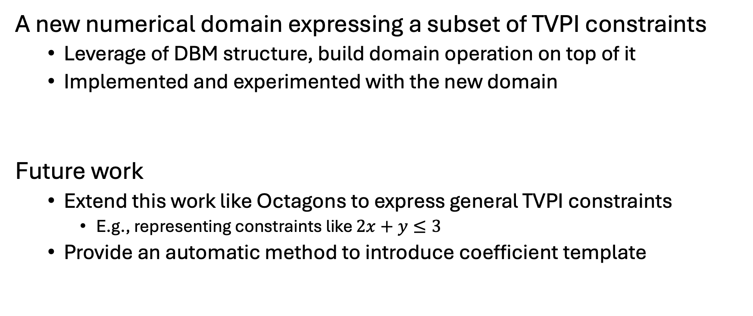
Conclusion
A new numerical domain expressing a subset of TVPI constraints
  Leverage of DBM structure, build domain operation on top of it
  Implemented and experimented with the new domain
Future work
  Extend this work like Octagons to express general TVPI constraints
    E.g., representing constraints like $2x+y≤3$
  Provide an automatic method to introduce coefficient template
Notes:
Overall, we designed and built a new abstract domain to express …

Slide 30



Questions?
Paper
Artifact
Code

Slide 31
A Challenge of Using Polyhedra and TVPI
Challenge: do not scale up on a program with larger number of variables
  Constraints blow-up
Reason: cost on domain operations
  Domain operation like Join
    Implement as a convex hull algorithm (expensive)
Polyhedra
  worst-case exponential complexity in both time and space
Even TVPI has Quasi-cubic cost runtime operations
  Arbitrary coefficients make the number of constraints can still grow large
Notes:
Why exponential time complexity?
Example, Klee–Minty cube. Basically is such constraints set form a cube with exponential number of vertices.
Why TVPI domain achieve polynomial time algorithm?
This requires you to read and understand how TVPI domain represent constraints.
Their join algorithms work as piece-wise convex hull. Why piece-wise? Because they represent constraints as a half matrix, each cell represent a subset constraints with respect to two variables.
This just show why slow and how slow. If someone ask,then show this slide and explain.
Hide this slide and show table of efficientcy is ok.

Slide 32
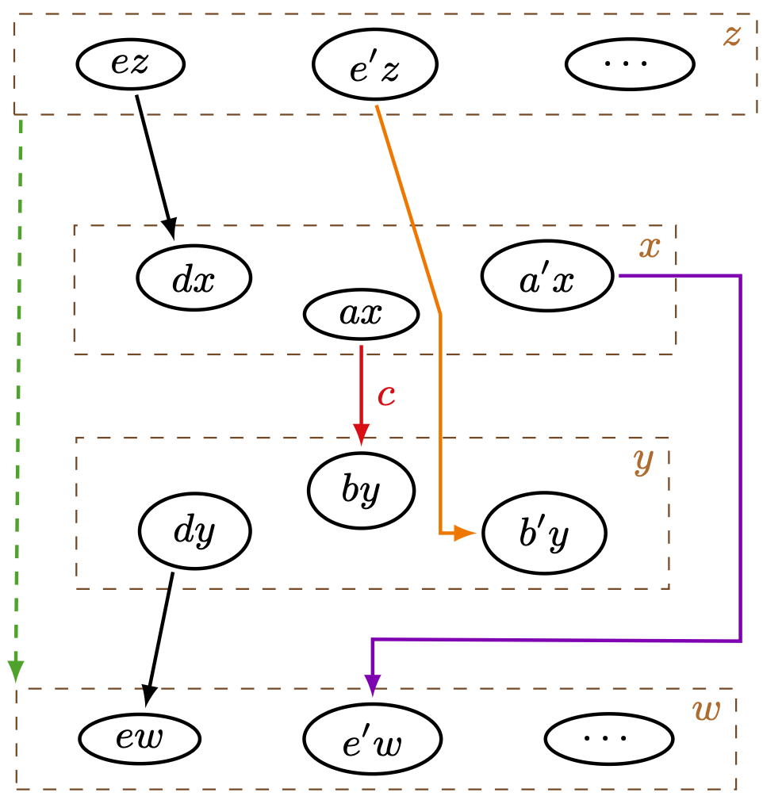
Incremental Saturation
Saturation algorithm has Quasi-cubic cost
  In analysis, only few constraints are added at a time
  You do not need to run the resultant rule for all pairs
Incremental saturation only updates tDBM for impacted rows/cols

Slide 33
Experiment – reuse a Case Study
AI4BMC: pipeline integrates abstract interpreter (AbsInt) with bounded model checker (BMC)
Goal: AbsInt removes buffer checks to reduce BMC overhead
Pipeline:
  Before unrolling: AbsInt proves checks and discharges proved ones
  After unrolling: AbsInt handles remaining checks

