Slide 1
High Range Resolution Software Defined Radar

Slide 2
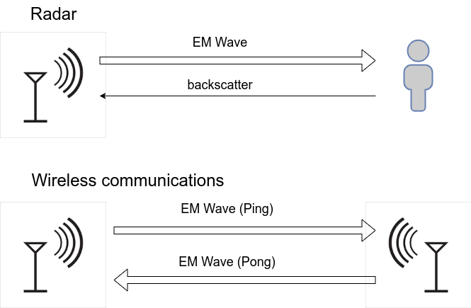
High Range Resolution Software Defined Radar
Motivation
Radar: Transmitting RF signals and then analysis of their reflections
Software Defined Radio: a radio that can change its purpose with a simple software update
Software Defined Radar: Radar implemented on top of a SDR
Flexibility
Cost-Effectiveness
Adaptability
Rapid Prototyping

Slide 3
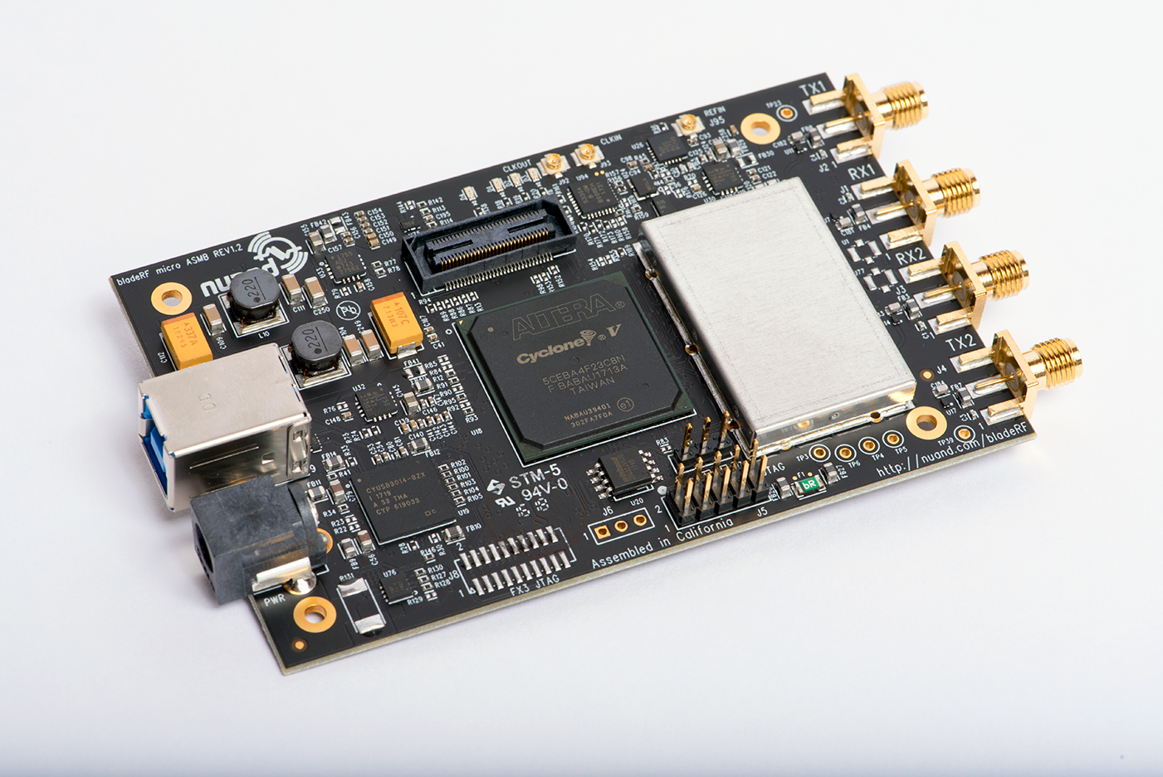
High Range Resolution Software Defined Radar
BladeRF 2.0 Micro
Spec | Value
ADC/DAC Sample Rate | 61.44 MHz
Max IBW | 56 MHz
RF Tuning Range (TX) | 47 MHz to 6 GHz
RF Tuning Range (RX) | 70 MHz to 6 GHz
CW Output Power | Around 8 dBm (6.3 mW)
Dimensions | 6.3 x 10.2 x 1.8 cm^3
Weight | 90 g
Host communication | USB 3.0
$540

Slide 4
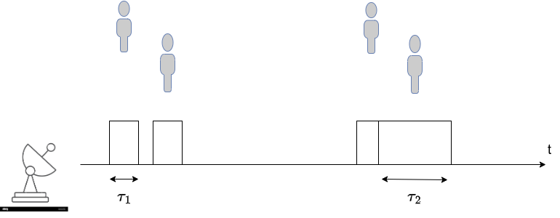
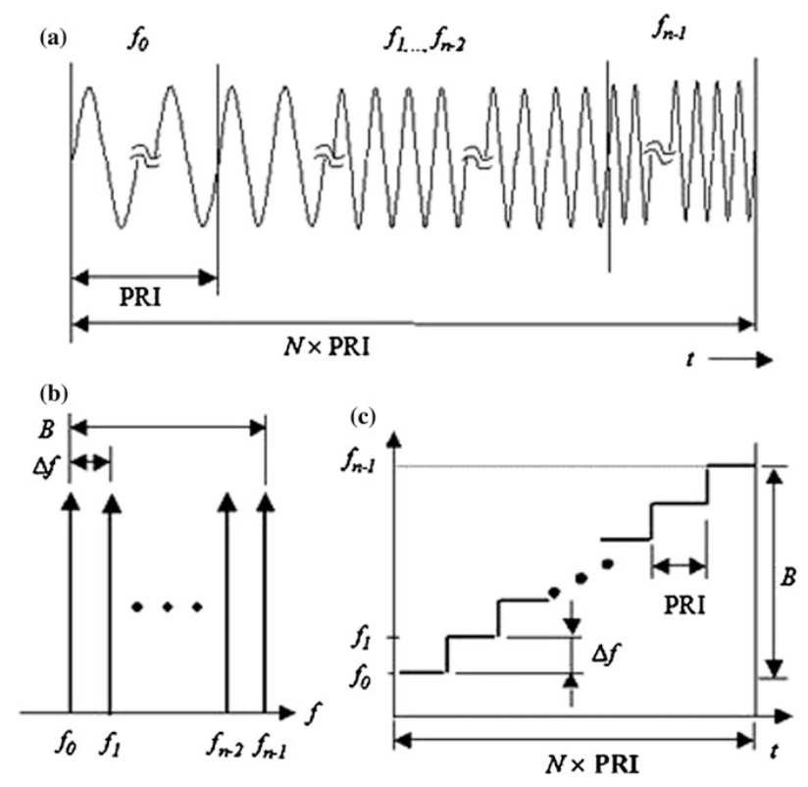
High Range Resolution Software Defined Radar
Challenge 1: Radar Range Resolution
Type of Radar | Output Power | Instantaneous Bandwidth
Pulsed Radar | High | Wide
FMCW Radar | Low | Wide
SFCW Radar | Low | Narrow
Shorter pulse→Larger bandwidth→Finer resolution
Range Resolution = Speed of Light / (2*Bandwidth)
  2 GHz → 0.075m
  1 GHz → 0.15m
  56 MHz → 2.73m
  10 MHz → 15m
SFCW radar: a) waveform, b) frequencies and c) spectrogram

Slide 5
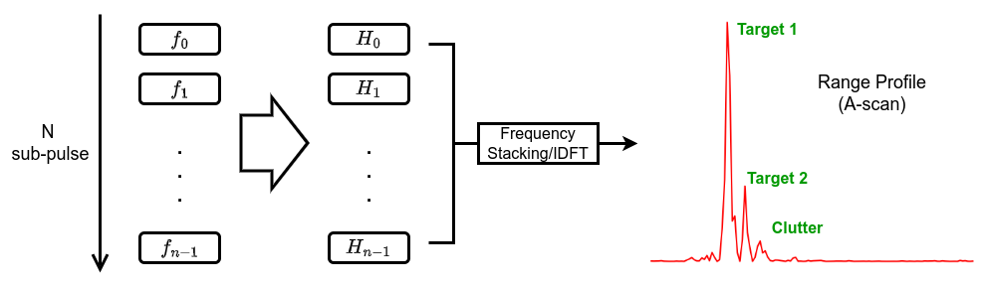
High Range Resolution Software Defined Radar
SFCW Radar
Transmit pulse and receive echo at each frequency step
Calculate channel responses for each frequency step
Coherently process the collected channel responses to get range profile

Slide 6
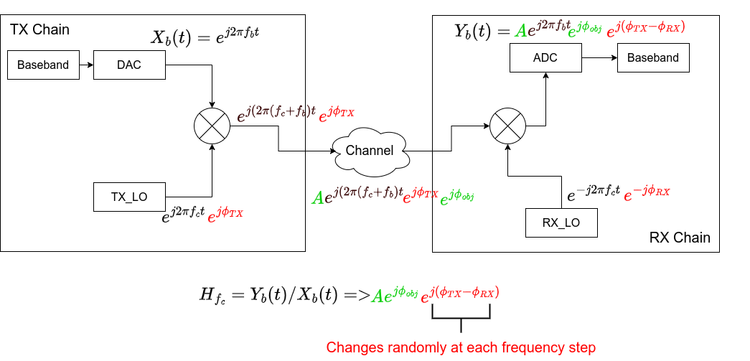
High Range Resolution Software Defined Radar
Challenge 2: None-coherent TX/RX

Slide 7
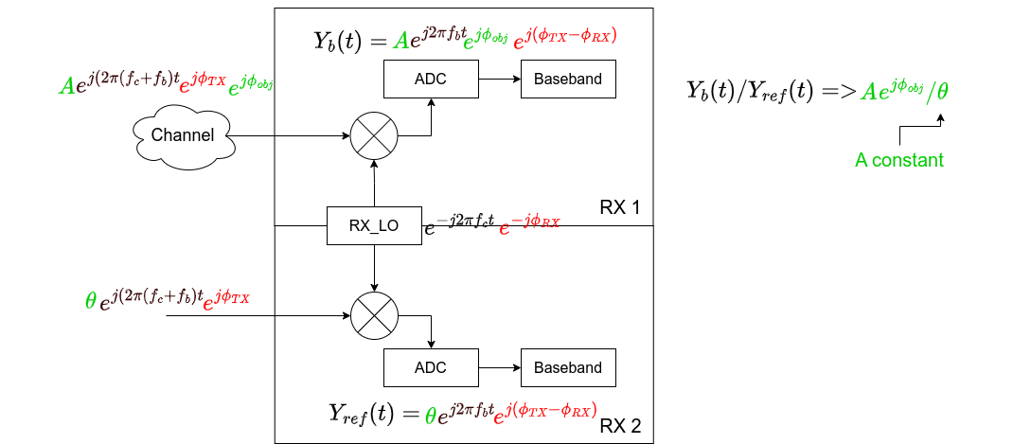
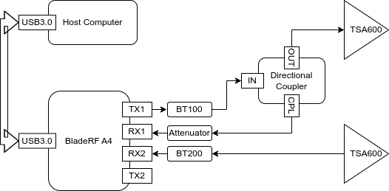
High Range Resolution Software Defined Radar
Use MIMO

Slide 8
High Range Resolution Software Defined Radar
Challenge 3: Internal Coupling
The received signal from RX channels is the sum of radar echos, a copy of TX signals and noise due to internal circuit
Internal coupling won’t hurt much for communication purpose but introduce strong phase noise for radar application
A calibration method was proposed to reduce the impact of internal coupling (See the upcoming paper)
The method reduces the SCR from -7db to -14db

Slide 9
High Range Resolution Software Defined Radar
Results: A Low-cost Software Defined Radar
Real time re-configurable
Real time re-configurable
Build in single tone and chirp waveform, support user defined waveform
Minimum range resolution: 3 cm
Noise floor: -70 db
Detection range: 30 meter for door size objects
  1 GHz effective bandwidth
  Central frequency 2.4 GHz
Penetrating capability: 0.5 meter
  Dry sands
  20 cm x 20 cm reflection surface
  1 GHz to 2 GHz bandwidth

Slide 10
Ground penetrating radar – SDR implementation
Hardware
BoM
Components | Units | Unit price | Spec
BladeRF micro A4 | 1 | 540 US dollar | Software defined radio with 2x2 MIMO channels. Frequency range: 47MHz to 6GHz Max sampling rate: 61.44MHz
BT-100 Bias-tee | 1 | 30 US dollar | Power amplifier (TX) Frequency range: 50 MHz to 6 GHz Typ Gain: +15.6 dB at 200 MHz, +10.7 db at 2.4 GHz
BT-200 Bias-tee | 1 | 30 US dollar | Low noise amplifier (RX) Frequency range: 50 MHz to 6 GHz Typ Gain: +20.2 db at 200 MHz, +16 db at 2.4 GHz
BladeRF 2.0 micro case | 1 | 20 US dollar | PolyCarbonate case for the BladeRF micro A4
RFSpace TSA600 | 2 | 74 US dollar | UWB tapered slot antenna Frequency range: 600 MHz to 6 GHz Gain: 7 to 11 dBi
ZFDC-20-50-S+ | 1 | 97.53 Euro | Directional Coupler Frequency range: 20 MHz to 2 GHz Coupling Factor: 19.5 +/- 0.5 dB
BECEN Attenuator | 1 | 11.5 Euro | -20 dB attenuator
SMA cables | 4 | 8.5 Euro | Male to male 30 cm

Slide 11
Ground penetrating radar – SDR implementation
Software
Library | Version | Licensing
Python3 | 3.11 | PSF
numpy | 1.17.4 | MIT
scipy | 1.3.3 | MIT
Library | Version | Licensing
libbladeRF | 2.5.0 | LGPLv2.1
GNURadio | 3.10 | GPLv3
volk | 2.4 | GPLv3
List of Dependencies
Software components
Module | Status | Language | DIR | Functions
bladerf_device.cc | Developed | c++ | lib/ | Base class to control bladeRF to transmit pulse and receive echo signals
sfcw_radar_mimo_cc_impl.cc | Developed | c++ | lib/ | Sfcw radar implementation using the second TX channel for reference signals
sfcw_radar_miso_cc_impl.cc | Developed | c++ | lib/ | Sfcw radar implementation using direction coupler for reference signals
RawSamplesSink.py | Developed | python | python/sfcwRadar/ | Record raw radar echos
rangeProfileSink.py | Developed | python | python/sfcwRadar | Record range profile and send to the remote server
ClutterRemover.py | Developed | python | script/ | Remove ground clutter
MatchedFilter.py | Developed | python | python/sfcwRadar/ | Matched filter implementation to extract channel response when using chirp waveform
Calibration.py | Developed | python | python/sfcwRadar/ | Calibration algorithm to address the internal coupling
GetRangeProfile.py | Developed | python | script/ | Signal processing pipeline from radar echos to range profile (A-scan)
sfcwRadarGui | Developed | python+grc | gui/ | The graph user interface of the ground penetrating radar. Use it for data collection or onsite survey

Slide 12
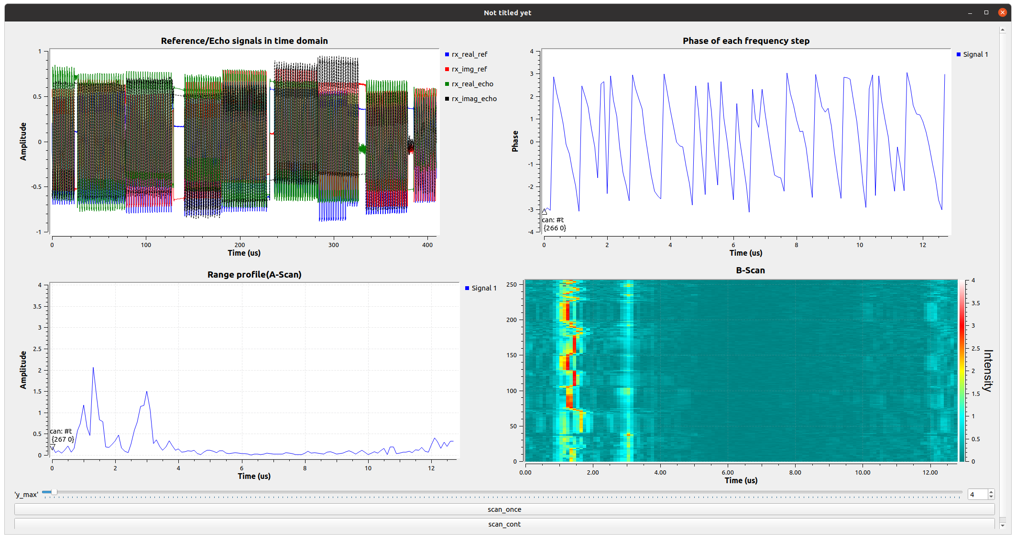
Ground penetrating radar – SDR implementation
A-scan and B-scan example
Ceiling echo
Metal plate echo
Ceiling echo
a metal plate moving back and forth
Close to radar
Away from radar
Close to radar
Away from radar
Click this button to scan just once
Scan contentiously

Slide 13
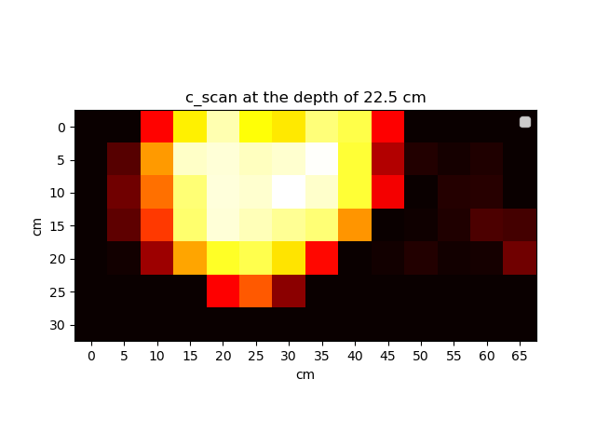
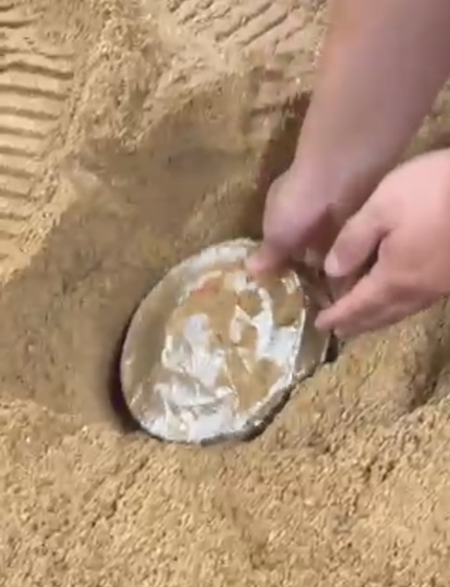
Ground penetrating radar – SDR implementation
C-Scan example

Slide 14
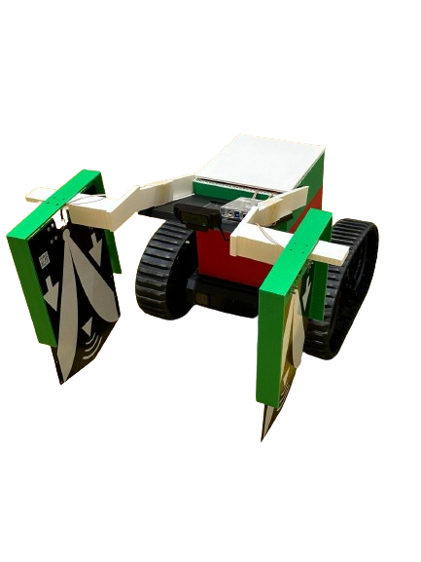
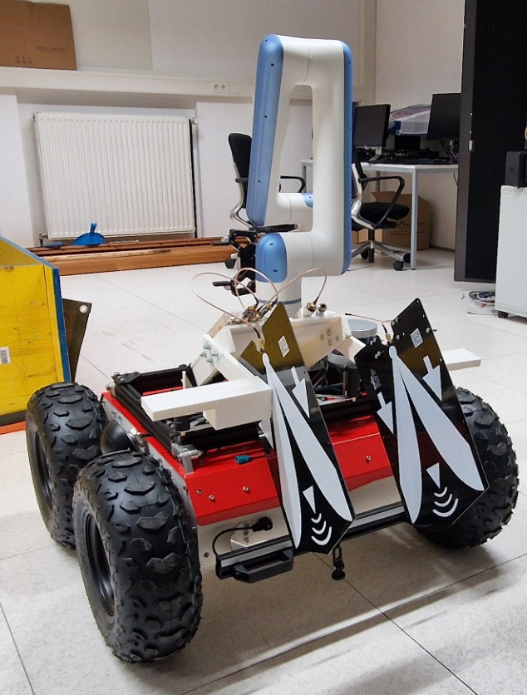
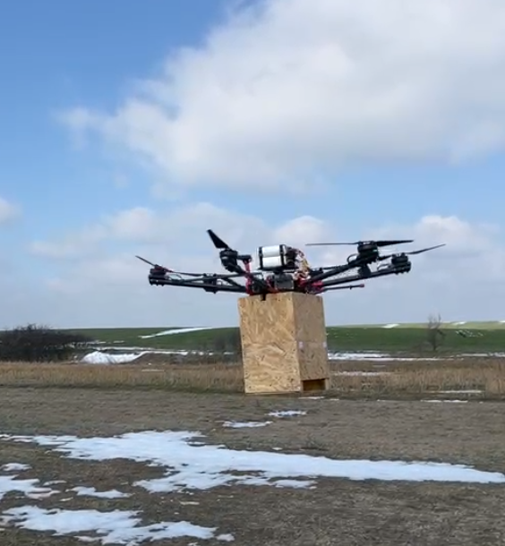
Ground penetrating radar – SDR implementation
Experiments

