Slide 1
Ground Penetrating Radar – A SDR Implementation

Slide 2
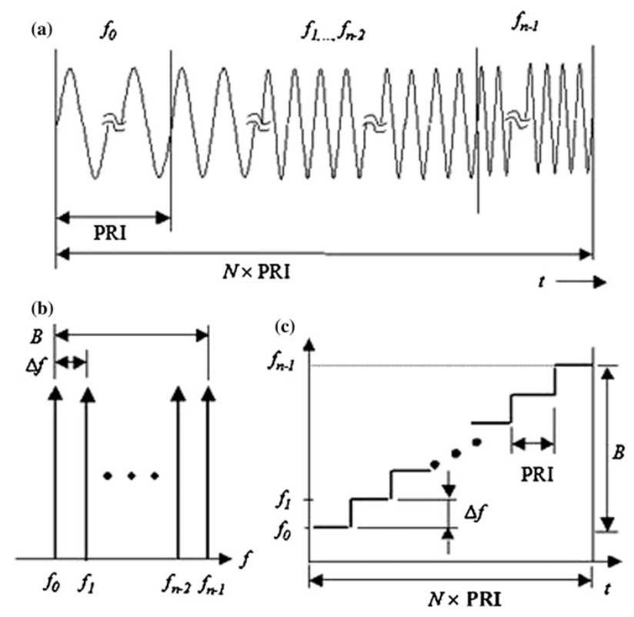
Ground penetrating radar – SDR implementation
SFCW Radar Principle
Stepped-frequency continuous-wave (SFCW) radar transmits consecutive trains of sinusoidal signals at different frequencies
The reflected signals from the targets is transformed into a synthetic pulse in time domain using IDFT
The synthetic pulse reveal the target’s position and other information
Suitable for SDR implementation as SFCW radar requires small instantaneous bandwidth
SFCW radar signals: a) waveform, b) frequencies adn c) spectrogram

Slide 3
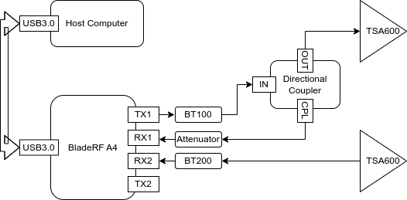
Ground penetrating radar – SDR implementation
Hardware
System diagram

Slide 4
Ground penetrating radar – SDR implementation
Hardware
BoM
Components | Units | Unit price | Spec
BladeRF micro A4 | 1 | 540 US dollar | Software defined radio with 2x2 MIMO channels. Frequency range: 47MHz to 6GHz Max sampling rate: 61.44MHz
BT-100 Bias-tee | 1 | 30 US dollar | Power amplifier (TX) Frequency range: 50 MHz to 6 GHz Typ Gain: +15.6 dB at 200 MHz, +10.7 db at 2.4 GHz
BT-200 Bias-tee | 1 | 30 US dollar | Low noise amplifier (RX) Frequency range: 50 MHz to 6 GHz Typ Gain: +20.2 db at 200 MHz, +16 db at 2.4 GHz
BladeRF 2.0 micro case | 1 | 20 US dollar | PolyCarbonate case for the BladeRF micro A4
RFSpace TSA600 | 2 | 74 US dollar | UWB tapered slot antenna Frequency range: 600 MHz to 6 GHz Gain: 7 to 11 dBi
ZFDC-20-50-S+ | 1 | 97.53 Euro | Directional Coupler Frequency range: 20 MHz to 2 GHz Coupling Factor: 19.5 +/- 0.5 dB
BECEN Attenuator | 1 | 11.5 Euro | -20 dB attenuator
SMA cables | 4 | 8.5 Euro | Male to male 30 cm

Slide 5
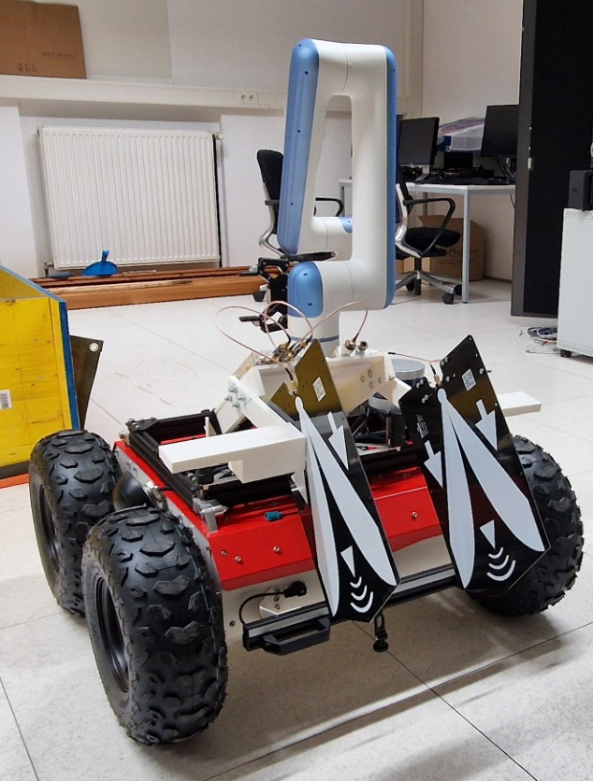
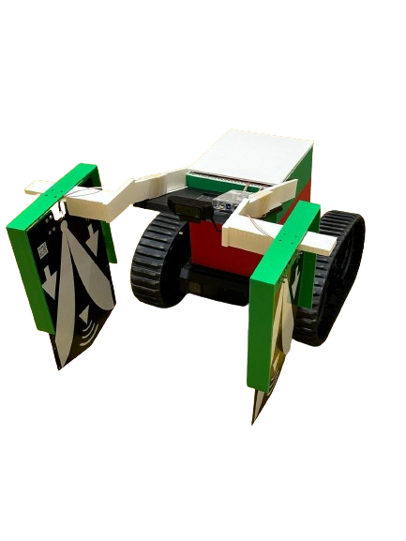
Ground penetrating radar – SDR implementation
Hardware

Slide 6
Ground penetrating radar – SDR implementation
Software
List of Dependencies
Library | Version | Licensing | Purpose | Link
libbladeRF | 2.5.0 | LGPLv2.1 | BladeRF A4 api | https://github.com/Nuand/bladeRF
GNURadio | 3.10 | GPLv3 | SDR development kit | https://github.com/gnuradio/gnuradio/tree/main
volk | 2.4 | GPLv3 | The Vector Optimized Library | https://github.com/gnuradio/volk/tree/main
Python3 | 3.11 | PSF
numpy | 1.17.4 | MIT |  | https://github.com/numpy/numpy
scipy | 1.3.3 | MIT |  | https://github.com/scipy/scipy/tree/main
Software components
Module | Status | Language | DIR | Functions
bladerfRadarBurst_cc | Developed | c++ | lib/ | Control bladeRF to transmit CW in different frequencies and receive echo signals
rawSignalSink_cc | Developed | c++ | lib/ | Recording raw samples of echo signals to binary file
rangeProfileSink | Developed | python | python/sfcwRadar/ | Recording range profile to json file, add gps tags (currently pseudo gps)
radarTxRxSimulator | Developed | python | python/sfcwRadar/ | A simulator to test the signal processing algorithm
clutterRemover | Developing | python | script/ | Remove ground clutter
sfcwRadarGui | Developed | python+grc | gui/ | The graph user interface of the ground penetrating radar. Use it for data collection or onsite survey

Slide 7
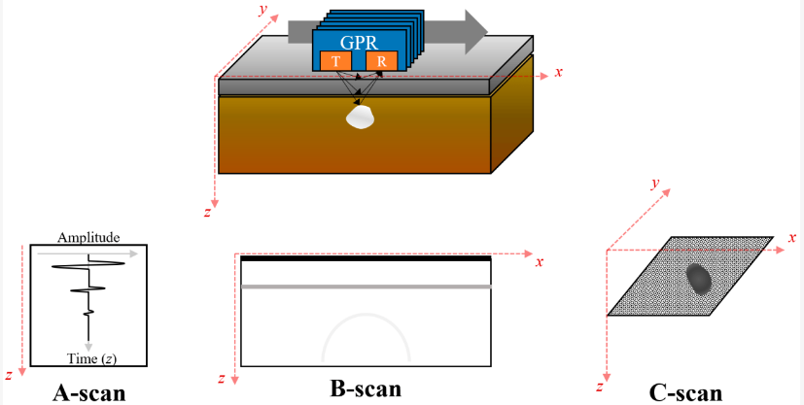
A-scan, B-scan and C-scan

Slide 8
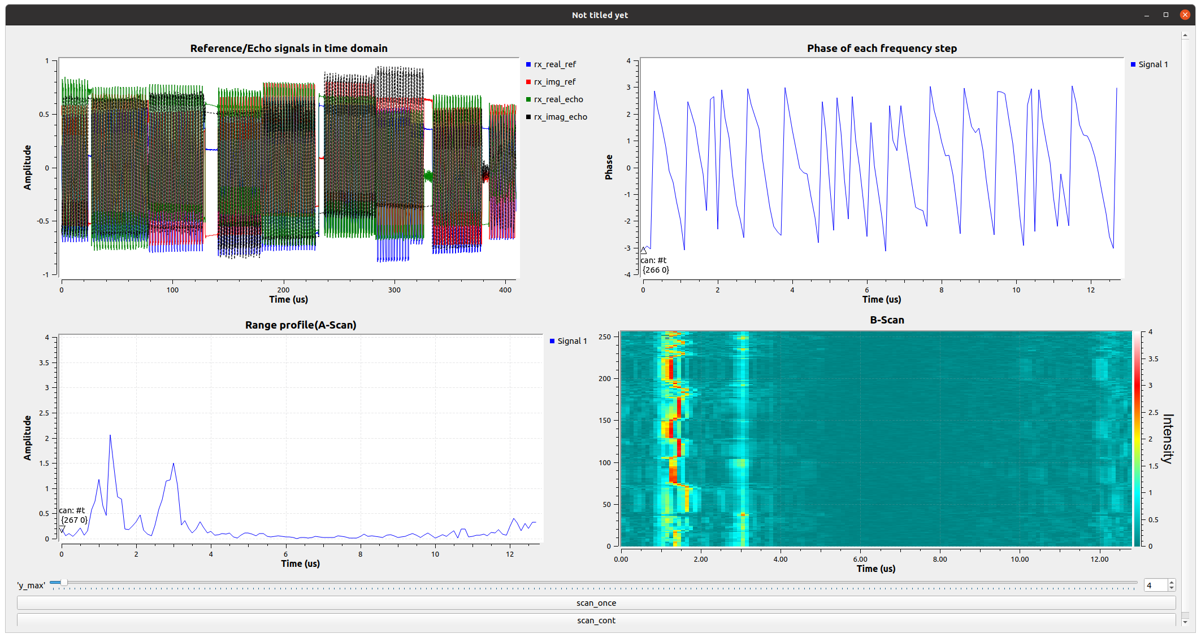
Ground penetrating radar – SDR implementation
A-scan and B-scan example
Ceiling echo
Metal plate echo
Ceiling echo
a metal plate moving back and forth
Close to radar
Away from radar
Close to radar
Away from radar
Click this button to scan just once
Scan contentiously

Slide 9
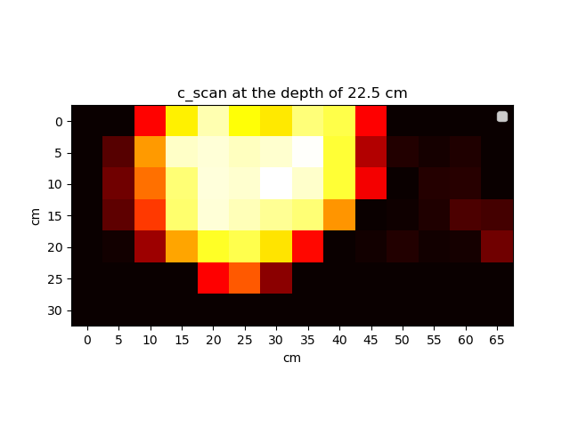
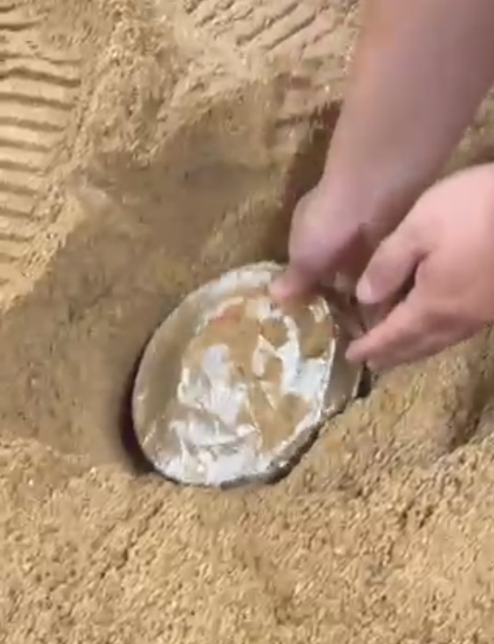
Ground penetrating radar – SDR implementation
C-Scan example

