Slide 1
Soil Moisture Estimation using Software Defined Radar

Slide 2
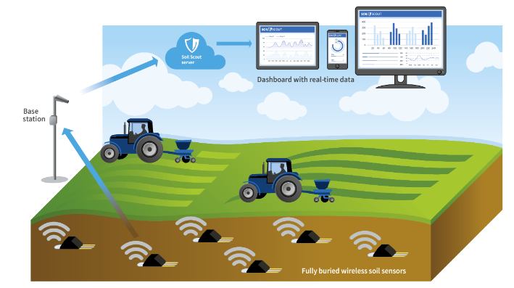
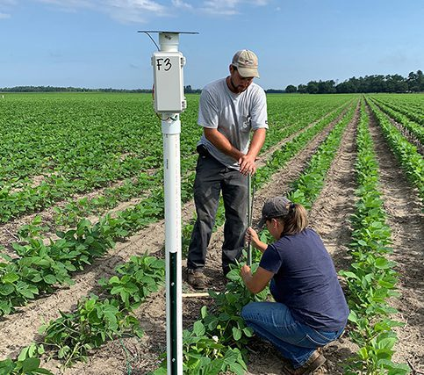
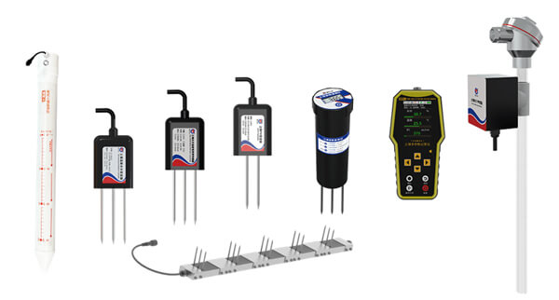
Soil moisture estimation using software defined radar
Importance of soil moisture measurements
69% of the global fresh water supply is used for agriculture
More than 15% of water is wasted due to over watering
Accurate, real time soil moisture monitoring leads to a water
saving of around 50%
Soil sensors on the market
Electricity resistance sensors
Tensiometers
Radioactive sensors
Less than 10% of irrigated field in the US deploy moisture sensors
Reason of low deployments
Costs: hundreds of dollars per sensor kit, each farm needs to deploy hundreds of them
Maintenance: need to bury soil sensors under ground, re-installation required every tilling
Contamination: batteries and decomposed electronic components have the risk to contaminate soil

Slide 3
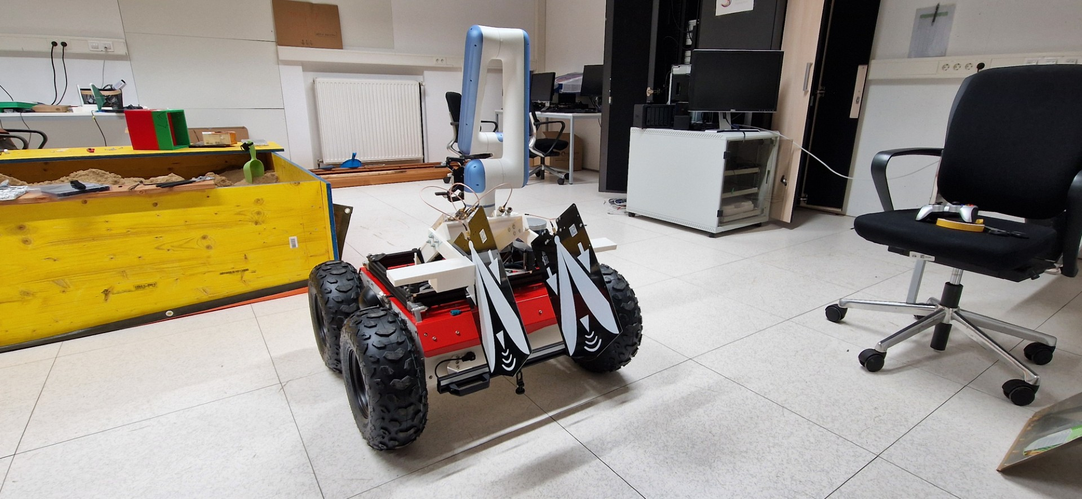
Soil moisture estimation using software defined radar
Our solution – radio frequency signals (radar)
Environmental friendly: contact-less, no need to bury hazardous materials
Low cost: one radar can scan a large area when mounted on a robot
Multiple depth: the radar can measure soil moisture at multiple depths underneath the surface
Easy maintenance: greatly reduces the labor required for sensor network maintenance
Beyond soil moisture: root monitoring, soil compactness etc.

Slide 4
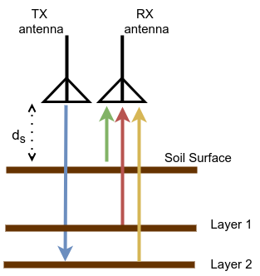
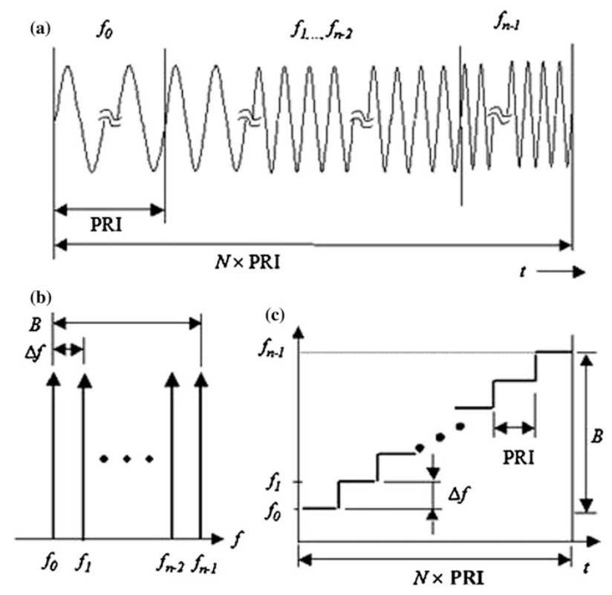
Soil moisture estimation using software defined radar
The Working Principle
Stepped-frequency continuous-wave (SFCW) radar transmits consecutive trains of sinusoidal signals at different frequencies
The reflected signals from different soil layers and underground objects are transformed into a synthetic pulse in time domain
The synthetic pulse reveal the soil layers’ depth, moisture and other information
Suitable for SDR implementation as SFCW radar requires small instantaneous bandwidth
SFCW radar signals: a) waveform, b) frequencies adn c) spectrogram

Slide 5
Soil moisture estimation using software defined radar
Hardware
BoM
Components | Units | Unit price | Spec
BladeRF micro A4 | 1 | 540 US dollar | Software defined radio with 2x2 MIMO channels. Frequency range: 47MHz to 6GHz Max sampling rate: 61.44MHz
BT-100 Bias-tee | 1 | 30 US dollar | Power amplifier (TX) Frequency range: 50 MHz to 6 GHz Typ Gain: +15.6 dB at 200 MHz, +10.7 db at 2.4 GHz
BT-200 Bias-tee | 1 | 30 US dollar | Low noise amplifier (RX) Frequency range: 50 MHz to 6 GHz Typ Gain: +20.2 db at 200 MHz, +16 db at 2.4 GHz
BladeRF 2.0 micro case | 1 | 20 US dollar | PolyCarbonate case for the BladeRF micro A4
RFSpace TSA600 | 2 | 74 US dollar | UWB tapered slot antenna Frequency range: 600 MHz to 6 GHz Gain: 7 to 11 dBi
ZFDC-20-50-S+ | 1 | 97.53 Euro | Directional Coupler Frequency range: 20 MHz to 2 GHz Coupling Factor: 19.5 +/- 0.5 dB
BECEN Attenuator | 1 | 11.5 Euro | -20 dB attenuator
SMA cables | 4 | 8.5 Euro | Male to male 30 cm

Slide 6
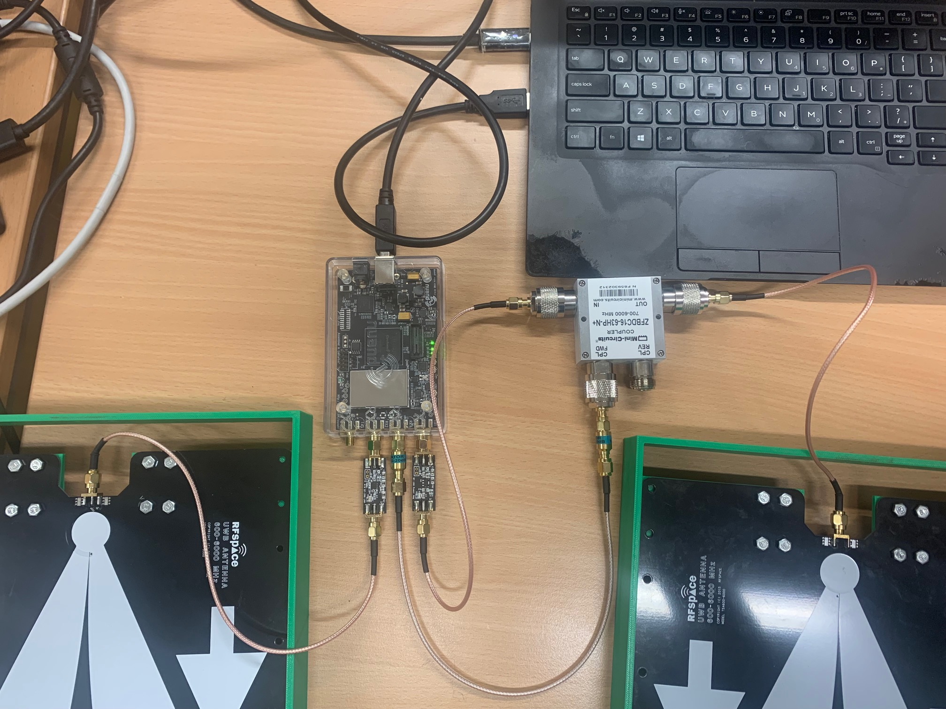
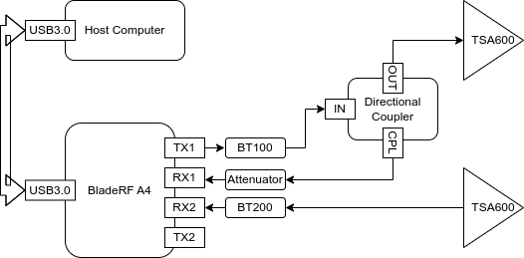
Soil moisture estimation using software defined radar
Hardware
Central frequency: 1.5Ghz or 3.5Ghz
Bandwidth: Maximum 6Ghz
Depth Resolution: 15 cm
Mean measurement error: 5%
BladeRF
Directional
Coupler
BT200
BT100
TSA600
Attenuator

Slide 7
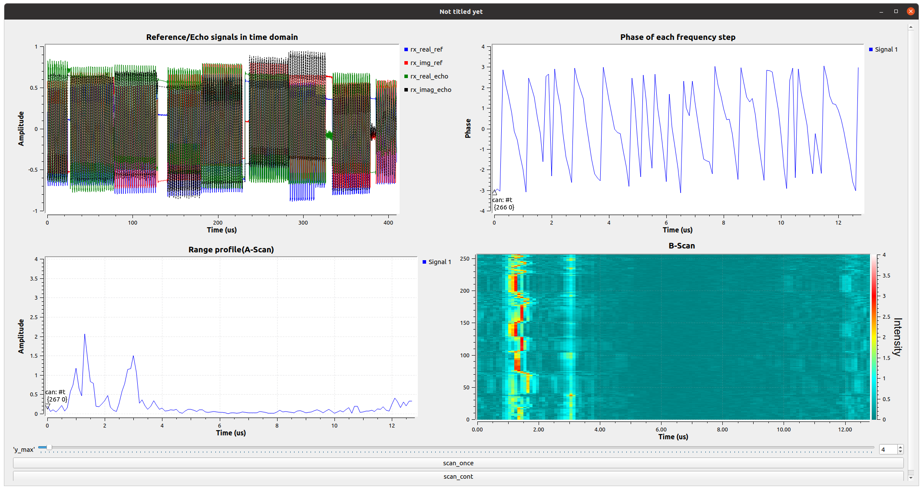
Soil moisture estimation using software defined radar
Experiment example
Buried objects
Soil layer 1
Soil layer 2
Buried objects
Close to radar
Away from radar
Close to radar
Away from radar
Click this button to scan just once
Scan contentiously

