Slide 1

ZFApp Preview Walkthrough
Notes:
Theme created by
Sakari Koivunen and Henrik Omma
Released under the LGPL license.

Slide 2
What is ZFApp?
ZFApp is an application framework built on top of Zend Framework
Fully compatible with the latest ZF Versions
Designed to bridge the gap between the framework and using the framework as an application platform for a new application

Slide 3
Motivations
The current Zend Framework doesn't lend itself very well as an Application platform at present
Relatively high barrier to entry
It's free-form structure which makes it useful for integration with current applications makes it less apt at ground-up development
Created to serve the needs of the Professional Services department at Zend

Slide 4
Issues ZFApp is designed to address
One-step download to deployment
  ZFApp in its final form will provide a helper application to create a new application:
  $ ./createapp ZFBlog
Increased ease of use of Zend Framework's MVC model
  Auto Templating
  Clear controller / view flow
  Improved Controller abilities

Slide 5
Issues ZFApp is designed to address
Consistency and Best Practice
  Automatic usage of Zend_Filter_Input when possible
  Consistent Error handling
    Can be plugged directly into Zend Platform for application monitoring
  Recommended Architecture
    ZFApp gives you enough to reproduce the pattern, using a solid architecture, without writing so much of the application for you that it becomes bloated and difficult to grasp.
GOAL: Blog in 30 minutes from zero

Slide 6
Where ZFApp currently is
This Preview release, while may contain bugs, provides the following:
  AutoTemplates
  “Pretty” global Error handling and debugging facilities
  “Pretty” noRoute handling
  Clear separation between controller and rendering of controller
  Basic Database support
  Improved APIs over that of Zend Framework

Slide 7
Getting Started
Getting Started with Framework is fairly easy, even without an automated installer
  1) Copy entire ZFApp/ directory to application location
  2) Execute appgen.php
  3) Provide write-access to the web server to the webtmp/ directory of your app
  4) Set up Apache's DocumentRoot to the www/ dir of the app and turn on AllowOverride = All
Note: All 5 steps will be automated in future version. More detailed can be found in the “INSTALL” file

Slide 8
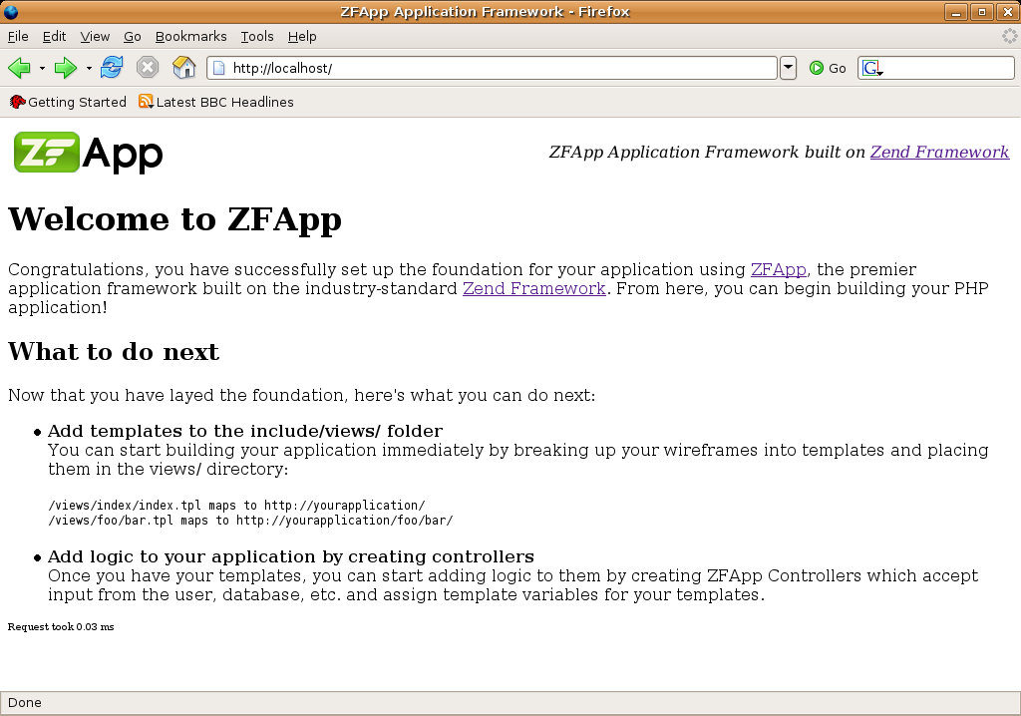
Getting Started
Once the 5 steps are completed your're all set, just point your browser to the local server!

Slide 9
ZFApp Layout
ZFApps have a consistent structure
  include/ application-specific includes
  include/views/ Application views
  webtmp/ application temp storage
  ZFApp/ ZFApp framework
  lib/ ZFApp supporting libraries (Zframework, Smarty)
  www/ application document root
  ZFApp/ itself is structured in the same way as Zframework (ZFApp/ZFApp/Controller/Front.php)

Slide 10
Provided Templates
ZFApp provides the View component of MVC and as such a number of templates
views/_main/index.tpl
  Global shell template, contains basic HTML for a well-formed page
views/_main/error.tpl
  Global error template for professional looking, consistent, and useful error messages

Slide 11
Provided Templates (Continued)
views/_main/noroute.tpl
  Standardized No-route template
views/index/index.tpl
  Provided introduction template (welcome screen)

Slide 12
Autotemplates
In ZFApp, controllers are optional
  If a controller isn't found, ZFApp will look for a template instead
  http://localhost/foo/bar -> /views/foo/bar.tpl
Very powerful, you can create nearly all of your templates without writing a single line of PHP code

Slide 13
Render Flow
In ZFApp, execution and render are cleanly separated into two phases
Action's responsibility is to assign view vars
  $this->view()->assign('foo', bar);
After all controllers in the chain have executed, ZFApp renders the _main/index.tpl controller, which in turn will render the primary controller
  Primary is the controller executed by user.. i.e. /foo/bar -> FooController::bar()

Slide 14
Render Flow
Every action is rendered using the {render} function from within the template itself
{render module=”blog” action=”view”}
  Calls BlogController::render(“viewAction”)
Default implementation of render() will look for the views/blog/view.tpl template
  Makes writing functionality very easy
_main/index.tpl contains initial {render} to render the primary controller

Slide 15
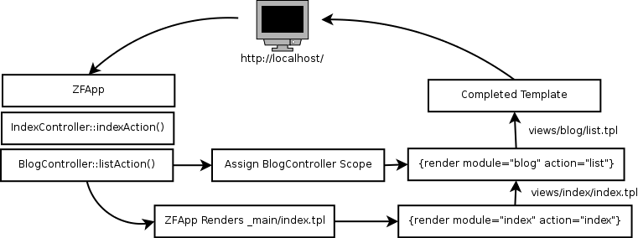
Basic Render Flow

Slide 16
View Binding
Sometimes it makes sense to have two actions use the same view Within a Controller
i.e. BlogController::postAction() and BlogController::editAction() use the same form
Handled by adding an entry to $this->_viewMap
  $this->_viewMap('editAction' => 'postAction');

Slide 17
Final Render Notes
Each Controller has it's own view scope
  $this->assign() will set variables in it's own scope only
  $this->assignGlobal() will set globally available variables (username, etc)
You can also pass parameters into a sub-template
  {render module=”Blog” action=”view” entry=$entry} will set blog/view.tpl {$entry}

Slide 18
Error Handling
ZFApp uses a completely exception-based error model
  Smarty and PHP internal errors are converted into a child of ZFApp_Exception
  Exceptions are caught by ZFApp if uncaught elsewhere, and a useful error page is displayed which can be customized

Slide 19
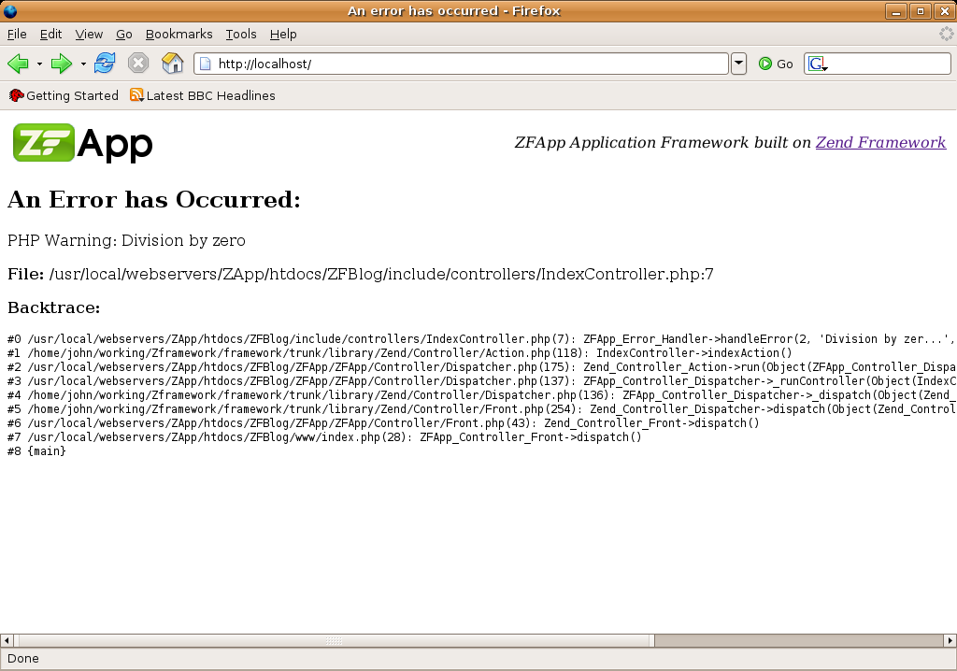
Error Handling
_main/error.tpl

Slide 20
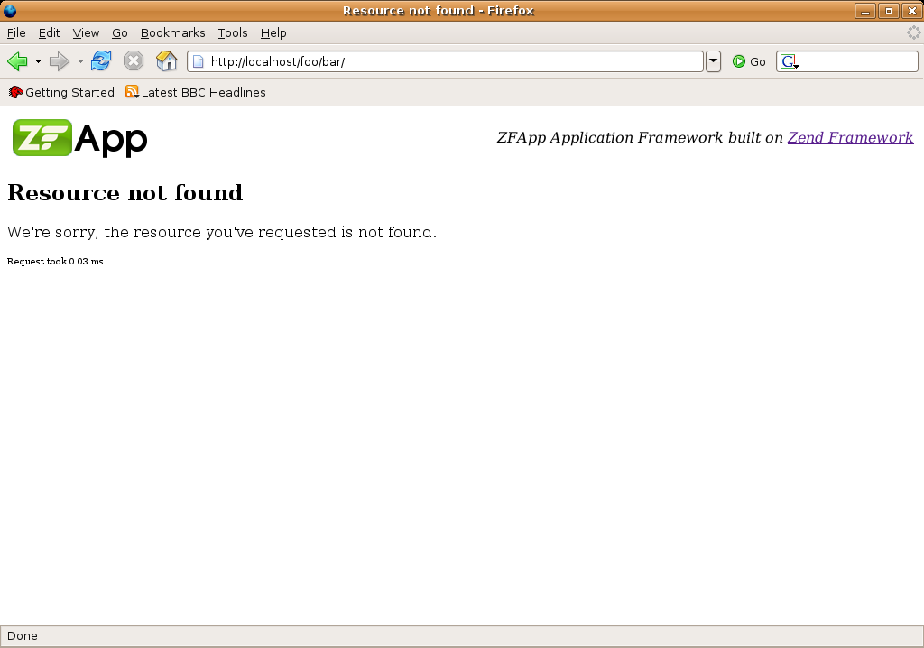
Error Handling
_main/noroute.tpl

Slide 21
Controller Features
ZFApp improves Controllers significantly
  DB(), View() provide instances of the respective components
  GET(), POST(), SERVER() methods provide Filtered access to superglobals
  Default render() implementation provides automatic rendering of templates even when a controller is provided
  _requireParam() provides easy access to Controller Parameters which are required for action to take place

Slide 22
Application Controller
All ZFApp Controllers extend from ZFApp_Controller_Action_Base, and most should extend from ApplicationController
  ApplicationController provides a “global” controller where actions available to all controllers can be placed
  Base Controller provides all of the aforementioned nice functionality

Slide 23
Future Plans
Auto Installation support
Automatic filtering of URL parameters
Internal (trusted) and External (untrusted) Controller parameters
Implementation of neat view data modifiers
  {$string|textify}
AJAX-focused Controller subclasses abstracting away JSON interaction

Slide 24
Future plans (continued)
Perhaps merge with current Zend Framework Code base?
  Or provided as part of the Zend Framework package
Providing of Zend Studio Templates for quick controller creation
Will have own home at www.zfapp.[com|org|net] regardless

Slide 25
That's it!
Feel free to send me questions / comments / hate mail
  john@zend.com
Help wanted!!
  This is already a ton of code for one guy to write between real job projects

