Slide 1
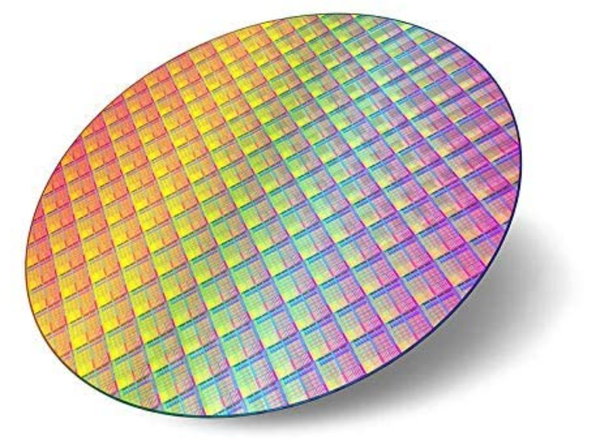
The Importance of IC Development
Brian Dam Pedersen
Chief Technology Officer, GN
DTU Chip Day
April 14th 2026

Slide 2
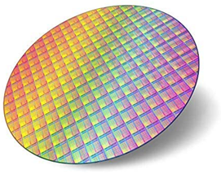
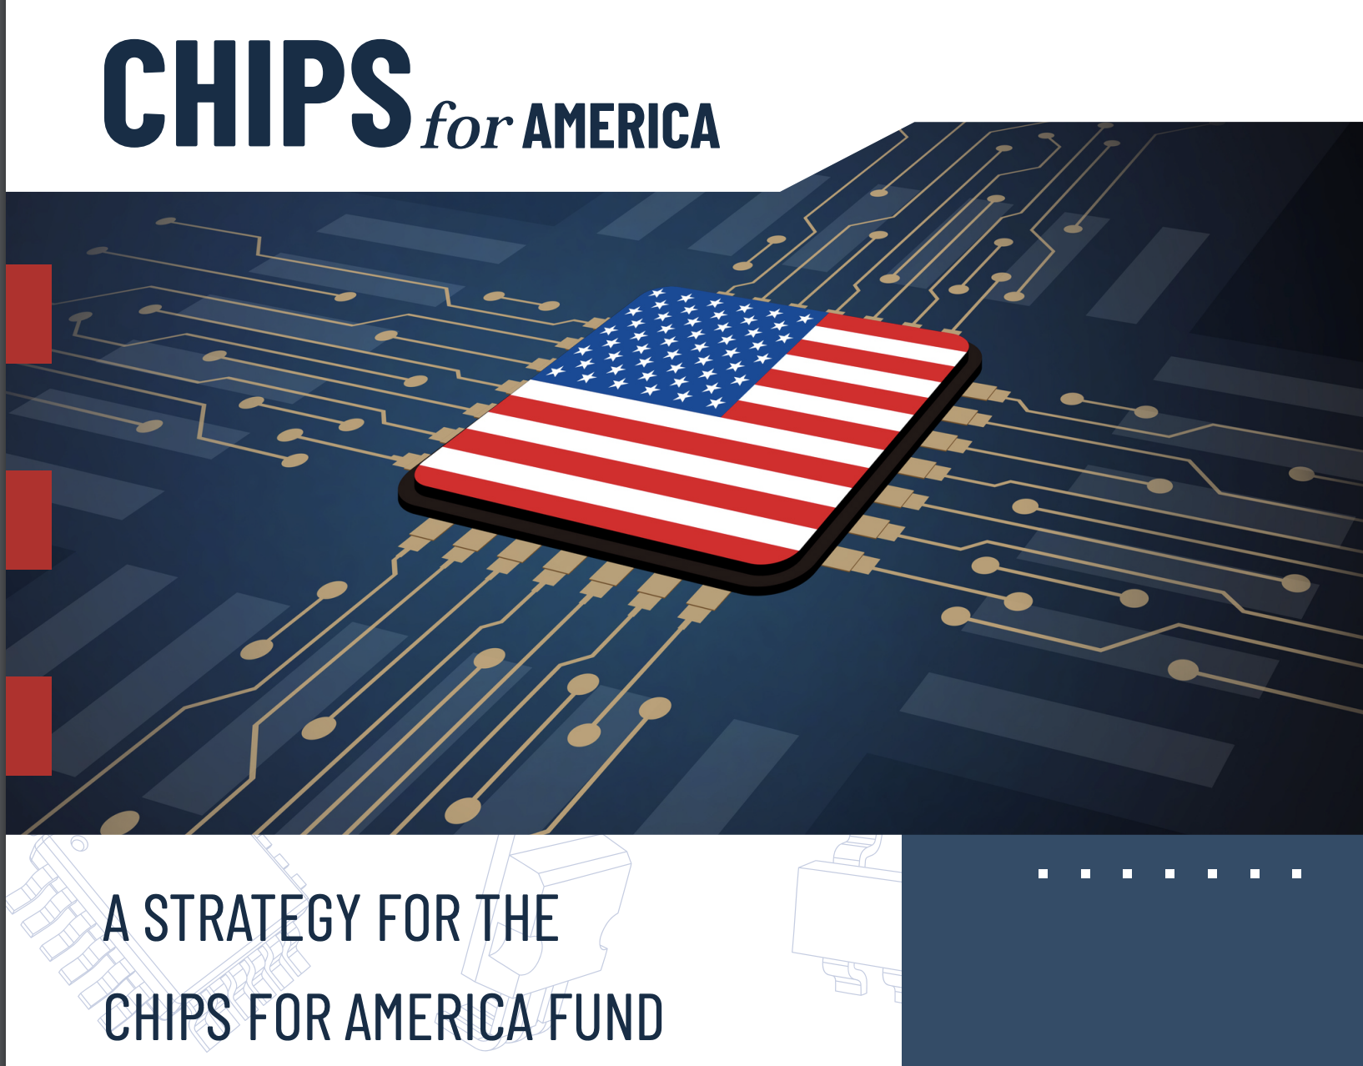
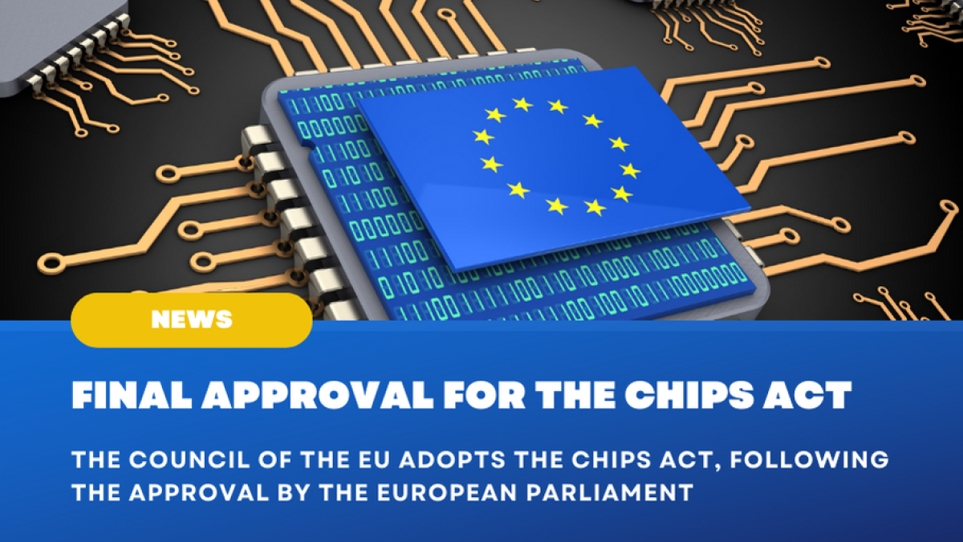
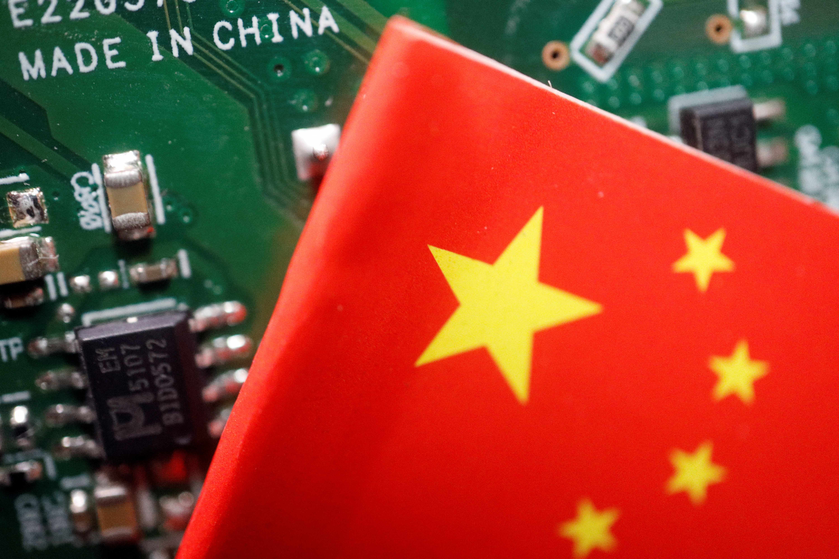
Chips have become a strategic ressource
Notes:
We are at an important inflection point in the chip development history. I have a degree in IC development from 2000, and back then the general sentiment was that chip development was a US thing, soon to be commoditized outside very specific niches. Within the past years, companies like Apple has show how controlling the entire stack (chip, electronics, software) can create unique user experiences, and this has created a rennaisance for chip design in many sectors. Today EU, US and China have heavy investment programs in the order of 50 billion dollars each to ensure supply and knowhow for their respective industries. This has maybe created the sentiment that we have dropped the ball completely as a continent, and granted – the lack of focus during the 2010s has really hurt the capabilities in Europe but we are far from lost

Slide 3

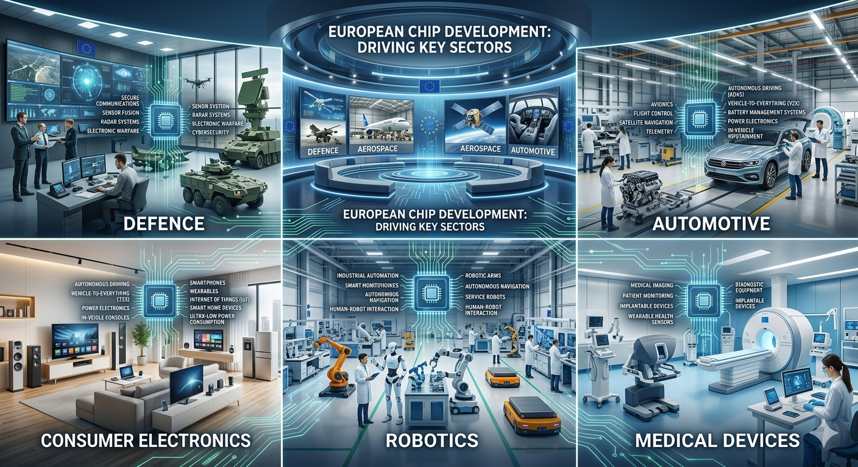

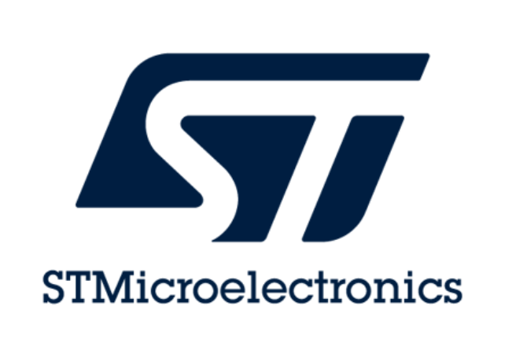

European chip development is very much alive – and need you
Notes:
European chip industry is far from lost. We have big industry players that ensure that we have an european ecosystem to drive our industries in the future.

Slide 4
Chip design is vital for a number of
Danish sectors as well
Radar systems
High speed networking
High-end audio
Hearing aids and other medical devices
Notes:
In Denmark we have a proud tradition within certain niches – high speed design and audio applications. Here FPGAs and ASICs are vital components. Especially hearing aids is interesting as we are very dependent on advanced IC technologies, and 2/3 of the worlds hearing aids are designed within a 6 km radius west of Copenhagen.

Slide 5
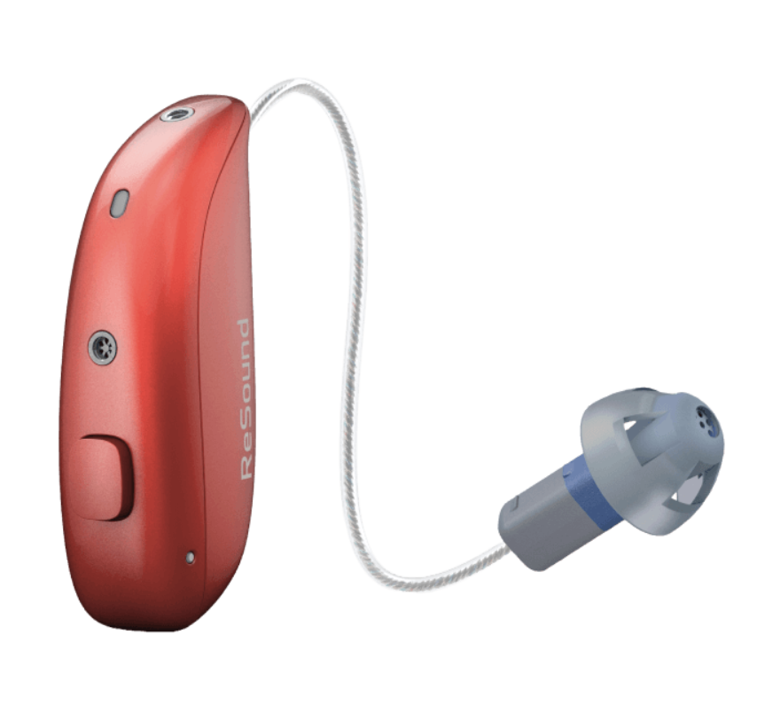
No modern hearing aids without ASICs
Digital Signal Processing and control
  Multichannel compression
  Adaptive Feedback suppression
  4-microphone Beamformer systems
  DNN based noise reduction
  Audio Codecs
  Cryptographic accelerators
Analog
  High-efficiency Li-Ion conversion
  High-SNR ADC and class-D amplifiers
RF
  Low latency audio via NFMI
  Bluetooth connectivity to PCs and mobile phones
2.5 mW average power consumption

Slide 6
Thank you
Notes:
Thank you for joining chip day and I hope you see the perspective in a carreer in this exciting field

