Slide 1
Sesion 3 - Practica 6
estadisticalemon@delarivagroup.com

Slide 2
Creacion de reportes - R Markdown
En este reporte exploraremos la base de datos “mtcars”

Slide 3
 | mpg | cyl | disp | hp | drat | wt | qsec | vs | am | gear | carb
Mazda RX4 | 21.0 | 6 | 160 | 110 | 3.90 | 2.620 | 16.46 | 0 | 1 | 4 | 4
Mazda RX4 Wag | 21.0 | 6 | 160 | 110 | 3.90 | 2.875 | 17.02 | 0 | 1 | 4 | 4
Datsun 710 | 22.8 | 4 | 108 | 93 | 3.85 | 2.320 | 18.61 | 1 | 1 | 4 | 1
Hornet 4 Drive | 21.4 | 6 | 258 | 110 | 3.08 | 3.215 | 19.44 | 1 | 0 | 3 | 1
Hornet Sportabout | 18.7 | 8 | 360 | 175 | 3.15 | 3.440 | 17.02 | 0 | 0 | 3 | 2
Valiant | 18.1 | 6 | 225 | 105 | 2.76 | 3.460 | 20.22 | 1 | 0 | 3 | 1
Resumen de datos tabla mtcars

Slide 4
Vizualizacion de la informacion
A continuacion generaremos un grafico de dispersion para visualizar el comportamiento de las variables de las base de datos mtcars

Slide 5
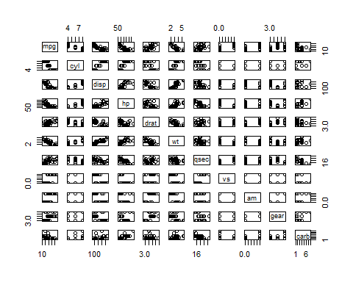

Slide 6
Adicional al grafico imprimiremos una tabla con el coeficiente de correlacion de cada variable de la base de datos mtcars
cor(mtcars) %>% knitr::kable(digits = 3, caption = 'Coeficiente de Correlacion "mtcars"')

Slide 7
 | mpg | cyl | disp | hp | drat | wt | qsec | vs | am | gear | carb
mpg | 1.000 | -0.852 | -0.848 | -0.776 | 0.681 | -0.868 | 0.419 | 0.664 | 0.600 | 0.480 | -0.551
cyl | -0.852 | 1.000 | 0.902 | 0.832 | -0.700 | 0.782 | -0.591 | -0.811 | -0.523 | -0.493 | 0.527
disp | -0.848 | 0.902 | 1.000 | 0.791 | -0.710 | 0.888 | -0.434 | -0.710 | -0.591 | -0.556 | 0.395
hp | -0.776 | 0.832 | 0.791 | 1.000 | -0.449 | 0.659 | -0.708 | -0.723 | -0.243 | -0.126 | 0.750
drat | 0.681 | -0.700 | -0.710 | -0.449 | 1.000 | -0.712 | 0.091 | 0.440 | 0.713 | 0.700 | -0.091
wt | -0.868 | 0.782 | 0.888 | 0.659 | -0.712 | 1.000 | -0.175 | -0.555 | -0.692 | -0.583 | 0.428
qsec | 0.419 | -0.591 | -0.434 | -0.708 | 0.091 | -0.175 | 1.000 | 0.745 | -0.230 | -0.213 | -0.656
vs | 0.664 | -0.811 | -0.710 | -0.723 | 0.440 | -0.555 | 0.745 | 1.000 | 0.168 | 0.206 | -0.570
am | 0.600 | -0.523 | -0.591 | -0.243 | 0.713 | -0.692 | -0.230 | 0.168 | 1.000 | 0.794 | 0.058
gear | 0.480 | -0.493 | -0.556 | -0.126 | 0.700 | -0.583 | -0.213 | 0.206 | 0.794 | 1.000 | 0.274
carb | -0.551 | 0.527 | 0.395 | 0.750 | -0.091 | 0.428 | -0.656 | -0.570 | 0.058 | 0.274 | 1.000
Coeficiente de Correlacion “mtcars”

Slide 8
Principales salidas de reportes que se pueden crear en RMarkdown
beamer_presentation
github_document
html_document
ioslides_presentation
latex_document
md_document
odt_document
pdf_document
powerpoint_presentation
rtf_document
slidy_presentation
word_document

