Slide 1
AZ-900T0x Module 01: Cloud concepts
Notes:
Adjust the title page for AZ-900T00 or AZ-900T01.
This content in SkillPipe is now aligned with the content in Learn. The notes section of the PPT will call out any free Learn sandbox exercises available and provide direct links that can be shared with students (if they are not able to create a free Azure account and/or are not following along in Learn).
Learn learning path - Describe Azure cloud concepts https://docs.microsoft.com/en-us/learn/paths/az-900-describe-cloud-concepts

Slide 2

Module Outline

Slide 3

Module 01 - Outline
You will learn the following concepts:
Cloud Models
Public, Private, and Hybrid cloud
Choosing the best for you
Cloud Benefits and Considerations
Benefits of the cloud
Cloud considerations
Cloud Services
IaaS, PaaS, and SaaS
Sharing responsibility

Slide 4

Cloud Models

Slide 5
Cloud Models - Objective Domain
Define cloud computing
Describe Public cloud
Describe Private cloud
Describe Hybrid cloud
Compare and contrast the three different cloud models

Slide 6




What is cloud computing?
Cloud Computing is the delivery of computing services over the internet, enabling faster innovation, flexible resources, and economies of scale.
Compute
Networking
Storage
Analytics
Notes:
Cloud Computing is:
A model for enabling on-demand access to a shared pool of configurable computing resources – servers, network, storage, applications, and services
Ubiquitous, convenient, on-demand network access
Rapidly provisioned and released with minimal management effort or service provider interaction
Definitions found at:
Cloud computing - https://azure.microsoft.com/en-us/overview/what-is-cloud-computing/
NIST definition - https://csrc.nist.gov/publications/detail/sp/800-145/final
Learn and SkillPipe content order note: https://docs.microsoft.com/en-us/learn/modules/intro-to-azure-fundamentals/what-is-cloud-computing
There are 4 additional slides in Learn (and SkillPipe) that cover a high level introduction to Azure:
What is Azure? https://docs.microsoft.com/en-us/learn/modules/intro-to-azure-fundamentals/what-is-microsoft-azure
Tour of Azure Services https://docs.microsoft.com/en-us/learn/modules/intro-to-azure-fundamentals/tour-of-azure-services
Get started with Azure accounts https://docs.microsoft.com/en-us/learn/modules/intro-to-azure-fundamentals/get-started-with-azure-accounts
Case study introduction (Tailwind Traders) https://docs.microsoft.com/en-us/learn/modules/intro-to-azure-fundamentals/case-study-introduction Throughout the Azure Fundamentals learning paths, we'll work with Tailwind Traders, a fictitious home improvement retailer. It operates retail hardware stores across the globe and online. The scenarios are in both the SkillPipe and Learn content.

Slide 7
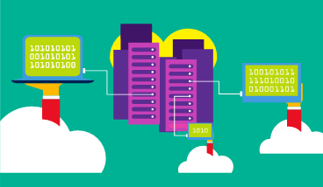
Public cloud
Owned by cloud services or hosting provider.
Provides resources and services to multiple organizations and users.
Accessed via secure network connection (typically over the internet).
Notes:
What are public, private, and hybrid clouds? - https://azure.microsoft.com/en-us/overview/what-are-private-public-hybrid-clouds/
Learn and SkillPipe content order note:
Slides 7-10 https://docs.microsoft.com/en-us/learn/modules/fundamental-azure-concepts/types-of-cloud-computing

Slide 8
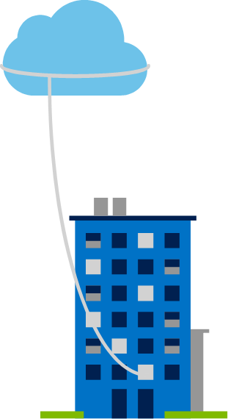
Private cloud
Organizations create a cloud environment in their datacenter.
Organization is responsible for operating the services they provide.
Does not provide access to users outside of the organization.
Notes:
Owned and operated by the organization that uses cloud resources.
Organizations create a cloud environment in their datacenter.
Self-service access to compute resources provided to users within the organization.
Organization is responsible for operating the services they provide.
Learn and SkillPipe content order note:
Slides 7-10 https://docs.microsoft.com/en-us/learn/modules/fundamental-azure-concepts/types-of-cloud-computing

Slide 9
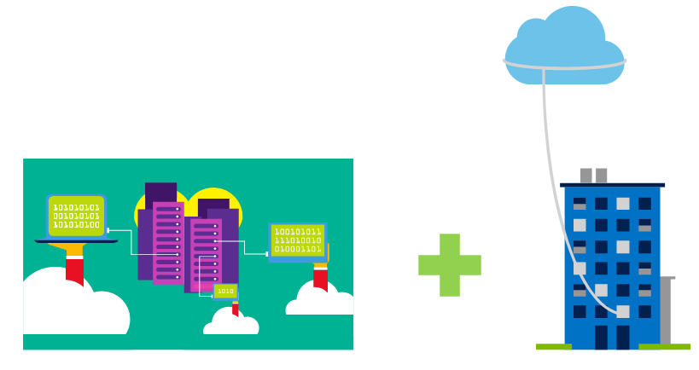
Hybrid cloud
Combines Public and Private clouds to allow applications to run in the most appropriate location.
Notes:
Hybrid cloud models have the following characteristics:
Resource location. Specific resources run or are used in a public cloud, and others run or are used in a private cloud.
Cost and efficiency. Hybrid cloud models allow an organization to leverage some of the benefits of cost, efficiency, and scale that are available with a public cloud model.
Control. Organizations retain management control in private clouds.
Skills. Technical skills are still required to maintain the private cloud and ensure both cloud models can operate together.
Learn and SkillPipe content order note:
Slides 7-10 https://docs.microsoft.com/en-us/learn/modules/fundamental-azure-concepts/types-of-cloud-computing

Slide 10
Cloud model comparison
Public Cloud
No capital expenditures to scale up.
Applications can be quickly provisioned and deprovisioned.
Organizations pay only for what they use.
Private Cloud
Organizations have complete control over resources and security.
Hybrid Cloud
Provides the most flexibility.
Organizations determine where to run their applications.
Organizations control security, compliance, or legal requirements.
Organizations are responsible for hardware maintenance and updates.
Hardware must be purchased for start-up and maintenance.
Notes:
Learn and SkillPipe content order note:
Slides 7-10 https://docs.microsoft.com/en-us/learn/modules/fundamental-azure-concepts/types-of-cloud-computing

Slide 11
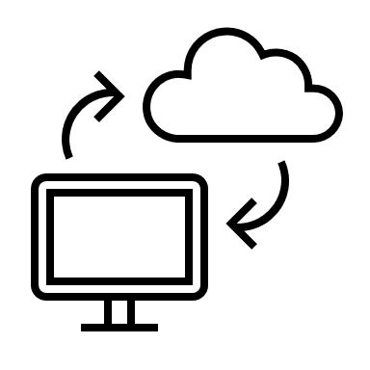
Cloud benefits and considerations
Notes:
Learn and SkillPipe content order note:
Slides 11-15 https://docs.microsoft.com/en-us/learn/modules/fundamental-azure-concepts/benefits-of-cloud-computing

Slide 12
Cloud Benefits - Objective Domain
Identify the benefits of cloud computing such as High Availability, Scalability, Elasticity, Agility, and Disaster Recovery.
Identify the differences between Capital Expenditure (CapEx) and Operational Expenditure (OpEx).
Describe the consumption-based model.
Notes:
Learn and SkillPipe content order note:
Slides 11-15 https://docs.microsoft.com/en-us/learn/modules/fundamental-azure-concepts/benefits-of-cloud-computing

Slide 13
Cloud Benefits
High availability
Fault tolerance
Scalability
Elasticity
Global reach
Customer latency capabilities
Agility
Predictive cost considerations
Disaster recovery
Security
Notes:
There is a term reference guide available at https://azure.microsoft.com/en-us/overview/cloud-computing-dictionary/
Learn and SkillPipe content order note:
Slides 11-15 https://docs.microsoft.com/en-us/learn/modules/fundamental-azure-concepts/benefits-of-cloud-computing

Slide 14
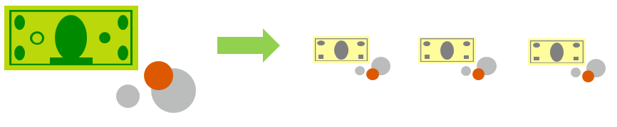
Compare CapEx vs. OpEx
Capital Expenditure (CapEx)
The up-front spending of money on physical infrastructure.
Costs from CapEx have a value that reduces over time.
Operational Expenditure (OpEx)
Spend on products and services as needed, pay-as-you-go
Get billed immediately
Notes:
Capital Expenditure (CapEx)
Spend on physical infrastructure upfront.
Deduct the expense from your tax bill.
High upfront cost, but the value of your 6investment reduces over time.
Operational Expenditure (OpEx)
Spend on services or products as needed.
Get billed immediately.
Deduct the expense from your tax bill in the same year.
No upfront cost, pay-as-you use.
Learn and SkillPipe content order note:
Slides 11-15 https://docs.microsoft.com/en-us/learn/modules/fundamental-azure-concepts/benefits-of-cloud-computing

Slide 15

Consumption-based model
Cloud service providers operate on a consumption-based model, which means that end users only pay for the resources that they use. Whatever they use is what they pay for.
Better cost prediction
Prices for individual resources and services are provided
Billing is based on actual usage
Notes:
This consumption-based model brings with it many benefits, including:
No upfront costs.
No need to purchase and manage costly infrastructure that they may or may not use to its fullest.
The ability to pay for additional resources when they are needed.
The ability to stop paying for resources that are no longer needed.
Learn/SkillPipe content note:
Slides 11-15 https://docs.microsoft.com/en-us/learn/modules/fundamental-azure-concepts/benefits-of-cloud-computing

Slide 16

Cloud services
Notes:
Learn/SkillPipe content note:
Slides 16-23 https://docs.microsoft.com/en-us/learn/modules/fundamental-azure-concepts/categories-of-cloud-services

Slide 17
Cloud Services - Objective Domain
Describe Infrastructure-as-a-Service (IaaS)
Describe Platform-as-a-Service (PaaS)
Describe Software-as-a-Service (SaaS)
Identify a service type based on a use case
Describe the shared responsibility model
Describe serverless computing
Notes:
Learn/SkillPipe content note:
Slides 16-23 https://docs.microsoft.com/en-us/learn/modules/fundamental-azure-concepts/categories-of-cloud-services

Slide 18
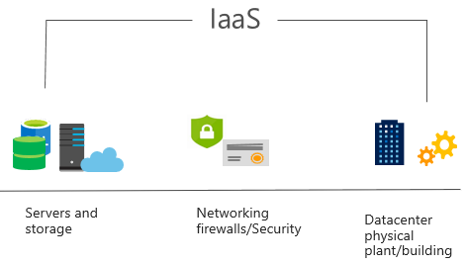
Infrastructure as a Service (IaaS)
Build pay-as-you-go IT infrastructure by renting servers, virtual machines, storage, networks, and operating systems from a cloud provider.
Notes:
For more information on IaaS, visit https://azure.microsoft.com/en-us/overview/what-is-iaas/
Most basic cloud computing services category.
Build pay-as-you-go IT infrastructure by renting servers, virtual machines, storage, networks, and operating systems from a cloud provider.
Instant computing infrastructure, provisioned and managed over the internet.
Learn and SkillPipe content order note:
Slides 11-15 https://docs.microsoft.com/en-us/learn/modules/fundamental-azure-concepts/benefits-of-cloud-computing

Slide 19
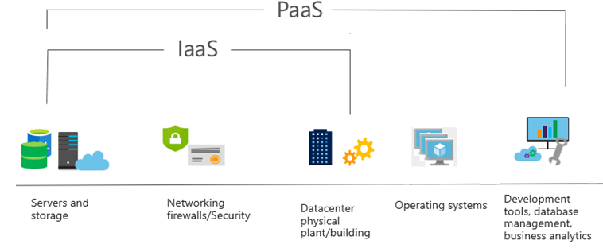
Platform as a Service (PaaS)
Provides environment for building, testing, and deploying software applications; without focusing on managing underlying infrastructure.
Notes:
For more information on PaaS, see https://azure.microsoft.com/en-us/overview/what-is-paas/
Provides environment for building, testing, and deploying software applications.
Helps create applications quickly, without focusing on managing underlying infrastructure.
Learn and SkillPipe content order note:
Slides 16-23 https://docs.microsoft.com/en-us/learn/modules/fundamental-azure-concepts/categories-of-cloud-services

Slide 20
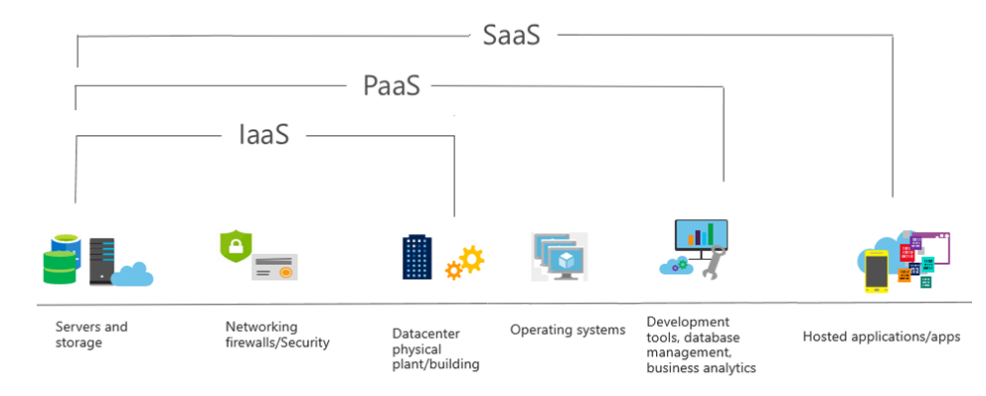
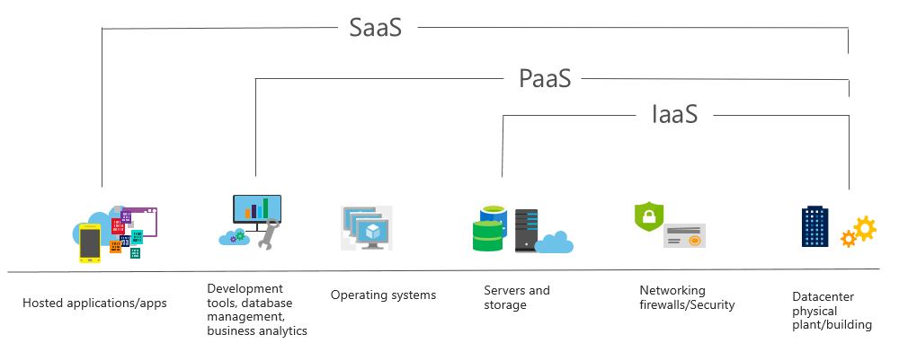
Software as a Service (SaaS)
Users connect to and use cloud-based apps over the internet: for example, Microsoft Office 365, email, and calendars.
Notes:
Common usage scenarios:
Examples of Microsoft SaaS services include Microsoft Office 365, Skype, and Microsoft Dynamics CRM Online.
For more information on SaaS, see https://azure.microsoft.com/en-us/overview/what-is-saas/
Learn and SkillPipe content order note:
Slides 16-23 https://docs.microsoft.com/en-us/learn/modules/fundamental-azure-concepts/categories-of-cloud-services

Slide 21
Cloud service comparison
IaaS
PaaS
SaaS
The most flexible cloud service.
Focus on application development.
Pay-as-you-go pricing model.
You configure and manage the hardware for your application.
Platform management is handled by the cloud provider.
Users pay for the software they use on a subscription model.
Notes:
The slide contains only so
Learn and SkillPipe content order note:
Slides 16-23 https://docs.microsoft.com/en-us/learn/modules/fundamental-azure-concepts/categories-of-cloud-services

Slide 22
Shared responsibility model
On-Premises
( Private Cloud )
Infrastructure
( as a Service )
Platform
( as a Service )
Software
( as a Service )
Data & Access
Data & Access
Data & Access
Data & Access
Applications
Applications
Applications
Applications
You Manage
Runtime
Runtime
Runtime
Runtime
Cloud Provider Manages
Operating System
Operating System
Operating System
Operating System
Virtual Machine
Virtual Machine
Virtual Machine
Virtual Machine
Compute
Compute
Compute
Compute
Networking
Networking
Networking
Networking
Storage
Storage
Storage
Storage
Notes:
IaaS, PaaS, and SaaS have dedicated topics, coming up.
Learn and SkillPipe content order note:
Slides 16-23 https://docs.microsoft.com/en-us/learn/modules/fundamental-azure-concepts/categories-of-cloud-services

Slide 23


Serverless Computing
With serverless computing applications, the cloud service provider automatically provisions, scales, and manages the infrastructure required to run the code.
 | Azure Functions is code running your service and not the underlying platform or infrastructure. It creates infrastructure based on an event.
 | Azure Logic Apps is a cloud service that helps you automate and orchestrate tasks, business processes, and workflows when you need to integrate apps, data, systems, and services.
Notes:
What is serverless computing?
Serverless computing enables developers to build applications faster by eliminating the need for them to manage infrastructure. With serverless applications, the cloud service provider automatically provisions, scales, and manages the infrastructure required to run the code.
In understanding the definition of serverless computing, it’s important to note that servers are still running the code. The serverless name comes from the fact that the tasks associated with infrastructure provisioning and management are invisible to the developer. This approach enables developers to increase their focus on the business logic and deliver more value to the core of the business. Serverless computing helps teams increase their productivity and bring products to market faster, and it allows organizations to better optimize resources and stay focused on innovation.
Azure Functions - https://docs.microsoft.com/en-us/azure/azure-functions/
Azure Logic Apps - https://docs.microsoft.com/en-us/azure/logic-apps/
Azure Event Grid - https://docs.microsoft.com/en-us/azure/event-grid/
Note: For more details about serverless services available with Azure, see https://azure.microsoft.com/en-us/solutions/serverless/
Learn and SkillPipe content order note:
Slides 16-23 https://docs.microsoft.com/en-us/learn/modules/fundamental-azure-concepts/categories-of-cloud-services

Slide 24

Knowledge Check
Populate with instructions to use the polling tool of your choice
Which one?
A). Azure Portal
B). PowerShell
C). Local Tool
Module 1
Use your Smartphones or Mobile Devices
Go to (insert polling app link of your choice)
Enter Code: 123-45-678
Please participate in the quiz for this section
Notes:
WWL recommends using polling to be completed for every 7 – 10 slides and preferably at the end of each section. This helps break classes up and adds more interactivity especially for remote classes.
In order to promote interactivity, WWL suggests the use of Mentimeter, Kahoot or a similar polling technology. Please feel free to adjust this slide as needed and populate with the instructions based on the polling tool of your choice.
Learn/SkillPipe note:
SkillPipe has a Module 1 review questions slide, while Learn has Knowledge checks individually through the Learn modules that follow this first PPT.
https://docs.microsoft.com/en-us/learn/modules/intro-to-azure-fundamentals/knowledge-check
https://docs.microsoft.com/en-us/learn/modules/fundamental-azure-concepts/knowledge-check

Slide 25

Module 01 Review
Microsoft offers Public, Private, and Hybrid cloud models so you can build based on your needs.
From high-availability to elasticity to disaster recovery to pay-as-use the benefits of the Azure cloud are numerous.
IaaS, PaaS, SaaS, and serverless, or a combination.
Shared responsibility.
Microsoft Learn Modules (docs.microsoft.com/Learn)
Notes:
Learn/SkillPipe note:
SkillPipe has a Module 1 review questions slide, while Learn has summary units individually through the Learn modules that follow this first PPT.
https://docs.microsoft.com/en-us/learn/modules/intro-to-azure-fundamentals/summary
https://docs.microsoft.com/en-us/learn/modules/fundamental-azure-concepts/summary

