Slide 1
AZ-900T0x Module 02: Core Azure Services
Notes:
Adjust the cover for either AZ-900T00 or AZ-900T0
This content in SkillPipe is now aligned with the content in Learn. The notes section of the PPT will call out any free Learn sandbox exercises available and provide direct links that can be shared with students (if they are not able to create a free Azure account and are not following along in Learn).
Learn learning path: https://docs.microsoft.com/en-us/learn/paths/az-900-describe-core-azure-services/

Slide 2

Module Outline
Notes:
Learn and SkillPipe content order note:
Slides 1-5
https://docs.microsoft.com/en-us/learn/modules/azure-architecture-fundamentals/introduction
https://docs.microsoft.com/en-us/learn/modules/azure-architecture-fundamentals/overview

Slide 3

Module 02 – Outline
You will learn the following concepts:
Azure Architectural Components
Regions and Availability Zones
Subscriptions and Resource Groups
Core Azure Resources
Compute
Networking
Storage
Databases
Notes:
Learn and SkillPipe content order note:
Slides 3-5
https://docs.microsoft.com/en-us/learn/modules/azure-architecture-fundamentals/introduction
https://docs.microsoft.com/en-us/learn/modules/azure-architecture-fundamentals/overview

Slide 4

Core Azure architectural components
Notes:
Learn and SkillPipe content order note:
Slides 3-5
https://docs.microsoft.com/en-us/learn/modules/azure-architecture-fundamentals/introduction
https://docs.microsoft.com/en-us/learn/modules/azure-architecture-fundamentals/overview

Slide 5
Core Azure architectural components – Objective Domain
Describe the benefits and usage of:
Regions and Region Pairs
Availability Zones
Azure Resources
Resource Groups
Azure Resource Manager
Subscriptions
Azure Management Groups
Notes:
Learn and SkillPipe content order note:
Slides 3-5
https://docs.microsoft.com/en-us/learn/modules/azure-architecture-fundamentals/introduction
https://docs.microsoft.com/en-us/learn/modules/azure-architecture-fundamentals/overview

Slide 6
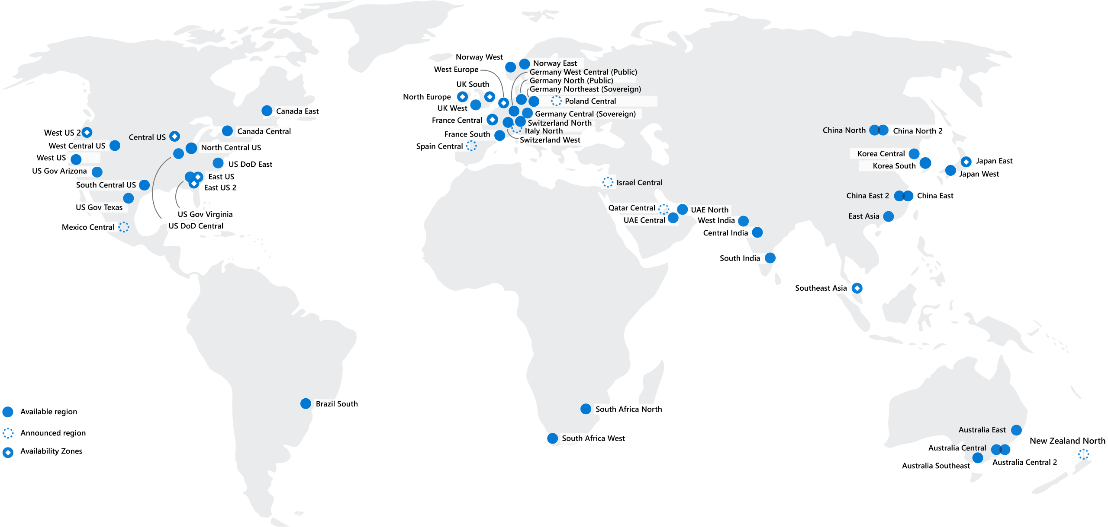
Regions
Azure offers more global regions than any other cloud provider with 60+ regions representing over 140 countries
Regions are made up of one or more datacenters in close proximity.
Provide flexibility and scale to reduce customer latency.
Preserve data residency with a comprehensive compliance offering.
© Copyright Microsoft Corporation. All rights reserved.
Notes:
A region represents a collection of datacenters.
Provide flexibility and scale.
Preserve data residency.
Select regions close to your users.
Be aware of region deployment availability.
There are global services that are region independent.
A list of regions and their locations is available at https://azure.microsoft.com/en-us/global-infrastructure/locations/
Learn and SkillPipe content order note:
Slides 6-10
https://docs.microsoft.com/en-us/learn/modules/azure-architecture-fundamentals/regions-availability-zones

Slide 7
Region Pairs
Region
North Central US​
East US​
West US 2​
US East 2​
Canada Central​
North Europe​
UK West​
Germany Central​
South East Asia​
East China​
Japan East​
Australia Southeast​
India South​
Brazil South (Primary)​
Region
South Central US​
West US​
West Central US​
Central US​
Canada East​
West Europe​
UK South​
Germany Northeast​
East Asia​
North China​
Japan West​
Australia East​
India Central​
South Central US ​
At least 300 miles of separation between region pairs.
Automatic replication for some services.
Prioritized region recovery in the event of outage.
Updates are rollout sequentially to minimize downtime.
Web Link: https://aka.ms/PairedRegions
© Copyright Microsoft Corporation. All rights reserved.
Notes:
Each Azure region is paired with another region.
Azure prefers at least 300 miles of separation between datacenters in a regional pair.
Some services provide automatic replication to the paired region.
In an outage, recovery of one region is prioritized out of every pair.
Azure system updates are rolled out to paired regions sequentially (not at the same time).
List of geographies, regions, region-pairs, and other details -https://azure.microsoft.com/en-us/global-infrastructure/geographies/
A full list of region pairs is available at https://docs.microsoft.com/en-us/azure/best-practices-availability-paired-regions#what-are-paired-regions
Learn and SkillPipe content order note:
Slides 6-10
https://docs.microsoft.com/en-us/learn/modules/azure-architecture-fundamentals/regions-availability-zones

Slide 8
Geographies
This slide is hidden and not part of the default deck. Include it in your presentation if you want to talk about Geographies as part of Data Residency. Just delete this text box and unhide. Otherwise, feel free to delete the slide.
Discrete markets that preserve data residency and compliance boundaries.
Typically contain two or more regions.
Allow customers with specific data-residency and compliance needs to keep their data and applications in close proximity.
Categorized as Americas, Europe, Asia Pacific, Middle East, and Africa.
© Copyright Microsoft Corporation. All rights reserved.
Notes:
A list of geography locations is available at : https://azure.microsoft.com/en-us/global-infrastructure/geographies/
Learn and SkillPipe content order note:
Slides 6-10
https://docs.microsoft.com/en-us/learn/modules/azure-architecture-fundamentals/regions-availability-zones

Slide 9
Availability Options
VM SLA
99.9% with Premium Storage
VM SLA
99.99%
MULTI-REGION DISASTER RECOVERY
Region 1
Region 2
SINGLE VM
Easier lift and shift
AVAILABILITY ZONES
Protection from entire datacenter failures
REGION PAIRS
Regional protection within Data Residency Boundaries
Notes:
This slide is to introduce the upcoming topics. You could also use the slide at the end of the lesson to
Learn and SkillPipe content order note:
Slides 6-10
https://docs.microsoft.com/en-us/learn/modules/azure-architecture-fundamentals/regions-availability-zones
review.

Slide 10
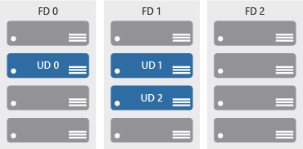

Availability zones
Azure Region
Provide protection against downtime due to datacenter failure.
Physically separate datacenters within the same region.
Each datacenter is equipped with independent power, cooling, and networking.
Connected through private fiber-optic networks.
Availability Zone 1
Availability Zone 2
Availability Zone 3
© Copyright Microsoft Corporation. All rights reserved.
Notes:
Physically separate locations within an Azure region.
Takes availability sets to the next level
Includes one or more datacenters, equipped with independent power, cooling, and networking.
Acts as an isolation boundary.
If one availability zone goes down, the other continues working.
More details about Availability Zones in Azure are available at https://docs.microsoft.com/en-us/azure/availability-zones/az-overview
Learn and SkillPipe content order note:
Slides 6-10
https://docs.microsoft.com/en-us/learn/modules/azure-architecture-fundamentals/regions-availability-zones

Slide 11






Azure Resources
Azure resources are components like storage, virtual machines, and networks that are available to build cloud solutions.
Virtual Machines
Storage Accounts
Virtual Networks
App Services
SQL Databases
Functions
Notes:
Learn and SkillPipe content order note:
Slides 11-13
https://docs.microsoft.com/en-us/learn/modules/azure-architecture-fundamentals/resources-resource-manager

Slide 12
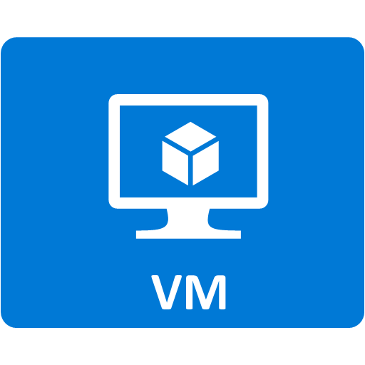


Resource groups
Resource groups (web + DB, VM, Storage) in one group
A resource group is a container to manage and aggregate resources in a single unit.
Resources can exist in only one resource group.
Resources can exist in different regions.
Resources can be moved to different resource groups.
Applications can utilize multiple resource groups.
OR
Web and DB resource group
Virtual machine resource group
Storage resource group
© Copyright Microsoft Corporation. All rights reserved.
Notes:
Containers for multiple resources that share the same life cycle.
Aggregates resources into a single manageable unit.
Every Azure resource must exist in one (and only one) resource group.
Secure at the resource group (or resource) level - using role-based access control (RBAC).
Learn and SkillPipe content order note:
Slides 11-13
https://docs.microsoft.com/en-us/learn/modules/azure-architecture-fundamentals/resources-resource-manager

Slide 13
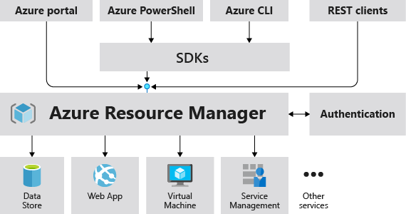
Azure Resource Manager
The Azure Resource Manager (ARM) provides a management layer that enables you to create, update, and delete resources in your Azure subscription.
© Copyright Microsoft Corporation. All rights reserved.
Notes:
Provides a management layer that enables you to create, update, and delete resources in your Azure subscription.
Create, configure, manage and delete resources and resource groups.
Organizes resources.
Controls access and resources.
Automates using different tools and SDKs.
Stores layouts in JSON files.
You can view more details about Azure Resource Manager at https://docs.microsoft.com/en-us/azure/azure-resource-manager
Learn and SkillPipe content order note:
Slides 11-13
https://docs.microsoft.com/en-us/learn/modules/azure-architecture-fundamentals/resources-resource-manager

Slide 14
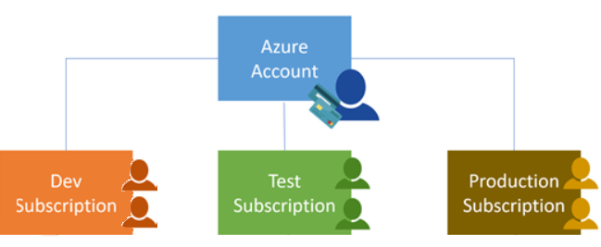
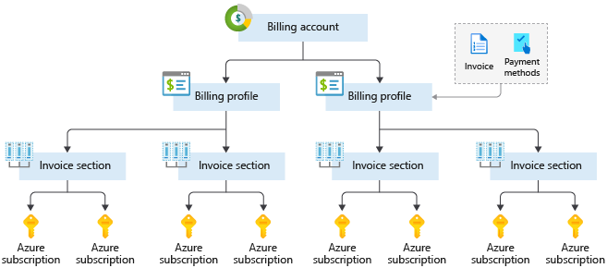
Azure Subscriptions
An Azure subscription provides you with authenticated and authorized access to Azure accounts.
Billing boundary: generate separate billing reports and invoices for each subscription.
Access control boundary: manage and control access to the resources that users can provision with specific subscriptions.
Notes:
An account can have one subscription or multiple subscriptions.
Azure subscription offers - https://azure.microsoft.com/en-us/support/legal/offer-details/
Learn and SkillPipe content order note:
Slides 14 & 16
https://docs.microsoft.com/en-us/learn/modules/azure-architecture-fundamentals/management-groups-subscriptions

Slide 15
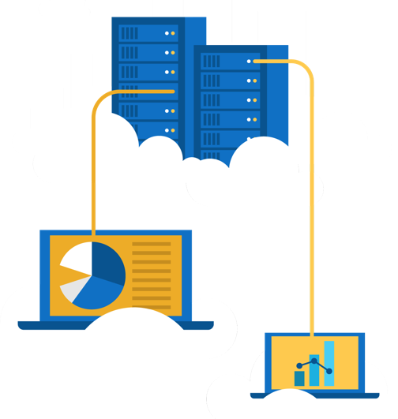
Walkthrough – Explore the Azure Portal
Launch the Azure Portal and have a look at the common components used everyday building cloud solutions
Connect to https://portal.azure.com
Explore the home screen.
Find “All Services” and see what is available.
Notes:
Learn and SkillPipe content order note:
Learn has a sandbox exercise at roughly the same place as this one, but that isn’t specifically aligned to this one, but does give some experience in the Azure portal - Exercise - Create a website hosted in Azure
https://docs.microsoft.com/en-us/learn/modules/azure-architecture-fundamentals/exercise-create-website

Slide 16
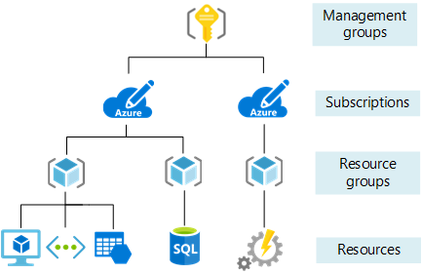
Management Groups
Management groups can include multiple Azure subscriptions.
Subscriptions inherit conditions applied to the management group.
10,000 management groups can be supported in a single directory.
A management group tree can support up to six levels of depth.
Notes:
Management groups can include multiple Azure subscriptions.
Subscriptions inherit conditions applied to the management group.
10,000 management groups can be supported in a single directory.
A management group tree can support up to six levels of depth.
Management groups - https://docs.microsoft.com/en-us/azure/governance/management-groups/
Learn and SkillPipe content order note:
Slides 14 & 16
https://docs.microsoft.com/en-us/learn/modules/azure-architecture-fundamentals/management-groups-subscriptions

Slide 17

Core Azure workload products
Notes:
Consider covering the Azure Management Tools slide before you do any of the walkthroughs. This slide is in Lesson 05.
Learn and SkillPipe content order note:
Slides 17-18
https://docs.microsoft.com/en-us/learn/modules/azure-compute-fundamentals/introduction

Slide 18
Core Azure Workloads - Objective Domain
Describe the benefits and usage of:
Virtual Machines, Azure App Services, Azure Container Instances (ACI), Azure Kubernetes Service (AKS), and Azure Virtual Desktop
Virtual Networks, VPN Gateway, Virtual Network peering, and ExpressRoute
Container (Blob) Storage, Disk Storage, File Storage, and storage tiers
Cosmos DB, Azure SQL Database, Azure Database for MySQL, Azure Database for PostgreSQL, and SQL Managed Instance
Azure Marketplace
Notes:
The task of automating, managing, and interacting with a large number of containers is known as orchestration. Azure Kubernetes Service (AKS) is a complete orchestration service for containers with distributed architectures and large volumes of containers. Orchestration is the task of automating and managing a large number of containers and how they interact.
Learn and SkillPipe content order note:
Slides 17-18
https://docs.microsoft.com/en-us/learn/modules/azure-compute-fundamentals/introduction

Slide 19




Azure compute services
Azure compute is an on-demand computing service that provides computing resources such as disks, processors, memory, networking, and operating systems.
Virtual
Machines
App
Services
Container Instances
Azure Kubernetes Services (AKS)
Azure Virtual Desktop
Notes:
https://azure.microsoft.com/en-us/services/app-service/#product-overview
Learn and SkillPipe content order note:
https://docs.microsoft.com/en-us/learn/modules/azure-compute-fundamentals/overview

Slide 20
Azure virtual machines
Azure Virtual Machines (VM) are software emulations of physical computers.
Includes virtual processor, memory, storage, and networking.
IaaS offering that provides total control and customization.
© Copyright Microsoft Corporation. All rights reserved.
Notes:
Development and test – Azure VMs offer a quick and easy way to create a computer with specific configurations required to code and test an application.
Applications in the cloud – Because demand for your application can fluctuate, it might make economic sense to run it on a VM in Azure. You pay for extra VMs when you need them and shut them down when you don’t.
Extended datacenter – Virtual machines in an Azure virtual network can easily be connected to your organization’s network.
Azure virtual machines - https://azure.microsoft.com/en-us/services/virtual-machines/
App services - https://azure.microsoft.com/en-us/services/app-service/
Learn and SkillPipe content order note:
https://docs.microsoft.com/en-us/learn/modules/azure-compute-fundamentals/azure-virtual-machines

Slide 21
Walkthrough – Create a Virtual Machine
Create a virtual machine in the Azure Portal, connect to the virtual machine, install the web server role, and test.
Create the virtual machine.
Connect to the virtual machine.
Install the web server role and test.

Slide 22

Azure App Services
Azure App Services is a fully managed platform to build, deploy, and scale web apps and APIs quickly.
Works with .NET, .NET Core, Node.js, Java, Python, or php.
PaaS offering with enterprise-grade performance, security, and compliance requirements.
© Copyright Microsoft Corporation. All rights reserved.
Notes:
Learn and SkillPipe content order note:
https://docs.microsoft.com/en-us/learn/modules/azure-compute-fundamentals/azure-app-services

Slide 23
Walkthrough – Create an App Service
Create a new Web App by using a Docker image stored in Azure Container Registry.
Create a Web App using a Docker image.
Test the Web App.

Slide 24
Azure Container Services
Azure Containers are a light-weight, virtualized environment that does not require operating system management, and can respond to changes on demand.
Azure Container Instances: a PaaS offering that runs a container in Azure without the need to manage a virtual machine or additional services.
Azure Kubernetes Service: an orchestration service for containers with distributed architectures and large volumes of containers.
© Copyright Microsoft Corporation. All rights reserved.
Notes:
Containers are a virtualization environment. However, unlike virtual machines, you do not manage an operating system. Containers are meant to be lightweight, and are designed to be created, scaled out, and stopped dynamically.
Azure Container Instances - https://azure.microsoft.com/en-us/services/container-instances/
Azure Kubernetes Service - https://azure.microsoft.com/en-us/services/kubernetes-service/
Learn and SkillPipe content order note:
https://docs.microsoft.com/en-us/learn/modules/azure-compute-fundamentals/azure-container-services

Slide 25
Walkthrough - Deploy Azure Container Instances
Using the Azure Portal create, configure, and deploy a Docker container to an Azure Container Instance. The container will deploy a Hello HTML page.
Create a container instance.
Deploy the container and test.

Slide 26
Azure Virtual Desktop
Azure Virtual Desktop is a desktop and app virtualization that runs in the cloud.
Create a full desktop virtualization environment without having to run additional gateway servers.
Publish unlimited host pools to accommodate diverse workloads.
Reduce costs with pooled, multi-session resources.
© Copyright Microsoft Corporation. All rights reserved.
Notes:
https://docs.microsoft.com/en-us/azure/virtual-desktop/overview
Learn and SkillPipe content order note:
https://docs.microsoft.com/en-us/learn/modules/azure-compute-fundamentals/windows-virtual-desktop
Note: Windows Virtual Desktop was updated to Azure Virtual Desktop, although the URL listed in the notes will remain the same until the next JTA update.

Slide 27


Azure networking services
Azure Virtual Network (VNet) enables Azure resources to communicate with each other, the internet, and on-premises networks.
Virtual Private Network Gateway (VPN) is used to send encrypted traffic between an Azure virtual network and an on-premises location over the public internet.
Azure Express Route extends on-premises networks into Azure over a private connection that is facilitated by a connectivity provider.
Notes:
Learn and SkillPipe content order note:
Multiple Learn units cover the content in this slide
https://docs.microsoft.com/en-us/learn/modules/azure-networking-fundamentals/introduction
https://docs.microsoft.com/en-us/learn/modules/azure-networking-fundamentals/azure-virtual-network-fundamentals
https://docs.microsoft.com/en-us/learn/modules/azure-networking-fundamentals/azure-virtual-network-settings
https://docs.microsoft.com/en-us/learn/modules/azure-networking-fundamentals/azure-vpn-gateway-fundamentals
https://docs.microsoft.com/en-us/learn/modules/azure-networking-fundamentals/express-route-fundamentals

Slide 28
Walkthrough - Create a virtual network
Create a virtual network with two virtual machines and then test connection between the machines.
Create a virtual network.
Create two virtual machines.
Test the connection.

Slide 29


Azure storage services
Container storage (blob) is optimized for storing massive amounts of unstructured data, such as text or binary data.
Disk storage provides disks for virtual machines, applications, and other services to access and use.
Azure Files sets up a highly available network file shares that can be accessed by using the standard Server Message Block (SMB) protocol.
Notes:
Storage services - https://azure.microsoft.com/en-us/product-categories/storage/
Learn and SkillPipe content order note:
Multiple Learn units cover the content in this slide
https://docs.microsoft.com/en-us/learn/modules/azure-storage-fundamentals/introduction
https://docs.microsoft.com/en-us/learn/modules/azure-storage-fundamentals/azure-storage-accounts
https://docs.microsoft.com/en-us/learn/modules/azure-storage-fundamentals/azure-disk-storage
https://docs.microsoft.com/en-us/learn/modules/azure-storage-fundamentals/azure-blob-container-storage
https://docs.microsoft.com/en-us/learn/modules/azure-storage-fundamentals/azure-file-storage

Slide 30



Azure storage access tiers
Hot | Cool | Archive
Optimized for storing data that is accessed frequently. | Optimized for storing data that is infrequently accessed and stored for at least 30 days. | Optimized for storing data that is rarely accessed and stored for at least 180 days with flexible latency requirements.
You can switch between these access tiers at any time.
Notes:
Learn and SkillPipe content order note:
https://docs.microsoft.com/en-us/learn/modules/azure-storage-fundamentals/azure-storage-tiers

Slide 31
Walkthrough - Create blob storage
Create a storage account with a blob storage container. Work with blob files.
Create a storage account.
Work with blob storage.
Monitor the storage account.

Slide 32



Azure database services
Azure Cosmos Database is a globally-distributed database service that elastically and independently scales throughput and storage.
Azure SQL Database is a relational database as a service (DaaS) based on the latest stable version of the Microsoft SQL Server database engine.
Azure Database for MySQL is a fully-managed MySQL database service for app developers.
Azure Database for PostgreSQL is a relational database service based on the open-source Postgres database engine.
© Copyright Microsoft Corporation. All rights reserved.
Notes:
✔️ These are just a few of our database service offerings. Take a minute to review other database services and [find the product you need](https://azure.microsoft.com/en-us/product-categories/databases/).
Azure Cosmos DB - https://azure.microsoft.com/en-us/services/cosmos-db/
Azure SQL Database - https://azure.microsoft.com/en-us/services/sql-database/
Learn and SkillPipe content order note:
Multiple Learn units cover the content in this slide
https://docs.microsoft.com/en-us/learn/modules/azure-database-fundamentals/introduction
https://docs.microsoft.com/en-us/learn/modules/azure-database-fundamentals/azure-cosmos-db
https://docs.microsoft.com/en-us/learn/modules/azure-database-fundamentals/azure-sql-database
https://docs.microsoft.com/en-us/learn/modules/azure-database-fundamentals/azure-mysql-database
https://docs.microsoft.com/en-us/learn/modules/azure-database-fundamentals/azure-postgresql-database

Slide 33

Azure SQL Managed Instance
Azure SQL Managed Instance allows existing SQL Server customers to lift and shift their on-premises applications to the cloud with minimal application and database changes.
Fully managed and evergreen platform as a service.
Preserves all PaaS capabilities (automatic patching and version updates, automated backups, and high availability)
Exchange existing licenses for discounted rates on SQL Managed Instance using the Azure Hybrid Benefit
Notes:
Azure SQL Managed Instance is the intelligent, scalable cloud database service that combines the broadest SQL Server database engine compatibility with all the benefits of a fully managed and evergreen platform as a service. SQL Managed Instance has near 100% compatibility with the latest SQL Server (Enterprise Edition) database engine, providing a native virtual network (VNet) implementation that addresses common security concerns, and a business model favorable for existing SQL Server customers. SQL Managed Instance allows existing SQL Server customers to lift and shift their on-premises applications to the cloud with minimal application and database changes. At the same time, SQL Managed Instance preserves all PaaS capabilities (automatic patching and version updates, automated backups, high availability) that drastically reduce management overhead and TCO.
Learn and SkillPipe content order note:
https://docs.microsoft.com/en-us/learn/modules/azure-database-fundamentals/azure-sql-managed-instance

Slide 34
Walkthrough-Create a SQL database
Create a SQL database in Azure and then query the data in that database.
Create the database.
Query the database.
Notes:
In order to promote interactivity, WWL suggests the use of Mentimeter, Kahoot or a similar polling technology. Please feel free to adjust this slide as needed and populate with the instructions based on the polling tool of your choice.
Learn and SkillPipe content order note:
Learn has a sandbox exercise that mirrors this walkthrough - Exercise - Create a SQL database
https://docs.microsoft.com/en-us/learn/modules/azure-database-fundamentals/exercise-create-sql-database

Slide 35

Explore Azure Marketplace
Azure Marketplace allows customers to find, try, purchase, and provision applications and services from hundreds of leading service providers, which are all certified to run on Azure.
Open source container platforms.
Virtual machine and database images.
Application build and deployment software.
Developer tools.
And much more, with 10,000+ listings!
Notes:
Connects end users with Microsoft partners, Independent Software Vendors (ISVs), and start-ups that offer solutions and services for Azure.
Azure customers, IT professionals and cloud developers can find, try, purchase, and provision Azure applications and services from certified service providers.
Includes close to 10,000 product listings.
There is also a Marketplace FAQ available at https://azure.microsoft.com/en-us/marketplace/faq/
Azure Marketplace - https://azuremarketplace.microsoft.com/en-us/
Learn and SkillPipe content order note:
Note in Learn

Slide 36

Knowledge Check
Which one?
A). Azure Portal
B). PowerShell
C). Local Tool
Populate with instructions to use the polling tool of your choice
Module 2
Use your Smartphones or Mobile Devices
Go to (insert polling app link of your choice)
Enter Code: 123-45-678
Please participate in the quiz for this section
Notes:
WWL recommends using polling to be completed for every 7 – 10 slides and preferably at the end of each section. This helps break classes up and adds more interactivity especially for remote classes.
Learn/SkillPipe note:
SkillPipe has a Module 2 review questions slide, while Learn has Knowledge checks individually through Learn modules that follow this PPT.
https://docs.microsoft.com/en-us/learn/modules/azure-architecture-fundamentals/knowledge-check
https://docs.microsoft.com/en-us/learn/modules/azure-compute-fundamentals/knowledge-check
https://docs.microsoft.com/en-us/learn/modules/azure-networking-fundamentals/knowledge-check
https://docs.microsoft.com/en-us/learn/modules/azure-storage-fundamentals/knowledge-check
https://docs.microsoft.com/en-us/learn/modules/azure-database-fundamentals/knowledge-check

Slide 37

Module 02 Review
Microsoft provides more global presence than any other cloud provider with over 60 regions distributed worldwide
Azure Management tools
Azure's multiple services (compute, networking, storage, and databases)
Azure Marketplace
Microsoft Learn Modules (docs.microsoft.com/Learn)
Notes:
Learn/SkillPipe note:
SkillPipe has a Module 2 summary slide, while Learn has summary units individually through Learn modules that follow this PPT.
https://docs.microsoft.com/en-us/learn/modules/azure-architecture-fundamentals/summary
https://docs.microsoft.com/en-us/learn/modules/azure-compute-fundamentals/summary
https://docs.microsoft.com/en-us/learn/modules/azure-networking-fundamentals/summary
https://docs.microsoft.com/en-us/learn/modules/azure-storage-fundamentals/summary
https://docs.microsoft.com/en-us/learn/modules/azure-database-fundamentals/summary

