Slide 1
AZ-900T0x Module 04: Security
Notes:
Adjust the cover for either AZ-900T00 or AZ-900T01.
This content in SkillPipe is now aligned with the content in Learn. The notes section of the PPT will call out any free Learn sandbox exercises available and provide direct links that can be shared with students (if they are not able to create a free Azure account and/or are not following along in Learn).
https://docs.microsoft.com/en-us/learn/paths/az-900-describe-general-security-network-security-features/

Slide 2

Module outline
Notes:
Learn and SkillPipe content order note:
Slides 1-5
https://docs.microsoft.com/en-us/learn/modules/iot-fundamentals/1-introduction

Slide 3

Module 04 – Outline
You will learn the following concepts:
Azure Security features
Defender for Cloud and resource hygiene
Key Vault, Sentinel, and Dedicated Hosts
Azure network security
Defense in depth
Network Security Groups and Firewalls
DDoS protection
Notes:
Learn and SkillPipe content order note:
Slides 1-5
https://docs.microsoft.com/en-us/learn/modules/iot-fundamentals/1-introduction

Slide 4

Security tools and features
Notes:
Learn and SkillPipe content order note:
Slides 1-5
https://docs.microsoft.com/en-us/learn/modules/iot-fundamentals/1-introduction

Slide 5
Security tools and features - Objective Domain
Describe the features and the functionality of:
Microsoft Defender for Cloud, including policy compliance, security alerts, secure score, and resource hygiene
Microsoft Sentinel
Key Vault
Azure Dedicated Hosts
Notes:
Learn and SkillPipe content order note:
Slides 1-5
https://docs.microsoft.com/en-us/learn/modules/iot-fundamentals/1-introduction

Slide 6
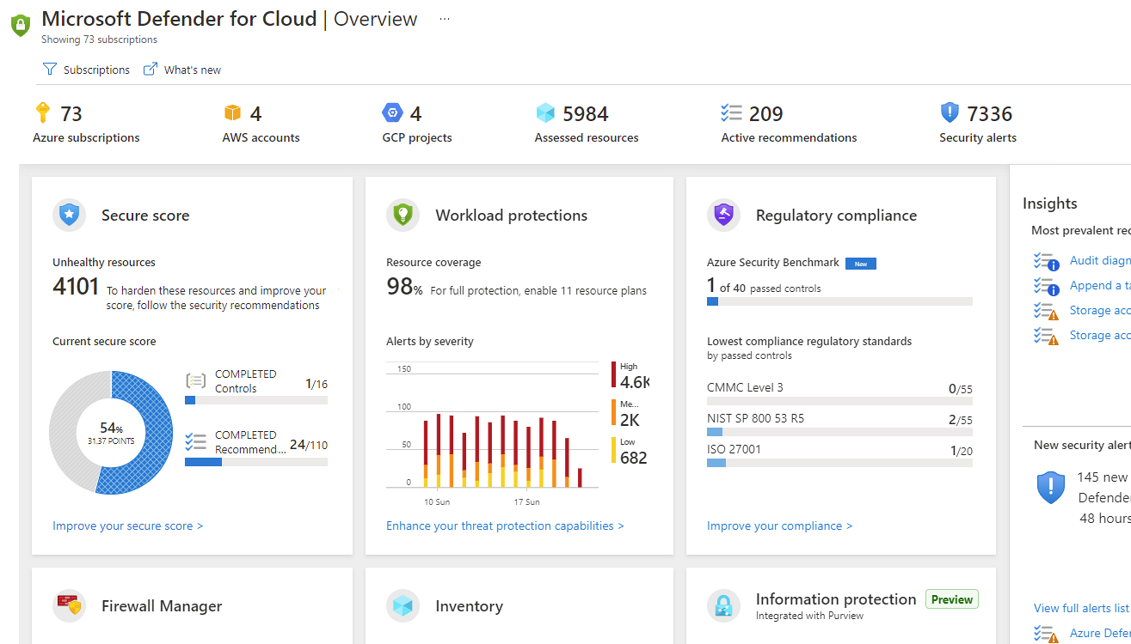
Microsoft Defender for Cloud
Microsoft Defender for Cloud is a monitoring service that provides threat protection across both Azure and on-premises datacenters.
Provides security recommendations
Detect and block malware
Analyze and identify potential attacks
Just-in-time access control for ports
Notes:
Microsoft Defender for Cloud is a unified infrastructure security management system that strengthens the security posture of your data centers and provides advanced threat protection across your hybrid workloads in the cloud - whether they're in Azure or not - as well as on premises.
Strengthen security posture: Defender for Cloud assesses your environment and enables you to understand the status of your resources, and whether they are secure.
Protect against threats: Defender for Cloud assesses your workloads and raises threat prevention recommendations and security alerts.
Get secure faster: In Defender for Cloud, everything is done in cloud speed. Because it is natively integrated, deployment is easy, providing you with auto-provisioning and protection with Azure services.
Policy compliance
Defender for Cloud is built on top of Azure Policy controls so you can set and monitor your policies to run on management groups, across subscriptions, and even for a whole tenant.
Security alerts
Defender for Cloud automatically collects, analyzes, and integrates log data from your Azure resources like firewall and endpoint protection to detect real threats. Then list of prioritized security alerts is shown in Microsoft Defender for Cloud along with the information you need to quickly investigate and remediate an attack.
Secure score
Defender for Cloud continually assesses your resources for security issues; then aggregates all the findings into a single score so that you can tell your current security situation.
Microsoft Defender for Cloud - https://azure.microsoft.com/en-us/services/defender-for-cloud/
Learn and SkillPipe content order note:
Slides 6 & 8-9
https://docs.microsoft.com/en-us/learn/modules/protect-against-security-threats-azure/2-protect-threats-security-center

Slide 7
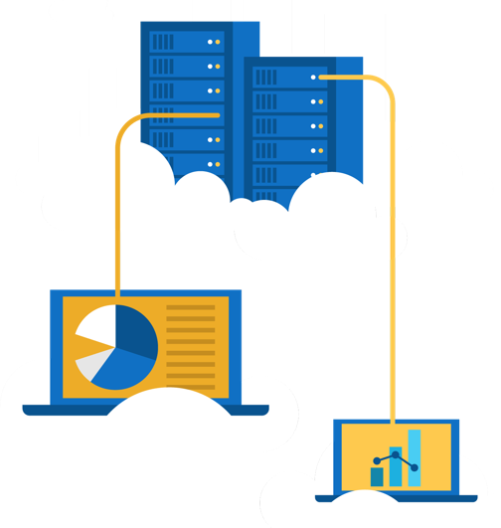
Walkthrough-Defender for Cloud
Open Defender for Cloud and view some of the common features and configuration options.
Launch Microsoft Defender for Cloud.
View Policy compliance options.
Review your Secure Score.
Set a Security Alert.

Slide 8

Defender for Cloud - capabilities
Policy Compliance
Continuous Assessments
Run policies across management groups, subscriptions, or tenants.
Assess new and deployed resources to ensure that they are configure properly.
Tailored Recommendations
Threat Protection
Recommendations based on existing workload with instructions on how to implement them.
Analyze attempted threats through alerts and impacted resource reports.
Notes:
Defender for Cloud - https://azure.microsoft.com/en-us/services/defender-for-cloud/
https://docs.microsoft.com/en-us/azure/defender-for-cloud/managing-and-responding-alerts
https://docs.microsoft.com/en-us/azure/defender-for-cloud/secure-score-security-controls
Secure score – Defender for Cloud continually assesses your resources, subscriptions, and organization for security issues; then aggregates all the findings into a single score so that you can tell, at a glance, your current security situation: the higher the score, the lower the identified risk level
Learn and SkillPipe content order note:
Slides 6 & 8-9
https://docs.microsoft.com/en-us/learn/modules/protect-against-security-threats-azure/2-protect-threats-security-center

Slide 9
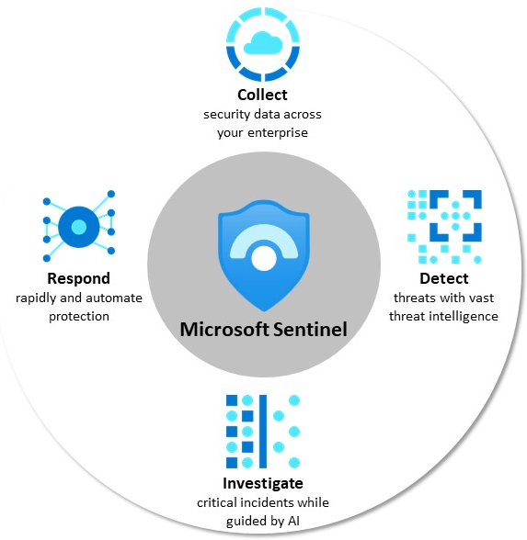
Microsoft Sentinel
Microsoft Sentinel is a security information and event management (SIEM) solution that provides security analytics and threat intelligence across an enterprise.
Connector and Integrations:
Microsoft 365 Defender
Azure Active Directory
Azure Advanced Threat Protection
Microsoft Cloud App Security
Notes:
Collect - data across all users, devices, applications, and infrastructure, both on-premises and in multiple clouds.
Detect threats and minimize false positives using analytics.
Investigate threats with AI and hunt suspicious activities at scale.
Respond to incidents with built-in orchestration and automation of common tasks.
Learn and SkillPipe content order note:
https://docs.microsoft.com/en-us/learn/modules/protect-against-security-threats-azure/3-detect-respond-threats-sentinel

Slide 10

Azure Key Vault
Azure Key Vault stores application secrets in a centralized cloud location in order to securely control access permissions and access logging.
Secrets management.
Key management.
Certificate management.
Storing secrets backed by hardware security modules (HSMs).
Notes:
Azure Key Vault -https://azure.microsoft.com/en-us/services/key-vault/
Learn and SkillPipe content order note:
https://docs.microsoft.com/en-us/learn/modules/protect-against-security-threats-azure/4-manage-secrets-key-vault

Slide 11
Walkthrough-Implement Azure Key Vault
Create an Azure Key vault and then create a password secret within the key vault.
Create an Azure key vault.
Add a secret to the Azure key vault.
Notes:
Learn and SkillPipe content order note:
Learn has a sandbox exercise - Exercise - Manage a password in Azure Key Vault
https://docs.microsoft.com/en-us/learn/modules/protect-against-security-threats-azure/5-manage-password-key-vault

Slide 12

Azure Dedicated Host
Azure Dedicated Host provides physical servers that host one or more Azure virtual machines that is dedicated to a single organization’s workload.
Benefits
Hardware isolation at the server level
Control over maintenance event timing
Aligned with Azure Hybrid Use Benefits
Notes:
https://docs.microsoft.com/en-us/azure/virtual-machines/windows/dedicated-hosts
Azure Dedicated Host is a service that provides physical servers - able to host one or more virtual machines - dedicated to one Azure subscription. Dedicated hosts are the same physical servers used in our data centers, provided as a resource. You can provision dedicated hosts within a region, availability zone, and fault domain. Then, you can place VMs directly into your provisioned hosts, in whatever configuration best meets your needs.
Limitations
Virtual machine scale sets are not currently supported on dedicated hosts.
Benefits
Reserving the entire host provides the following benefits:
Hardware isolation at the physical server level. No other VMs will be placed on your hosts. Dedicated hosts are deployed in the same data centers and share the same network and underlying storage infrastructure as other, non-isolated hosts.
Control over maintenance events initiated by the Azure platform. While the majority of maintenance events have little to no impact on your virtual machines, there are some sensitive workloads where each second of pause can have an impact. With dedicated hosts, you can opt-in to a maintenance window to reduce the impact to your service.
With the Azure hybrid benefit, you can bring your own licenses for Windows and SQL to Azure. Using the hybrid benefits provides you with additional benefits. For more information, see Azure Hybrid Benefit.
Learn and SkillPipe content order note:
https://docs.microsoft.com/en-us/learn/modules/protect-against-security-threats-azure/6-host-virtual-machines-dedicated-hosts

Slide 13
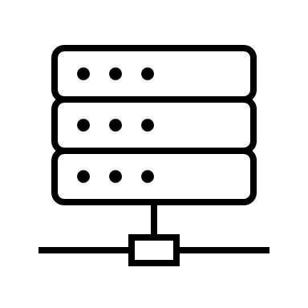

Secure network connectivity
Notes:
Learn and SkillPipe content order note:
Slides 14-15
https://docs.microsoft.com/en-us/learn/modules/secure-network-connectivity-azure/1-introduction

Slide 14
Secure Network Connectivity - Objective Domain
Describe the concept and functionality of:
Defense in depth
Network Security Groups (NSG)
Azure Firewall
Azure DDoS protection
Notes:
Learn and SkillPipe content order note:
Slides 14-15
https://docs.microsoft.com/en-us/learn/modules/secure-network-connectivity-azure/1-introduction

Slide 15
Defense in depth
Physical Security
A layered approach to securing computer systems.
Provides multiple levels of protection.
Attacks against one layer are isolated from subsequent layers.
Identity & Access
Perimeter
Network
Compute
Application
Data
Notes:
This is conceptual, to be kept high level, explaining how security options can be targeted at each layer.
Learn and SkillPipe content order note:
Slides 16-17
https://docs.microsoft.com/en-us/learn/modules/secure-network-connectivity-azure/2-what-is-defense-in-depth

Slide 16
Shared Security
Responsibility | On-Premises | IaaS | PaaS | SaaS
Data governance and Rights Management | Customer | Customer | Customer | Customer
Client endpoints | Customer | Customer | Customer | Customer
Account and access management | Customer | Customer | Customer | Customer
Identity and directory infrastructure | Customer | Customer | Microsoft/ Customer | Microsoft/ Customer
Application | Customer | Customer | Microsoft/ Customer | Microsoft
Network controls | Customer | Customer | Microsoft/ Customer | Microsoft
Operating system | Customer | Customer | Microsoft | Microsoft
Physical hosts | Customer | Microsoft | Microsoft | Microsoft
Physical network | Customer | Microsoft | Microsoft | Microsoft
Physical datacenter | Customer | Microsoft | Microsoft | Microsoft
Migrating from customer-controlled to cloud-based datacenters shifts the responsibility for security.
Security becomes a shared concern between cloud providers and customers.
Notes:
This is comparable to the Shared Responsibility slide, but specific to security.
Learn and SkillPipe content order note:
Slides 16-17
https://docs.microsoft.com/en-us/learn/modules/secure-network-connectivity-azure/2-what-is-defense-in-depth

Slide 17

Network Security Groups (NSGs)
Network Security Groups (NSGs) filter network traffic to and from Azure resources on Azure Virtual Networks.
Set inbound and outbound rules to filter by source and destination IP address, port, and protocol.
Add multiple rules, as needed, within subscription limits.
Azure applies default, baseline security rules to new NSGs.
Override default rules with new, higher priority rules.
Notes:
NSG -https://docs.microsoft.com/en-us/azure/virtual-network/security-overview#network-security-groups
Filters network traffic to, and from, Azure resources on Azure Virtual Networks.
Set inbound and outbound rules to filter by source and destination IP address, port, and protocol.
Add multiple rules, as needed, within subscription limits.
Azure applies default, baseline, security rules to new NSGs.
Override default rules with new, higher priority, rules.
Learn and SkillPipe content order note:
https://docs.microsoft.com/en-us/learn/modules/secure-network-connectivity-azure/5-filter-traffic-network-security-groups

Slide 18


Azure Firewall
A stateful, managed Firewall as a Service (FaaS) that grants/denies server access based on originating IP address, in order to protect network resources.
Applies inbound and outbound traffic filtering rules
Built-in high availability
Unrestricted cloud scalability
Uses Azure Monitor logging
Azure Application Gateway also provides a firewall, Web Application Firewall (WAF). WAF provides centralized, inbound protection for your web applications.
Notes:
✔️ Azure Application Gateway also provides a firewall, called the Web Application Firewall (WAF). WAF provides centralized, inbound protection for your web applications against common exploits and vulnerabilities.
Applies inbound and outbound traffic filtering rules.
Built-in high availability.
Unrestricted cloud scalability.
Uses Azure Monitor logging.
Azure Firewall - https://azure.microsoft.com/en-us/services/azure-firewall/
Learn and SkillPipe content order note:
https://docs.microsoft.com/en-us/learn/modules/secure-network-connectivity-azure/3-protect-network-azure-firewall

Slide 19
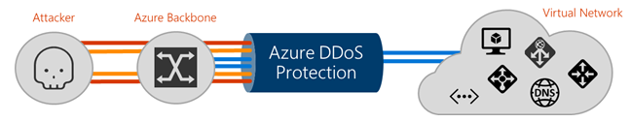
Azure Distributed Denial of Service (DDoS) protection
DDoS attacks overwhelm and exhaust network resources, making apps slow or unresponsive.
Sanitizes unwanted network traffic before it impacts service availability.
Basic service tier is automatically enabled in Azure.
Standard service tier adds mitigation capabilities that are tuned to protect Azure Virtual Network resources.
Notes:
Azure DDoS Protection - https://azure.microsoft.com/en-us/services/ddos-protection/
Learn and SkillPipe content order note:
https://docs.microsoft.com/en-us/learn/modules/secure-network-connectivity-azure/4-protect-attacks-azure-ddos-protection

Slide 20
Defense in Depth Reviewed
Combining network security solutions
NSGs with Azure Firewall to achieve defense in depth.
Perimeter layer protects your network boundaries with Azure DDoS Protection and Azure Firewall.
Networking layer only permits traffic to pass between networked resources with Network Security Group (NSG) inbound and outbound rules.
Physical Security
Identity & Access
Perimeter
Network
Compute
Application
Data
Notes:
This slide uses the Defense in Depth perimeter and networking layers as examples. Discussing Azure networking security solutions at each layer is beyond the scope of this course.
Learn and SkillPipe content order note:
https://docs.microsoft.com/en-us/learn/modules/secure-network-connectivity-azure/7-combine-services-complete-solution

Slide 21
Walkthrough - Secure network traffic
Create and configure inbound & outbound security port rules.
Deploy a custom template to create a virtual machine.
Create a network security group.
Create an inbound security port rule to allow RDP.
Configure an outbound security port rule to deny Internet access.
Notes:
Learn and SkillPipe content order note:
Learn has a sandbox exercise - Exercise - Configure network access to a VM by using a network security group
https://docs.microsoft.com/en-us/learn/modules/secure-network-connectivity-azure/6-configure-access-network-security-group

Slide 22

Knowledge Check
Which one?
A). Azure Portal
B). PowerShell
C). Local Tool
Populate with instructions to use the polling tool of your choice
Module 4
Use your Smartphones or Mobile Devices
Go to (insert polling app link of your choice)
Enter Code: 123-45-678
Please participate in the quiz for this section
Notes:
WWL recommends using polling to be completed for every 7 – 10 slides and preferably at the end of each section. This helps break classes up and adds more interactivity especially for remote classes.
In order to promote interactivity, WWL suggests the use of Mentimeter, Kahoot or a similar polling technology. Please feel free to adjust this slide as needed and populate with the instructions based on the polling tool of your choice.
Learn/SkillPipe note:
SkillPipe has a Module 4 review questions slide, while Learn has Knowledge checks individually through Learn modules that follow this PPT.
https://docs.microsoft.com/en-us/learn/modules/protect-against-security-threats-azure/7-knowledge-check
https://docs.microsoft.com/en-us/learn/modules/secure-network-connectivity-azure/8-knowledge-check

Slide 23

Module 4 Review
Microsoft Defender for Cloud
Key Vault, Sentinel, and Dedicated Hosts
Defense in depth
DDoS protection
Microsoft Learn Modules (docs.microsoft.com/Learn)
Notes:
Learn/SkillPipe note:
SkillPipe has a Module 3 summary slide, while Learn has summary units individually through Learn modules that follow this PPT.
https://docs.microsoft.com/en-us/learn/modules/protect-against-security-threats-azure/summary
https://docs.microsoft.com/en-us/learn/modules/secure-network-connectivity-azure/summary

