Slide 1
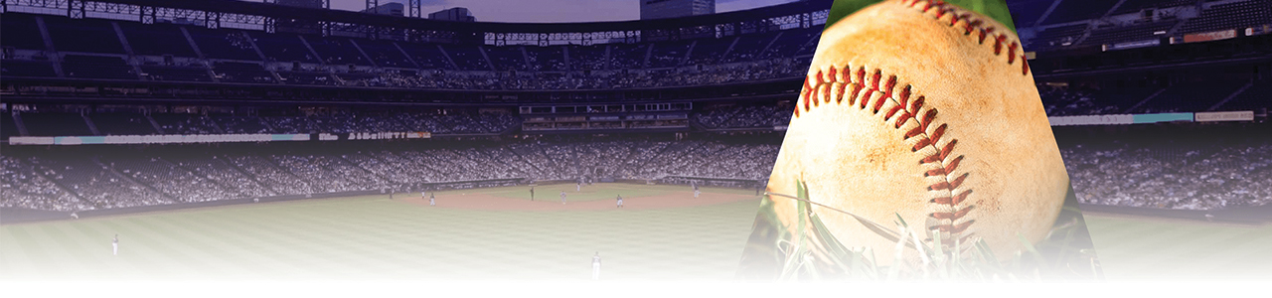
Baseball Game Attendance Drivers
Jorge Pires
Keala Schultz
Kelsey An

Slide 2

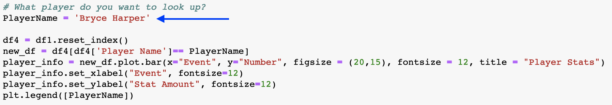
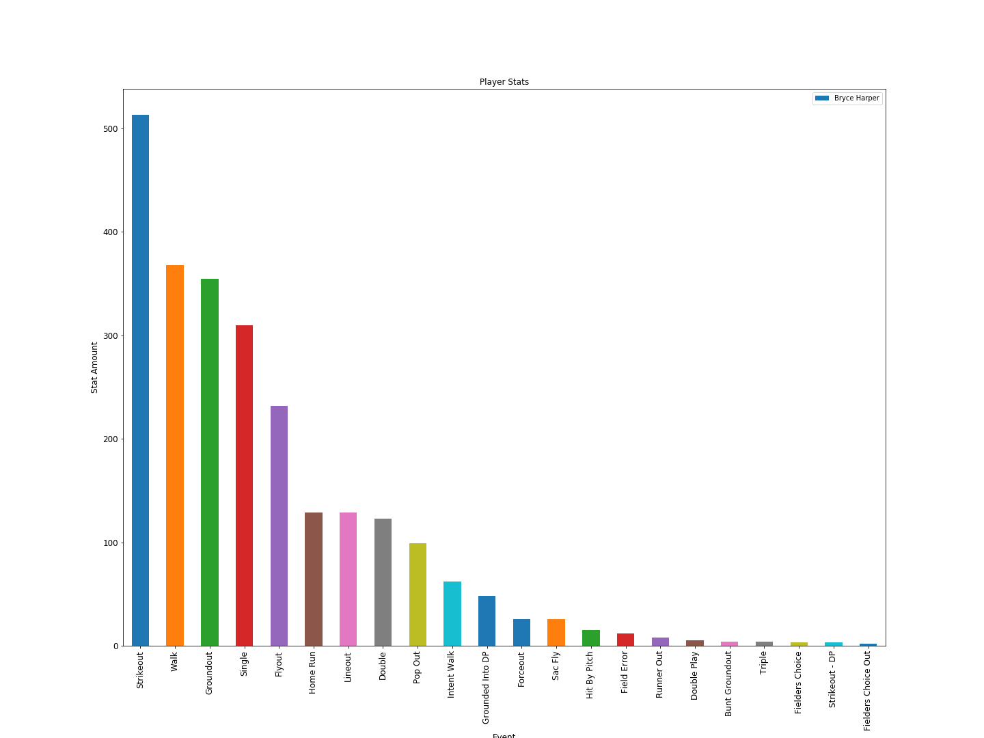
Player Stats
Look up a players stats by their name.
This shows all of the player batting events.

Slide 3
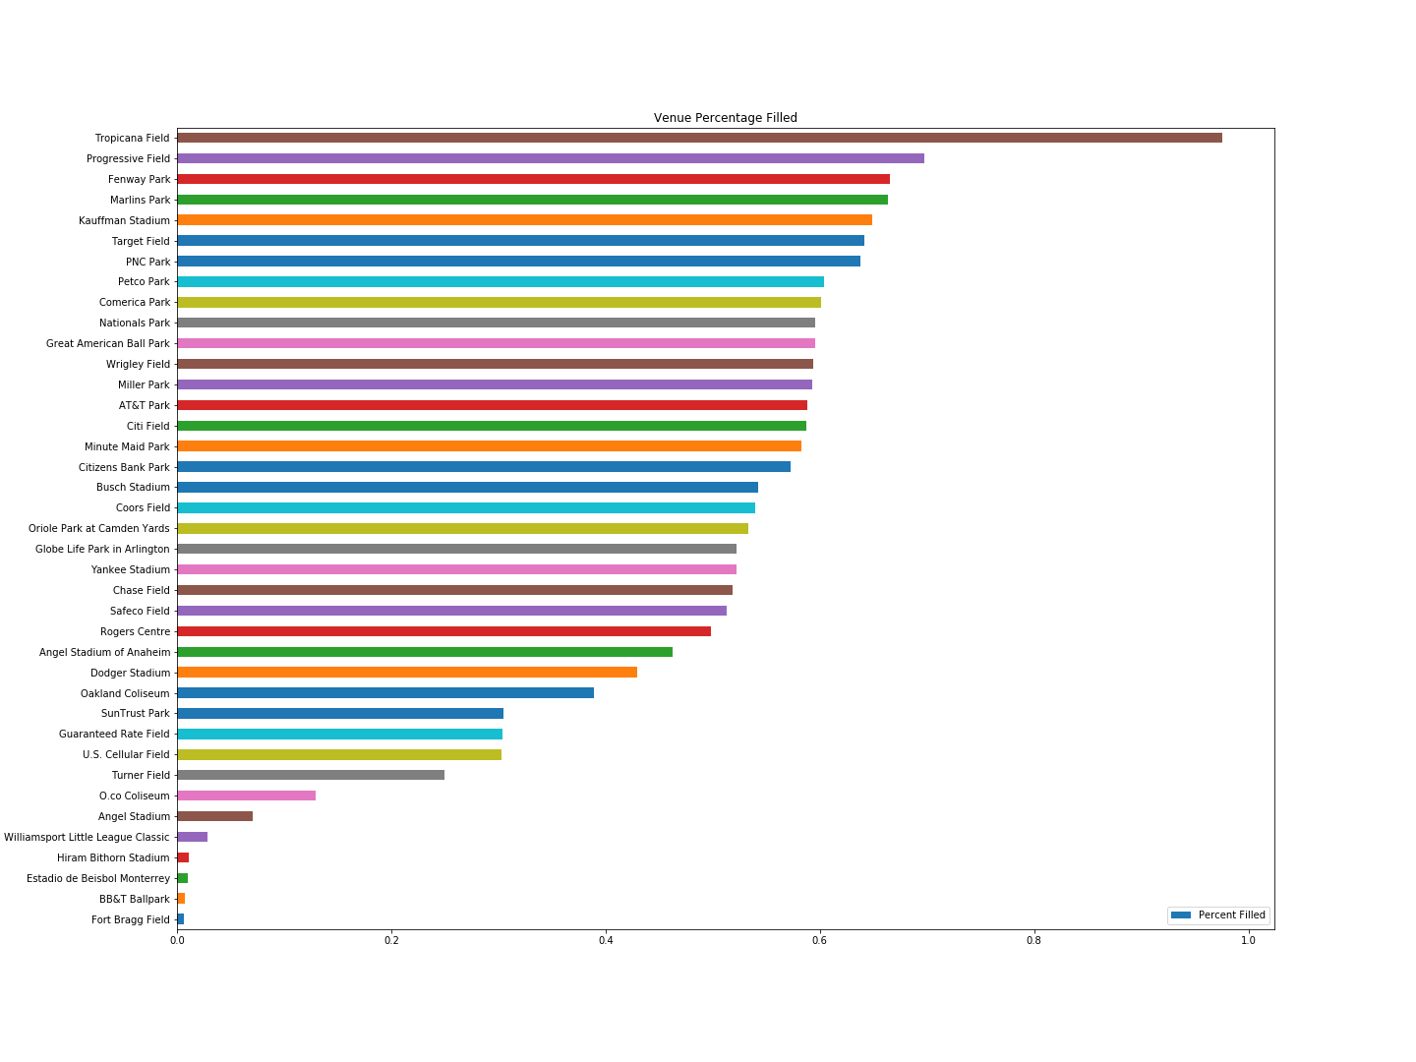
Venue Percentage Filled
Tropicana Field looks like it draws a larger crowd than any of the other stadiums.
It looks like, on average, stadiums usually fill about 50%.
Hiram Bithorn Stadium, Estadio de Beisbol Monterrey, BB&T Ballpark, and Fort Bragg Field don’t pull a large crowd since mainly pre-season or exhibition games occur here.

Slide 4
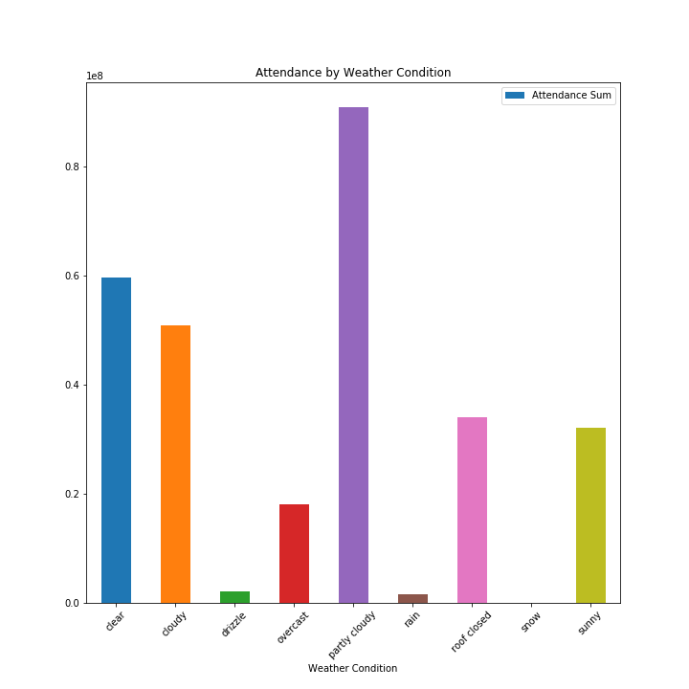
Attendance by Weather Conditions
Partly cloudy weather conditions appears to be the most appealing for game-goers.
Drizzle and rain have the least attendance and appear to be big deterrents.
There was only one game where there was snow documented in our dataset and it was a pre-season game so attendance was very low.
Some ambiguity may be present since cloudy, overcast, and rain are all similar and the rating is human-based. The same can be said about sunny and clear.

Slide 5
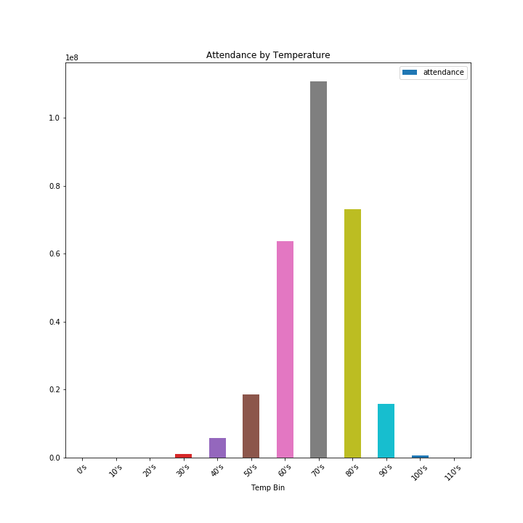
Attendance by Temperature
Temperature in the 70’s looks ideal for game-goers.
This is also the most common temperature so the results are not surprising.
There was only one game in the 30’s so that would be an outlier.

Slide 6
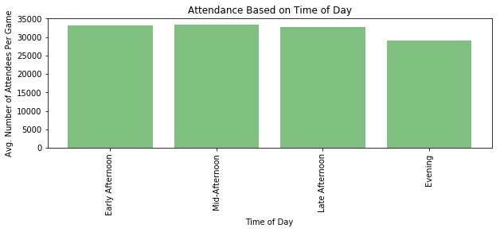
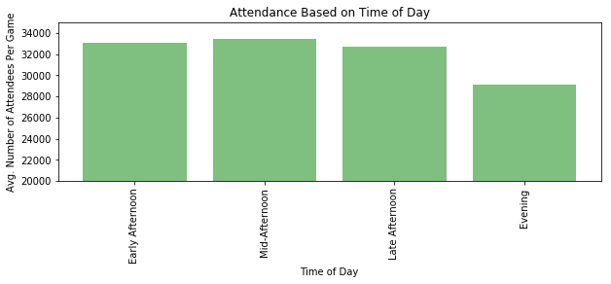
Attendance by Time of Day
Upon first look, it seemed that time of day had little influence on average number of attendees per game (first) graph.
After zooming in on just the top portions of the bar graphs, time of day seemed to have more relevance in terms of game attendance.
Based on further look, the attendance numbers seem to suggest a preference for games in the early and mid afternoon.
----------------------------------------------------------------------------

Slide 7
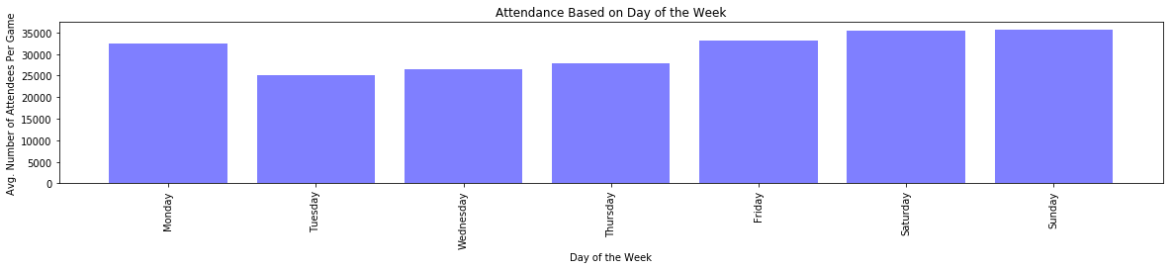
Attendance by Day of Week
With first look at the average attendance based on day of the week, there seems to be a strong. preference for games toward the end of the week
The exception to that trend is Monday, which suggests the preference is likely for games closer to the weekend.
On Tuesdays, when people realize how far off Friday is they don’t seem to have the heart to go to a baseball game.

Slide 8
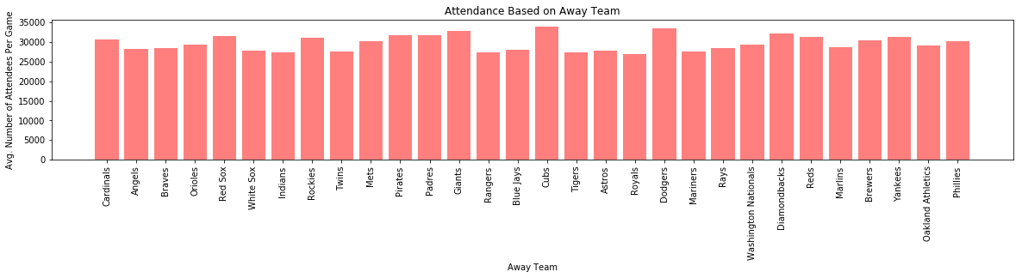
Attendance by Away Team
We wanted to see whether the visiting (away) team would affect average attendance for games because some teams have rivalries with others as well as other potential hype.
The teams that drove up the attendance numbers the most are the Dodgers, the Giants, and the Cubs while the teams with the lowest attendance are the Indians, the Rangers, and the Royals.
Given a difference in average attendance of over 5000 attendees between teams like the Cubs and the Rangers, the data implies that the visiting team affects average attendance.

Slide 9
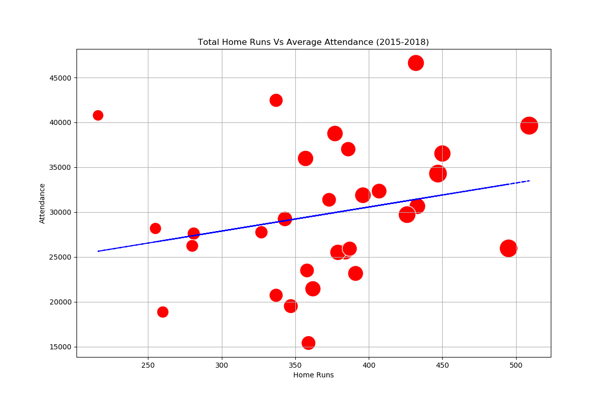
Attendance by Home Runs
The team with the least amount of home runs was third in most average attendance.
The team with the lowest attendance had more home runs than 11 other teams
The team with the highest attendance ranked fifth in total home runs
The team with the most home runs had the 4th largest average attendance.
Only 2 teams that had less than 350 home runs averaged more than 40,000 attendees while the remaining 8 in that grouping averaged an attendance less than 30,000
The trendline while positive suggests that the amount of home runs does not have much correlation to the attendance.

Slide 10
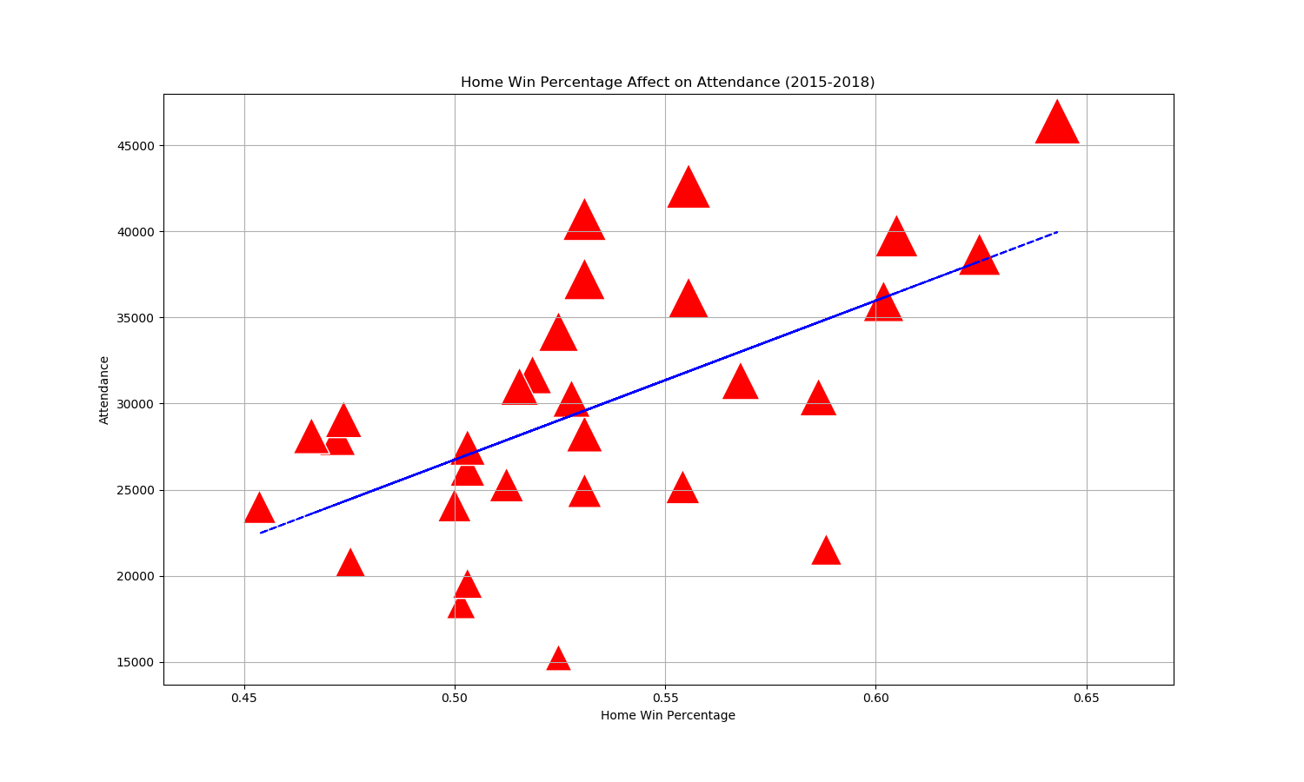
Attendance by Home Percentage Wins
A winning home record does not translate to high attendance, 5 teams with a record better than .500 averaged less than 25,000. Three of those averaged less than 20,000.
The team with the best home record also had the highest average attendance above 45,000
One team had a home record over .500 over the span of the 4 seasons but had the lowest average attendance of approximately 15,000
No teams with a losing record averaged over 30,000 average attendance
Of the 6 highest records, one team averaged just above 20,000 attendees.
The trendline suggests the expected, more wins draws a larger crowd.

Slide 11
Limitations
Attendance
Day of game ticket purchase data
Fan sentiment
Weather
Forecasted weather for the day of game
Time/Date
Is it a doubleheader?
Is it a rescheduled game?
Players
Starting pitcher for either team
Marque player
Fan popular player returning from disabled list
Fan popular player returning after being traded

Slide 12
Conclusions
Venue plays a small roll in driving attendance as some more important games are held in specific venues and other mainly host pre-season games.
People don’t like attending games in drizzle, rain, or snow.
Temperature doesn’t play a huge roll in driving attendance but drastic temperature conditions on opposite sides of the spectrum do deter attendees.
Attendance numbers seem to suggest a preference for games in the early and mid afternoon.
Preference is likely for games closer to the weekend.
Visiting team affects average attendance.
More wins draws a larger crowd.

