Slide 1
💧
🌊
💧
🌊
⚓
Hundir la flota
💧
⛵
⛵
⛵
🌊
The Bridge | Data Science Bootcamp
💧
💧
🌊
🌊
🛟
Jorge Sánchez Hernández
🌊
⛴️
⛴️
💥
🌊
⚓
🌊
⚓
🌊
🌊

Slide 2
Estructura del proyecto
utils.py
bot.py
visual.py
numpy, random
random
time, sys
Tableros, barcos, disparos y vidas
La CPU y sus 3 niveles
Slowprint: texto lento en la visualización del terminal
main.py
numpy, random
Bucle de la partida y turnos
main.py importa funciones de los otros tres módulos para el correcto funcionamiento de la partida

Slide 3
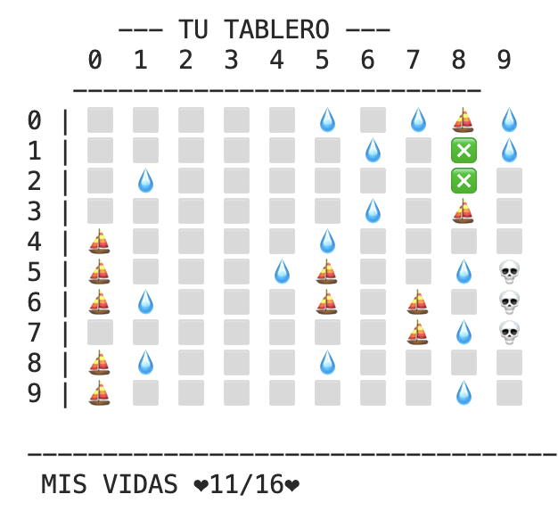
Leyenda: El tablero y la flota.
⬜
Agua sin disparar
Terminal
⬛
Casilla vecina a un barco (Máscara)
Agua disparada
💧
❎
Barco tocado
💀
Barco hundido
⛵
Barco no tocado
utils.py (create_fleet)
fleet_lengths = [4,3,3,2,2,2]

Slide 4
utils.py · Crear el tablero y los barcos
create_board
create_ship
Matriz 10×10 llena de ⬜
Elige orientación y posición al azar y evita que no choque con otros Barcos ni que se salga del tablero
create_board
create_ship
ship = []
for i in range(length):
if orientation == 'H':
ship.append((row, column + i))
else:
ship.append((row + i, column))
collision = False
for row, column in ship:
if board[row, column] != '⬜':
collision = True
break
if not collision:
return ship
def create_board(size=10):
return np.full(
(size, size), '⬜')
def create_ship(length, board):
size = 10
while True:
orientation = random.choice
(['H', 'V'])
if orientation == 'H':
row = np.random.randint
(0, size)
column = np.random.randint
(0, size - length + 1)
else:
row = np.random.randint
(0, size - length + 1)
column = np.random.randint
(0, size)

Slide 5
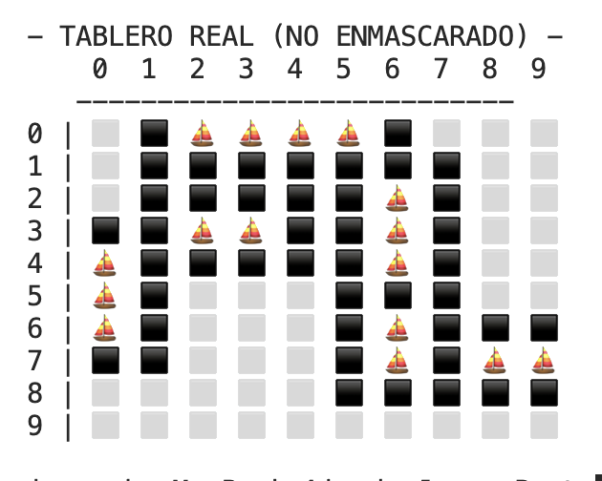
utils.py · Colocación de barcos
place_ship
Terminal
Rodea el barco de ⬛ y pone ⛵ por cada eslora
def place_ship (ship, board):
size = 10
boxes_around = [(-1, -1), (-1, 1), (1, -1), (1, 1)
, (0,1), (1,0), (-1, 0), (0, -1)]
for row, col in ship:
for row_around, col_around in boxes_around:
row_mask, col_mask = row_around + row, col_around + col
if 0 <= row_mask < size and 0 <= col_mask < size:
if board[row_mask, col_mask] == '⬜':
board[row_mask, col_mask] = '⬛'
for row, column in ship:
board[row, column] = '⛵'
return board
place_ship
Terminal
Notes:
'''En horizontal, limitamos la COLUMNA para que el barco no se salga por la derecha. Ej: Si el tablero mide 10 y el barco mide 4, el inicio máximo permitido es la columna 6 (10-4 = 6) NumPy excluye el último número en el rango, sumamos +1 (6 + 1 = 7) para que incluya el 6'''

Slide 6
⛵
⛵
create_fleet
⛵
⛵
Recorre [4,3,3,2,2,2]: crea, coloca y guarda cada barco en fleet_list.
⛵
⛵
create_fleet
def create_fleet (board):
  fleet_lenghts = [4,3,3,2,2,2]
  fleet_list = []
  for lenght in fleet_lenghts:
  new_ship = create_ship(lenght, board)
  board = place_ship(new_ship, board)
  fleet_list.append(new_ship)
  return board, fleet_list
⛵
⛵
⛵
⛵

Slide 7
utils.py · Crear máscara para no ver tablero enemigo
hidden
def hidden_board_cpu(board):
hidden = board.copy()
hidden[hidden =='⛵'] = '⬜'
hidden[hidden == '⬛'] = '⬜'
return hidden
def hidden_board_player(board):
hidden= board.copy()
hidden[hidden == '⬛'] = '⬜'
return hidden
def lost_board_cpu(board):
hidden= board.copy()
hidden[hidden == '⬛'] = '⬜'
return hidden
⛵ ⛵ ⛵
⛵ ⛵ ⛵
player_board
hidden_player_board
⛵ ⛵ ⛵
cpu_board
hidden_cpu_board
Player POV

Slide 8
utils.py · shoot
1
shoot
def shoot(board, fleet_list, box=None):
if box is None:
  while True:
  try:
  row = int(input("Escoge una fila del 0 al 9:"))
  if 0 <= row <= 9:
  break
  else:
  slowprint("⚠️ ERROR ⚠️ Introducir un número del 0 al 9")
  except ValueError:
  slowprint("⚠️ ERROR ⚠️ Introducir un número del 0 al 9")
  while True:
  try:
  column = int(input("Escoge una columna del 0 al 9:"))
  if 0 <= column <= 9:
  break
  else:
  print("⚠️ ERROR ⚠️ Introducir un número del 0 al 9")
  except:
  if ValueError:
  print("⚠️ ERROR ⚠️ Introducir un número del 0 al 9")
box = (row, column )
row, column = box
Coordenadas
Input (0 al 9)
Fila
Columna

Slide 9
utils.py · shoot
2
shoot
if board[row, column] == '⛵':
board[row, column] = '❎'
shipwreck = True
for ship in fleet_list:
if (row, column) in ship:
for row_ship, column_ship in ship:
if board[row_ship, column_ship] == '⛵':
shipwreck = False
break
if shipwreck:
for row_ship, column_ship in ship:
board[row_ship,column_ship] = '💀'
break
if shipwreck == False:
slowprint(f"\nDisparo en ({row}, {column}): TOCADO 💣˖✷")
else:
slowprint(f"\nDisparo en ({row}, {column}): 💥 TOCADO Y HUNDIDO!!!")
¿Hay ⛵?
Pasa a ❎ (tocado)
3
¿Hundido?
Si no quedan ⛵,
todo el barco pasa a 💀

Slide 10
utils.py · shoot
4
shoot
elif board[row, column] in ('⬜', '⬛'):
board[row, column] = '💧'
slowprint(f"\nDisparo en ({row}, {column}): AGUA ⋆｡ﾟ🌊｡")
else:
slowprint(f"\nYa has disparado en ({row}, {column})")
return board
Agua
⬜/⬛ pasan a 💧
5
Repetido
“Ya has disparado”

Slide 11

utils.py · shoot /lives
4
shoot
elif board[row, column] in ('⬜', '⬛'):
board[row, column] = '💧'
slowprint(f"\nDisparo en ({row}, {column}): AGUA ⋆｡ﾟ🌊｡")
else:
slowprint(f"\nYa has disparado en ({row}, {column})")
return board
Agua
⬜/⬛ pasan a 💧
5
Repetido
“Ya has disparado”
lives
Cuenta los ⛵ que quedan con np.sum. Llega a 0 = flota hundida.
lives
def lives(board):
remaining_lives = np.sum(board == '⛵')
return remaining_lives

Slide 12
print_boards - Interfaz partida
def print_boards(player_board, cpu_board):
import sys
import time
sys.stdout.write("\n📡 Escaneando tablero")
sys.stdout.flush()
for _ in range(3):
time.sleep(0.3)
sys.stdout.write(".")
sys.stdout.flush()
time.sleep(0.2)
cpu_hidden_board = hidden_board_cpu(cpu_board)
player_hidden_board = hidden_board_player(player_board)
print("\n --- TU TABLERO --- --- TABLERO ENEMIGO ---")
print(" 0 1 2 3 4 5 6 7 8 9 0 1 2 3 4 5 6 7 8 9")
print(" --------------------------- ---------------------------")
for r in range(10):
player_row = " ".join(player_hidden_board[r])
cpu_row = " ".join(cpu_hidden_board[r])
print(f"{r} | {player_row} {r} | {cpu_row}")
time.sleep(0.12)
lives_player = lives(player_board)
lives_cpu = lives(cpu_board)
print(f" MIS VIDAS ❤{lives_player}/16❤ VIDAS ENEMIGO ❤{lives_cpu}/16❤")
print_boards

Slide 13
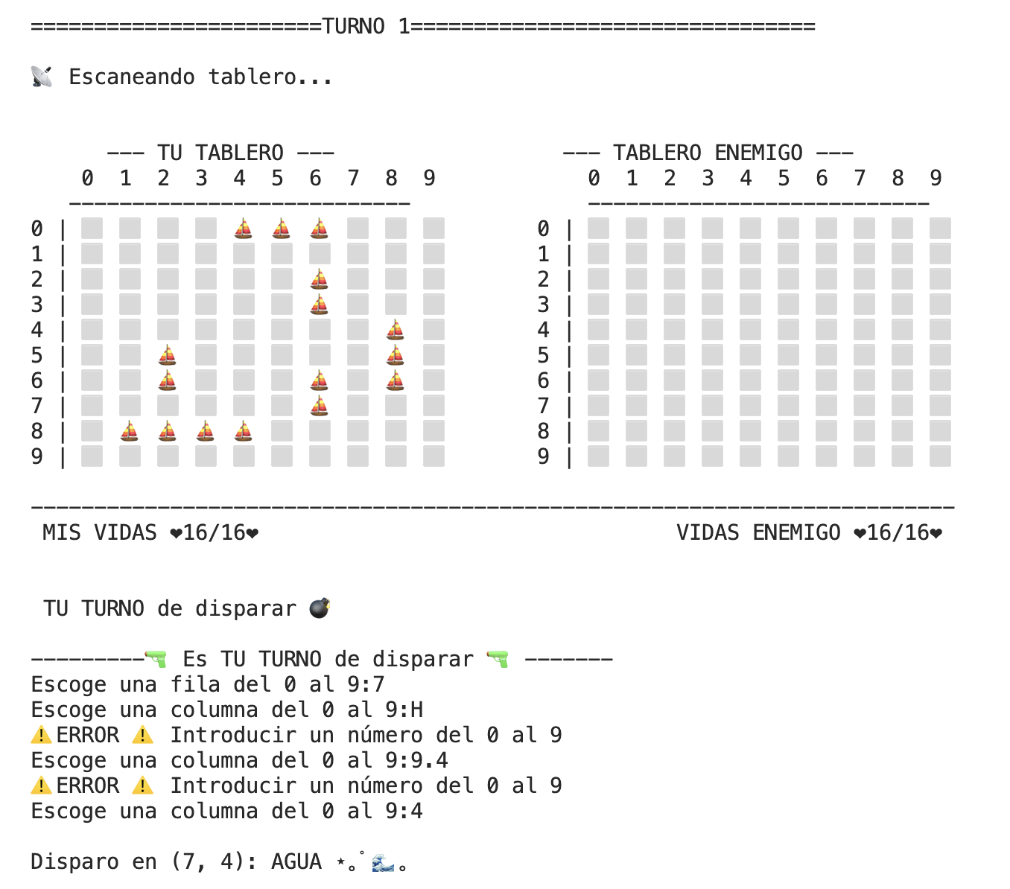
Terminal

Slide 14
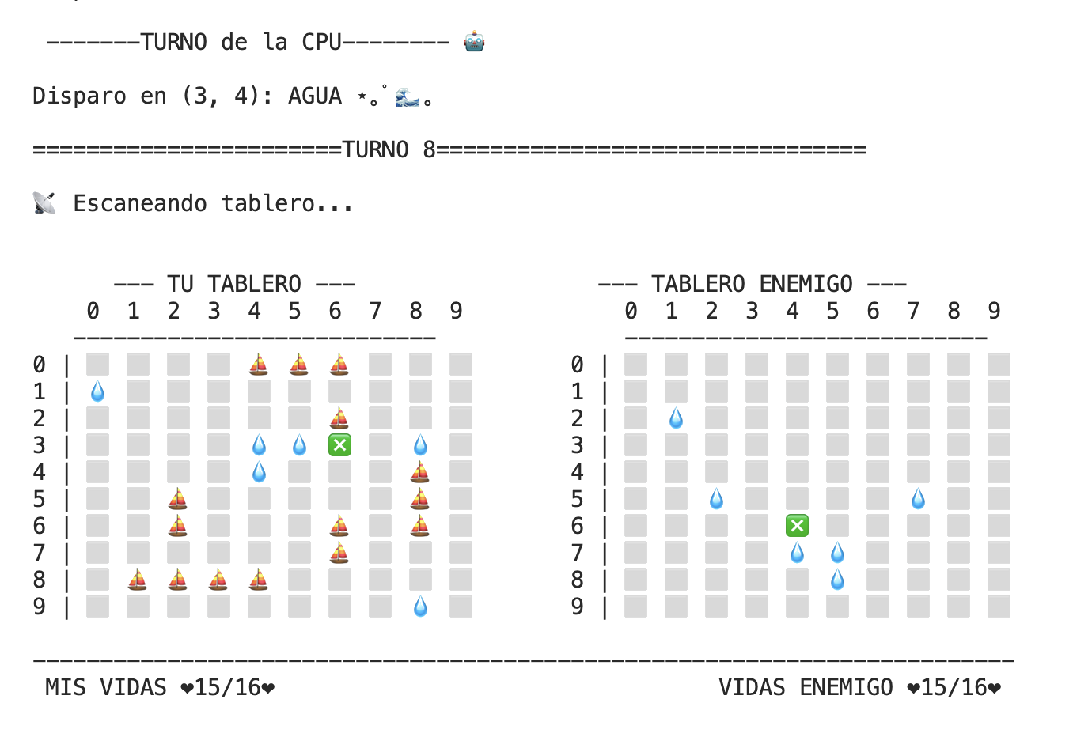
Terminal

Slide 15
bot.py · Niveles de la cpu
Easy: Aleatorio
Medium: tras un ❎ dispara a los 4 vecinos. Sin ❎ → Easy
Hard: sin ❎ pendientes, dispara en damero. Tras un ❎ → Medium

Slide 16
bot.py · easy cpu
__init__
class cpu:
def __init__(self, size = 10):
self.size = 10
self.parity = random.choice([0,1])
Guarda size y una paridad aleatoria (0/1).
easy_cpu
Dispara al azar
Devuelve None si no quedan casillas
class cpu
def easy_cpu(self, player_board):
random_shots = []
for rows in range (self.size):
for columns in range (self.size):
if player_board [rows, columns] == '⬜' or player_board [rows, columns] == '⛵':
random_shots.append((rows, columns))
if len(random_shots) > 0:
return random.choice(random_shots)
else:
return None

Slide 17
bot.py · medium cpu
medium_cpu
def medium_cpu(self, player_board):
hit_boxes = []
for hit_rows in range(self.size):
for hit_columns in range(self.size):
if player_board[hit_rows, hit_columns] == '❎':
hit_boxes.append((hit_rows, hit_columns))
for (hit_rows, hit_columns) in hit_boxes:
boxes_around = [(0,1), (1,0), (-1,0), (0,-1)]
for around_rows, around_columns in boxes_around:
new_rows = around_rows + hit_rows
new_columns = around_columns + hit_columns
if (new_rows >= 0 and new_rows < self.size and
new_columns >= 0 and new_columns < self.size):
if (player_board[new_rows, new_columns] == '⬜' or
player_board[new_rows, new_columns] == '⛵'):
return (new_rows, new_columns)
return self.easy_cpu(player_board)
Medium: tras un ❎ dispara a los 4 vecinos. Si no hay ❎ → Easy.cpu

Slide 18
bot.py · hard cpu
hard_cpu
def hard_cpu(self, player_board):
hit_boxes = []
for hit_rows in range(self.size):
for hit_columns in range(self.size):
if player_board[hit_rows, hit_columns] == '❎':
hit_boxes.append((hit_rows, hit_columns))
if len(hit_boxes) > 0:
return self.medium_cpu(player_board)
pair_boxes = []
for pair_rows in range(self.size):
for pair_columns in range(self.size):
pair_box = player_board[pair_rows, pair_columns]
if pair_box in ('⬜', '⛵'):
if (pair_rows + pair_columns) % 2 == self.parity:
pair_boxes.append((pair_rows, pair_columns))
if len(pair_boxes) > 0:
return random.choice(pair_boxes)
return self.easy_cpu(player_board)
Hard: sin ❎ pendientes, dispara con un patron de tablero de ajedrez
Tras un ❎ → Medium

Slide 19
main.py · play() – Configuración de la partida
1
2
Inicio
Setup
Bienvenida y elección de nivel validada
Dos tableros y dos flotas con create_fleet
main.py
def play():
dificulty = input(Escoge nivel de la CPU: Easy, Medium o Hard ⚔️n").strip().lower()
while dificulty not in ["easy","medium", "hard"]:
slowprint("Introduce una dificultad válida")
dificulty = input(Escoge nivel de la CPU: Easy, Medium o Hard ⚔️).strip().lower()
slowprint("Prepárate, vamos a desplegar las flotas”)
player_board = create_board()
cpu_board = create_board()
player_board, player_fleet = create_fleet(player_board)
cpu_board, cpu_fleet = create_fleet(cpu_board)
game_over = False
turn = 1

Slide 20
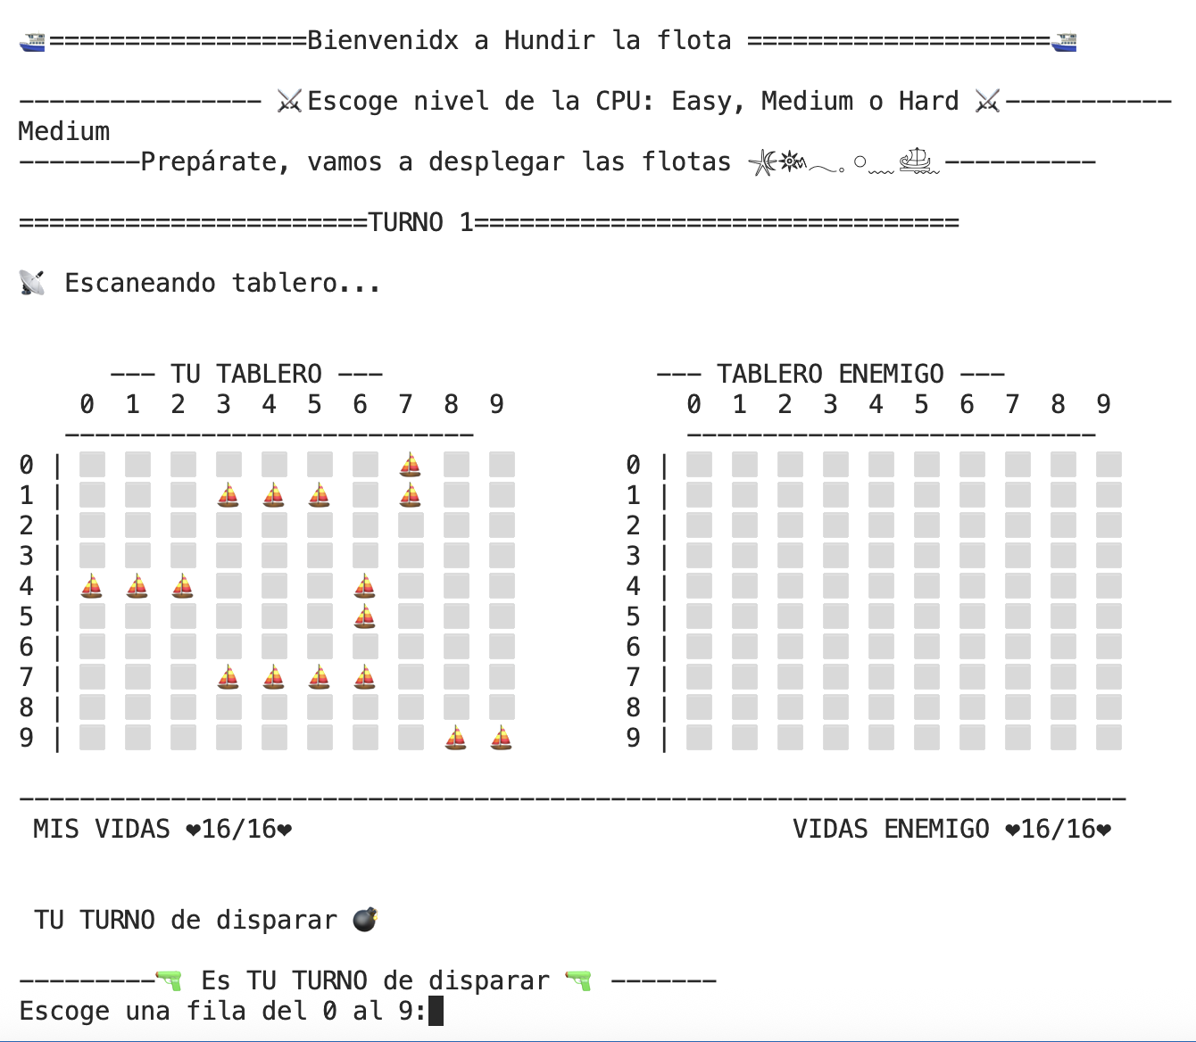

Slide 21
main.py · play() – Bucle del juego
3
Tu turno: Dispara la casilla elegida y comprueba las vidas de la CPU
play()
…
while game_over == False:
print(f"\n=======================TURNO {turn}================================")
print_boards(player_board, cpu_board)
slowprint("\n TU TURNO de disparar 💣")
cpu_board = shoot(cpu_board, cpu_fleet)
if lives(cpu_board) == 0:
print_boards(player_board, cpu_board)
slowprint ("\n🏆🏆🏆 ENHORABUENA!! HAS HUNDIDO LA FLOTA ENEMIGA 🏆🏆🏆")
break

Slide 22
main.py · play() – Bucle del juego
4
Turno de la CPU: Dispara la casilla elegida y comprueba las vidas de la CPU
…(while)
play()
cpu_level = {"easy": bot.easy_cpu, "medium": bot.medium_cpu, "hard": bot.hard_cpu}
player_mask_board = hidden_board_player(player_board)
player_mask_board[player_mask_board == '⬛'] = '⬜'
shot_box = cpu_level[dificulty](player_mask_board)
if shot_box is not None:
player_board = shoot(player_board, player_fleet, box = shot_box)
else:
print("La CPU ya no tiene más casillas a las que disparar")
if lives(player_board) == 0:
print_boards(player_board, cpu_board)
slowprint(f"\n☠️ ¡HAS SIDO DERROTADO)
slowprint(f"Revelando la posición de la flota enemiga...")
cpu_lost_board = lost_board_cpu(cpu_board)
game_over = True
break
turn += 1

Slide 23
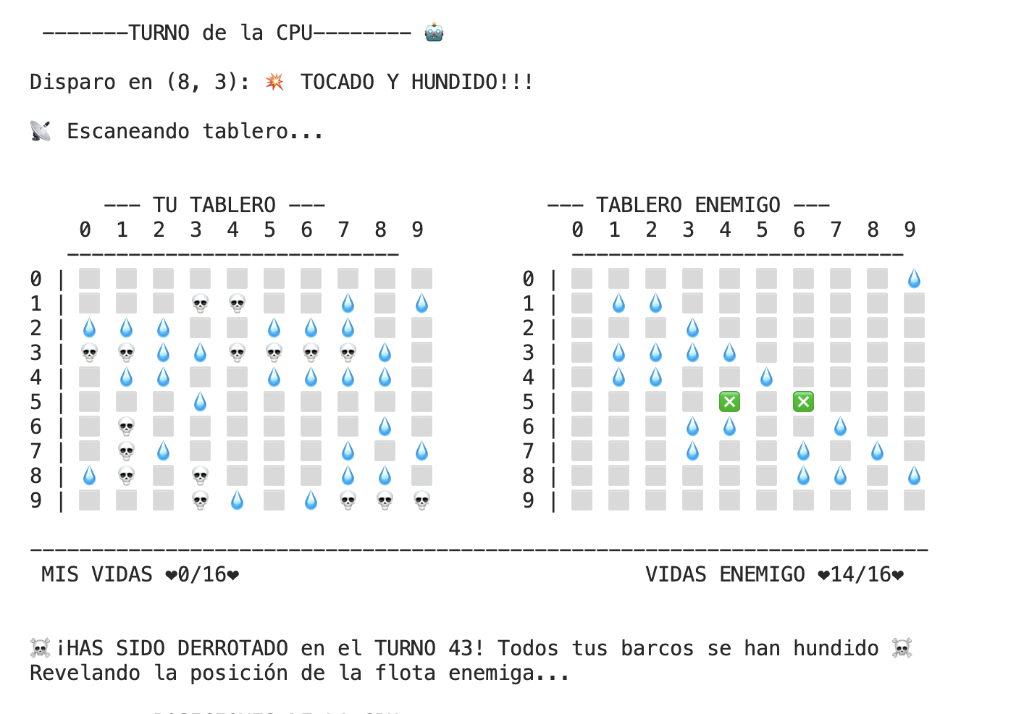
Terminal
🤯
💥
👎
👎
💣
🤯
💥
💣
😞
👎

Slide 24
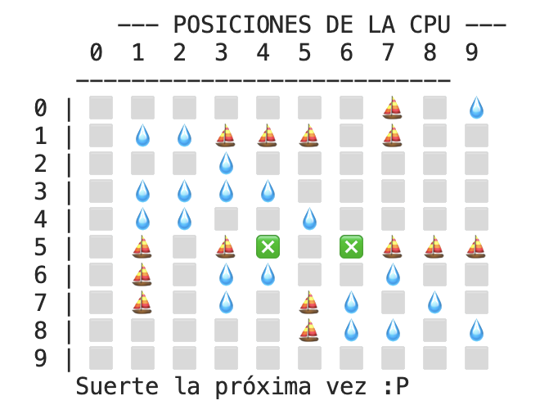
🤯
💥
👎
Terminal
👎
💣
🤯
💥
💣
😞
👎

Slide 25
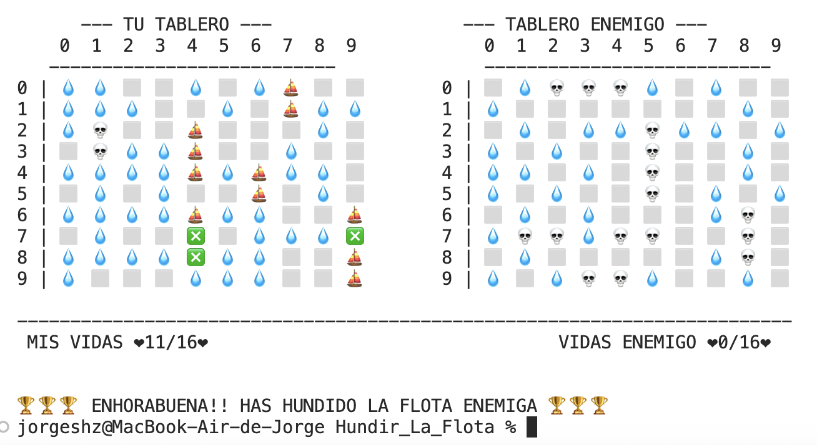
🏅
🏅
Terminal
🏆
🏆
🏅
🏅
🏆
🏆
🥳
🥳

Slide 26
💧
🌊
💧
🌊
⚓
¡Muchas gracias!
💧
⛵
⛵
⛵
🌊
The Bridge | Data Science Bootcamp
💧
💧
🌊
🌊
🛟
Jorge Sánchez Hernández
🌊
⛴️
⛴️
💥
🌊
⚓
🌊
⚓
🌊
🌊

