Slide 1
NLP Market Predictor
By Nirav Pancholi and Jorge Neyra

Slide 2
Introduction
Background:
After seeing hype of GME and AMC stocks, we all thought why didn’t we get on this earlier? There was a particular group on reddit called “r/wallstreetbets” who were driving force behind the hype.
How about we use NLP and Social Media mining to predict these hypes?
Thesis:
In this project, our effort will be to get data from various social media sites such as, twitter, reddit, and news headlines to predict stock price of APPLE (NASDAQ: AAPL).
Source(https://www.nytimes.com/2021/01/27/business/gamestop-wall-street-bets.html)

Slide 3
Data
Reddit API (limited to top/rising posts)
https://www.reddit.com/dev/api/#GET_rising
Twitter API ()
https://developer.twitter.com/en/docs/twitter-api
NY Times API ()
https://developer.nytimes.com/apis

Slide 4
Previous Work
A Robust Predictive Model for Stock Price Prediction Using Deep Learning and Natural Language Processing
Uses previous closing prices and Twitter sentiment analysis to predict future values
https://papers.ssrn.com/sol3/papers.cfm?abstract_id=3502624
Collective Sentiment Mining of Microblogs in 24-Hour Stock Price Movement Prediction
Tweets and market data to create a sentiment analysis and correlate with stock trading volumes
https://ieeexplore.ieee.org/document/6904304
Did not find literature where transformers are used market prediction models
Already tried this but accuracy was not great
https://github.com/jorgeso/nlp_market_prediction/blob/main/notebooks/Code.ipynb

Slide 5
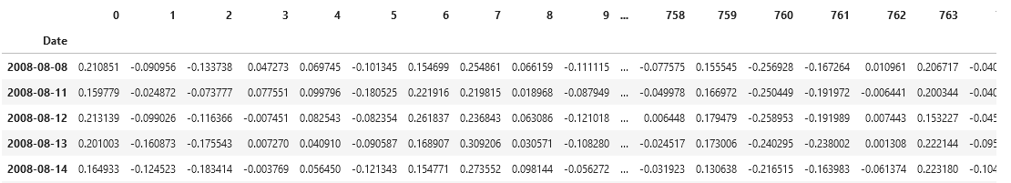
Methods - Embedding
Use pre-trained BERT models to create embedding for text data
Encoder
Decoder
Masked Text
Latent Space
Complete Text

Slide 6
Methods - Prediction Model
Use embeddings to train a deep learning model:
Attention mechanism
Long-short term memory (LSTM) layers
Output layer
Input Embedding
Attention Layer
LSTM Layer
Output Layer
(Linear, Sigmoid, or Softmax)

Slide 7



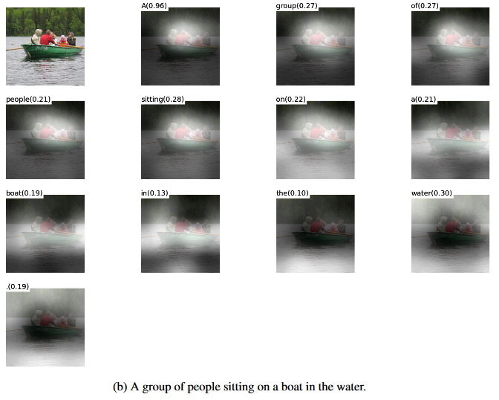
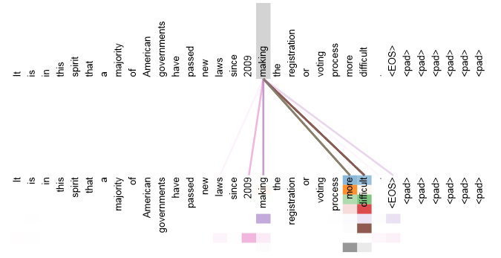
(Optional) Interpretability using Attention
scores:
weights:
Weighted sum:
References:
https://machinelearningmastery.com/the-attention-mechanism-from-scratch/
https://arxiv.org/pdf/1706.03762.pdf
https://arxiv.org/pdf/1502.03044.pdf

