Slide 1
Using News Headlines to Predict Stock Price
By Jorge Neyra

Slide 2
Introduction
There may be several are external factors that affect the price of a stock, like:
Fed rate fluctuations
Company scandals
Tariffs
Natural catastrophes
News headlines can capture information about some of this factors, which then can potentially be used to predict stock values. So with this project, I intend to capture the effect of news headlines on stock prediction.

Slide 3
Introduction
Overview of deep learning
Overview of Long Short Term Memory (LSTM)
Latent space representation with BERT
Data
Modeling
Model trained with news headlines and previous closing values
Model trained only with previous closing values
Model trained only with news headlines
Conclusion

Slide 4

Overview of Deep Learning
Hidden Layers
Each layer takes an input (either the input to the network or the output of the previous layer) which is multiplied by a weights matrix and the product is ran through a nonlinear function.
Non-linearity
This helps the model fit non-linear data.
Features Vector
Predictors for the model
Weights Matrix
The values that are “calibrated” until we reduce the error of the model to a minimum
Output Layer
This produces the desire output. For the example, if the last hidden layer produces a matrix of 1000 x 100, but the desire output is a matrix of 1000 x 1 (sample size of 1000 and 1 continuous prediction for each sample), then the output layer would be a matrix of 100 x 1.
Hidden layer
Non-linearity
(activation function)
Features vector
Weights matrix
Output layer

Slide 5
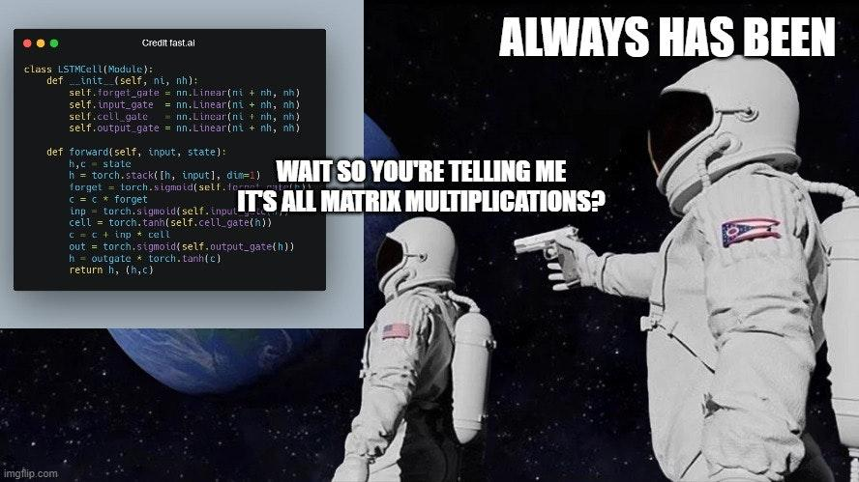
Overview of Deep Learning

Slide 6
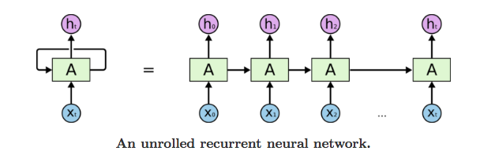
Long Short Term Memory
Source: https://purnasaigudikandula.medium.com/recurrent-neural-networks-and-lstm-explained-7f51c7f6bbb9

Slide 7
BERT
Language model that creates a numerical representation of a given string of text
Trained on all of Wikipedia and a dataset of unpublished books
The numerical representation “contains” syntactic and semantic information about the string
Model available through Hugging Face package
This model is used to create numerical representation of each headline to be used as features
Source: https://arxiv.org/pdf/1810.04805.pdf

Slide 8
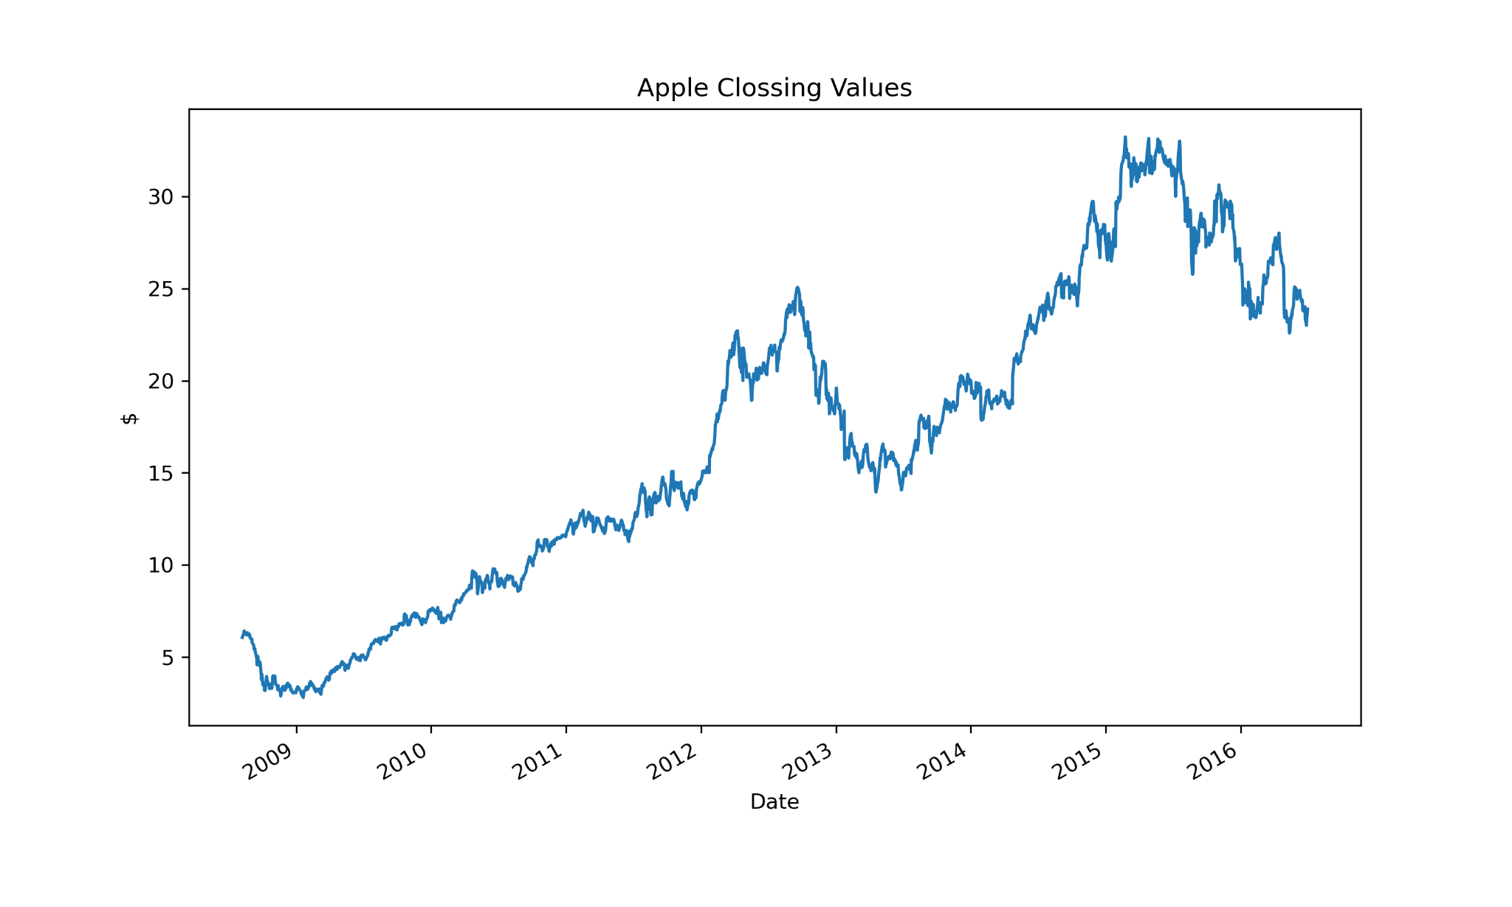
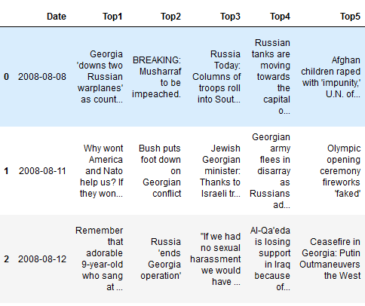
Data
Date range: 08/08/2008 - 07/01/2016
Headlines: 25 headlines for any given day
Splits: 70% train, 15% validate, 15% test

Slide 9
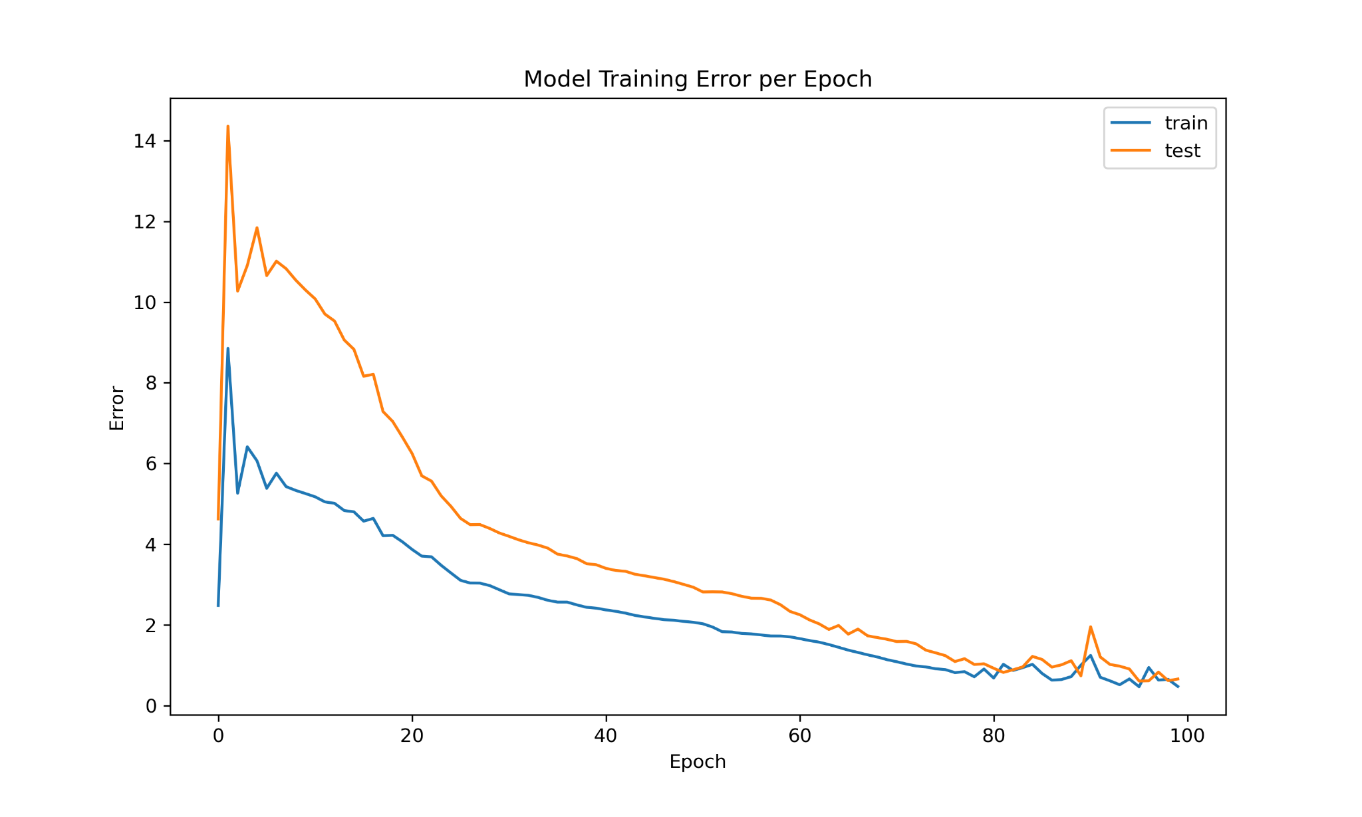
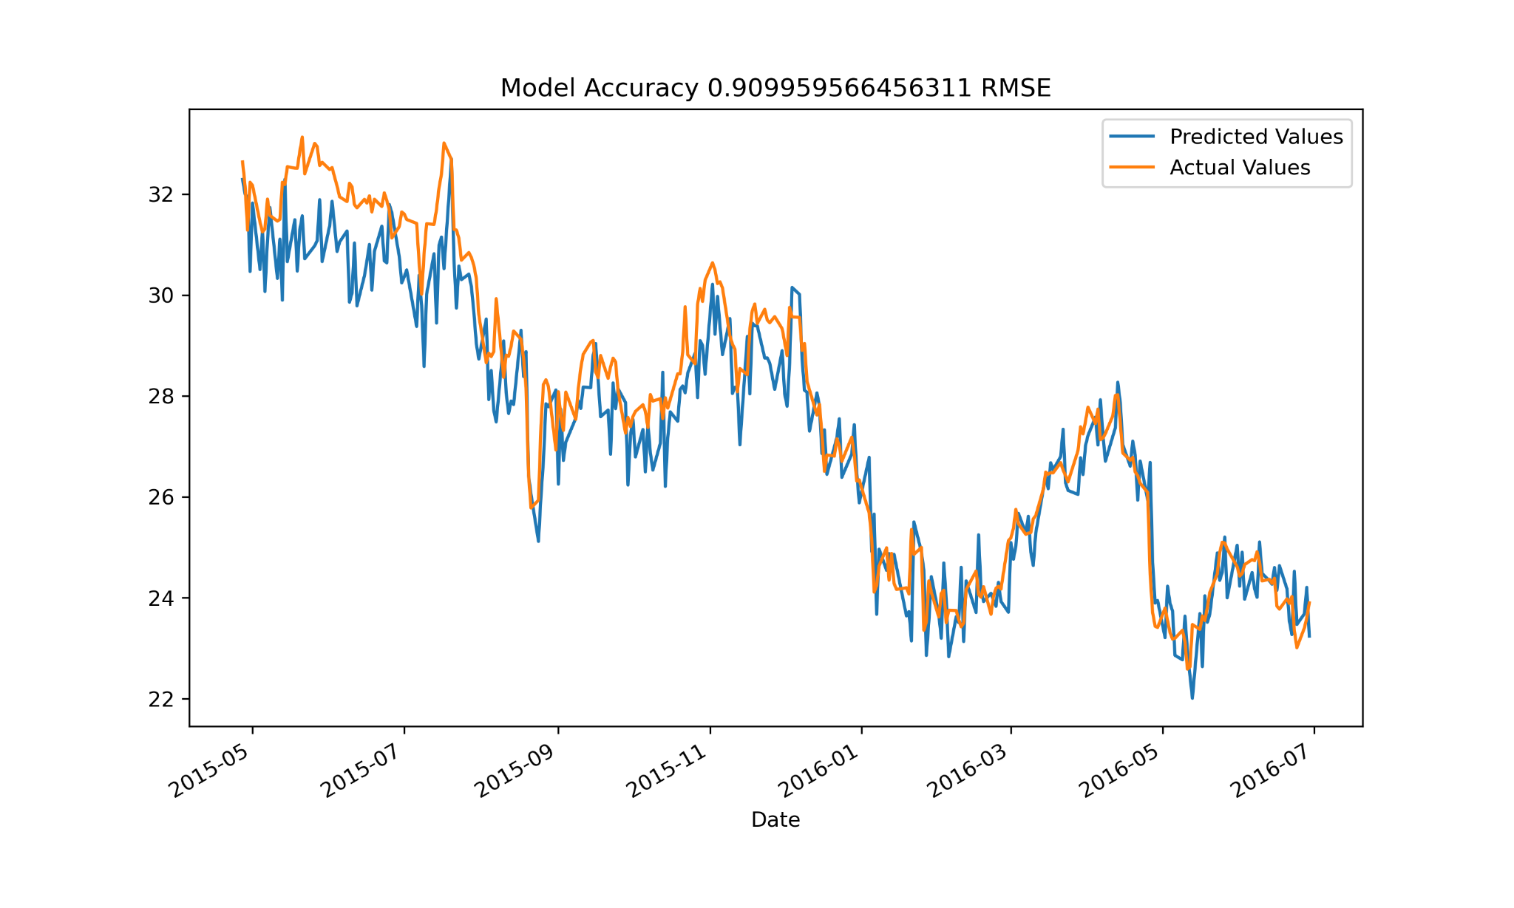
Model Trained with Headlines and Previous Closing Values

Slide 10
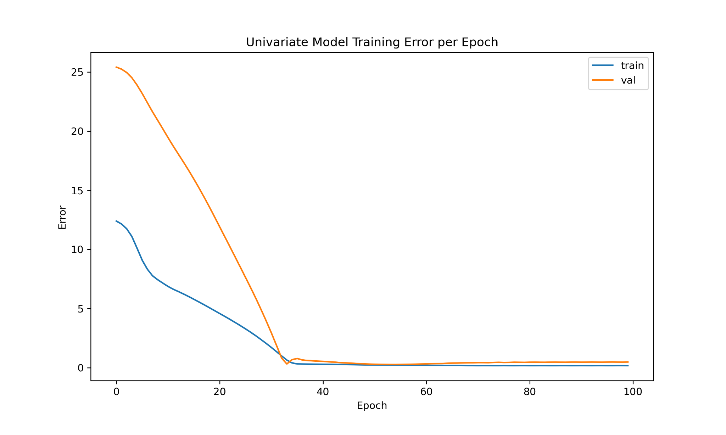
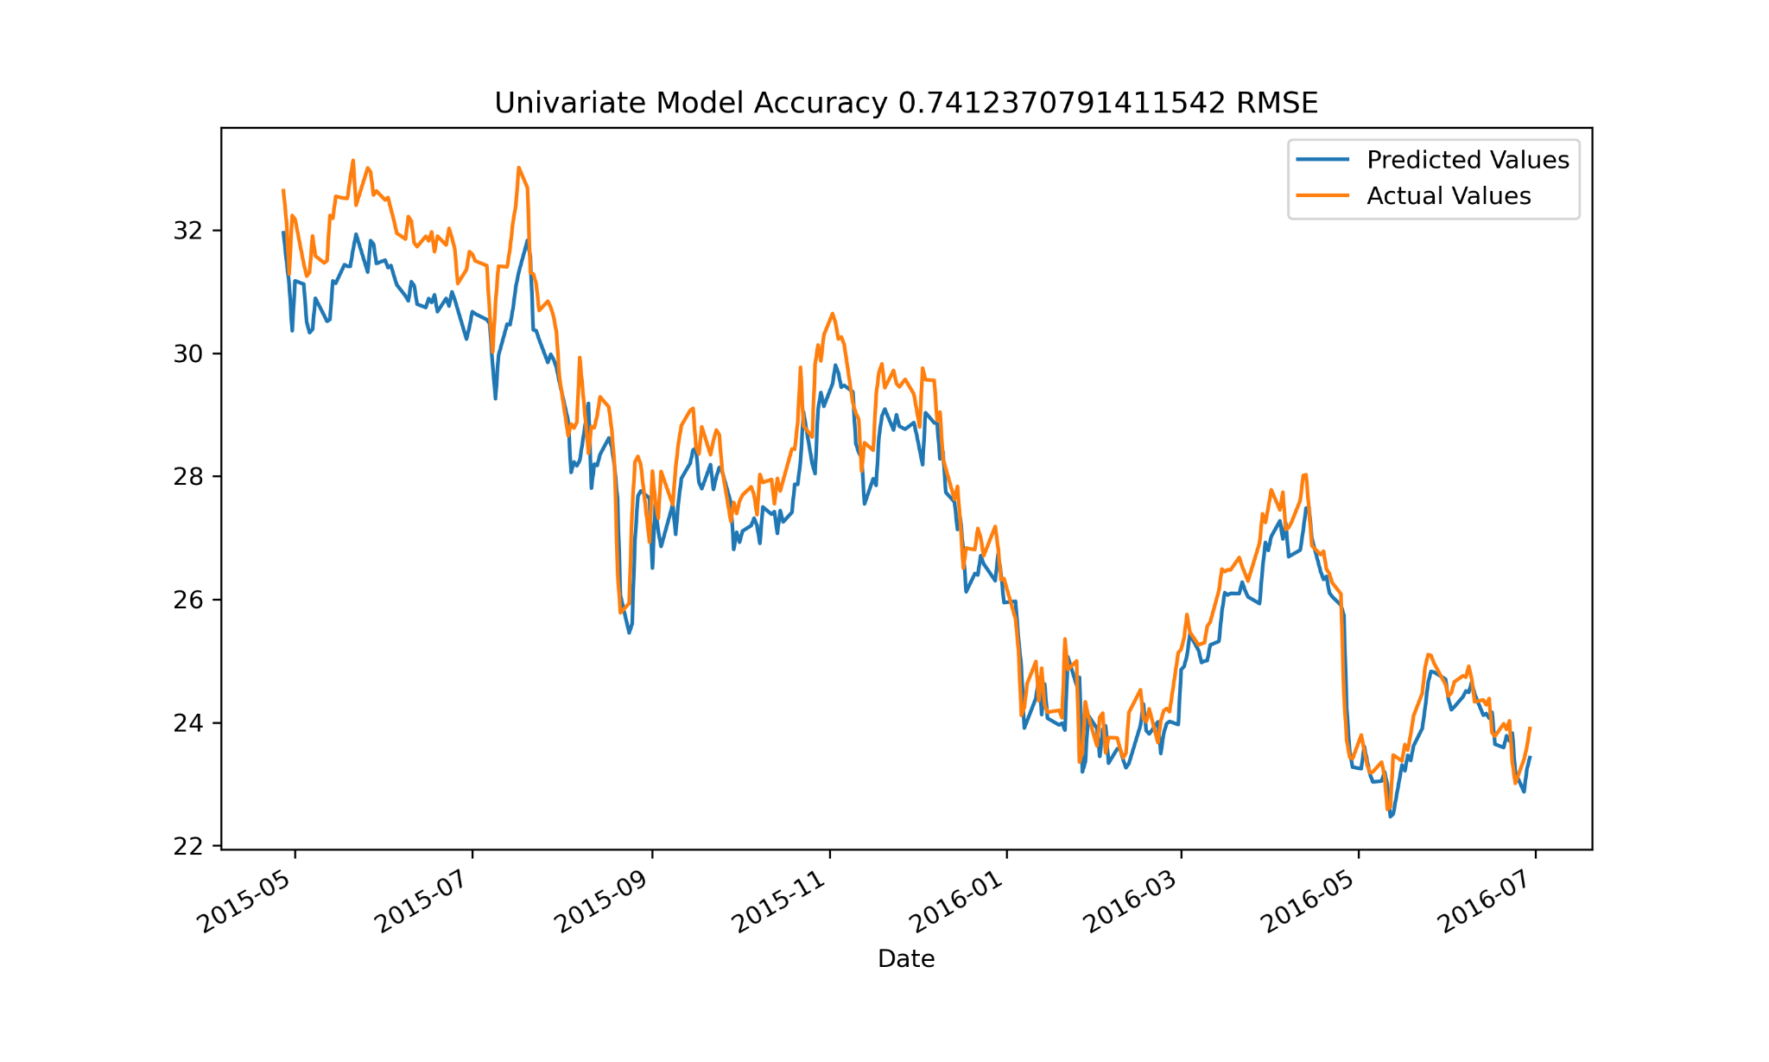
Model Trained Only with Closing Values

Slide 11
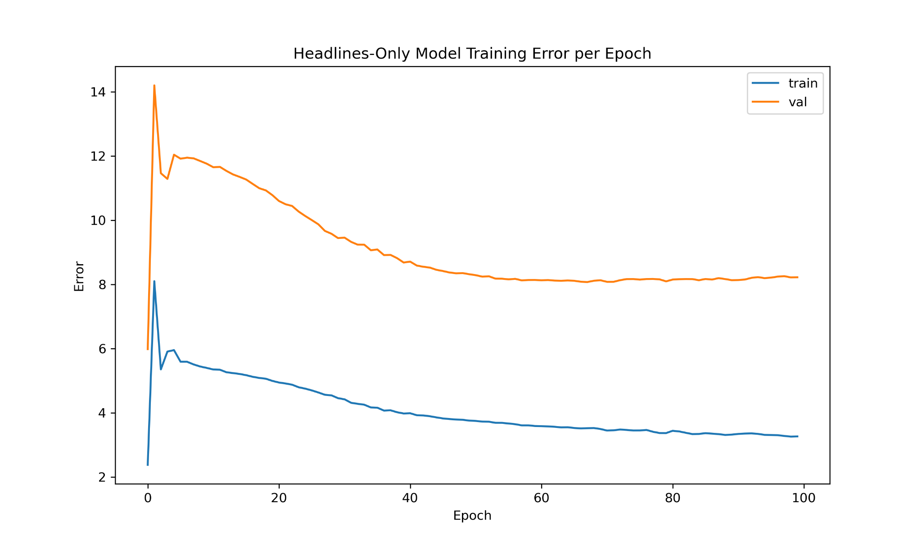
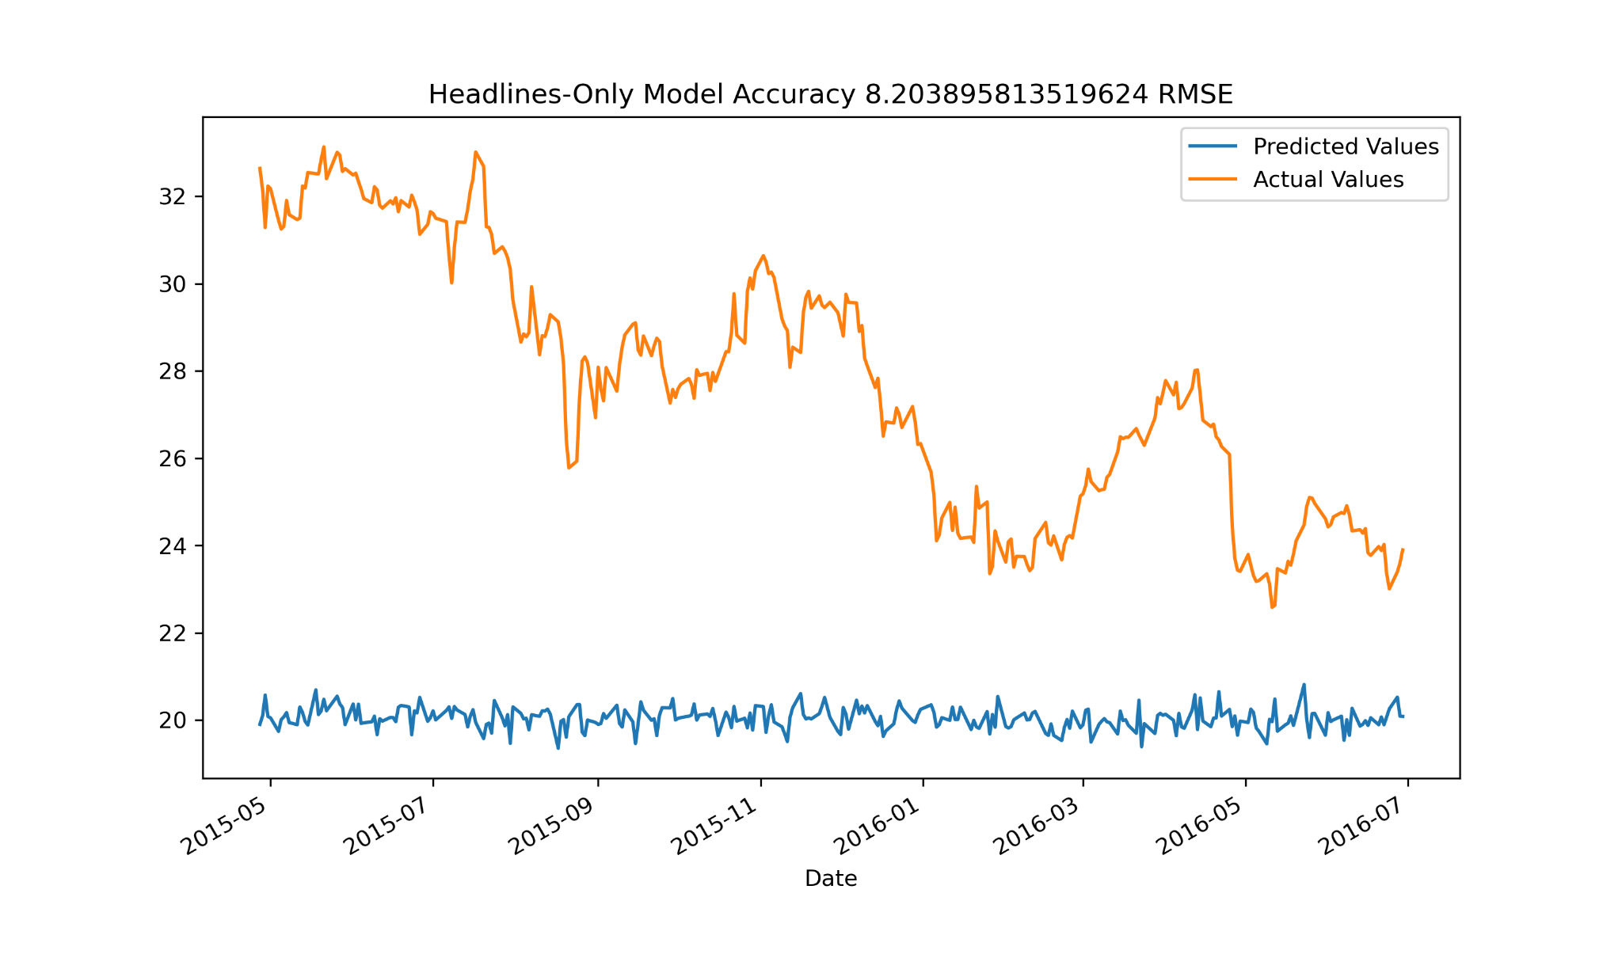
Model Trained Only with News Headlines

Slide 12
Conclusion
News headlines as represented in this project only provide noise to the model
Some of the reasons why this may happen
BERT may not provide a good representation of the headlines
Calculating the mean of BERT’s output may not be best way to reduce the dimension of the data
Maybe using PCA or t-SNE is a better option
Maybe the sources of the news are not the best for this type of predictions
Maybe not enough headlines
Maybe the news don’t have any effect on stock prices

Slide 13
?

