Slide 1
altair
Jorge Wassmann
Advanced Programming for Business Analytics

Slide 2


Slide 3
Installation:
pip install altair
import altair as alt

Slide 4
Data:
Data in Altair is built around the pandas Dataframe. One of the defining characteristics of statistical visualization is that it begins with tidy Dataframes.
import pandas as pd
data = pd.DataFrame({'a': list('CCCDDDEEE'), 'b': [2, 7, 4, 1, 2, 6, 8, 4, 7]})
When using Altair, datasets are most commonly provided as a Dataframe. As we will see, the labeled columns of the dataframe are an essential piece of plotting with Altair.

Slide 5
The Chart Object:
The fundamental object in Altair is the Chart, which takes a dataframe as a single argument:
chart = alt.Chart(data)
So far, we have defined the Chart object, but we have not yet told the chart to do anything with the data. That will come next.

Slide 6
Chart Visualization:
With this chart object in hand, we can now specify how we would like the data to be visualized. This is done via the mark_*
chart = alt.Chart(data).mark_bar()
Mark | Method | Description
Arc | mark_arc() | A pie chart.
Area | mark_area() | A filled area plot.
Bar | mark_bar() | A bar plot.
Circle | mark_circle() | A scatter plot with filled circles.
Geoshape | mark_geoshape() | Visualization containing spatial data
Image | mark_image() | A scatter plot with image markers.
Line | mark_line() | A line plot.
Point | mark_point() | A scatter plot with configurable point shapes.
Rect | mark_rect() | A filled rectangle, used for heatmaps
Rule | mark_rule() | A vertical or horizontal line spanning the axis.
Square | mark_square() | A scatter plot with filled squares.
Text | mark_text() | A scatter plot with points represented by text.
Tick | mark_tick() | A vertical or horizontal tick mark.
Trail | mark_trail() | A line with variable widths.

Slide 7
Types of Graphs:
Bar Charts
Line Charts
Area Charts
Circular Plots
Scatter Plots
Uncertainties And Trends
Distributions
Tables
Maps
Interactive Charts
Advanced Calculations

Slide 8
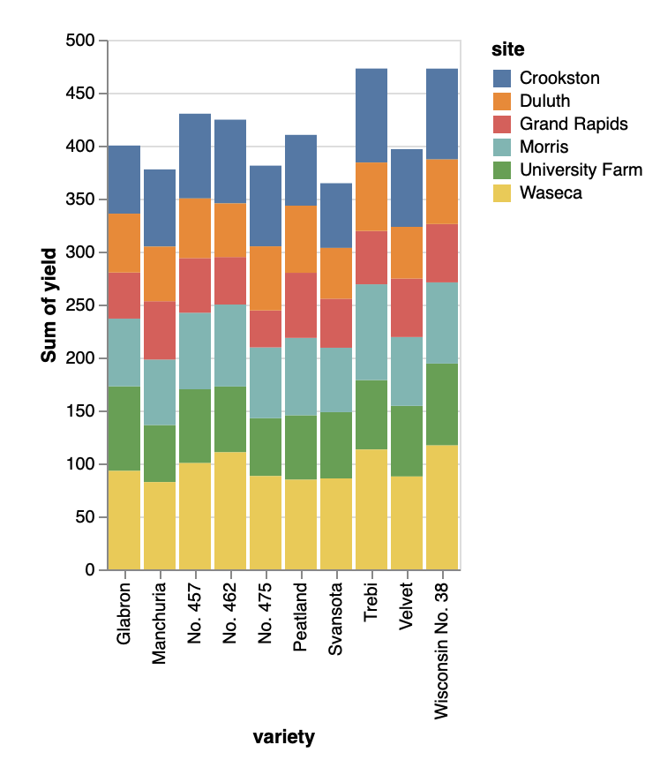
1. Bar Charts
chart = alt.Chart(data).mark_bar()

Slide 9
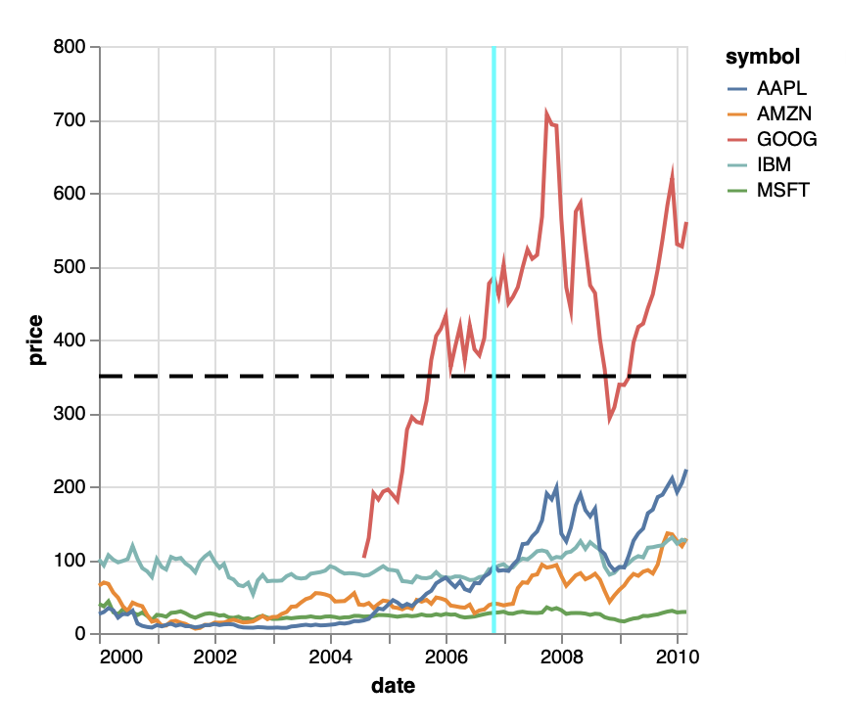
2. Line Charts
chart = alt.Chart(data).mark_line()

Slide 10
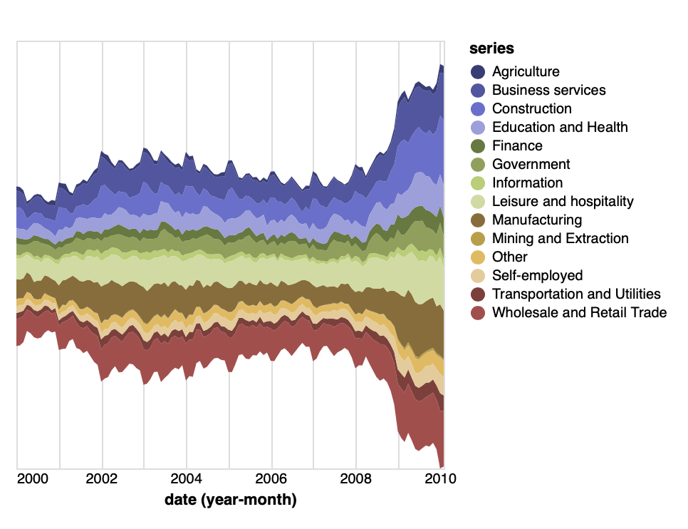
3. Area Charts
chart = alt.Chart(data).mark_area()

Slide 11
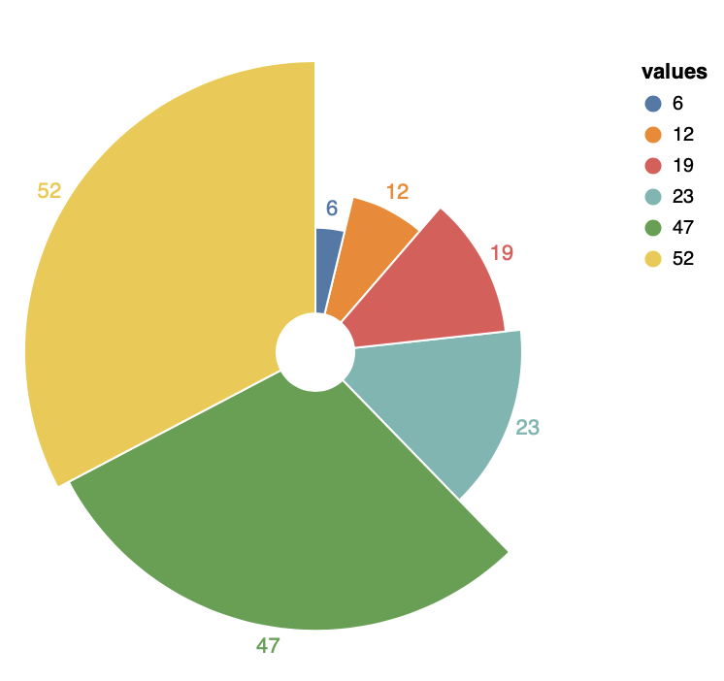
4. Circular Plots
chart = alt.Chart(data).mark_arc()

Slide 12
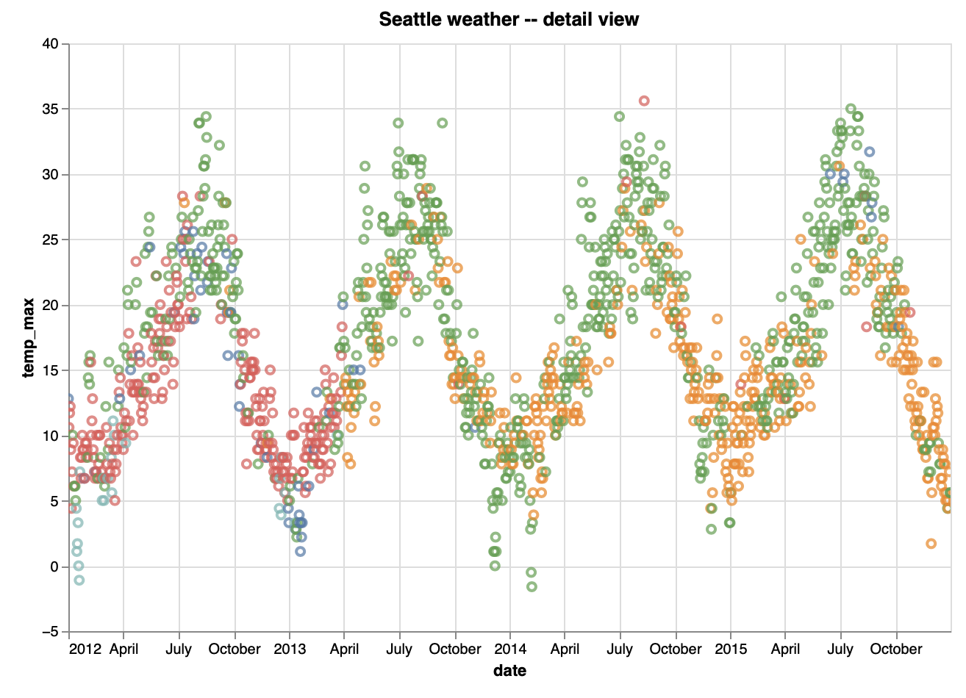
5. Scatter Plots
chart = alt.Chart(data).mark_point()

Slide 13
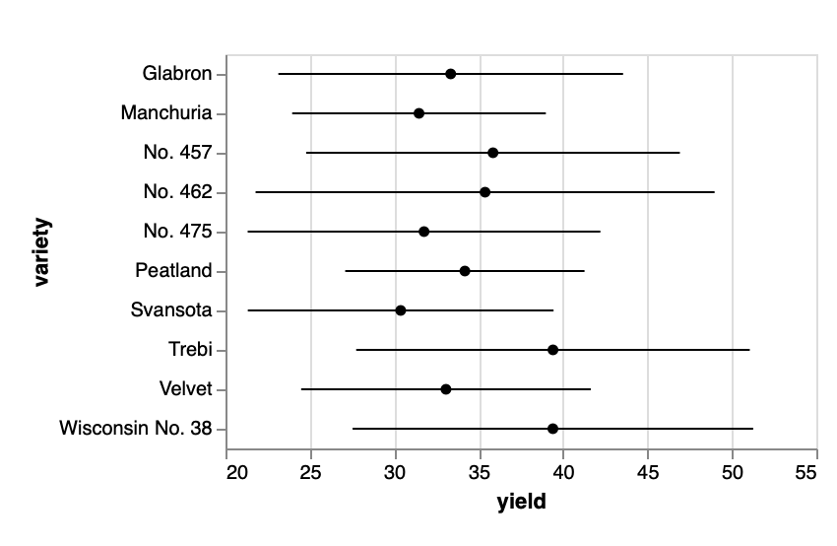
6. Uncertainties and Trends
chart = alt.Chart(data).mark_errorbar()

Slide 14
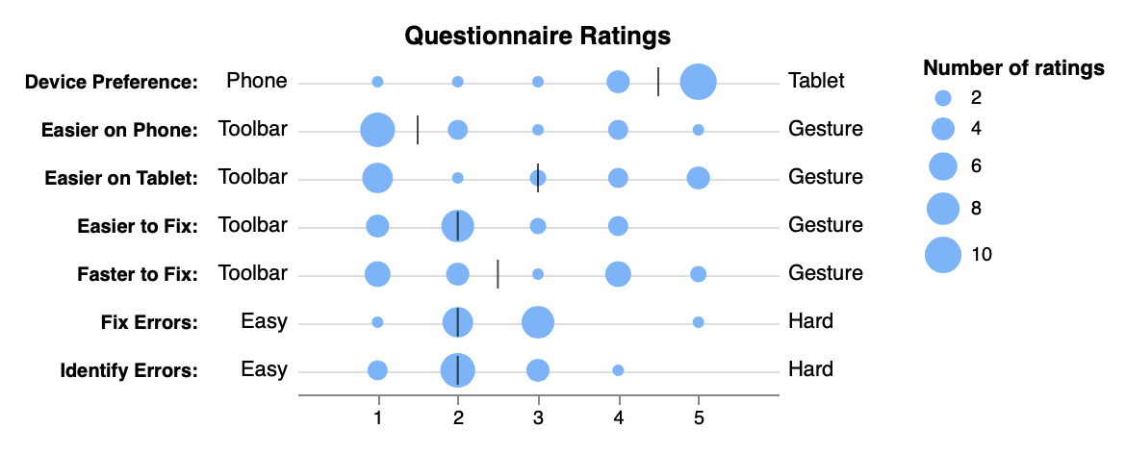
7. Ditributions
chart = alt.Chart(data).mark_circle()
Source: https://altair-viz.github.io

Slide 15
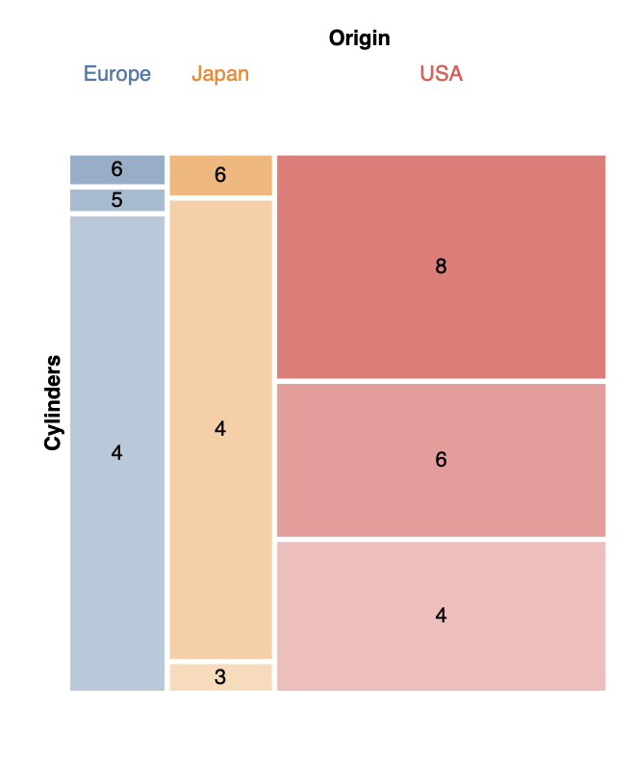
8. Tables
chart = alt.Chart(data).mark_rect()

Slide 16
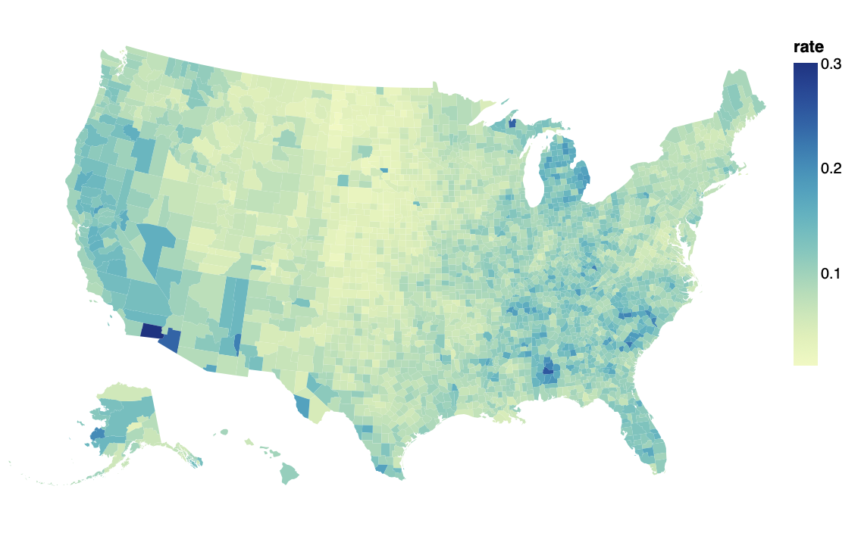
9. Maps
chart = alt.Chart(data).mark_geoshape()

Slide 17
10. Interactive Charts
Source: https://altair-viz.github.io

Slide 18
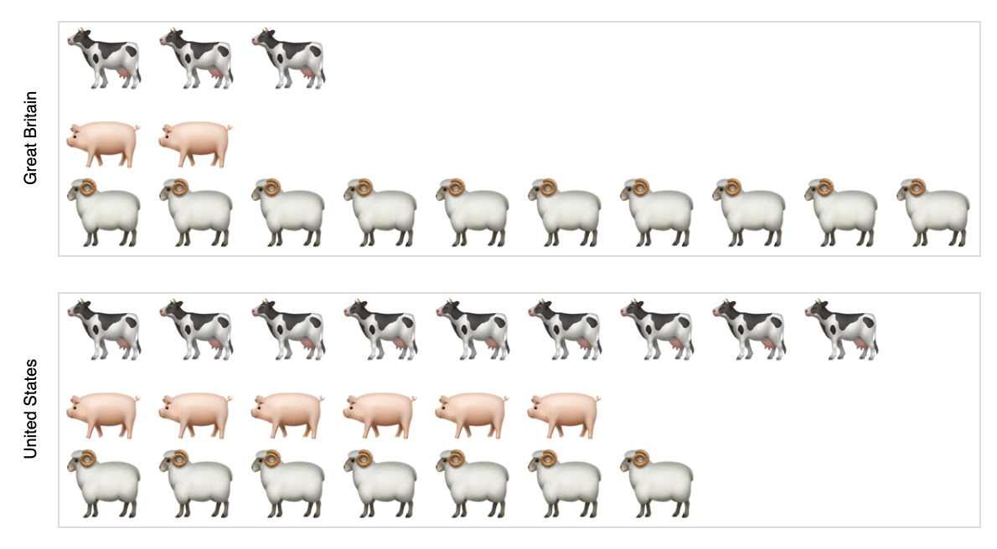
11. Advanced Calculations
Source: https://altair-viz.github.io

Slide 19
Encoding:
Finally, we encode the variable a of the data with the x channel, which represents the x-axis.. This can be done straightforwardly via the Chart.encode() method.
We can also transform the data directly in the econding:
chart = alt.Chart(data).mark_bar().enconde(
x = ‘Horsepower:Q’,
y = ‘average(Price)’,
)
Encoding Data Types. The details of any mapping depend on the type of the data. Altair recognizes five main data types:
Quantitative Q
Ordinal O
Nominal N
Temporal T
Json G

Slide 20
Customizing Visualizations:
Adding Titles and Labels | Adjusting Colors, Sizes, and Shapes
iris_triangle_chart = alt.Chart(iris).mark_point(size=50, shape='triangle', filled=True).encode(
x=alt.X('petalLength:Q', title='Petal Length (cm)'),
y=alt.Y('petalWidth:Q', title='Petal Width (cm)'),
color=alt.Color('species:N', scale=alt.Scale(scheme='category10'), legend=alt.Legend(title='Species')),
tooltip=['species', 'petalLength', 'petalWidth']
).properties(title='Scatter Plot of Petal Length vs. Petal Width')
1. We customize the scatter plot by setting the size of data points to 50, changing the shape to triangles, and filling the data points.
2. We adjust the axis labels to provide descriptive titles for the x-axis and y-axis.
3. We customize the color of data points based on the species using a categorical color scheme and add a legend with a title.
4. Finally, we add a title to the chart to provide context for the visualization.

Slide 21
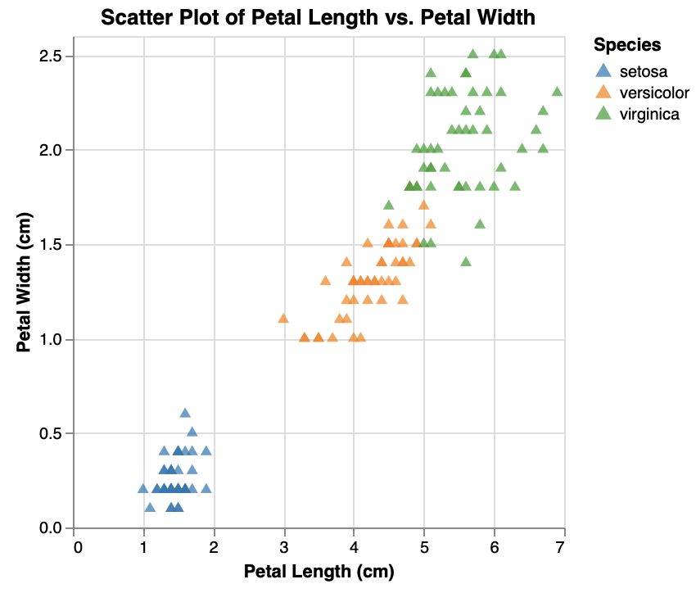
iris_triangle_chart

Slide 22
Interactivity:
Adding Tooltips | Selection | Zooming and Panning
iris_interactive = alt.Chart(iris).mark_point().encode(
x='petalLength:Q',
y='petalWidth:Q',
color='species:N',
tooltip=['species', 'petalLength', 'petalWidth']
).properties(title='Interactive Scatter Plot with Tooltips'
).interactive()
iris_interactive
1. We add tooltips to display the species, petal length, and petal width when users hover over data points.
2. We enable interactivity by calling the .interactive() method on the chart, allowing users to interact with the plot.

Slide 23
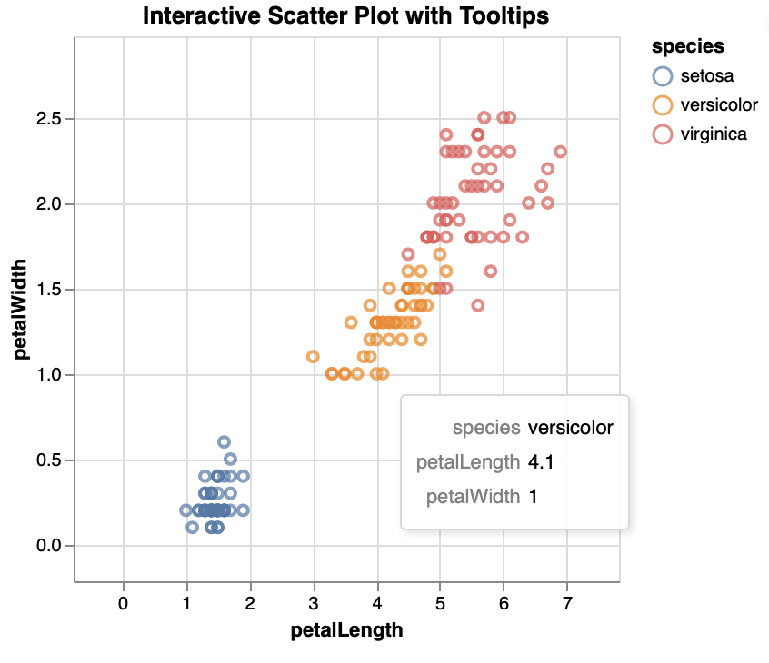
iris_interactive

Slide 24
Advanced Visualization Techniques:
Faceting
facet_chart = alt.Chart(cars).mark_point().encode(
x='Horsepower:Q',
y='Miles_per_Gallon:Q',
color='Origin:N'
).properties(
title='Horsepower vs. Miles per Gallon by Car Origin'
).facet(
column='Origin:N'
)
facet_chart
1. We create a scatter plot with horsepower on the x-axis and miles per gallon on the y-axis, colored by car origin.
2. We use the facet() method to facet the scatter plot by the 'Origin' column, which splits the data into separate subplots for each car origin.

Slide 25
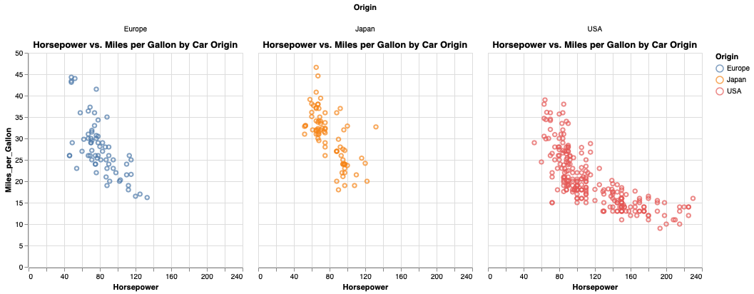
facet_chart

Slide 26
Advanced Visualization Techniques:
Layering
line_chart = alt.Chart(cars).mark_line(color='blue').encode(
x='Year:O',
y=alt.Y('mean(Horsepower):Q', title='Average Horsepower'),
)
scatter_plot = alt.Chart(cars).mark_point(color='red').encode(
x='Horsepower:Q',
y='Miles_per_Gallon:Q’,
)
layered_plot = alt.layer(line_chart, scatter_plot)
1. We create a line chart showing the average horsepower over time, and a scatter plot showing the relationship between horsepower and miles per gallon.
2. We use the alt.layer() function to layer the line chart and scatter plot together into a single visualization.

Slide 27
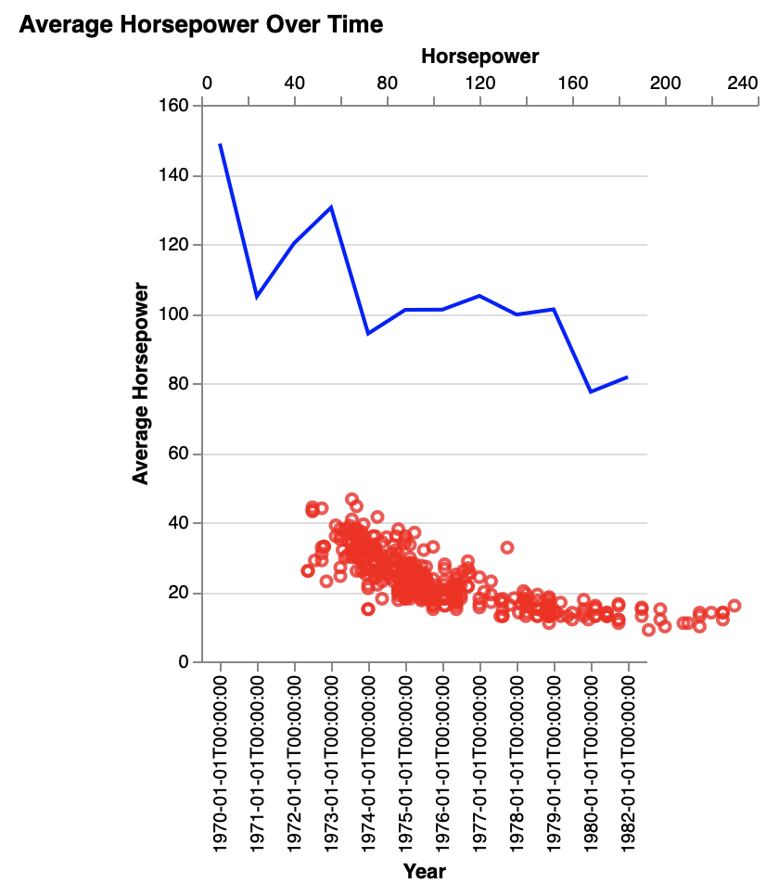
layered_plot

Slide 28
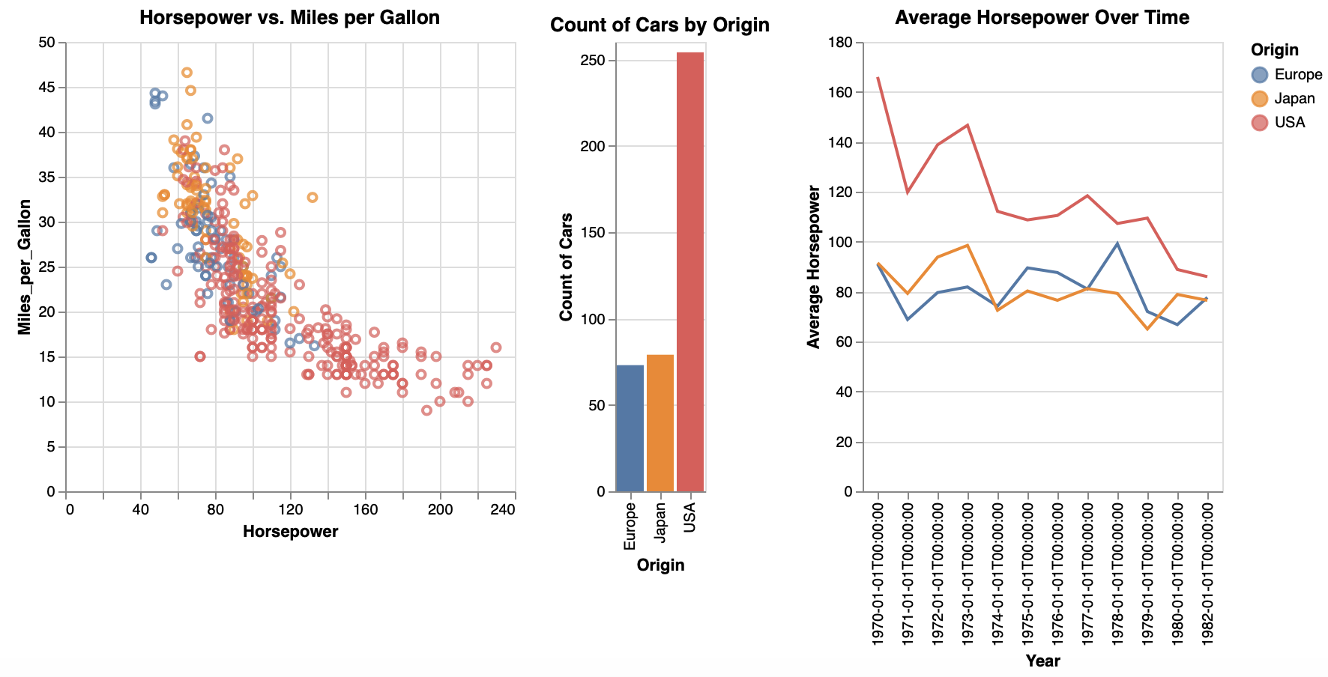
Advanced Visualization Techniques:
Composition
composition = scatter_plot | bar_chart | line_chart

Slide 29
Annotations
Text Annotations
outliers = cars[(cars['Horsepower'] > 200) & (cars['Miles_per_Gallon'] < 20)]
annotations = alt.Chart(outliers).mark_text(
align='left',
baseline='middle',
dx=7
).encode(
x='Horsepower:Q',
y='Miles_per_Gallon:Q',
text='Name'
).interactive()
scatter_with_annotations = scatter_plot + annotations
1. We create a scatter plot = scatter_plot
2. We filter outliers (cars with high horsepower and low miles per gallon) to be annotated.
3. We add text annotations to label the outliers' names directly onto the scatter plot.
4. We combine the scatter plot with the annotations to create a composite visualization.

Slide 30
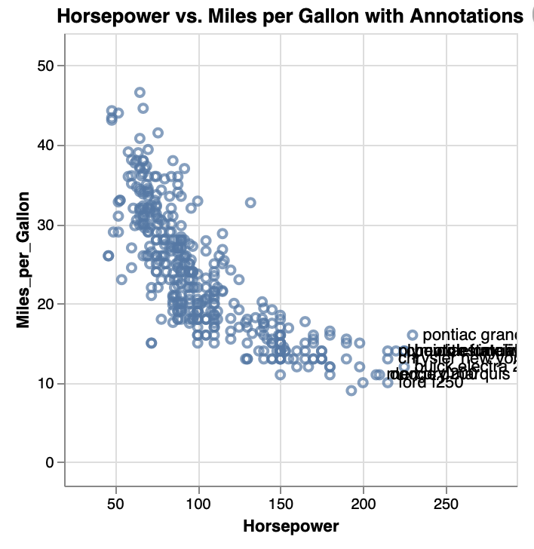
scatter_with_annotations

Slide 31
Annotations
Geometric Annotations
rect_annotation = alt.Chart().mark_rect(color='red', opacity=0.3).encode(
x=alt.value(150), # X-coordinate of the rectangle
y=alt.value(250), # Y-coordinate of the rectangle
x2=alt.value(245), # X-coordinate of the right side of the rectangle
y2=alt.value(200) # Y-coordinate of the top side of the rectangle
)
circle_annotation = alt.Chart().mark_circle(color='blue', opacity=0.5).encode(
x=alt.value(250), # X-coordinate of the circle
y=alt.value(240), # Y-coordinate of the circle
size=alt.value(1600) # Size of the circle
)
scatter_with_annotations = scatter_plot + rect_annotation + circle_annotation
1. We define two geometric annotations: a red rectangle and a blue circle, to highlight specific regions in the plot. The red rectangle is positioned from (150, 250) to (245, 200), and the blue circle is centered at (250, 240) with a size of 1600.
3. Finally, we combine the scatter plot (from the previous example) with the geometric annotations to create a composite visualization.

Slide 32
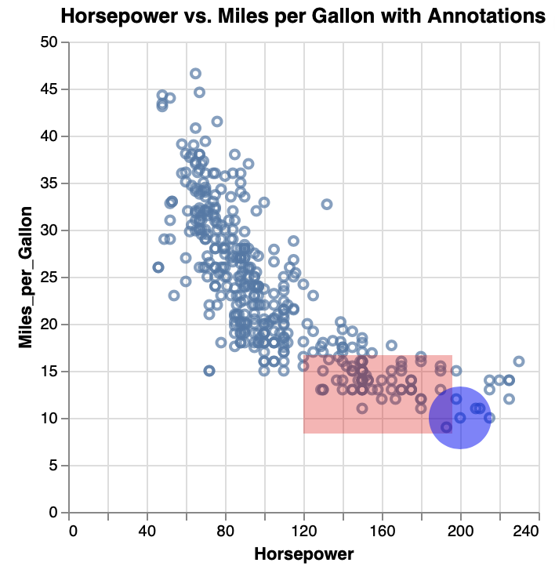
scatter_with_annotations
CAVEAT: Geometric annotations are static and will remain in the same location relative to the frame

Slide 33
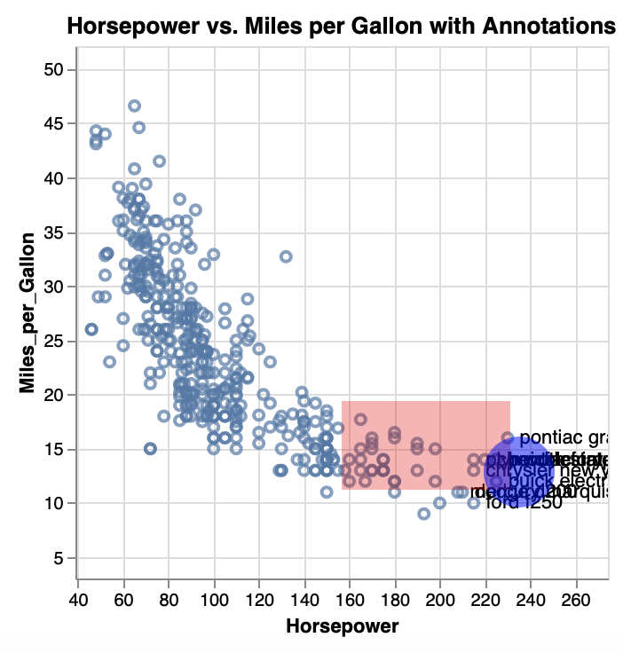
Annotations
Layering with Annotations
layered_plot = scatter_plot + annotations + rect_annotation + circle_annotation

Slide 34
Geographic Maps
Altair offers robust support for creating interactive and visually appealing maps.
The types of inputs for map "type" need to be any of the following, which will display a specific type of geographical map: albers
albersUsa
azimuthalEqualArea
azimuthalEquidistant
conicConformal
conicEqualArea
conicEquidistant
equalEarth
Equirectangular
gnomonic', 'identity', 'mercator', 'naturalEarth1', 'orthographic', 'stereographic', 'transverseMercator'.

Slide 35
Geographic Maps
Geometric Annotations
counties = alt.topo_feature(data.us_10m.url, 'counties')
source = data.unemployment.url
unemployment = alt.Chart(counties).mark_geoshape().encode(
color='rate:Q'
).transform_lookup(
lookup='id',
from_=alt.LookupData(source, 'id', ['rate'])
).project(
type='albersUsa'
).properties(
width=500,
height=300
)
1. We load the US State Unemployment data, which contains unemployment rates for each state.
2. We create an interactive choropleth map by encoding the unemployment rate data with color gradients on a map of the United States.
3. The map is projected using the Albers USA projection.

Slide 36
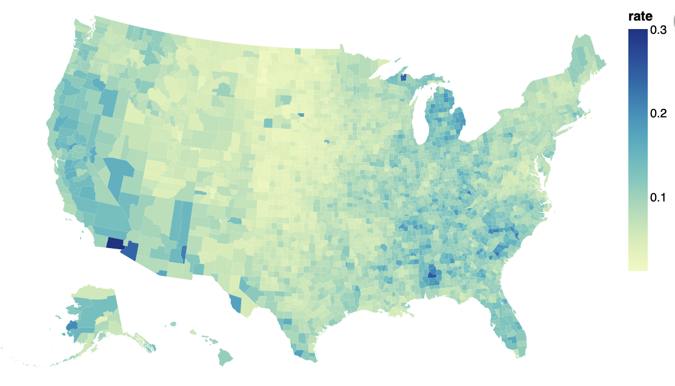
unemployment

Slide 37
quiz

Slide 38
Question 1
Which one is the correct method?
alt.Chart(iris).mark_point(50, triangle, True)
alt.Chart(iris).mark_point(size=50, shape='triangle', filled=True)
alt.Chart(iris).mark_triangle()
None of the above

Slide 39
Question 1
Which one is the correct method?
alt.Chart(iris).mark_point(50, triangle, True)
alt.Chart(iris).mark_point(size=50, shape='triangle', filled=True)
alt.Chart(iris).mark_triangle()
None of the above

Slide 40
Question 2
Which one is the correct method?
alt.Chart(data).mark_round()
alt.Chart(data).mark_area()
alt.Chart(data).mark_circle()
None of the above

Slide 41
Question 2
Which one is the correct method?
alt.Chart(data).mark_round()
alt.Chart(data).mark_area()
alt.Chart(data).mark_circle()
None of the above - alt.Chart(data).mark_arc()

Slide 42
Question 3
Which one is the correct method?
new_chart = line_chart | scatter_plot
new_chart = line_chart + scatter_plot
new_chart = alt.layer(line_chart, scatter_plot)
None of the above

Slide 43
Question 3
Which one is the correct method?
new_chart = line_chart | scatter_plot
new_chart = line_chart + scatter_plot
new_chart = alt.layer(line_chart, scatter_plot)
None of the above

Slide 44
Thank you
Jorge Wassmann
Advanced Programming for Business Analytics

