Slide 1

Be a good internet citizen Secure your site and your users
Daniele Howell
Jørgen Tellnes
Vidar Drageide

Slide 2
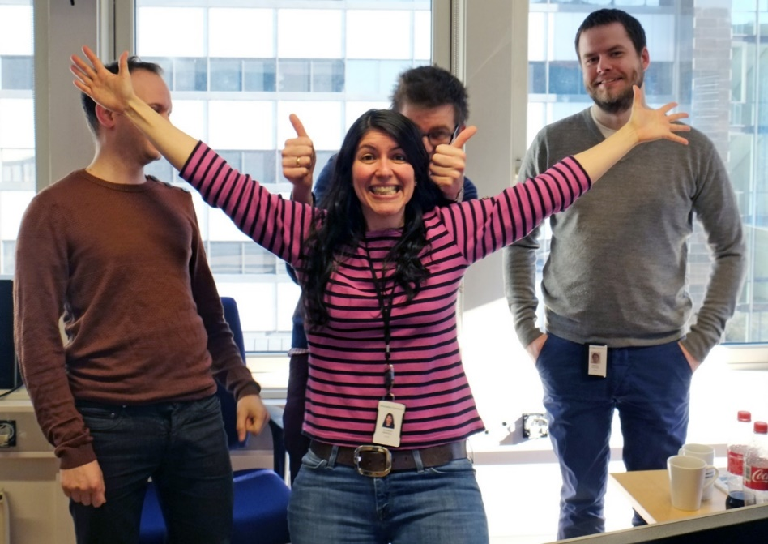
Who are we?
Security (development) Team at Skandiabanken
Daniele
Vidar
Jørgen
J

Slide 3
What do we do?
Online bank security
Development (authentication, signing, app security, etc)
Security testing (pentesting)
TLS config, security headers
Super epic mountain voyages →
J

Slide 4
What’s this?
We often focus on securing our own services
Our users and customers aren’t security experts
It’s our responsibility to help them stay safe
We are all internet citizens – we need to raise the bar
At minimum, proper TLS and security headers
None of this is hard nor expensive, it just requires vigilance
J
Notes:
- We encounter vendors all the time that fails on the basics. If everyone just gets a grip on this, the world would be a better place.

Slide 5
Why encryption at all?
You open your customers to interposition attacks (MITM)
Stolen secrets
Tampered content
Solution: always encrypt
Development: encrypted
Staging: encrypted
Production: encrypted
It’s not hard
V
Notes:
At skandiabanken, we run TLS on all levels:
Developer workstations
Development servers
Testing/staging servers
Production (OFC)

Slide 6

Dwall
V

Slide 7
Structure
13:30 – 15:00:
PKI, TLS, certificates, current state of web security
Security headers, CSP
15:00 – 15:15
Stimulant break
15:15 – 16:45
Workshop section – we’ll build a site using best practices
V

Slide 8
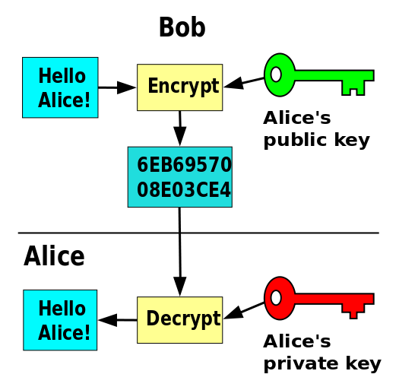
PKI in 5 minutes – asymmetric cryptography
Public-private key pairs
Ensure that only the recipient can read your message
Can be used for signatures
Recipient can use the public key to:
Verify that content is unchanged
Verify that only the private key owner has generated the signature
Signatures are not encryption
J

Slide 9
PKI in 5 minutes – Certificates
«ID card» for server
Contains servers public key
Signed (issued) by a trusted third party
Essential fields
Subject (hostname)
Expiry (notBefore, notAfter)
many many more
J
Notes:
EV certs are typically unavailable for personal use – don’t let perfect be the enemy of good

Slide 10
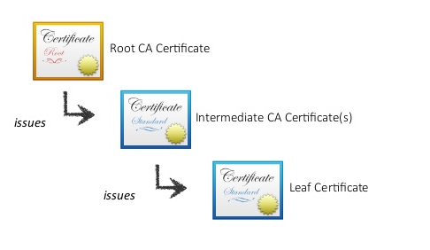
PKI in 5 minutes
PKI – Public Key Infrastructure
Certification Authority (CA)
Issues certificates
Trust chain built using signatures
Walk the chain up to a trusted cert
Root certificate is explicitly trusted
(> 90 default roots in your browser)
J
Notes:
Go quickly through the process of validating the server -> server cert issuer/validity check ++, then walking the chain to a trust anchor

Slide 11
SSL and TLS
Secure Sockets Layer (SSL)
SSL 2.0 in 1995, SSL 3.0 in 1996
New name – TLS (Transport Layer Security)
TLS 1.0 in 1999
TLS 1.1 in 2006
TLS 1.2 in 2008
TLS 1.3 – working draft, prelim. support in Chrome/Firefox this year
J

Slide 12
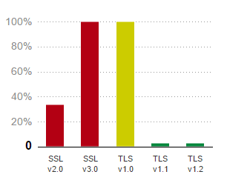
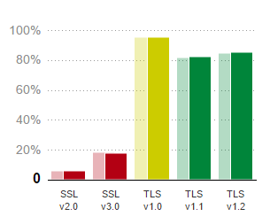
SSL and TLS
Slow adoption – but we are getting there
Held back by old browsers
April 2012
March 2017
J

Slide 13
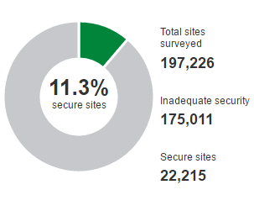
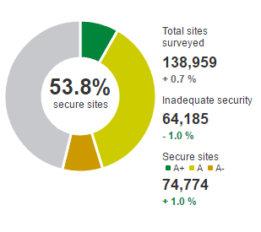
Current state of TLS and web security
April 2012:
March 2017:
https://www.trustworthyinternet.org/ssl-pulse/ - scan of alexa top list
J
Notes:
What do you think the adoption level is today?
NB! FIX FIX FIX Dette ser ut til å være andelen som har A-grade vs. andelen som har under A – IKKE andelen som har TLS i det hele tatt (som er noe annet).

Slide 14
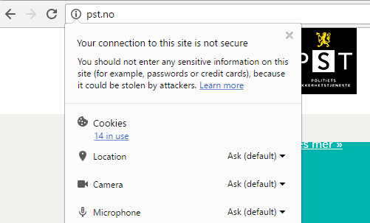
Current state of TLS and web security
Let’s encrypt probably has a lot of the credit for this
But still only ~50% TLS
Some glaring omissions
Advanced techniques still rare
HSTS found in about 5-10%
HPKP adoption at < 1%
J

Slide 15
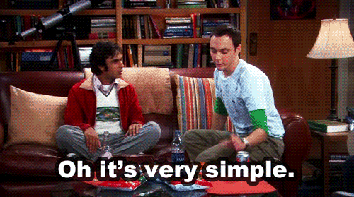
Weak TLS configuration
Let’s breeze through the TLS handshake first
J

Slide 16
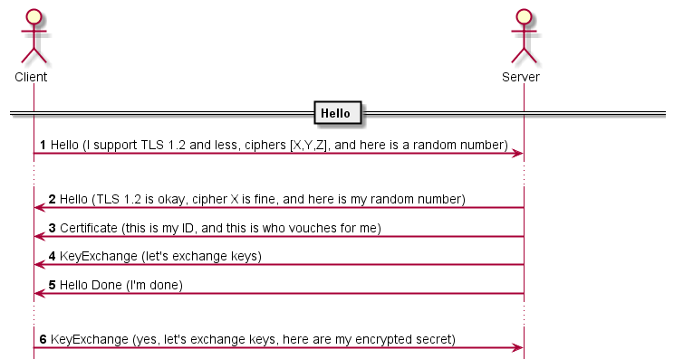
Weak TLS configuration - TLS in 3 minutes
J

Slide 17
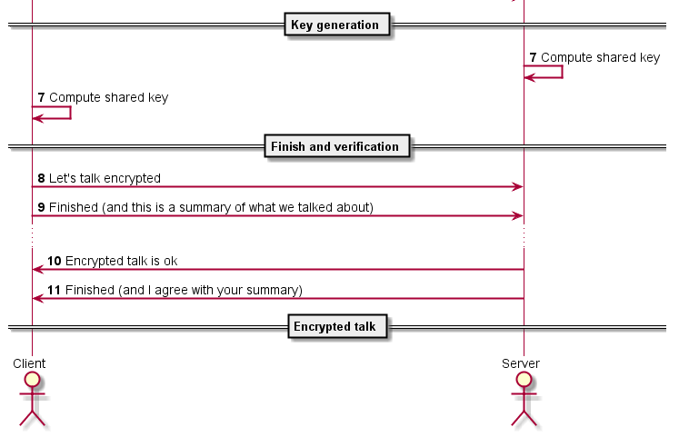
Weak TLS configuration - TLS in 3 minutes
J
Notes:
- The shared key is used for more efficient communication (asymmetric crypto is tough)

Slide 18

Weak TLS configuration
Ciphers (encryption algorithms) are important
Bad ciphers
ECB, RC4, null ciphers
Ciphers with short keys
DES, 3DES
Bad hash algorithms
SHA1, MD5
J
Notes:
- Null ciphers are ciphers with cipher length 0 – originally intended for debug

Slide 19
Weak TLS configuration
Old TLS/SSL version support is a risk - actual exploitable vulnerabilites:
BEAST
POODLE
DROWN – vuln. if just one server uses SSL v2
Missing Perfect Forward Secrecy – not NSA future-proof
Qualys SSL Labs has a super sweet validator
J
Notes:
BEAST –
POODLE – ssl v3 downgrade vulnerability
DROWN – a single sslv2 server with privkey can let someone decrypt a connection somewhere else
Also CRIME, BREACH, HEARTBLEED etc. etc.
SSL Labs – we’ll do more with this in the workshop section

Slide 20

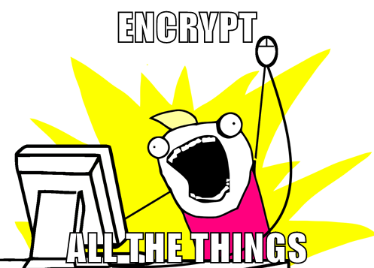
Let’s Encrypt
Launched on April 12, 2016
Project started in 2012 by a team from Mozilla, EFF and University of Michigan
Completely free
Wildly popular (> 25 million active certificates)
Easy to use
Secure
The private key is always generated and managed on your own servers
Transparent
All certificates issued or revoked will be publicly recorded and available for anyone to inspect
D
Notes:
EFF – Eletronic Frontier Foundation: nonprofit organization defending civil liberties in the digital world
CRL – Certificate Revocation List
OCSP – Online Certificate Status Protocol
http://ocsp.int-x3.letsencrypt.org/

Slide 21
Let’s Encrypt
Requires control over the domain
Uses Automatic Certificate Management Environment (ACME) protocol
https://ietf-wg-acme.github.io/acme/
Typically runs on your web host
Without Shell Access
Needs support from your hosting provider
Azure offers Let’s Encrypt Extension (hassle to setup but awesome results)
With Shell Access
Uses Certbot ACME client to automate certificate issuance and installation
Easy to use
D
Notes:
ACME: interactions between CA and their users' web servers
Azure Let’s Encrypt Step-by-step guide is available in the Handouts folder (later on)

Slide 22
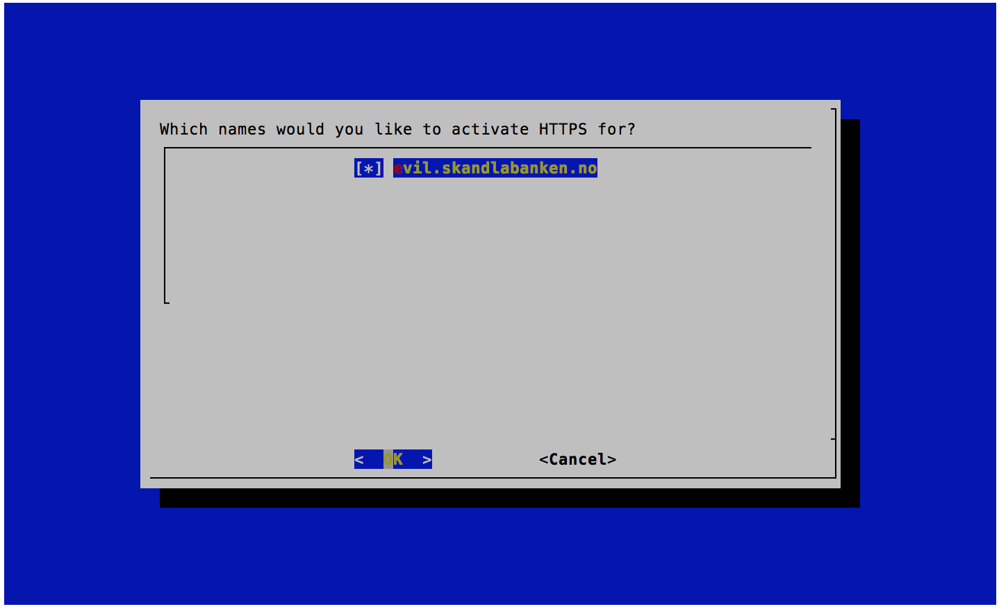
Let’s Encrypt
D
Notes:
Certbot ACME client – certboot-auto certonly
Simple semi-graphical tool
Let’s encrypt deserves a lot of credit for making it this easy

Slide 23
TLS stripping attack (downgrade attacks)
Courtesy of Moxie Marlinspike – Blackhat DC 2009
Downgrade the users connection to a given domain from TLS/SSL to plaintext.
User
GET www.bank.no
Server
302 https://www.bank.no
V
Notes:
Details: https://www.blackhat.com/presentations/bh-dc-09/Marlinspike/BlackHat-DC-09-Marlinspike-Defeating-SSL.pdf
PoC: https://moxie.org/software/sslstrip/

Slide 24

Simplified SSL-strip
User
SSL Strip
Server
GET www.bank.no
GET www.bank.no
302 https://www.bank.no
GET https://www.bank.no
200 https://www.bank.no
200 http://www.bank.no
V

Slide 25
sslstrip
V
Notes:
- ba.no

Slide 26
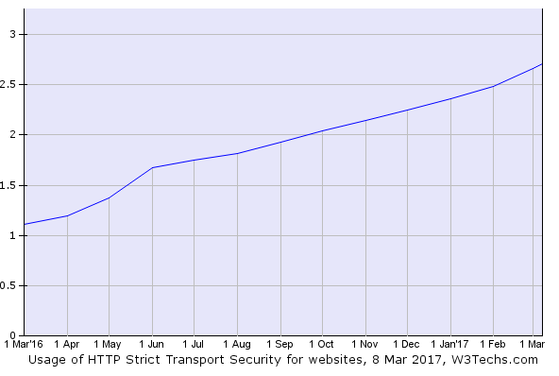
HTTP Strict Transport Security (HSTS)
”Use only HTTPS from now until $time$”
For the next [seconds], the user agent should only access the server securely
Used by only 2.7% of all surveyed websites (w3techs.com)
Reduces ability to intercept requests and responses between a user and a web server.
Strict-Transport-Security: max-age=[seconds]; includeSubDomains; preload
D
Notes:
2,7% of top 10 million websites

Slide 27

Still bad on first visit «ever»
HSTS is just a vaccine
For the first visit ever on the page your browser cannot know that your site serves the HSTS header
D
Notes:
There is also a lot of other crap to worry about.
Rouge Cas
Symantec / Bluecoat etc.

Slide 28
sslstrip despite HSTS
V
Notes:
spv.no – blocked by HSTS
Spv.no - demo different (unused) browser – HSTS record not present

Slide 29
HSTS preloading
Hard-coded list of «preloaded» HSTS headers
Process:
Add «preload» and «includeSubdomains»
Submit to https://hstspreload.org
Allow 6-8 weeks for delivery
Result: TLS even on the first request
D
Notes:
- Requires “includeSubdomains” and ”preload” in HSTS header
Only root domain can be preloaded – works across all subdomains
Will not scale – list is currently > 20 000 sites

Slide 30
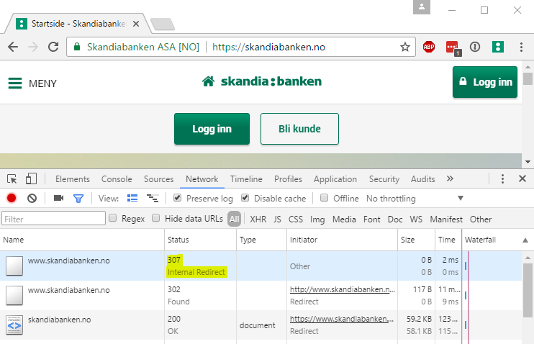
HSTS preloading
D
Notes:
- Requires “includeSubdomains” and ”preload” in HSTS header
Only root domain can be preloaded – works across all subdomains
Will not scale – list is currently > 20 000 sites

Slide 31
Keep your cookies secure
Secure and HttpOnly
Otherwise the cookies may be sent unencrypted
Request to http://yoursecuredomain.com will include your cookies
From stortinget.no (what’s missing?):
Set-Cookie: sessid=[snip]; Path=/; Domain=.example.com; Secure; HttpOnly
Set-Cookie: ASP.NET_SessionId=flt[…]zb; path=/; HttpOnly
V
Notes:
Stortinget.no fails to set their ASP.net session-cookie as secure -> since demoing actual exploitable violators would be dropping real vulns i’ll just stick to stortinget no.

Slide 32
Security headers
Partnership between server and client
Server defines the rules for the website
Uses HTTP headers
May reduce the impact of vulnerabilities
Publicly visible scorecard
V
Notes:
Browsers started to care about security
Headers are outside the DOM and page context – cannot be fiddled with e.g. javascript
also gives the world a way of looking at a webpage and assess the level of attention to security awareness presented by the developers.
For instance I’ve found XSS vulnerabilities that went from critical to low due to the presence of CSP/HSTS/X-FRAME-OPTIONS etc.
Important: NOT a first-line defence, does NOT replace actual vulnerability patching

Slide 33
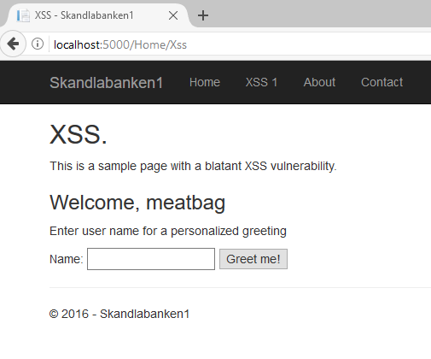
Headers to consider
Content-Security-Policy (CSP)
HTTP Strict Transport Security (HSTS)
HTTP Public Key Pinning (HPKP)
X-XSS-Protection
X-Frame-Options
X-Content-Type-Options
Referrer Policy
V
Notes:
X-XSS -> old experimental header that tells browser not to allow reflected xss
HSTS -> already covered this. Please remember that you should alway connect directly to port 443 for my page
HPKP -> This is my key, never trust any other! ( Ok, not that simple, may be a never trust any keys not issued by this CA etc. but you get the drift.. Less trust anchors)
X-Frame-Options -> indicates to the browser whether or not a page should be allowed to be rendered inside an iFrame. ( also allow-from but that’s IE so psss)
X-Content-Type-Options -> Do not change and follow MIME-types from Content-Type headers ( Did you just assume my content type )
CSP -> Content Security Policy – Attempt at organizing experimental headers into one –basically a source whitelist - allows the developer to instruct where the browser should allow content from for a particular webpage, Script, fonts, css, objects
Referrer-policy – instructs the browser on how to set the referrer-field depending on where the user navigates

Slide 34
Content Security Policy
Unification of security headers
Reminder: Security headers and CSP is not a first-line defence
Level 2 support in all browsers except IE/Edge (yet)
Hash/nonce based whitelisting
CSP Level 3 is in working draft status
J
Notes:
Reminder - Always use input validation, output encoding etc.
Still a lifesaver for legacy applications

Slide 35
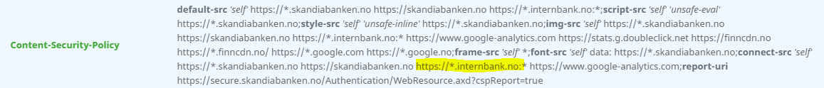
Content Security Policy
Content-Security-Policy
Content-Security-Policy-Report-Only
Violation reports only, no blocking
Report-uri.io – excellent (free!) service
Dangers
Information leakage (internal domains, preproduction, etc)
J

Slide 36
CSP directives
Fetch directives – i.e. «from where can i fetch what resource»
default-src
script-src
font-src
img-src
…
Document directives
sandbox
plugin-types
Navigation directives
form-action
frame-ancestors
Reporting directives
report-uri
J
Notes:
- A lot more here to dive into if we had time – developer.mozilla.org has a great page on CSP

Slide 37
Securityheaders.io
Excellent validator and public scorecard
By Scott Helme (@scotthelme)
V
Notes:
Scott helme made securityheaders.io which basically is a very public scorecard outlining how good you are at using these headers

Slide 38
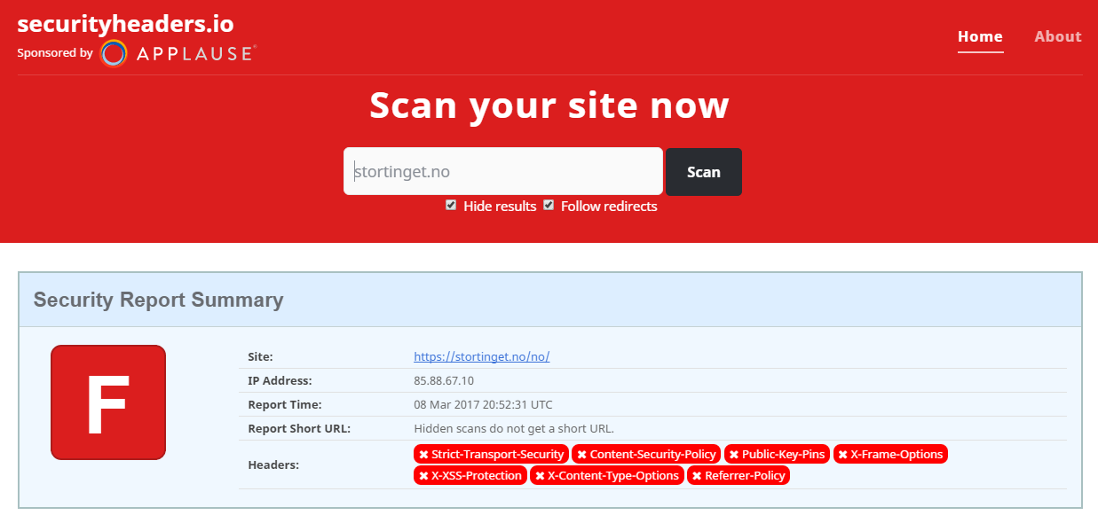
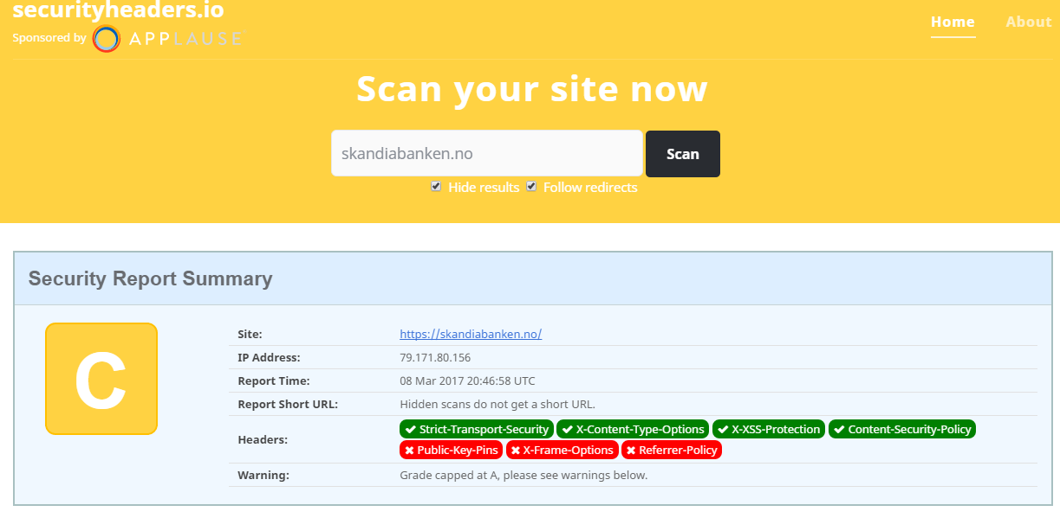
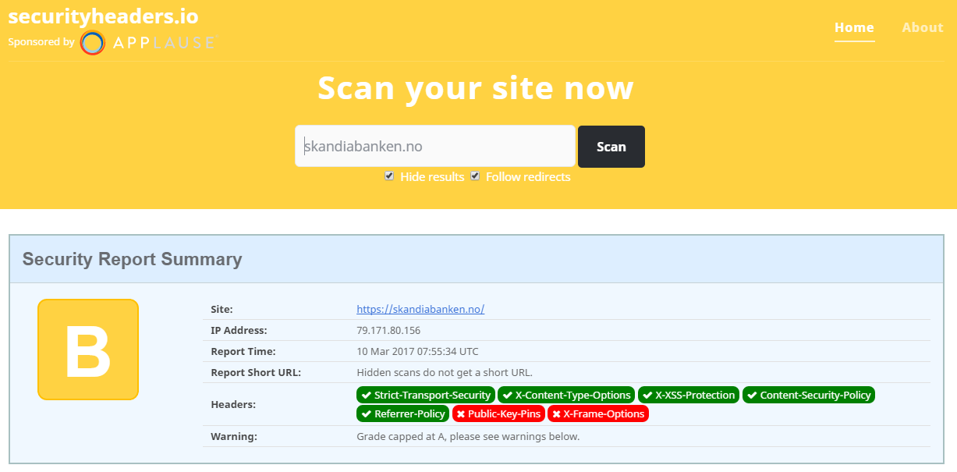
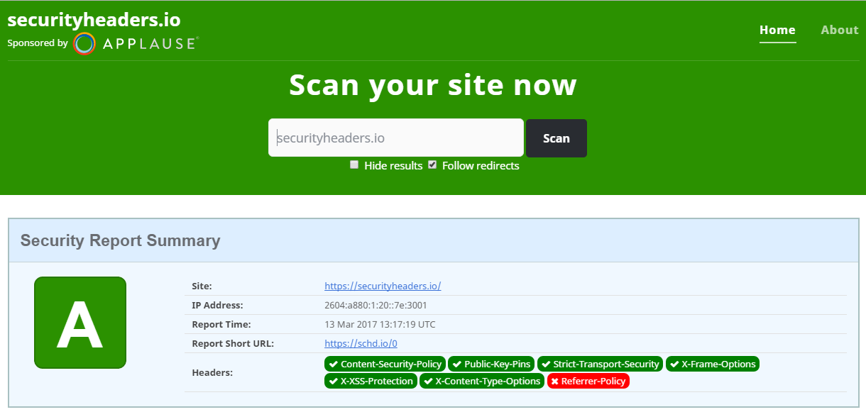
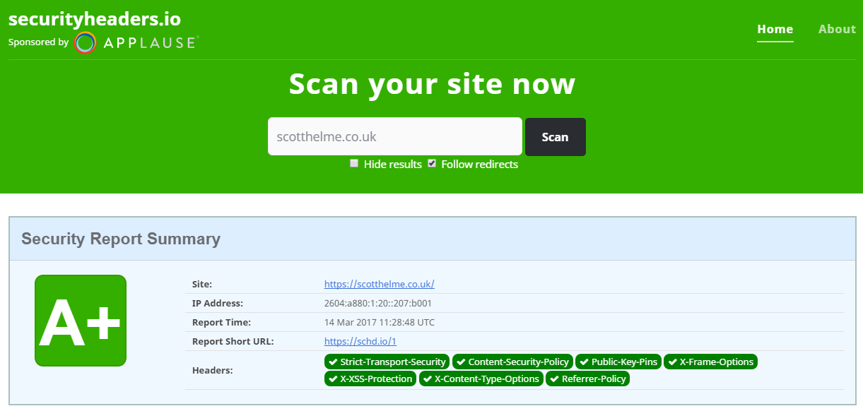
Securityheaders.io
V
Notes:
Scott helme made securityheaders.io which basically is a very public scorecard outlining how good you are at using these headers

Slide 39
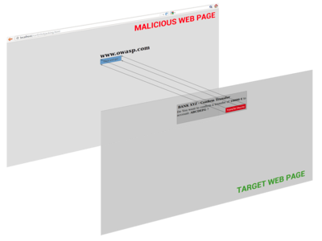
Ui-redressing (clickjacking) attacks
Trick the user into performing clicks on the target webpage
Abuses iFrames, z-index and transparent layers
V
Notes:
Abuses iFrames, z-index and transparent layers
Current demo:
https://evil.skandlabanken.no/ck/iframeyou.html
Old/other:
http://evil.skandlabanken.no/ck/booster1.html
http://evil.skandlabanken.no/ck/booster2.html

Slide 40
Clickjacking defence
Control who’s allowed to iframe your site
X-Frame-Options:
CSP – frame-ancestors
X-Frame-Options: ALLOW-FROM https://example.com
X-Frame-Options: DENY
X-Frame-Options: SAMEORIGIN
Content-Security-Policy: frame-ancestors <source>;
V
Notes:
X-Frame-Options – coarse – either you support iFraming or you dont ( there is also allow-from that takes one domain and is IE. Specific yay! )

Slide 41
Referrer-Policy
Brand-spanking new header (this year)
Control the value of the referer header
Stop information leakage
Varying degrees (‘no-referrer’ to ‘unsafe-url’)
Referrer-Policy: no-referrer-when-downgrade
V
Notes:
- if you screw up and include something sensitive in a URL on a page containing outbound links nothing will leak
unsafe-url - everything is included, even query strings
Be mindful of analytics that may depend on this

Slide 42
Summary
TLS
Weak TLS, vulnerabilities
Security headers
Use them – run scans!
Content security policy
Partially replaces security headers
Beware of legacy browsers
Public scorecards
SSL Labs and securityheaders.io is effective public shaming
V

Slide 43
Questions?

Slide 44

Notes:
First: escape opportunity / stimulant break
Next up is a workshop section

Slide 45
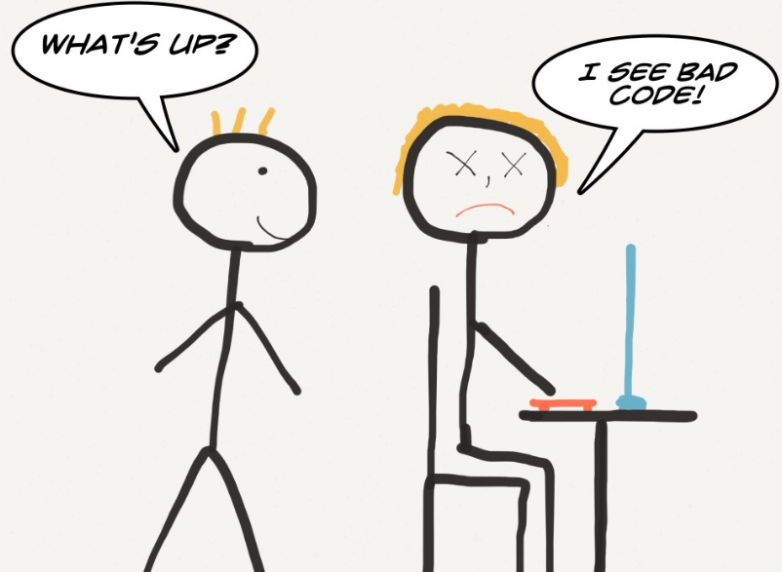
Get ready for some coding
Development environment:
Any text editor (we use Visual Studio Code with C# ext.)
.NET Core 1.1.1 https://www.microsoft.com/net/core
Git https://git-scm.com/downloads
Workshop projects and handouts:
https://github.com/jorgis/boosterconf2017
Host environment:
Azure App Service - Free trial
https://azure.microsoft.com/en-us/try/app-service/web/
D
Notes:
Github: Download or Clone
Two projects: Boosterconf and Boosterconf_solved

Slide 46
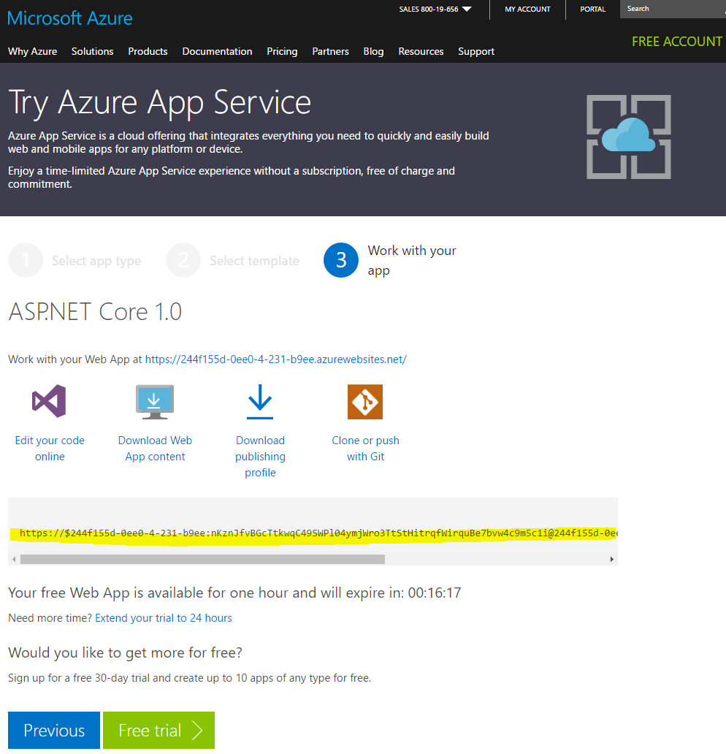
Publishing your project to Azure
Go to https://azure.microsoft.com/en-us/try/app-service/
Select Web App → Choose ASP.NET Core 1.0
Sign in using whatever
Click “Extend to 24 hours”
Select “Clone or Push with Git” to get your git remote url
Open our github repo, add Azure remote and push
git remote add Azure [your-url]
git push Azure master (you may have to use --force)
D

Slide 47
Workshop
Open workshop.pdf in the Handouts folder of the github repo
https://github.com/jorgis/boosterconf2017
Form small groups – 2-3 people
We’ll help as best we can – ask us anything
D
Notes:
We will walk around and help and answer questions – just raise your hand or something

Slide 48
Wrapping it up
J

Slide 49
Pitfalls
HSTS and HPKP can be DoS-generators
HPKP Ransom
HSTS includeSubdomains can be dangerous
Preload is impossibly hard to disable – be careful!
Too tight controls can ruin your site
Always start with *-Report-Only
Don’t forget old browsers – also use legacy headers
Browser support is always a pain
J

Slide 50
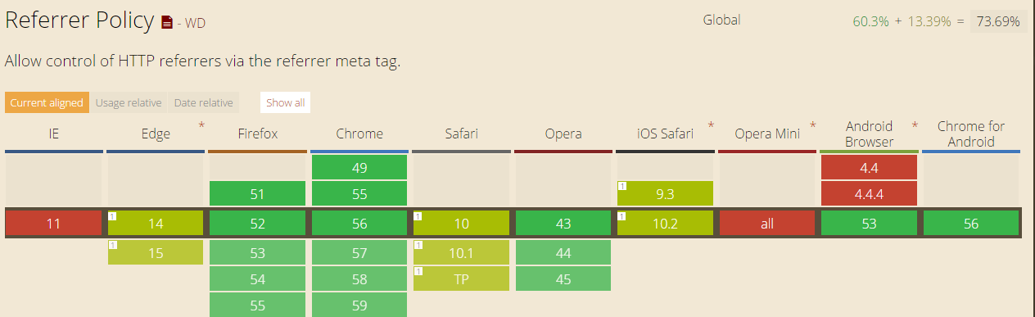
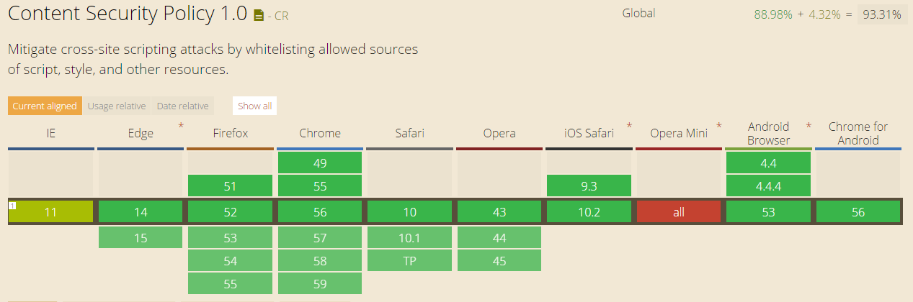
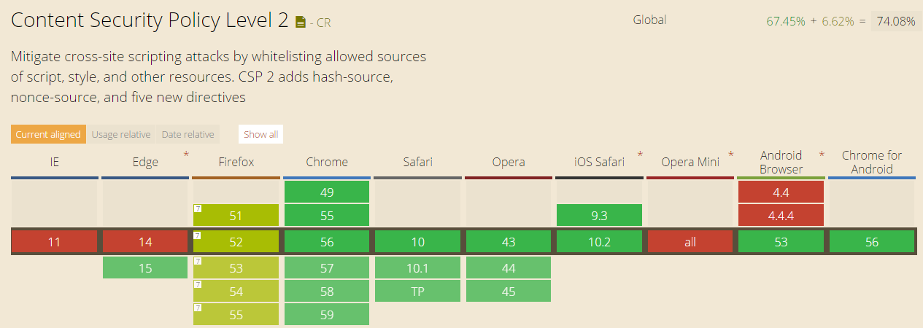
Pitfalls – browser support
J

Slide 51
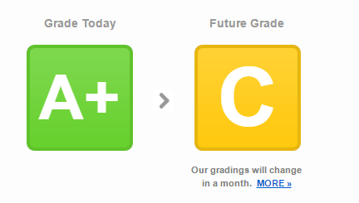
Summary
It isn’t hard – although crypto is always scary
It’s not just for you – it also benefits your users
Adding security headers is easy
Determining your actual policy is hard
Use SSL Labs and securityheaders.io
Run periodic scans – things change
J

Slide 52
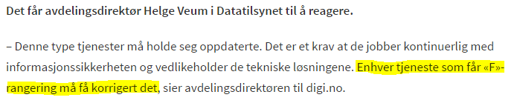
Summary
J
Notes:
Remember to translate this if we need to

Slide 53
Summary – what’s next?
TLS in HTTP/2 (and no browser supporting unencrypted connections)
TLS1.3
Enabled in Firefox
Chrome backtracked
CSP level 3
Currently a W3C draft
Out-of-band reporting
More directives
In the app world – App Transport Security, Android Network Security Configuration
J
Notes:
ATS default on in iOS – disables unencrypted HTTP altogether
NSC allows for cleartext opt-out, TLS pinning and much more

Slide 54




Daniele Howell
daniele.howell@skandiabanken.no
@daniele_mh
Jørgen Tellnes
jorgen.tellnes@skandiabanken.no
Thanks
Vidar Drageide
vidar.drageide@skandiabanken.no
@vidard

