Slide 1
Schema.org → ARC → FAIRagro Workflow
TA3/4 Retreat 2026
Notes:
Agricultural research data lives across dozens of repositories with different schemas, formats, and conventions. ARCs (Annotated Research Contexts) are the emerging standard for packaging that data, and FAIRagro's Search Hub is where researchers discover it. FAIRweaver's conversion pipeline bridges the gap: take metadata from any source, map it into an ARC, then extract the FAIRagro-specific schema for Search Hub ingestion.
The challenge is structural. Every ARC is a JSON-LD graph, and different research groups model the same domain concepts at different depths and in different graph locations. The pipeline must handle that variability — or define conventions to eliminate it.

Slide 2
FAIRagro Metadata Transformation Pipeline
Sequential dependency: Output B (FAIRagro JSON) is derived from Output A (ARC RO-Crate) — not a parallel output
Two harvest paths converge on the same FAIRagro JSON schema:
• Path 1 (solid): Direct harvest from GitLab DataHub where ARCs are stored
• Path 2 (dashed): Via FAIRagro Middleware API (federated service)
Both paths produce identical FAIRagro schema.json ingested into SearchHub
Notes:
The pipeline is strictly sequential. Schema.org JSON-LD from an RDI enters at the top, gets transformed by FAIRagro templates, and produces two outputs in order: 1. Output A — ARC RO-Crate. 2. Output B — FAIRagro JSON, derived from Output A.
Two paths feed the ARC into Search Hub:
- Path 1 (direct harvest): GitLab DataHub stores the ARC; a harvester reads it.
- Path 2 (orchestrated): The FAIRagro Middleware API coordinates the full workflow.

Slide 3
Three File Scenarios: Input → ARC → FAIRagro Output
Case | Input File | ARC Output | FAIRagro Output
Synthetic | schema-org-wheat-full.json | arc-ro-crate-wheat-full ✓ compliant | Full extraction ✓
Real — Small | arc-ro-crate-dronflyover.json (<10 MB) | Manual, partial ⚠ | Partial — mappable fields only
Real — Large | arc-ro-crate-muenchenberg-lte.json (>100 MB) | Manual, partial ⚠ | Basic harvest only
💡 If an ARC follows the FAIRagro specification → full metadata extraction. If not → only basic information is harvested.
Notes:
Three test files: Synthetic (wheat-full) → full extraction. Real — Small (dronflyover) → partial, mappable fields only. Real — Large (muenchenberg-lte) → basic harvest only.
Compliance determines extraction depth. Well-structured ARCs enable full extraction.

Slide 4
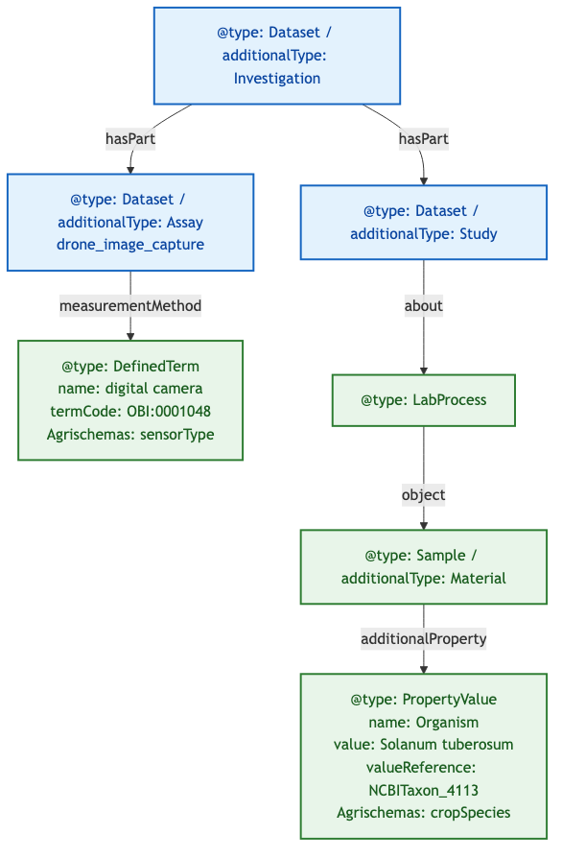
Examining ARC Structure: Domain Objects at Different Depths
Goal:
• Understand how Agrischemas concepts map into ARC RO-Crate
• Show that equivalent domain concepts require very different traversal depths
Example ARC RO-Crate: UC13 drone-flyover
Notes:
Drone Flyover (UC13): sensorType is 1 hop from Assay via measurementMethod → DefinedTerm. cropSpecies is 4 hops from Study via about → LabProcess → object → Sample → additionalProperty → PropertyValue.

Slide 5
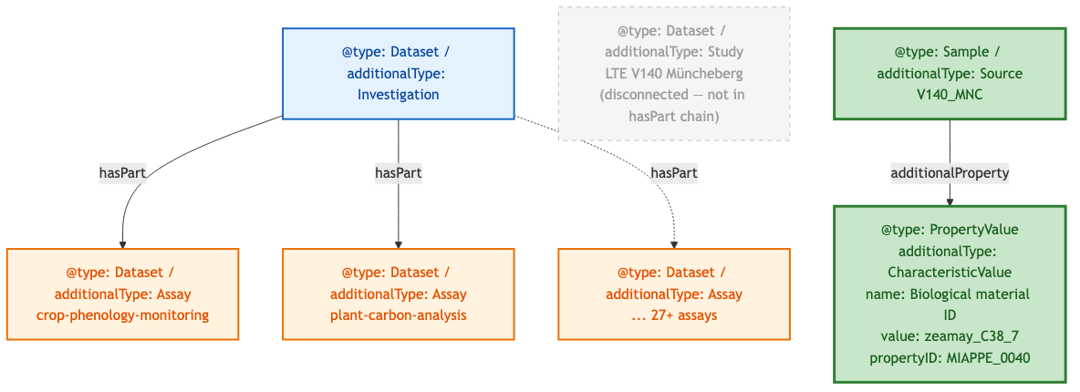
Müncheberg ARC: A Different Structural Pattern
Goal:
• Show another real ARC with a different structural pattern
• Reinforce that parser must handle multiple modeling conventions
Aspect | Drone Flyover | Müncheberg LTE
Study entity | Explicit, in hasPart chain | Present but disconnected (not in hasPart)
Crop species path (short) | Study → LabProcess → Sample → PropertyValue (4 hops) | Source → additionalProperty → CharacteristicValue (2 hops)
Crop species path (long) | Same as short (only path) | ALSO via LabProcess → object → Source → additionalProperty
Sensor metadata | Present (DefinedTerm) | Absent
Assay count | 1 | 27+
Example ARC RO-Crate: Müncheberg LTE
Notes:
Müncheberg LTE: Study disconnected from hasPart chain. Crop species via shorter path: Source → additionalProperty → CharacteristicValue (2 hops). 27+ assays, no sensor metadata (crop phenology, not remote sensing).

Slide 6
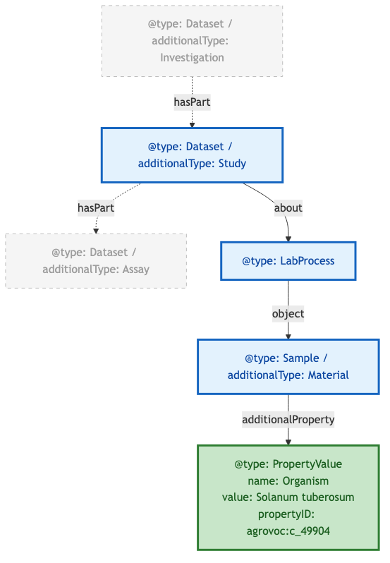
Required Modeling Pattern & Standardization Gap
Goal:
• Define the required path for unambiguous extraction
• Identify what still needs standardization
In bold: required objects/properties to represent Crop
Example ARC RO-Crate: UC13 drone-flyover
Question | Details
Structure: ? | How to formally specify the required traversal path?
propertyID: SSSOM mapping | How to standardize ontology term mappings?
Notes:
Required path for unambiguous crop extraction: Study → about → LabProcess → object → Sample/additionalType:Material → additionalProperty → PropertyValue/propertyID.
Open questions: (1) How to formally specify traversal paths? (2) How to standardize ontology term mappings via SSSOM?

