Slide 1
FAIRweaver: Schema.org → ARC → FAIRagro Workflow
TA3/4 Retreat 2026

Slide 2
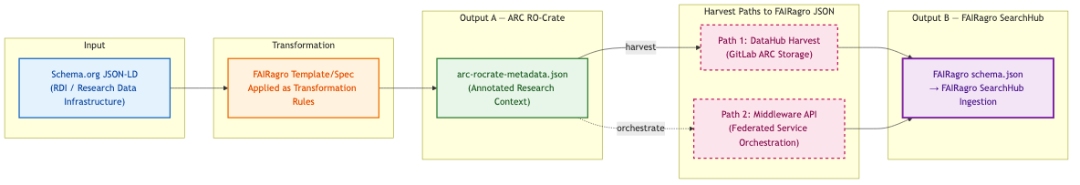
Slide 1 — FAIRagro Metadata Transformation Pipeline

Slide 3
Slide 1 — Key Points
Sequential dependency: Output B (FAIRagro JSON) is derived from Output A (ARC RO-Crate) — not a parallel output
Two harvest paths converge on the same FAIRagro JSON schema:
• Path 1 (solid): Direct harvest from GitLab DataHub where ARCs are stored
• Path 2 (dashed): Via FAIRagro Middleware API (federated service)
Both paths produce identical FAIRagro schema.json ingested into SearchHub

Slide 4
Slide 2 — Three File Scenarios: Input → ARC → FAIRagro Output
Case | Input File | ARC Output | FAIRagro Output
Synthetic | schema-org-wheat-full.json | arc-ro-crate-wheat-full ✓ compliant | Full extraction ✓
Real — Small | arc-ro-crate-dronflyover.json (<10 MB) | Manual, partial ⚠ | Partial — mappable fields only
Real — Large | arc-ro-crate-muenchenberg-lte.json (>100 MB) | Manual, partial ⚠ | Basic harvest only
💡 If an ARC follows the FAIRagro specification → full metadata extraction. If not → only basic information is harvested.

Slide 5
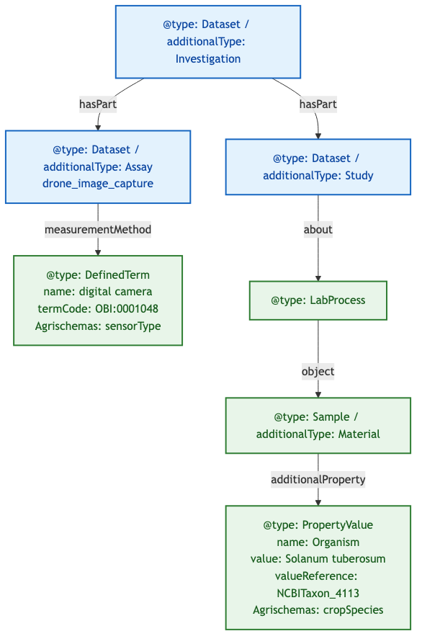
Slide 3 — Examining ARC Structure: Domain Objects at Different Depths
Goal:
• Understand how Agrischemas concepts map into ARC RO-Crate
• Show that equivalent domain concepts require very different traversal depths
Example ARC RO-Crate: UC13 drone-flyover

Slide 6
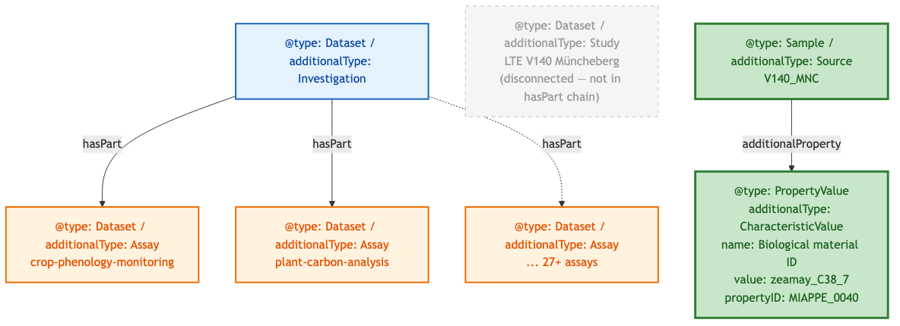
Slide 4 — Müncheberg ARC: A Different Structural Pattern
Goal:
• Show another real ARC with a different structural pattern
• Reinforce that parser must handle multiple modeling conventions
Example ARC RO-Crate: Müncheberg LTE

Slide 7
Slide 4 — Comparison: Drone Flyover vs Müncheberg
Aspect | Drone Flyover | Müncheberg LTE
Study entity | Explicit, in hasPart chain | Present but disconnected (not in hasPart)
Crop species path (short) | Study → LabProcess → Sample → PropertyValue (4 hops) | Source → additionalProperty → CharacteristicValue (2 hops)
Crop species path (long) | Same as short (only path) | ALSO via LabProcess → object → Source → additionalProperty
Sensor metadata | Present (DefinedTerm) | Absent
Assay count | 1 | 27+

Slide 8
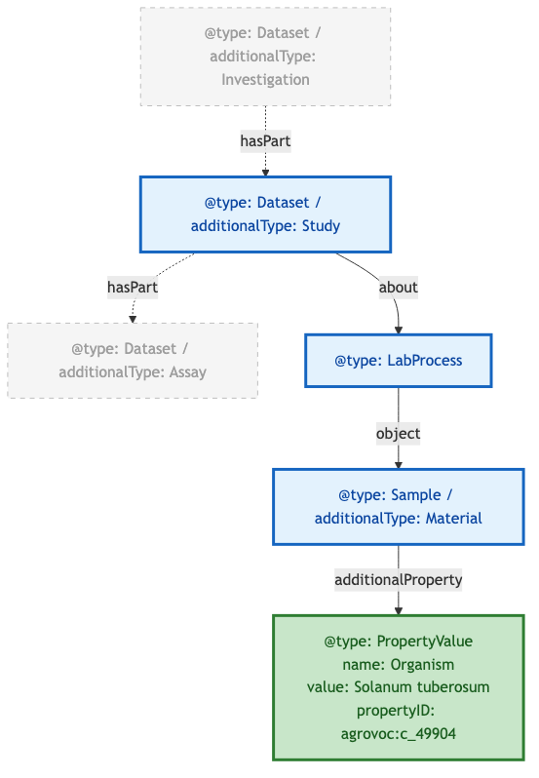
Slide 5 — Required Modeling Pattern & Standardization Gap
Goal:
• Define the required path for unambiguous extraction
• Identify what still needs standardization
In bold: required objects/properties to represent Crop
Example ARC RO-Crate: UC13 drone-flyover

Slide 9
Slide 5 — Open Questions
Question | Details
Structure: ? | How to formally specify the required traversal path?
propertyID: SSSOM mapping | How to standardize ontology term mappings?

