Slide 1
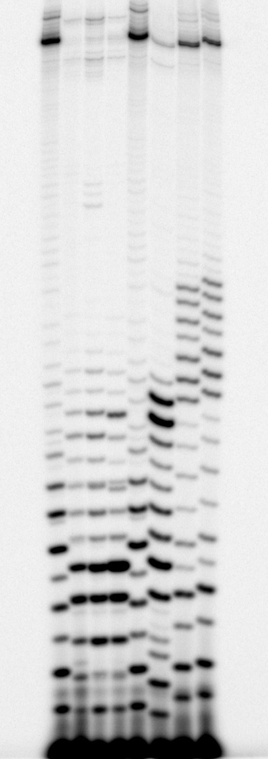
4
1
2
3
4
5
6
7
In vitro transcription reaction: 30 nM DNA,
in 200 mM KCl, 1 X trxn buffer III(10),
100 μM NTP with 5 μCi [γ-³²P]ATP, and
50 nM RNAP, 10 min, 37 ºC.
FL
FL
1: RL1 (WT)
2: RL2 (L4-3)
3: RL3 (L5-1)
4: N25
5: N25anti
6: DG203-1
7: DG203-2
19
15
11
10
10
+1
+10
+20
RL1 (WT): AACAUGUACA AUAAUAAUGG
RL2 (L4-3): AACAUGUACA AUAAUACACG
RL3 (L5-1): AACAUGUACC AUUAUAACGG
N25: AUAAAUUUGA GAGAGGAGUU
N25anti: AUCCGGAAUC CUCUUCCCGG
DG203-1: AUACGACCGG GAGAGGAGUU
DG203-2: AUGCGACCGG GAGAGGAGUU
9
8
7
6
6
5
4
3
2
2

