Slide 1
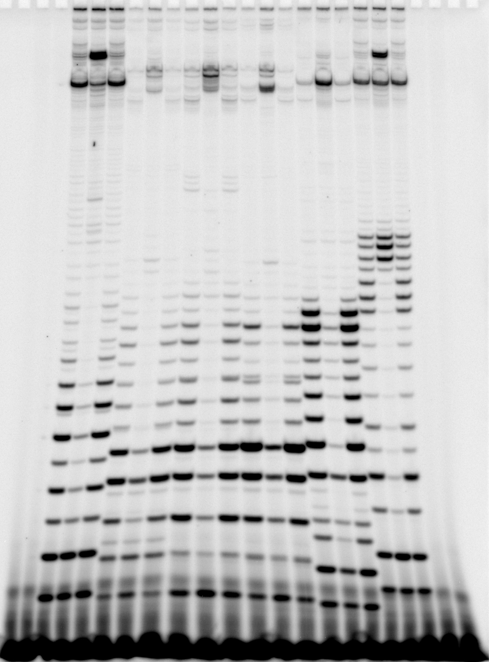
DG203-2
N25
RL1
RL2
RL3
N25anti
-NZ
-NZ
1 2 3 4 5 6 7 8 9 10 11 12 13 14 15 16 17 18
Effect of GreB supplementation: In vitro
transcription reactions were performed
with 30 nM DNA, in 200 mM KCl, 1 X trxn
buffer III(10), 100 μM NTP with 5 μCi
[γ-³²P]ATP, and 50 nM RNAP or
RNAP/GreB (1:10) for 10 min at 37 ºC.
-NZ: minus enzyme controls
N25: lanes 1-3 (-,+,- GreB)
RL1 (WT): lanes 4-6 (-,+,- GreB)
RL2 (L4-3): lanes 7-9 (-,+,- GreB)
RL3 (L5-1): lanes 10-12 (-,+,- GreB)
N25anti: lanes 13-15 (-,+,- GreB)
DG203-2: lanes 16-18 (-,+,- GreB)
+1
+10
+20
N25: AUAAAUUUGA GAGAGGAGUU
RL1 (WT): AACAUGUACA AUAAUAAUGG
RL2 (L4-3): AACAUGUACA AUAAUACACG
RL3 (L5-1): AACAUGUACC AUUAUAACGG
N25anti: AUCCGGAAUC CUCUUCCCGG
DG203-2: AUGCGACCGG GAGAGGAGUU

