Slide 1
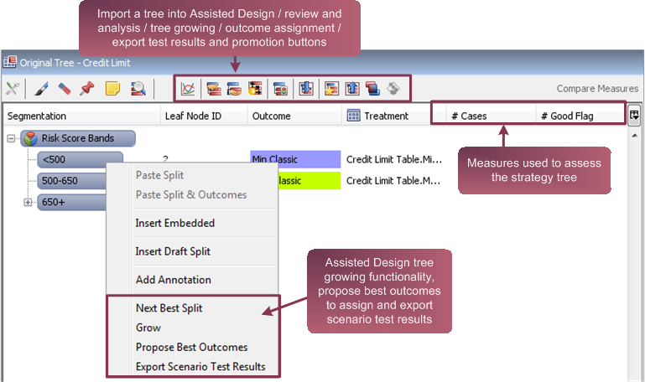
Import a tree into Assisted Design / review and analysis / tree growing / outcome assignment / export test results and promotion buttons
Assisted Design tree growing functionality, propose best outcomes to assign and export scenario test results

Slide 2
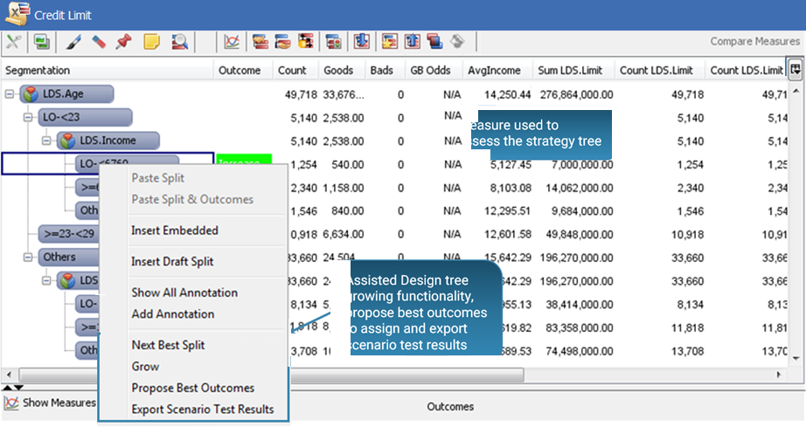
Import a tree into Assisted Design / review and analysis / tree growing / outcome assignment / export test results and promotion buttons
Measure used to assess the strategy tree
Measure used to assess the strategy tree

Slide 3
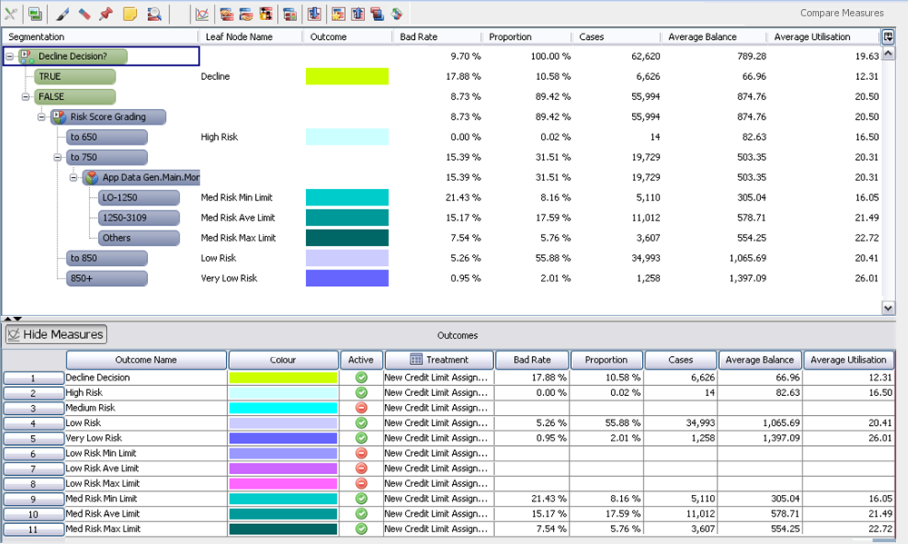
Calculate measures button
Calculated Measures
Measures calculated by outcome
Show/Hide Measures Button

Slide 4
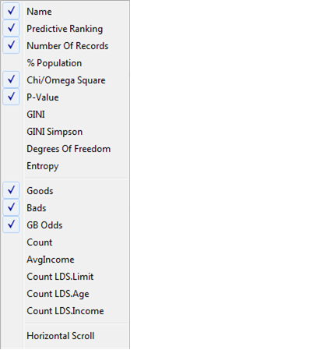
Statistical measure of predictor strengths
Assisted Design Project measures, target-based measures automatically selected for display

Slide 5
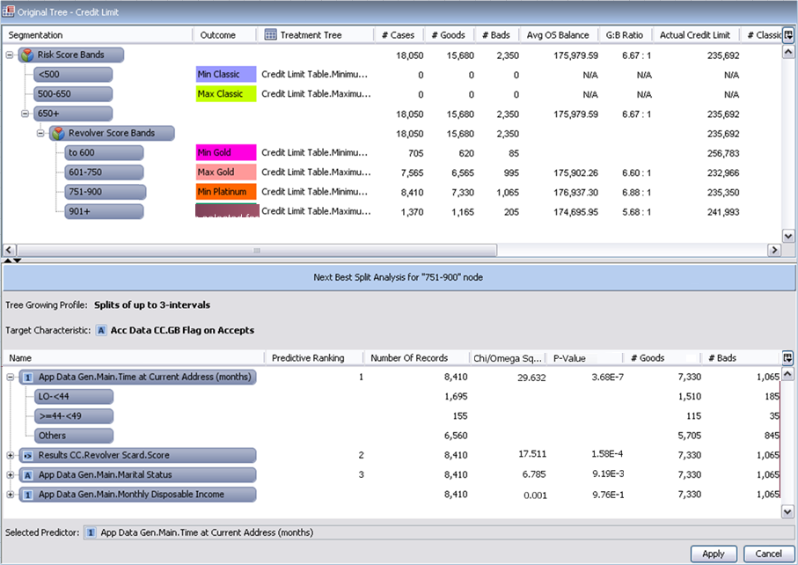
Original tree view
Node selected for Next Best Split analysis
Relative statistical measure of predictor strengths
Values of target-based measures for each selected predictor
Next Best Split
analysis view
Sets of suggested predictors

Slide 6
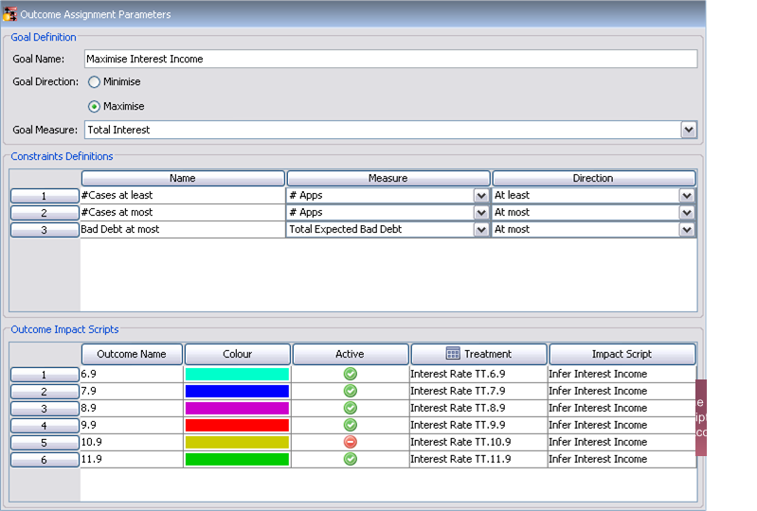
Specify the goal to use for Propose Best Outcomes
Specify the constraints placed on the goal
Define impact scripts for outcomes

Slide 7
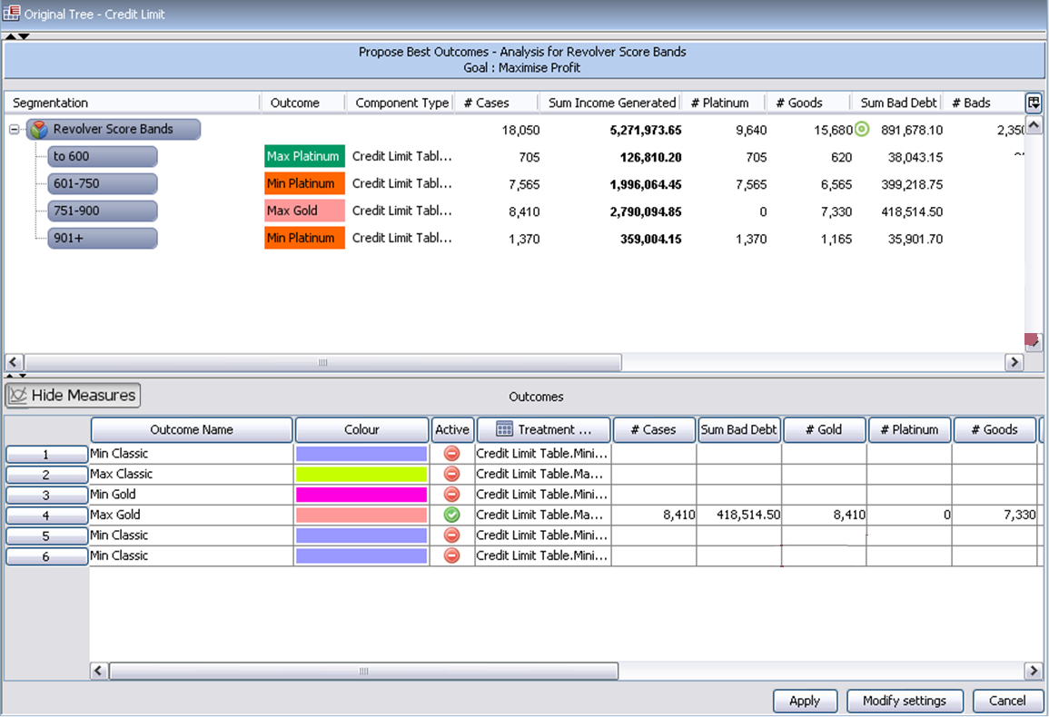
Node/branch for which analysis is run, and goal of the analysis
Expected results if the proposed assignment is applied to the tree
Goal measures highlighted in black
Constraint measures highlighted by green target if satisfied, red if broken
Only eligible outcomes are displayed

Slide 8
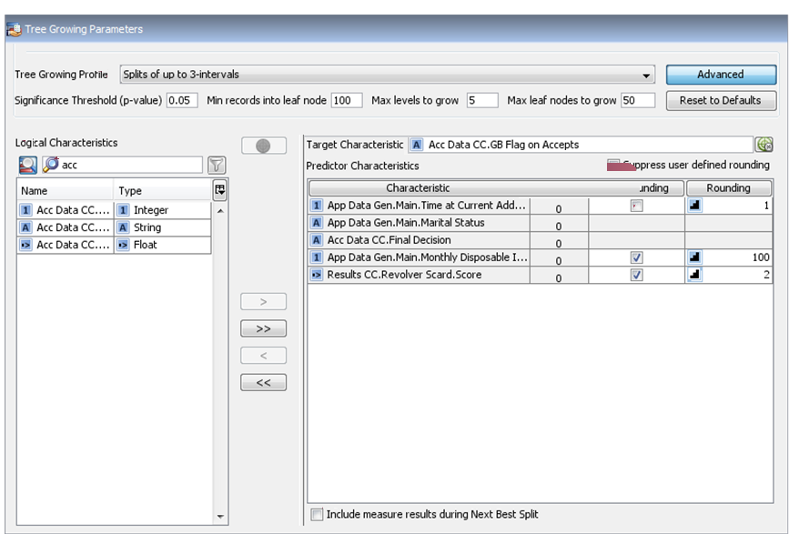

Tree Growing Profile’s advanced settings
Tree growing profile
Logical characteristics name filter
Show tree view
Target characteristic
Filter for data types
Predictor characteristics
Tree growing characteristics that have been mapped
Check box to include measure results during Next Best Split

Slide 9
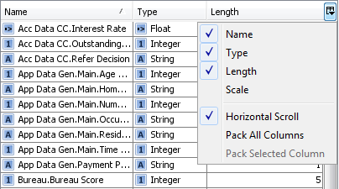
Column display button

Slide 10
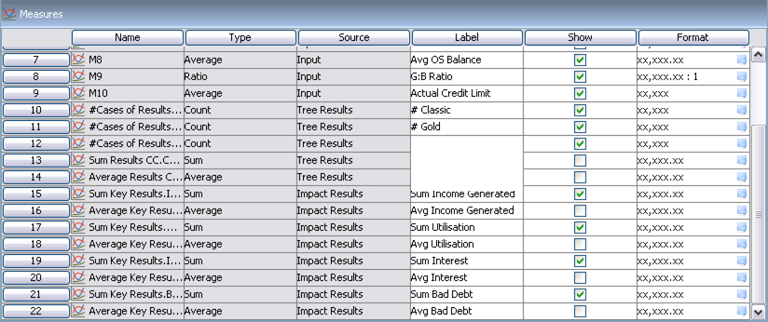
Embedded and referenced measures

Slide 11
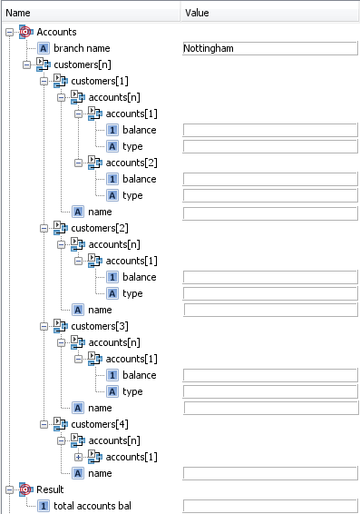
Customer 1
Account 1
Account 2
Customer 2
Customer 3
Customer 4

Slide 12
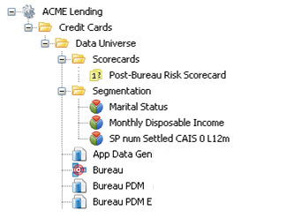
Solution Structure
Scorecard to be exported
Components referenced by the exported scorecard

Slide 13
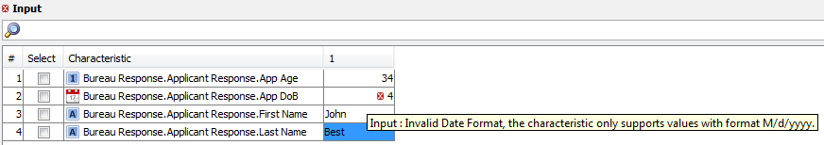

Slide 14
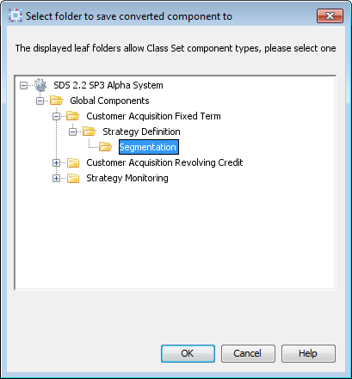
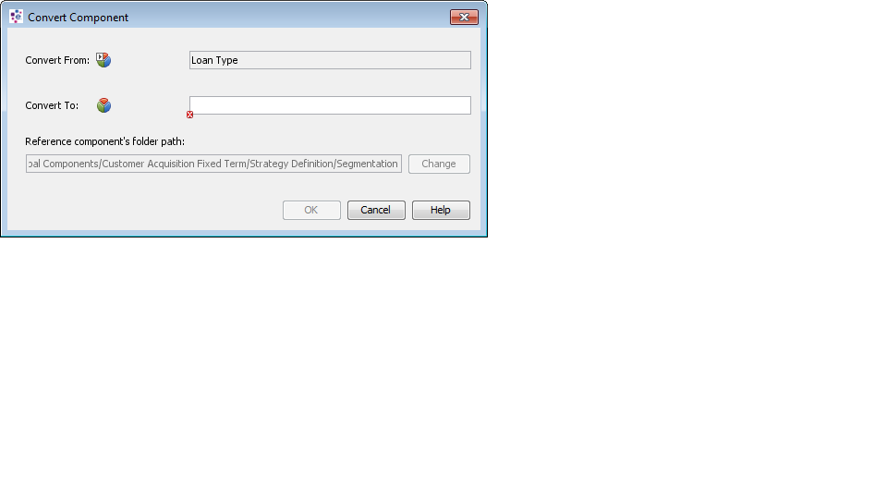
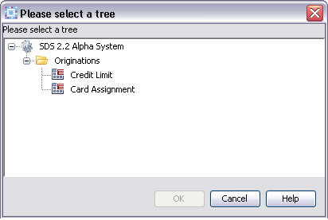
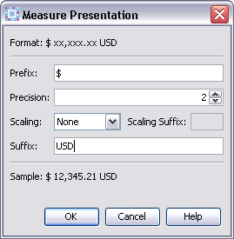

Slide 15
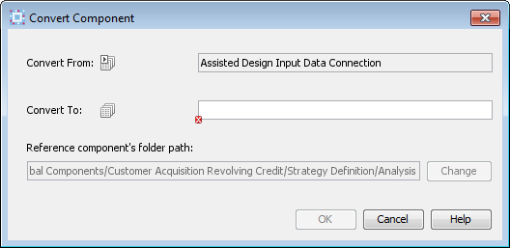
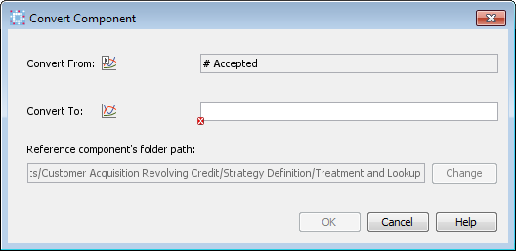
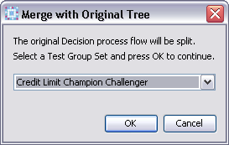
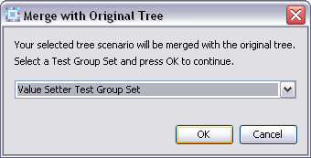

Slide 16
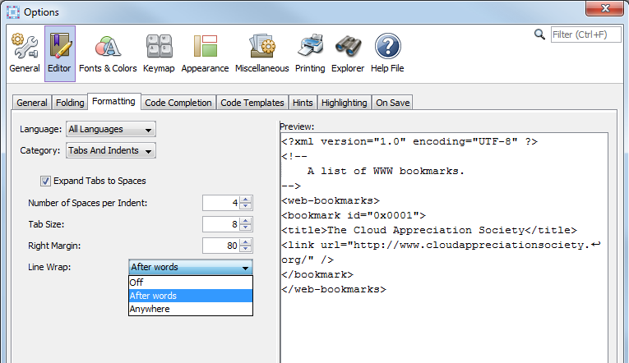

Slide 17
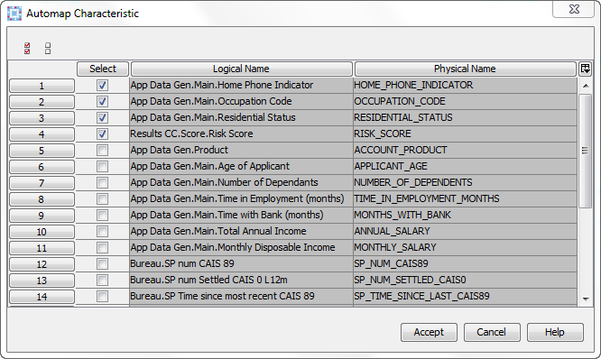

Slide 18
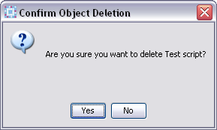
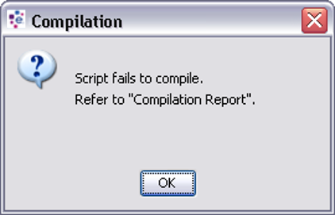

Slide 19
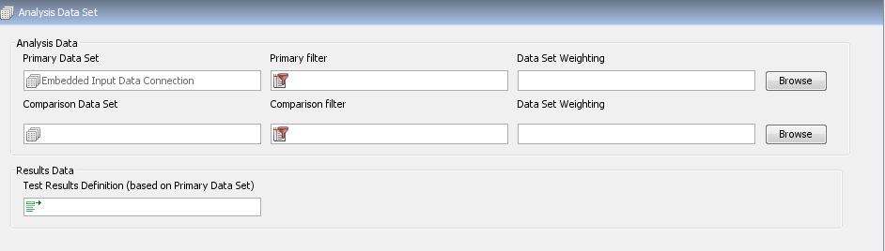

Slide 20
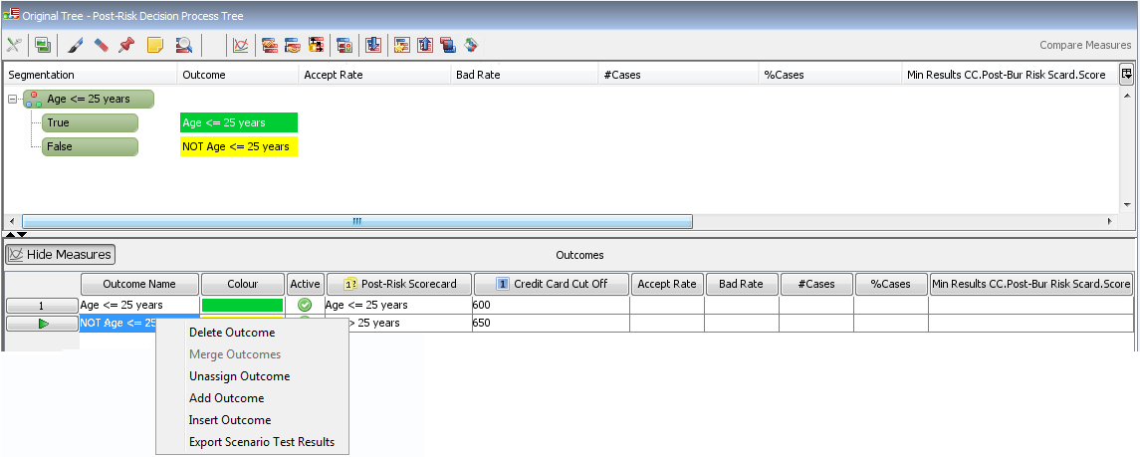

Slide 21
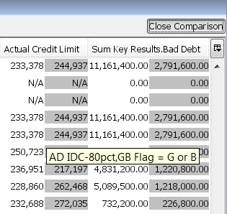
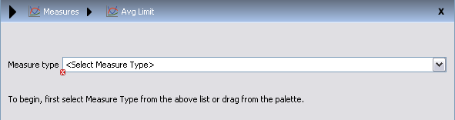
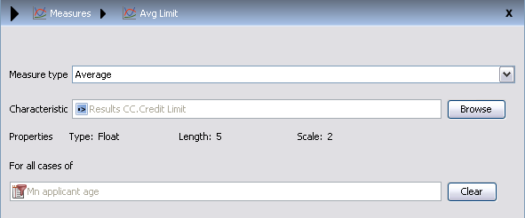

Slide 23
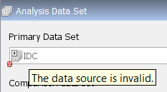
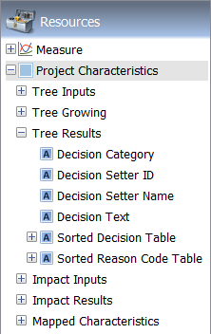

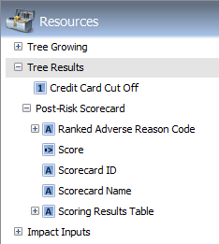

Slide 24
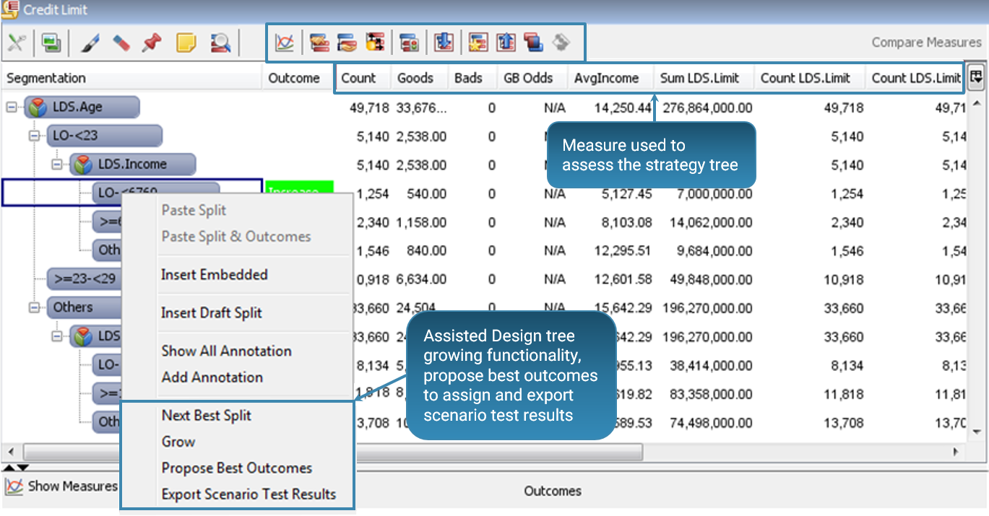
Import a tree into Assisted Design / review and analysis / tree growing / outcome assignment / export test results and promotion buttons
Measure used to assess the strategy tree
Assisted Design tree growing functionality, propose best outcomes to assign and export scenario test results

Slide 25

