Slide 1
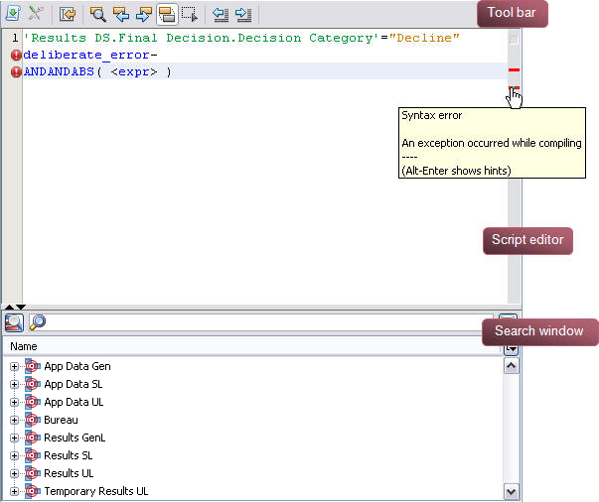
Toolbar
Script editor
Search window

