Slide 1
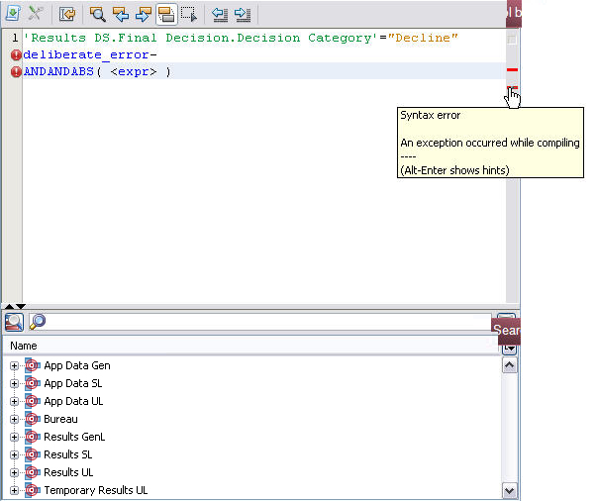

Toolbar
Script editor
Search window
Escape character
Space

Slide 2
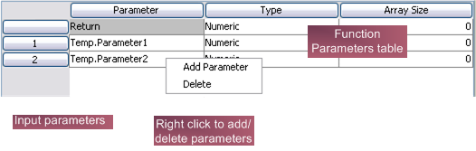
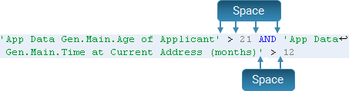
Function Parameters table
Input parameters
Right click to add/ delete parameters
Space
Space

Slide 3

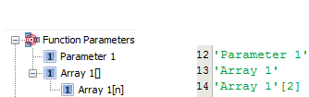
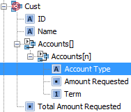

Click for more options
Highlighted results
Characteristic Chooser
Script editor
Characteristic Chooser
Function Parameters
Script editor

Slide 4



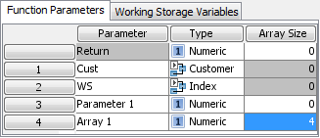
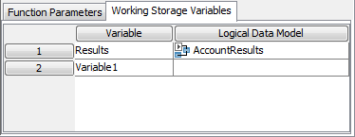
Working Storage Variables
Characteristic Chooser
Logical Data Model
Script editor
Local variables
Right click to add/
delete parameters
Input parameters
Right click to add/
delete parameters

Slide 5
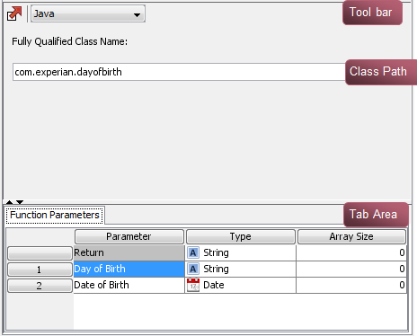
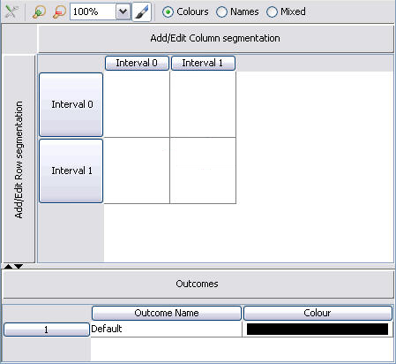
Toolbar
Class Path
Tab area
Cells

Slide 6
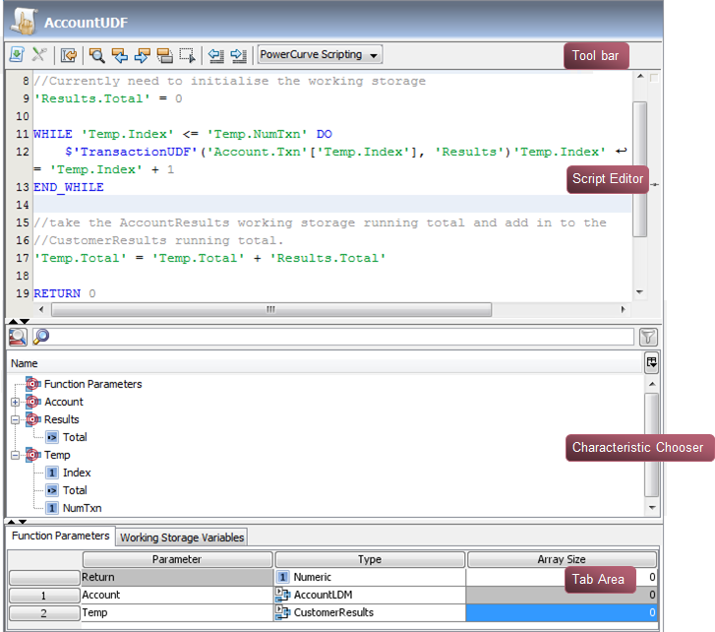
Toolbar
Script editor
Characteristic Chooser
Tab area

Slide 7
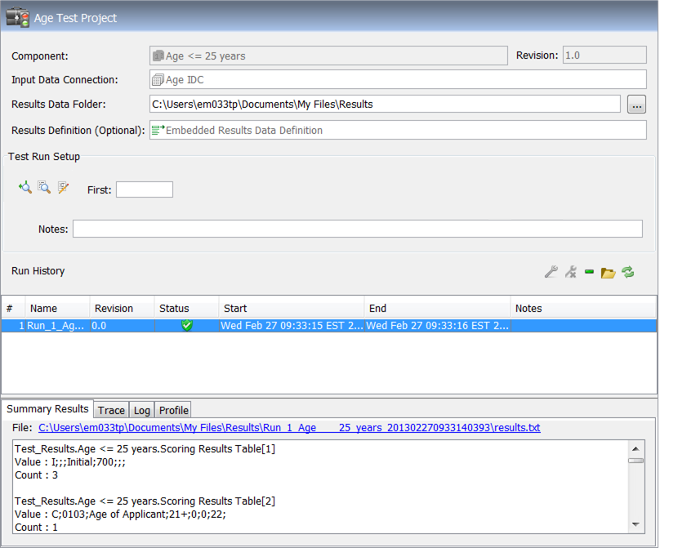
Tested component
Trace buttons
Execute Test button
Run history
Results, Trace, Log and Profile tabs

Slide 8
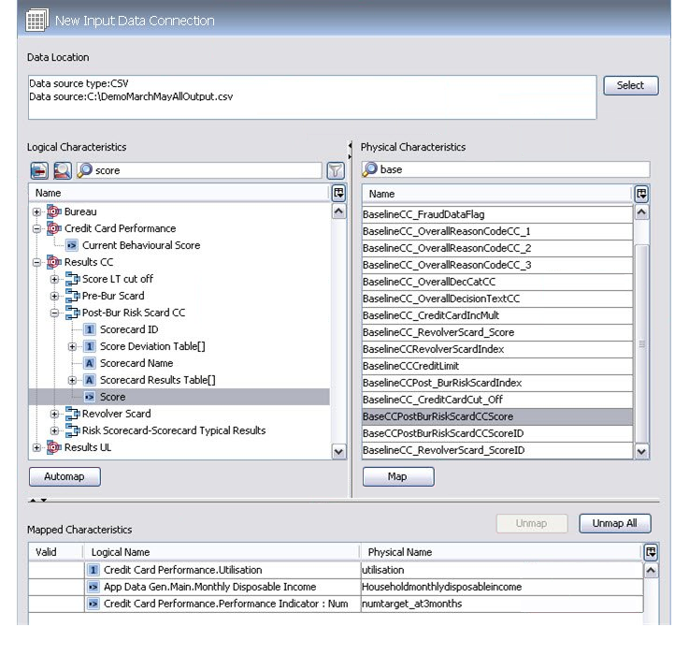
Data source type and location
Logical characteristics name filter
Physical characteristics name filter
Select Logical Data Sources
Show table view
Physical characteristics
Mapping buttons
Mapped characteristics

Slide 9
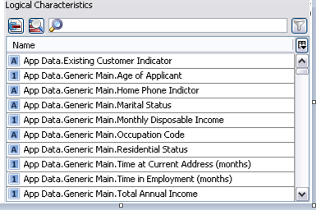
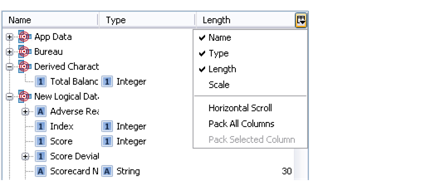
Show table view
Column display button

Slide 10
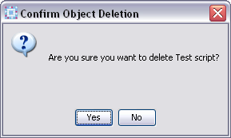
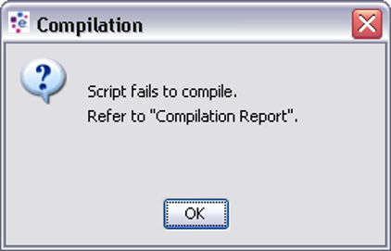

Slide 11
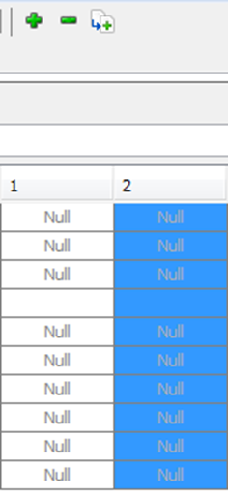
New button
New test case column

Slide 12
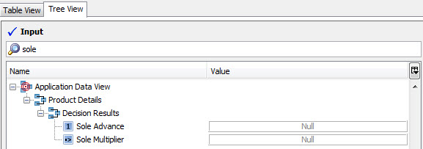
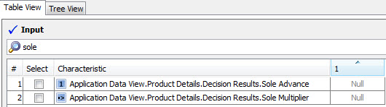

Slide 13
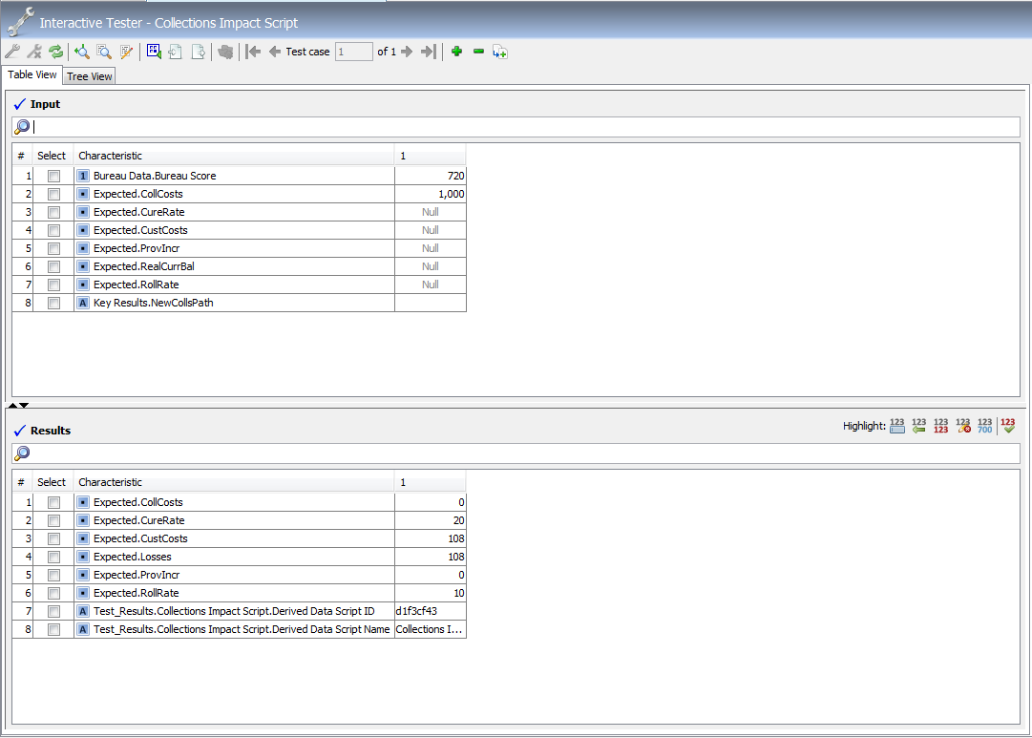
Filter box
Table View/ Tree View tabs
Input table
Highlight buttons
Filter box
Results table

Slide 14
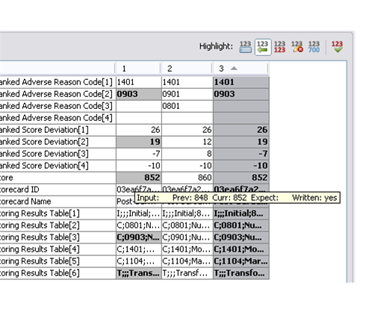
Highlight option
Tooltip displays highlight details
Differences highlighted on grey background

Slide 15
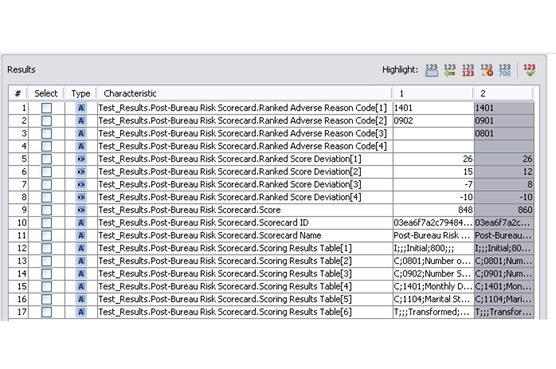
Highlight buttons
Specify expected results
Results for test case 1
Results for test case 2

Slide 16
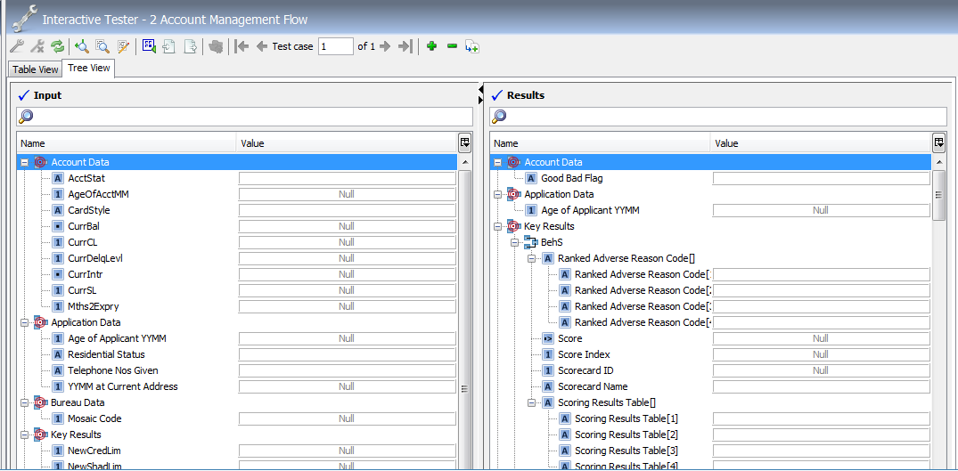
Table View/ Tree View tabs
Filter boxes

Slide 17
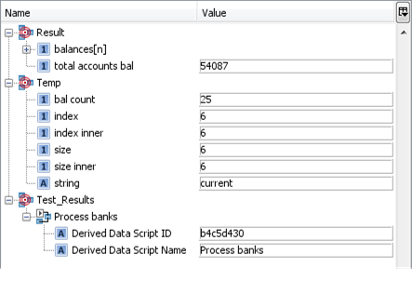
Column display button

Slide 19
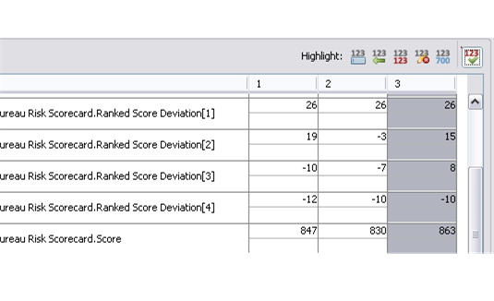
Results for test case 2
Enter expected values

Slide 20
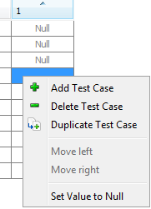
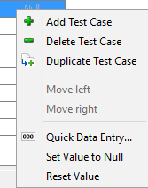

Slide 21
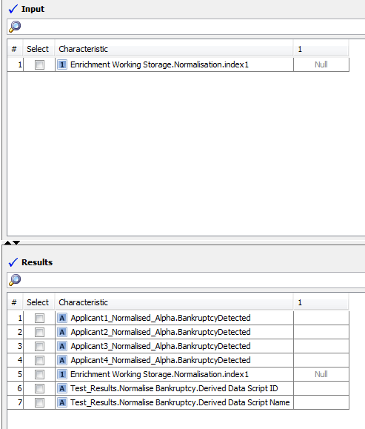
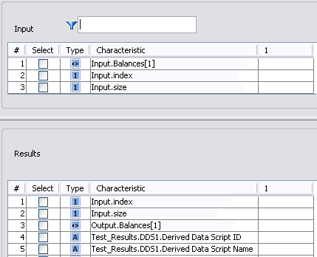

Slide 22
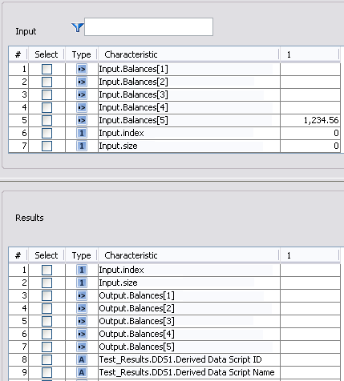

Slide 23
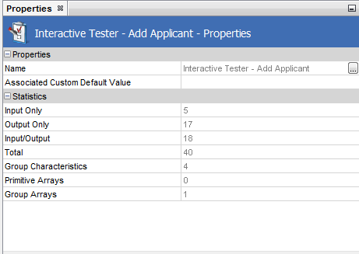

Slide 24
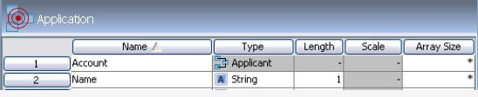

Slide 26
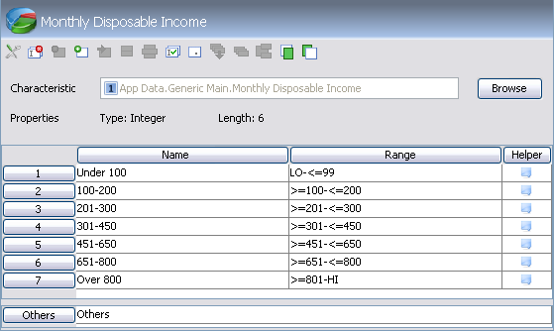

Slide 27
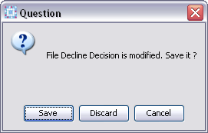

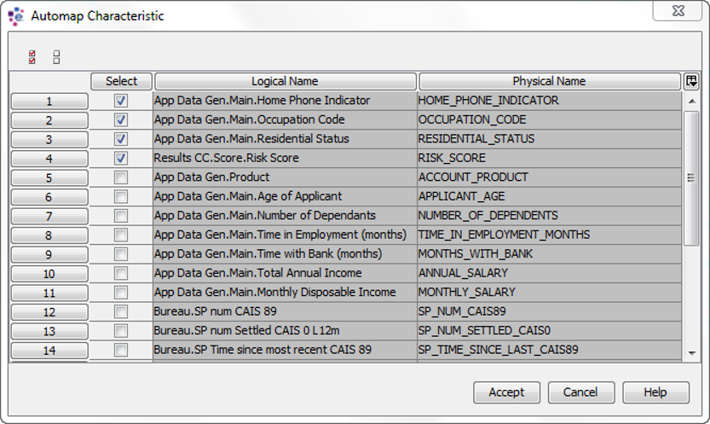

Slide 28
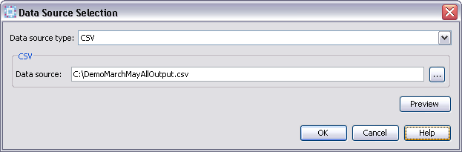
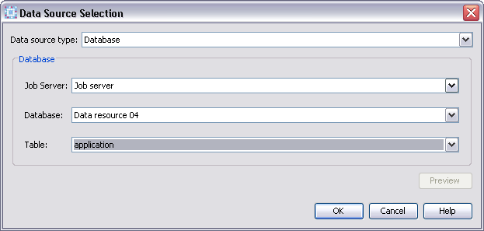

Slide 29
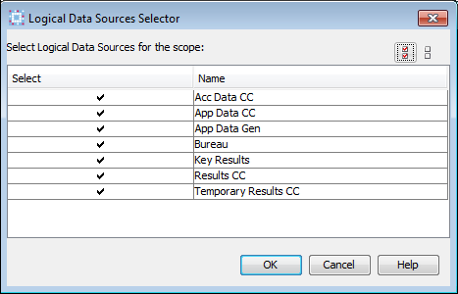
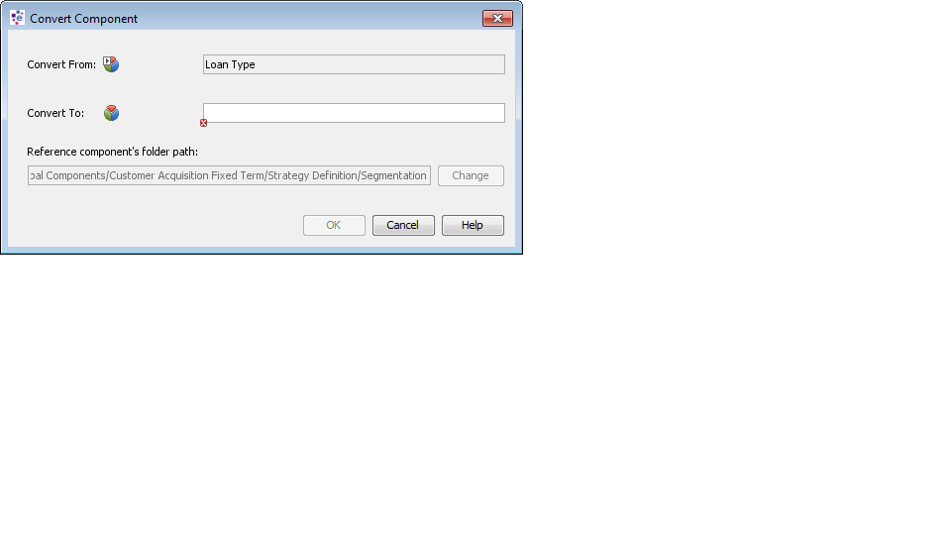
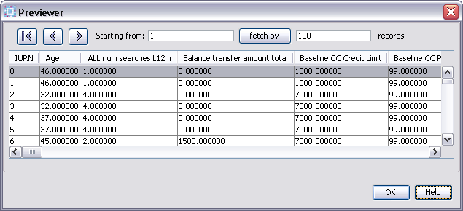

Slide 30
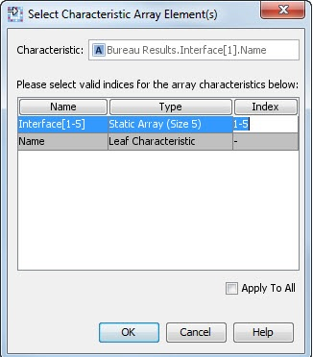
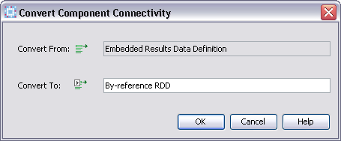

Slide 31
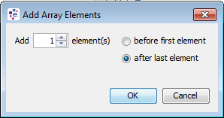

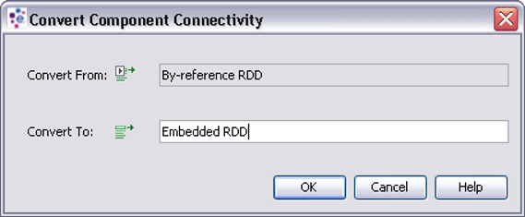
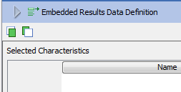

Slide 32
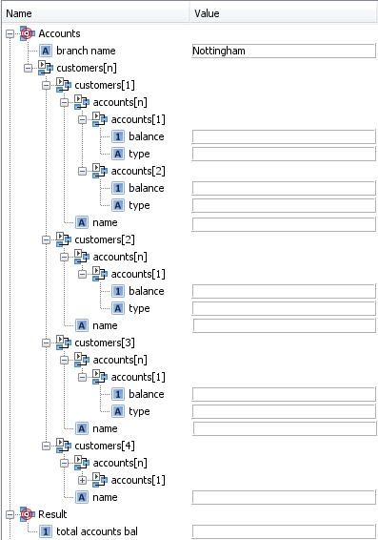
Customer 1
Account 1
Account 2
Customer 2
Customer 3
Customer 4

Slide 33
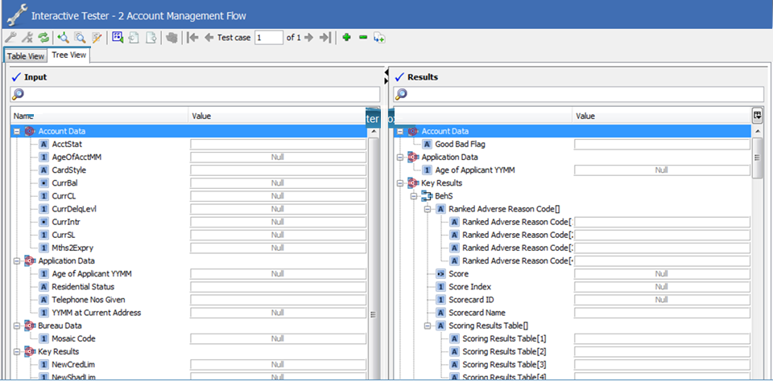
Table view/Tree view tabs
Filter Boxes

Slide 34
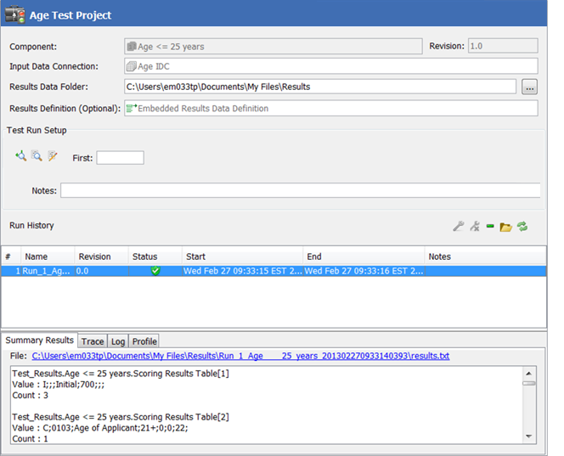
Tested component
Trace buttons
Execute test button
Run history
Results, Trace, Log and Profile tabs

