Slide 1


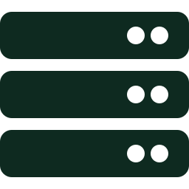
Names That Never Swap
Self-calibrating multi-camera UWB-to-video fusion on the edge
Phones
UWB tags
Edge server
Notes:
Open with the coach scenario on the next slide. This slide is only on screen while you introduce yourself and the project name.

Slide 2
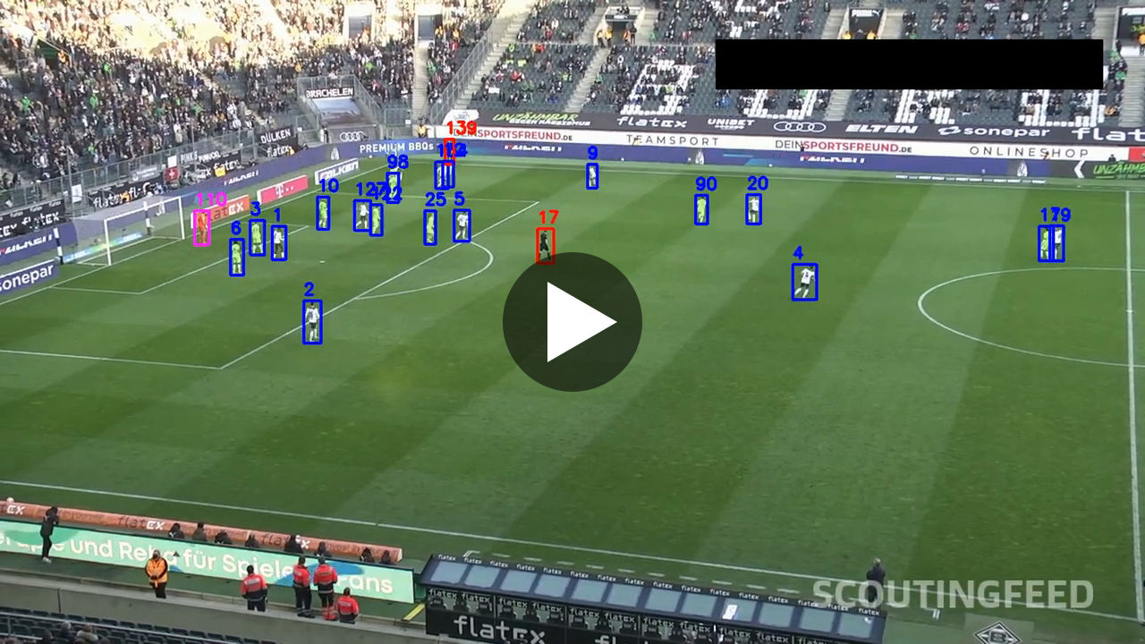
Trackers lose who is who
3,089
identity switches by ByteTrack on the SportsMOT test set
Hours
of re-labelling by hand per match, so training sessions go unanalysed
YOLOv8 + ByteTrack, 25 s. About 25 people are on the pitch, yet labels like 90, 98 and 110 appear by 18 s: each new number is a lost identity. Video: Darkmyter, Football-Players-Tracking, youtu.be/7bFXjk8wYs0
Notes:
About 30 seconds. Click the video to start it; it runs 25 seconds with no sound, so talk over it. From about 10 seconds, numbers above 25 appear (84 at the right edge). By 18 seconds there are labels like 90, 98 and 110. Point at one: every new number is a player the tracker lost.
Picture a coach reviewing training video. Players cross, cluster, and block each other, and the video tracker loses who is who. On the SportsMOT benchmark, the standard ByteTrack tracker makes over 3,000 identity mistakes. So analysts fix it by hand, for hours, and most training sessions are never analysed at all.

Slide 3

UWB knows. Video doesn't.
Video
LocusConnect UWB
Shows the play coaches need
Loses identity when players cross or cluster
Same jerseys make it worse
Knows every player's identity
3D position through occlusion: radio passes through bodies
No picture of the play
Today they meet only on a timeline. Putting names on players in the frame needs a surveyed, fixed camera, so training footage from phones never gets it.
Notes:
About 15 seconds.
LocusConnect's UWB tags already know exactly where every player is, and never mix them up, because radio passes through bodies. But today that data only lines up with video in time. Drawing it onto the players in the frame needs a camera surveyed in advance.

Slide 4

Players calibrate the cameras
1
2
3
Point phones anywhere
Calibrate
Names that never swap
Two or more phones on tripods. No board, no survey, no overlap between cameras.
UWB knows each tag's position; the camera sees people move. Solve pose, focal length, clock offset.
Every tag projected into every view. A blocked player's feed switches camera within a frame.
Not yet published: calibrating any camera to UWB from several tagged players at once.
Notes:
About 35 seconds.
Our idea: point two or more ordinary phones at the court, anywhere. In the first minute of play, the system calibrates each camera by itself, using the players as the calibration target. UWB says where each tag is in metres, the camera sees people moving, and we find the one camera position and lens that make the two agree. Then every player carries a name label that never swaps. And when a player is blocked in one camera, the system switches their feed to the other camera within a frame, because the tag carries the identity across.

Slide 5



Video never leaves the phone
Phones
LocusConnect edge server
Cloud
Run pose detection on device and send only hip keypoints
Calibration, identity matching, camera switching, beside the positioning engine it already runs
Comparison only, to measure latency
> 95%
< 100 ms
less uplink per phone than streaming 720p video
per frame on the edge, measured against a cloud round trip
Notes:
About 25 seconds.
This is a fog computing system. Phones run pose detection and send only keypoints, a few kilobytes a second instead of video. The LocusConnect edge server, which already runs the positioning engine, does the calibration, matching, and switching. We will measure both numbers: bandwidth saved, and edge versus cloud latency.
Stretch goal if asked: a learned association model trained on labels the fusion produces itself, compared against plain Hungarian matching.

Slide 6
How the pieces connect
EDGE DEVICES
FOG NODE: LocusConnect edge server
Phone cameras
1 to N; pose on device, keypoints only
Self-calibration
per camera, first minute: pose, focal length, clock offset
Identity association
tags projected into every view, matched per frame
Occlusion switch
blocked view: switch to best other camera
Outputs
named views, player clips
once
every frame
UWB tags and anchors
ID, x, y, z, time
Shared UWB world frame
smoothed 3D tag tracks link all cameras
Stretch goal
learned matching from its own labels
Cloud
latency test only
Dashed amber: one-time setup per camera. Solid: every frame. Dashed grey: optional or comparison only.
Notes:
About 20 seconds; skip it if you are short on time.
Walk left to right. Phones run pose detection and send only keypoints into the edge server. The UWB tags feed the shared world frame on the same server. In the first minute, each camera calibrates itself against that frame. After that, every frame, each tag is projected into every view, matched to a person, and a blocked player's feed switches to another camera. The cloud only appears as a latency comparison.

Slide 7

What we will show live
1
Self-calibration
How we measure it
Two phones at arbitrary spots calibrate within a minute of play.
ID switches vs ByteTrack | 90% fewer
Calibration vs court lines | < 1°, < 20 cm
Player visible in chosen view | > 95% of frames
Uplink saved vs video | > 95%
Edge latency per frame | < 100 ms
2
Labels hold, feed switches
Names survive crossings; a blocked player's feed jumps cameras.
3
Fusion off
Flip it off and the labels start swapping again.
Notes:
About 25 seconds.
By the end of the semester we will show it live. Two phones on tripods calibrate themselves in a minute while four people play. Names stay on through crossings. Someone steps in front of a player, and that player's feed jumps to the other camera. Flip fusion off, and the labels swap. We will measure identity switches against ByteTrack, calibration error against the court lines, bandwidth, and latency.
Why a semester: identity is the measured weak point of sports video tracking, and radio identity fixes it. It is real fog engineering with numbers we can measure, on hardware we already have.

Slide 8


Calibration and geometry
Phone app
Edge server and networking
Evaluation and data
RANSAC, PnP, clock offset
Pose on device, keypoint streaming
MQTT streams, matching, switching
Recording sessions, labels, metrics
Notes:
About 20 seconds.
I am looking for teammates for four parts: calibration and geometry, the phone app, the edge server and networking, and evaluation and data collection. If any of that sounds like you, come talk to me after class.

