Slide 1
Recording processing, per robot and pass
mobile_1 · Ouster LiDAR + ZED 2i
Each pass
Raw bag
lidar + IMU packets,
metadata, ZED IMU
Decode
packets → points + IMU
(sensor time, _mobile1)
Retime
sensor → PC clock (clock fit);
ZED IMU re-synced to Ouster
GLIM
LiDAR-inertial
SLAM
LiDAR
trajectory
ZED SVO2
(stereo video)
ZED replay: images, depth, odometry, pose
on the capture clock
ZED bags
Merge
every robot's
retimed + ZED bags,
checked against
record.yaml;
calibrations
to /tf_static
trajectories → the mapping session or the sequence (next slide)
mobile_2 · Ouster LiDAR + RealSense + Isaac VSLAM
Raw bag
lidar + IMU packets,
metadata
Decode
packets → points + IMU
(sensor time, _mobile2)
Retime
sensor → PC clock
(clock fit)
GLIM, own config
+ pose-time
correction +46 ms
LiDAR
trajectory
Merged bag
RealSense, IMU,
Isaac VSLAM
copied as recorded: already on the PC clock;
frames renamed per robot
one robot alone (20261015):
its own retimed bag, no merge
Notes:
Each robot's recording is processed on its own, then the pass is merged. mobile_1: its raw bag holds the Ouster's lidar and IMU packets; they are decoded into points and IMU in sensor time, retimed onto the PC clock with a clock fit, and the ZED IMU is re-synced to the Ouster IMU (its driver stamps it late, 2.12 s on 20260924). GLIM gives the LiDAR trajectory. The ZED's SVO2 is replayed into image, depth and odometry bags on the capture clock. mobile_2: the same Ouster chain; GLIM runs with its own config and its poses are moved 46 ms on export. Its RealSense and Isaac VSLAM topics are already on the PC clock and are copied. The merge checks every robot's bags against record.yaml and adds the calibrations; a pass with one robot uses its own retimed bag.

Slide 2
Reference pipeline
Mapping session (once per site)
Board poses
Processed
recording
LiDAR-inertial SLAM
+ pose-time correction
Plane bundle
adjustment
TSDF fusion
Frozen reference
map + trajectory
through the boards
Infrastructure
camera poses
checks: wall thickness · loop closure · pose time · control distances
Every sequence
frozen map, boards
Processed
recording
LiDAR-inertial SLAM
+ pose-time check
Per-agent registration
LiDAR: scan-to-map ICP
RGB-D: odometry + ICP + boards
Independent
validation
(held-out boards)
Reference
poses (site)
Labels and
geometry
Notes:
Top: the mapping session, once per site. GLIM with its pose-time correction, plane bundle adjustment and TSDF fusion give the frozen reference map and trajectory; the boards are posed in it and the infrastructure cameras placed through them. Wall thickness, loop closure, pose time and control distances check it. Bottom: every sequence is registered into the frozen map per agent, validated on held-out boards, and exported in the site frame.

Slide 3
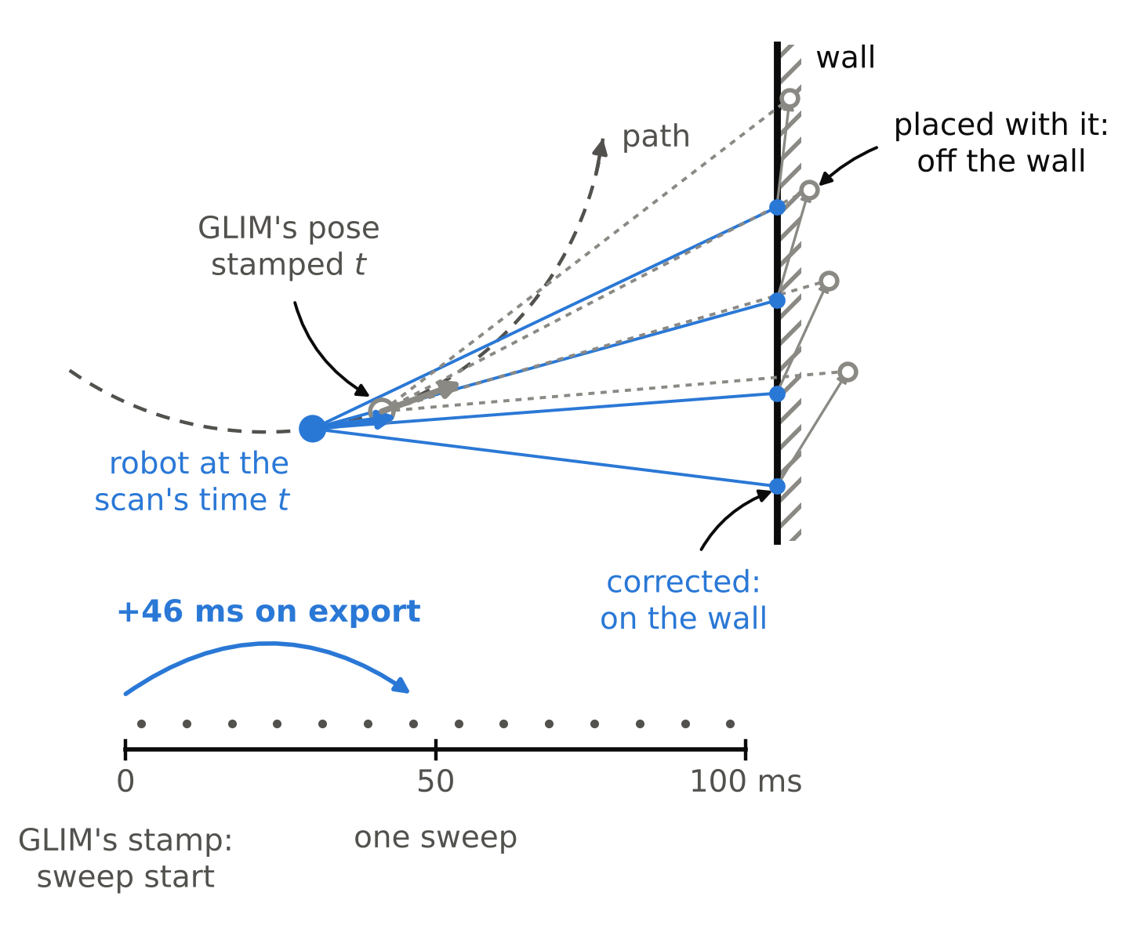
Pose-time correction
GLIM stamps each pose with the start of its LiDAR sweep; the pose is the robot about half a sweep (50 ms) later.
A scan placed with the pose stamped at its own time lands off the walls whenever the robot turns.
Fix: every pose moved +46 ms on export (recording.yaml, pose_time_offset).
20261015: 4 ms left; checked on every pass (heading against turning rate)
Notes:
GLIM writes each pose with the time its sweep started, but the pose describes the robot about half a sweep later. Looking up the pose at a scan's own time therefore gives where the robot was 50 ms later; while turning, that scan lands beside the walls. We move every pose 46 ms on export, and check the remaining offset on every pass.

Slide 4
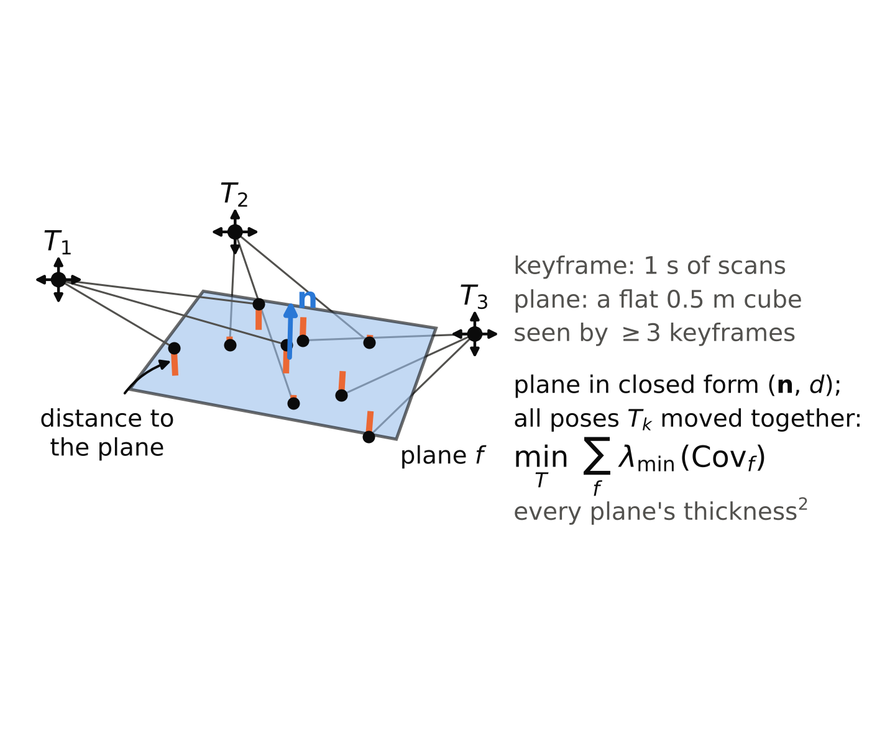
Plane bundle adjustment
Keyframes: 1 s of scans each. Planes: flat 0.5 m cubes seen by at least 3 keyframes.
Each plane is solved in closed form, so only the poses are unknown; the cost is every plane's thickness squared.
All keyframe poses move together; odometry keeps what no plane sees, gravity holds roll and pitch; 3 rounds.
20261015: whole-run walls 12.3 cm (GLIM as output) → 9.0 cm (reference)
Notes:
Like bundle adjustment with cameras, but the shared features are planes instead of points. Each keyframe sees part of a plane; if its pose is off, its points sit above or below the others. The plane is fitted in closed form, and all poses are moved together until every plane is as thin as the scans allow.

Slide 5
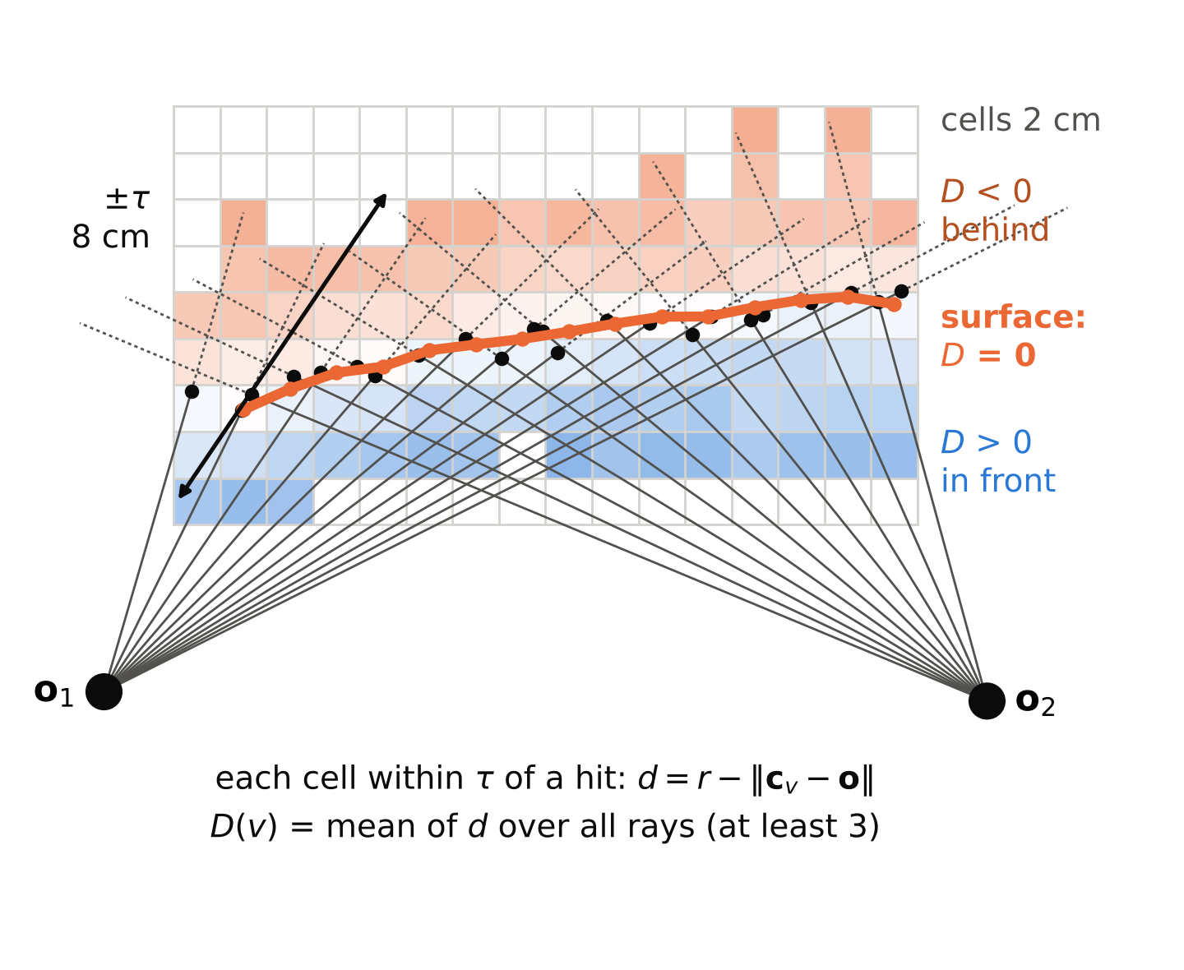
TSDF fusion
Each point is a ray: every 2 cm cell within ±8 cm of the hit gets its signed distance (+ in front, − behind).
Averaged over all rays; the surface is where the average crosses zero (cells seen by at least 3 rays).
One surface instead of every cell any scan hit: the union's band grows with every pass.
20261015: map walls 7.8 cm, against 12.8 cm for the union
Notes:
The union of points keeps every cell any scan ever hit, so a rarely hit cell counts as much as the dense centre and walls grow thicker with every pass. The TSDF instead averages, along each ray, how far each cell is in front of or behind the hit, and puts the surface where that average is zero.

Slide 6
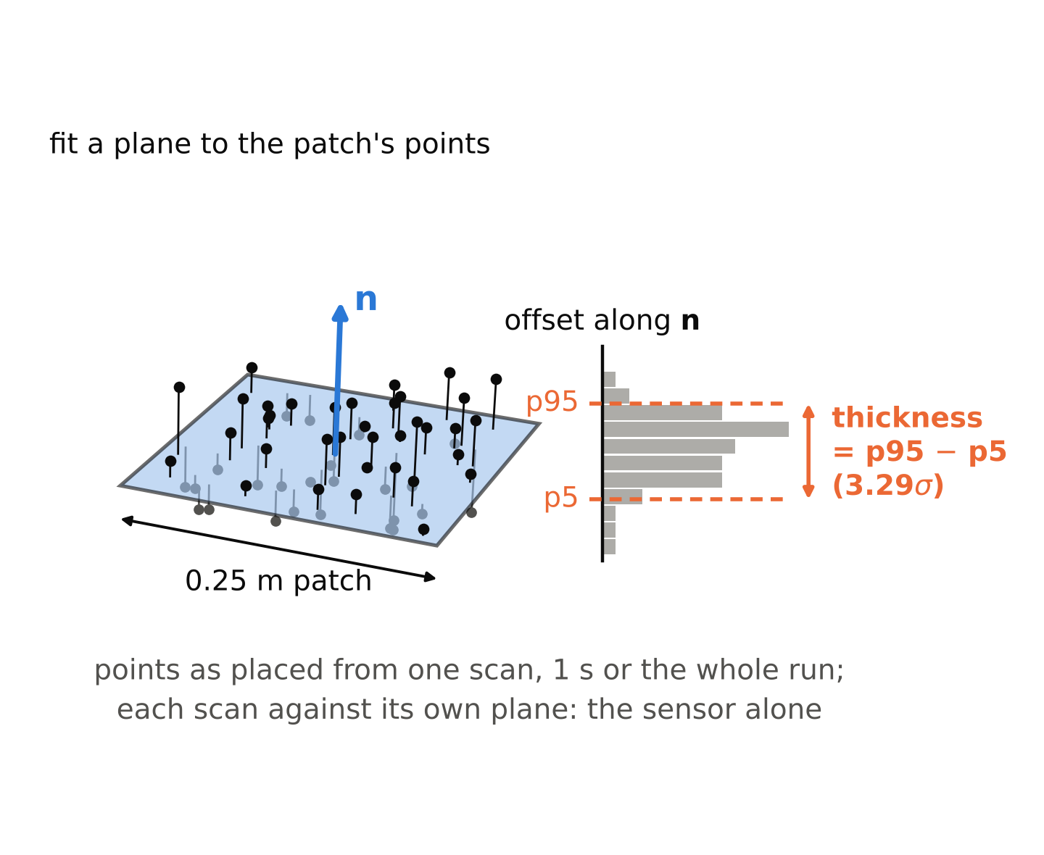
Wall thickness
Each 0.25 m patch: fit a plane, take the points' offsets along its normal.
Thickness = p95 − p5 of the offsets (3.29σ for Gaussian noise).
Points from one scan, 1 s or the whole run, as placed: separates sensor, motion and pose error.
20261015 reference: sensor alone 3.0 · 1 scan 4.7 · 1 s 6.7 · whole run 9.0 cm
Notes:
This is how every thickness in the tables is measured. The same patches are measured with the points of one scan, of one second, or of the whole run as placed by the trajectory; each scan against its own plane gives the sensor alone.

