Slide 1
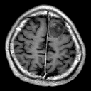
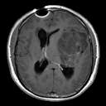
Latent
( f )
z
Intermediate latent
ẑ
w
(g)
4 × 4
tensor
4²
8²
A_{i}(w)
16²
32²
64²
ATS
128²
Synthetic MRI
ADA
GU
Real MRI
(D)
DU

Slide 2
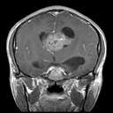
Input MRI
128 × 128
32 ch
BN
64 ch
BN
128 ch
BN
256 ch
BN
512 ch
BN
512-d vector
FC 512 → 1024, p = 0.3
FC → 3, p = 0.3
3 Anatomical
Planes
FC → 4, p = 0.3
4 Tumour
Classes

Slide 3
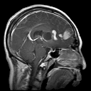
Input MRI
ImageNet-1K Weights
128×128
512-d vector
p = 0.2
FC → 3, p = 0.3
3 Anatomical
Planes
FC → 4, p = 0.3
4 Tumour
Classes

