Slide 1
Isolation & QoS In PaaS Cloud CLSF Open Discussion
Oliver Yang
http://oliveryang.net
2018 10.11

Slide 2
Background
Machine
Virtualization (Xen, KVM, Container)
Service consolidation
Application
Docker
Colocation

Slide 3
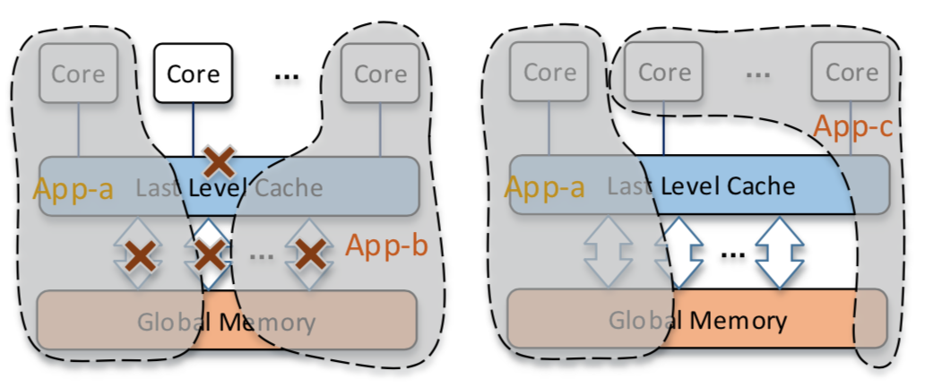
Colocation
Increase data center hardware utilization
Consolidate multiple workloads with acceptable QoS loss
Borg/Kubernetes, VMware DRS etc.
Challenge: Avoid contentions among multiple workloads
Workload characterizations
Resource model: Compute bound + IO bound
Time sharing: Peak time + Off-peak time
OS resource control & isolation features

Slide 4
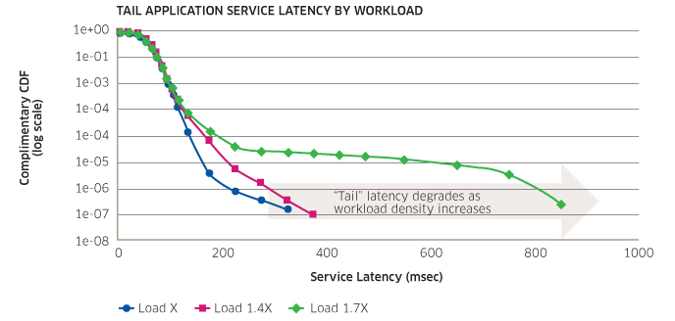
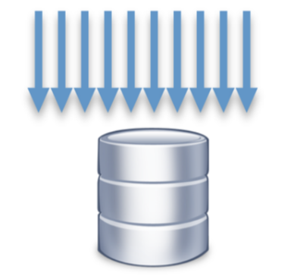
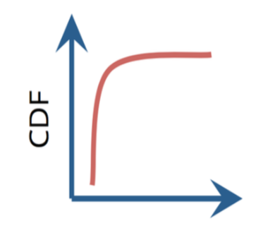

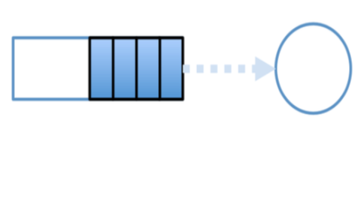
Performance Jitters & Causes
System performance jitters RCA (Root Cause Analysis) can be very challenge…
Burst randomly
In a very short period
Reported/found very late
Always postmortem analysis
Without enough debug data
Tradeoff between utilization and QoS
Avoid jitters by resource isolations
HW Resource Contentions
Skewed Access Pattern
Queuing Delays
Background Activities

Slide 5
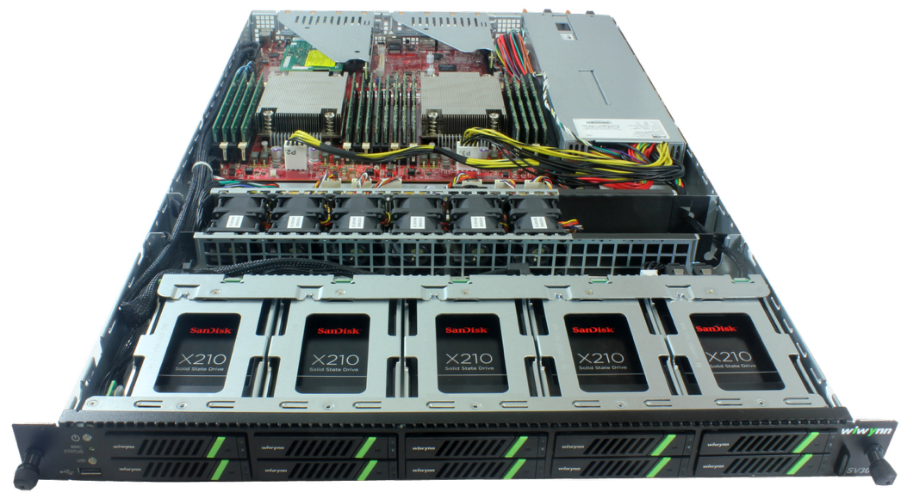
System wide optimizations
Hardware & Software cooperate together
Full stack optimizations
CPU: CAT, Cgroup, Noise Clean, Scheduler Optimization
Memory: MBM, MBA, Cgroup, Idle page tracking
Network: TC, HTB, Lockless Qdisc
IO: Write back Cgroup, Low/Upper limit，
Weight, File Level-Based IO Throttle

Slide 6
Challenges from web-scale data center
Scale-out optimization at large scale
Resource QoS classifications & scheduling
Workload placements(Bin-packing) algorithm
Dynamic distributed load balance & scheduling
Constantly varying load challenges
The synthetic test environment has poor coverage
Many issues can be only found on real online environment
Using statistics to determine the impact of a change
Performance or resource characters could be totally changed after a time period
Paper: Performance Analysis of Cloud Applications – NSDI 2018

Slide 7
Application-centric Architecture
4 key aspects need to be re-considered…
Security Isolation
Fault Isolation
Performance Isolation
Resource Utilization

Slide 8
Security Isolation
Virtualization spectrum: Kata, Gvisor, LinuxD, Cgroup
Quantitative security measurement?
Performance overhead？
What are the key performance metrics?
Boot time
Run time
Compute bound?
IO bound?

Slide 9
Fault Isolation
Hardware Isolation
CE, UE, TDP issues
Device retire: offline and fence
Disk Hotplug?
Software Isolation
Split-lock usage
OOM Handling
Segfault from application
Priority Reversion in FS
Error Resilience
Checkpoint/Restore
Live Migration
CRIU
Backup schedule
VM/Container/Job reschedule

Slide 10
Performance Isolation
Hardware Resource Contention
Intel RDT, SRIOV, NVME WRR
Flexibility (Static vs. Dynamic)
Fine granularity
Lack of latency bound support
Share, Weight, Quota caused latency problems
Scheduling: preempt latency
Memory: slow path
IO: sync io

Slide 11
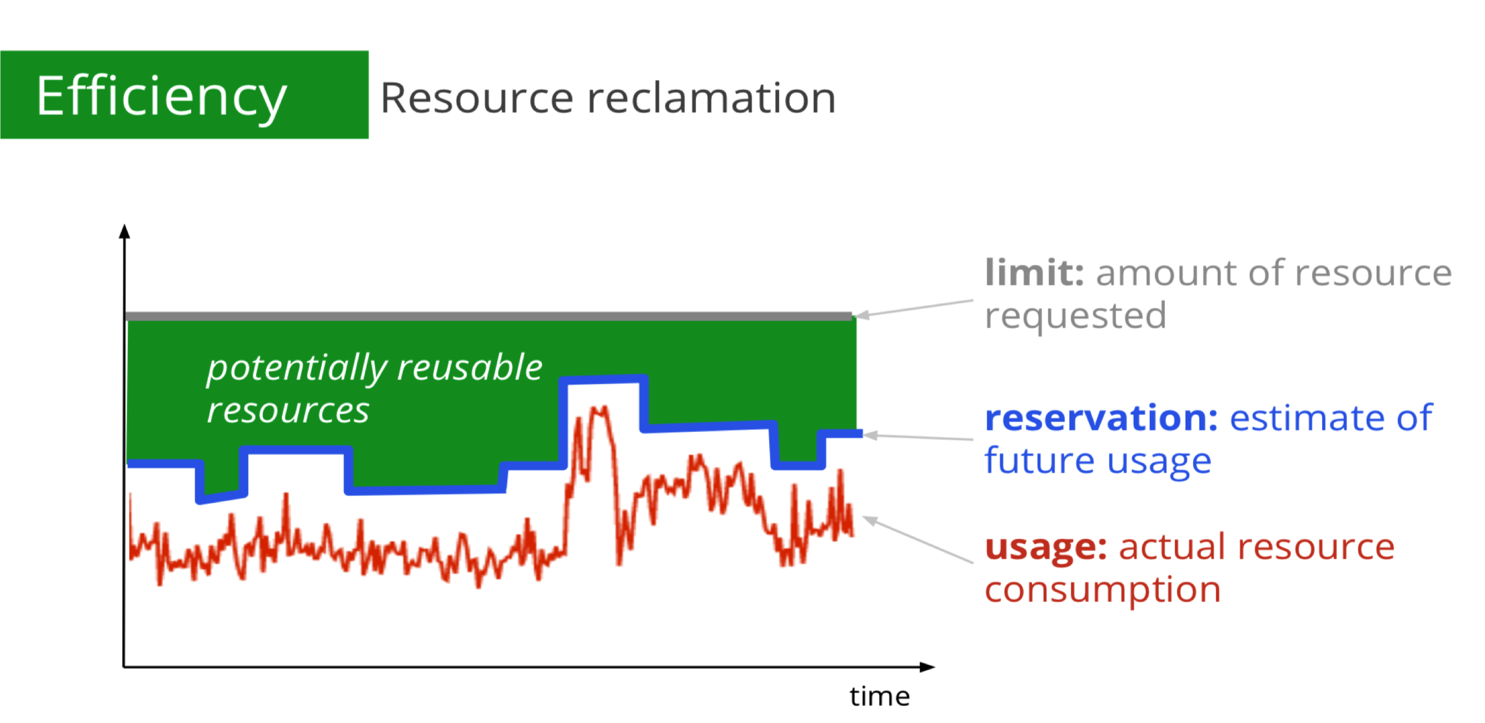
Resource Utilization
Deployment density & scalability
Partitioning vs. Sharing
Small resource footprint
QoS Classes & SLA
Kubernetes: Guaranteed, Burstable, Besteffort
Resource reclamation & QoS
Paper: Large-scale cluster management at Google with Borg - EuroSys 2015

Slide 12
References
System memory QoS Challenges
Colocation in Alibaba Private Cloud

Slide 13
Performance Isolation - Direct Memory Access
Problem: Hardware resource contention
Analysis: CPU PMU counters
Solution: Hardware & software work together
Intel RDT (CAT/MBA)
Software memory access pattern optimization
TLB/Cache/Memory(NUMA)
Memory Performance
Direct Access
TLB
L1
L2
L1/L2/LLC
Local
Remote
DRAM
Local
Remote
Device MMIO
Paging on demand
Fast Path
Slow Path
Local
Remote

Slide 14
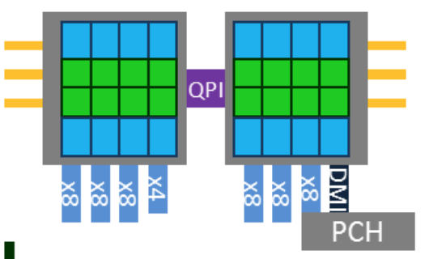
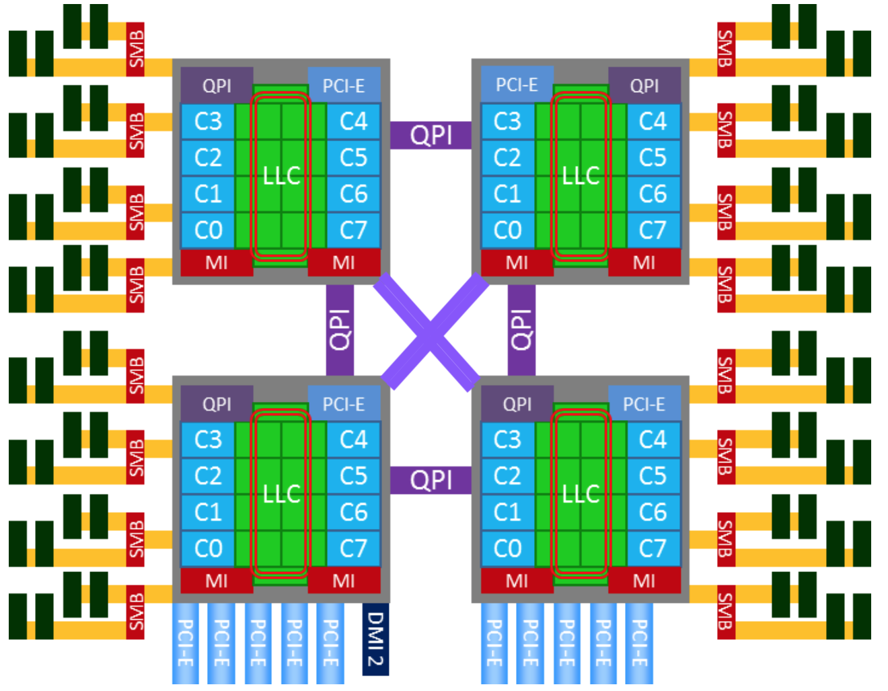
Perf Metrics For Direct Memory Access
CPI/IPC/MIPS
Perf stat - IPC
Pmu-tools – toplev, ocperf
TLB Hit/Miss/Flush
Perf stat – tlb miss, flush events
Cache Hit/Miss
Perf mem – access ratio
Memory Latency/BPS/IOPS
Numatop - Local/Rmote
Perf c2c – access ratio, latency
Perf c2c – access ratio, latency
Perf stat – cache miss events
Resctrl - CQM and MBM
perf mem – access ratio
Notes: Some metrics have performance overheads

Slide 15
Performance Isolation - On Demand Paging
Problem: Overheads from kernel paging mechanism
Analysis: Kernel counters and dynamic tracing
Solutions: Avoid running into slow path
Warm up and lock the pages
Increase min_free_kbytes vs. memory utilization
Google patch: per-memcg kswapd (incomplete & need more enhancements)
Paging on demand
Fast Path
Buddy
Slow Path
Compact
Direct
Background
Reclaim
Direct
Loop & Yield
Sleep
Background
THP
Zero out
COW
Split
Collapse
Lock contention
Dirty
Congestion

