Slide 1
Multi-objective optimization
Jovan Vukićević, mi19090

Slide 2
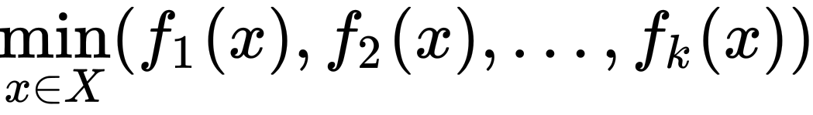
Problem
Minimization of multiple objective functions at the same time.
These functions can potentially be conflicting. Reducing the value of one function can lead to the increase of value in another.

Slide 3
Solution: Pareto fronts
A feasible solution x1 is said to dominate another solution x2 if:
A solution is called Pareto optimal if there does not exist any other solution that dominates it.
The set of Pareto optimal solutions is called a Pareto front.
There are many methods of finding Pareto fronts, one of them being the use of evolutionary algorithms.
, and

Slide 4
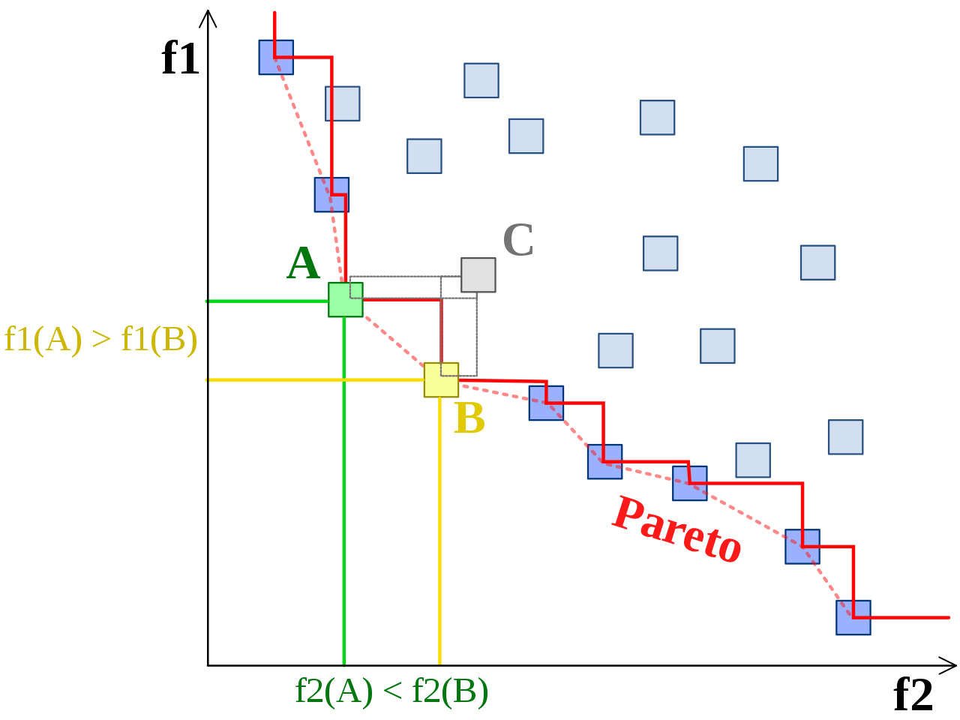
Solution: Pareto fronts

Slide 5
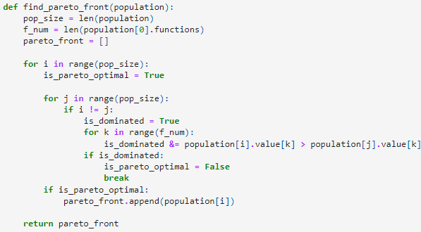
Pareto front algorithm

Slide 6
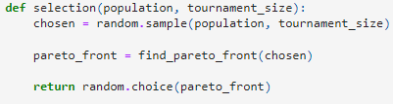
Simple genetic algorithm
Selection: Tournament selection modification.

Slide 7
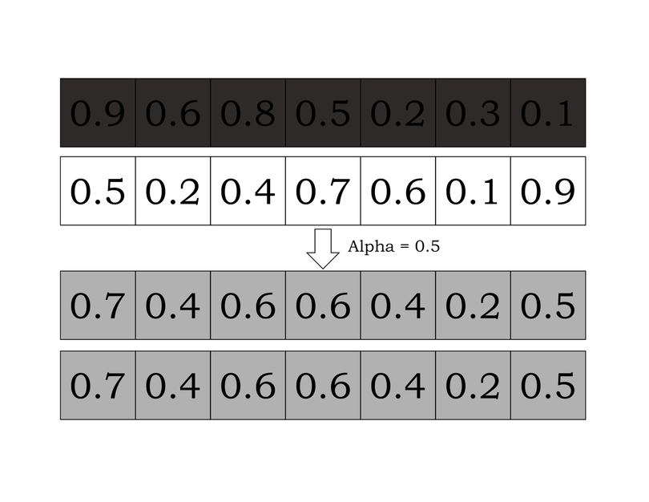

Simple genetic algorithm
Crossover: Whole arithmetic recombination.

Slide 8
Simple genetic algorithm
Mutation: Uniform mutation.
The mutating solution takes a new random value in its domain.

Slide 9
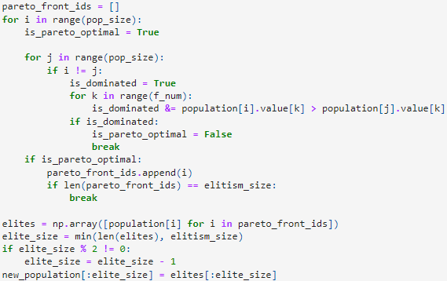
Simple genetic algorithm
Elitism: Keeping previous generations Pareto front individuals alive in the next generation.

Slide 10
NSGA-II
Non-dominated sorting genetic algorithm, or NSGA-II for short, is a genetic algorithm optimized for multi-objective optimization which bases itself on the concept of sorting the population by non-dominance and crowding distance.
The main concept of non-dominated sorting in this algorithm works by finding the Pareto front of the population and giving them all members of the front a ranking, then finding the pareto front of the remaining population and giving it a rank lower than the one before, and so on until there are no unranked elements.
After that, the individuals belonging to the same fronts are ranked by their Euclidean distance from one another, making more distant elements better ranked, giving the opportunity for more diverse final Pareto fronts.

Slide 11
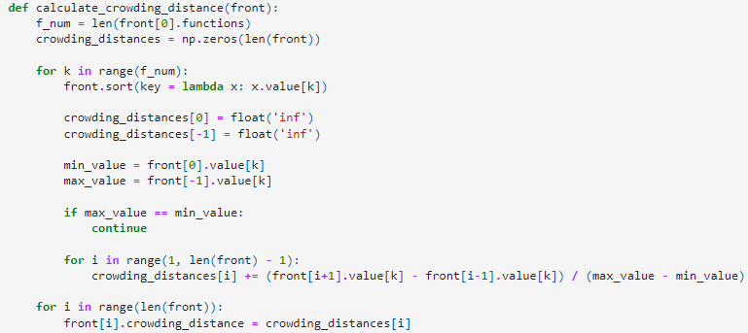
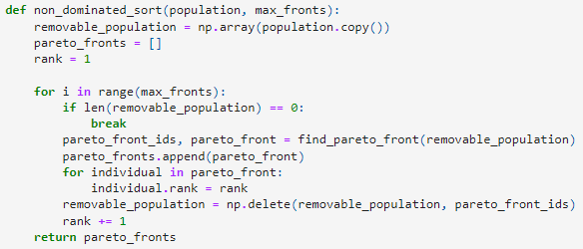
NSGA-II

Slide 12

NSGA-II
Selection: Tournament selection.

Slide 13
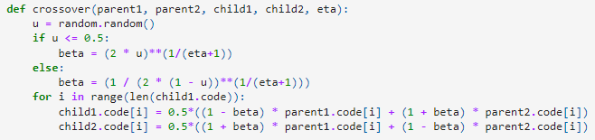
NSGA-II
Crossover: Simulated binary crossover.

Slide 14
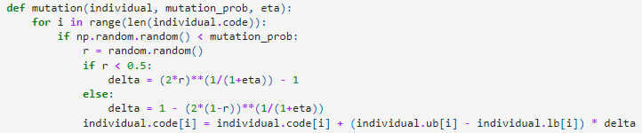
NSGA-II
Mutation: Polynomial mutation.
Empirically, mutation eta should take a higher value than crossover eta.

Slide 15
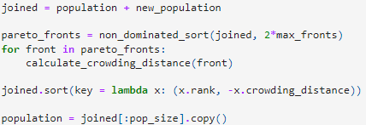
NSGA-II
Elitism: Implicit elitism.

Slide 16
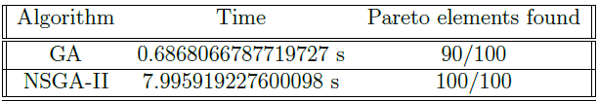

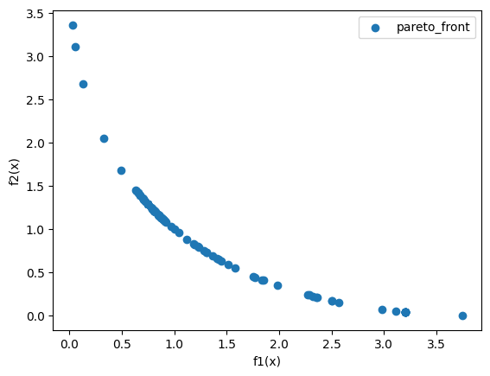
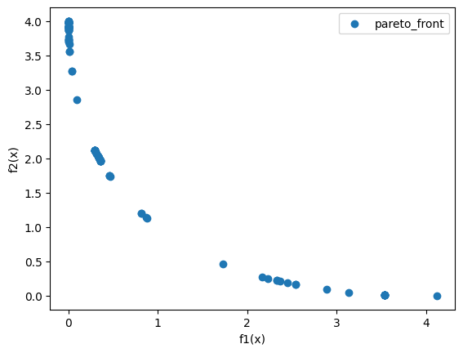
Genetic algorithm comparisons
Schaffer function N.1:
, -A <= x <= A & 10 <= A <= 10^5
GA
NSGA-II

Slide 17
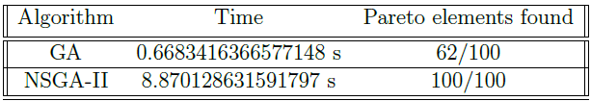
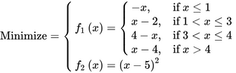
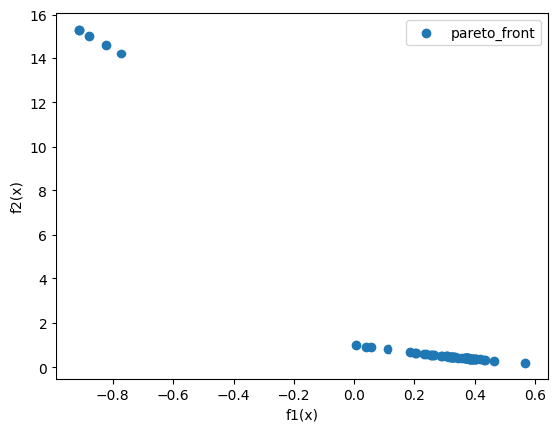
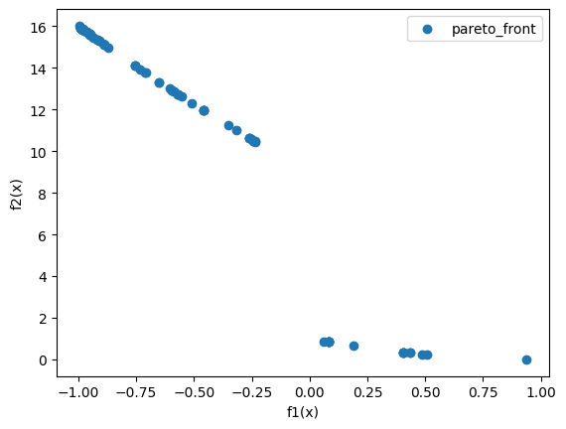
Genetic algorithm comparisons
Schaffer function N.2:
, -5 <= x <= 10
GA
NSGA-II

Slide 18


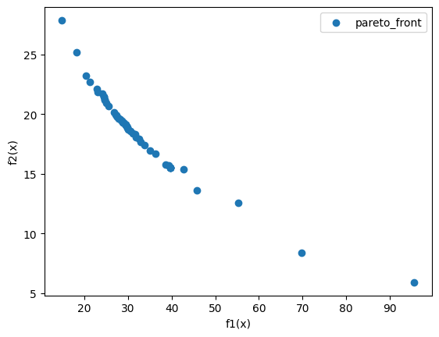
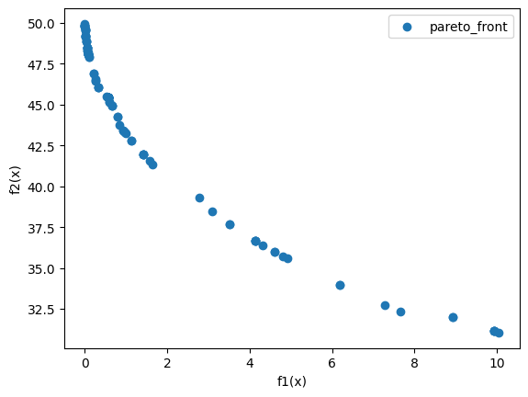
Genetic algorithm comparisons
Bihn and Korn function:
, , 0 <= x <= 5 & 0 <= y <= 3
GA
NSGA-II

Slide 19


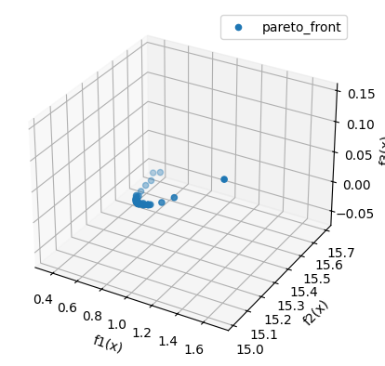
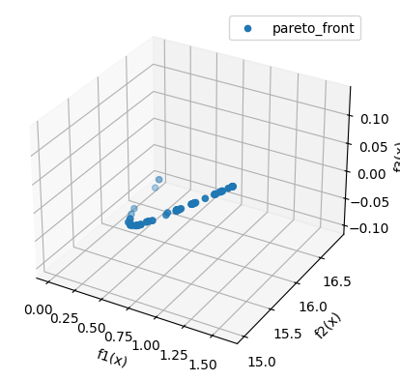
Genetic algorithm comparisons
Viennet function:
, -3 <= x, y <= 3
GA
NSGA-II

Slide 20
Genetic algorithm comparisons
NSGA-II has a much longer computation time.
NSGA-II is very complex and harder to fine-tune with many different parameters.
As problems become more complex, simple GA begins to fail.
NSGA-II can solve same problems in much less generations, with a detriment in diversity.

Slide 21
Thank you for your attention!

