Slide 1
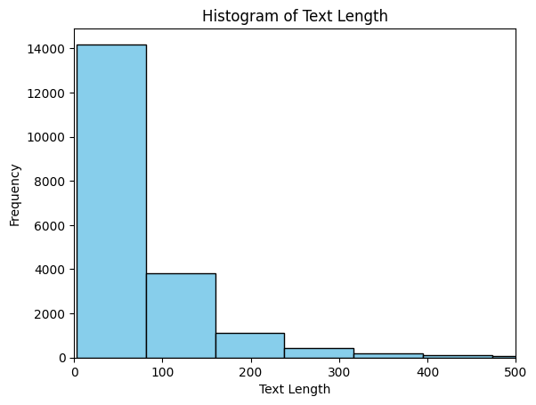
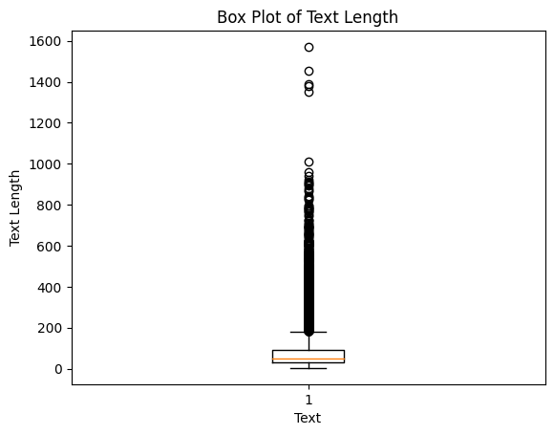

Slide 2
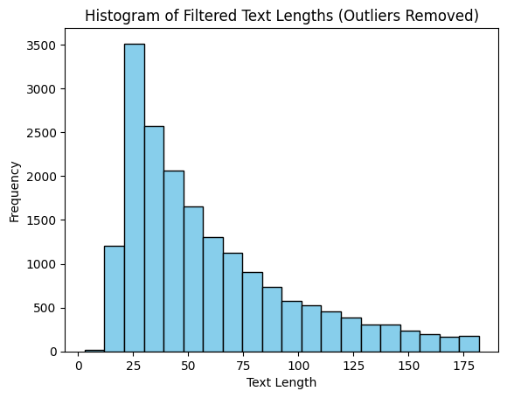
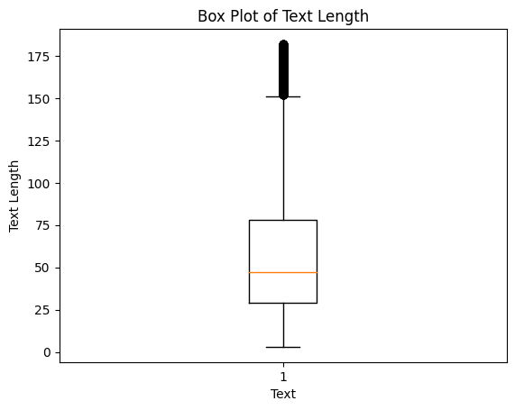

Slide 3
“jenna went back to university”
Tokenize
“jenna”, “went”, “back”, “to”, “university”
Remove Stop Words
“jenna”, “went”, “university”
Stem / Lemmatize
“jenna”, “go”, “univers”

Slide 4
0 Been going to honk for quite a while . This ma...
1 We have been a frequent visitor at this chain ...
2 Excellent staff, very cooperative and gentle ....
3 I have always visit this place.they always off...
4 Lot of appraise about Chef Deepak Chef Wangmo ...
0 going honk quite man falesh always top job mak...
1 frequent visitor chain year sad restaurant dec...
2 excellent staff cooperative gentle specially a...
3 always visit place always offer good food one ...
4 lot appraise chef deepak chef wangmo service s...

