Slide 1
Templates and the Standard Template Library
Part II

Slide 2
Standard Template Library
1990
In 1990, Alex Stepanov and Meng Lee of Hewlett Packard Laboratories extended C++ with a library of class and function templates which has come to be known as the STL.
1994
In 1994, STL was adopted as part of ANSI/ISO Standard C++.

Slide 3
Component of STL
STL had three basic components:
Containers
Generic class templates for storing collection of data.
Algorithms
Generic function templates for operating on containers.
Iterators
Generalized ‘smart’ pointers that facilitate use of containers.
They provide an interface that is needed for STL algorithms to operate on STL containers.

Slide 4
Taken from: http://cs.calvin.edu/books/c++/ds/1e/

Slide 5
Why Use STL?
STL offers an assortment of containers
STL publicizes the time and storage complexity of its containers
STL containers grow and shrink in size automatically
STL provides built-in algorithms for processing containers
STL provides iterators that make the containers and algorithms flexible and efficient.
STL is extensible which means that users can add new containers and new algorithms such that:
STL algorithms can process STL containers as well as user defined containers
User defined algorithms can process STL containers as well user defined containers

Slide 6
Why Use STL?
Thus, use of STL leads to:
Programming ease and flexibility
Program robustness
Storage efficiency

Slide 7
STL Containers
The STL containers are classified into three categories:
Sequence containers (also called sequential containers)
Associative containers
Container adapters

Slide 8
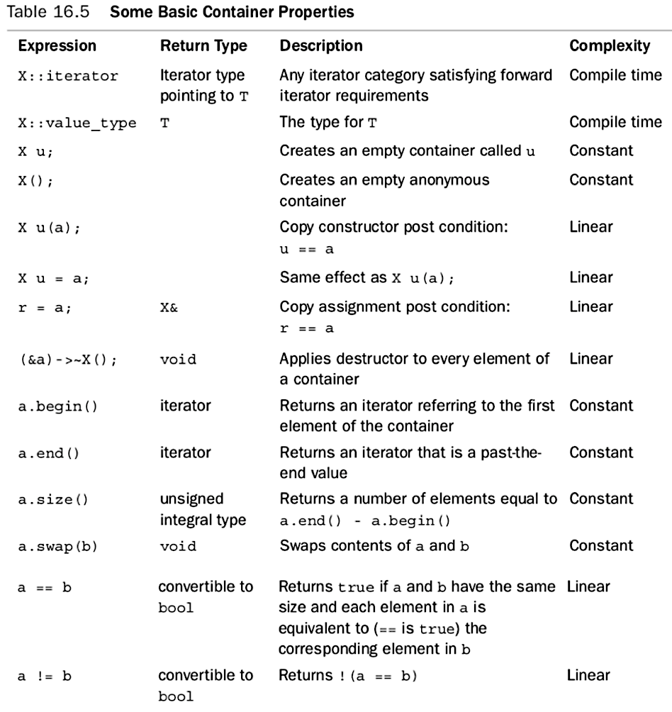
Basic Container Properties

Slide 9
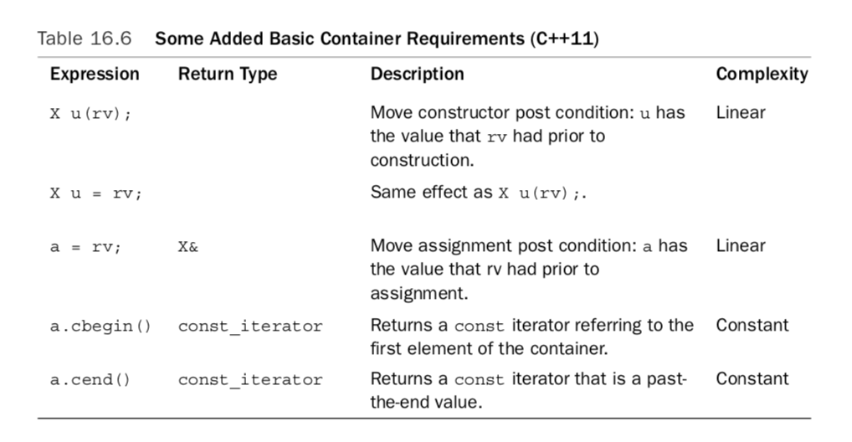
C++ 11 Container Requirements

Slide 10
Sequence Containers
Every object in a sequence container has a specific position
Listed below are the predefined sequence containers:
Vector
Deque
List
Forward_list (C++11)

Slide 11
Associative Containers
Associative container elements are automatically sorted according to some ordering criteria; the default sorting criteria is the operator < (less than), sorted in ascending order
Associative containers are implemented using binary search trees
The predefined associative containers in the STL are
Sets
Multisets
Maps
Multimaps
Unordered Associative containers (C++11)

Slide 12
Container Adapters
In addition to the containers that work in a general framework, the STL provides containers to accommodate special situations
These containers, called container adapters, are standard STL containers adapted to work in a specific environment
The three container adapters are:
Stacks
Queues
Priority Queues
Container adapters do not support any type of iterator

Slide 13
Sequence Container: vector
A vector container stores and manages its objects in a dynamic array
An array is a random access data structure, therefore the elements of a vector can be accessed randomly
Item insertion in the middle or beginning of an array is time-consuming, especially if the array is large
Inserting at the end is quite fast

Slide 14
Sequence Container: vector
The name of the class that implements the vector container is vector
The name of the header file containing the class vector is vector
To use a vector container in a program, the program must include the following statement:
#include <vector>

Slide 15
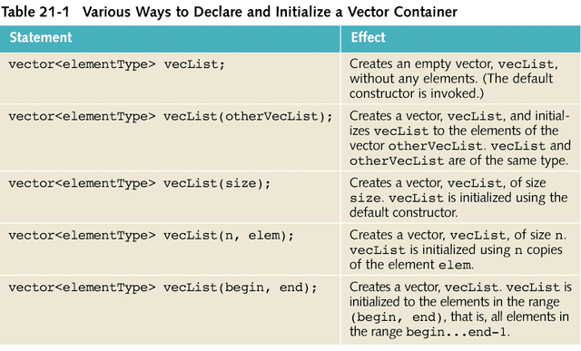
Sequence Container: vector

Slide 16
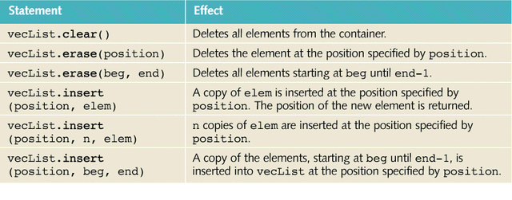
Sequence Container: vector
Item insertion and deletion are accomplished using the operations listed in the table below

Slide 17
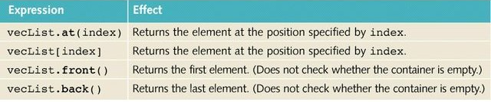
Sequence Container: vector
The elements in a vector container can be accessed directly using the following operations

Slide 18
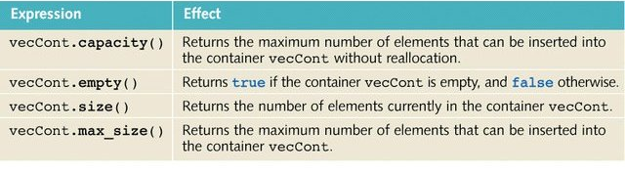
Sequence Container: vector

Slide 19
Sequence Container: vector
Declaring an Iterator to a Vector Container:
The class vector contains a typedef iterator, which is declared as a public member
An iterator to a vector container is declared using the typedef iterator
For example, the statement
vector<int>::iterator intVecIter;
declares intVecIter to be an iterator into a vector container of the type int

Slide 20
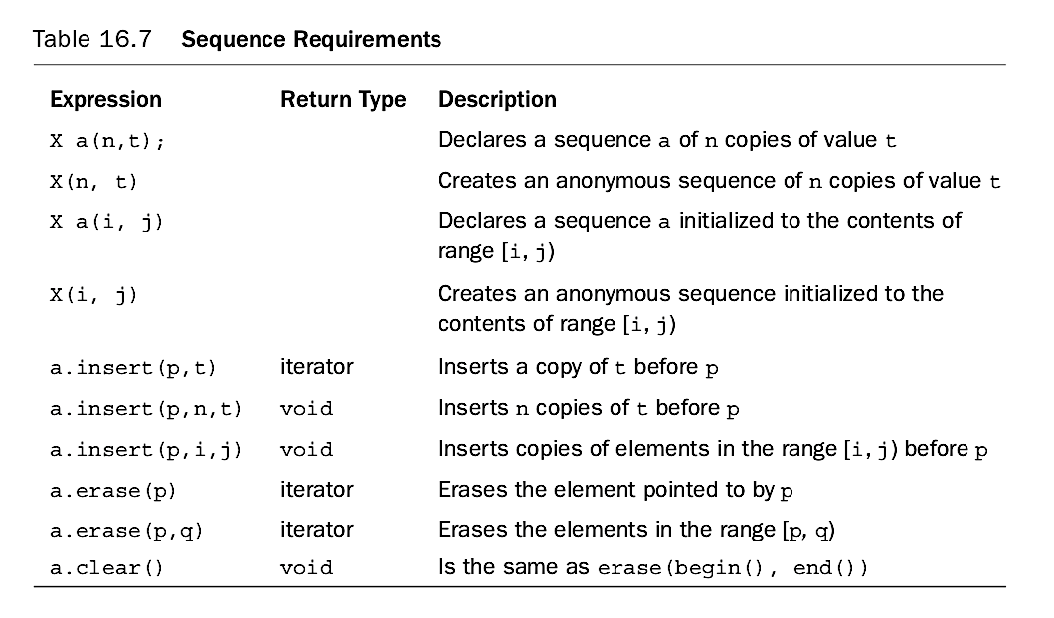
Sequence Container Requirements

Slide 21
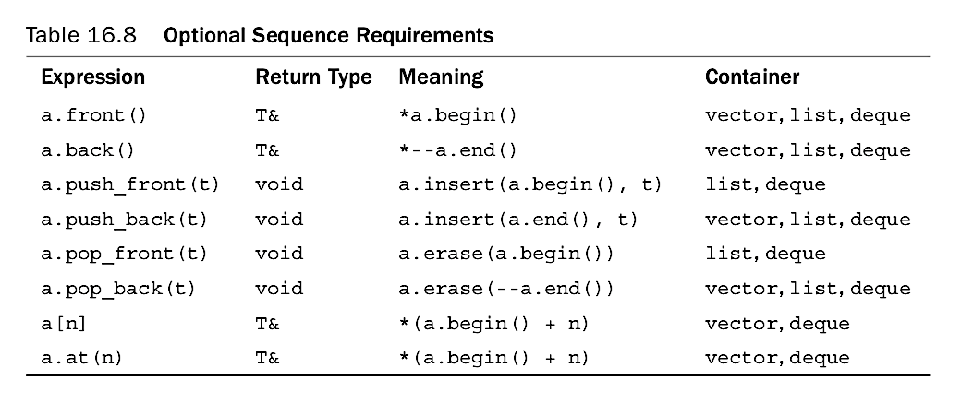
Sequence Container Requirements - Optional

Slide 22
Sequence Container: deque
deque stands for double ended queue
Deque containers are implemented as dynamic arrays in such a way that the elements can be inserted at both ends
A deque can expand in either direction
Elements are also inserted in the middle, however it is time-consuming because the elements in the queue need to be shifted
The name of the class defining the deque container is deque

Slide 23
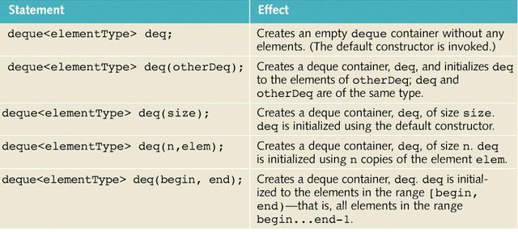
Sequence Container: deque

Slide 24
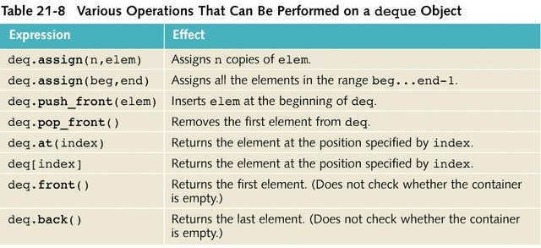
Sequence Container: deque

Slide 25
Sequence Container: list
List containers are implemented as doubly linked lists
Every element in a list points to both its immediate predecessor and its immediate successor (except the first and last element)
The list is not a random access data structure
The name of the class containing the definition of class list is list

Slide 26
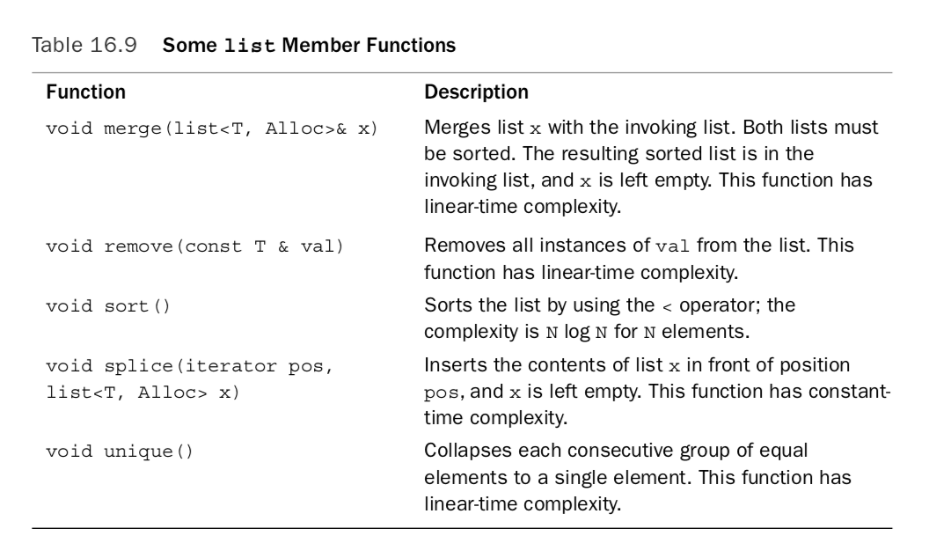
Sequence Container: list

Slide 27
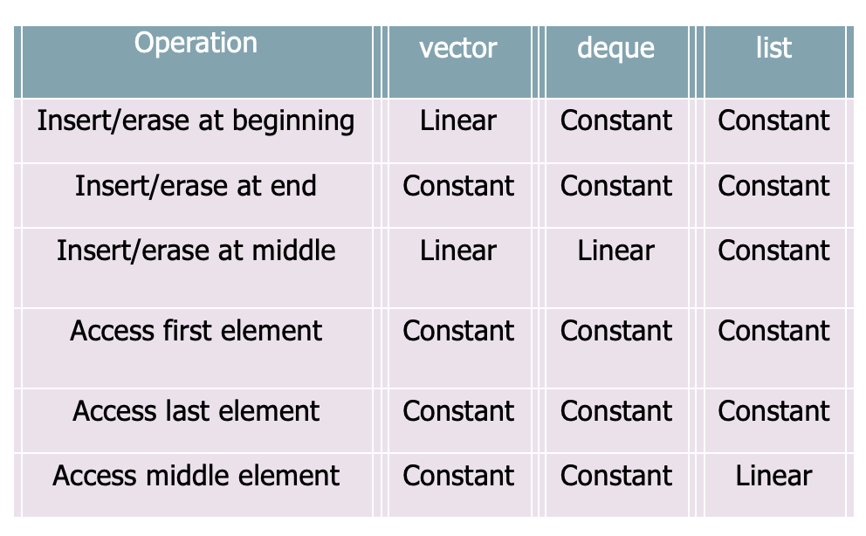
Sequence Containers: a comparison

Slide 28
Associative Containers: set & multiset
A set is a collection of zero or more nonduplicate, unordered elements called keys
A multiset is a set that allows duplicate keys.

Slide 29
Associative Containers: map & multimap
A map is a collection of zero or more unordered pairs; in each pair, one element is a nonduplicate key and the other is a value associated with the key
1
A multimap is a map that allows duplicate keys
2

Slide 30
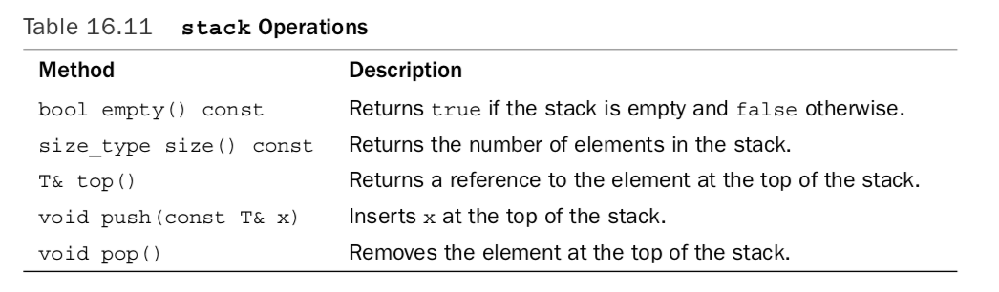
Container Adapter: stack
The STL provides a class to implement a stack in a program, the name of the class defining a stack is stack
Operations supported by the stack container class:

Slide 31
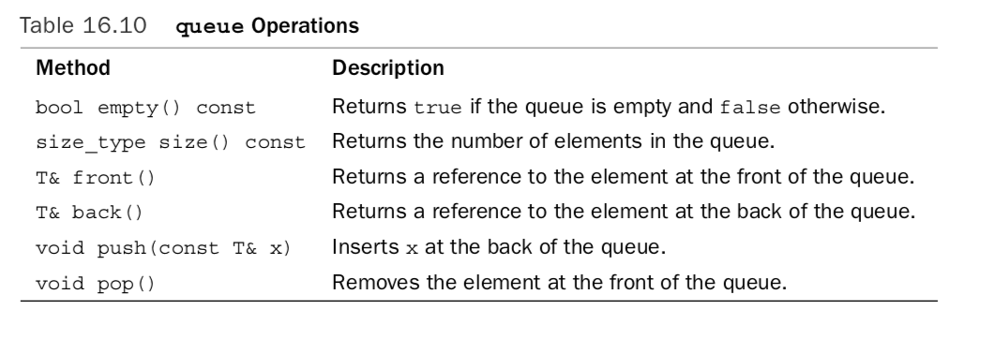
Container Adapter: queue
The STL provides a class to implement queues in a program, the name of the class being queue
Operations supported by the queue container class:

Slide 32
STL Algorithms
Some operations are specific to a certain type of container and therefore are provided as part of the container (a member function)
Operations such as find, sort, and merge are common to all containers and are provided as generic algorithms
The algorithms in the STL can be classified into the following categories
Non-modifying algorithms
Modifying algorithms
Numeric algorithms
Heap algorithms

Slide 33
STL Algorithms
The function copy is provided as a part of the generic algorithm and can be used with any container type
The function copy in conjunction with an ostream iterator can be used to output the elements of a container; it also allows you to copy the elements from one place to another
For example, you can use copy to output the elements of a vector or to copy the elements of a vector into another vector

Slide 34
STL Algorithms
The functions fill and fill_n
the function fill is used to fill a container with elements
the function fill_n fills in the next n elements
the element that is used as a filling element is passed as a parameter to these functions
The functions generate and generate_n are used to generate elements and fill a sequence
The functions find, find_if, find_end, and find_first_of are used to find the elements in a given range

Slide 35
STL Algorithms
The functions remove, remove_if, remove_copy, and remove_copy_if
The function remove is used to remove certain elements from a sequence
The function remove_if is used to remove elements from a sequence by using some criteria
The function remove_copy copies the elements of a sequence into another sequence by excluding certain elements of the first sequence
The function remove_copy_if copies the elements of a sequence into another sequence by excluding certain elements of the first sequence, using some criteria from the first sequence

Slide 36
STL Algorithms
The functions replace, replace _if, replace_copy, and replace_copy_if
The function replace is used to replace all occurrences, within a given range, of a given element with a new value
The function replace_if is used to replace the values of the elements, within a given range, satisfying certain criteria with a new value
The function replace_copy is a combination of replace and copy
The function replace_copy_if is a combination of replace_if and copy

Slide 37
STL Algorithms
The functions swap, iter_swap, and swap_ranges are used to swap elements
The functions search, search_n, sort, and binary_search
used to search and sort elements
described in the header file algorithm

Slide 38
STL Algorithms
The functions adjacent_find, merge, and inplace_merge
The algorithm adjacent_find is used to find the first occurrence of consecutive elements that meet criteria
The algorithm merge merges the sorted lists. Both lists must be sorted according to the same criteria, for example, both must be in ascending order
The algorithm inplace_merge is used to combine the sorted sequences

Slide 39
STL Algorithms
The functions reverse, reverse_copy, rotate, and rotate_copy
The algorithm reverse reverses the order of the elements in a given range
The reverse_copy reverses the elements of a given range while copying into a destination range; the source is not modified
The algorithm rotate rotates the elements of a given range
The algorithm rotate_copy is a combination of rotate and copy, that is, the elements of the source are copied at the destination in a rotated order; the source is not modified

Slide 40
STL Algorithms
The functions count, count_if, min, max, min_element, max_element
The algorithm count counts the occurrence of a given item in a given range; the function returns the number of times the value specified by the parameter occurs in the range
The algorithm count_if counts the occurrences of a given value in a given range satisfying a certain criterion
The algorithm min/max is used to determine the minimum/maximum of two values
The algorithm min_element/max_element is used to determine the smallest/largest element in a given range

Slide 41
STL Algorithms
The functions for_each and transform
The algorithm for_each is used to access and process each element in a given range by applying a function, which is passed as a parameter
The algorithm transform has two forms; this function creates a sequence of elements at the destination by applying the unary operation to each element in the range

Slide 42
STL Algorithms
The functions includes, set_intersection, set_union, set_difference, and set_symmetric_difference
Algorithms set_intersection, set_union, set_difference, and set_symmetric_difference all assume that the elements within each given range are already sorted
The algorithm includes determines whether the elements in one range appear in another range
The algorithm set_intersection is used to find the elements that are common to two ranges of elements

Slide 43
STL Algorithms
The algorithm set_union is used to find the elements that are contained in two ranges of elements
The algorithm set_difference is used to find the elements in one range that do not appear in another range of elements
The algorithm set_symmetric_difference creates a sequence of sorted elements that are in one sorted range but not in another sorted range

Slide 44
STL Algorithms
The functions accumulate, adjacent_difference, inner_product, and partial_sum
The functions accumulate, adjacent_difference, inner_product, and partial_sum are numerical functions and thus manipulate numeric data
The algorithm accumulate finds the sum of all the elements in a given range
The algorithm adjacent_difference returns an iterator positioned one past the last element copied at the destination
The algorithm inner_product is used to manipulate the elements of two ranges

Slide 45
STL Iterators
Iterators are similar to pointers. In general, an iterator points to the elements of a container (sequence or associative)
With the help of iterators we can successfully access each element of a container
The most common operations on iterators are ++ (increment), and * (deference)

Slide 46
Types of Iterators
There are five types of iterators:
Input iterators
Output iterators
Forward iterators
Bidirectional iterators
Random access iterators
Others: ostream, istream, reverse, back_insert, front_insert and insert

Slide 47
Input Iterators
Input iterators, with read access, step forward element-by-element and so return the values element-by-element
These iterators are provided for reading data from an input stream
Suppose inputIterator is an input iterator
The table on the following slide describes operations on inputIterator

Slide 48
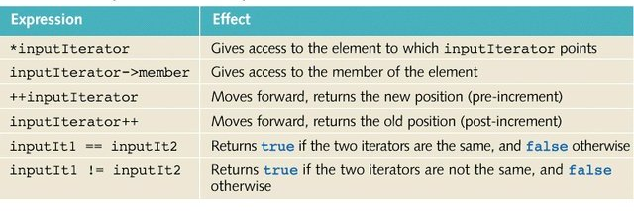
Operations on an Input Operator

Slide 49
Output Iterators
Output iterators, with write access, step forward element-by-element
These iterators are provided for writing data to an output stream
Suppose outputIterator is an output iterator
The table on the following slide describes operations on outputIterator

Slide 50
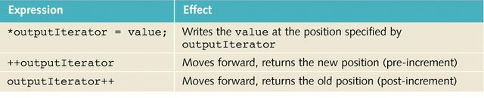
Operations on an Output Operator

Slide 51
Forward Iterators
Forward iterators combine all of the functionality of input iterators and almost all of the functionality of output iterators
Suppose forwardIterator is a forward iterator.
The table on the following slide describes operations on forwardIterator

Slide 52
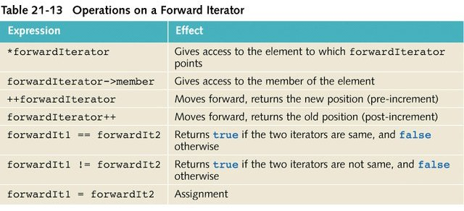
Operations on a Forward Iterator

Slide 53
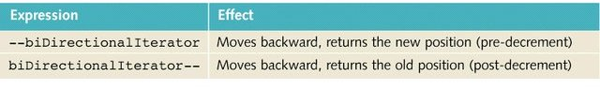
Bidirectional Iterators
Bidirectional iterators are forward iterators that can also iterate backward over the elements
Suppose biDirectionalIterator is a bidirectional iterator, the operations defined for forward iterators are also applicable to bidirectional iterators
To step backward, the decrement operations are also defined for biDirectionalIterator
Additional operations on a bidirectional iterator:

Slide 54
Random Access Iterators
Random access iterators are bidirectional iterators that can randomly process the elements of a container
These iterators can be used with containers of the types vector, deque, string, as well as arrays
The operations defined for bidirectional iterators are also applicable to random access iterators
The table on the following slide shows additional operations on a random access iterator

Slide 55
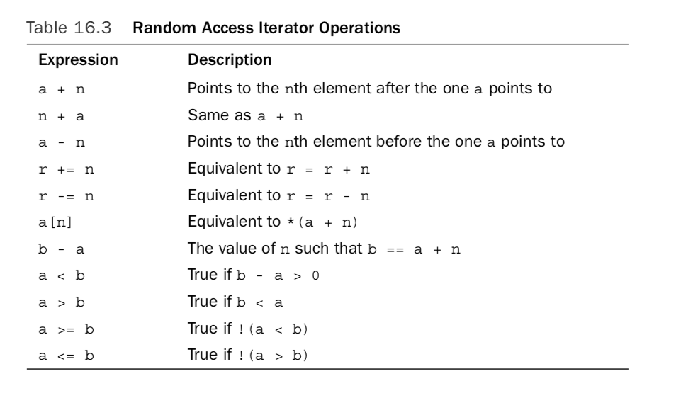
Additional Operations on a Random Access Iterator

Slide 56
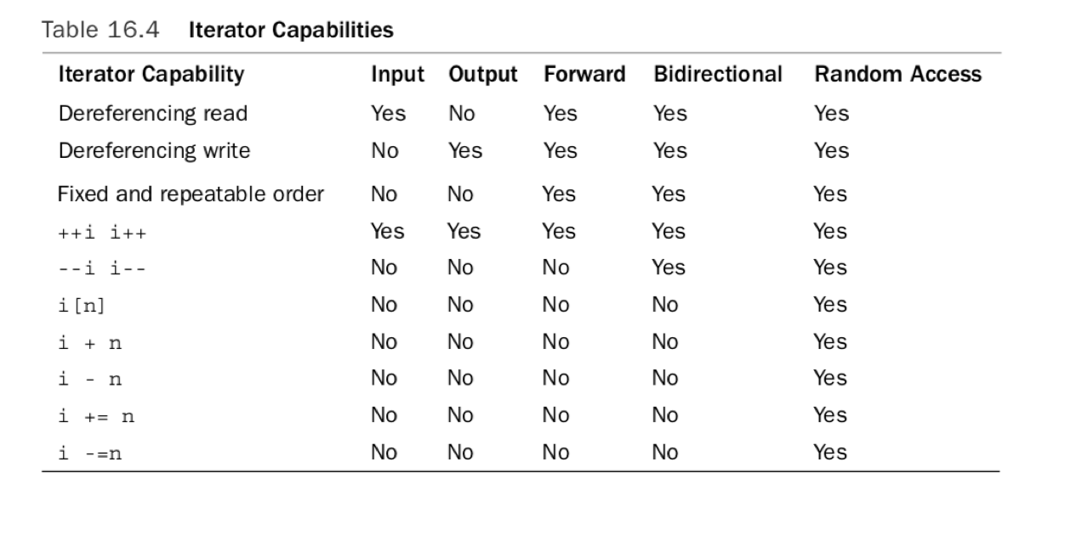
Iterator Capabilities

Slide 57
typedef iterator
Every container contains a typedef iterator, thus, an iterator into a container is declared using the typedef iterator
The statement
Vector<int>::iterator intVecIter;
declares intVecIter to be an iterator into a vector container of the type int

Slide 58
typedef const_iterator
Because an iterator works like a pointer, with the help of an iterator into a container and the deference operator, *, we can modify the elements of the container
However if the container is declared const, then we must prevent the iterator from modifying the elements
Every container contains typedef const_iterator to handle these situations

Slide 59
Stream Iterators
istream_iterator
the istream iterator is used to input data into a program from an input stream
ostream_iterator
the ostream iterators are used to output data from a program into an output stream

Slide 60
Other additions to C++ 11
Array
Valarray
Initializer_list
Complex
Smart pointers: shared_ptr & unique_ptr
Iterating using range based for loop

Slide 61
Sample Code using several STL elements
Listing 16.19

Slide 62
Sample Application Using STL: Stock Performance Reports
Problem:
Generate three reports on the daily performance of stocks for an exchange. The data comes from a file (stockData.txt) of records in the format
<symbol> <opening price> <closing price> <volume>
As can be seen in the sample report:
The first report prints the stock in descending order by percentage of gain
The second report prints the stocks in ascending order by percentage of loss
The third report prints the stocks in descending order by volume

Slide 63
Sample Application Using STL: Stock Performance Reports
Solution:
Create a class Stock to represent stocks as objects with appropriate data and methods
Use STL deque container to hold the Stocks created from data in input file
Use the STL sort algorithm to sort the deque twice
In descending order by percentage of gain
In descending order by volume
Use the STL for_each algorithm to print the deque’s contents

Slide 64
Sample Application Using STL: Stock Performance Reports
Advantages of Using STL components:
STL deque container grows dynamically to meet the storage requirements such that there is no need to keep track of the number of elements inserted
STL for_each algorithm eliminates the need for output loops.
The deque methods begin, end, rbegin and rend allow us straightforwardly to output in either regular or reverse order.

Slide 65
Summary
We have thus seen, that STL contributes to the application’s overall
Simplicity
Clarity
Efficiency
Robustness

Slide 66
Listings from Textbook
Vector | 16.7 to 16.9
Iterators | 16.10 and 16.11
List | 16.12
Associative | 16.13 and 16.14
Smart Pointers | 16.5 and 16.6

