Slide 1
Standard Template Library
Part II

Slide 2
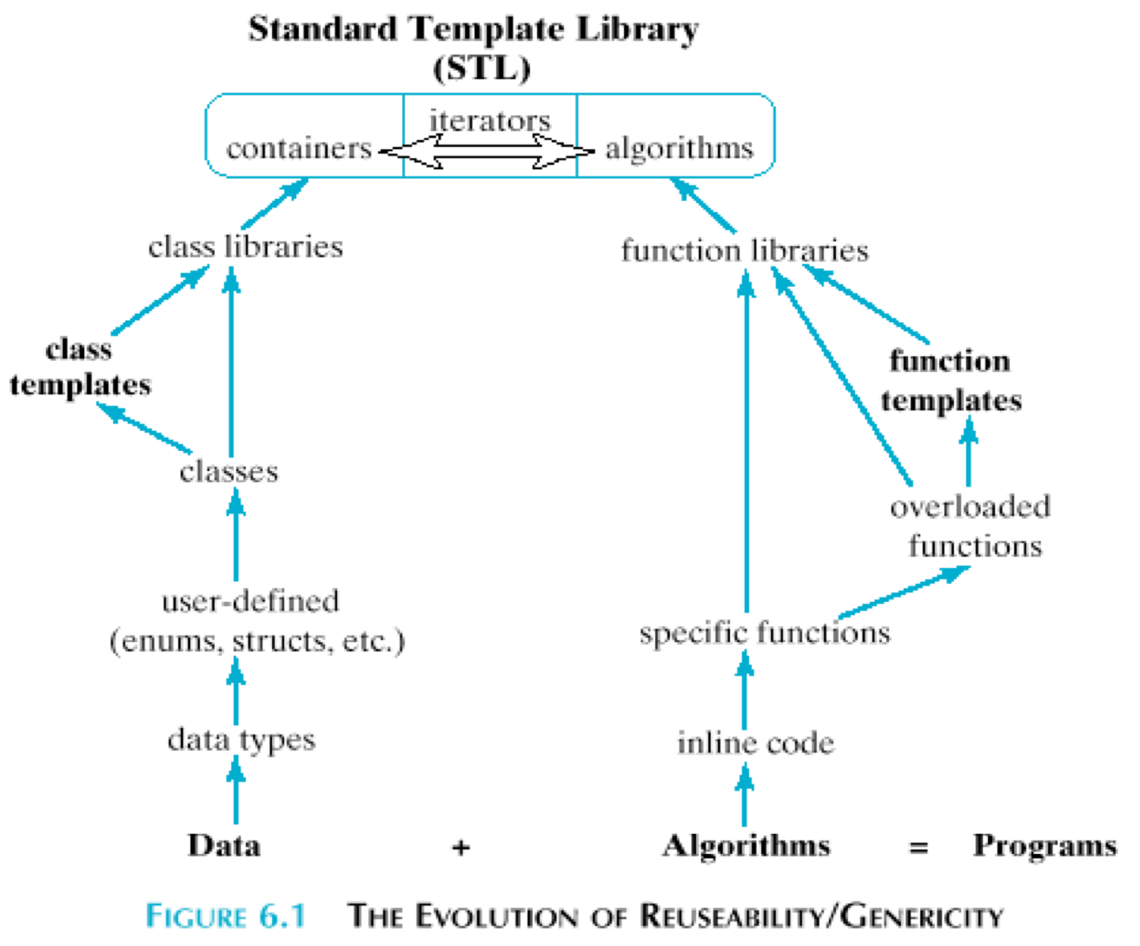

Slide 3
3 Main Parts of STL
Containers
Sequence
Algorithms
Modifying
Heap
Iterators
Input
Output
Non-modifying
Numeric
Forward
Bidirectional
Random Access
More....
Associative
Container Adaptors

Slide 4
Types of Containers
Sequence
Vector
Deque
Associative
Map
Adaptors
Stack
Priority Queue
List
Forward_list
Multi-map
Set
Multi-set
Unordered Associative
Queue

Slide 5
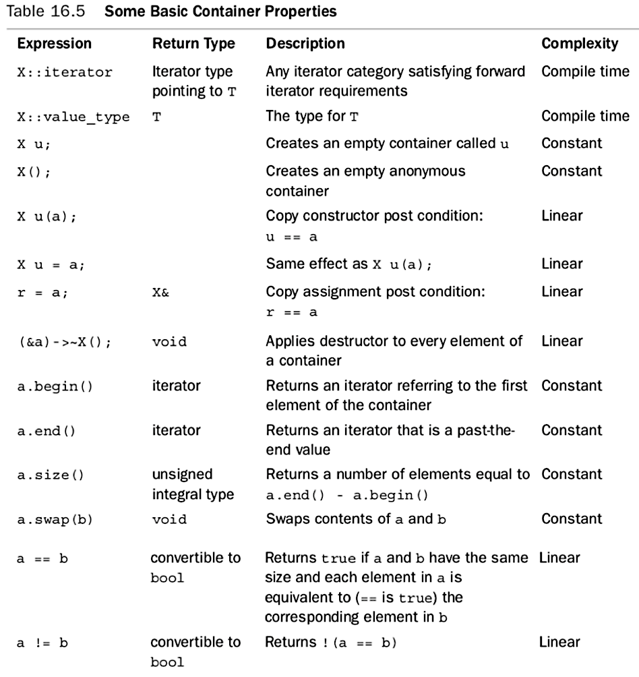
Basic Container Properties

Slide 6
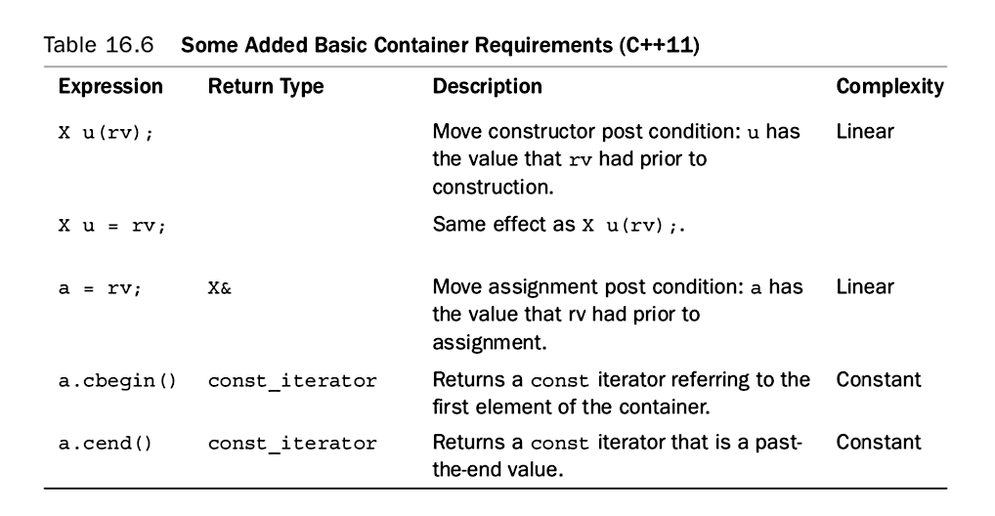

Slide 7
Algorithm
Non-Modifying
Operate on each element in a range
E.g. find()
Modifying
Operate on each element in a range
E.g. replace()
Numeric
Numeric header file
Heap
Can change contents of a container
Functions to sum the contents of a range
E.g. partial_sum()
Compact Data structure
Keeps element with the highest value first
E.g. make_heap()

Slide 8
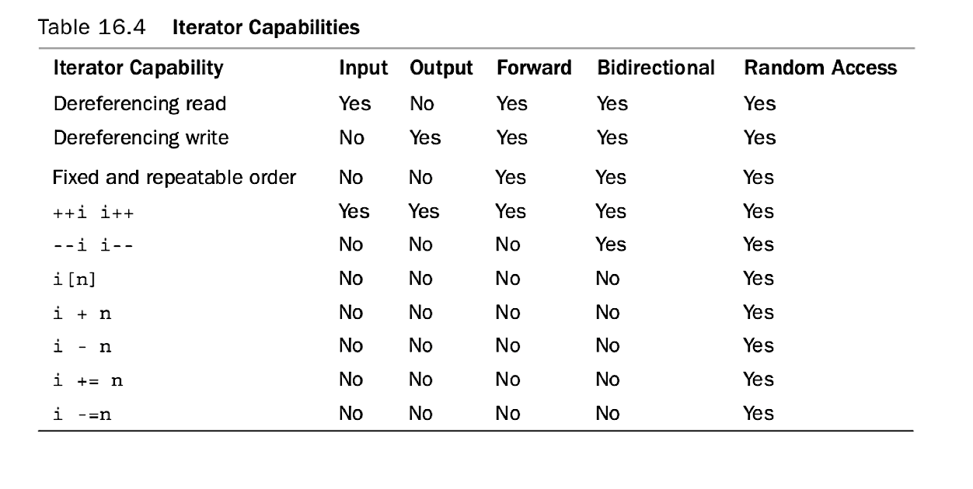
Iterators

Slide 9
Other additions to STL in C++ 11
Array
Valarray
Initializer list
Complex
Smart Pointers – shared pointer and unique pointer
Iterating through range based for-loop using auto
More information in Appendix G in the Text book

Slide 10
Sample Code from Text Book Listing 16.19

Slide 11
Listings from textbook
Vector | 16.7 to 16.8
Iterators | 16.10 and 16.11
List | 16.12
Associative | 16.13 and 16.14
Smart Pointers | 16.5 and 16.6

